Slide 1
Machine Learning for Computer Systems
Nick Feamster University of Chicago

Slide 2
Application Identification
Goal: Identify applications based on features in the network traffic trace.
Applications:
…

Slide 3
Performance Inference and Optimization

Slide 4
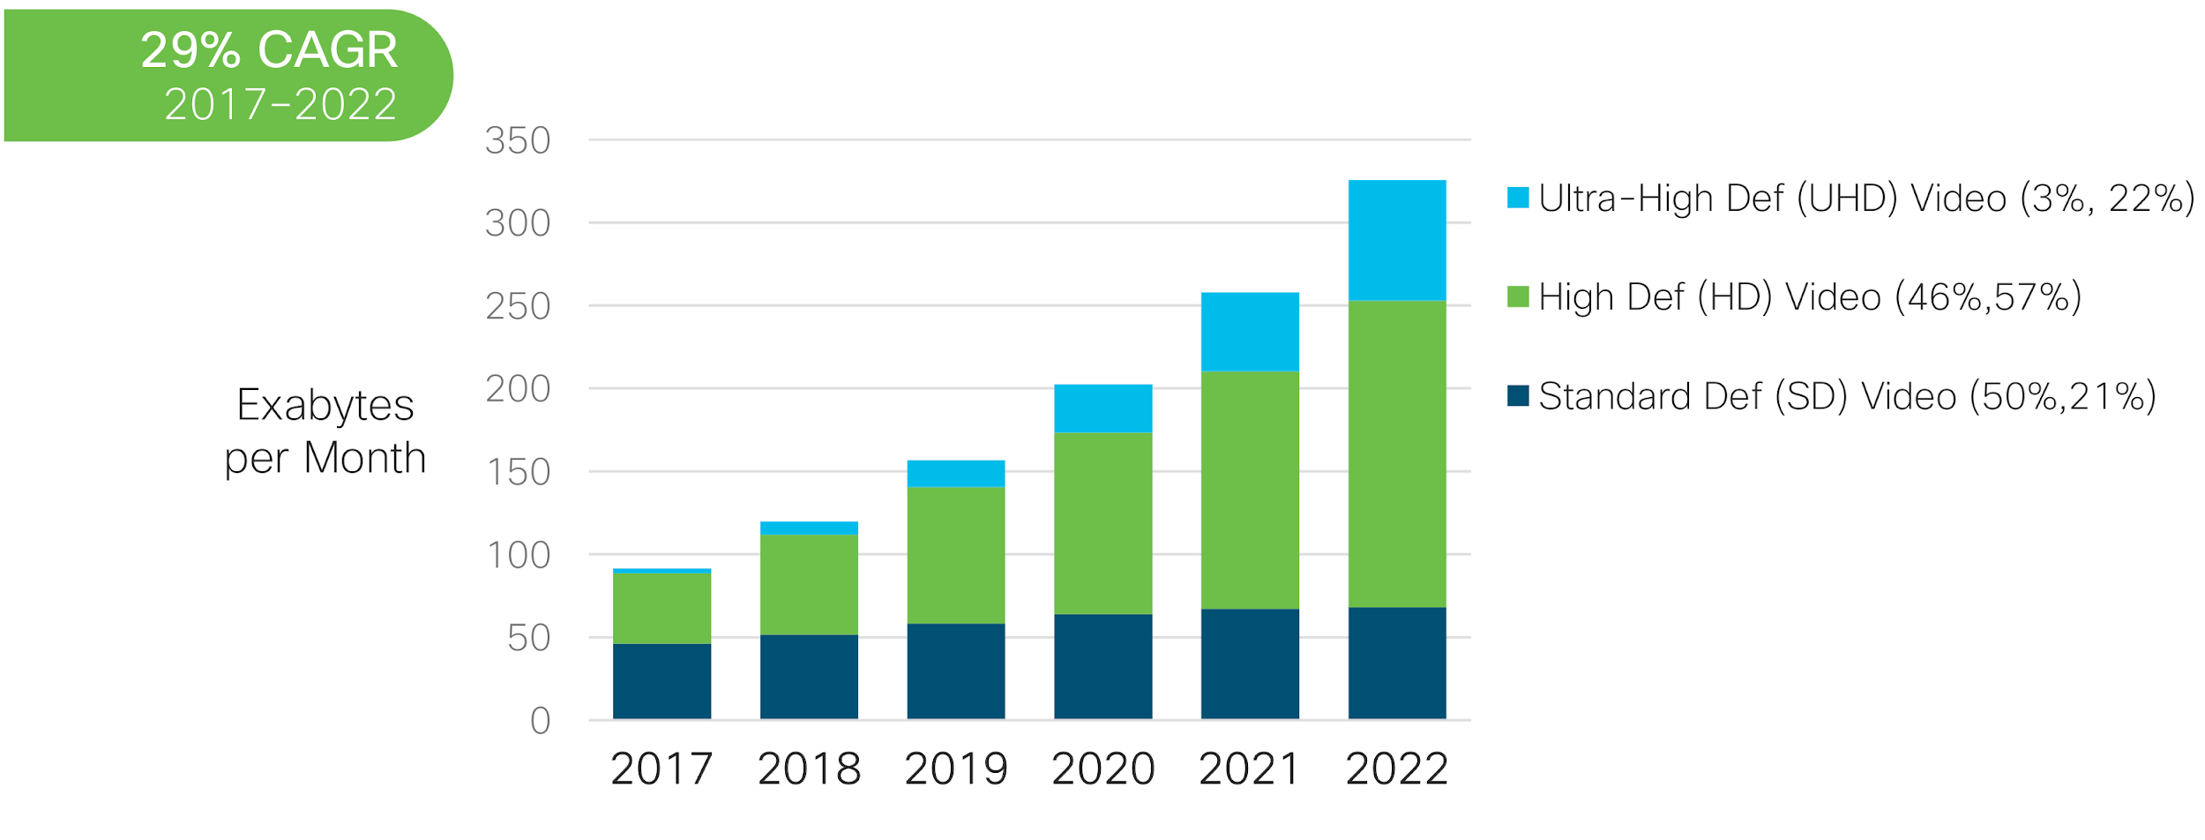
Increasing Amount of Video Traffic in ISP Networks
*Cisco Visual Networking Index: Forecast and Trends, 2017–2022 White Paper
Notes:
Video streaming traffic is by far the dominant application traffic on today’s Internet, and the total volume of traffic generated by these type of services is still constantly increasing
Forecasting reports like the one from Cisco shown in the figure, predict that by 2022 we will see a more than 60% additional increase in traffic
The amount of traffic has become so high that during the lockdown we are currently experiencing we heard from multiple services like Netflix and youtube that they would have reduced their quality to avoid over running the resources available in the network

Slide 5
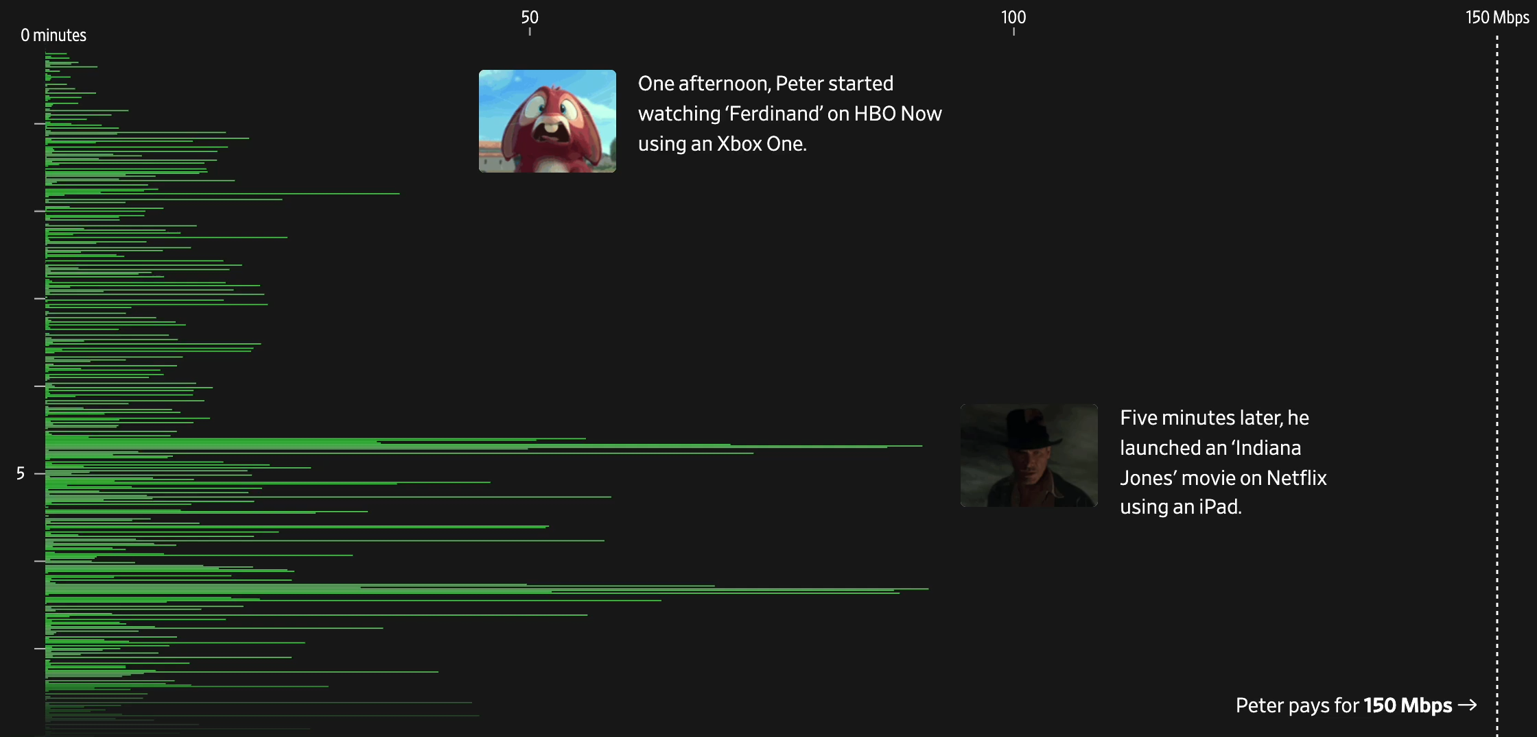
How Much Traffic Does Video Consume?

Slide 6

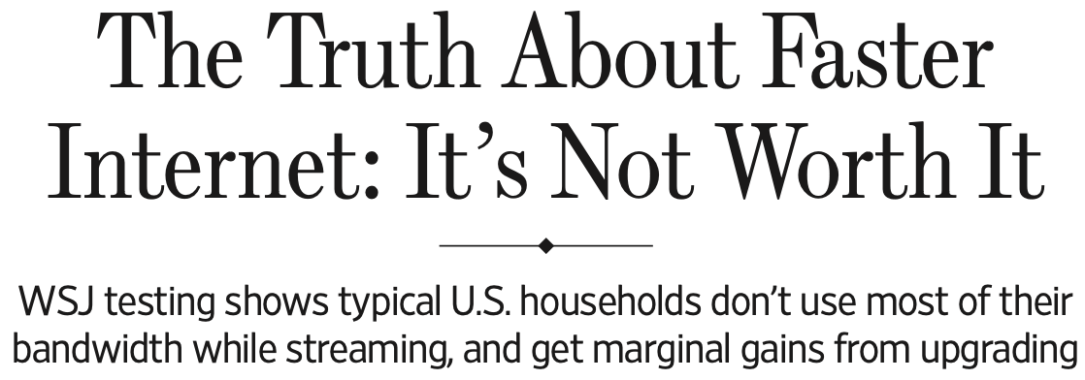
What “Speed” Is Needed for App Performance?

Slide 7









ISPs Aim to Perform Network Optimizations
Bitrate changes
Transcoding
Compression
Re-routing
Video Servers
ISP
Notes:
In order to cope with these large amounts of traffic, ISPs were able in the past to perform a number of optimizations on the video traffic traversing their networks
But why do we hear only video service providers telling us that they will reduce their quality rather than hearing from ISPs?
Well, with the now widespread adoption of encryption it has become basically impossible for them to apply any of the optimization techniques mentioned in this slide

Slide 8
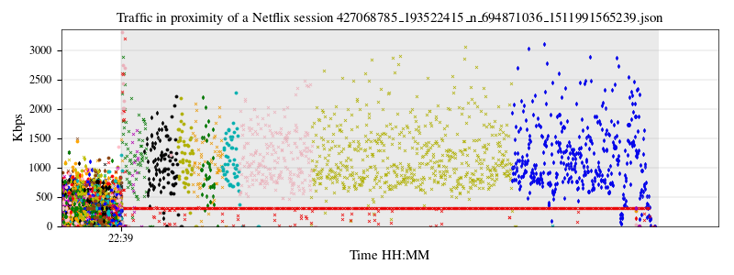
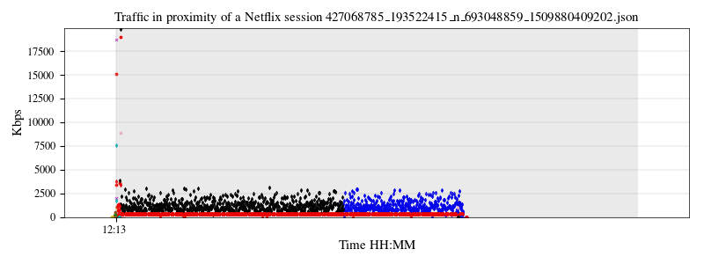
What ISPs see with encryption
Netflix Video Session
Netflix Video Session
Initial burst to fill the buffer
*Each color/symbol represents a different flow
MPD
Retrieval
Refill buffer as needed by the displayed bitrate
Notes:
When encryption is used, operators are left to observe raw features of the traffic, like for example the throughput of the flows that are generated by a service.
For example, in this figure, we see a sample Netflix session and the throughput generated every second by different flows, each identified by a different color.
From it we can observe that there is a certain amount of information that can still be extracted like for example the initial peak of traffic generated by the service to fill up the player buffer or how we can identify by observing the magnitude of the flows’ throughput the difference between the flows carrying the audio (in red in the picture) and the ones carrying video.
But aside for these piece of information we have no sense of what is the underlying quality of the content that is being transmitted. Furthermore, here we are showing a very clean session but normally they are a much more colorful mess.

Slide 9


Goal: Infer Quality from Encrypted Traffic
Target:
Startup delay
Resolution
Available features
Network layer (Net) | Transport layer (Tran) | Application layer (App)
Throughput | Flags | Segment sizes
Pkt counts | Retransmissions | Segment inter-arrivals
# of flows | Goodput | #pending requests
...
Costly
Notes:
But what do we refer to when we say video quality. Inferring the video streaming quality from encrypted network traffic consists in determining a number of metrics that impact the experience quality a user is perceiving during a session. Here we show two examples of this.
The startup delay which is the time that takes from the moment the user clicks the link of the video his interested in watching and the moment the video actually starts playing. And the resolution which is the common amount of pixels that constitute each frame of the video.
To infer these metrics from the traffic, we are then left with a number of features that can be collected by monitoring the traffic flowing through the network. In our work, we aggregated these features into three categories:
- The network layer features which are the features that solely rely on information available from observation of a network flow (identified by the IP/port four-tuple)
The transport layer features that are the ones that are extracted from observe layer 4 headers and possible keep track of the state that these protocols use to deliver data
Finally, the application layer features which include any feature related to the application data that can be deduced by observing the patterns of the traffic. For example for video we can identify individual video segments as they are downloaded. All of this does not involve any sort of deep packet inspection
An important thing to notice is that not all features are created equal. In particular, transport layer features are particularly expensive to track because they require to maintain
a lot of state which is not trivial when done at line right

Slide 10
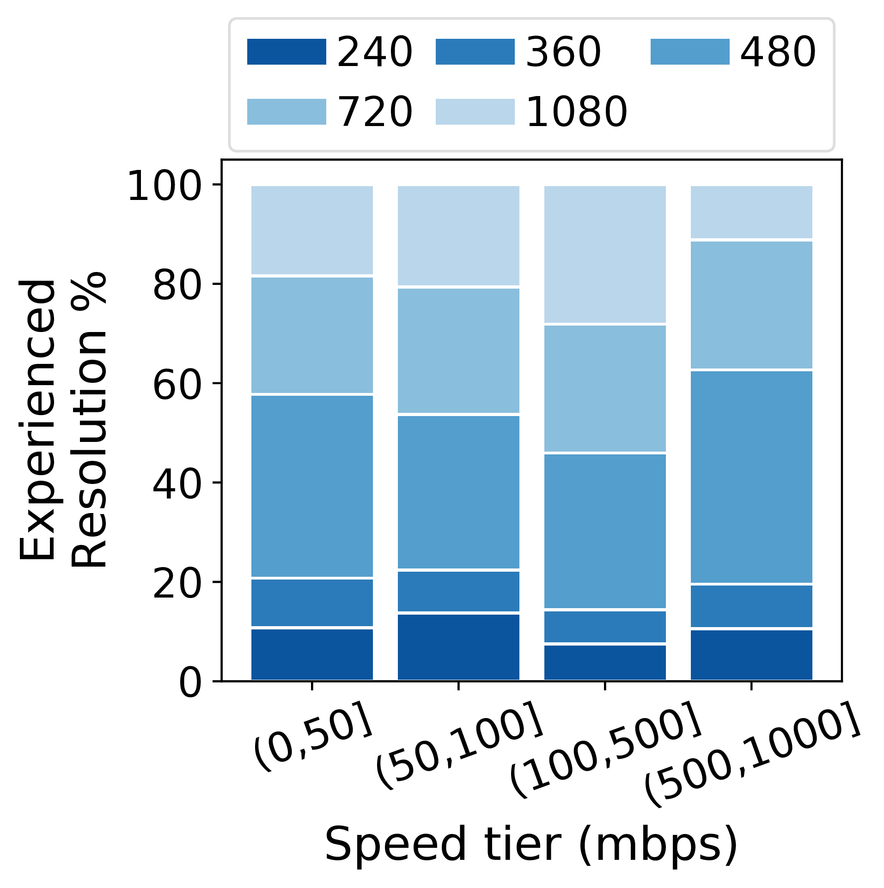
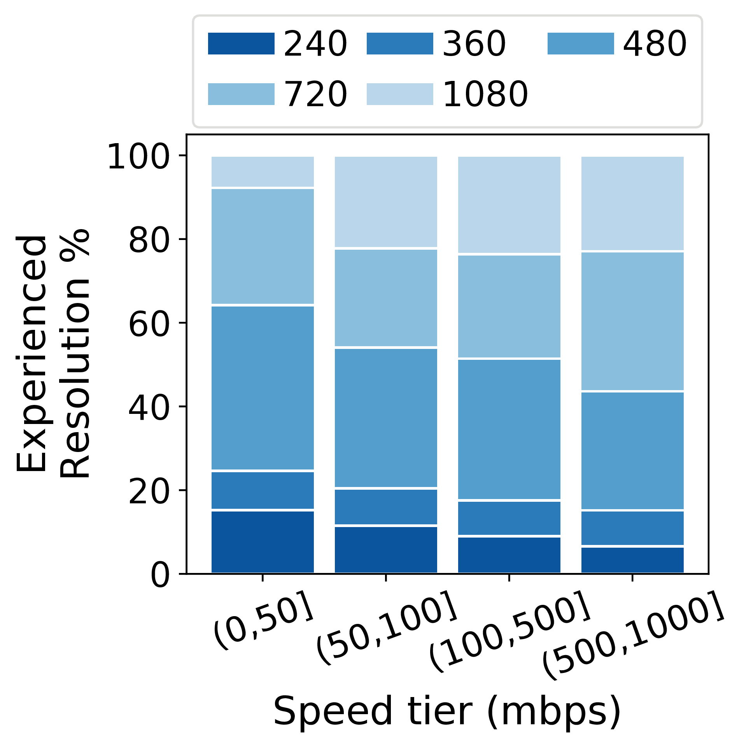
Result: How Does Access Link Capacity Relate to Resolution?
Nominal Speed
95th %ile Active Throughput
Notes:
With the newly generated models, we then tried to answer the question of what could an ISP would be able to learn about itself if it used these inferences in its network
To answer this questions we studied how the inferred quality metrics related to the speeds of the homes in our dataset. We employed two metrics of “capacity”: the nominal download subscription speed that users reported for each home, and the 95th percentile of active throughput measurements. In this particular plot we use Netflix as an example. e
Even though the majority of the homes in our deployment had high to very high speeds, we surprisingly didn’t observe that the vast majority of sessions were experiencing HD and FHD resolutions
We then concluded that this is because video resolution is dependent on more factors than simply the network conditions. For example, the device type can influence the max achievable resolution
We did observe and increase in quality as speeds go up, especially when studying results generated using active throughput. Netflix and YouTube in the highest speed tier achieve about 40% more 1080p. To understand whether this was due to possible network issues with these homes, we looked then in the actual results of active tests, but we found out that operators actually over provision their networks. Meaning that this result was to be recollected to other causes.

Slide 11
Method and Modeling
13k lab video sessions
Infer metrics every 10 seconds
Different combinations of input features
Limitation: Browser-based playback only
Random forest
Notes:
In our work, to design models that infer the aforementioned quality metrics, we collected these three categories of features for 13 thousand video sessions for four of the major video streaming services: Netflix, YouTube, Amazon Prime Video, and Twitch. In particular, we used a controlled lab environment to collect data for different network conditions as well to obtain the ground truth of the video sessions.
We aim to infer the two quality metrics at 10 second intervals, a good tradeoff between the precision of inferring the mtrics and the likelihood that each time bin to contain complete video segment downloads. We infer the startup in seconds using the features extracted for the first ten seconds of the session and classify the resolution for the remainin intervals.
We evaluate the accuracy of models relying on different feature sets for predicting the metrics, using all possible combinations of the three groups presented in the previous slide.
We also experimented with different regression methods and classification methods, but finally picked random forest as our model for both metrics as it lead to the best results.

Slide 12
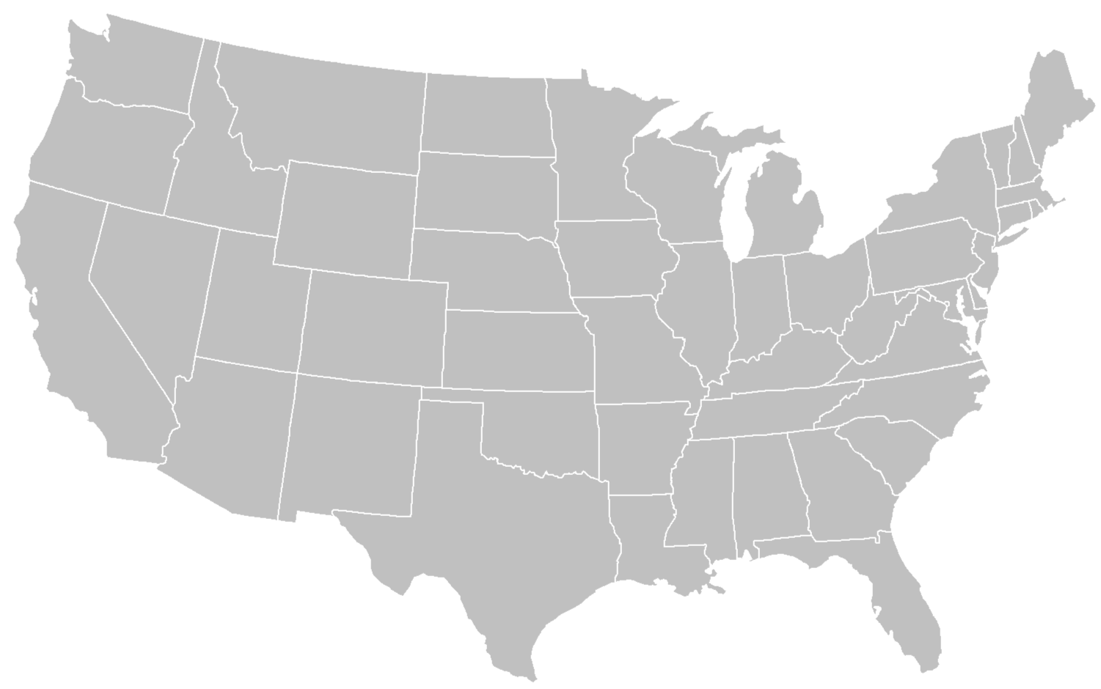


Model Deployed in U.S. and France
~60 in the US, ~10 in Paris
~210k video sessions, over 14 months
Notes:
Using the generated models, we analysed the data collected during a year long study in 66 homes across the United States and France. To gather the data used by the models, we developed a network monitoring that collects the features used during the inference.
Our dataset was very diverse as it included homes from different operators and with downstream throughputs ranging from 18 Mbps all the way to 1 Gbps. During the duration of the deployment, we have recorded a total of 216,173 video sessions from the four major video service providers we had developed models for: Netflix, YouTube, Amazon, and Twitch.
But testing our models in a long-running deployment raised a new set of challenges that are not faced by offline models that operate on curated traces in controlled lab settings. Two factors, in particular, affected the accuracy of the models:
the granularity of training data versus what is practical to collect in an operational system
the challenge of accurately detecting the start and end of a video session in the presence of unrelated cross-traffic
Here we discuss only the first problem. We refer to the paper for further information on how we solved the second one.

Slide 13
Model validation
Infer quality metrics at periodic time intervals
10 seconds
Different sets of input features
Net, Tran, App, Net+Tran, Net+App, All
Different sets of services
Specific: train one service - test same service
Combined: train on all services - test on one of the services
Excluded: train on three out of four services - test on the remaining one
Different models
Selected random forest (for both regression and classification)

Slide 14
Designing a Model: Lots of Questions
Time granularity for inference?
Which features to use?
Create one model per service or a single one for all services?
Which model to use?

Slide 15
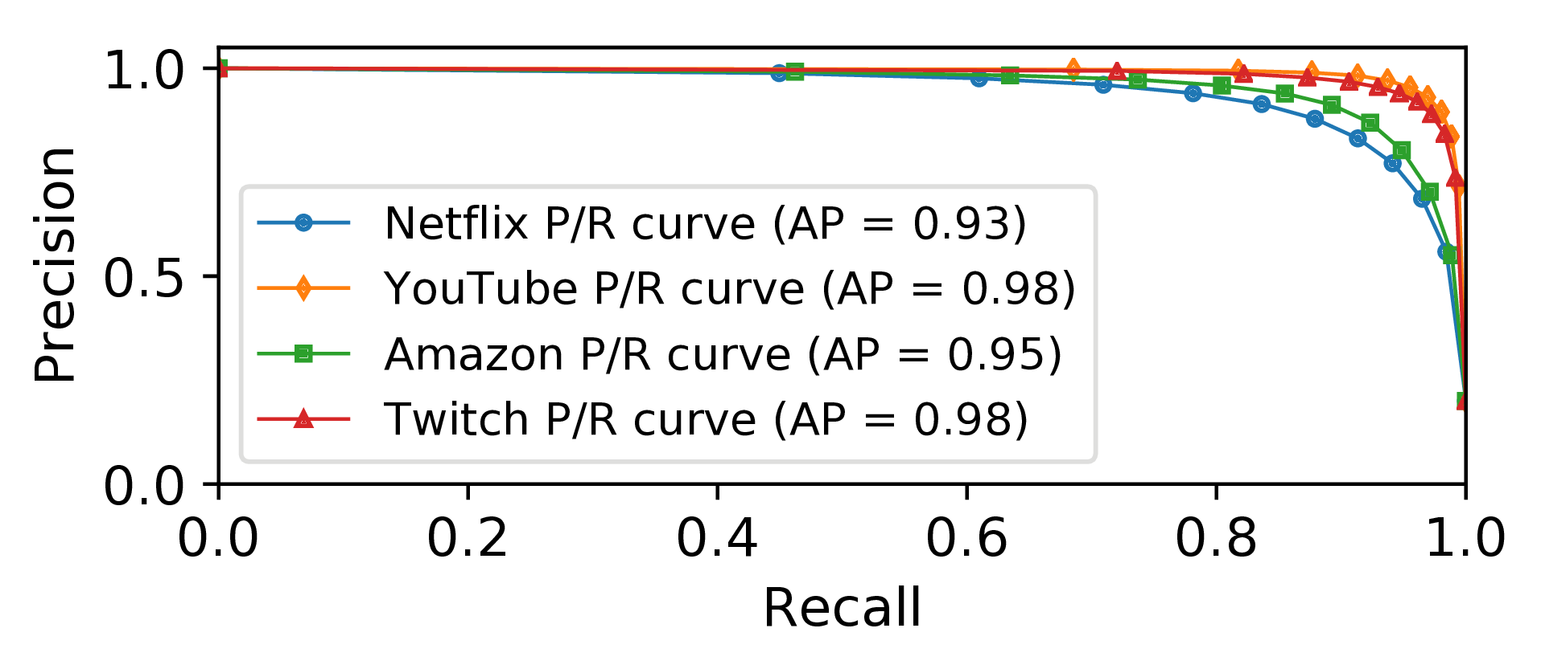
Goal: Generality Across Services
Notes:
We then study the accuracy for each video service using the the best performing model, the one using network plus application features.
We see that overall the precision and recall are above 81% across all services. The accuracy of the resolution inference model is particularly high for YouTube and Twitch with average precision of 0.98 for both services.
The accuracy is slightly lower for Amazon and Netflix, but this is probably due to the fact that these services change the resolution more frequently to adapt to playing conditions, whereas YouTube and Twitch often stick to a single, most likely lower, resolution for a longer period of time making it easier for the model to correctly infer the current quality.

Slide 16
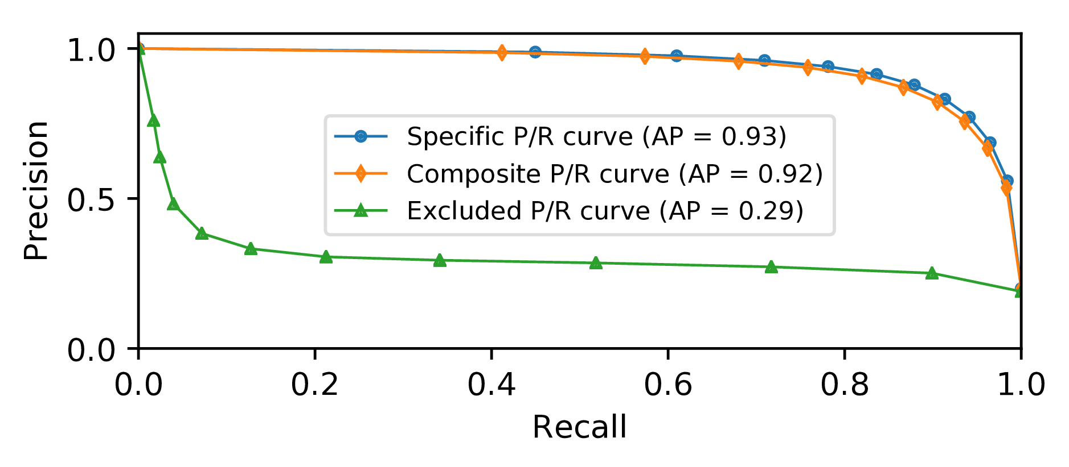
Goal: Generality Across Services
Notes:
We also evaluate the generality of our models. In this case, we refer to the generality as the ability of generating a single model using data from multiple services and that can work across multiple services.
In this figure, we see three possible solutions.
A composite model—a model trained using data from all services and used to predict the quality of any video the services used for training.
An excluded model-- which is trained with data from three services, in this case Amazon, YouTube, and Twitch, and is tested on a fourth one, in this case Netflix. This scenario is ideal as it removes the requirement to collect data with ground truth for a large number of services
Finally a specific model, which is the model used in the previous slides that uses a single service for training and test.
Our evaluation shows that the composite model performs nearly as well as specific models that rely only on sessions from a single service across both quality metrics. This result raises hopes that the composite model can generalize to a wide variety of video streaming services. When we train models using a subset of the services and evaluate it against the left out one (excluded models), however, the accuracy of both startup delay and resolution models degrades significantly, rendering the models unusable. This result highlights that although our modeling method is general in that it achieves good accuracy across four video services, the training set used to infer quality metrics should include all services that one aims to do prediction for.

Slide 17
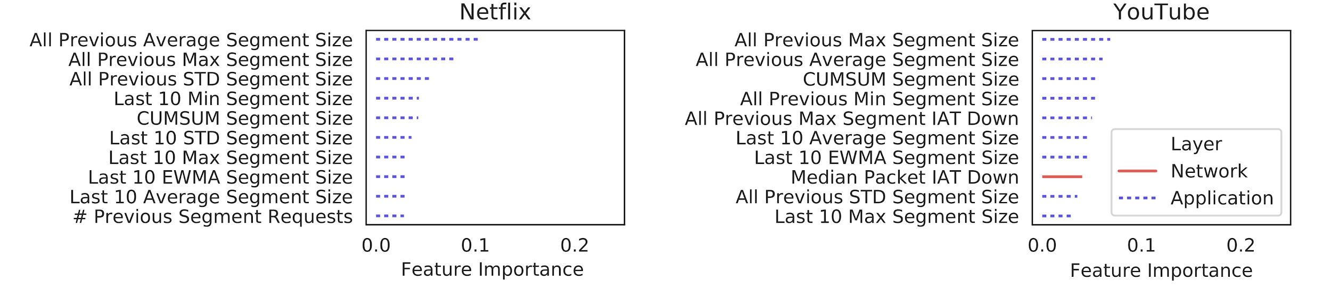
Systems Consideration: Lightweight Features
Most important features based on video segment size and interarrival times
Notes:
To reinforce the obtained result, we explore the GINI Index for feature importance in prediction obtained for the Net+App model
We report here the results for Netflix and YouTube but the same conclusions are observed for the other services. We observe that most features at the top of the ranking are related to segment size. This result confirms the general intuition that given similar content, a higher resolution implies more pixels-per-inch, thereby requiring more data to be delivered per video segment. In fact, without segment-related information and features, these models achieve comparatively lower precision and recall

Slide 18
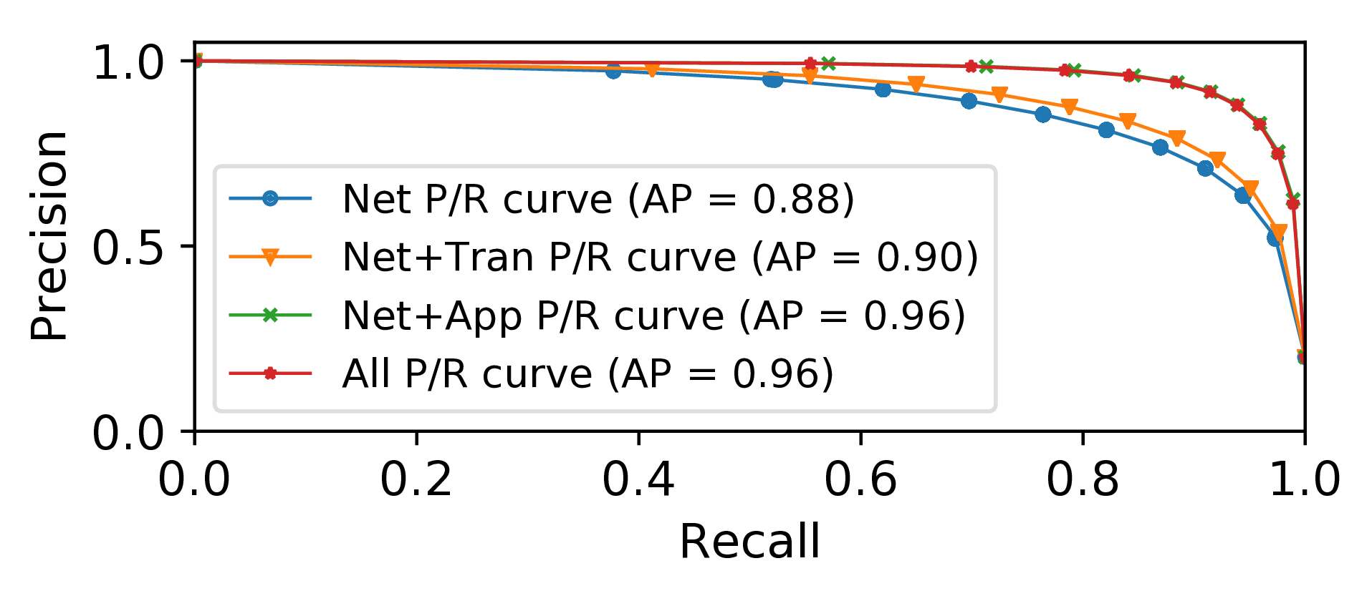
Goal: Lightweight Features
Notes:
We first show the results, expressed in terms of precision and recall of the inference models for resolution.
Remember that we divide each video session into ten-second time intervals. We then conduct the inference on each time bin. Each line corresponds to the random forest multi-class classifier trained for each feature. In this specific plot we present the aggregated results for the different layers across the studied services.
Our results show that models that rely on network- and application-layer features outperform models that rely on network- and transport-layer features across all services.
We do not show other possible combinations, for example the one that uses transport features only, because we assume that network features are the easiest to collect and would hence be used in any scenario.
The obtained results are in contrast with prior work which provided models that rely on transport-layer features This differs from previous attempts that really estimated a bad or good metric.

Slide 19
Data Granularity Affects Model Performance: Domain Adaptation
Netflix Video Session
F’₀
F’₁
F’₂
F’₃
F₀
F₁
F₂
F₃
F’’₀
F’’₁
F’’₂
F’’₃
Generate models that include error information
F’’’₀
F’’’₁
F’’’₂
F’’’₃
Notes:
The data granularity problem arises from the fact that (CLICK) the training data that we collected has a precise session start time that corresponds to the precise beginning of the session. This start time affects the location (CLICK) of the intervals that are used for aggregating the features used in the inference.
But an operational monitoring system cannot export information about each individual packet. It is hence common practice to report traffic statistics in fixed time intervals or time bins. Due to this limitation (CLICK), the data collected from a deployed system will only have data collected in time intervals that are not bound the precise session start time.
(CLICK) This corresponding mismatch in granularity creates a challenge for the inference models as the initial error propagates across time bins affecting the underlying statistics used by the models.
To address This challenge we decided to introduce the same type of noise that might be present in the data collected in the real world into the training data itself. So that it more closely resembles the data collected from the deployment.
The techniques that we apply are grounded in the general theory of domain adaptation. (CLICK) To achieve this goal we pre-process our training data and artificially adjust each session start time over a window of -5 to +5 seconds from the actual start value in increments of 0.5 seconds. For each new artificial start time, we recalculate all metrics based on this value for the entire session. This technique has two benefits: it makes the model more robust to noise, and it increases the volume of training data.

Slide 20
Looking Ahead
Key takeaways
Improved state of the art in inference of startup delay and resolution
More robust models in deployment settings
Higher access speeds provide marginal improvements to video quality
Future directions
Develop a truly general model for arbitrary services
Mitigate counter effects of domain adaptation
Notes:
In summary, we developed a new set of models that infer startup delay and resolution delay more precisely and with more granular indicators than previous work. Our models are robust to deployment settings thanks to the application of techniques such as domain adaptation. We applied these models to 16 months of traffic from 66 homes to demonstrate the applicability of our models in practice, and our study on the relationship between access link capacity and video quality found, surprisingly, that higher access speeds provide only marginal improvements to video quality.
Our work points to several avenues for future work. First, our composite models perform poorly for services that are not in the training set; a truly general model that can predict video quality for arbitrary services remains an open problem. Second, more work remains to be done to fully understand the potential of domain adaptation for network inference problems.

Slide 21
Inferring QoE for Video Conference Applications

Slide 22
Inferring WebRTC Quality
Video bitrate
Frame rate
Frame jitter
Resolution

Slide 23
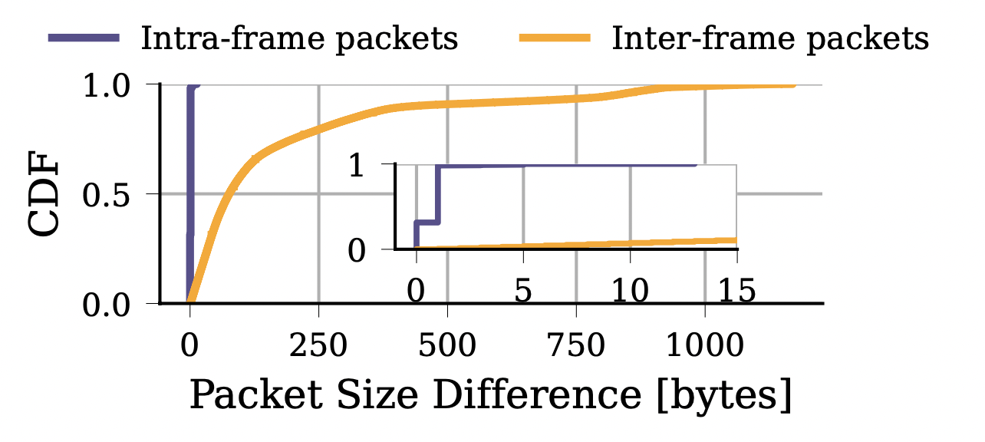
Key Insight: Packet Size Differences

Slide 24
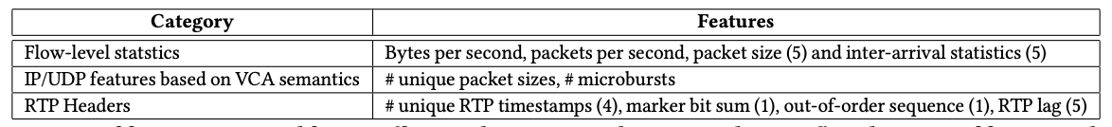
Input Features and Models

Slide 25
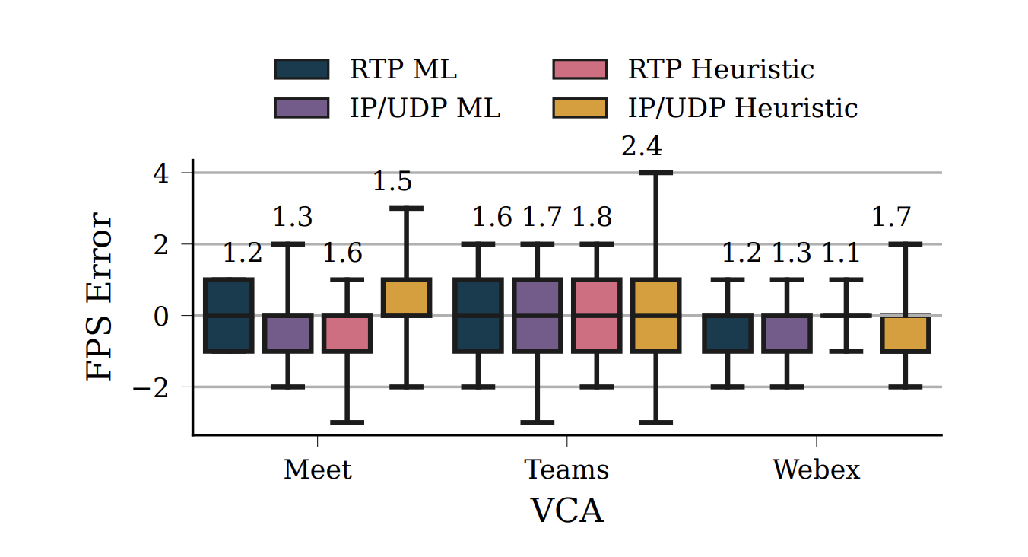
Inference Errors: Frame Rate

Slide 26
Hands-on exercises

Slide 27
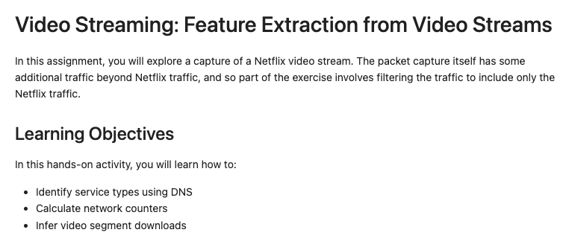
Hands-On: Extracting Features from Network Traffic

Slide 28
Problem Set 1: Video Inference
GOAL: learn the basics of how to create a video resolution inference model using network traffic statistics
Clean the dataset
Simple resolution inference
Feature importance
The impact of different layers on the inference accuracy

