Slide 1
Machine Learning for Computer Systems
Nick Feamster University of Chicago

Slide 2
Data Preparation: Features and Labels

Slide 3
Features: What and Why?
Features are hints/rules of thumb you give your model
Encoding domain knowledge for the model to use
Feature generation is one of the most important part of the machine learning modeling process.
Complexity in features may allow us to use less complex models that are faster to run, easier to understand and easier to maintain.

Slide 4
Generating Features
Categorical to Binary (Dummies)
Features for missing values
Discretization
Date/Time Features
Scaling/Normalizing
Transformations
Aggregations (space, time, space and time)
Relative (compared to the average…)
Interactions
One-Hot Encoding

Slide 5
Categorical to Binary
One vs. All (Dummy Variables)
Groups
Presence vs. Absence

Slide 6
Discretization
Equal width bins
Equal size bins
Entropy-based bins
Domain-Specific bins to incorporate domain specific discontinuities
Age in general
Education/school data
High school data
Lead poisoning problem

Slide 7

Normalization
Usually a good idea to scale features to have similar range: [-1,1] or [0,1] for example
Be careful with outliers
Standardize/Normalize
Zero mean and unit variance
Sklearn.preprocessing.normalize

Slide 8
Feature Transformations
Non-linear
Log (decreasing marginal utility)
(Square) Root
Squared

Slide 9
Aggregation
Date differences (# of days since…)
Aggregates over different time periods
Relative aggregates
Distances
Aggregates over different distances
Seasonality

Slide 10
Combining Features
Generate features for combination of features (product of two features)
Can use linear models but still model non-linear relationships
Random Forests are one way of discovering useful interactions

Slide 11
Pitfalls with Training Data

Slide 12
Challenges with Machine Learning
Insufficient quantity of training data
Nonrepresentative training data
Poor quality data
Irrelevant features
Overfitting/Underfitting

Slide 13
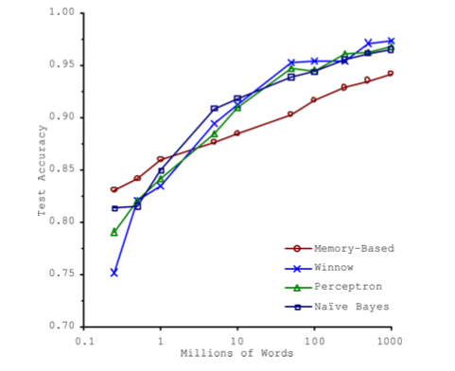
Insufficient Quantity of Training Data
Michele Banko and Eric Brill. 2001. Scaling to very very large corpora for natural language disambiguation. In Proceedings of the 39th Annual Meeting on Association for Computational Linguistics (ACL '01). Association for Computational Linguistics, USA, 26–33.
Machine learning models learn patterns from data to predict future outcomes
Most models require significant amounts of data to train (especially deep learning models)

Slide 14
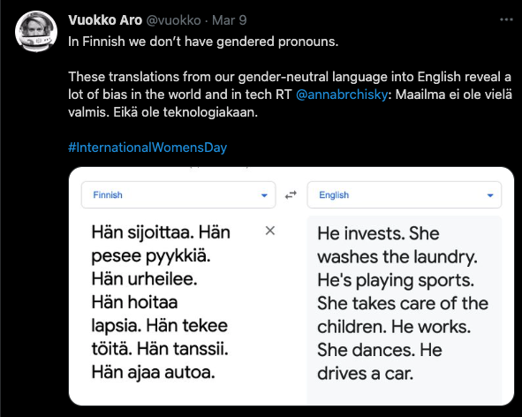
Non-Representative Training Data
Data must be representative of the new cases one wants to generalize to.
Datasets that are missing certain populations, segments, or are otherwise not representative can lead to poor predictions.
Well-studied phenomenon in statistics.
Also affects predictions in machine learning. Becoming especially more prominent in areas of algorithmic fairness.

Slide 15
Poor Quality Training Data
Erroneous or corrupt data
Data with obvious outliers
Try to understand the outliers
Are they systemic? Can they be explained by a phenomenon you want to model? If not, consider fixing or removing them.
Data with missing attributes
Either you need to fill these in (impute) or perhaps ignore the feature altogether

Slide 16
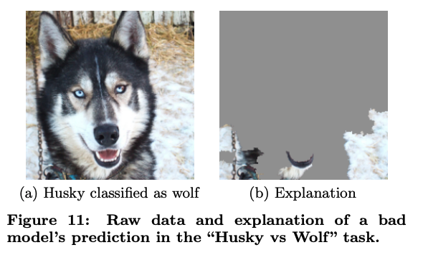
Irrelevant Features
Machine learning models that are fed features that are irrelevant to the underlying prediction.
When combined with non-representativeness, can be fatal to a good model.
Example: Computer vision algorithm that only had pictures of wolves in snow. Algorithm learned to see snow rather than distinguish huskies vs. wolves
Marco Tulio Ribeiro, Sameer Singh, and Carlos Guestrin. 2016. "Why Should I Trust You?": Explaining the Predictions of Any Classifier. In >Proceedings of the 22nd ACM SIGKDD International Conference on Knowledge Discovery and Data Mining (KDD '16. Association for Computing Machinery, New York, NY, USA, 1135–1144. DOI:https://doi.org/10.1145/2939672.2939778

