Slide 1
Machine Learning for Computer Systems
Nick Feamster University of Chicago

Slide 2
Logistic Regression

Slide 3
Maximum Likelihood
Linear Regression: One view of linear regression is probabilistic.
Given a set of i.i.d. observations and a parameterized model, determine the value of the parameter that best matches the observations.
For example, assuming Gaussian noise added to a linear model, goal is to estimate mean of the noise that would have produced those observations.
Logistic Regression: The target prediction is binary, which creates two problems:
Modeling a Gaussian distribution does not make sense: Need values between [0,1].
Coefficients times input features must map between [0,1].

Slide 4




Modeling Probabilities of (0,1) Observations: Bernoulli Distribution
Bernoulli Distribution: Biased coin flips, mean
Probability mass function:
We will say that the parameter is a function of the input x.
Need to map x into a 0-1 space.

Slide 5



Mapping Inputs to [0,1] Space: Logistic Function

Slide 6
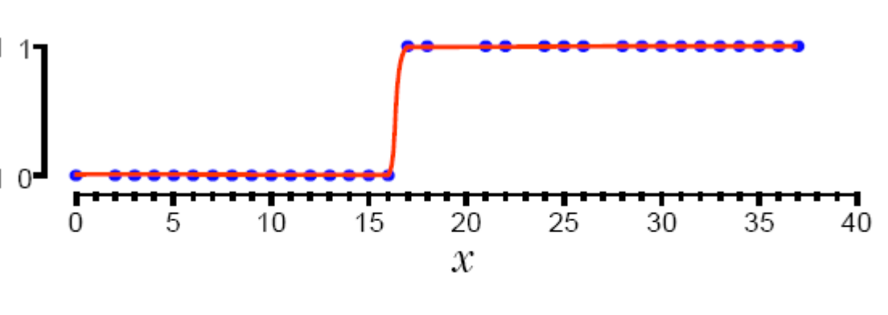
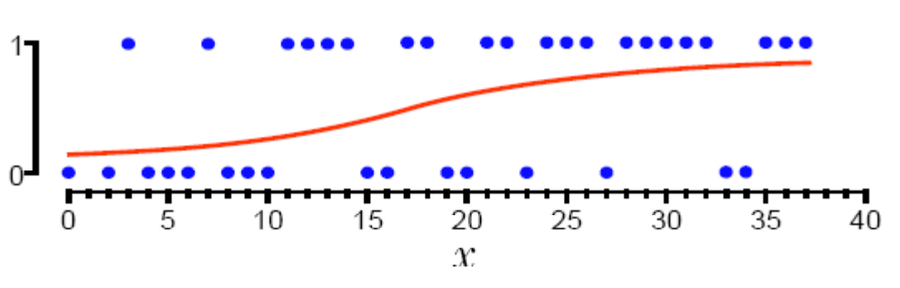



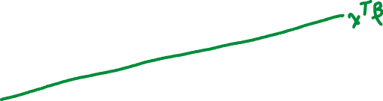


Decision Boundaries

Slide 7


















Relationship to Linear Regression

Slide 8
















Expressing as Log Likelihood

Slide 9
Solving Logistic Regression: Maximizing Log Likelihood
Gradient Descent
Negative gradient points in the direction of steepest descent
Option 1: Empirically determine by stepwise adjustments
Option 2: Newton’s method: Taylor expansion of function around current weights, take the gradient, set to zero.
Stochastic Gradient Descent
Only have access to a noisy version of the gradient
Gradient computed over a smaller subset of all of the data.

Slide 10
Summary
Logistic regression is an extension of linear regression models to predict K classes/values.
Common scenario is K=2 (binary), but can extend the approach to multinomial estimation.
Solution can be expressed as maximization of (log) likelihood, solved using gradient descent.

Slide 11
Support Vector Machines

Slide 12
Support Vector Machines
Refers to a set of classifiers of a certain type:
Maximal Margin Classifier
Support Vector Classifier
Support Vector Machine
These are three different types of classifier that rely on similar concepts.

Slide 13
Max Margin and Support Vector Classifier: Linear Classifiers

Slide 14
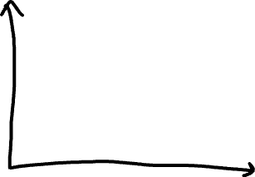
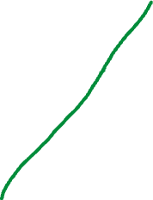
Maximal Margin Classifier: Hyperplanes
Attempts to separate data points in d dimensions into separate classes using hyperplanes.
In d dimensions, a hyperplane is a flat, affine subspace of dimension d-1.
In 2-dimensional space, a hyperplane is a line.
In 3-dimensions, a hyperplane is a plane.
Harder to visualize in higher dimensions, but the notion is well-defined.
A hyperplane divides a d-dimensional space into two halves.

Slide 15



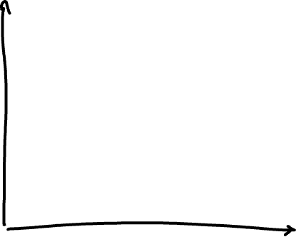


Example Hyperplane
Notes:
The hyperplane 1 + 2X1 + 3X2 = 0 is shown. The blue region is the set of points for which 1 + 2X1 + 3X2 > 0, and the purple region is the set of points for which 1 + 2X1 + 3X2 < 0.

Slide 16





















Separating Hyperplanes (Formally)
Notes:
Math here

Slide 17
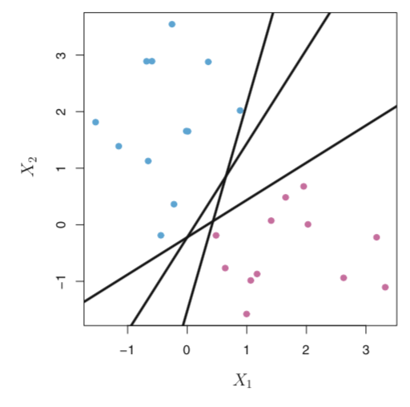
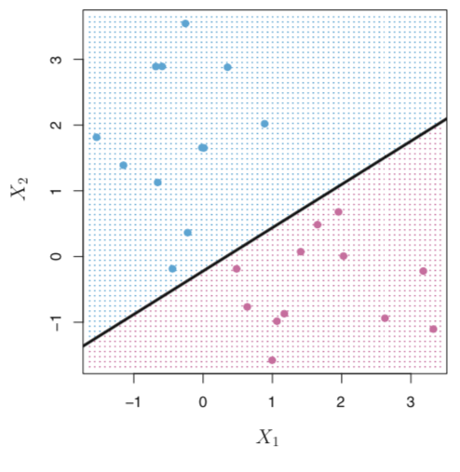
Examples of Separating Hyperplanes
Which separator is the “best”?
Credit: James et al. ISL

Slide 18
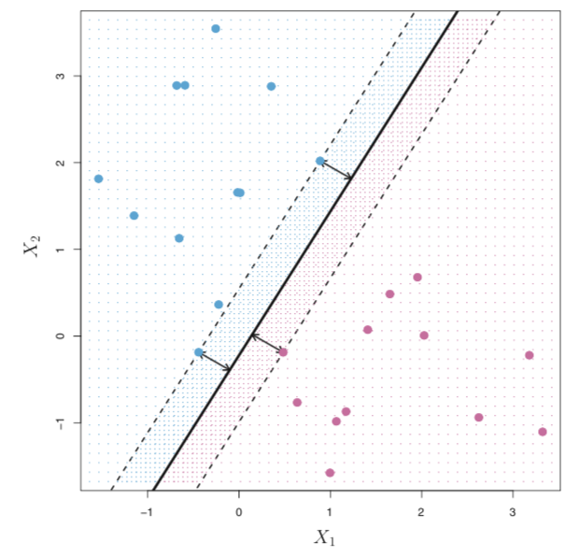



Maximal Margin Hyperplane
The separating hyperplane that is farthest from the training observations.
Intuitively: The widest straight “band” that separates the two classes.
Credit: James et al. ISL

Slide 19












Finding the Maximum Margin Hyperplane
Optimization problem:
Simpler than it looks…

Slide 20
Support Vector Classifier
Problems:
A separating hyperplane may not exist
The separating hyperplane may have very small margins
Solution: Support vector classifier (“soft margin classifier”)
Relax the constraint: Allow some training examples to be on the wrong side of the decision boundary.
Inevitable when no separating hyperplane exists…

Slide 21
Support Vector Classifiers
The goal of a support vector classifier is to find the optimal separating hyperplane that maximizes the margin of the training data.
ρ
r

Slide 22











Support Vector Classifier: Optimization
Notes:
Note: C is a tuning parameter typically given by cross validation.

Slide 23
Tuning the Support Vector Classifier
Tuning the parameter C affects bias-variance tradeoff
Larger values of C creates wider margins. More violations are allowed (higher bias, lower variance)
Smaller values of C have narrower margins More closely fit to the data (lower bias, higher variance)
Interesting property of SVM: Points on either side of the classifier do not affect the separating hyperplane.

Slide 24
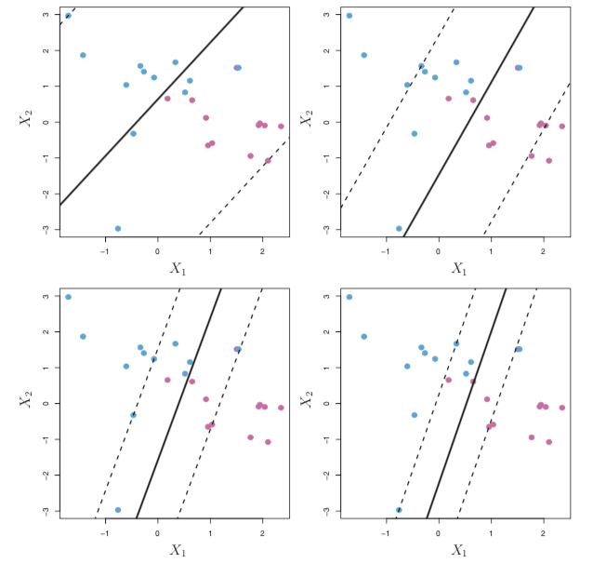


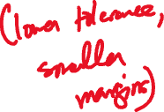

Credit: James et al. ISL

Slide 25






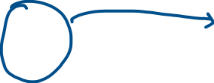













Support Vector Machine
Extension of the support vector classifier to allow for non-linear boundaries between classes.
Replace the linear support vectors with a kernel function that is a quantification of the similarity between two observations. (Effectively, the type of hyperplane that is used to separate the classes.)
Polynomial kernel:
Radial kernel:

Slide 26
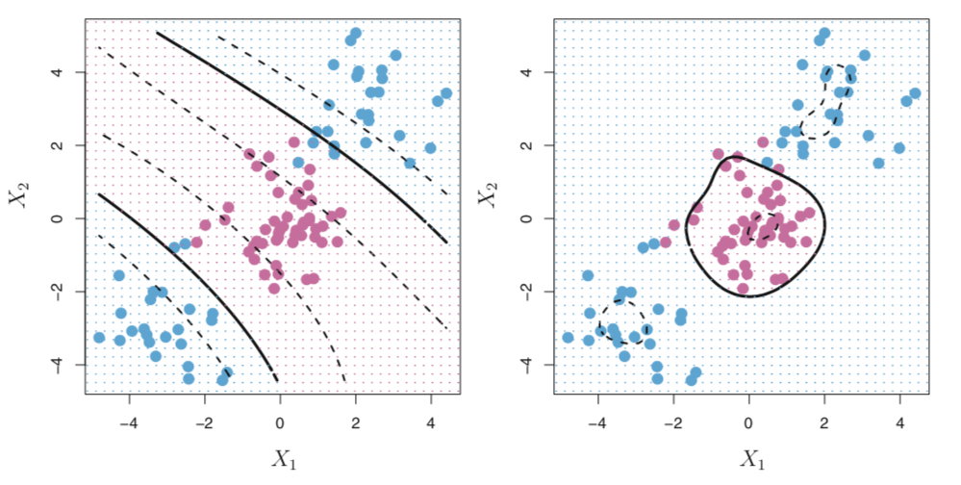




Credit: James et al. ISL

Slide 27
Summary
Support vector machines represent a set of classifiers
Goal: Hyperplanes that maximize the separation between classes.
Can represent complex relationships and decision boundaries through different types of kernels.

