Slide 1
Machine Learning for Computer Systems
Nick Feamster University of Chicago

Slide 2
Automation

Slide 3




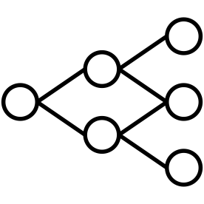
Bespoke Solutions
Application Identification
Hypothesize
Problem
Gather
Traffic
Data
Processing
Engineer
Features
Train
Models
Anomaly Detection
Hypothesize
Problem
Gather
Traffic
Data
Processing
Engineer
Features
Train
Models
Motivation

Slide 4
Generalizable Solutions?
Hypothesize
Problem
Gather
Traffic
Data
Processing
Engineer
Features
Train
Models
Motivation
Notes:
Do animation for all three parts

Slide 5
Features Are Expensive
Hypothesize
Problem
Gather
Traffic
Data
Processing
Engineer
Features
Train
Models
Feature
Engineering
Notes:
How is it expensive?
Time
Domain Expertise
Human Effort
Generally Custom to the problem

Slide 6
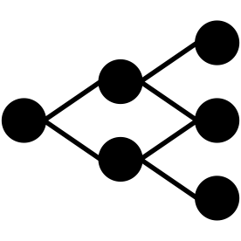
Data Processing
Hypothesize
Problem
Gather
Traffic
Data
Processing
Automated
Traffic Analysis
Data
Processing
Notes:
Explain metadata

Slide 7

Diverging Branches
Feature Extraction A
Model A
Model B
Feature Extraction B
Model A
Released Dataset
Metadata
Attachment A
Model B
Metadata
(CSV)
Traffic
(PCAP)
Model C
Feature Extraction C
Model D
Model C
Metadata
Attachment B
Feature Extraction D
Model D
Diverging
Branches

Slide 8
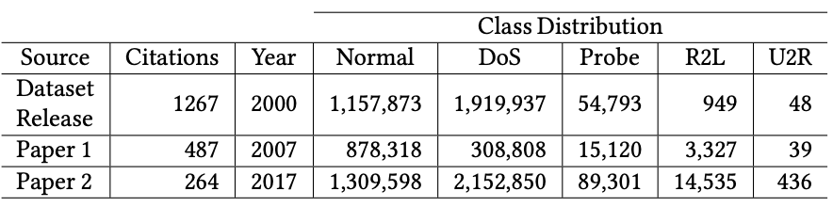
Diverging In Practice - KDD98
Branching
In
Practice
Notes:
Find original distribution

Slide 9
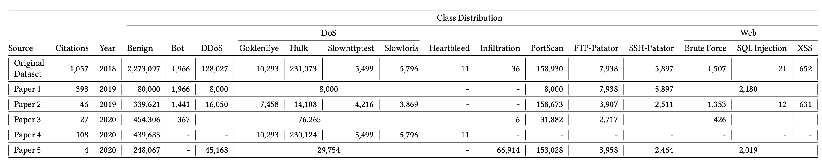
Diverging In Practice - CICIDS2017
Branching
In
Practice
Notes:
Sure, that dataset is old and it’s just 2 papers, right?

Slide 10
Identifying The Problems
Branching Methodologies inhibit reproducibility
Data cascades![7]
Custom pipelines create large barrier to entry for new techniques
And introduce errors!
Identifying
The
Problem

Slide 11
Identifying The Causes
Metadata released separate from raw traffic
Nebulous terminology
What is a session?
When does a traffic flow time out?
What flows make up an application?
Engineering effort / errors
Identifying
The
Problem

Slide 12
The Packet As An Atomic Unit
Every traffic analysis task can be represented by groups of packets
Working
Across
Tasks
Notes:
Very important point - theme of work is everything derives from packets
EVERYTHING involves groups of packets

Slide 13

Grouping Packets
Flow 1
Flow 2
Flow 1
Flow 1
Flow 1
Flow 2
Working
Across
Tasks

Slide 14
Regrouping Packets
Application Identification
Flow 1
Flow 2
Flow 1
Flow 1
Flow 1
Flow 2
Flow Identification
Flow 1
Flow 2
Flow 1
Flow 1
Flow 1
Flow 2
Working
Across
Tasks

Slide 15
Identifying Groups Of Packets
Generate a SampleID for packets associated with piece of metadata
Application Identification
B4de..
Netflix
B4de..
Netflix
B4de..
Netflix
B4de..
Netflix
B4de..
Netflix
B4de..
Netflix
Traffic Filter, Metadata
1.2.3.4 OR 4.3.2.1, Netflix
Sample ID
b4de67053944a28ec6e7721111dad309
SampleIDs

Slide 16
Inspiration From Other Fields
Image recognition
Website fingerprinting on Tor traffic [1,2]
Inspiration
Notes:
- Related work on website fingerprinting

Slide 17
Network Traffic Is Complex
Image recognition
Website fingerprinting on Tor traffic [1,2]
Problem - outside of Tor, network traffic not as simple!
Inspiration
Notes:
- Related work on website fingerprinting

Slide 18
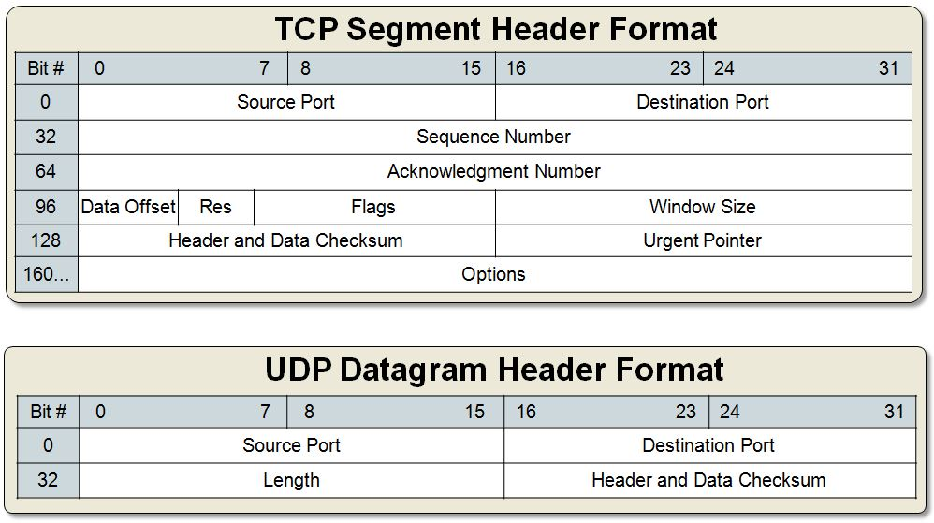
Different Protocols
[3]
Packet
Problems
Notes:
Different headers themselves
Different values in headers
UDP has no flags!!
3. Even worse, they’re all different length

Slide 19
Different Values
Packet
Problems
Notes:
Different values in headers
UDP has no flags!!

Slide 20
Different Lengths
Packet
Problems
Notes:
3. Even worse, they’re all different length

Slide 21
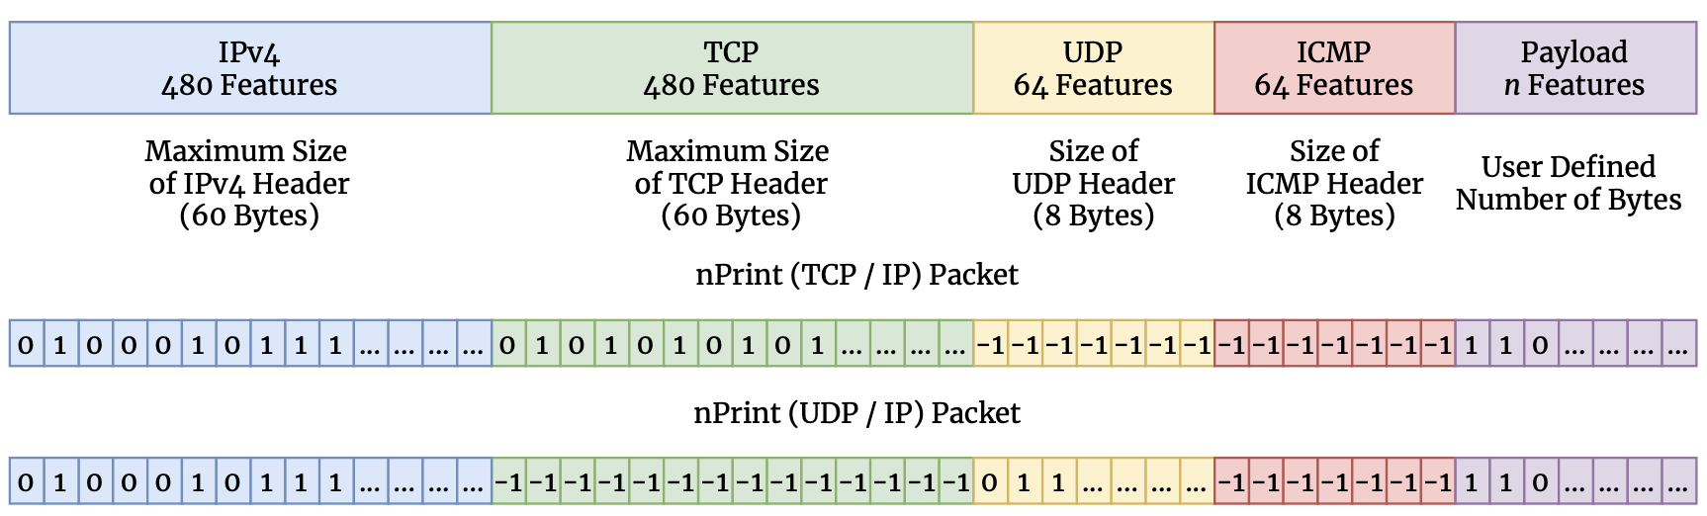
nPrint
nPrint
Notes:
nPrint represents a hybrid between a semantic representation and a binary representation
- best from both

Slide 22
Complete
nPrint
Notes:
nPrint represents a hybrid between a semantic representation and a binary representation
- best from both

Slide 23
Constant Size Per Problem
nPrint
Notes:
nPrint represents a hybrid between a semantic representation and a binary representation
- best from both

Slide 24
Inherently Normalized
nPrint
Notes:
nPrint represents a hybrid between a semantic representation and a binary representation
- best from both

Slide 25
Aligned
nPrint
Notes:
nPrint represents a hybrid between a semantic representation and a binary representation
- best from both

Slide 26
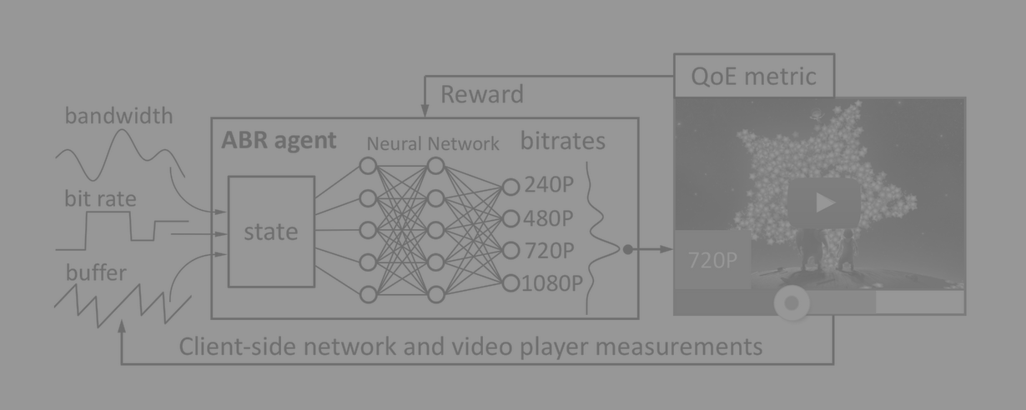
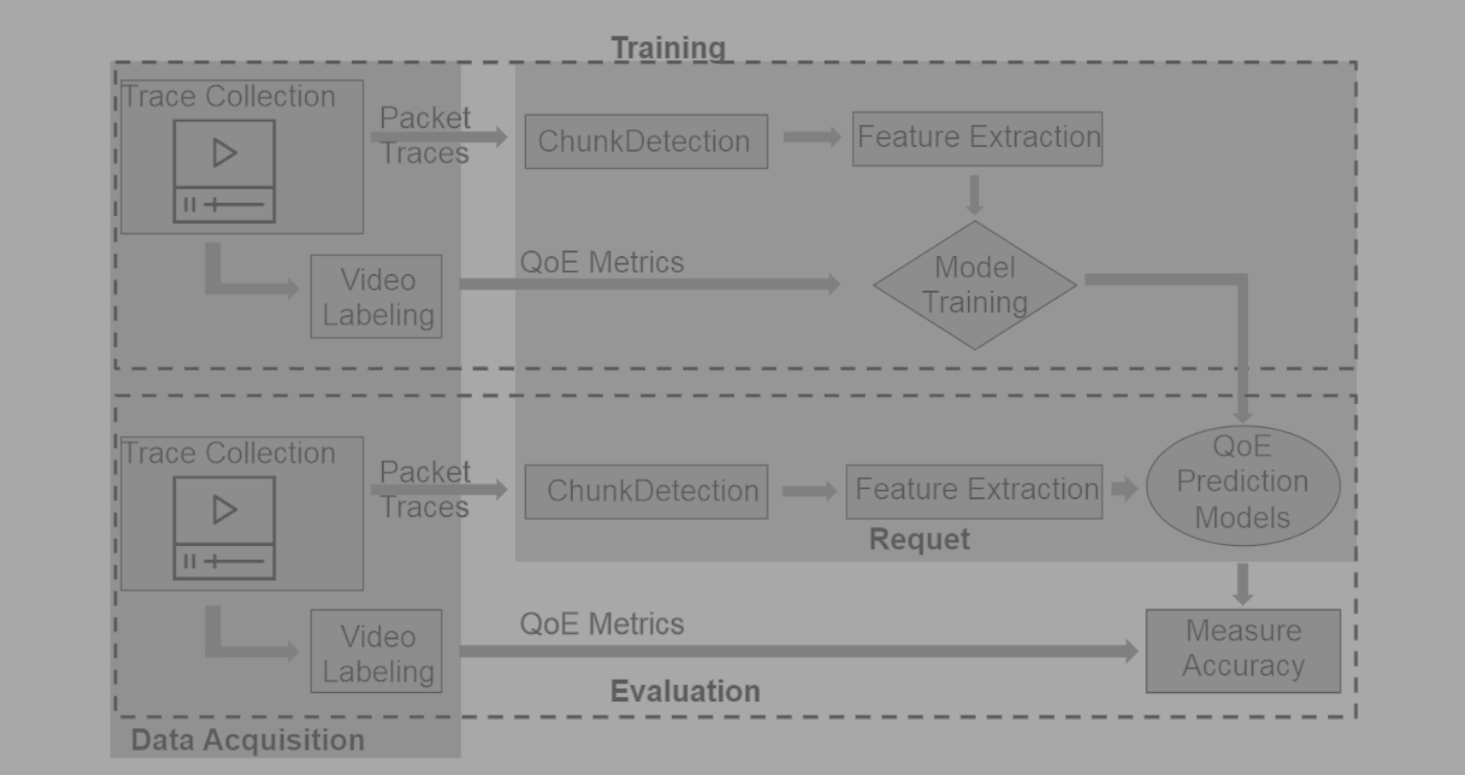
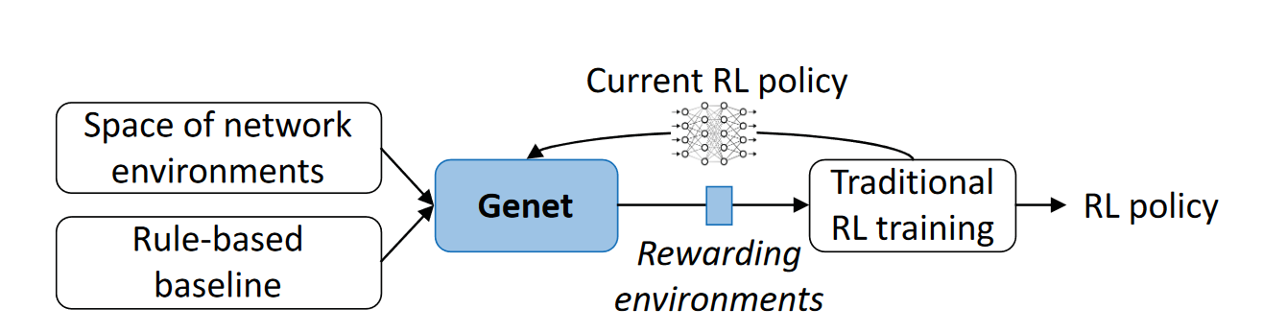
Shifting towards ML based solutions
Pensieve, SIGCOMM 2017
Requet, MMSys 2019
Genet, SIGCOMM 2022
Machine Learning is a valid and powerful tool
Notes:
asdasdasdasd

Slide 27


ML in Networking
Data
Production
Typical problems:
Out of distribution
Lack of generalization
Spurious correlations
Underspecified failure modes
Plain overfitting
…
Train ✅
Test✅
Deploy❓
Failure reasons: problems in data used for training

Slide 28


How to increase data quality?
Experiment #1
Different target infrastructures
For data collection
For artifacts testing
Code reusability
Reduced implementation time
More stable and error-free
Easier reproducibility and testing
Infrastructure #1
Infrastructure #2
Experiment #1
Experiment #2
Infrastructure #1
Solution: modular experiments

Slide 29
Roadblocks and solutions
Typical data collection pipeline:
Non-modular
development + deployment + execution
Written for a specific infrastructure
Pipelines’ subtasks are similar
Let’s split pipelines
Pipelines could be platform agnostic
We need an abstraction layer
Pipeline
Data Collection Infrastructure
Pipeline
Data Collection Infrastructure
Pipeline
Abstraction layer
Data Collection Infrastructure
Data Collection Infrastructure

Slide 30
Ideal solution: supported modes
Deployment modification:
Change deployment mode for the same infrastructure
Deploy the experiment to different infrastructure
Code modification:
Modify the pipeline’s code
Reuse parts of the pipeline

Slide 31
Ideal solution: supported modes
Deployment modification:
Change deployment mode for the same infrastructure
Deploy the experiment to different infrastructure
Code modification:
Modify the pipeline’s code
Reuse parts of the pipeline

Slide 32
Illustrative example: CIC-IDS2017
Intrusion Detection Dataset
5 days, 52 GB of traffic
Benign/attack traffic classification
Reported result: F1 0.99

Slide 33
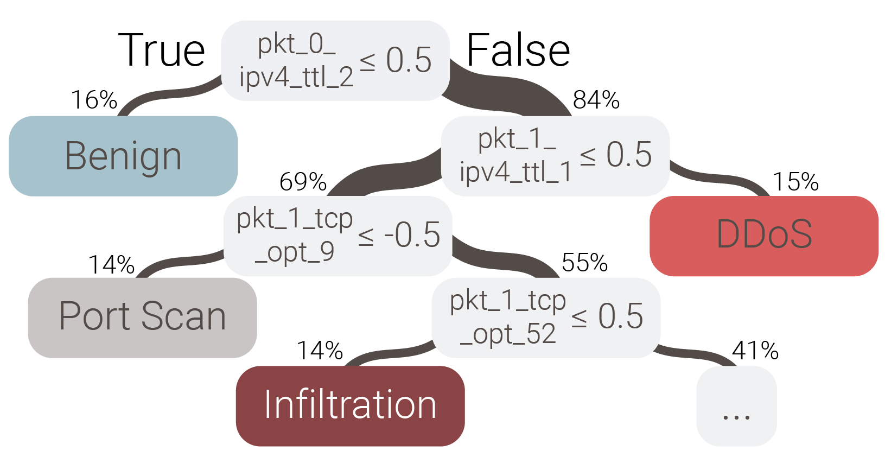
Illustrative example: CIC-IDS2017
Intrusion Detection Dataset
5 days, 52 GB of traffic
Benign/attack traffic classification
Reported result: F1 0.99

Slide 34
Illustrative example: fixing CIC-IDS2017
Reasons:
All victims are inside of the ‘internal’ network: TTLs are 64/128
All attackers are outside of the ‘internal’ network: TTLs are 63/127
Though this is often valid, we want attackers and victims to present in all (both inside and outside) networks
Deployment modification of the experiment
Add attackers from internal network
Add benign traffic from outside network

Slide 35
Ideal solution: supported modes
Deployment modification:
Change deployment mode for the same infrastructure
Deploy the experiment to different infrastructure
Code modification:
Modify the pipeline’s code
Reuse parts of the pipeline

Slide 36
Illustrative example: Heartbleed @ CIC-IDS2017
Particular attack classification (Heartbleed)
78 pre-computed features from flow statistics (e.g. flow duration, mean IA)
Reported F1 score: 0.99

Slide 37
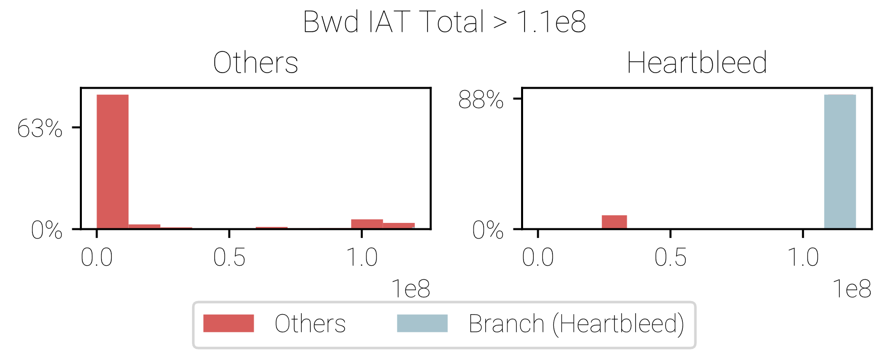
Illustrative example: Heartbleed @ CIC-IDS2017
Particular attack classification (Heartbleed)
78 pre-computed features from flow statistics (e.g. flow duration, mean IA)
Reported F1 score: 0.99

Slide 38
Illustrative example: fixing Heartbleed @ CIC-IDS2017
Reasons:
Heartbleed triggers with a single-packet request-response pattern
TCP connections were never closed between different requests from attacker
Result: very big inter-arrival packet time
Pipeline modification of the experiment
Close TCP connections immediately after receiving the response

Slide 39
Illustrative examples: takeaways
Data collection is a complicated process
Errors are hardly predictable and usually to be found empirically
Researcher often doesn’t know all problems and data they want to collect
Result:
We want to iteratively collect datasets
We want deployment modification
We want code modification

Slide 40
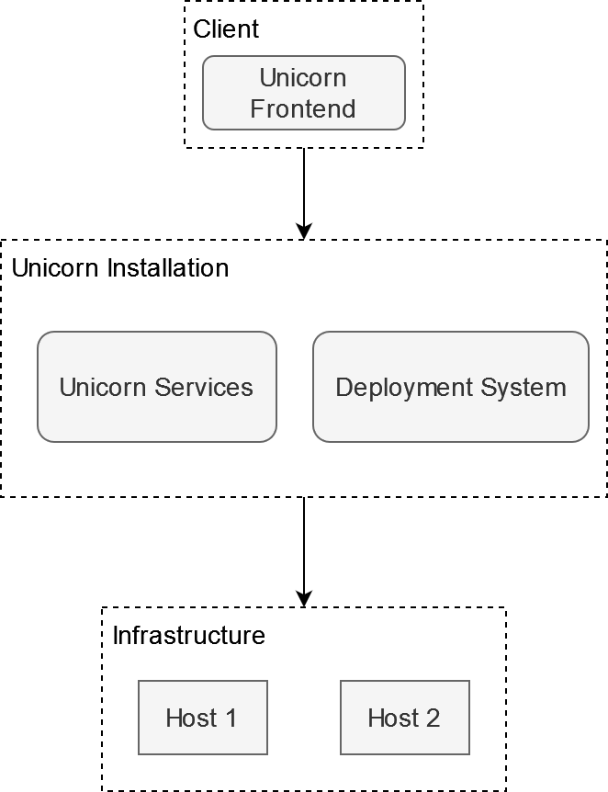
netUnicorn – general description

Slide 41
netUnicorn – typical workflow
User defines what, where, and when to execute
Arbitrary Python code
Node selection capabilities
Experiments synchronization capabilities
The platform prepares the experiment (compilation & distribution)
User starts the experiment
On a target host environment starts with an executor and code inside
Executor on a target host controls experiment’s flow
Executor reports results

Slide 42

netUnicorn – supporting modularity for tasks
Programming abstractions for experiment creation
Task

Slide 43
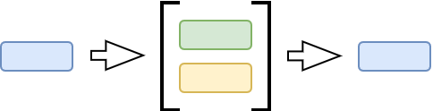
netUnicorn – supporting modularity for tasks
Programming abstractions for experiment creation
Task
Pipeline

Slide 44
netUnicorn – supporting modularity for tasks
Programming abstractions for experiment creation
Task
Pipeline
Node

Slide 45
netUnicorn – supporting modularity for tasks
Programming abstractions for experiment creation
Task
Pipeline
Node
Deployment (Node + Pipeline)

Slide 46
netUnicorn – supporting modularity for tasks
Programming abstractions for experiment creation
Task
Pipeline
Node
Deployment (Node + Pipeline)
Experiment (List of Deployments)
…

Slide 47
netUnicorn – providing encapsulated environment
Docker containers as a virtual environment
Pipeline encapsulation
Integrated dependencies
Easy cleanup
Reproducible environment
Hardware protection
No sudo access to the host
No ability to turn on undesirable features
E.g. Wi-Fi promiscuous mode
Possible resources constraints

Slide 48
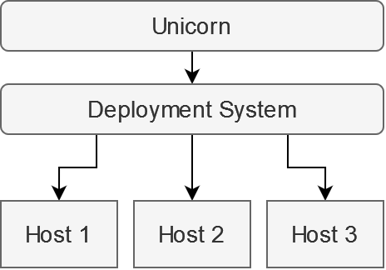
netUnicorn – supporting different infrastructures
Using “deployment systems” as a source of truth
netUnicorn integrates with existing infrastructure, not modify it
System as an overlay
Ability to work even in restricted environments
Connectors system
Extendable
Minimalistic
Secure

Slide 49
netUnicorn – possible target platforms
Local-based configuration management systems
SaltStack
Ansible
Cloud-based deployment systems
AWS EC2 & ECS
Azure VMs and Container
Local virtual systems
Mininet (Containernet)
NS-3
Global networking experiment systems
Chameleon Cloud
EdgeNet

Slide 50
Dos and Don’ts
Active measurements
Passive measurements
Rapid prototyping
Iterative and changing code / deployment scenarios
Not:
A magic pill for trustworthy ML
Data analytics system
Pre-defined fixed-size set of metrics / measurements
netunicorn.library

