Slide 1
Machine Learning for Computer Systems
Nick Feamster University of Chicago

Slide 2
Linear Regression and Polynomial Expansion

Slide 3
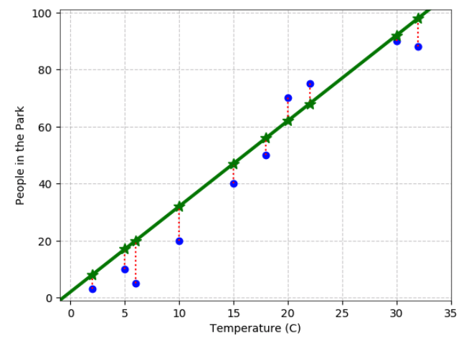
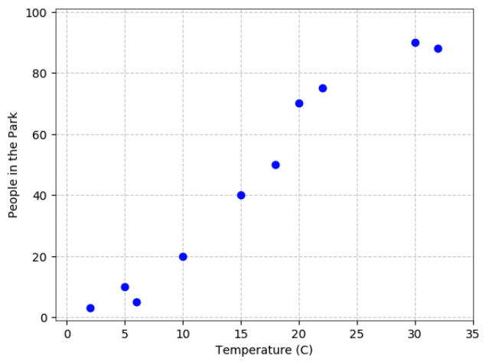
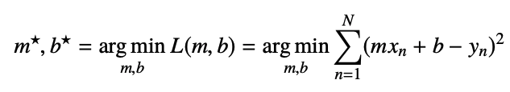
Least Squares Linear Regression, Single Input

Slide 4
Problem Framing
Given: Vector of inputs
Predict: Real-valued output
Inputs can come from different sources
Quantitative inputs
Transformations of quantitative inputs (log, square root, square)
Basis expansions (square, cube, etc.)
Numeric coding of qualitative inputs
Interactions between variables

Slide 5
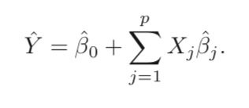
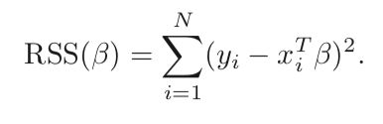




Least Squares with Multiple Inputs
One example loss function: Residual sum of squares.
Goal: Find beta that minimize loss.
Take derivative, set to zero.
Notes:
Mainstay of statistics for 30 years.

Slide 6
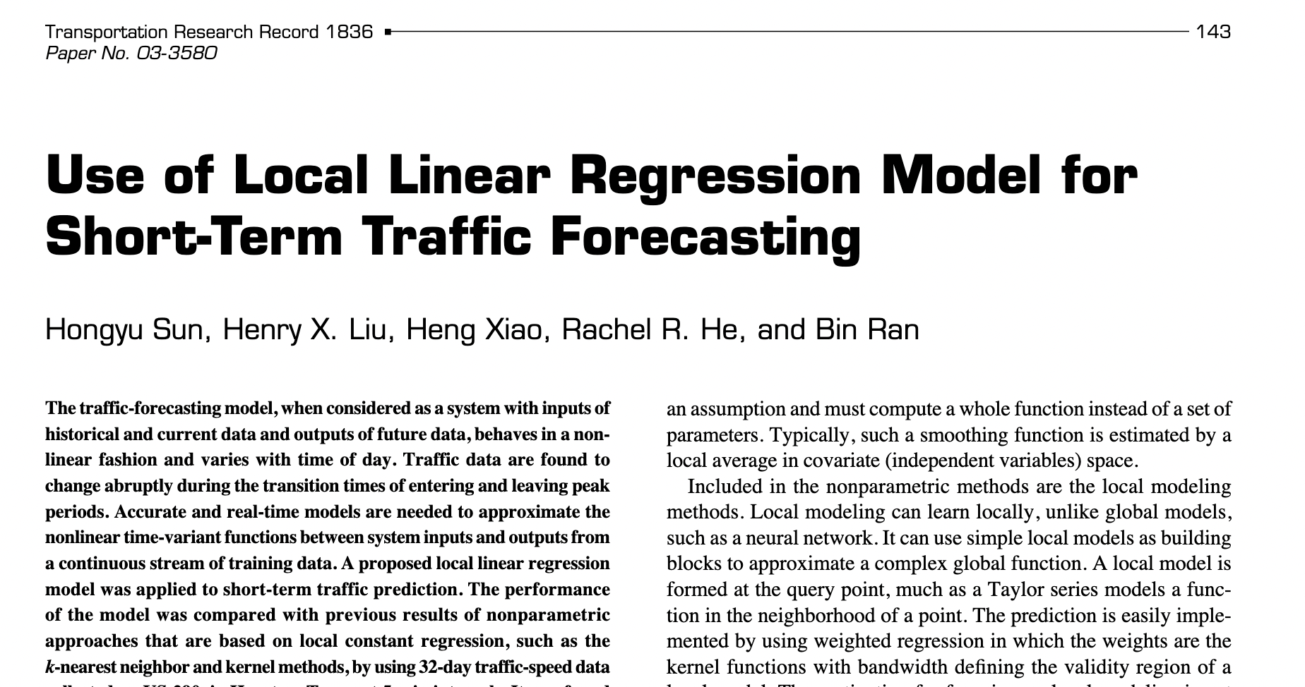
Notes:
https://journals.sagepub.com/doi/epdf/10.3141/1836-18

Slide 7
Assumptions About Underlying Data
Independence of inputs
Training observations independent random draws from the population
Conditionally independent given the inputs
Matrix should be full rank
If not, then it does not have an inverse
However, can be non-full rank in practice (redundant encodings)
Regression packages typically detect and remove redundancies
Regularization is another approach (will be discussed later)

Slide 8


Quality of the Estimation/Variable Significance
Assume that the linear model is the correct model for the mean that the conditional mean of Y is linear in the observations, X.
Test hypothesis that a particular coefficient is 0. Relevant statistics:
Z-Score (for a single coefficient; coefficient divided by its standard error)
F Statistic/F tests (for multiple coefficients)
Notes:
Good video on F tests: https://www.youtube.com/watch?v=ie-MYQp1Nic

Slide 9
Basis Expansion

Slide 10
Problem
Linear models may not fully capture the wide variety of functions we need to approximate in supervised learning.
Often, data does not always map to real-valued vectors
Molecules
Text
Graphs
…
Goal: Need a way to represent non-linear regression.

Slide 11
Examples of Non-Linear Relationships
Hours studied vs. score on tests.
Level in company vs. salary.

Slide 12
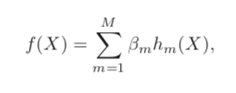
Key Idea: Transformations
Replace the vector of inputs, X, with additional variables that are transformations of X.
Then apply linear models to this set of derived input features.
Once the basis functions are determined, the same fitting functions apply as before!

Slide 13
Examples of Basis Functions
Polynomials
Fourier series
Piecewise linear: zero when x is not in the relevant interval, linear functions within the interval in question
Radial basis functions: symmetric around a point, decays to zero further from the point

Slide 14
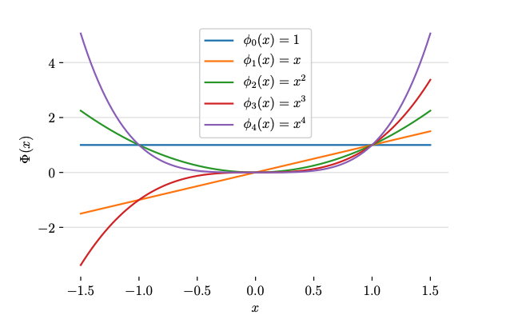
Polynomial Linear Regression
Not changing how the regression fits the model.
Only adding polynomial features to an existing linear model.

Slide 15
Transformation Applies to Each Observation

Slide 16
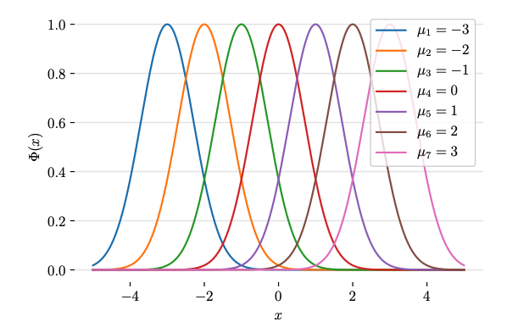
Radial Basis Function

Slide 17
Creating Vector Representations from Data
Images: DCTs, Wavelets, Convolutional Neural Network, …
Speech: Fourier, wavelet transforms
Text: Counts of words, n-grams, TF-IDF, word embeddings

Slide 18
Summary
Relationships between features and outcomes are often nonlinear.
Can still use linear regression to model/predict.
Main idea: Transform initial set of features with non-linear functions.
Polynomial
Piecewise linear
Radial basis
Ability to perform linear fit is preserved.

Slide 19
Overfitting and Regularization

Slide 20
Inductive Bias
Learning assumes some structure in:
Data that we have seen (training data)
Data that we have not seen (test data)
Consider two functions:
f (x’) = 0 if an there is no corresponding x with 1 in the dataset, 1 otherwise
g(x’) = 0 if an x with label 0 is in the training set, 1 otherwise
The two functions produce exactly the opposite answers for any datapoint not in the training set, yet both are based on training data!

Slide 21
Inductive Bias and Assumptions About Data
Restriction Bias: Only some kinds of hypotheses are possible.
Preference Bias: Prefer the higher ranked hypothesis, among multiple consistent hypotheses.
No Free Lunch Theorem: No inductive bias is correct across all universes. For any set of target functions over which inductive bias works well, it will perform poorly over the complement.

Slide 22
Underfitting and Overfitting
Underfitting: The model is too restrictive to capture relevant structure about the function/data being modeled.
Overfitting: The model is too permissive, capturing noise in the model that is not generalizable structure.
Tension: Fitting the data well vs. Generalizing to new examples.
Overfitting can be hard to spot, since it is reflected by reduced error in the training set.

Slide 23
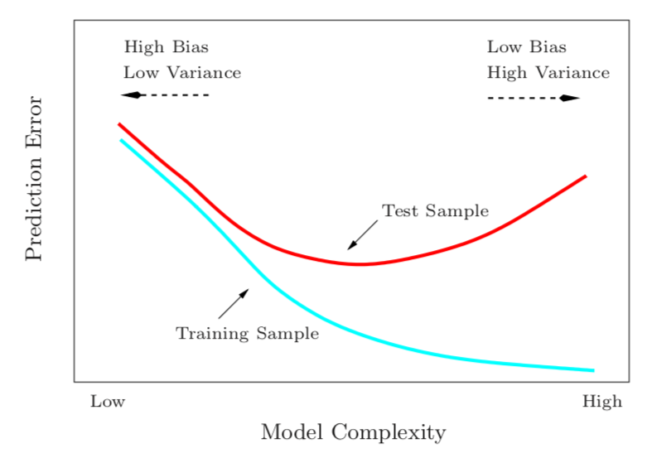
Bias-Variance Tradeoff

Slide 24
Bias-Variance Tradeoff
Variance: The expected fluctuation in predictions for f(x), given different datasets used to train f
Bias: The expected deviation of f(x) from the true target value y.
The mean squared error of an estimator is the sum of the variance plus the square of the bias.
Corollary: Reducing the variance increases bias, and vice versa.
True across all machine learning models.

Slide 25
Two Sources of Model Complexity
Two Sources of Model Complexity
Number of basis functions (e.g., in polynomial features, the degree of the polynomial)
Number of parameters (i.e., the number of parameters whose coefficient is non-zero)
Regularization: Penalize the number of non-zero parameters (coefficient shrinkage)

Slide 26
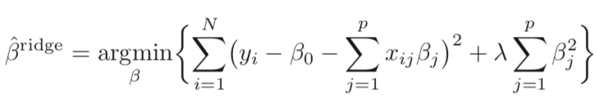

Coefficient Shrinkage: Ridge Regression
Impose a penalty on coefficient size. (sum of squares of all coefficients)
Lambda is a complexity (hyper)parameter that controls the amount of shrinkage. (in sklearn, the parameter is called “alpha”).
This concept will re-occur in neural networks (“weight decay”).
Important to standardize inputs before solving.

Slide 27

Coefficient Shrinkage: Lasso Regression
Impose a penalty on coefficient size. (sum of absolute values of all coefficients)
Solutions are nonlinear in y.
No closed form solution.

Slide 28

Ridge vs. Lasso?
Ridge often produces slightly better predictions.
Lasso often produces more interpretable models (through coefficient shrinkage)
Can also use both (“elastic net”)—a linear regression model that includes both penalties.

Slide 29
Summary
There is a tradeoff between:
the complexity of a model (which may tend to overfit) and
the bias of that model (the error against the training set)
There is no free lunch! Have to tradeoff!
Tuning the hyperparameters is itself an optimization.
Simpler models have several advantages:
Avoid overfitting
Interpretability

