Slide 1
Machine Learning for Computer Systems
Nick Feamster University of Chicago

Slide 2
Principal Component Analysis

Slide 3
What is Principal Component Analysis (PCA)?
Each data point can be represented as a linear combination of vectors/features.
PCA changes the set of component vectors to align in the directions that capture the most variance.
Principal components are linear combinations of the original vectors
Importance of principal components represented by “loading” vector.
In linear algebra terms, it is a “change in basis”.

Slide 4
Why Principal Component Analysis (PCA)?
Goal: Represent data in higher dimensions in a smaller number of dimensions.
Motivation: Why is Principal Component Analysis helpful?
Simplification: Reduce the dimension/complexity of the data while preserving variance (“interesting” properties of the data)
Visualization: Easiest to visualize data in two dimensions, but visualizing all pairs may be prohibitive.
Noise reduction: Keeping principal components that capture variance and removing the rest effectively filters noise.
Clustering: Spectral clustering attempts to map data points into principal components with the highest contributions.

Slide 5
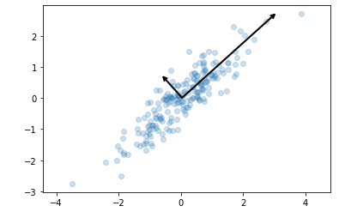
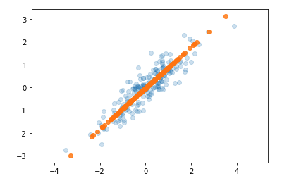
Two Views of Principal Component Analysis
Capturing Maximum Variance
Minimizing Distance to Projection
Principal component is the vector that captures the most variance in the dataset.
Principal component is the vector that is closest to the data points. (Minimize squared error to projection.)
Notes:
These vectors represent the principal axes of the data, and the length shown in Figure 5-81 is an indication of how “important” that axis is in describing the distribu‐ tion of the data—more precisely, it is a measure of the variance of the data when pro‐ jected onto that axis. The projection of each data point onto the principal axes are the “principal components” of the data.

Slide 6
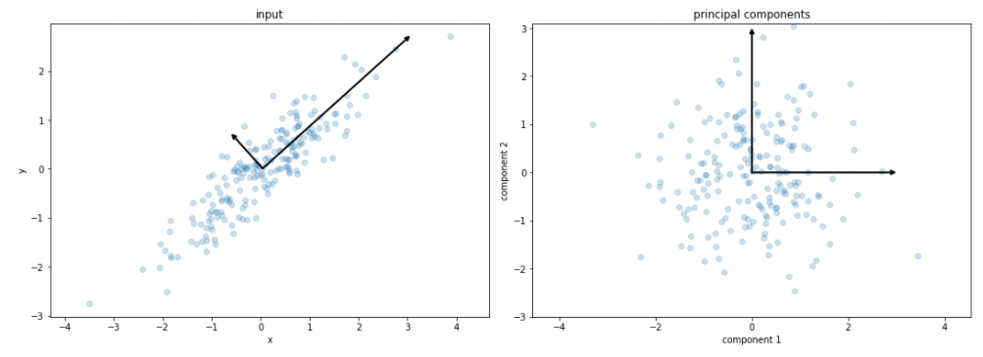
Interpreting Principal Component Projections
Projecting the data points onto the principal component yields the principal components themselves.

Slide 7

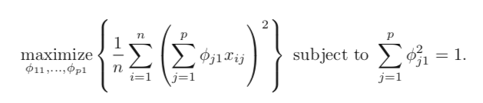
How to Compute Principal Components?
Given: An n x p dataset, X.
Want: n x m vectors where m << p, that capture most variance in X.
How: Project onto the sorted eigenvectors of the covariance matrix of X.
Notes:
https://towardsdatascience.com/pca-and-svd-explained-with-numpy-5d13b0d2a4d8

Slide 8
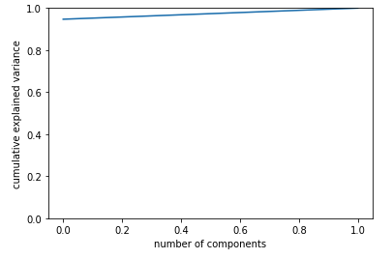
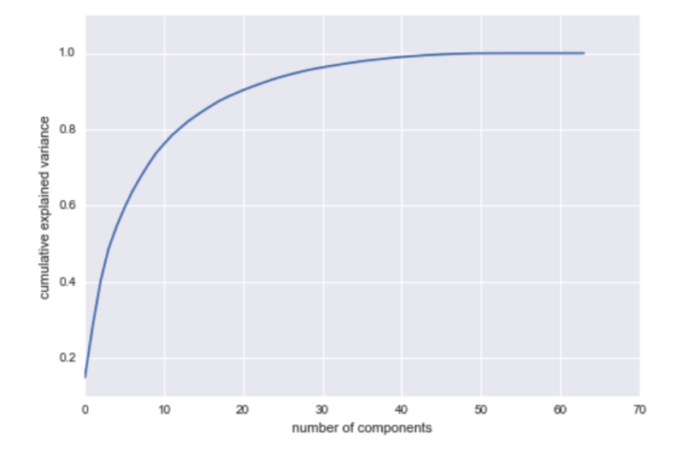
How Many Principal Components?
Scree plot shows the distribution of explained variance for the number of principal components (typically shown with eigenvalues).
Aim is to find a small number of principal components that capture the most variance.

Slide 9
Summary
Principal Component Analysis (PCA) is a way of representing high-dimensional data in lower dimensions.
Method: Projection of the data points onto the eigenvectors of the covariance matrix.
Useful for dimensionality reduction (simplification, visualization, noise reduction)

