Slide 1

Welcome to SENG 3130
Sina Keshvadi
September 06, 2022
Thompson Rivers University

Slide 2
Today’s Agenda
Welcome!
Software Requirements Basics and Definitions
SENG 3130 Overview
Administrative Details
Questions?

Slide 3
What do we learn from today lecture?
Why do we need to discover the requirements?
What are the software requirements?
Levels and types of requirements
Product vs Project requirements
Requirements engineering
Summary

Slide 4
What do we learn from today lecture?
Why do we need to discover the requirements?
What are the software requirements?
Levels and types of requirements
Product vs Project requirements
Requirements engineering
Summary

Slide 5

Let’s listen to this conversation
Ref: https://www.deepijatel.com/blog/uploads/images/How_to_set_up_a_call_center_in_India-01.png

Slide 6
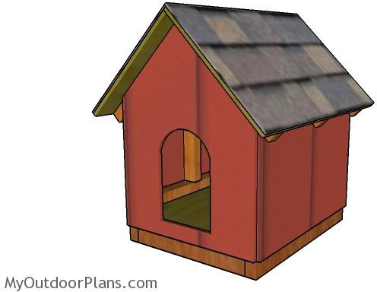
It is so easy to build a software system! Just write the code

Slide 7
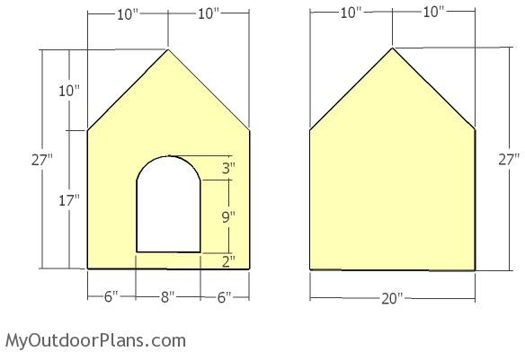
Just write the code

Slide 8
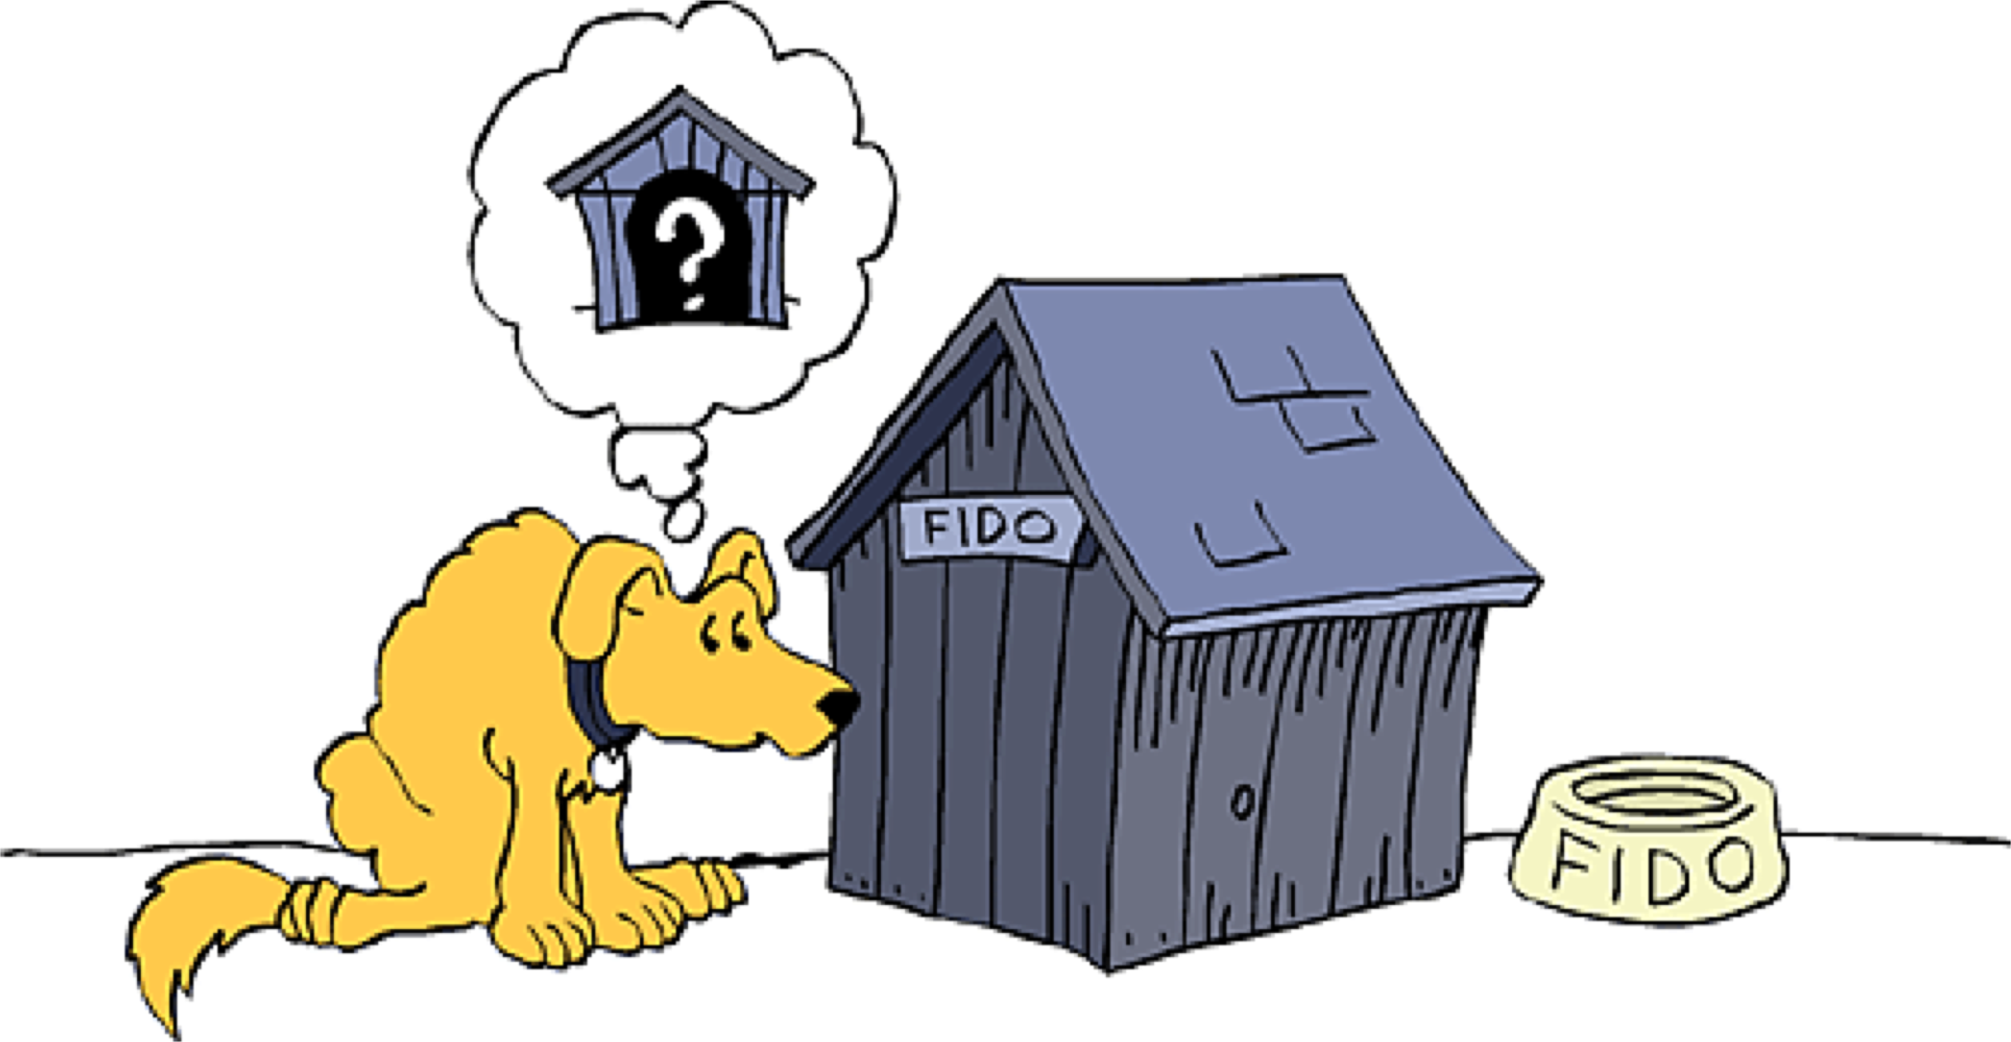
Just write the code
[1]
[1] McConnell, Steve. "Code complete", 2nd ed. 2004

Slide 9
It is so easy to build a software system! Just write the code
[1]
“The penalty for a mistake on a simple structure is only a little time and maybe some embarrassment” [1]
[1] McConnell, Steve. "Code complete", 2nd ed. 2004

Slide 10
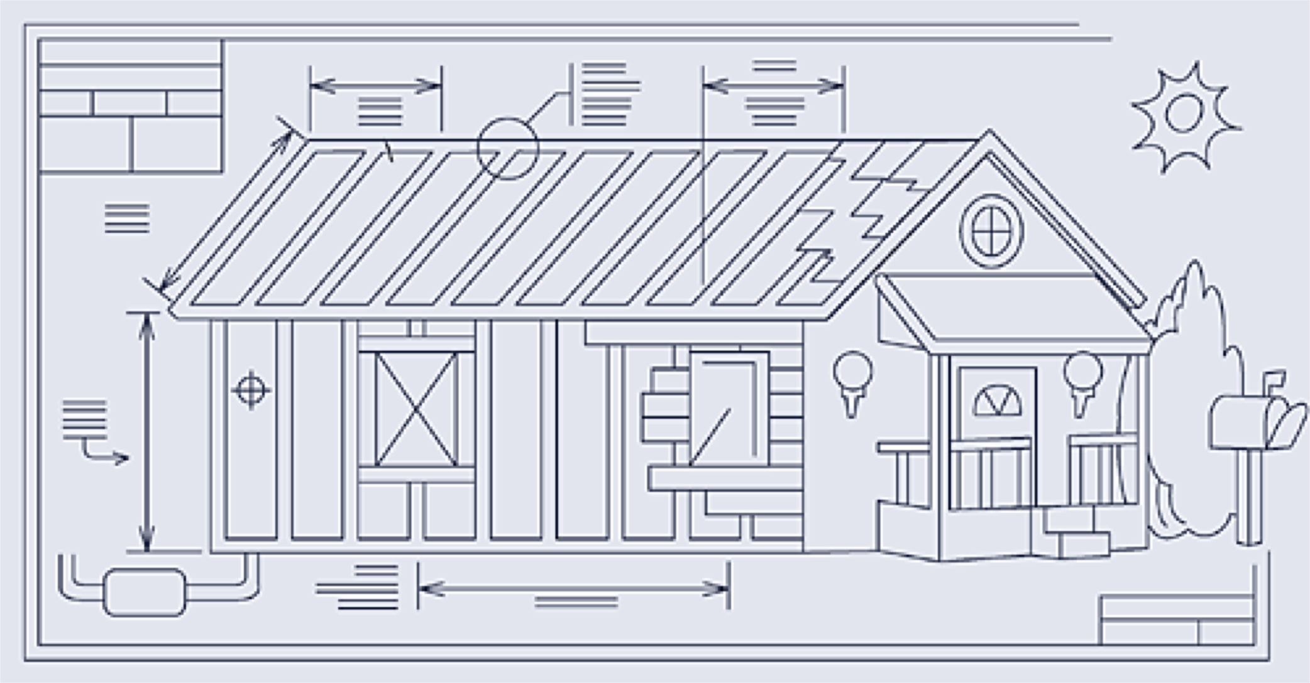
Actual software systems are very complex
[1]
In large-scale software systems, implementing a missing requirement takes considerable effort.
[1] McConnell, Steve. "Code complete", 2nd ed. 2004

Slide 11
Fixing requirements errors are very costly
Phase in Which a Defect Is Introduced
Cost
Requirements
Architecture Construction
Requirements _{Architecture} Construction _{System Test} Post-Release
Phase in Which a Defect Is Detected
[1]
[1] McConnell, Steve. "Code complete", 2nd ed. 2004

Slide 12

Single requirement error can lead to a mission failure
For example, the loss of the “Mars Climate Orbiter”
According to NASA reports “The root cause of the loss of the spacecraft was the failed translation of English units into metric units in a segment of ground- based, navigation-related mission software”_{[1]}
[1] https://mars.nasa.gov/msp98/news/mco991110.html

Slide 13
Single requirement error can lead to a mission failure (cont.)
The process to verify and validate certain engineering requirements and technical interfaces between some project groups, and between the project and its prime mission contractor, was inadequate.
[1] https://mars.nasa.gov/msp98/news/mco991110.html
36

Slide 14
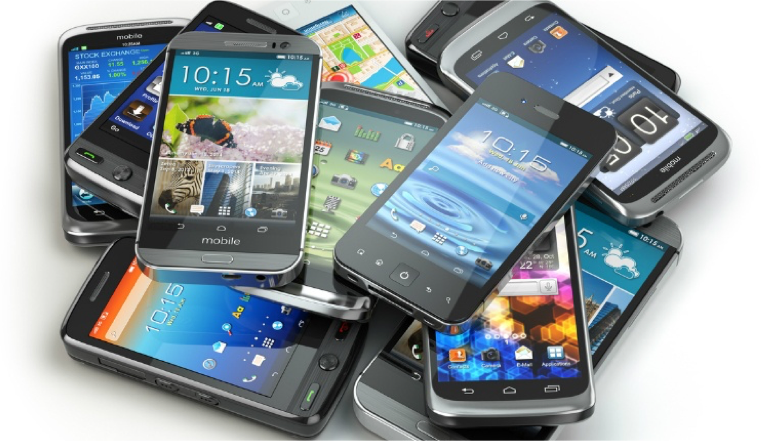

Defects in the software products can destroy your reputation
“Errors introduced during requirements activities account for 40 to 50 percent of all defects found in a software product” _{[1]}

Slide 15



Summary of the importance of software requirements
Determining the success of your product
Economic impact
Impacts your brand reputation

Slide 16
What do we learn from today lecture?
Why do we need to discover the requirements?
What are the software requirements?
Levels and types of requirements
Product vs Project requirements
Requirements engineering
Summary

Slide 17
What makes a successful project?
Think about the best software that you like and tell us why you liked it?

Slide 18
What are the software requirements?
“Requirements are a specification of what should be implemented.They are descriptions of how the system should behave, or of a system property or attribute.They may be a constraint on the development process of the system.” _{[1]}
[1] Ian Sommerville and Pete Sawyer (1997)
Notes:
show one or two software requirements

Slide 19
What do we learn from today lecture?
Why do we need to discover the requirements?
What are the software requirements?
Levels and types of requirements
Product vs Project requirements
Requirements engineering
Summary

Slide 20
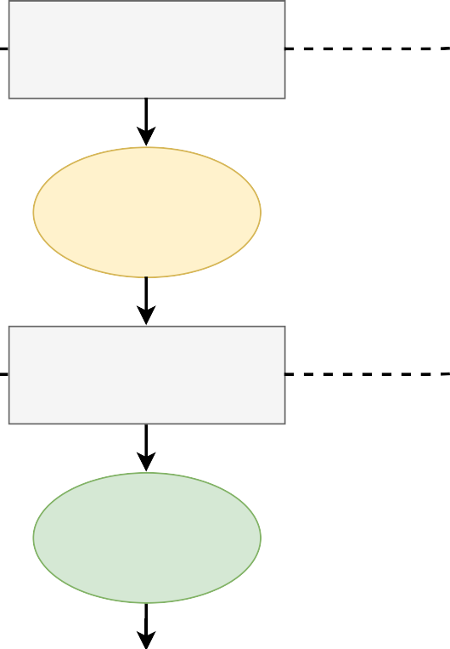
Levels and types of requirements
Business requirements
We have three levels of requirements:
(1) business requirements
(2) user requirements
(3) functional requirements
Vision and scope document
User requirements
User requirements
User requirements document
Functional requirements
Software requirements
specifcations (SRS)
43

Slide 21
Levels and types of requirements
Business requirements
“Business requirements represent high-level business objectives of the organization that builds the product or of a customer who procures it.”_{[1]}
Vision and scope document
User requirements
User requirements
User requirements document
Functional requirements
Software requirements
specifcations (SRS)
44

Slide 22
How to identify the high-level business objectives?
Business requirements reflect the answer to these questions:
Why the organization is implementing this system?
What are the benefits the organization hopes to achieve?

Slide 23

How to identify the high-level business objectives?
Business requirements reflect the answer to these questions:
Why the organization is implementing this system?
What are the benefits the organization hopes to achieve?
“Suppose an airline wants to reduce airport counter staff costs by 25%.This goal might lead to the idea of building a kiosk that passengers can use to check- in for their flights at the airport.”_{[1]}

Slide 24
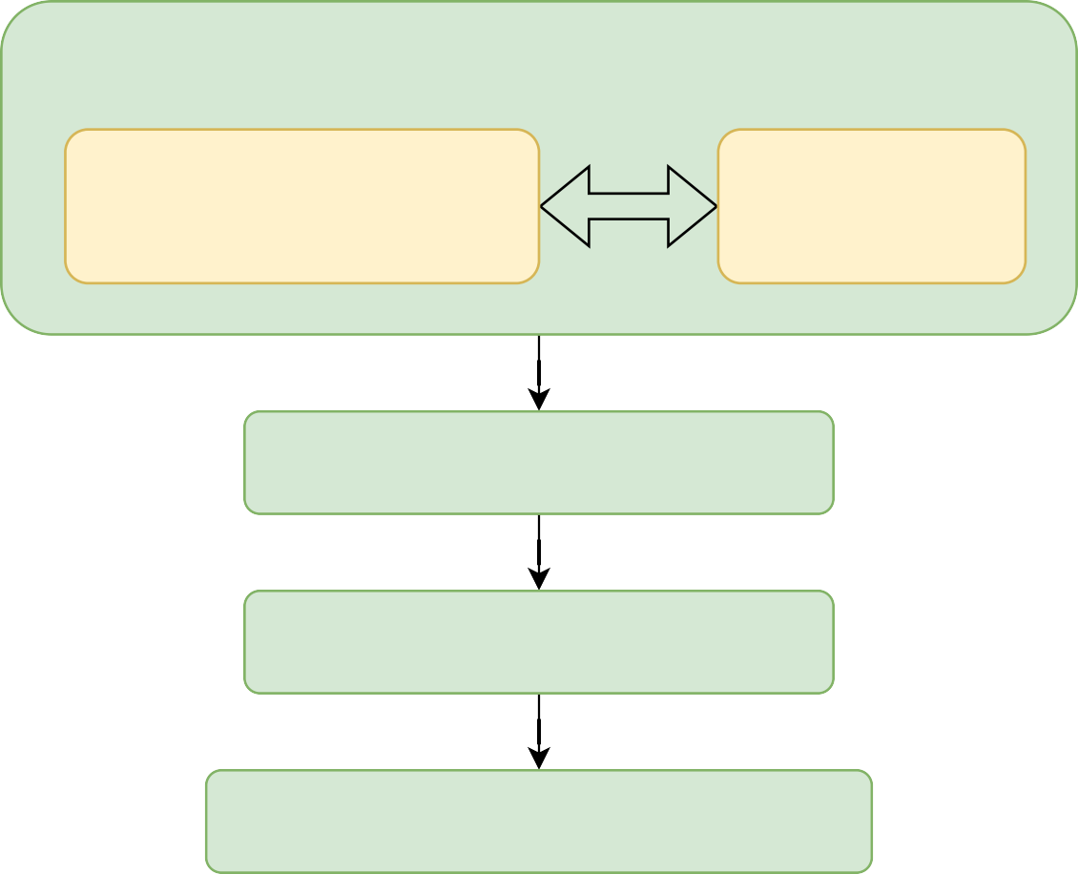
How to identify the high-level business objectives?
Business opportunities
Business needs
& current limitations
Business
benefits
Business objectives
Success metrics
Vision/mission statement

Slide 25
How to identify the high-level business objectives?
Business requirements
Defined by the business needs, market needs, or a new product concept
Stored in the “vision and scope document”
Include the vision statement or mission statement
Should represent short, simple, and clear objectives

Slide 26
How to identify the high-level business objectives?
Business requirements
Defined by the business needs, market needs, or a new product concept
Stored in the “vision and scope document”
Include the vision or mission statement
Should be represent short, simple, and clear objectives
“Perhaps the most famous mission statement is President Kennedy’s ‘To put a man on the moon by 1970’”_{[1]}.
[1] Discovering requirements: How to specify products and services

Slide 27
Levels and types of requirements
Business requirements
User requirements describe
the goals or tasks the users must be able to perform with the product
the product attributes or characteristics that tare important to user satisfaction._{[1]}
Vision and scope document
User requirements
User requirements document
Functional requirements
Software requirements specifcations (SRS)
50

Slide 28
Identifying user requirements
The definition of user requirements should be with a granularity level suitable for the users of the system.
User requirements should provide an answer to the question “what the user will be able to do with the system?”

Slide 29
Identifying user requirements
The definition of user requirements should be with a granularity level suitable for the users of the system.
User requirements should provide an answer to the question “what the user will be able to do with the system?”
For the airline system, “Check-in for a flight” and “Check the flight status” describe the airline system’s user requirements. _{[1]}

Slide 30
Levels and types of requirements
Business requirements
Functional requirements describe the behaviors the product will exhibit under specific conditions.
Vision and scope document
User requirements
User requirements
User requirements document
Functional requirements
Software requirements specifcations (SRS)
53

Slide 31
Identifying functional requirements
Functional requirements should provide answer to the question what the developers must implement to enable users to accomplish their tasks (i.e., user requirements)
Functional requirements are written using the “shall statements”

Slide 32
Identifying functional requirements
Functional requirements should provide answer to the question what the developers must implement to enable users to accomplish their tasks (i.e., user requirements)
Functional requirements are written using the “shall statements”
For the airline system, “The Passenger shall be able to print boarding passes for all flight segments for which she/he has checked in” or “If the Passenger’s profile does not indicate a seating preference, the reservation system shall assign a seat.” _{[1]}

Slide 33
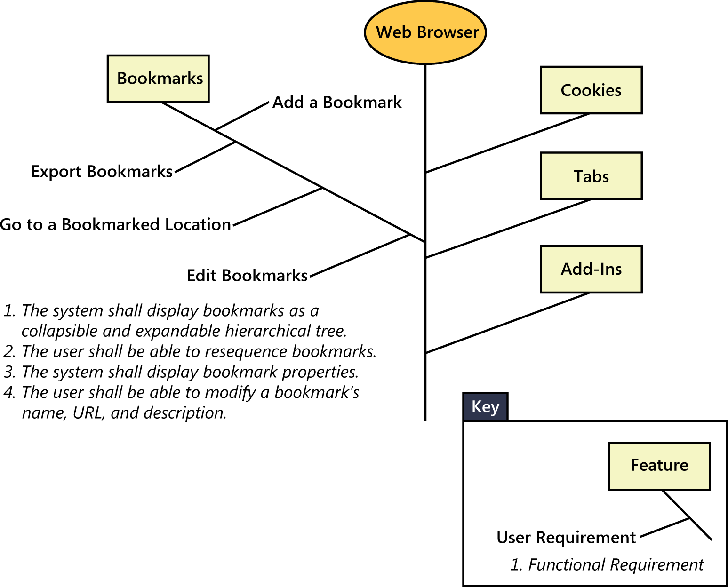
Group user requirements into features
L1
L2
[1]

Slide 34
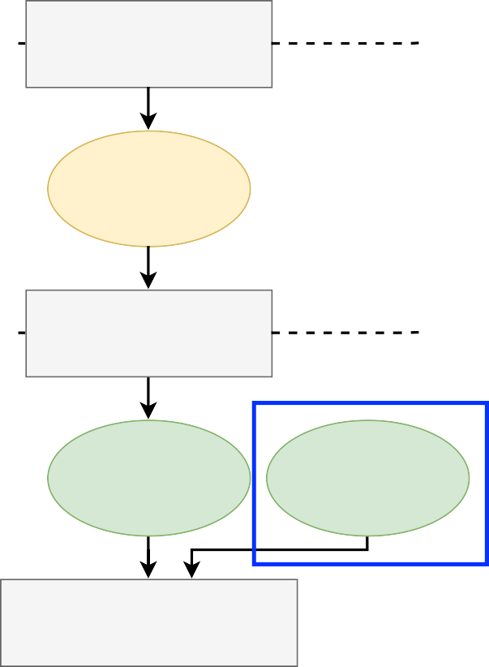

What are the nonfunctional requirements?
Nonfunctional requirements describe
1) quality attributes
2) constraints
3) external interfaces
of the product
Business requirements
Vision and scope document
User requirements
User requirements
User requirements document
Security
Usability
Functional requirements
Nonfunctional requirements
Reliability
Performance
Software requirements specifcations (SRS)

Slide 35
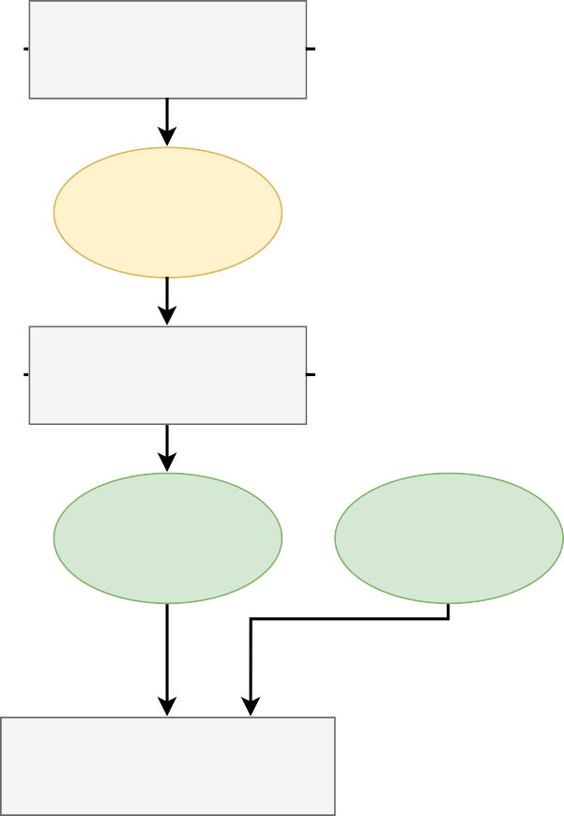
Connecting all pieces
Person Content
Manager or High-level
Marketing objectives
User _{Goals Tasks} Product representative attributes
_{Business} Functionalities Interfaces analyst (BA)
Constraints Quality attributes
Document
Business requirements
Vision and scope document
User requirements
User requirements
User requirements document
Functional requirements
Nonfunctional requirements
Software requirements
specifications (SRS)

Slide 36
Connecting all pieces
Person
Manager or
Marketing
User
representative
Business analyst (BA)
Content
Document
High-level objectives
Business requirements
Vision and scope document
Product attributes
User requirements
Goals
Tasks
User requirements
User requirements document
Functionalities
Interfaces
Functional requirements
Nonfunctional requirements
Constraints
Quality attributes
Software requirements
specifications (SRS)

Slide 37
Connecting all pieces
Person
Content
Document
Manager or
Marketing
High-level ob ectives
Business requirements
Vision and scope
document
User
representative
Product attributes
User requirements
Goals
Tasks
User requirements
User requirements
document
Business analyst (BA)
Functionalities
Interfaces
Functional requirements
Non-functional requirements
Constraints
Quality attributes
Software requirements
specifications (SRS)

Slide 38
What do we learn from today lecture?
Why do we need to discover the requirements?
What are the software requirements?
Levels and types of requirements
Product vs. Project requirements
Requirements engineering
Summary

Slide 39
Product vs. Project requirements
Product requirements represent business requirements, user requirements, functional and non-functional requirements.
Project requirements represent the resources needed to plan, develop, deploy, and maintain the project, such as training and infrastructure capabilities.

Slide 40
Requirements of the “Online Purchase System”
Auditing manager can export a summary report of the purchases of the last 12 months
Business requirements
Users shall enter his name and password to login
User requirements
Buyers need a system that speeds up the ordering process
Functional requirements
The system needs to be deployed on 60 different machines distributed across two contents
Project requirements

Slide 41
What do we learn from today lecture?
Why do we need to discover the requirements?
What are the software requirements?
Levels and types of requirements
Product vs. Project requirements
Requirements engineering
Summary

Slide 42
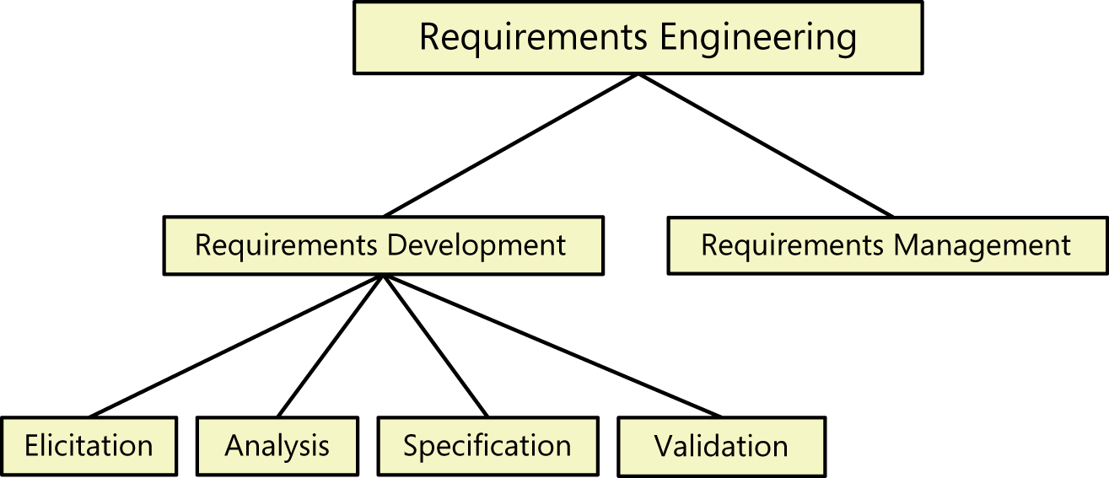
Requirements engineering (RE)
[1]
Explore
Evaluate
Document
Confirm

Slide 43
What do we learn from today lecture?
Why do we need to discover the requirements?
What are the software requirements?
Levels and types of requirements
Product vs Project requirements
Requirements engineering
Summary

Slide 44
Summary
Identifying requirements-related issues in the early phases of the project saves money, effort, and company reputation.
Business analyst (BA) explores requirements in phases.
Each phase describes the requirements from a particular perspective and with a certain level of details.
RE is an iterative process thought the requirements are explored, evaluated, documented, and confirmed.
44

Slide 45


Summary
45

Slide 46
Things to do
Read chapter 1 of the textbook
Start building your team for the course project

Slide 47
References
1. Software Requirements (Developer Best Practices) Karl Wiegers, Joy Beatty, 3rd Edition, Microsoft Press, 2013, ISBN-10: 0735679665

Slide 48
How to reach me?
Email: skeshvadi@tru.ca
Office hours:
Mondays 1:00 PM - 3:00 PM
Or by appointment

Slide 49
Course format
Lectures (two slots)
Tuesday and Thursday
10:00am - 11:15am, OM 1791
Lectures will explore theory and practices of software requirements engineering process
Labs (one slot)
Wednesday 3:30pm - 5:20pm, OM 1791
Labs will explore software requirements using Requirement Management tools

Slide 50
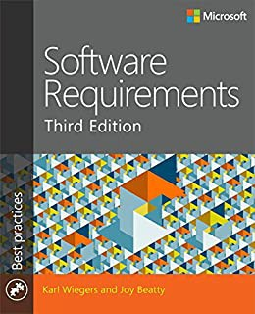
Textbook
Software Requirements (Developer Best Practices) Karl Wiegers, Joy Beatty, 3rd Edition, Microsoft Press, 2013, ISBN-10: 0735679665.

Slide 51
Overall evaluation scheme
Item | Weight | Due
A1: Vision and scope document | 10 % | September 23, 2022 (11:59pm)
Midterm 1 | 5 % | October 05, 2022
A2: User requirements document | 10 % | October 14, 2022 (11:59pm)
A3: SRS (functional aspects) | 10 % | November 04, 2022 (11:59pm)
Midterm 2 | 5 % | November 08, 2022
A4: SRS (non-functional aspects) | 10 % | November 18, 2022 (11:59pm)
Final presentation | 5 % | November 30, 2022
Final Report | 10 % | December 02, 2022 (11:59pm)
Lab Activities | 5 % | N/A
Final Exam | 30 % | TBA
20

Slide 52
Semester-long project
Topic: Write the requirements of the Volunteer Management System
Format: Team project
Four assignments: Vision and scope document (A1), user requirements (A2), Functional requirements (A3), Non-functional requirements (A4)
Final presentation & final report
No programming needed

Slide 53
What to do in labs
All labs are mandatory to attend
Sina gives Labs on software requirements using Requirement Management tools
You exercise the techniques covered in the Labs

Slide 54
What do we learn from the course?
Understand the software requirements engineering process
Differentiate functional and non-functional software requirements
Apply the knowledge of software requirements specifications in various application domains
Write and analyze the software requirements of a project

Slide 55
Teaching philosophy
Learning is a journey, during this journey we should
Gain knowledge
Enjoy
Achieve high-quality results
Knowledge
Enjoyment
Results
My teaching vision is to bridge the gap between the academic concepts and the needed practical hands- on experience

Slide 56
Questions?

