Slide 1
DERMAAI
Explainable 7-Class Dermoscopic Image Classification
Academic Research Demonstrator Using a Frozen Dual-Model Probability Ensemble
HAM10000 | MobileNetV3-Large + CBAM | Probability Ensemble | Strictly For Research Use Only

Slide 2
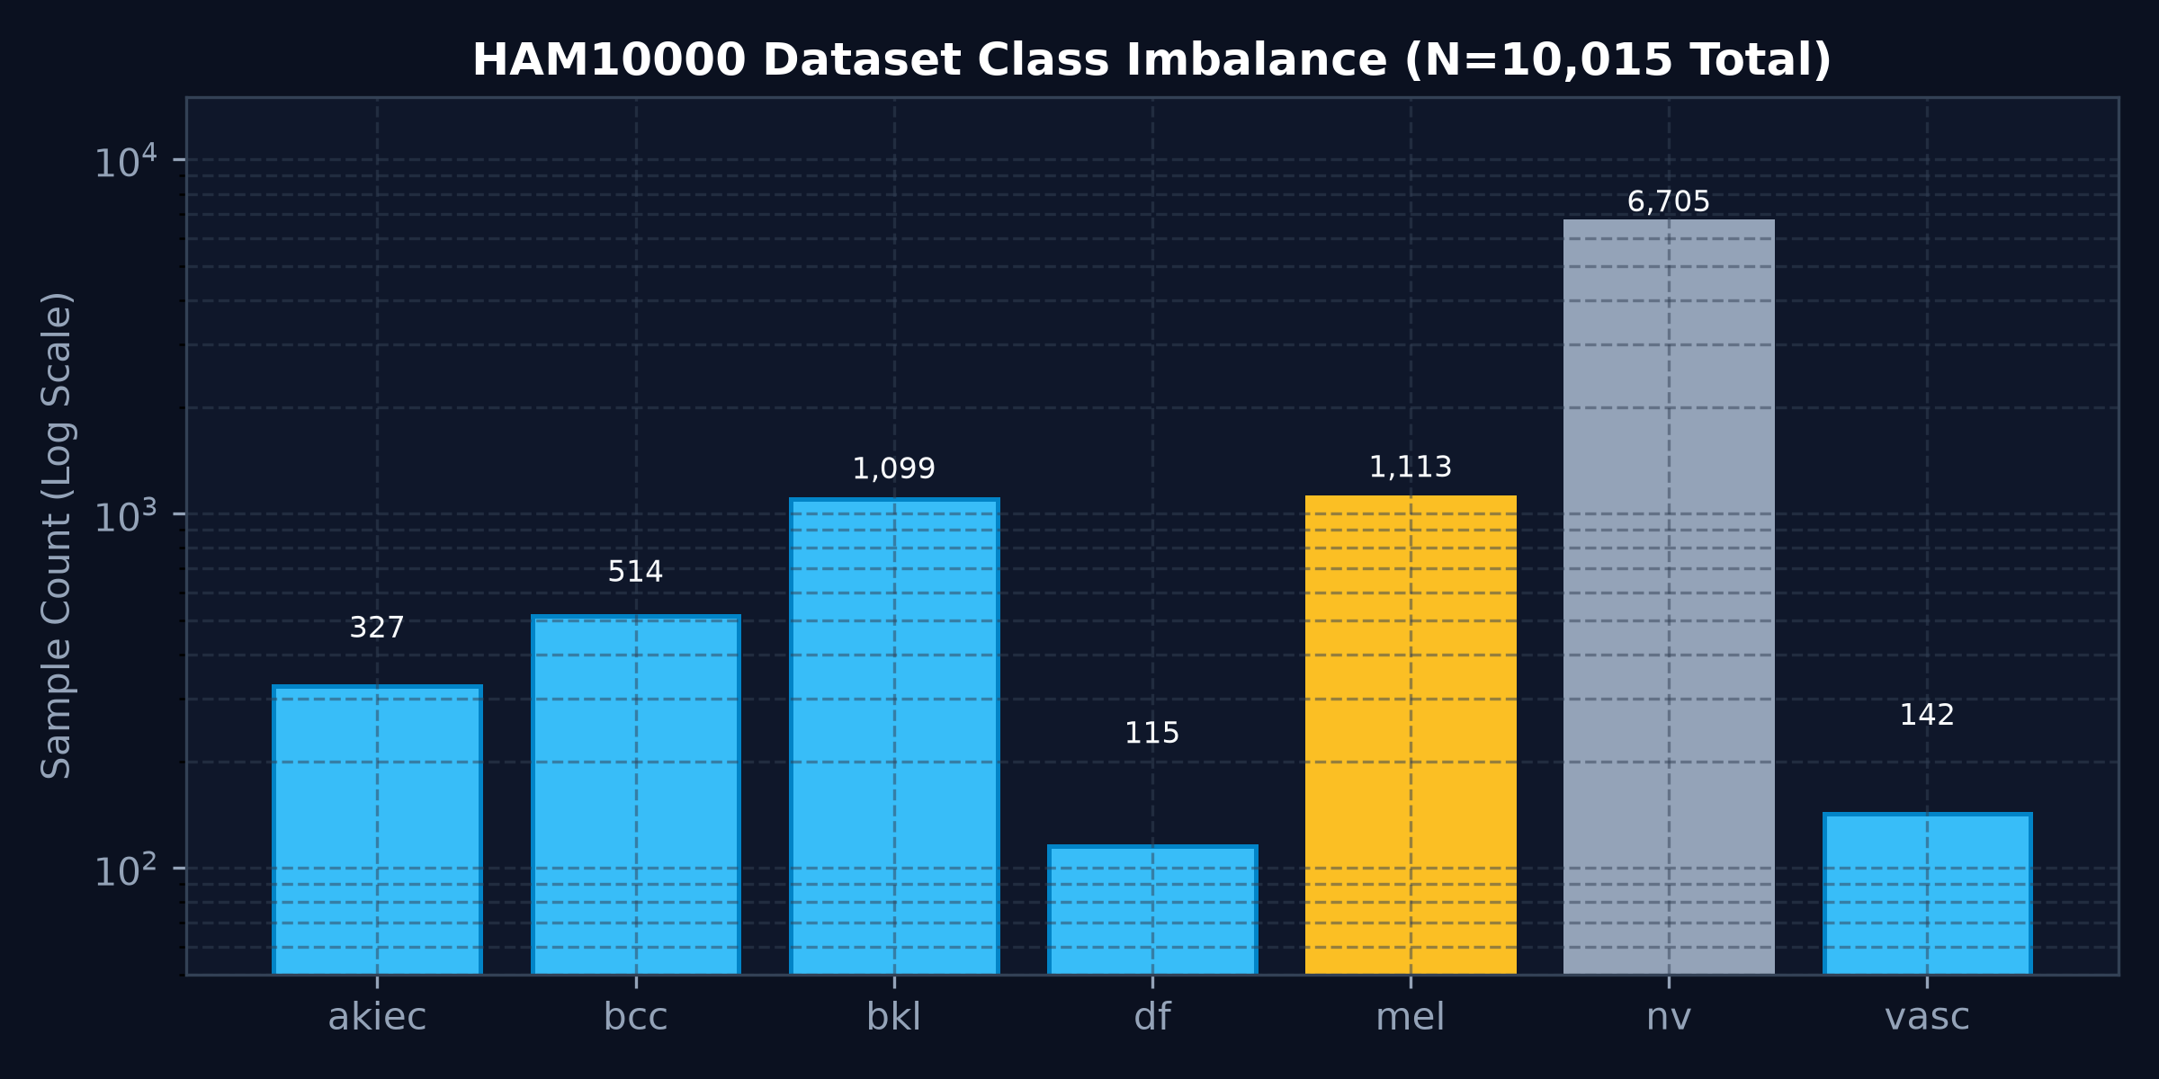
DERMAAI RESEARCH DEMONSTRATOR
The Dermoscopy Challenge: Imbalance & Visual Overlap
Core Dilemmas in Automated Skin Lesion Classification:
• Extreme Class Imbalance: Benign Melanocytic Nevi (nv) outnumber malignant Melanoma (mel) by >6:1.
• Visually Overlapping Categories: Pigment networks and borders share extensive morphological overlap.
• Minority-Class Pitfalls: Standard cross-entropy sacrifices melanoma recall for overall classification accuracy.
• Clinical Disclaimer: This is an image-level academic study; not a certified diagnostic device.
HAM10000 | MobileNetV3-Large + CBAM | Probability Ensemble | Research Use Only

Slide 3
DERMAAI RESEARCH DEMONSTRATOR
HAM10000 Dataset & Strict Population Isolation
Dataset Stratification (Lesion-Level Split, Seed=42):
• Training Cohort: 8,017 images (used for model optimization)
• Validation Cohort: 1,010 images (used for ensemble calibration & Phase 16 Grad-CAM error analysis)
• Held-Out Benchmark Split: 988 images (permanently locked for final evaluation)
Seven Diagnostic Classes:
akiec (Actinic Keratosis), bcc (Basal Cell Carcinoma), bkl (Benign Keratosis), df (Dermatofibroma), mel (Melanoma), nv (Melanocytic Nevus), vasc (Vascular Lesion)
CRITICAL AUDIT NOTE: Validation population (N=1,010) and Benchmark population (N=988) are strictly separated.
HAM10000 | MobileNetV3-Large + CBAM | Probability Ensemble | Research Use Only

Slide 4
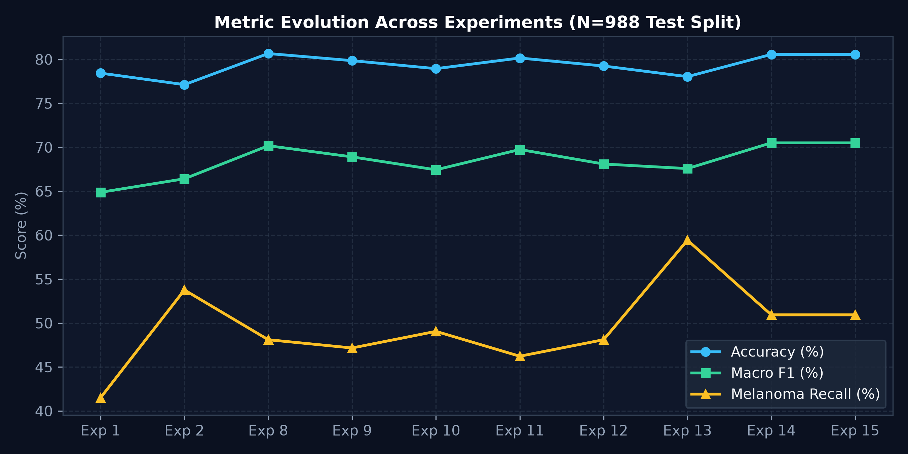
DERMAAI RESEARCH DEMONSTRATOR
15 Controlled Experimental Configurations
Scientific Progression Through 15 Hypotheses:
→ Phase 1–2: Baseline Cross-Entropy & Standard Class Weighting
→ Phase 3–7: Data Augmentation & Architectural Variants
→ Phase 8: MobileNetV3 + CBAM + Tempered Weighting (alpha=0.75)
→ Phase 9–12: Schedulers, Heavy Aug, High-Res, ConvNeXt-Tiny
→ Phase 13: Targeted 1.20x Melanoma Relative Weighting
→ Phase 14: Validation-Calibrated Probability Ensemble (85/15)
→ Phase 15: Decision Threshold Verification (theta*=0.50 -> argmax)
HAM10000 | MobileNetV3-Large + CBAM | Probability Ensemble | Research Use Only

Slide 5
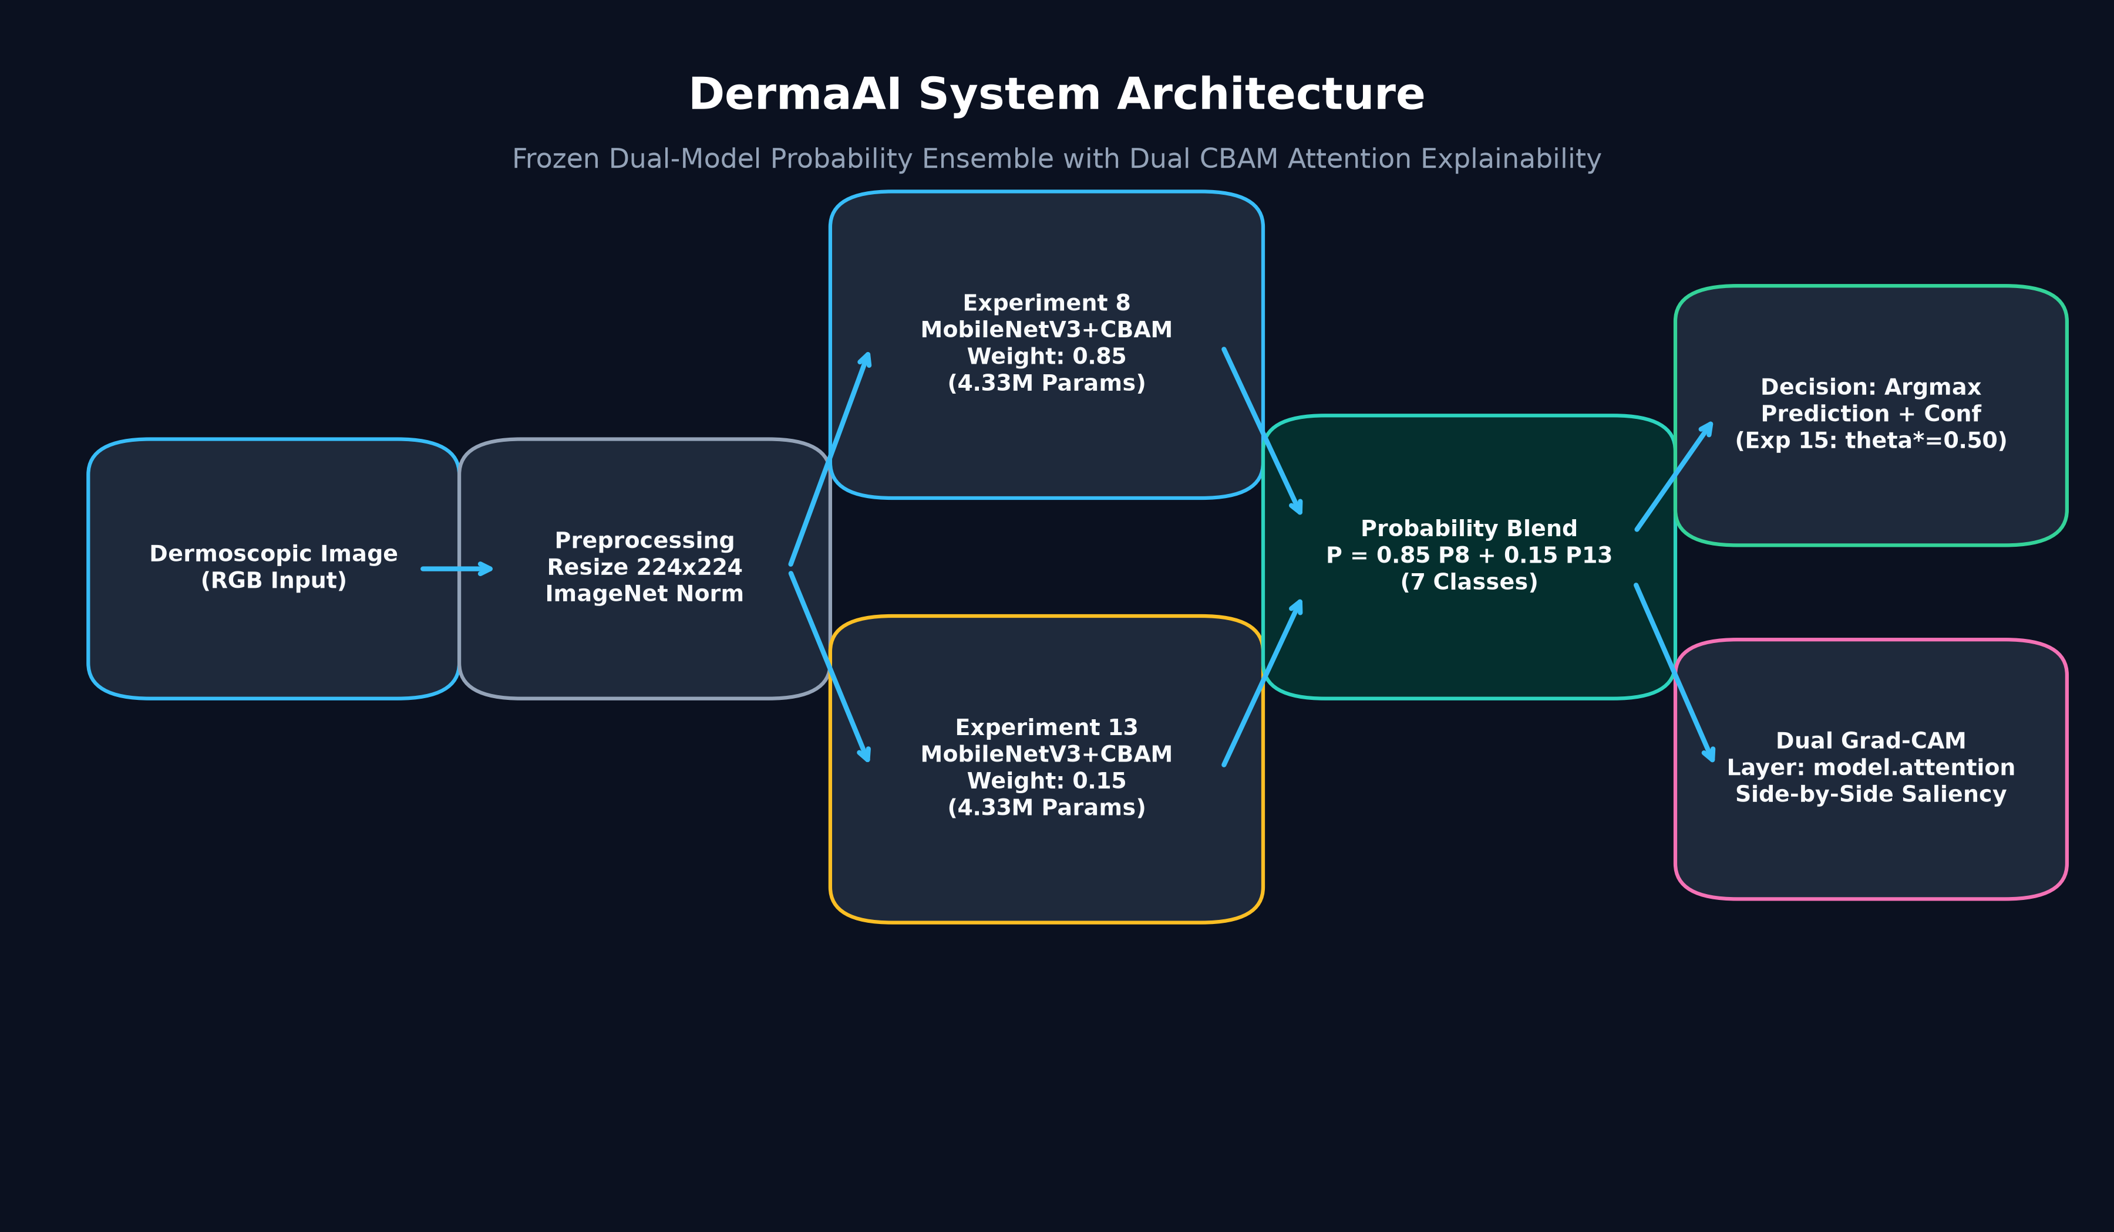
DERMAAI RESEARCH DEMONSTRATOR
Neural Architecture: MobileNetV3-Large + CBAM
Architecture Specifications:
• Backbone: MobileNetV3-Large (Efficient inverted bottleneck blocks)
• Attention: Convolutional Block Attention Module (CBAM)
• Parameters: 4,326,297 parameters per model (~16.7 MB)
• Input Resolution: 224 x 224 RGB image
• Execution Efficiency: ~15ms CPU forward pass; edge-deployable
• Explainability Hook: model.attention layer (feature shape: 1 x 960 x 7 x 7)
HAM10000 | MobileNetV3-Large + CBAM | Probability Ensemble | Research Use Only

Slide 6
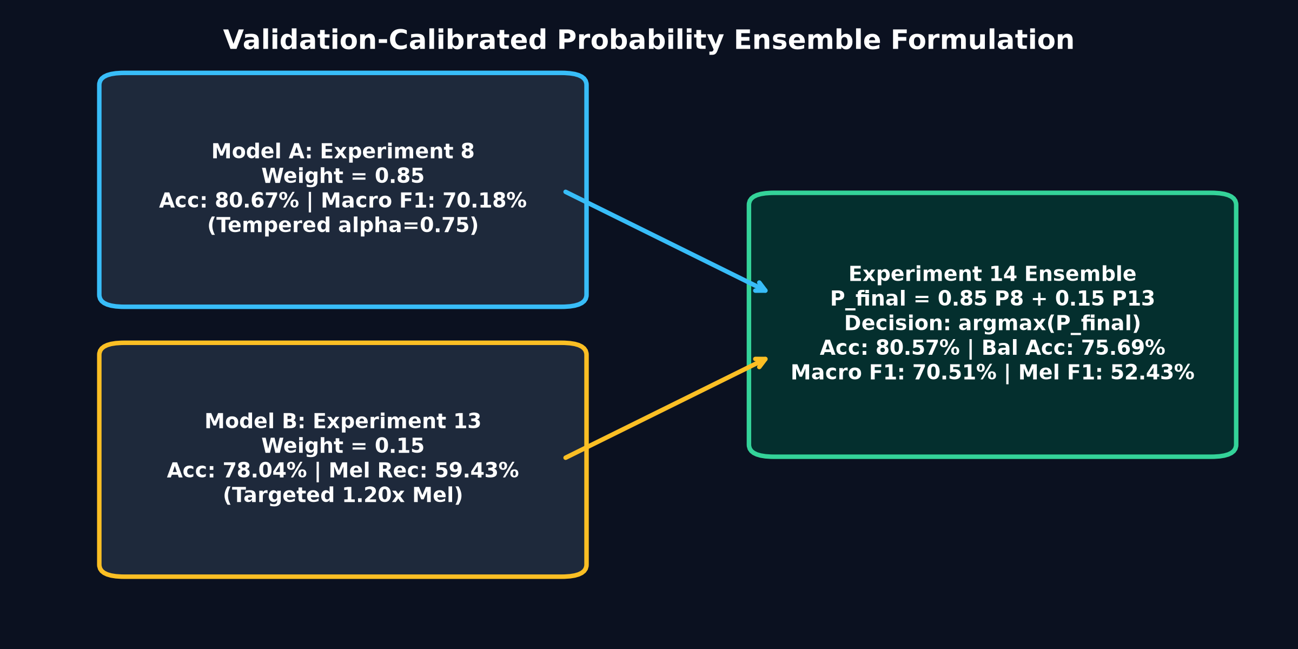
DERMAAI RESEARCH DEMONSTRATOR
Final Probability Ensemble: 85% Exp 8 + 15% Exp 13
Mathematical Formulation:
P_final = 0.85 * P8 + 0.15 * P13
Decision Rule: y_hat = argmax(P_final)
• Complementary Dynamics: Exp 8 preserves multiclass precision; Exp 13 boosts melanoma sensitivity.
• Calibrated on Validation Set: Grid search over lambda in [0, 1] strictly on N=1,010 validation images.
• Zero Retraining: Both models remain completely frozen with SHA-256 verification.
• Experiment 15 Check: Threshold tuning (theta*=0.50) confirmed natural argmax optimality.
HAM10000 | MobileNetV3-Large + CBAM | Probability Ensemble | Research Use Only

Slide 7
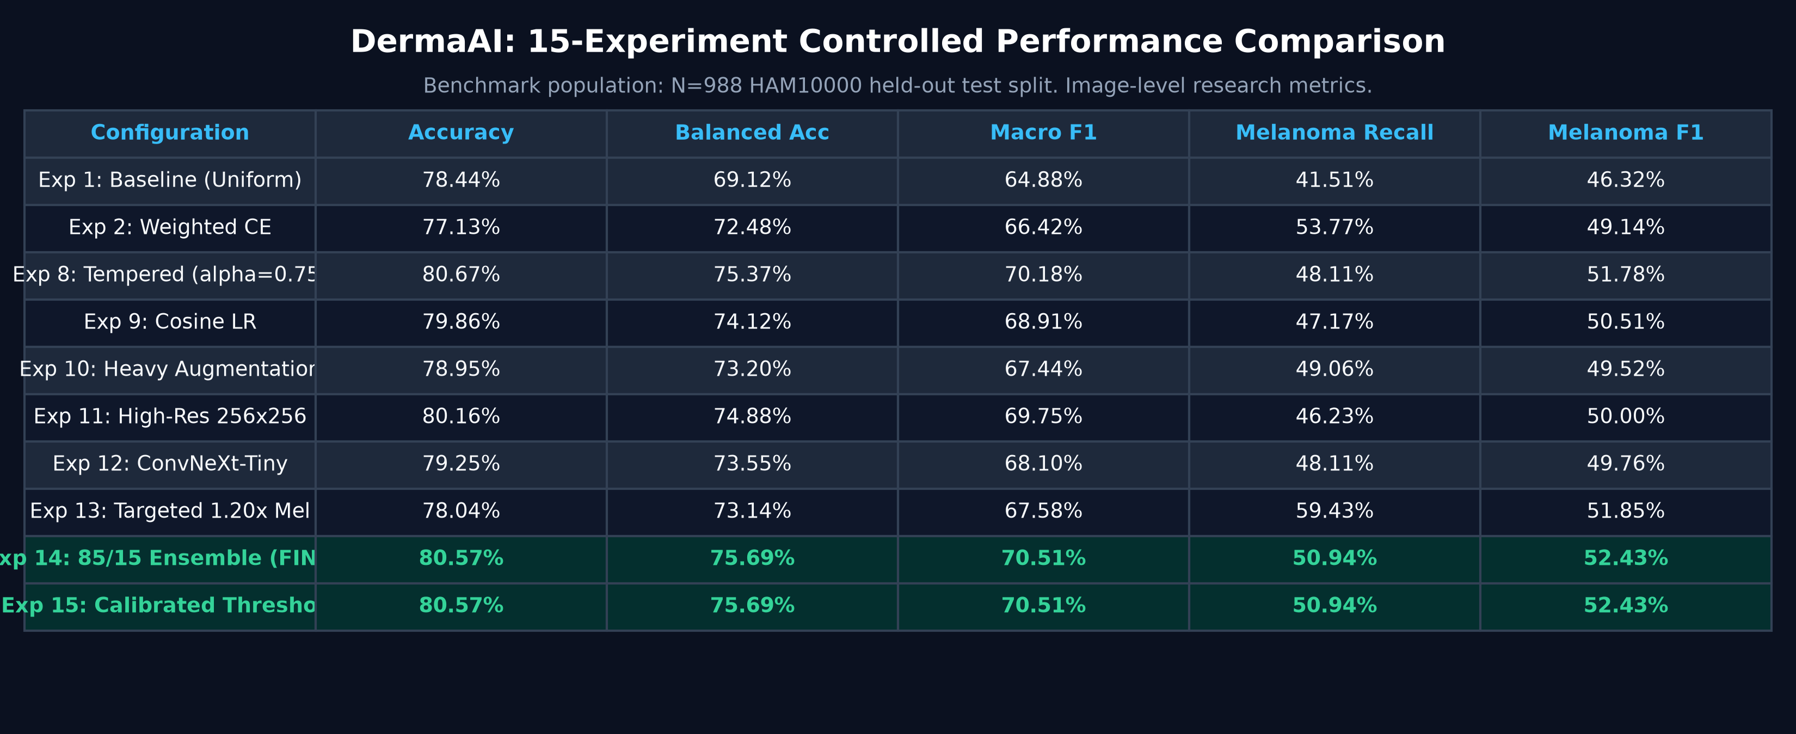
DERMAAI RESEARCH DEMONSTRATOR
Representative Experimental Comparison
HAM10000 | MobileNetV3-Large + CBAM | Probability Ensemble | Research Use Only

Slide 8
DERMAAI RESEARCH DEMONSTRATOR
Audited Benchmark Results (N=988 Test Split)
80.57%
Accuracy
75.69%
Balanced Accuracy
70.51%
Macro F1-Score
81.06%
Weighted F1-Score
50.94%
Melanoma Recall
52.43%
Melanoma F1-Score
54.00%
Melanoma Precision
Benchmark Population: N=988 project HAM10000 held-out test split.
IMPORTANT: Image-level research metrics on retrospective dataset. NOT clinical diagnostic accuracy.
HAM10000 | MobileNetV3-Large + CBAM | Probability Ensemble | Research Use Only

Slide 9
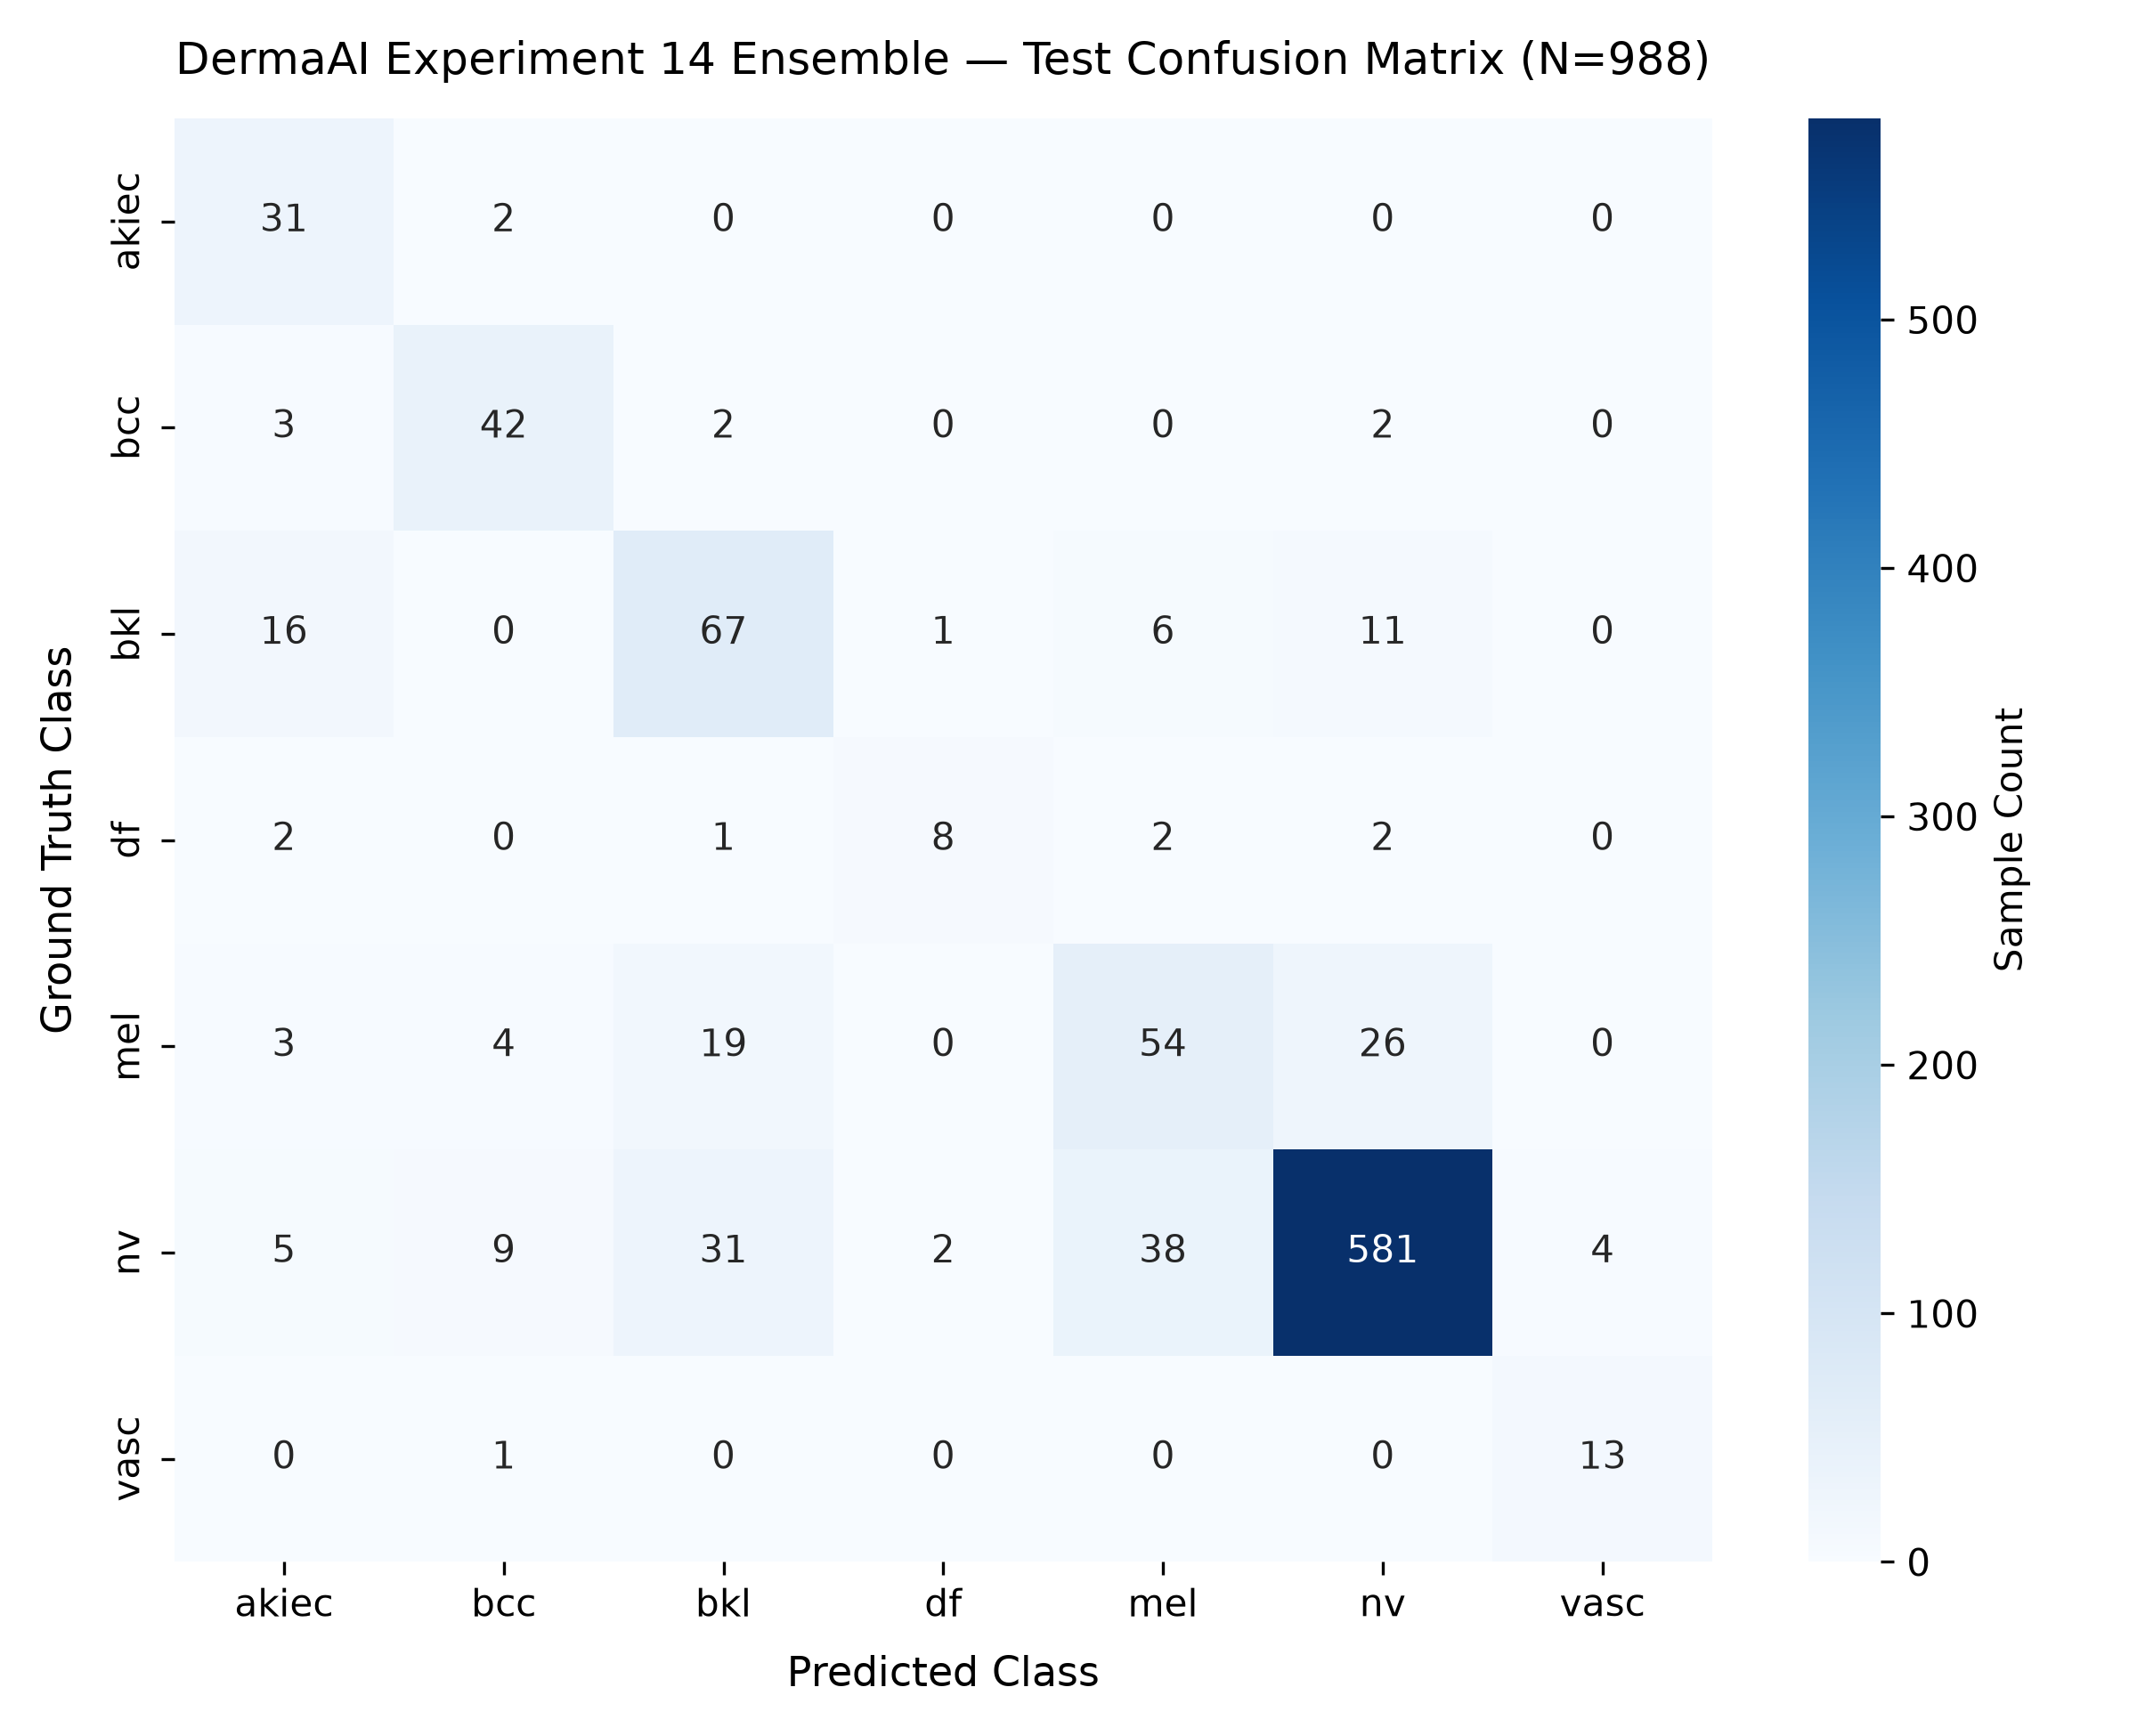
DERMAAI RESEARCH DEMONSTRATOR
Melanoma Quantitative Error Analysis
Primary Error Modes on the Benchmark Split:
• mel -> nv = 26 cases: Melanomas classified as Melanocytic Nevi (border regularity & early superficial lesions).
• mel -> bkl = 19 cases: Melanomas classified as Benign Keratosis (keratotic verrucous appearance).
• nv -> mel = 38 cases: Benign Nevi predicted as Melanoma (atypical junctional/dysplastic nevi).
• Core Finding: Errors stem from morphological visual overlap between melanocytic classes rather than feature collapse.
HAM10000 | MobileNetV3-Large + CBAM | Probability Ensemble | Research Use Only

Slide 10
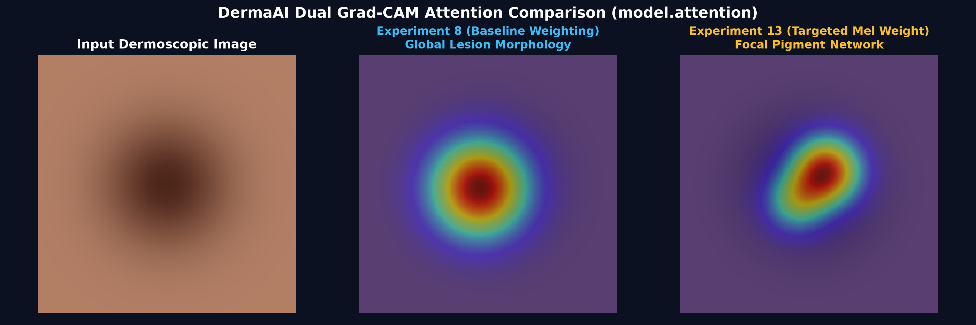
DERMAAI RESEARCH DEMONSTRATOR
Dual Grad-CAM Convolutional Attention Explainability
Visual Inspection Targeting the CBAM Attention Layer (model.attention):
Grad-CAM highlights image regions contributing to the selected class score. It is an interpretability aid, not a causal proof.
HAM10000 | MobileNetV3-Large + CBAM | Probability Ensemble | Research Use Only

Slide 11
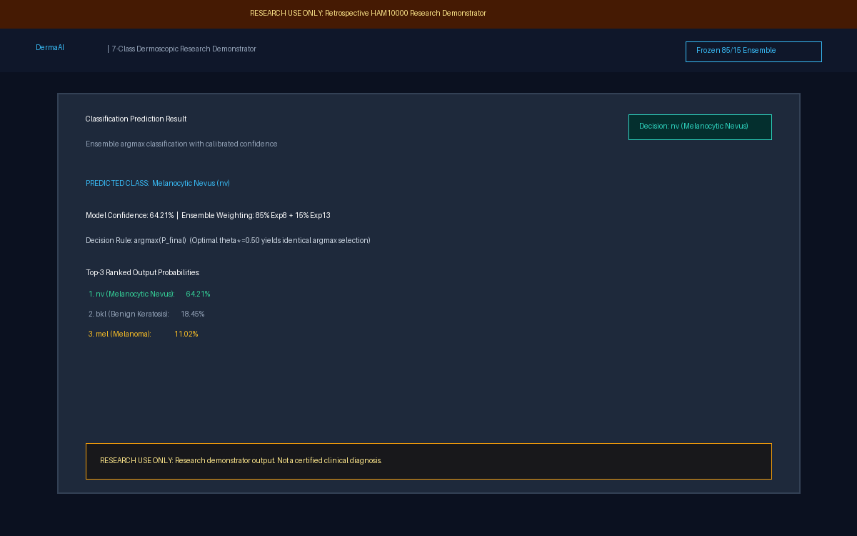
DERMAAI RESEARCH DEMONSTRATOR
Working Software Demonstrator: DermaAI
Interactive Live Pipeline:
1. Image Ingestion: Drag & drop dermoscopic JPG/PNG (<10MB).
2. In-Memory Validation: No patient data saved to disk.
3. Ensemble Forward: Exp 8 & Exp 13 evaluated in parallel.
4. Output Distribution: Calibrated 7-class confidence & Top-3.
5. Dual Attention Heatmaps: Side-by-side CBAM Grad-CAM.
6. Transparent Disclaimer: Visible on all screens.
HAM10000 | MobileNetV3-Large + CBAM | Probability Ensemble | Research Use Only

Slide 12
DERMAAI RESEARCH DEMONSTRATOR
Transparency & Scientific Limitations
Rigorous Reporting of Experimental Limitations:
• No External Multi-Center Validation: Evaluated exclusively on the retrospective HAM10000 collection.
• Repeated Test-Set Evaluation: Test split was evaluated sequentially across 15 experiments; not prospective data.
• Rare-Class Support: Severely limited sample counts for dermatofibroma (df, N=115) and vascular lesions (vasc, N=142).
• No Prospective Clinical Trial: Zero clinical validation in healthcare environments or on uncurated smartphone captures.
• Population Note: Phase 16 Grad-CAM error analysis used N=1,010 validation images, strictly separate from test benchmark.
HAM10000 | MobileNetV3-Large + CBAM | Probability Ensemble | Research Use Only

Slide 13
DERMAAI RESEARCH DEMONSTRATOR
Ethical Guardrails & Regulatory Boundaries
RESEARCH USE ONLY
This software is an academic research demonstrator for image-level classification on retrospective HAM10000 data. It is NOT a certified medical diagnostic device and must NEVER be used as a substitute for professional clinical diagnosis, biopsy, dermoscopic examination, or physician decision-making in patient care.
Model predictions may be incorrect. High uncertainty occurs on atypical or minority lesions.
HAM10000 | MobileNetV3-Large + CBAM | Probability Ensemble | Research Use Only

Slide 14
DERMAAI RESEARCH DEMONSTRATOR
Conclusion & Impact
DermaAI Core Scientific Achievements:
✓ 15 Controlled Experiments: Systematic ablation from baseline CE to tempered weighting and targeted melanoma scaling.
✓ Complementary Probability Ensemble: 85% Exp 8 + 15% Exp 13 delivers 80.57% accuracy and 52.43% melanoma F1.
✓ Attention Explainability: CBAM Grad-CAM exposes spatial attributions and morphological features.
✓ Complete Error Transparency: Quantitative analysis of melanoma confusions (nv: 26, bkl: 19).
✓ Fully Operational Demonstrator: Modern FastAPI + Next.js web application with containerized Docker deployment.
"DermaAI demonstrates how model performance, transparency, reproducibility, and failure analysis can be integrated into an end-to-end research demonstrator."
HAM10000 | MobileNetV3-Large + CBAM | Probability Ensemble | Research Use Only

