Slide 1

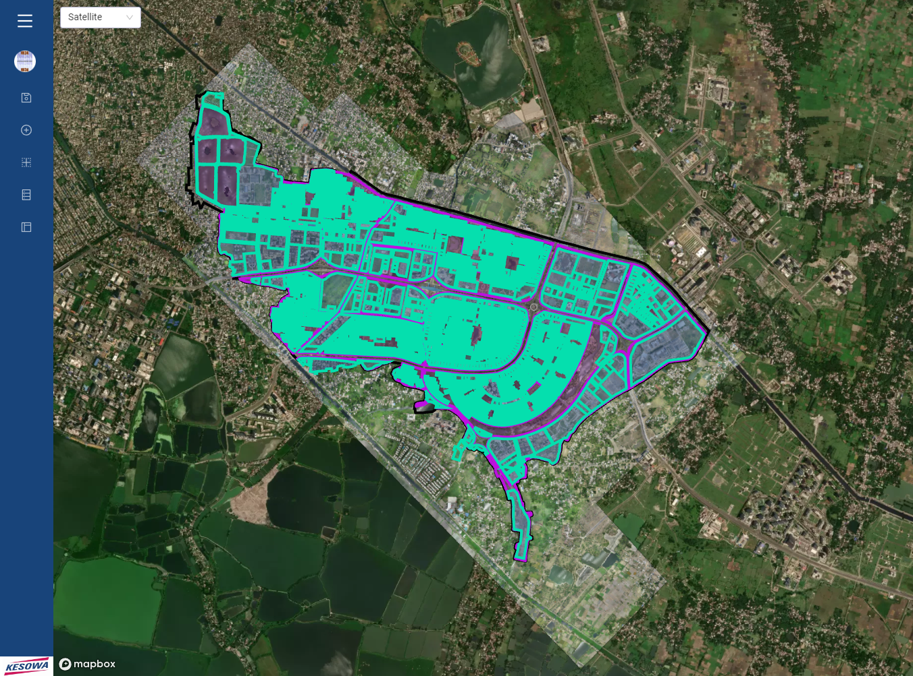

AA-I - Plot Report Factoring in NKDA Occupancy Data
This report is a part of an ongoing contract with Newtown Kolkata Development Authority and is issued for parties under contract only. Terms and Conditions of contract preside over all parties and their actors.
Akash Adhikary & Subhendu Kumar Panja
dt. 13/09/2023

Slide 2
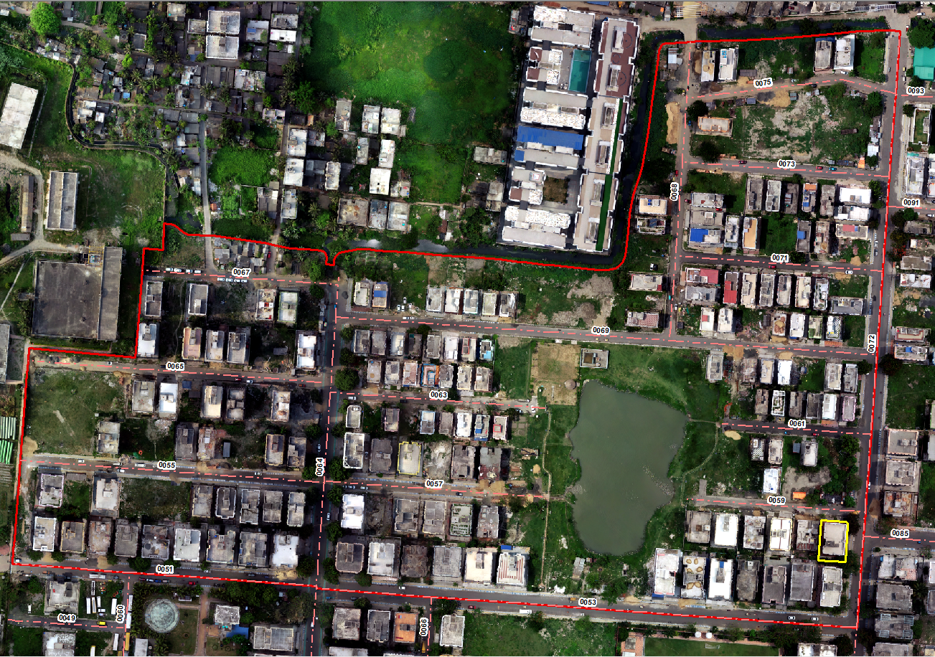
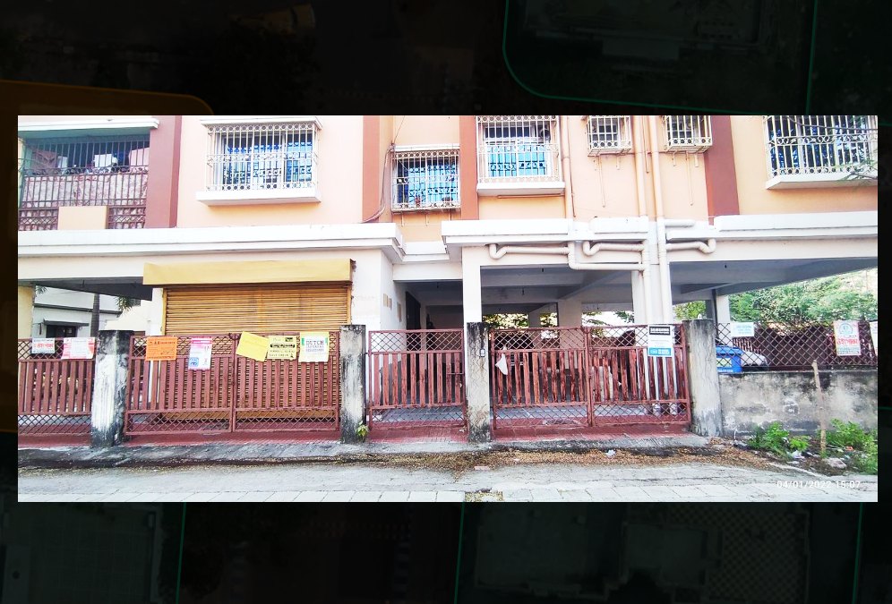
Block Image
AA/8

Slide 3
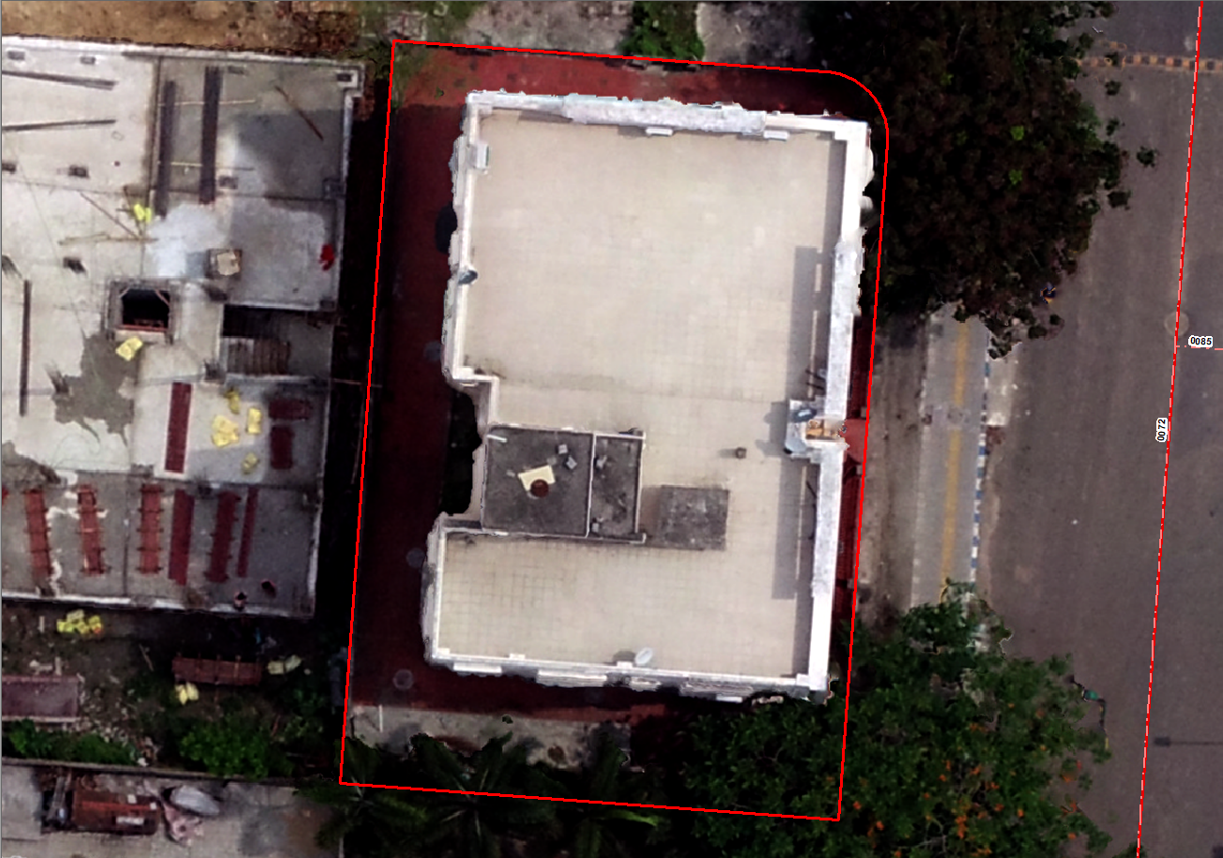
Plot Image

Slide 4
Front View Image
(D.o.C: 04.01.2022)

Slide 5
Annual Invoice Commitment to Resident Name: Address: | Block: AA
Plot Data
Plot No | AA/8
Premises No | 18-0072Pl
Plot Area (Sq.mt) | 333.62
Building Available | Yes
Pincode | 700163
Plot Category | Residential
No. of Floor | G+4
Sanctioned Building No.
Building Area (Sq.mt) | 186.17
Building Footprint | 55.80%
Completion Certificate
Average Building Height
Infraction
Eligible For Green Top / Solar Plant Incentives | Yes/no
Trade License | No Available Record
Property Tax | No Available Record
Block Data
Garbage Collector Information
Average Building Height
Average Block Height
Average Incentives
Block Insights
 | Water | %
 | Green | %
 | Tree Canopy | %
Block Announcement

