Slide 1





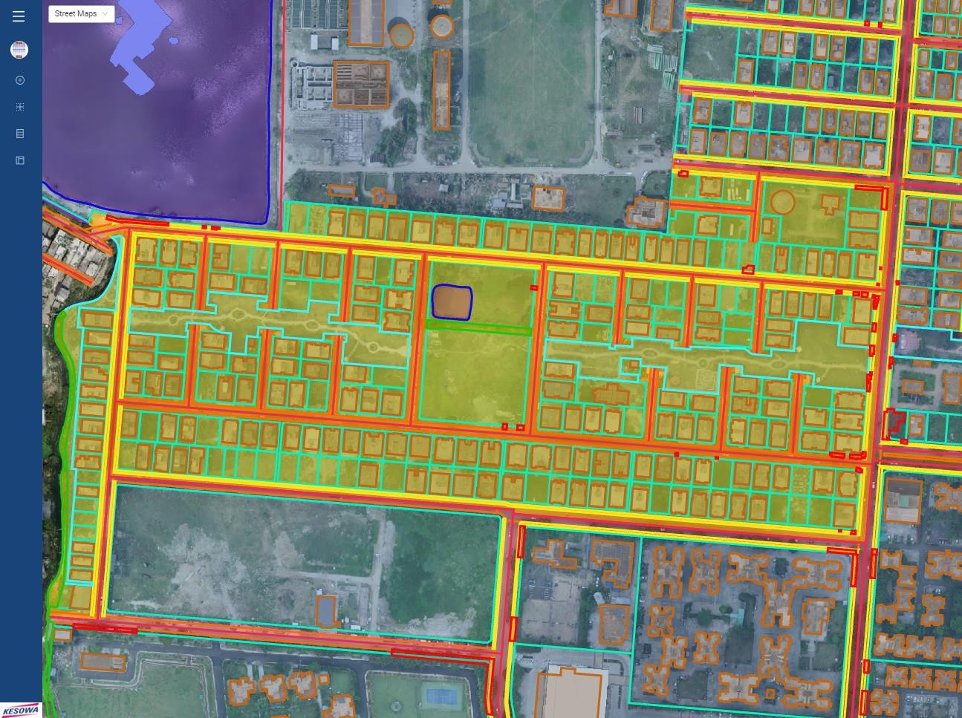
ACTION AREA I
BLOCK AC
Geospatial Intelligence Block Report
FSIPL/NKDA/R/003
BLOCK/AC | Akash Adhikary & Subhendu Kumar Panja
dt. 12/01/2023 | P: +91 9163827816 | Y: akash.adhikary@shanta.in & subhendu.panja@shanta.in
STATEMENT OF CONFIDENTIALITY | This report is a part of an ongoing contract with Newtown Kolkata Development Authority and is issued for parties under contract only. Terms and Conditions of contract preside over all parties and their actors.

Slide 2
Summary Report
Total Area of Block |  | Area in Sq.Km. | Area in Sq.Mt. | Area in Acres
 |  | 0.14 | 142129.41 | 35.12
Structure of Block |  | Boundary Area |  | Total % Area
 |  | In Sq.Mt. | In Acres | 100
Private Space
 | Private Commercial | 0 | 0.00 | 0.00
 | Residential | 76473.75 | 18.90 | 53.81
 | Govt. Commercial | 0 | 0.00 | 0.00
 | Housing Complex | 0 | 0.00 | 0.00
Public Space
 | Government | 14259.07 | 3.52 | 10.03
 | Motorable Roads | 19,495.55 | 4.82 | 13.72
 | Footpath | 4873.41 | 1.20 | 3.43
 | Cycle Track | 584.46 | 0.14 | 0.41
 | Parks & Green | 14430.05 | 3.57 | 10.15
 | Waterbody | 701.82 | 0.17 | 0.49
Other |  | 11311.3 | 2.80 | 7.96
Occupancy
 | Visibly Occupied | Visibly Under Cons. | Visibly Vacant | Total No. of Plots
Private Commercial | 0 | 0 | 0 | 0
Residential | 157 | 22 | 50 | 229
Govt. Commercial | 0 | 0 | 0 | 0
Housing Complex | 0 | 0 | 0 | 0
Government | 3 | 1 | 7 | 11
ACTION AREA -01 AC BLOCK
**(Building Occupied: Sanctioned Plot, Which Have Received Completion Certificate, Plot Availing Construction Power, Plot Availing Permanent Water Connection, Per Plot Revenue Tax, Trade License Data Not Integrated)

Slide 3
BLOCK SPECIFIC INSIGHT
Roads | Footpath | Greenery | Canal
No of roads: 23 Road’s length: 3913.31 mt.(Approx.) Roads are sharing with adjacent blocks: Adjacent block- AF, AD, AG, AA Street no. of roads- 32,39,41,51,64 Roads segment length- 1633.50 mt.(Approx.) Street no. sharing with adjacent block: 51 with AA Block 64 with AD & AG Block 39, 41 & 42 with AF Block Major road problem: NA | Street with footpath: 32, 47, 51, 64, 41 Street with partial footpath: 39 Street without footpath: 34, 36, 38, 40, 42, 43, 44, 46, 48, 49, 50, 52, 54, 56, 58, 60, 62 | Area: 14430.05 sq mt. No. of tree: 197 Green verges & Public Park AC Block Park NKDA Park NKDA Sensory Park | Name & length (Approx.) i. “C” Canal: 338.86 mt.
Water Bodies | Waste Bin | Major Construction Sites | Cycle Track
Name- AC Block Perimeter: 99.79 mt. Area: 701.82 sq mt. Clean: Not Verified swimmable: Not Verified | NA | 23 Nos | Cycle track length: 1800.17 mtr. (Approx) Street no with cycle track: 64, 41 Major problem: NA Cycle route: No
Street Lights
Parking
Public Market
Stubble Burning
Others
100
00
00
NA
Neighbourhood Center: 01
Police Stations/Fire Stations | Water & Drainage Network | Public Art
00 | No. of Water tank: 01 | NA
 | Water Tank 01
Rooftop Solar | Water logging: NA | Public Gym
NA | Water Harvesting pit: NA | NA

Slide 4


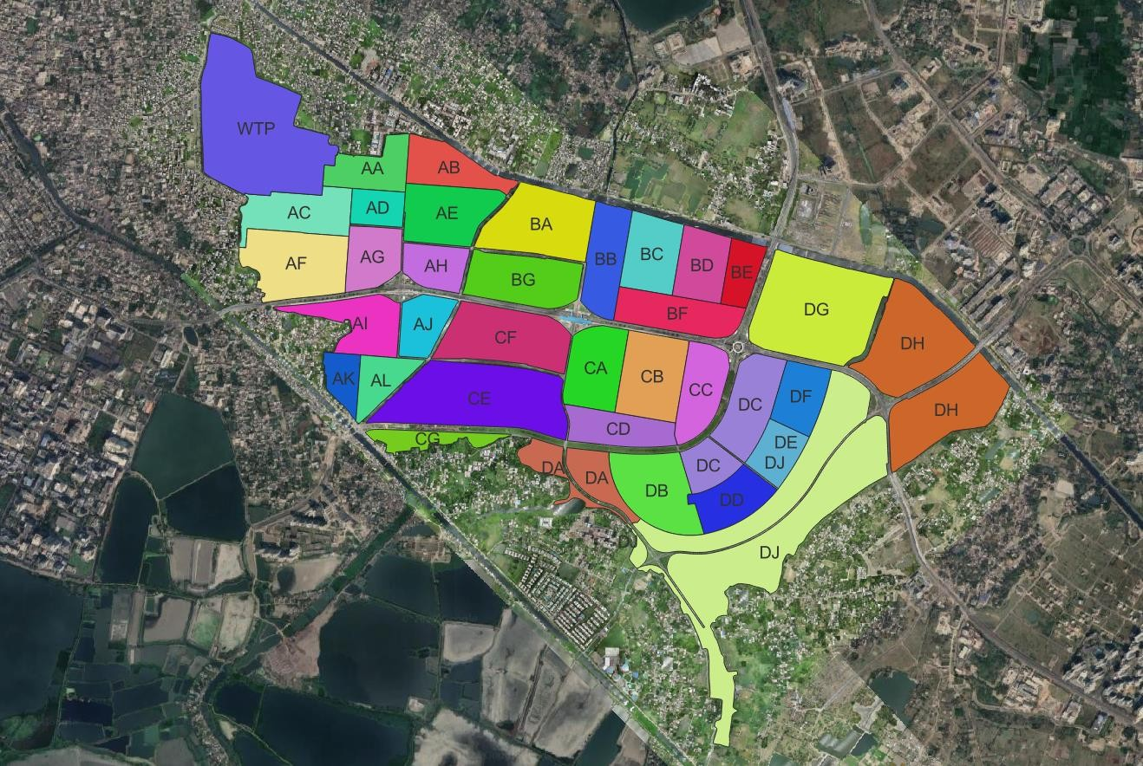


ACTION AREA – I
BLOCK OVERVIEW
Rajarhat
Rajarhat
Action Area - II
Saltlake
Action Area - III
East Calcutta Wetland

Slide 5

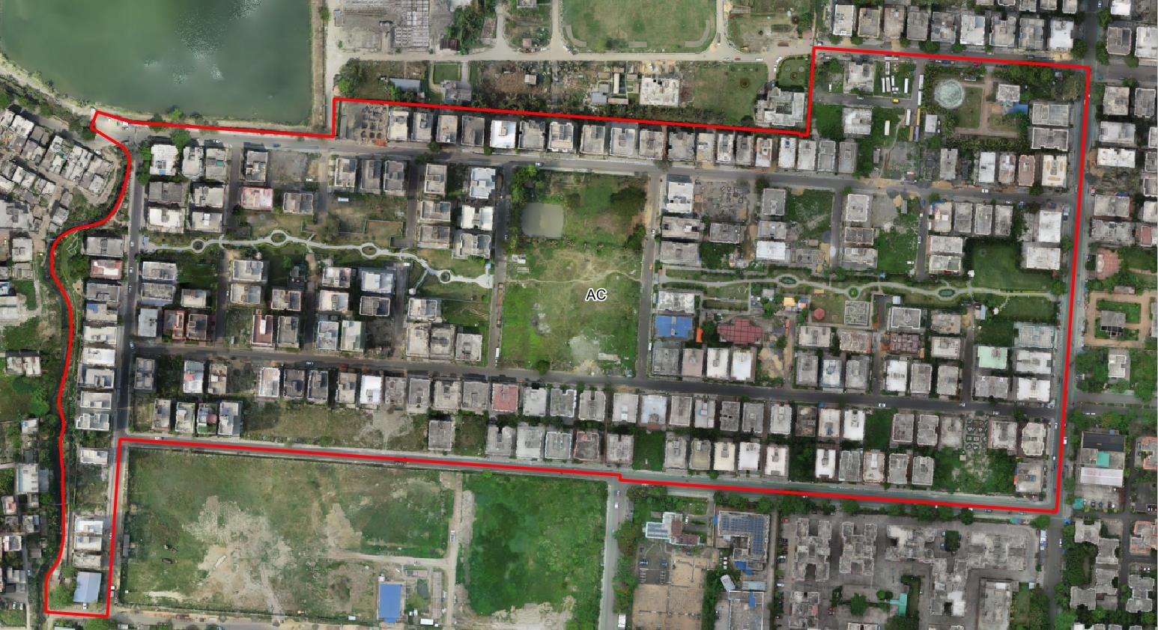

ACTION AREA – I
BLOCK: ‘AC’ BOUNDARY
( DoC: 22.06.22)
AA Block
WTP
Rajarhat
AF Block

Slide 6

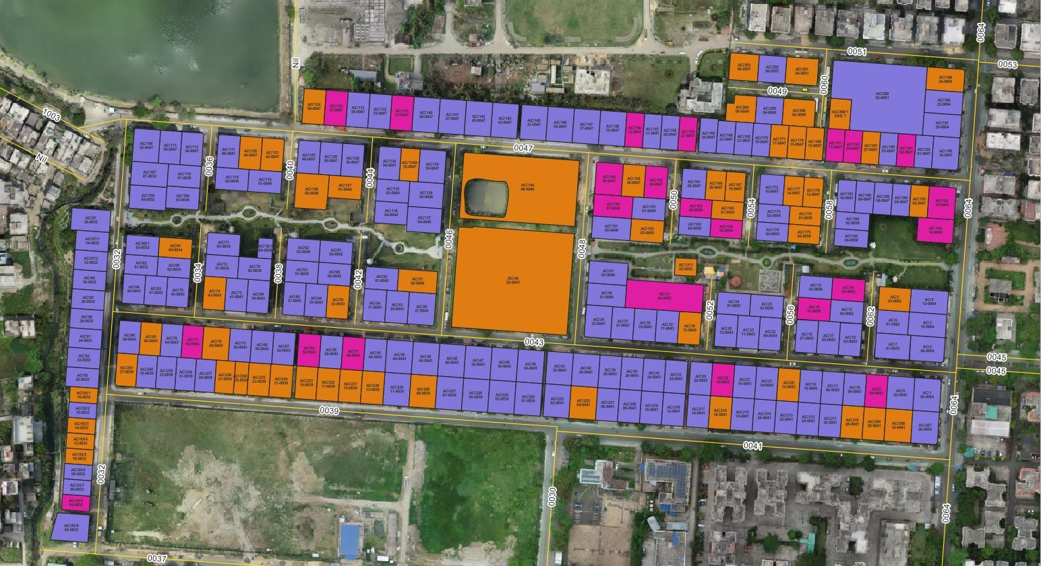
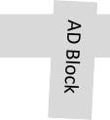

ACTION AREA – I, BLOCK: ‘AC’
PLOT DETAILS PART 01
AA Block
AA Block
WTP
Rajarhat
AB Block
a WTP
t
rh
a j
Ra
WTP
Rajarhat
AF Block

Slide 7





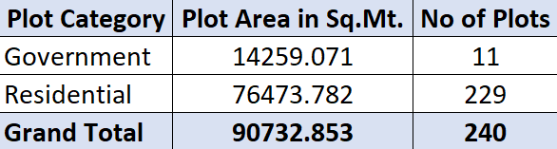




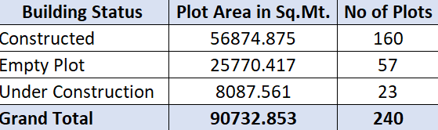




ACTION AREA – I , BLOCK: ‘AC’
PLOT DETAILS PART 02
AC - Block Plot Details
AC - Block Plot Area distribution by Plot Category
100%
1
22
90%
80%
70%
50
Building Stat in %
60%
50%
40%
30%
20%
10%
0%
7
16%
157
Government
Residential
3
 |  |  | Government | Residential
 |  |  | 1 | 22
 |  | Empty Plot | 7 | 50
 |  | Constructed | 3 | 157
Under Construction
84%
Plot Category
Fig. 01
Fig. 02
AC - Block Plot Area distribution by Plot Status
Fig. 02
9%
Constructed
Empty Plot
Under Construction
28%
63%
Fig. 03
Fig. 03

Slide 8
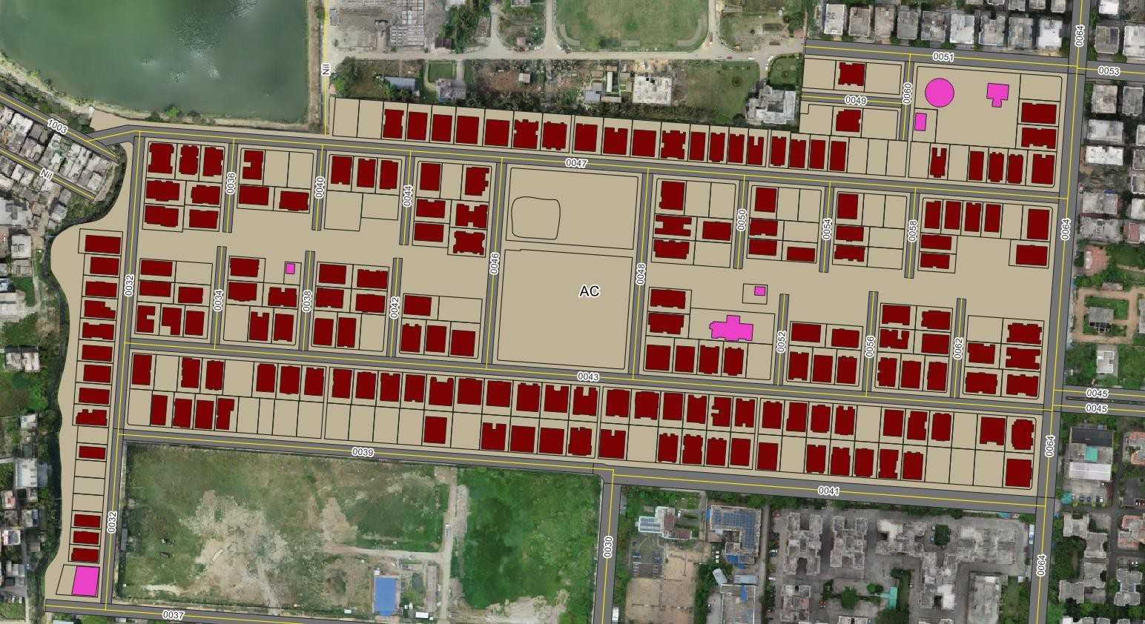
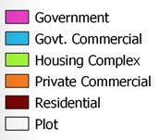
ACTION AREA – I, BLOCK: AC
BUILT-UP AREA
AA Block
AA Block
WTP
AB Block
a WTP
t
rh
a j
Ra
WTP
Rajarhat
AF Block

Slide 9
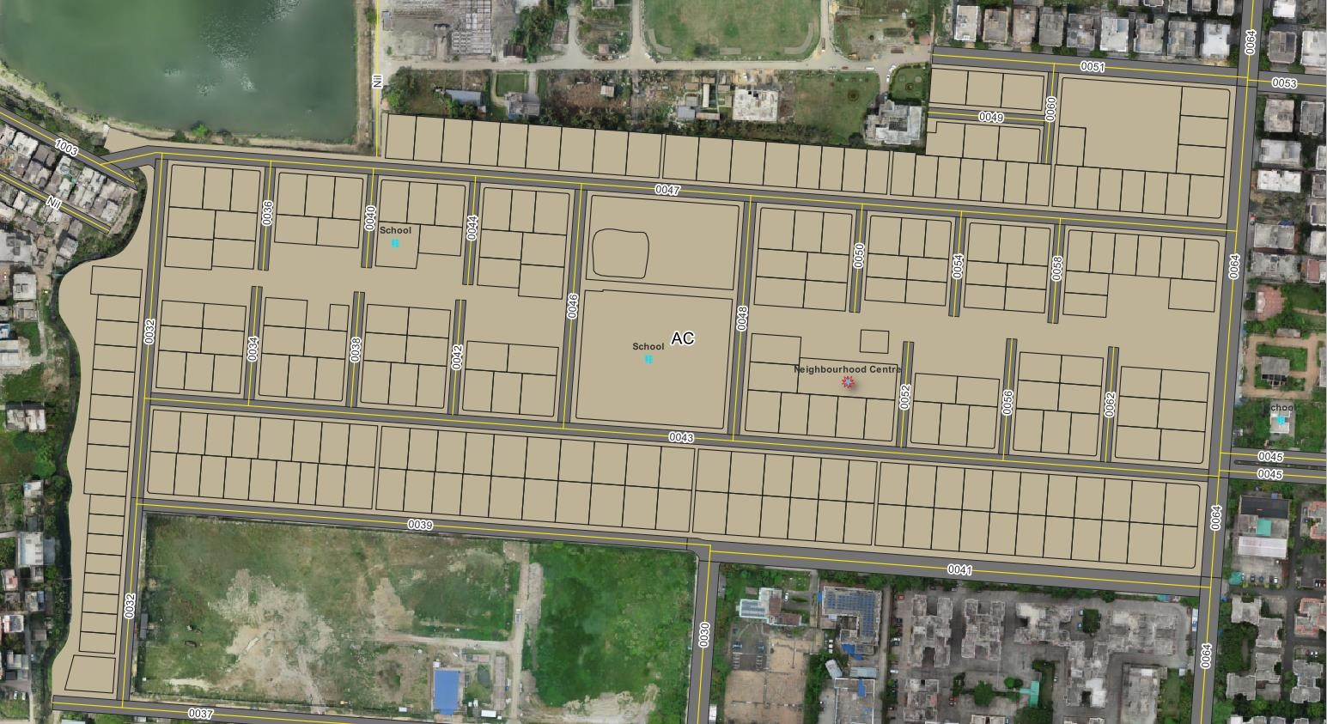

ACTION AREA – I, BLOCK: ‘AC’
AMENITIES & POI
AA Block
AA Block
WTP
t
a
rh
a j
Ra
WTP
Rajarhat
AF Block

Slide 10

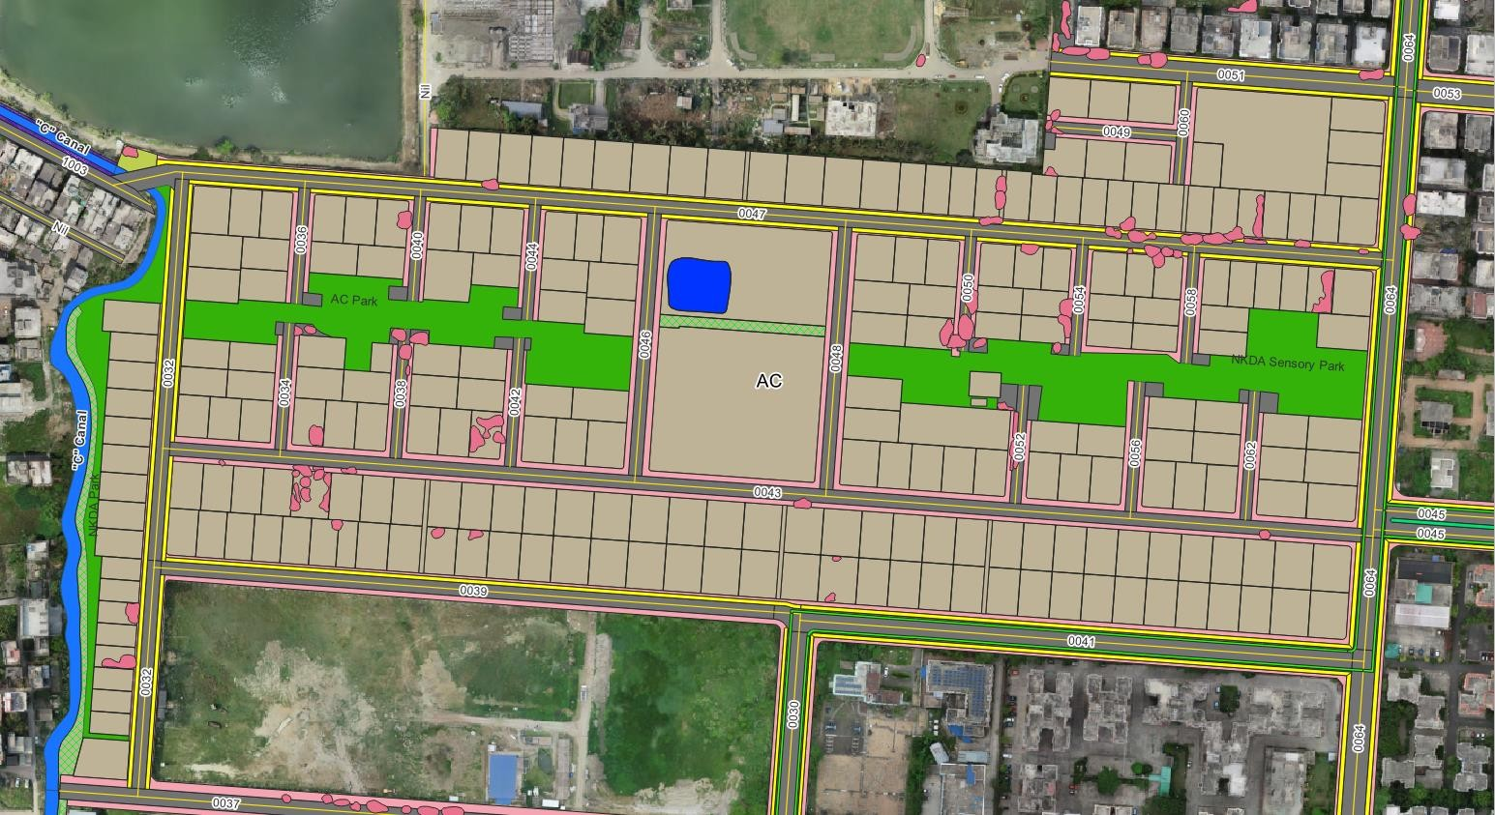
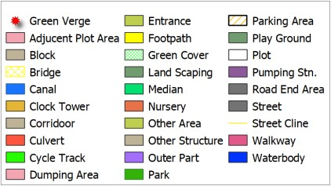
ACTION AREA – I, BLOCK: ‘AC’
OTHER FEATURES
AA Block
WTP
Rajarhat
AF Block

Slide 11
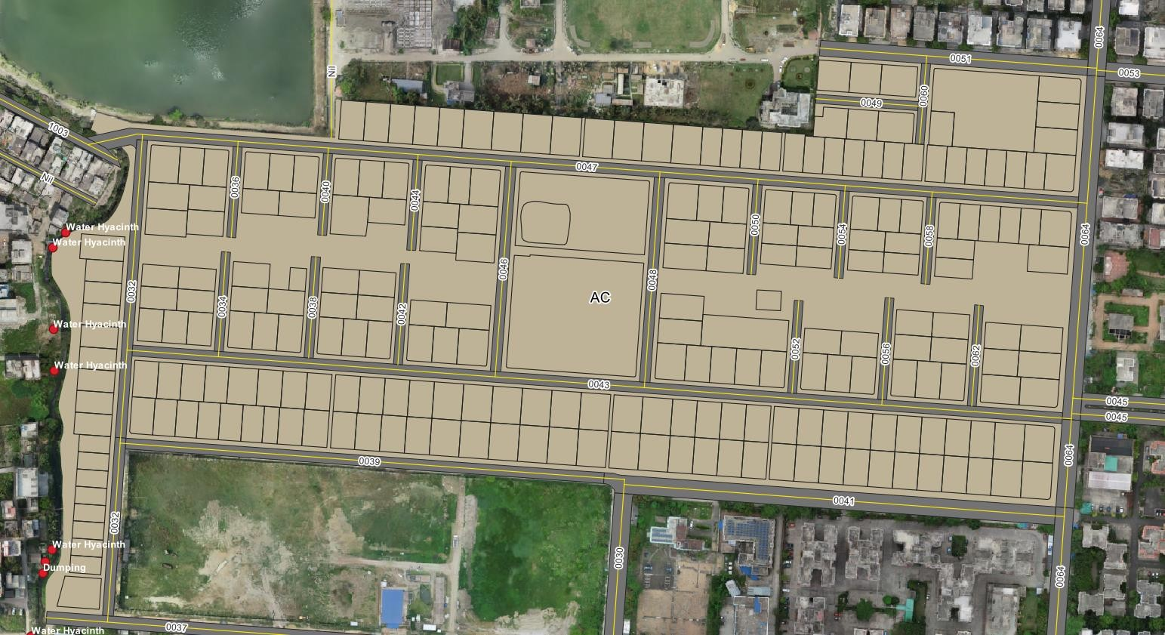
ACTION AREA – I, BLOCK: ‘AC’
ACTIONABLE POINTS
AA Block
AA Block
WTP
t
a
rh
a j
Ra
WTP
Rajarhat
AF Block

Slide 12
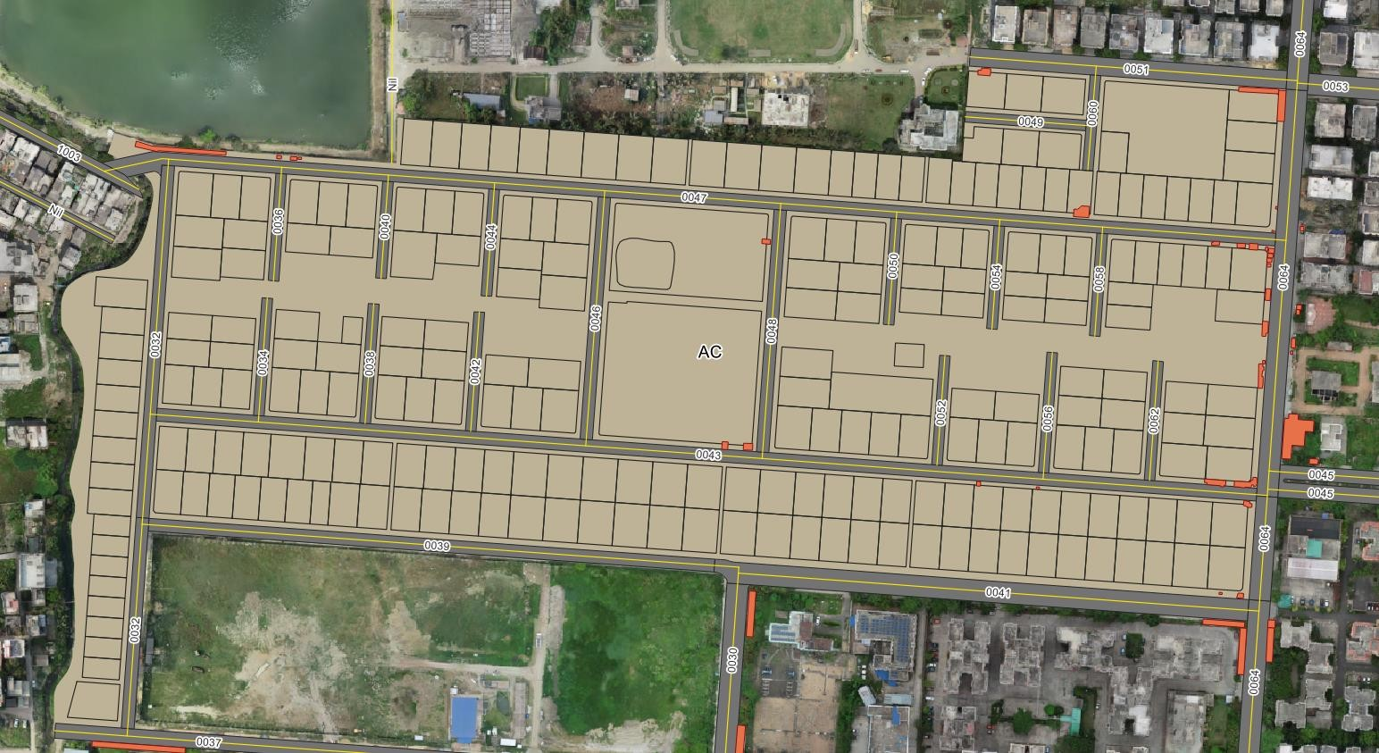
ACTION AREA – I, BLOCK: ‘AC’ OCCUPIED UNTAXED AREA (ENCROACHMENT)
AA Block
AA Block
WTP
t
a
rh
a j
Ra
WTP
Rajarhat
AF Block

Slide 13
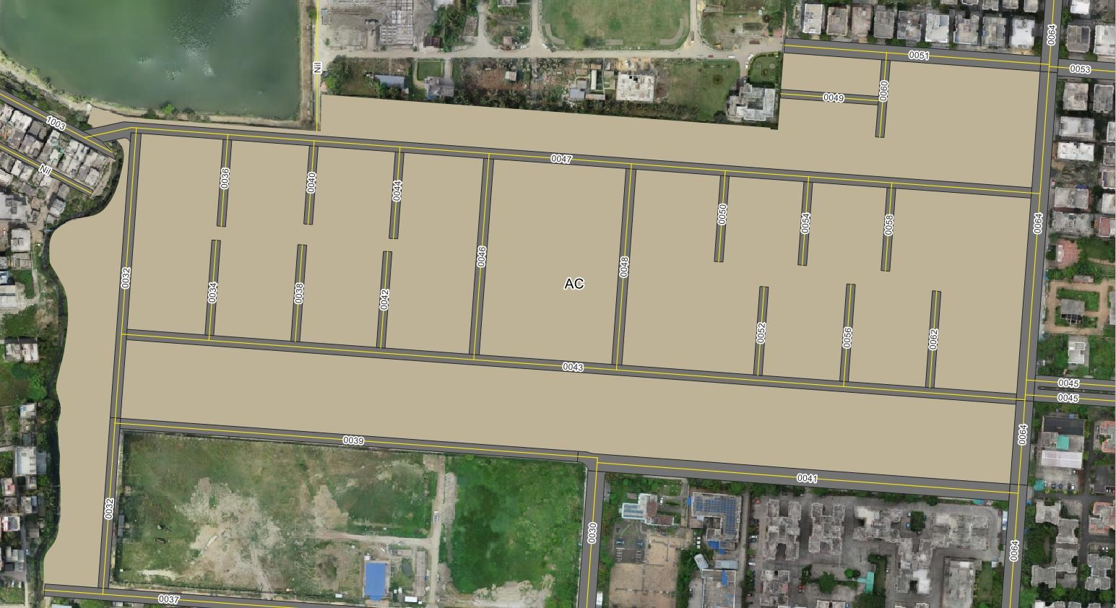
ACTION AREA – I, BLOCK: ‘AC’
ROAD DETAILS
AA Block
AA Block
WTP
t
a
rh
a j
Ra
WTP
Rajarhat
AF Block

Slide 14
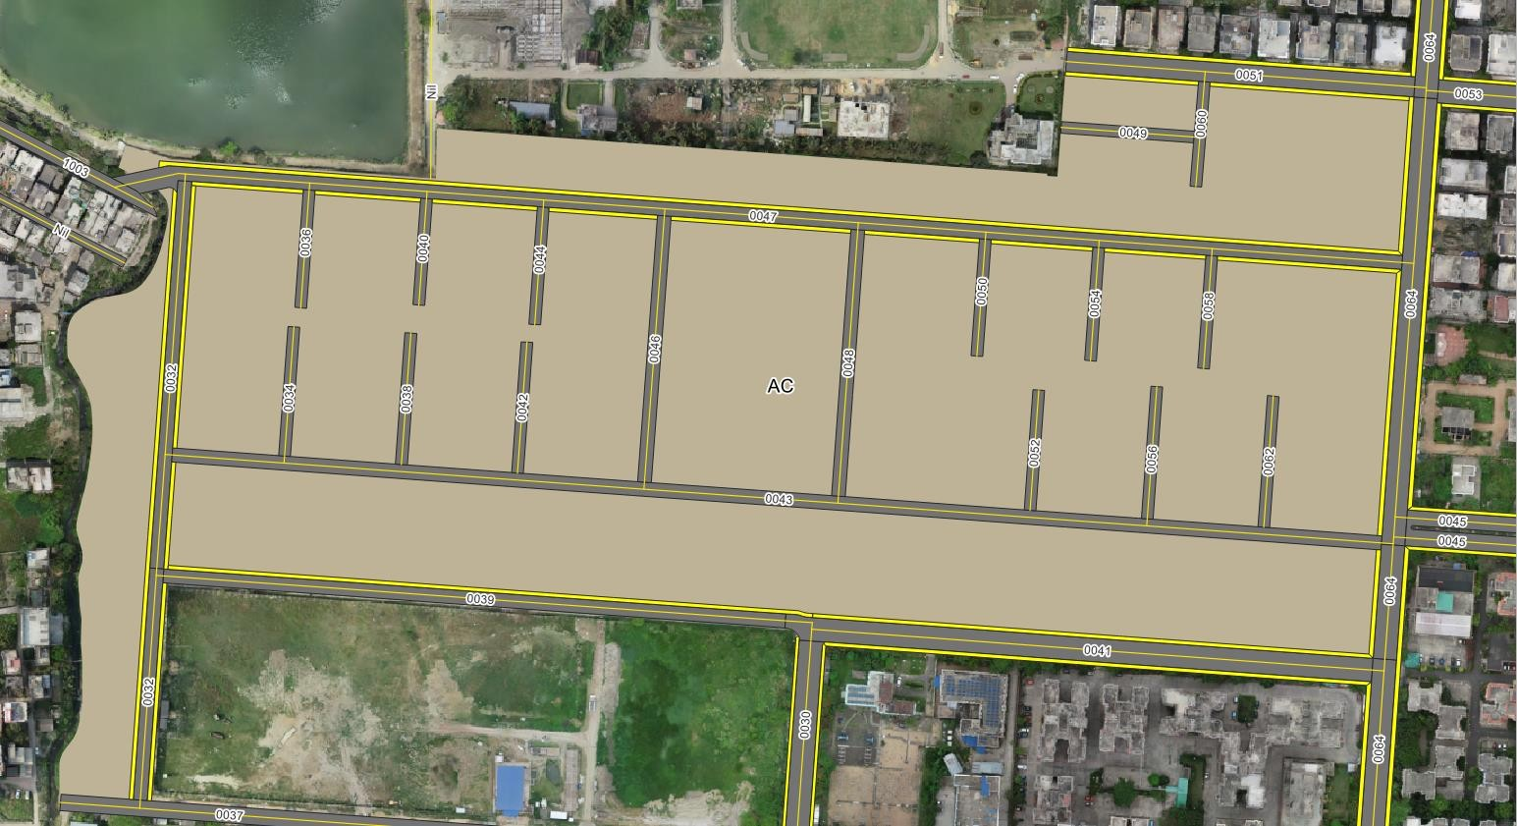
ACTION AREA – I, BLOCK: ‘AC’
FOOTPATH DETAILS
AA Block
AA Block
WTP
t
a
rh
a j
Ra
WTP
Rajarhat
AF Block

Slide 15

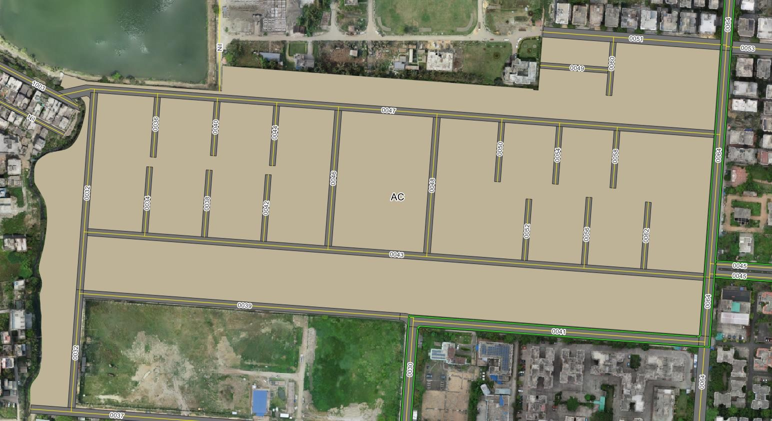
ACTION AREA – I, BLOCK: ‘AC’
CYCLE TRACK DETAILS
AA Block
AA Block
WTP
t
a
rh
a j
Ra
WTP
Rajarhat
AF Block

Slide 16
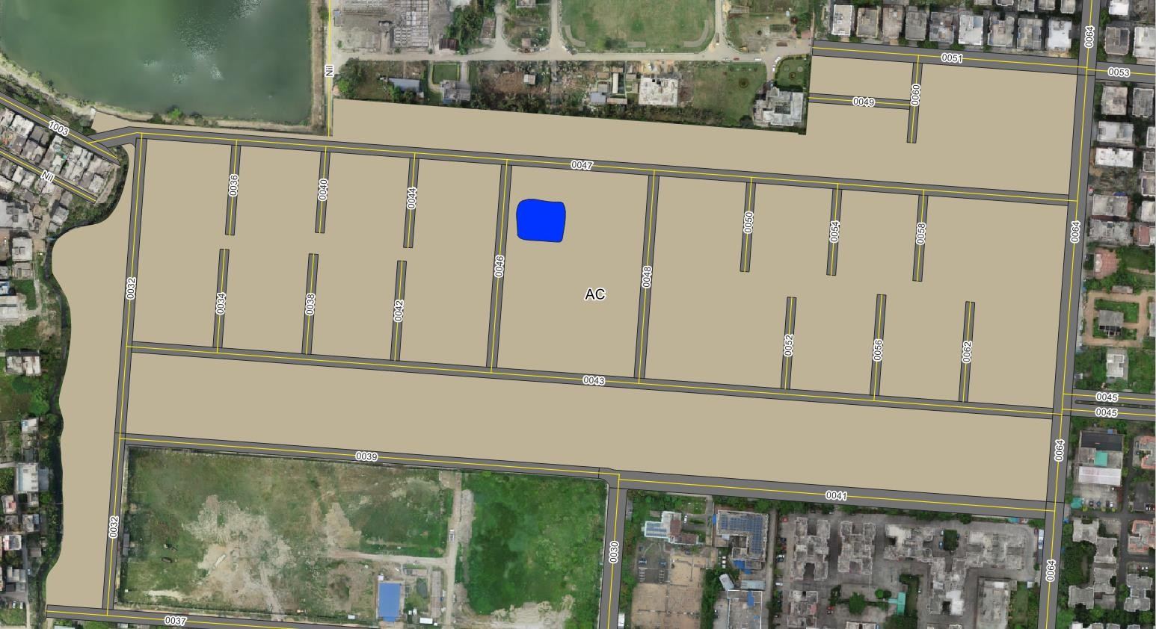

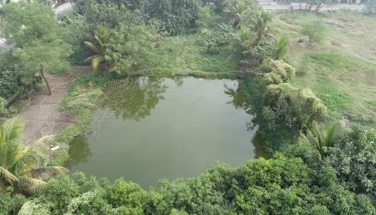
ACTION AREA – I, BLOCK: ‘AC’
WATERBODIES DETAILS
AA Block
WTP
Rajarhat
AF Block

Slide 17
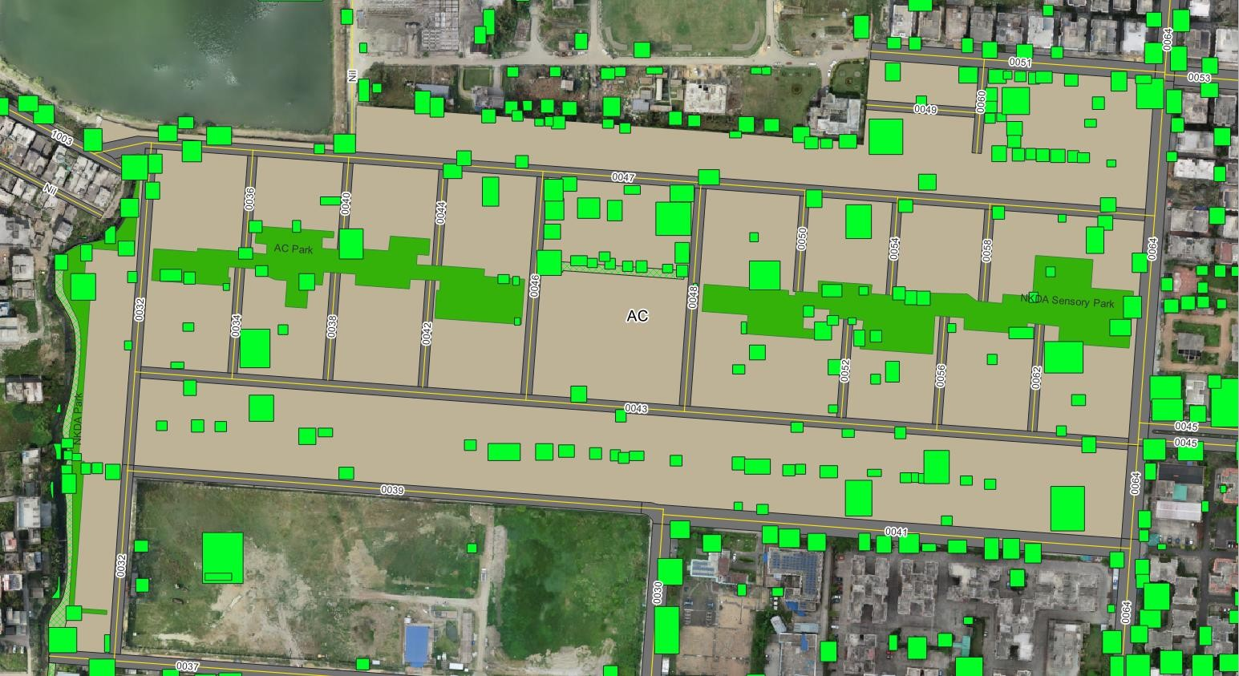
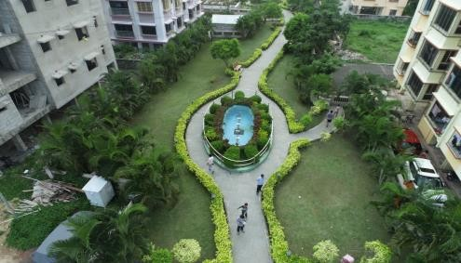
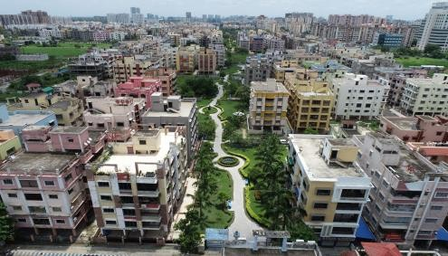
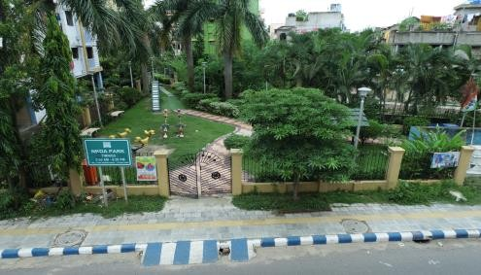
ACTION AREA – I, BLOCK: ‘AC’
GREENERY DETAILS
AA Block
WTP
Rajarhat
AF Block

Slide 18


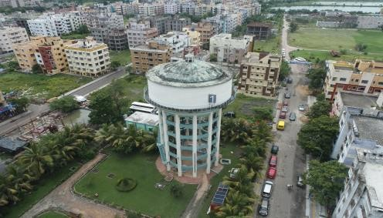
ACTION AREA – I, BLOCK: ‘AC’
WATER TANK
AA Block
WTP
Rajarhat
Water Tank: 01
AF Block

Slide 19
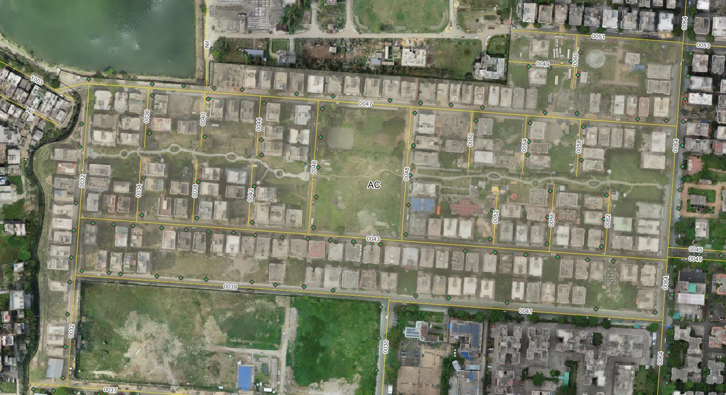
ACTION AREA – I, BLOCK: ‘AC’
STREET-LIGHT DETAILS
( Disclaimer: Not Updated By Field Visit)
AA Block
AA Block
WTP
t
a
rh
a j
Ra
WTP
Rajarhat
AF Block

