Slide 1

Backtesting with Python
Satoru, Hao, Toby

Slide 2

Main Goals
Compare popular trading strategies:
SMA
RSI
MACD
Buy & Hold
Optimizing profits/maximize overall value of holdings

Slide 3






The Process
TA-Lib

Slide 4
Simple Moving Average (SMA)
Simple moving average uses constantly updated average price data over a chosen period and then making trades based on when these moving averages cross one another on a chart.
We used the 20 day MA and the 50 day MA, a made a buy signal when the 20 moves above the 50 day, and a sell signal when the 20 day moves below the 50 day.

Slide 5
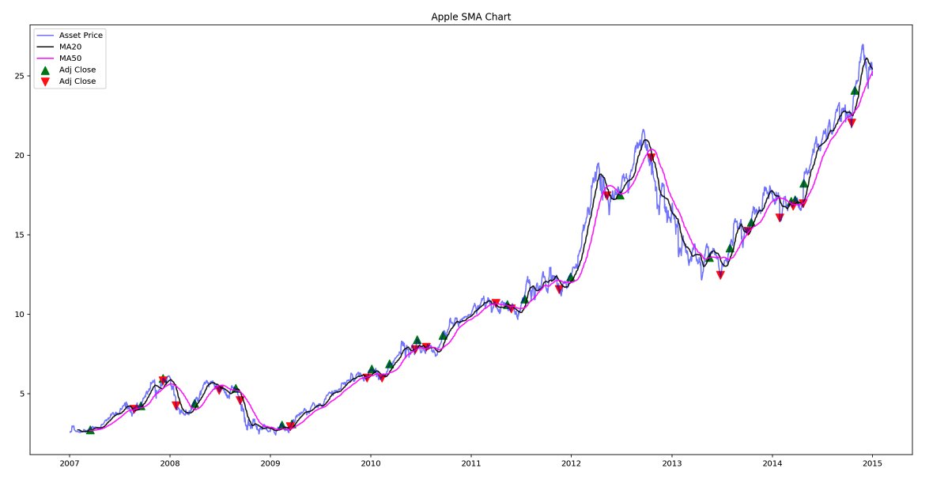
APPLE

Slide 6
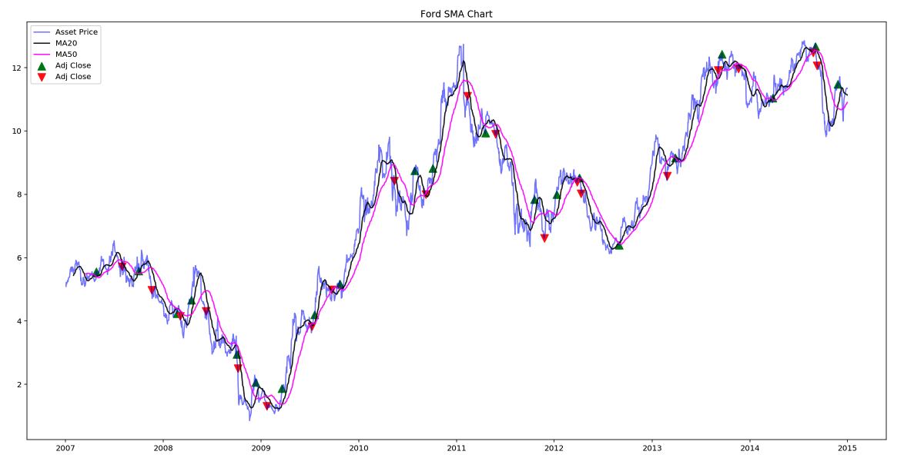
FORD

Slide 7
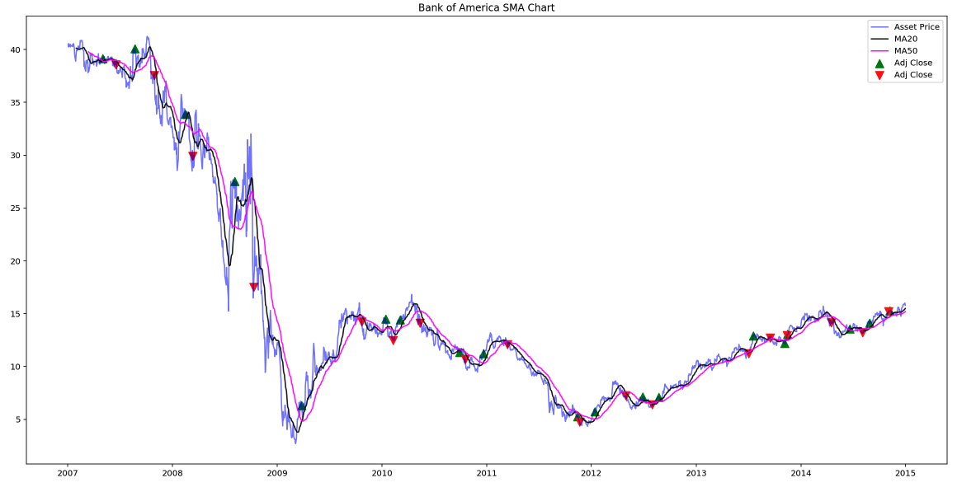
BANK OF AMERICA

Slide 8
Moving Average Convergence Divergence (MACD)
Moving average convergence divergence is a trend-following momentum indicator that shows the relationship between two moving averages of an asset's price. It's calculated by subtracting the 26-period exponential moving average (EMA) from the 12-period EMA.
This calculation, when plotted, gives us the MACD line. A 9 day EMA of the MACD is then plotted over the top of the MACD line. This "signal line" then functions as the buy or sell signal. The MACD line reacts to price movements faster than the signal line, so when the MACD crosses above it's signal line it can trigger a buy signal and when it crosses below, a sell signal.

Slide 9
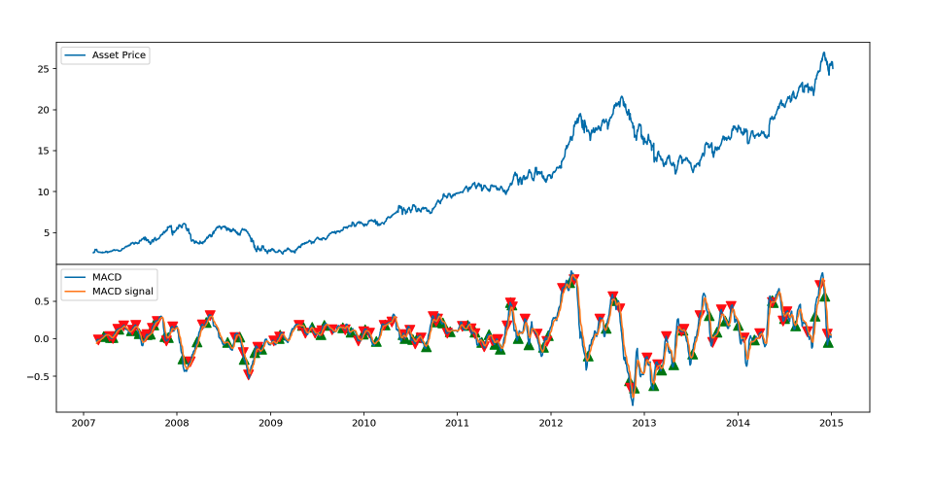
APPLE

Slide 10
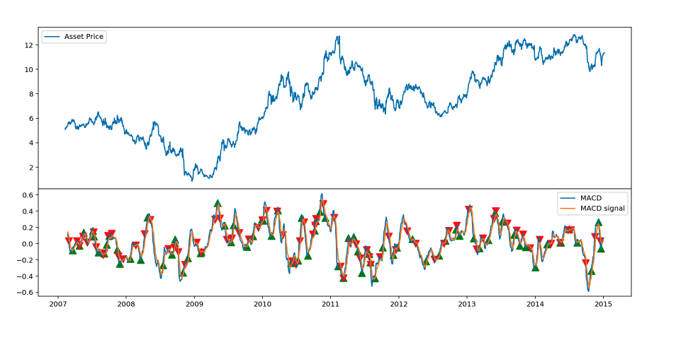
FORD

Slide 11
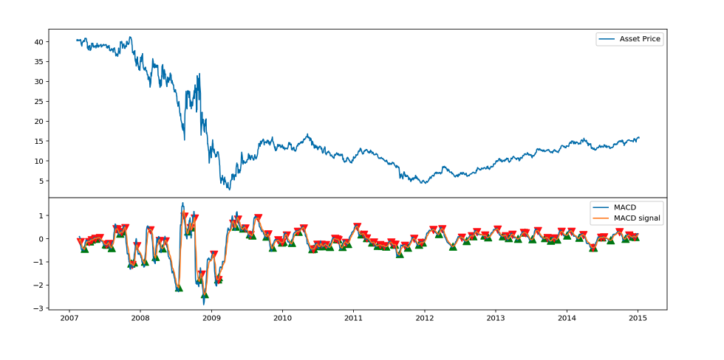
BANK OF AMERICA

Slide 12
Relative Strength Index (RSI)
Relative strength index is an oscillating indicator designed to measure a stock's speed and size of price changes over a chosen time period. The average gains divided by average losses over chosen time period gives us the relative strength value. It's then plotted on a graph between 0 and 100. Many traders use this indiactor to determine if a stock is overbought, or oversold, indicating a trend reversal and therefore a buy or sell signal. For example, if a stock has risen rapidly in a short period of time and may reverse lower.

Slide 13
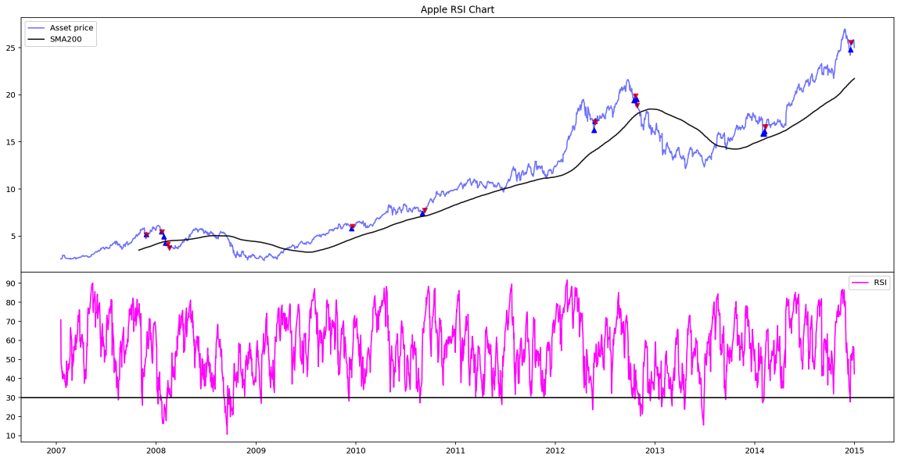
APPLE

Slide 14
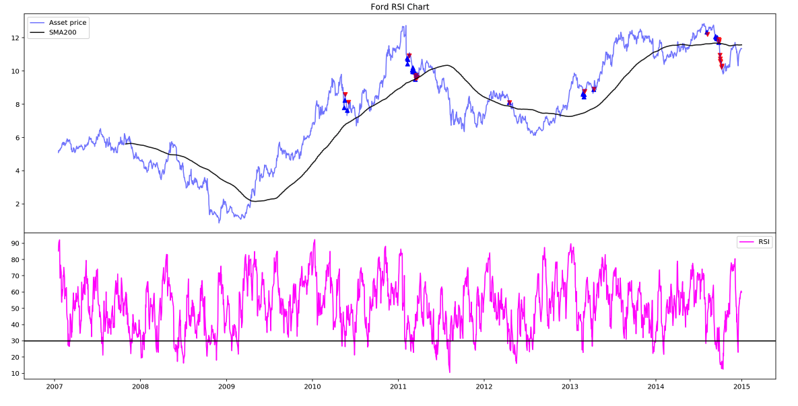
FORD

Slide 15
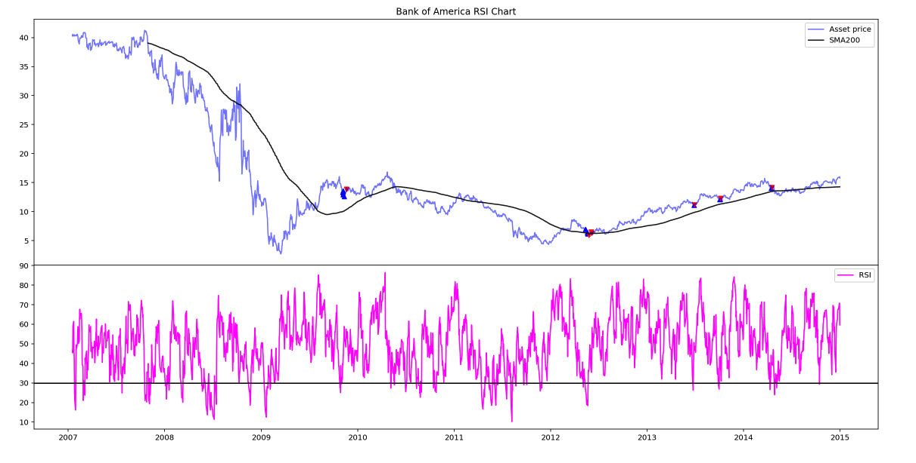
BANK OF AMERICA

Slide 16
Summary & Comparison
Comparing all stocks and strategies, the best decision would have been to buy and hold Apple stock for the entire period. Buying and holding Bank of America on the other hand would have given the opposite result.
Of the active strategies we used, the MACD was shown to be the most successful overall. This is not to say that another combination of moving average periods wouldn’t be more successful, but in our comparison this is the result.
We note the success of SMA with Bank of America. Although the company never fully recovered from the full during 2008, it would have sold in September 2008, then bought on the reversal of the trend.
Taking into account the tax implications of trading frequently, and the returns we charted, we believe the best strategy is to buy and hold, unless something changes within the business negatively.

Slide 17
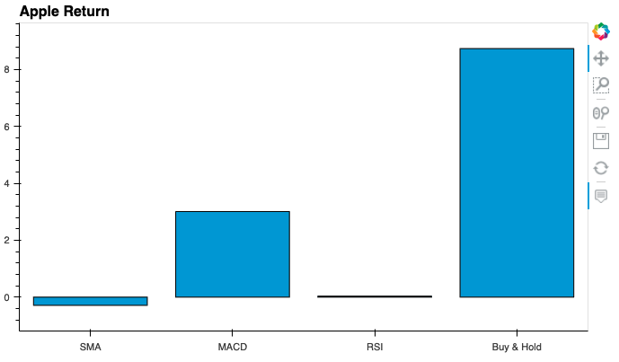
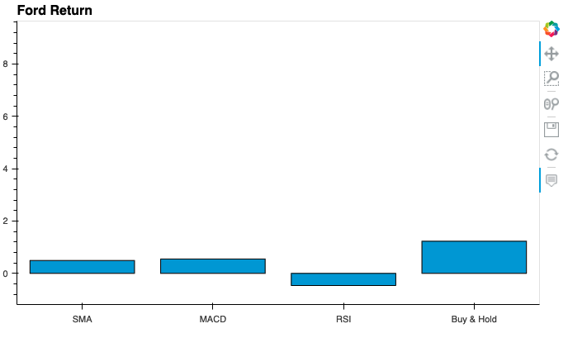
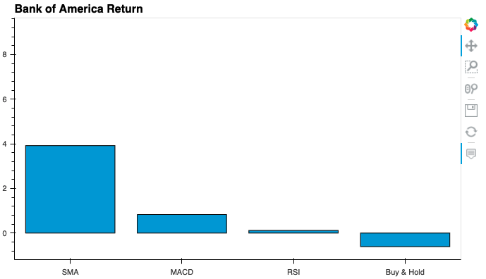
+837%
Strategy Returns
+300%
-28.8%
+3.59%
+122.8%
+49.2%
+54.9%
-46.4%
+392%
+83%
+11.6%
-60.8%

Slide 18
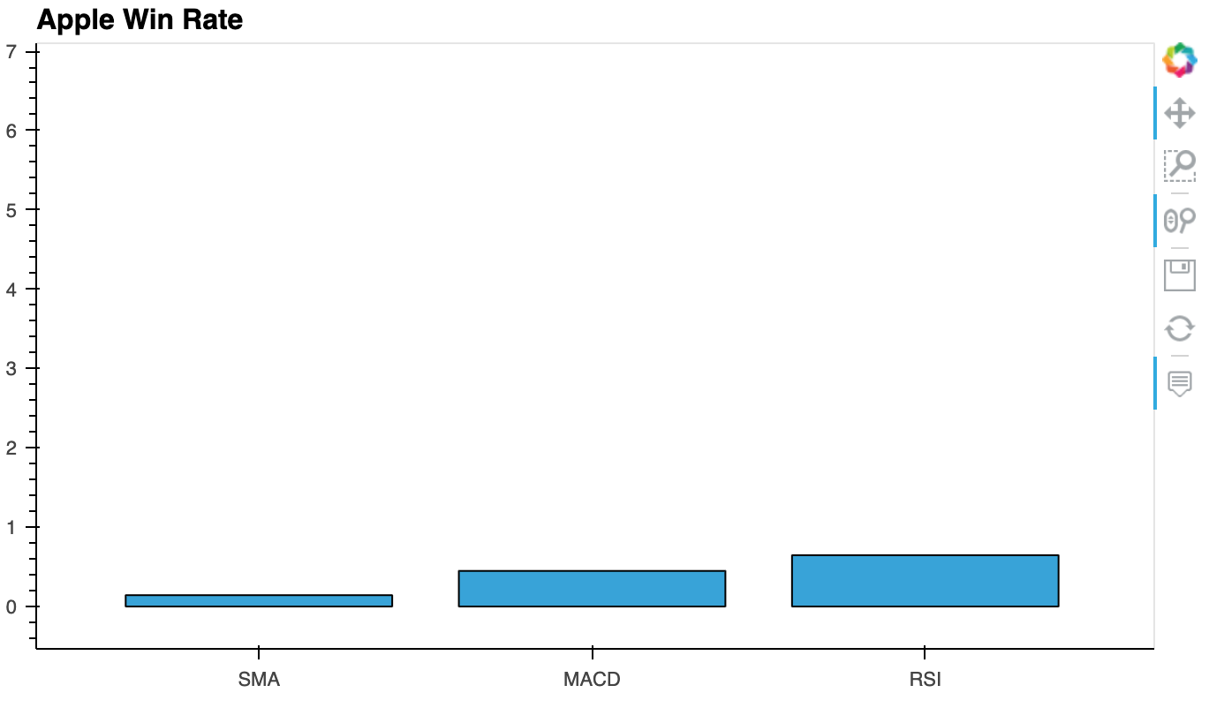
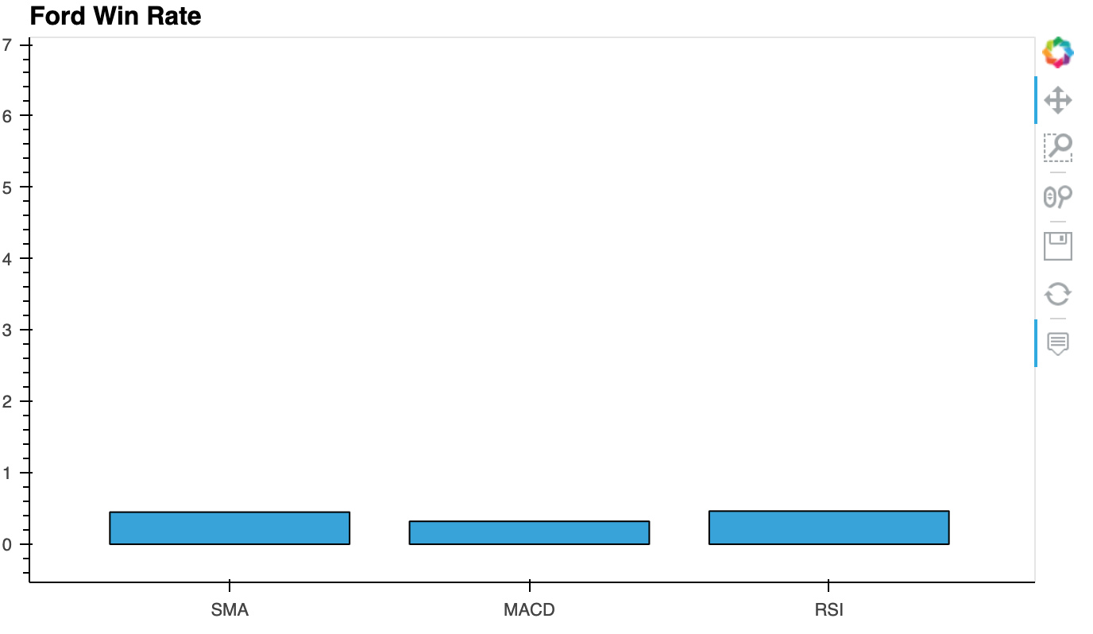
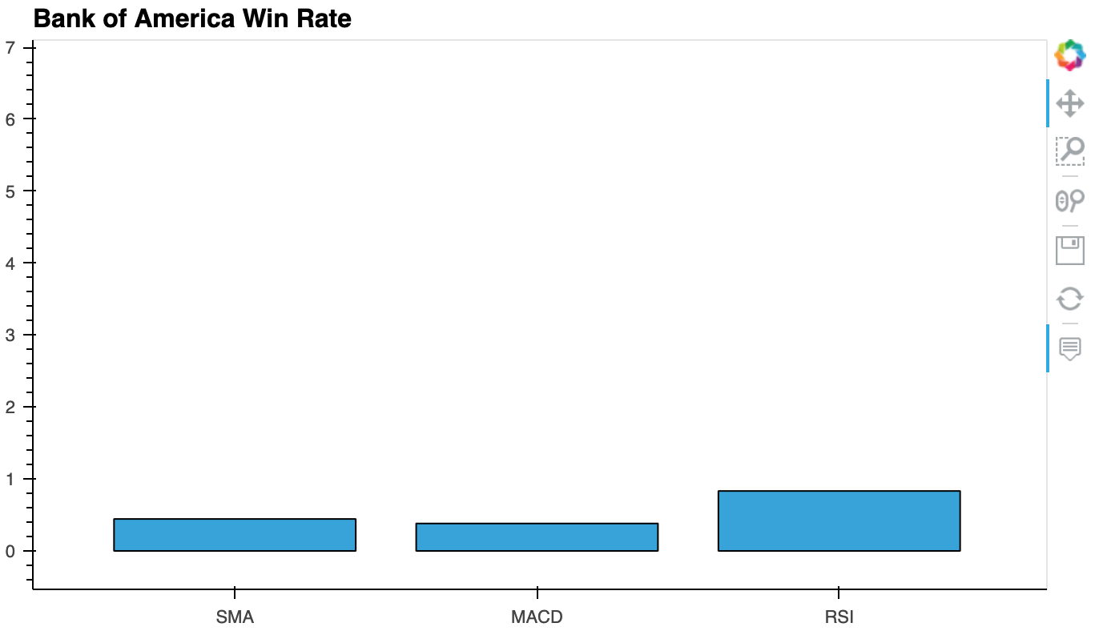
Comparing Strategy Win Rates
44.9%
64.7%
14.3%
45%
46.4%
32.1%
83.3%
44.4%
38.2%

Slide 19
Challenges
We had a few problems with Github; sometimes it would seem to work seamlessly and other times the same thing we had been doing would suddenly not work or do something different. We created a spare repo in order to practice, which helped, but we still had some issues which wasted some time.
Had some issues with scale of bar charts in the dashboard.
We decided not use a comprehensive, existing back testing library in favour of writing more of the code ourselves, which took more time.
Different time zones.

Slide 20
If we had another two weeks?
Back test more stocks, cryptocurrencies, compare the differences between assets as well as strategies.
Make our presentation more visually stimulating with more interaction and 3D visualization.
Would have drawn data directly (scrapings).

Slide 21
Questions & Answers

