Slide 1
Hodl, ma, lstm?
Viseth
Simon
Luke
toby

Slide 2
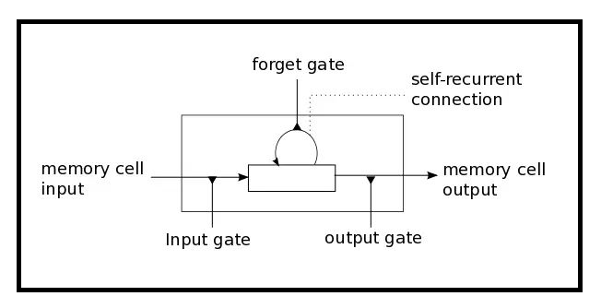
THE LONG SHORT TERM MEMORY MODEL
LSTM has three gates:
The Input Gate: The input gate adds information to the cell state
The Forget Gate: It removes the information that is no longer required by the model
The Output Gate: Output Gate at LSTM selects the information to be shown as output

Slide 3
Parameters
Batch Size: number of samples a network is shown before a weight can be updated
Window Size: the number of observations a prediction takes into account
Dropout Rate: the probability of not training a given node in a layer which helps the model to not overfit the training data
Epoch: the number of times the data is ran through the model
Random Seed: can be manually set to ensure reproducibility

Slide 4
Limitations of the LSTM model
Complexity of parameters
Many parameters that can be altered
Extremely volatile models due to randomness
May lead to false positives/negatives
Potentially time consuming training
Due to parameters such as epoch and window size

Slide 5
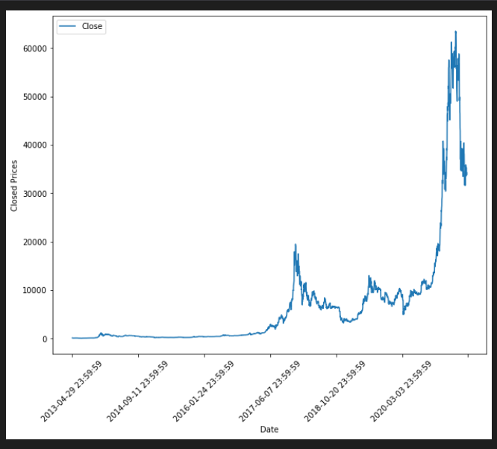
Limitation of HODL strategy
May over/underperform depending on market conditions
Extremely bullish markets lead to over- exaggeration of hodl performance

Slide 6
Limitations of custom MA strategy
Assumes infinite capital
Performance heavily dependent on bullish/bearish market
Holding period parameters may be arbitrary
ROI calculated based on total capital invested since simultaneous positions may exist

Slide 7

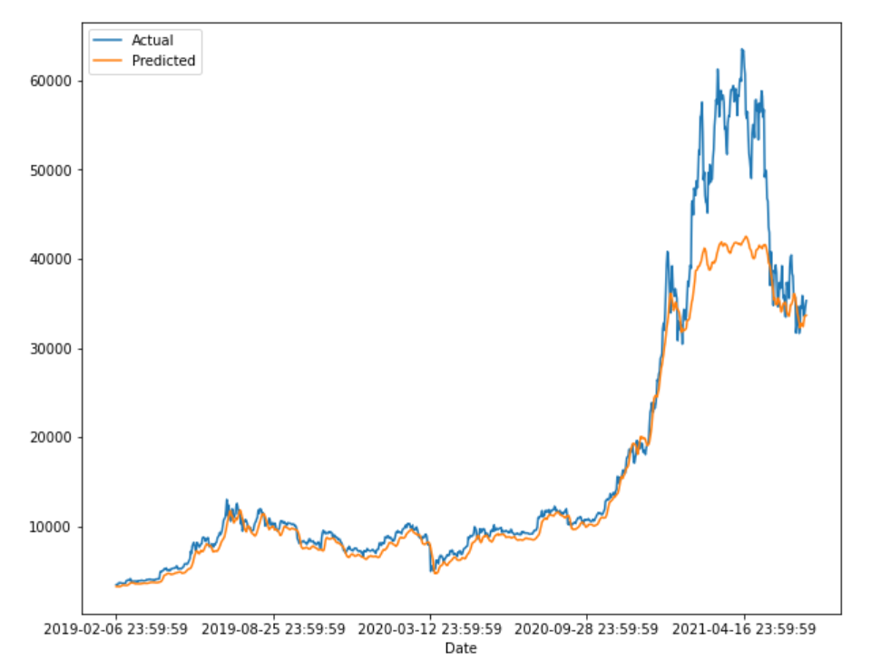
Limitation to LSTM strategy
Assumes infinite capital
No trades for extended period of time if the estimation is severely over or underestimating the price
ROI calculated based on maximum trade since only one positions exists at a time

