Slide 1

Team:
Group_A_Allstarz
Viseth Auk (PROJECT MANAGER)
Toby Martin
Simon Zhang
Luke Macumber

Slide 2

“Can we utilise ML to accurately predict entry and exit signals whilst trading, in order to make a consistent profit on Bitcoin?”

Slide 3

The strategies
3 different trading strategies:
Buy and Hold “HODL”
Moving Averages (MA)
Long Short Term Memory (LSTM)

Slide 4

LSTM Model and Its Application in the Financial Markets
In many research publications there has been a lot of discussions around a new trading phenomenon used in various trading strategies known as the LSTM Model, often referred to as the Long-Term Short-Term Memory Model which is used in the neural network or machine learning arena. We would like to uncover the truth behind this style of trading, is it truth or fiction?
In this project, we will explore and demonstrate how one type of RNN model, the Long Short-Term Memory (LSTM) network, can be used to predict price movement in financial time series data which is considered to be perhaps the most chaotic and difficult of all time series. We will also seek to compare a two other strategies with LSTM to try and predict price movements and profit, and determine the best approach.

Slide 5
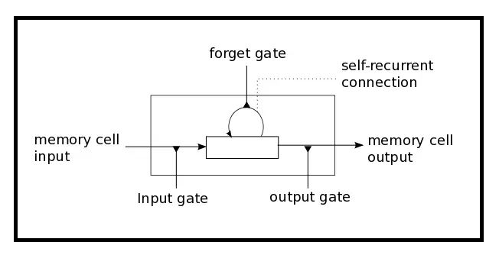
THE LONG SHORT TERM MEMORY MODEL
LSTM has three gates:
The Input Gate: The input gate adds information to the cell state
The Forget Gate: It removes the information that is no longer required by the model
The Output Gate: Output Gate at LSTM selects the information to be shown as output

Slide 6
Parameters
Batch Size: number of samples a network is shown before a weight can be updated
Window Size: the number of observations a prediction takes into account
Dropout Rate: the probability of not training a given node in a layer which helps the model to not overfit the training data
Epoch: the number of times the data is ran through the model
Random Seed: can be manually set to ensure reproducibility

Slide 7
Limitations of the LSTM model
Complexity of parameters
Many parameters that can be altered
Extremely volatile models due to randomness
May lead to false positives/negatives
Potentially time consuming training
Due to parameters such as epoch and window size

Slide 8
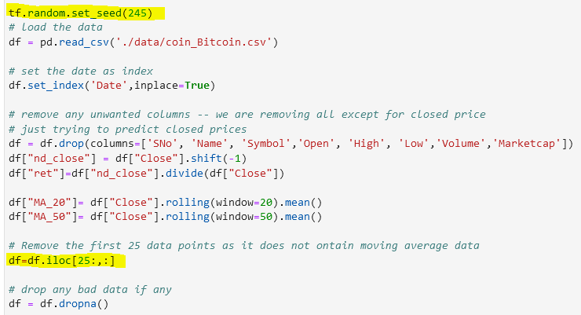
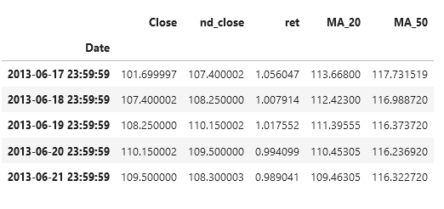
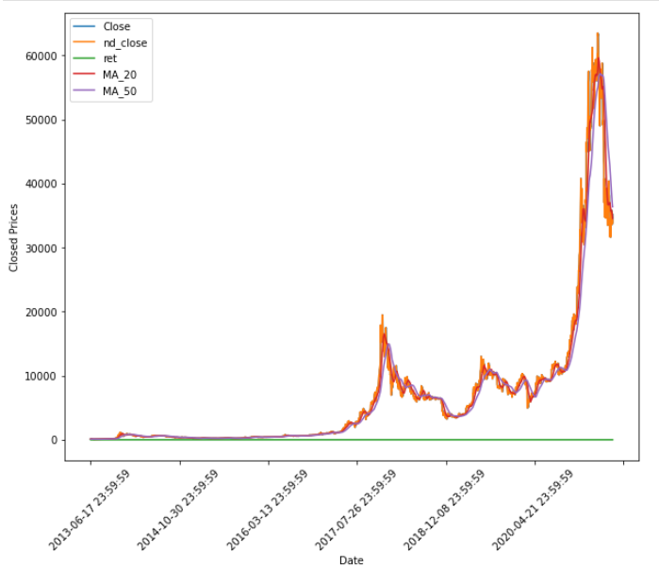
Data Exploration
code snippet
The data we will be working with will be daily data of cryptocurrencies.
We will be focusing on the prices of BTC, however if we have time we could look at other cryptocurrencies.
The data is taken from coinmarketcap.com and extracted into a CSV file.
dataframe
visualise the data

Slide 9
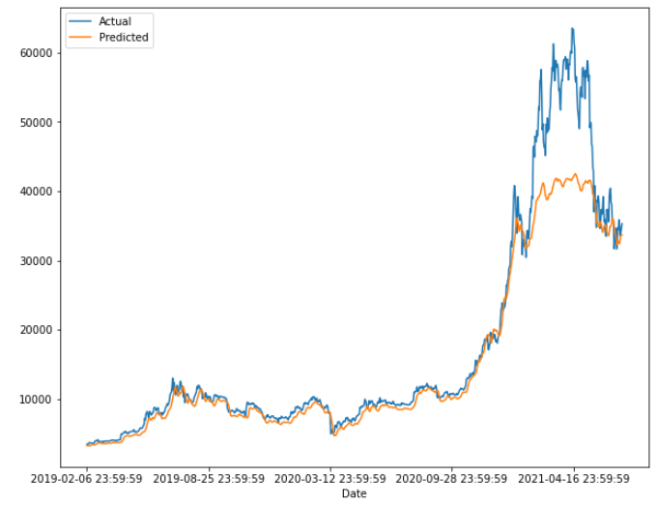

Our lstm strategy
After performing the necessary steps in building the machine learning model such as: splitting, scaling, reshaping and training the data sets we observe:
Our LSTM trading strategy are as follows: buy if:
(actual / predicted) < 1 – threshold (2%) close position if: (actual / predicted) > 1 + threshold (2%)
strategy result

Slide 10
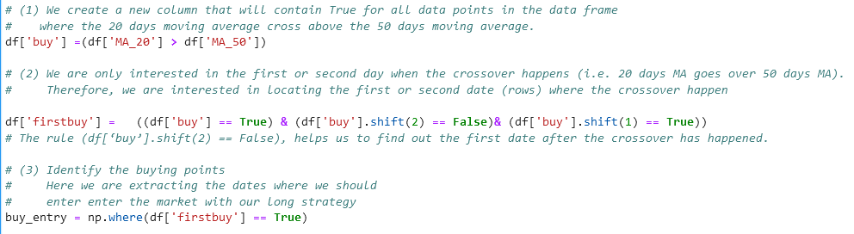
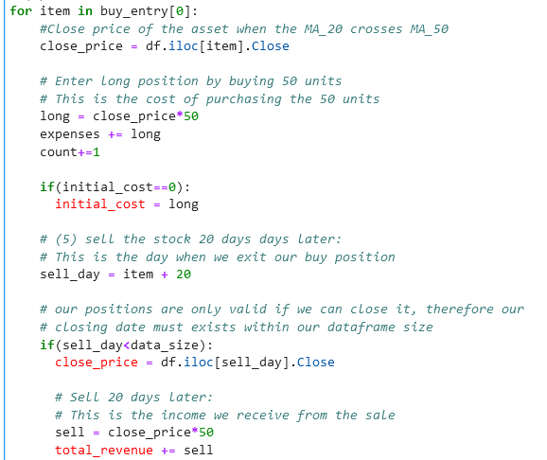
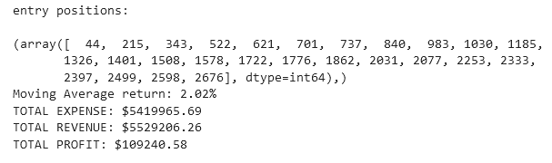
Our Moving average strategy
2 Moving Averages: 20 Day & 50 Day
For simplicity, we take long only positions
Only enter 1 day after the 20 Day MA > 50 Day MA ( this removes trading noise )
On entry we purchase 50 units of the specified asset
We hold each position for 20 days then close it at the close of that day

Slide 11
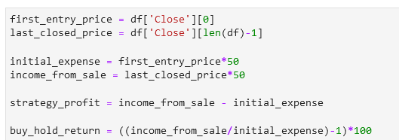
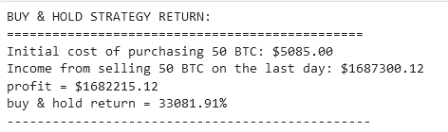
Our BUY & HOLD strategy
To buy and hold simply means buy on the first day and sell on the last day. In this case, we will be buying 50 units of bitcoin and then selling 50 units at the close price of the last day on the timeseries.
The return above of over 33000% is the return of holding the 50 units of Bitcoin from the start of our dataset, which is 2013.
However, for comparison sake for our LSTM model, buying Bitcoin on the 6th February 2019, and holding it until the same date as our LSTM model finishes on 9th July 2021, the ROI would be 900%.

Slide 12
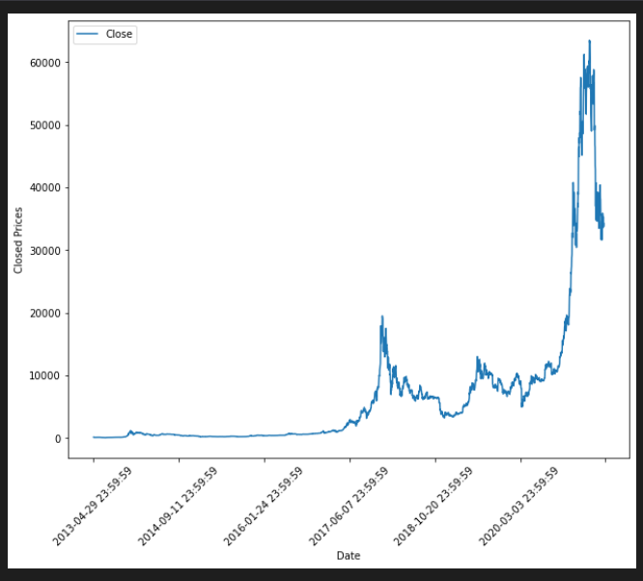
Limitation of HODL strategy
May over/underperform depending on market conditions
Extremely bullish markets lead to over- exaggeration of hodl performance

Slide 13
Limitations of custom MA strategy
Assumes infinite capital
Performance heavily dependent on bullish/bearish market
Holding period parameters may be arbitrary
ROI calculated based on total capital invested since simultaneous positions may exist

Slide 14
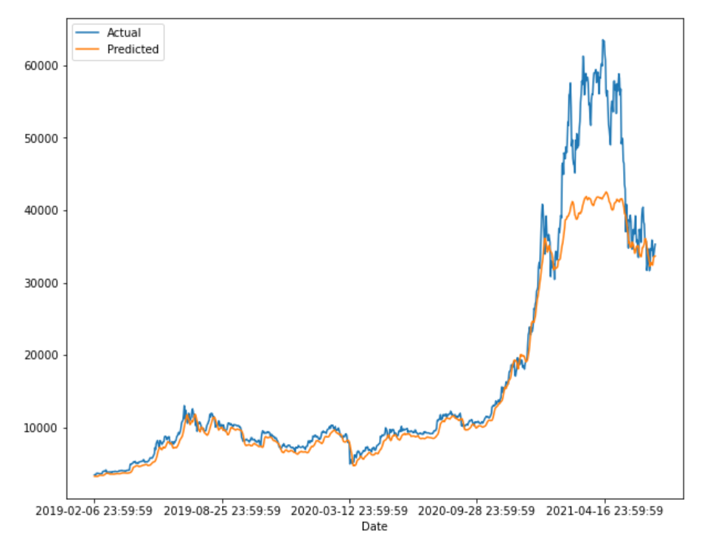
Limitation to LSTM strategy
Assumes infinite capital
No trades for extended period of time if the estimation is severely over or underestimating the price
ROI calculated based on maximum trade since only one positions exists at a time

Slide 15
conclusion
Over the history of Bitcoin, the buy and hold strategy still wins out when compared to our MA strategy and the LSTM model.
LSTM is very difficult to configure to get the best results as it relies on so many parameters and we would need to understand and test each parameter thoroughly. Furthermore, there is still randomness in our results and for a while we were unable to compare due to the fact the same parameters are not always reproduceable. This is because the LSTM model drops random data points as it is executed. To combat this we had to include a seed.
With more time and honing of the parameters, we believe that it could be possible to out perform other investments using the LSTM model. However, when it comes to Bitcoin, the price appreciation year-on-year would be hard to beat.
If we tested LSTM model on an asset that performed differently than Bitcoin, we may have a different result. Further exploration required.

Slide 16
Challenges
We had half of our team away in different states for a considerable time.
Found it difficult to find time where everyone was available to collaborate.
LSTM parameters randomness made it difficult to replicate.
Beating the return of holding an asset such as Bitcoin over this period is next to impossible. If you find a way, stick with it.

Slide 17
qa

