Slide 1
Hodl, ma, lstm?
Viseth
Simon
Luke
toby

Slide 2
“Can we utilise ML to accurately predict entry and exit signals whilst trading, in order to make a consistent profit on Bitcoin?”
In this project, we will explore and demonstrate how one type of RNN model, the Long Short-Term Memory (LSTM) network, can be used to predict price movement in financial time series data which is considered to be perhaps the most chaotic and difficult of all time series. We will also seek to compare a two other strategies with LSTM to try and predict price movements and profit, and determine the best approach.

Slide 3
DEFINITIONS
RNN : Recurrent Neural Networks
Features : The feature / object we implement to predict the next price value.
Dropout : The dropout rate is the probability of not training a given node in a layer. This helps the model to not overfit our training data.
Optimiser : Optimisation algorithm to use (defaults to Adam).
Batch Size : The number of data samples to use on each training iteration.
Epoch : The number of times that the learning algorithm will pass through the entire training dataset
HODL : Hold On For Dear Life

Slide 4
The strategies
3 different trading strategies:
Buy and Hold “HODL”
Moving Averages (MA)
Long Short Term Memory (LSTM)

Slide 5
LSTM Model and Its Application in the Financial Markets
In many research publications there has been a lot of discussions around a new trading phenomenon used in various trading strategies known as the LSTM Model, often referred to as the Long-Term Short-Term Memory Model which is used in the neural network or machine learning arena. We would like to uncover the truth behind this style of trading, is it truth or fiction? In previous works we have seen much of the hype surrounding neural networks and its applications more focused in image-based applications such as fingerprint recognition, facial recognition, etc. However, models in **Recurrent Neural Networks** (RNNs) have been successfully used in recent years to predict future events in time series as well. RNNs have contributed to breakthroughs in a wide variety of fields centered around predicting sequences of events. The reason they work so well is because LSTM is able to store past information that is important, and forget the information that is not.

Slide 6
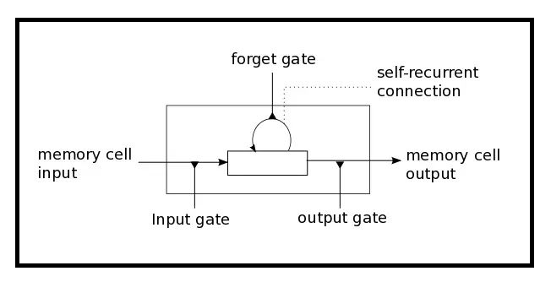
THE LONG SHORT TERM MEMORY MODEL
LSTM has three gates:
The Input Gate: The input gate adds information to the cell state
The Forget Gate: It removes the information that is no longer required by the model
The Output Gate: Output Gate at LSTM selects the information to be shown as output

Slide 7
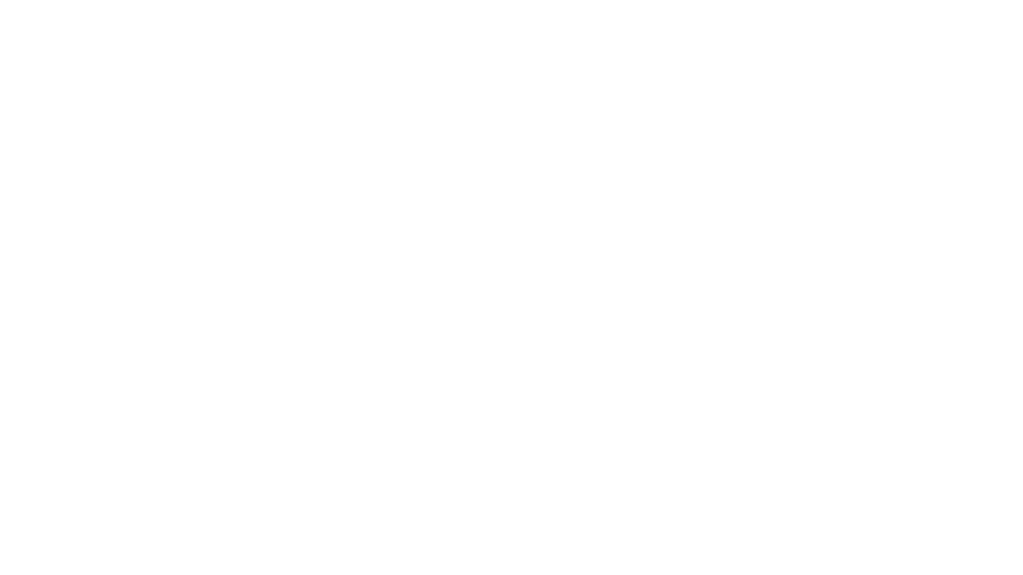
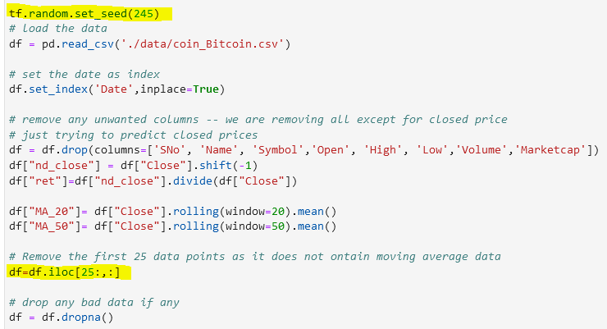
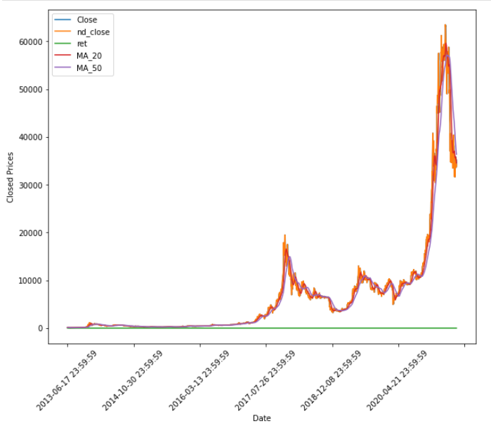
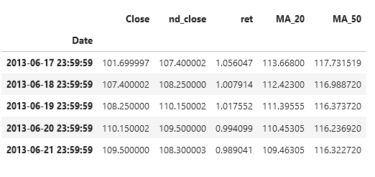
Data Exploration
code snippet
The data we will be working with will be daily data of cryptocurrencies.
We will be focusing on the prices of BTC, however if we have time we could look at other cryptocurrencies.
The data is taken from coinmarketcap.com and extracted into a CSV file
visualise the data
dataframe

Slide 8
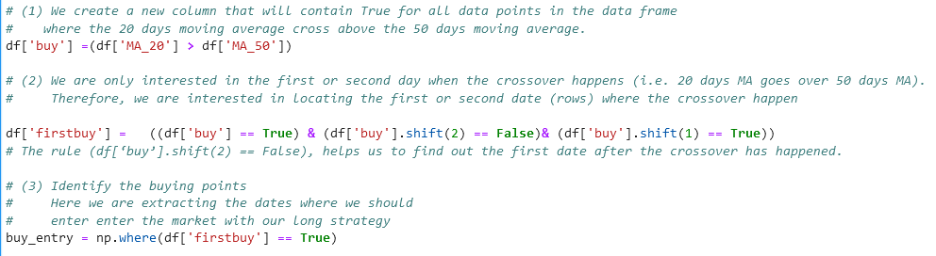
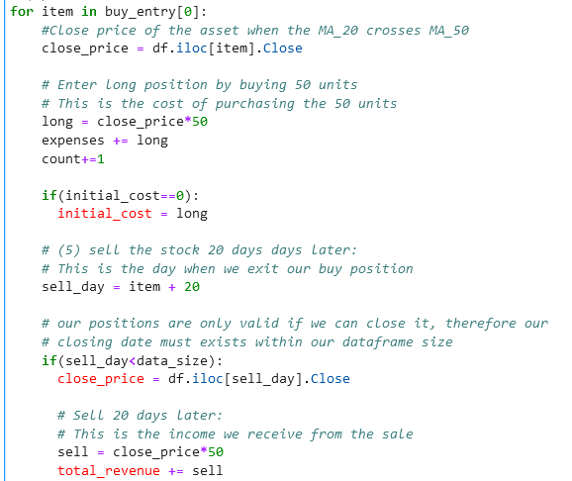
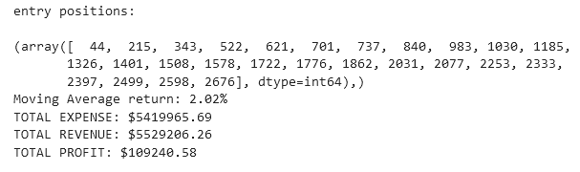
Our Moving average strategy
2 Moving Averages: 20 Day & 50 Day
For simplicity, we take long only positions
Only enter 1 day after the 20 Day MA > 50 Day MA ( this removes trading noise )
On entry we purchase 50 units of the specified asset
We hold each position for 20 days then close it at the close of that day

Slide 9
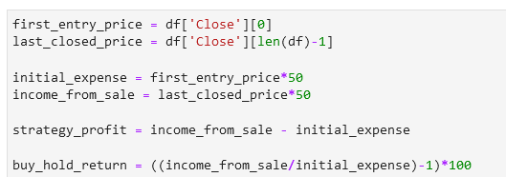
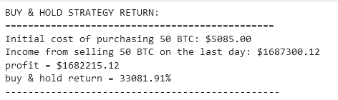
Our BUY & HOLD strategy
To buy and hold simply means buy on the first day and sell on the last day. In this case, we will be buying 50 units of bitcoin and then selling 50 units at the close price of the last day on the timeseries.

Slide 10
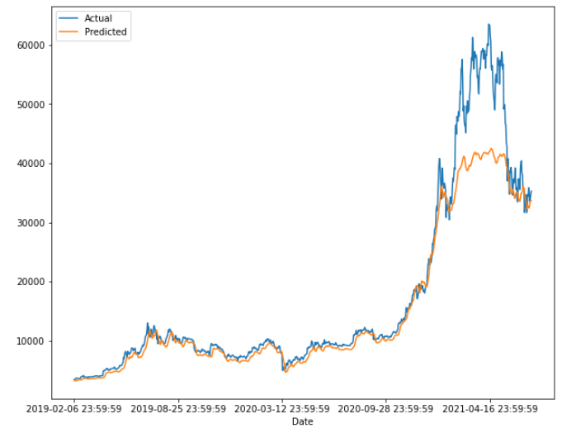

Our lstm strategy
After performing the necessary steps in building the machine learning model such as: splitting, scaling, reshaping and training the data sets we observe:
Our LSTM trading strategy are as follows: buy if:
(actual / predicted) < 1 – threshold (2%) close position if: (actual / predicted) > 1 + threshold (2%)
strategy result

Slide 11
conclusion
Over the history of Bitcoin, the buy and hold strategy still wins out when compared to our MA strategy and the LSTM model.
LSTM is very difficult to configure to get the best results as it relies on so many parameters and we would need to understand and test each parameter thoroughly. Furthermore, there are still randomness in our results and we are unable to compare due to the fact the same parameters are not always reproduceable. This is because the LSTM model drops random data points as it is executed.
With more time and honing of the parameters, we believe that it could be possible to out perform other investments using the LSTM model. However, when it comes to Bitcoin, the price appreciation year-on-year would be hard to beat.

