Slide 1
Hodl, ma, lstm?
Viseth
Simon
Luke
toby

Slide 2
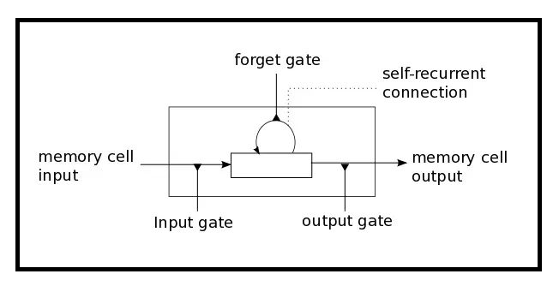
THE LONG SHORT TERM MEMORY MODEL
LSTM has three gates:
The Input Gate: The input gate adds information to the cell state
The Forget Gate: It removes the information that is no longer required by the model
The Output Gate: Output Gate at LSTM selects the information to be shown as output

Slide 3
Parameters
Batch Size: number of samples a network is shown before a weight can be updated
Window Size: the number of observations a prediction takes into account
Dropout Rate: the probability of not training a given node in a layer which helps the model to not overfit the training data
Epoch: the number of times the data is ran through the model
Random Seed: can be manually set to ensure reproducibility

Slide 4
Limitations of the LSTM model
Complexity of parameters
Many parameters that can be altered
Extremely volatile models due to randomness
May lead to false positives/negatives
Potentially time consuming training
Due to parameters such as epoch and window size

Slide 5
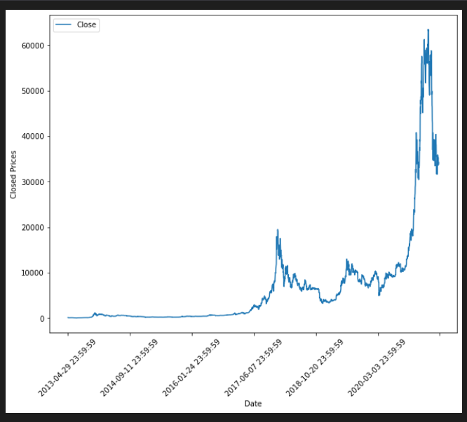
Limitation of HODL strategy
May over/underperform depending on market conditions
Extremely bullish markets lead to over- exaggeration of hodl performance

Slide 6
Limitations of custom MA strategy
Assumes infinite capital
Performance heavily dependent on bullish/bearish market
Holding period parameters may be arbitrary

