Slide 1

Team:
Group ‘a’ allstarz
* Viseth Auk (PROJECT MANAGER) * Simon Zhang
* Toby martin * Luke macumber

Slide 2




“Can we utilise ML to accurately predict entry and exit signals whilst trading, in order to make a consistent profit on Bitcoin?”

Slide 3

The strategies
3 different trading strategies:
Buy and Hold “HODL”
Moving Averages (MA)
Long Short Term Memory (LSTM)

Slide 4

LSTM Model and Its Application in the Financial Markets
In many research publications there has been a lot of discussions around a new trading phenomenon used in various trading strategies known as the LSTM Model, often referred to as the Long-Term Short-Term Memory Model which is used in the neural network or machine learning arena. We would like to uncover the truth behind this style of trading, is it truth or fiction?
In this project, we will explore and demonstrate how one type of RNN model, the Long Short-Term Memory (LSTM) network, can be used to predict price movement in financial time series data which is considered to be perhaps the most chaotic and difficult of all time series. We will also seek to compare a two other strategies with LSTM to try and predict price movements and profit, and determine the best approach.

Slide 5
DEFINITIONS
RNN : Recurrent Neural Networks
Features : The feature / object we implement to predict the next price value.
Dropout : The dropout rate is the probability of not training a given node in a layer. This helps the model to not overfit our training data.
Optimiser : Optimisation algorithm to use (defaults to Adam).
Batch Size : The number of data samples to use on each training iteration.
Epoch : The number of times that the learning algorithm will pass through the entire training dataset
HODL : Hold On For Dear Life

Slide 6
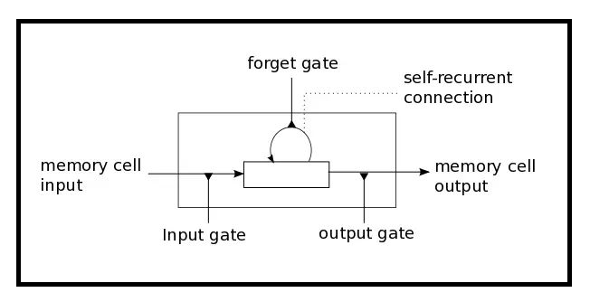
THE LONG SHORT TERM MEMORY MODEL
LSTM has three gates:
The Input Gate: The input gate adds information to the cell state
The Forget Gate: It removes the information that is no longer required by the model
The Output Gate: Output Gate at LSTM selects the information to be shown as output

Slide 7
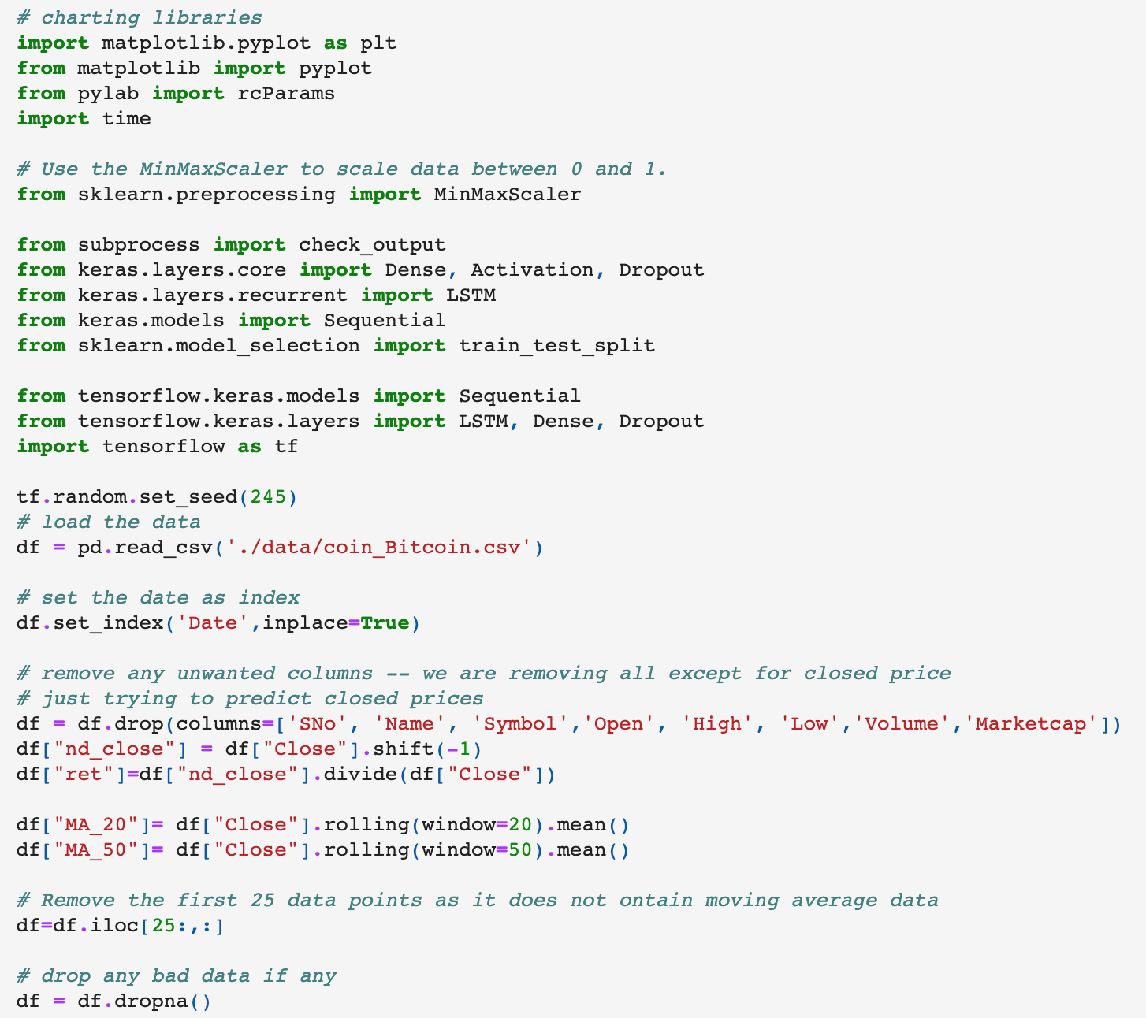
Data Exploration
The data we will be working with will be daily data of cryptocurrencies. We will be focusing on the prices of BTC, however if we have time we could look at other cryptocurrencies.
The data is taken from coinmarketcap.com and extracted into a CSV file

Slide 8
CODe + chosen parameters

Slide 9
conclusion
Over the history of Bitcoin, the buy and hold strategy still wins out when compared to our MA strategy and the LSTM model.
LSTM is very difficult to configure to get the best results as it relies on so many parameters and we would need to understand and test each parameter thoroughly. Furthermore, there are still randomness in our results and we are unable to compare due to the fact the same parameters are not always reproduceable. This is because the LSTM model drops random data points as it is executed.
With more time and honing of the parameters, we believe that it could be possible to out perform other investments using the LSTM model. However, when it comes to Bitcoin, the price appreciation year-on-year would be hard to beat.

