Slide 1
My IMS project

Slide 2
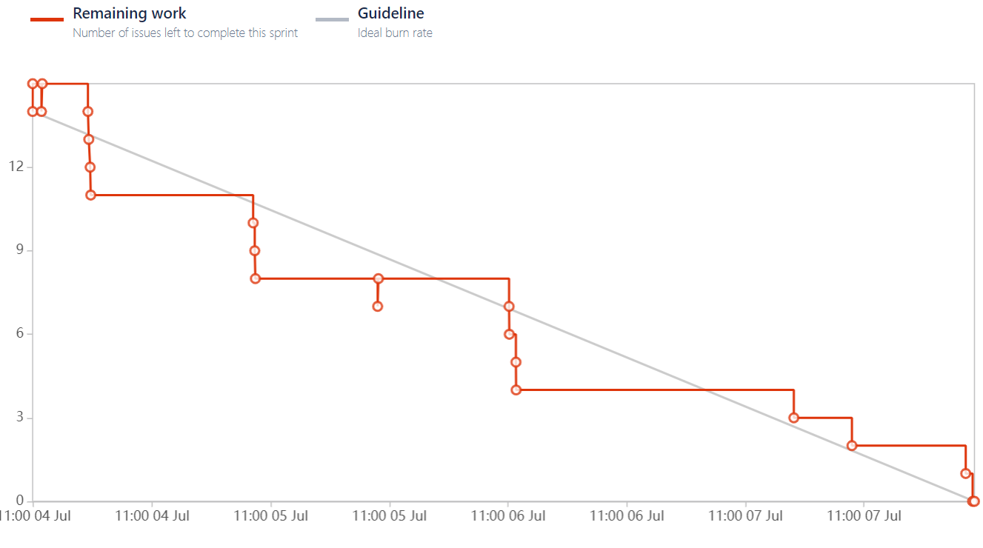
Jira burndown

Slide 3
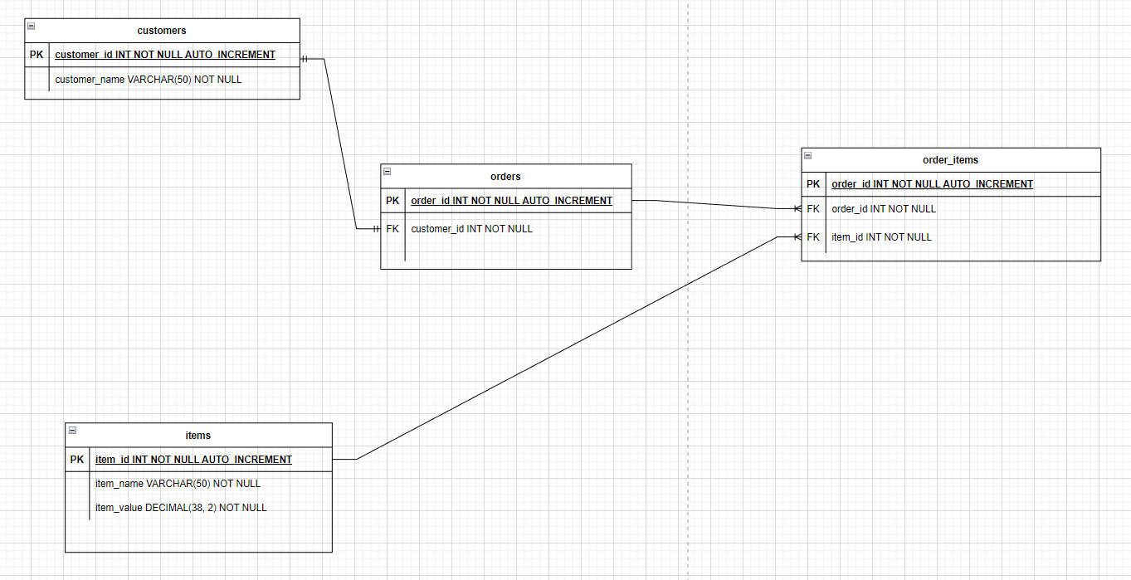
ERD

Slide 4
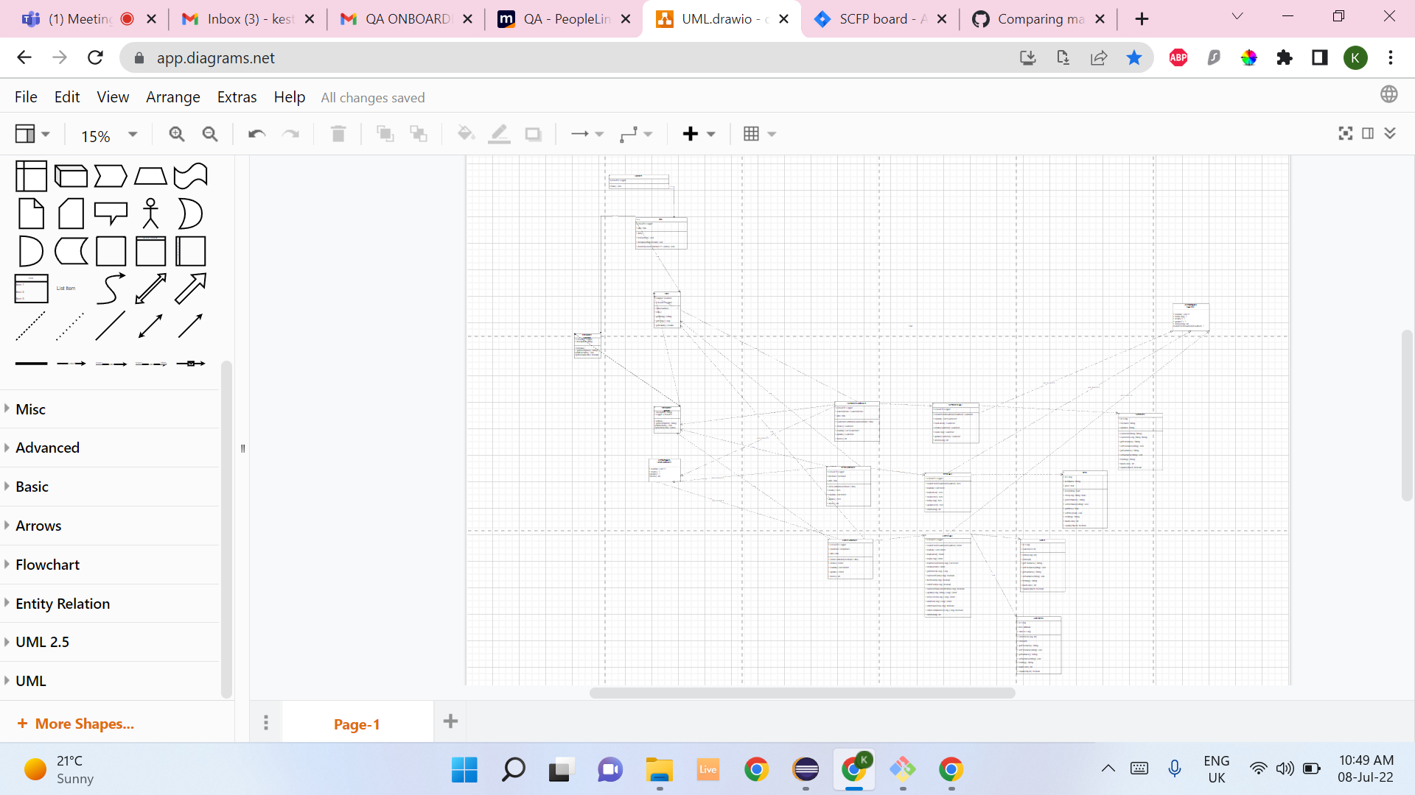
UML

Slide 5
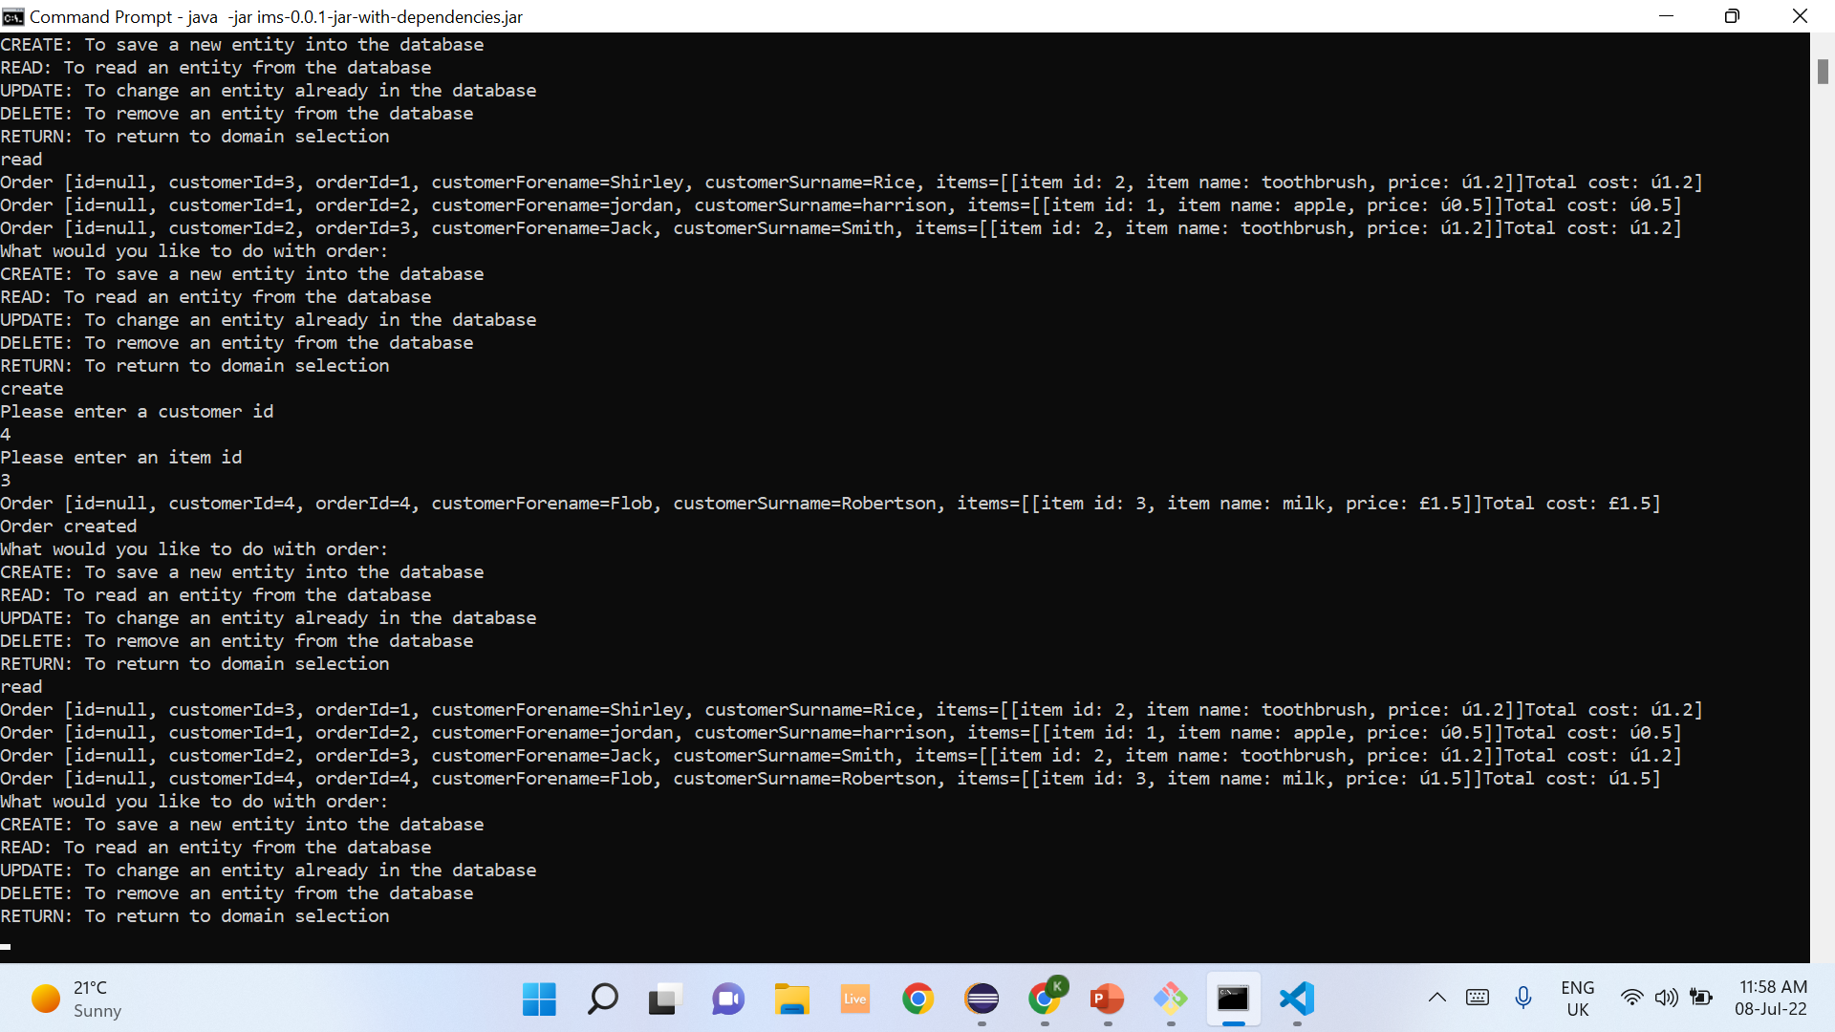
Finished product

Slide 6
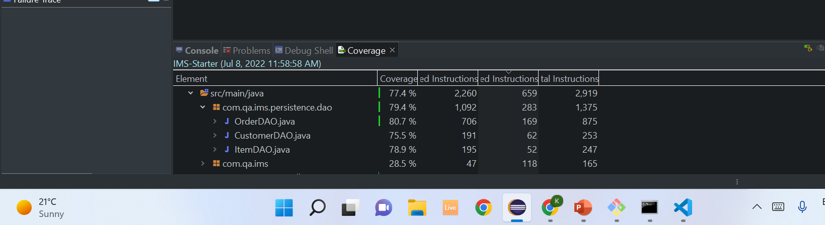
Coverage

Slide 7

Unit tests

Slide 8

Integration tests

