Slide 1
My Practical Project

Slide 2
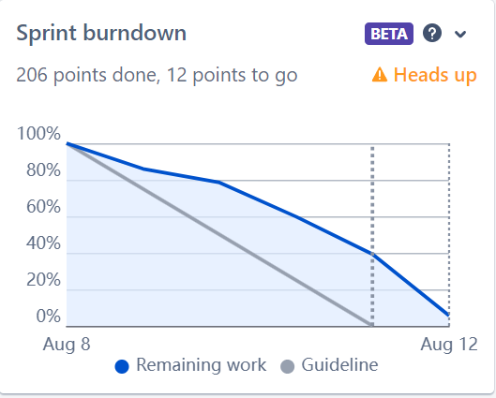
Jira burndown

Slide 3

ERD

Slide 4
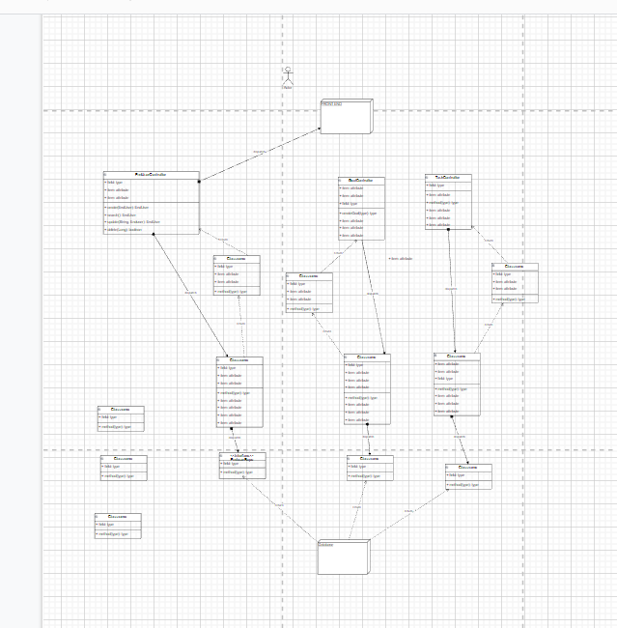
UML

Slide 5
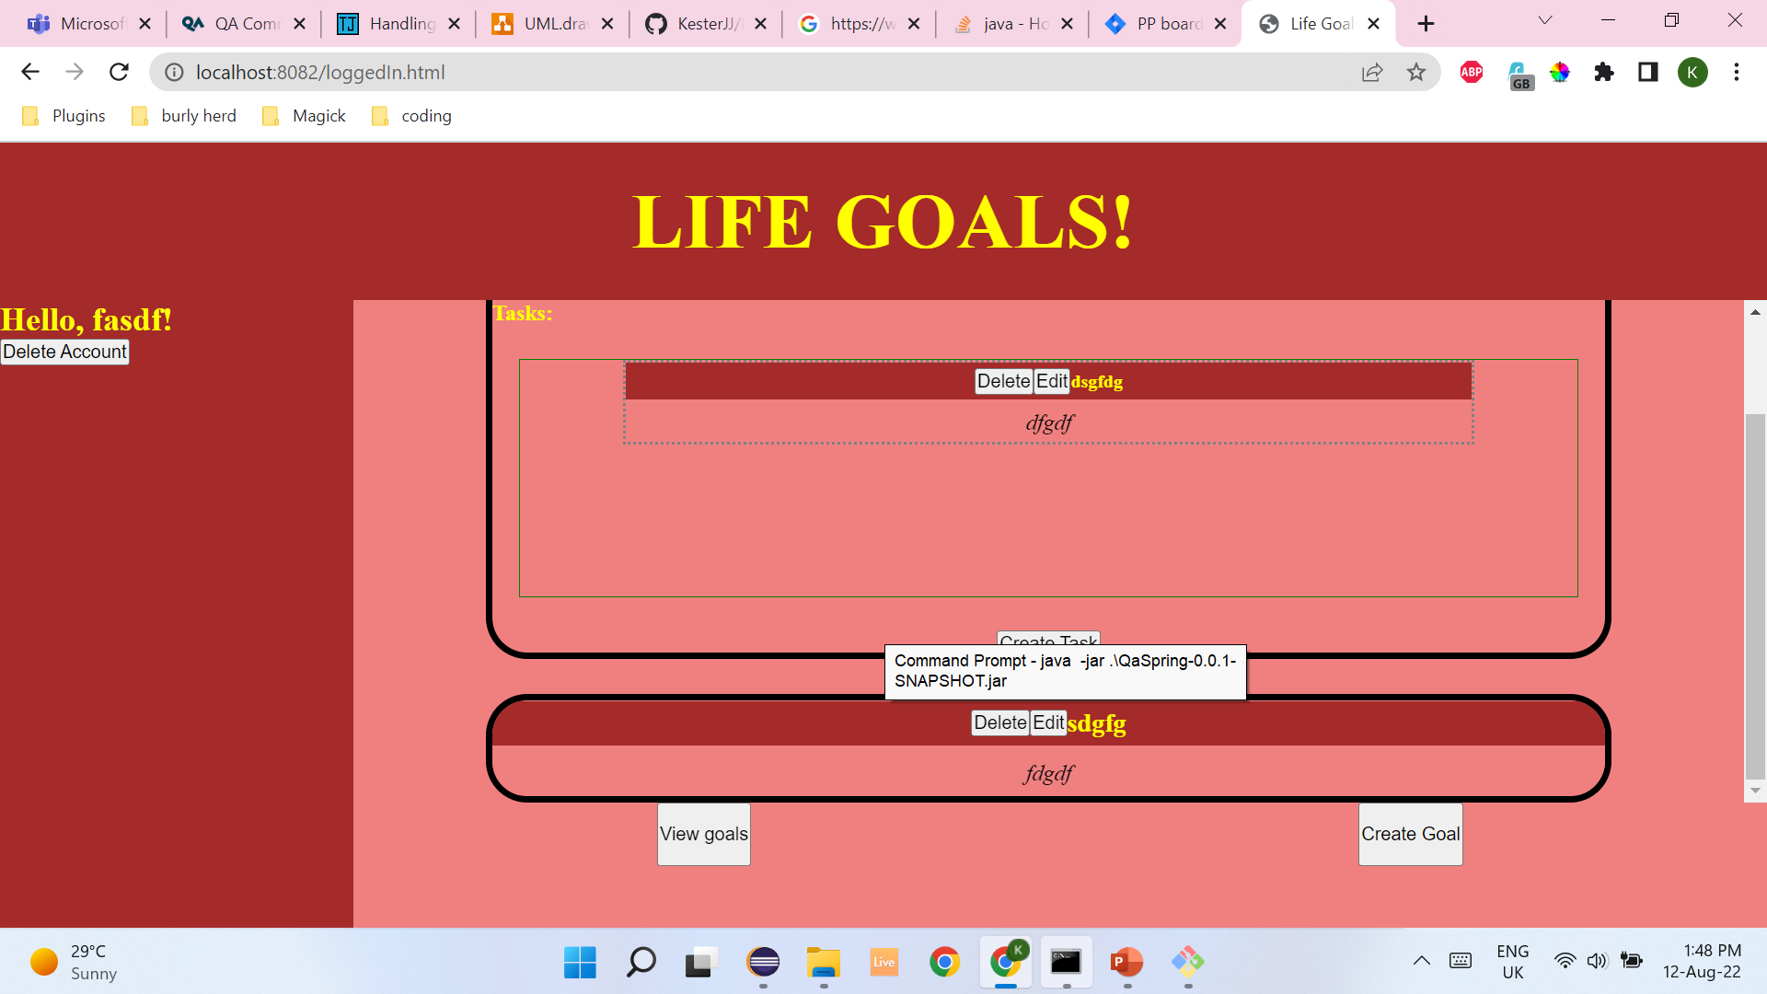
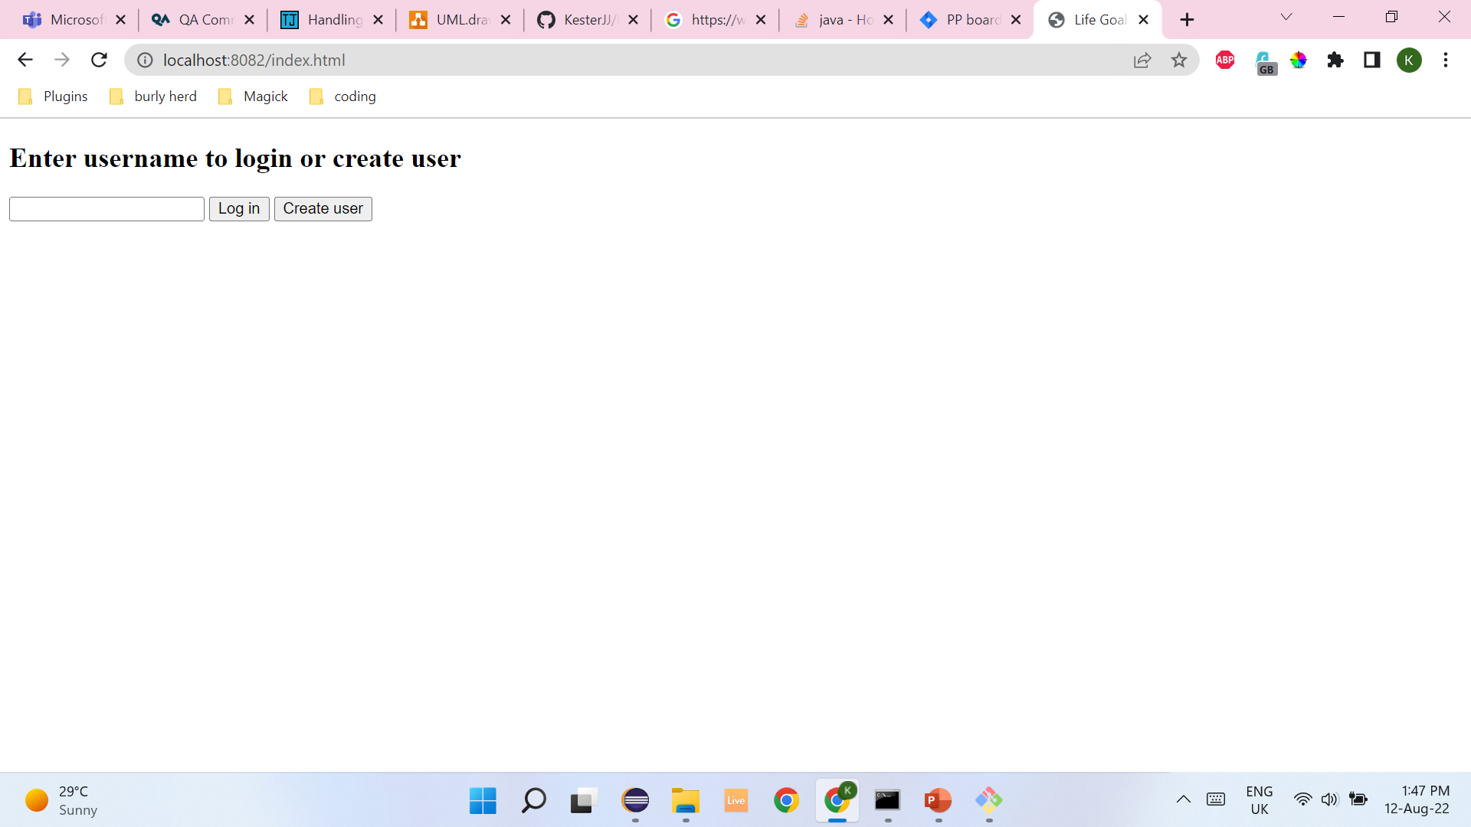
Finished product

Slide 6
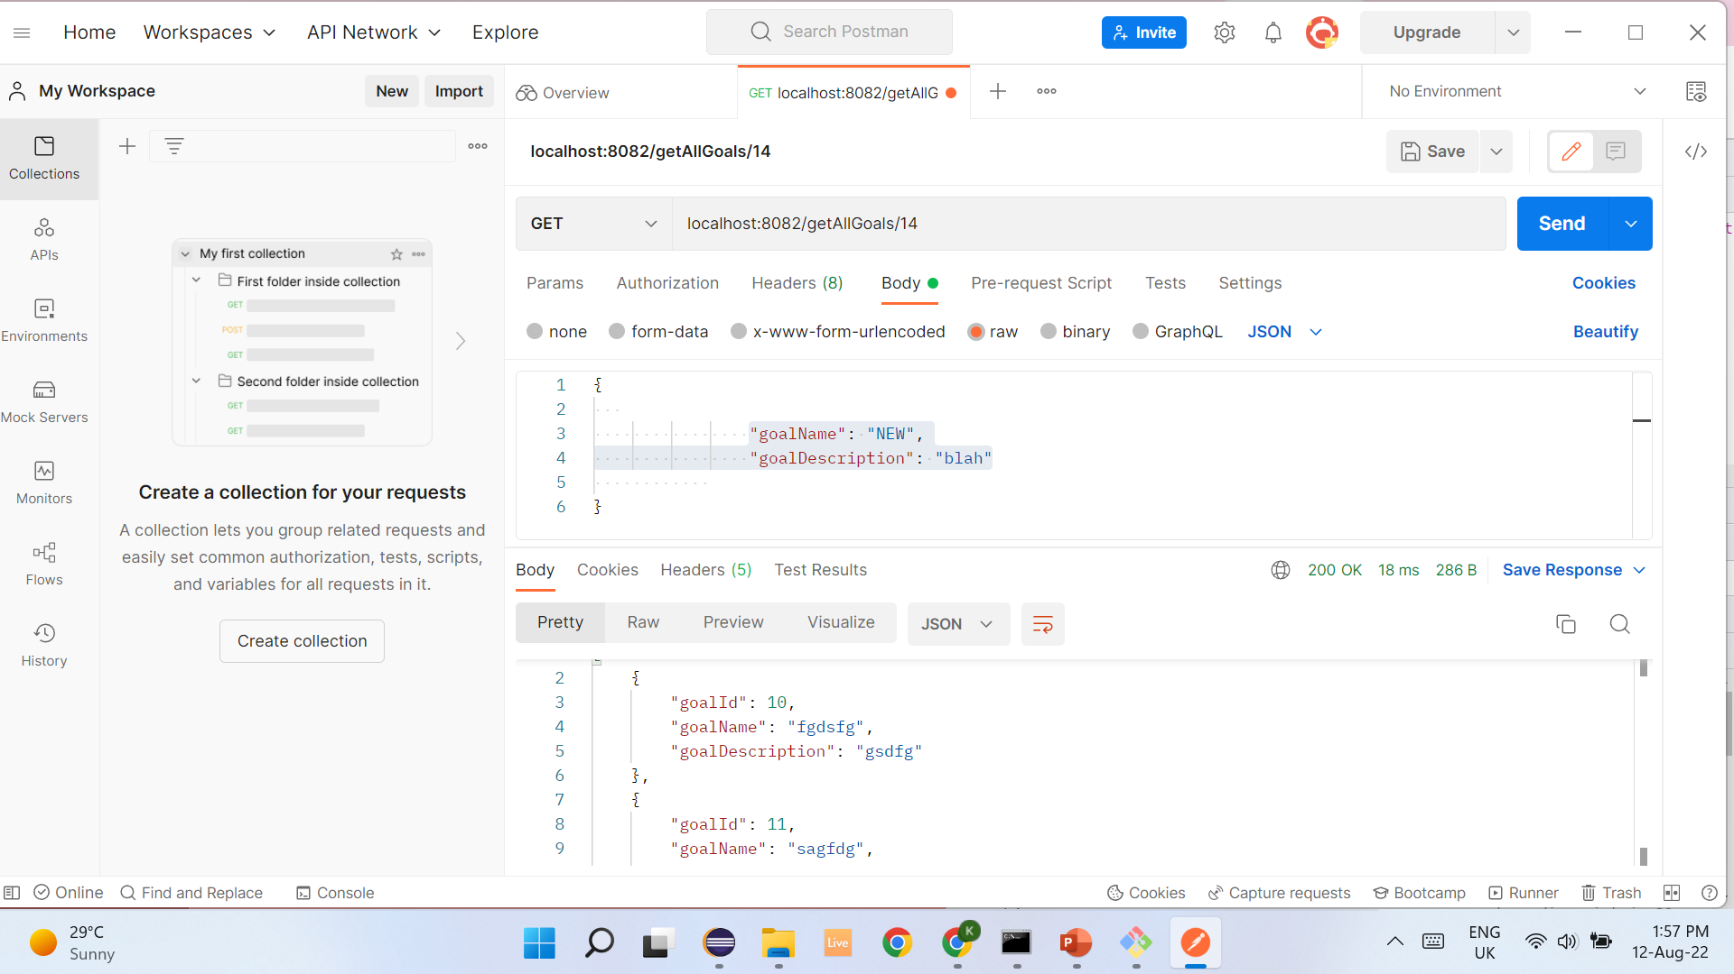
Postman

Slide 7
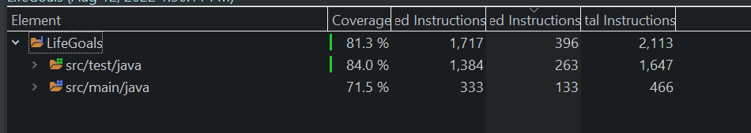
Coverage

Slide 8

Unit tests

Slide 9

Integration tests

Slide 10
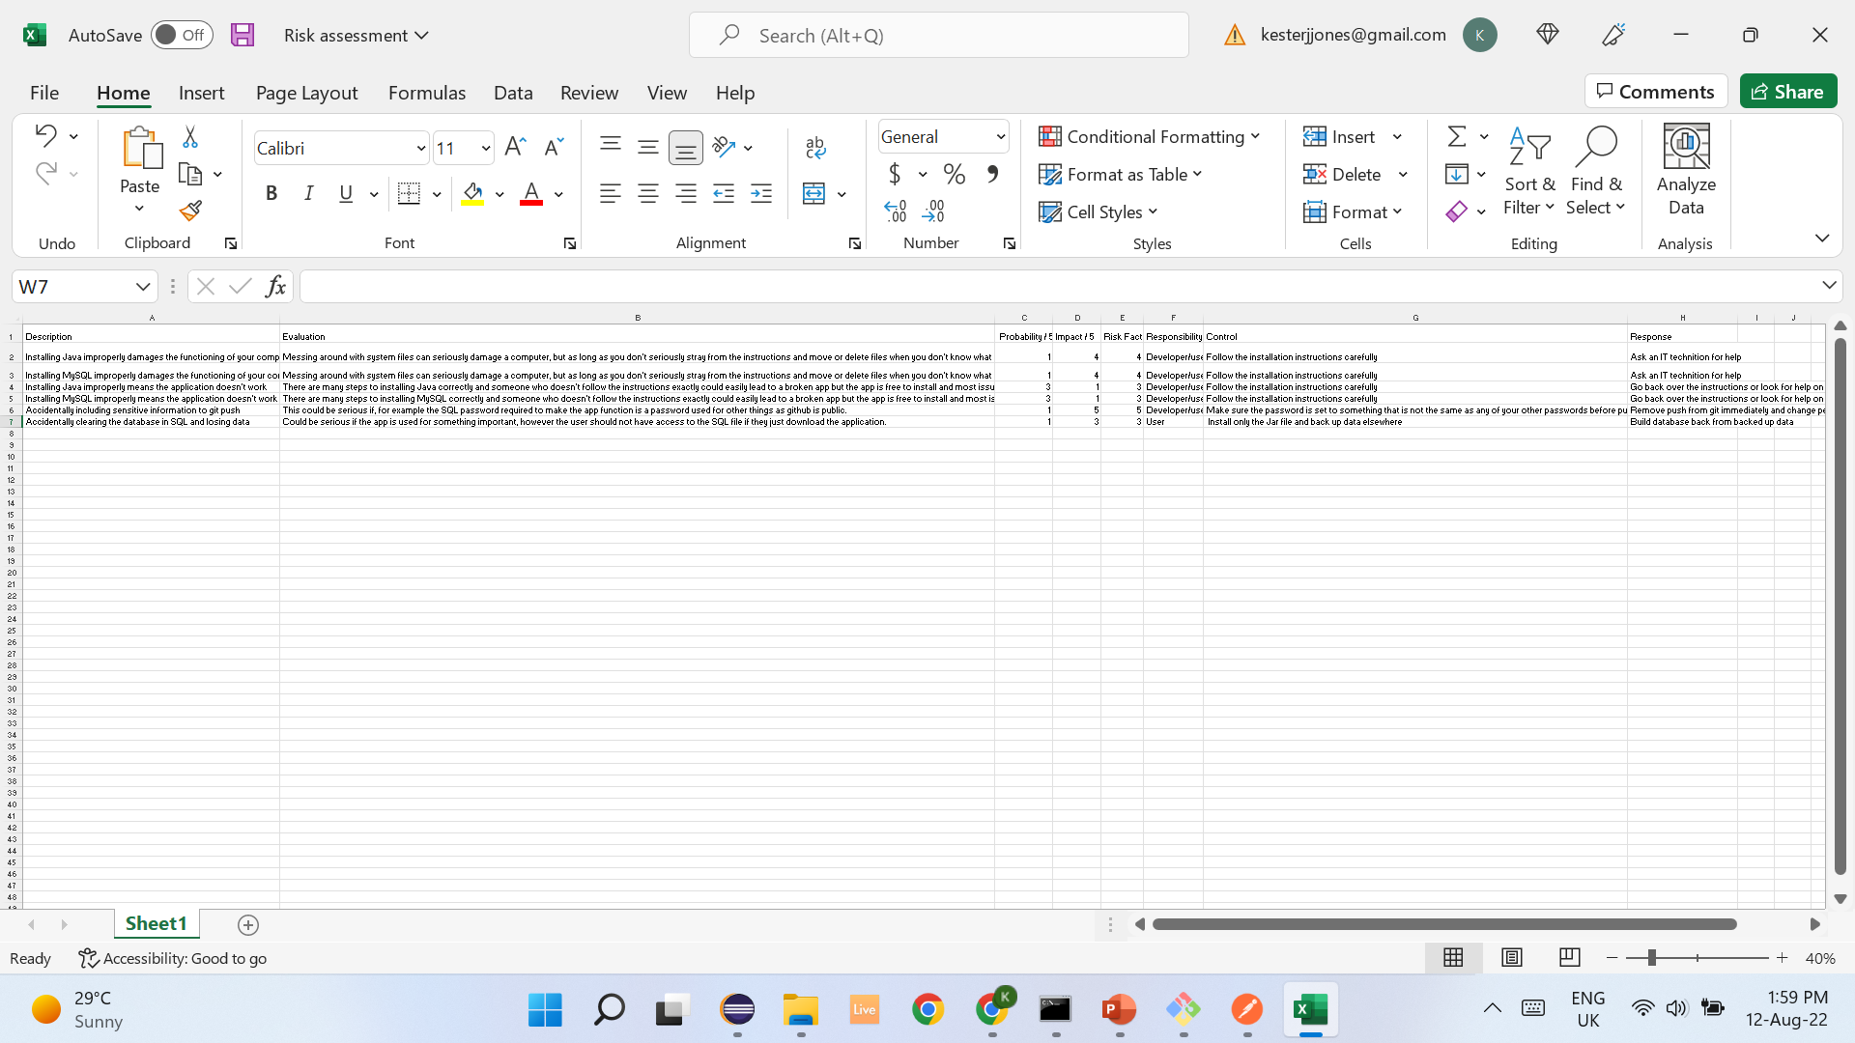
Risk Assessment

