Slide 1
SQL
Pranešėjas: Kęstutis Matavičius
2018 kovas

Slide 2
SQL
SQL is an ANSI (American National Standards Institute) standard, there are different versions of the SQL language.
RDBMS is the basis for SQL, and for all modern database systems such as MS SQL Server, IBM DB2, Oracle, MySQL, and Microsoft Access
RDBMS stands for Relational Database Management System

Slide 3
SQL – kas tai, ką galima daryti?
SQL - stands for Structured Query Language;
SQL can execute queries against a database
SQL can retrieve data from a database
SQL can insert records in a database
SQL can update records in a database
SQL can delete records from a database
SQL can create new databases
SQL can create new tables in a database
SQL can create stored procedures in a database
SQL can create views in a database
SQL can set permissions on tables, procedures, and views

Slide 4
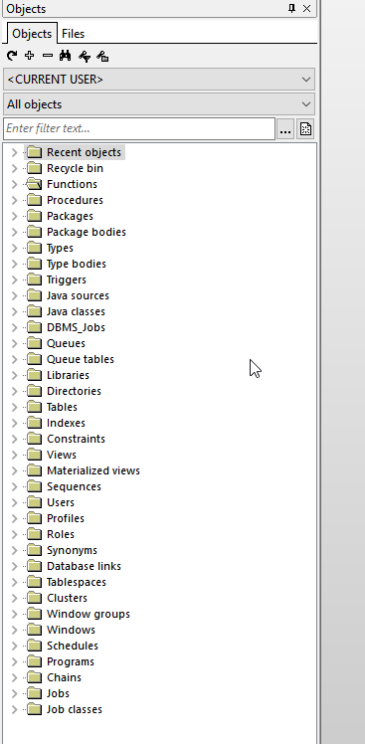
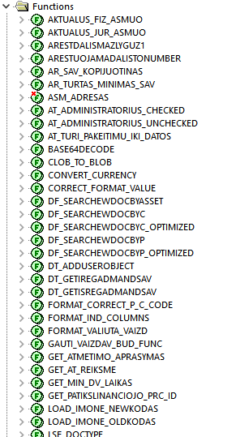
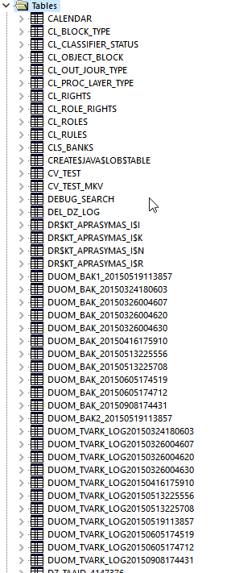
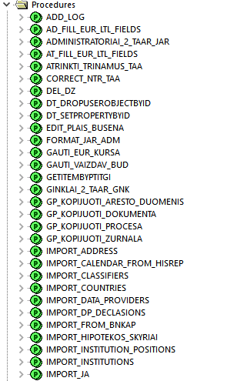
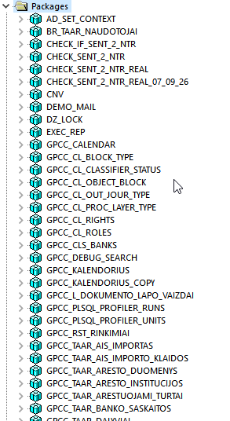
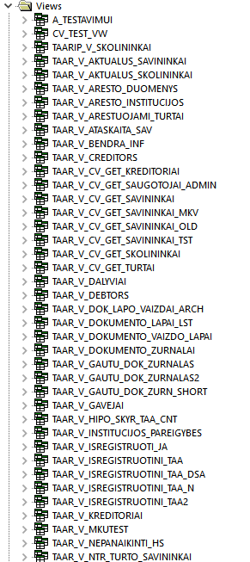
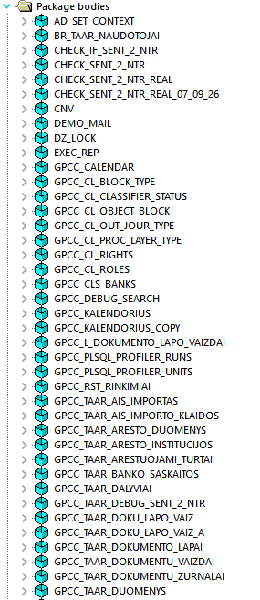
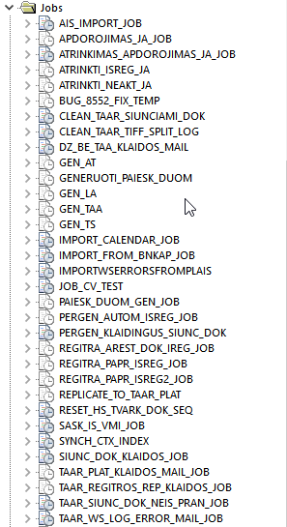
Real DB

Slide 5
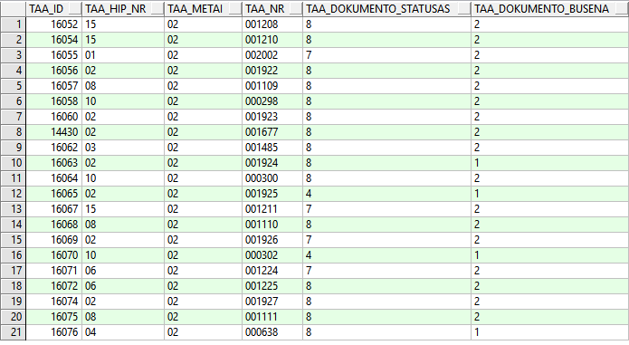
Table

Slide 6
DB – SQL Server
Naudosimės Visual Studio dirbti su DB.
Sukuriame duomenų struktūrą: https://github.com/keidaas/Akademija_SQL.git
Notes:
CREATE TABLE Asmenys
(ID INT,
Vardas VARCHAR(200),
Pavarde VARCHAR(200),
Gimimo_data DATETIME);
CREATE TABLE Vietos
(ID INT,
Miestas VARCHAR(200),
Gyvenviete VARCHAR(100),
Gatve VARCHAR(200),
Namo_Nr NUMERIC,
Buto_Nr NUMERIC,
Asmuo_Id INT);
CREATE TABLE Dokumentai
(ID INT,
Dok_Tipas VARCHAR(200),
Dok_Numeris VARCHAR(100),
Galioja_nuo DATETIME,
Asmuo_Id INT);
insert into Asmenys (ID, Vardas, Pavarde, Gimimo_data) VALUES (1, 'Kęstutis', 'Matavičius','1985-12-12');
insert into Asmenys (ID, Vardas, Pavarde, Gimimo_data) VALUES (2, 'Tomas', 'Tomaitis','1992-05-18');
insert into Asmenys (ID, Vardas, Pavarde, Gimimo_data) VALUES (3, 'Tomas', 'Linas','1990-10-25');
insert into Asmenys (ID, Vardas, Pavarde, Gimimo_data) VALUES (4, 'Darius', 'Gudas','1942-09-21');
insert into Asmenys (ID, Vardas, Pavarde, Gimimo_data) VALUES (5, 'Lina', 'Smulkytė','1999-10-12');
insert into Vietos (ID,Miestas, Gyvenviete, Gatve, Namo_Nr, Buto_Nr, Asmuo_Id) VALUES (1, 'Kaunas', 'Dainava', 'Kovo 11-osios g.',1254, 2547,1);
insert into Vietos (ID,Miestas, Gyvenviete, Gatve, Namo_Nr, Buto_Nr, Asmuo_Id) VALUES (2, 'Kaunas', 'Dainava', 'Tunelio g.',12, 2544,2);
insert into Vietos (ID,Miestas, Gyvenviete, Gatve, Namo_Nr, Buto_Nr, Asmuo_Id) VALUES (4, 'Kaunas', null, 'Savanorių pr.',254, 47,3);
insert into Vietos (ID,Miestas, Gyvenviete, Gatve, Namo_Nr, Buto_Nr, Asmuo_Id) VALUES (3, 'Kaunas', null, 'Gėlių g.',154, 247,4);
insert into Dokumentai (ID, dok_tipas, dok_numeris, galioja_nuo, asmuo_id) VALUES (1,'Pasas', 'LK-784512', '2015-01-25',1);
insert into Dokumentai (ID, dok_tipas, dok_numeris, galioja_nuo, asmuo_id) VALUES (2,'Kortelė', 'LK-741512', '2015-01-25',3);
insert into Dokumentai (ID, dok_tipas, dok_numeris, galioja_nuo, asmuo_id) VALUES (6,'Pasas', 'LK-784589', '2016-03-05',3);
insert into Dokumentai (ID, dok_tipas, dok_numeris, galioja_nuo, asmuo_id) VALUES (3,'Kortelė', 'LK-7512', '2015-01-25',2);
insert into Dokumentai (ID, dok_tipas, dok_numeris, galioja_nuo, asmuo_id) VALUES (4,'Pasas', 'LK-78422', '2015-01-25',4);
insert into Dokumentai (ID, dok_tipas, dok_numeris, galioja_nuo, asmuo_id) VALUES (5,'Pasas', 'LK-78912', '2015-01-25',5);
/**/
https://livesql.oracle.com
https://www.postgresql.org/
https://www.postgresql.org/
https://www.enterprisedb.com/thank-you?anid=209611
https://www.enterprisedb.com/downloads/postgres-postgresql-downloads#windows nrdkma\nrdkma1
https://www.tutorialspoint.com/sql/sql-overview.htm--tutorial
https://drive.google.com/drive/folders/0B2PW1AN6bblkfkVrRno2NERmMUxFU3FuX1BzZjhnalY5RFc2bURWTzB4ak9DWTRBQ2NBa1k
pgadmin
create table "Kestutis".kma4 (ID numeric, vardas varchar(50));
insert into "Kestutis".kma1 (ID, vardas) values (3, 'Pytis');
select hj.* from "Kestutis".kma2 hj where id = 1;
delete from kma1 where id = 1;
drop table kma1;
create table public.kma2 (ID numeric, pavarde varchar(50));
insert into public.kma2 (ID, pavarde) values (1, 'Matavičius');
select kma1.vardas ||' ' || kma2.pavarde from kma1 join kma2 on kma1.id=kma2.id where kma1.id = 1
SELECT *
FROM "Kestutis".kma1 ORDER BY 1 DESC
LIMIT 1;
select hj.id ||' ' ||hj.vardas "Numeris" from "Kestutis".kma1 hj where lower(hj.vardas) LIKE '[p]%'
SELECT *
INTO "Kestutis".kma2
FROM "Kestutis".kma1;
CREATE TABLE Persons (
PersonID int,
LastName varchar(255),
FirstName varchar(255),
Address varchar(255),
City varchar(255)
);
ALTER TABLE "Kestutis".kma2
ALTER column vardas varchar(200);
ALTER TABLE table_name
ALTER COLUMN column_name TYPE datatype;
ALTER TABLE "Kestutis".kma2
ADD labas varchar(10);
ALTER TABLE "Kestutis".kma2
DROP labas;
ALTER TABLE "Kestutis".kma2
ADD CONSTRAINT vardas_constr1 not null (id)
ALTER TABLE Persons
ADD UNIQUE (ID);
CREATE TABLE Personsa (
ID int NOT NULL,
LastName varchar(255) NOT NULL,
FirstName varchar(255),
Age int,
CONSTRAINT PK_Person PRIMARY KEY (ID,LastName)
);
ALTER TABLE table_name
ALTER COLUMN column_name SET NOT NULL;
CREATE TABLE Persons (
ID int NOT NULL,
LastName varchar(255) NOT NULL,
FirstName varchar(255) NOT NULL,
Age int
);
CREATE TABLE Persons1 (
ID int NOT NULL UNIQUE,
LastName varchar(255) NOT NULL,
FirstName varchar(255),
Age int
);
ALTER TABLE "Kestutis".kma3
ADD PRIMARY KEY (ID);
ALTER TABLE "Kestutis".kma4
ADD CONSTRAINT PK_Person PRIMARY KEY (ID);
ALTER TABLE "Kestutis".kma4
DROP PRIMARY KEY;
ALTER TABLE "Kestutis".kma4
DROP CONSTRAINT PK_Person;
CREATE TABLE kma.Orders (
OrderID int NOT NULL,
OrderNumber int NOT NULL,
PersonID int,
PRIMARY KEY (OrderID)
);
CREATE TABLE kma.Persons (
ID int NOT NULL,
LastName varchar(255) NOT NULL,
FirstName varchar(255),
Age int,
PRIMARY KEY (ID)
);
ALTER TABLE kma.Orders
ADD FOREIGN KEY (PersonID) REFERENCES kma.Persons(ID);
ALTER TABLE kma.Orders
ADD CONSTRAINT FK_PersonOrder
FOREIGN KEY (PersonID) REFERENCES Persons(ID);
ALTER TABLE Orders
DROP FOREIGN KEY FK_PersonOrder;
ALTER TABLE kma.Orders
DROP CONSTRAINT FK_PersonOrder;
CREATE TABLE Persons4 (
ID int NOT NULL,
LastName varchar(255) NOT NULL,
FirstName varchar(255),
Age int,
CHECK (Age>=18)
);
CREATE TABLE Persons6 (
ID int NOT NULL,
LastName varchar(255) NOT NULL,
FirstName varchar(255),
Age int,
City varchar(255)
);
ALTER TABLE Persons6
ADD CONSTRAINT CHK_PersonAge CHECK (Age>=18 AND City='Sandnes');
ALTER TABLE Persons
DROP CONSTRAINT CHK_PersonAge;
CREATE TABLE Persons7 (
ID int NOT NULL,
LastName varchar(255) NOT NULL,
FirstName varchar(255),
Age int,
City varchar(255) DEFAULT 'Sandnes'
);
CREATE TABLE Orders (
ID int NOT NULL,
OrderNumber int NOT NULL,
OrderDate date DEFAULT current_date
);
select * from Persons7
ALTER TABLE Persons7
ALTER City SET DEFAULT 'Sandnes';
ALTER TABLE Persons7
ALTER COLUMN City DROP DEFAULT;
CREATE INDEX index_namekma
ON Persons7 (City);
ALTER TABLE Persons7
DROP INDEX index_namekma;
DROP INDEX Persons7.index_namekma;
create view kma_view as select * from "Kestutis".kma2 hj
select * from kma_view
DROP VIEW kma_view;
select id, count(*) from "Kestutis".kma2 group by 1
insert into "Kestutis".kma2 (id) values(4);
CREATE TABLE KMA.Asmenys
(ID NUMERIC,
Vardas VARCHAR(200),
Pavarde VARCHAR(200),
Gimimo_data DATE);
CREATE TABLE KMA.Vietos
(ID NUMERIC,
Miestas VARCHAR(200),
Gyvenviete VARCHAR(100),
Gatve VARCHAR(200),
Namo_Nr NUMERIC,
Buto_Nr NUMERIC,
Asmuo_Id NUMERIC);
CREATE TABLE KMA.Dokumentai
(ID NUMERIC,
Dok_Tipas VARCHAR(200),
Dok_Numeris VARCHAR(100),
Galioja_nuo date,
Asmuo_Id NUMERIC);
insert into KMA.Asmenys (ID, Vardas, Pavarde, Gimimo_data) VALUES (1, 'Kęstutis', 'Matavičius','1985-12-12');
insert into KMA.Asmenys (ID, Vardas, Pavarde, Gimimo_data) VALUES (2, 'Tomas', 'Tomaitis','1992-05-18');
insert into KMA.Asmenys (ID, Vardas, Pavarde, Gimimo_data) VALUES (3, 'Tadas', 'Linas','1990-10-25');
insert into KMA.Asmenys (ID, Vardas, Pavarde, Gimimo_data) VALUES (4, 'Darius', 'Gudas','1942-09-21');
insert into KMA.Asmenys (ID, Vardas, Pavarde, Gimimo_data) VALUES (5, 'Lina', 'Smulkytė','1999-10-12');
insert into KMA.Vietos (ID,Miestas, Gyvenviete, Gatve, Namo_Nr, Buto_Nr, Asmuo_Id) VALUES (1, 'Kaunas', 'Dainava', 'Kovo 11-osios g.',1254, 2547,1);
insert into KMA.Vietos (ID,Miestas, Gyvenviete, Gatve, Namo_Nr, Buto_Nr, Asmuo_Id) VALUES (2, 'Kaunas', 'Dainava', 'Tunelio g.',12, 2544,2);
insert into KMA.Vietos (ID,Miestas, Gyvenviete, Gatve, Namo_Nr, Buto_Nr, Asmuo_Id) VALUES (4, 'Kaunas', '', 'Savanorių pr.',254, 47,3);
insert into KMA.Vietos (ID,Miestas, Gyvenviete, Gatve, Namo_Nr, Buto_Nr, Asmuo_Id) VALUES (3, 'Kaunas', '', 'Gėlių g.',154, 247,4);
insert into KMA.Dokumentai (ID, dok_tipas, dok_numeris, galioja_nuo, asmuo_id) VALUES (1,'Pasas', 'LK-784512', '2015-01-25',1);
insert into KMA.Dokumentai (ID, dok_tipas, dok_numeris, galioja_nuo, asmuo_id) VALUES (2,'Kortelė', 'LK-741512', '2015-01-25',3);
insert into KMA.Dokumentai (ID, dok_tipas, dok_numeris, galioja_nuo, asmuo_id) VALUES (6,'Pasas', 'LK-784589', '2016-03-05',3);
insert into KMA.Dokumentai (ID, dok_tipas, dok_numeris, galioja_nuo, asmuo_id) VALUES (3,'Kortelė', 'LK-7512', '2015-01-25',2);
insert into KMA.Dokumentai (ID, dok_tipas, dok_numeris, galioja_nuo, asmuo_id) VALUES (4,'Pasas', 'LK-78422', '2015-01-25',4);
insert into KMA.Dokumentai (ID, dok_tipas, dok_numeris, galioja_nuo, asmuo_id) VALUES (5,'Pasas', 'LK-78912', '2015-01-25',5);
select * from kma.Asmenys
update kma.Asmenys set id = 4 where vardas = 'Darius'
select * from KMA.Dokumentai order by 1
select asm.Vardas ||' '||asm.Pavarde as Asmuo, dok_tipas from kma.Asmenys asm
join kma.Vietos vt on vt.Asmuo_Id=asm.ID
join kma.Dokumentai dk on dk.asmuo_id=asm.Id
insert into KMA.Dokumentai (ID, dok_tipas, dok_numeris, galioja_nuo, asmuo_id) VALUES (5,'Pasas', 'LK-78912', '2015-01-25',5);
ALTER TABLE kma.Asmenys
ADD UNIQUE (ID);
ALTER TABLE kma.Dokumentai
ADD FOREIGN KEY (Asmuo_ID) REFERENCES kma.Asmenys (ID);

Slide 7
SQL
SQL keywords are NOT case sensitive: select is the same as SELECT
Some database systems require a semicolon at the end of each SQL statement.
Semicolon is the standard way to separate each SQL statement in database systems that allow more than one SQL statement to be executed in the same call to the server.

Slide 8
Some of The Most Important SQL Commands
SELECT - extracts data from a database
UPDATE - updates data in a database
DELETE - deletes data from a database
INSERT INTO - inserts new data into a database
CREATE DATABASE - creates a new database
ALTER DATABASE - modifies a database
CREATE TABLE - creates a new table
ALTER TABLE - modifies a table
DROP TABLE - deletes a table
CREATE INDEX - creates an index (search key)
DROP INDEX - deletes an index

Slide 9


SQL SELECT Statement
The SELECT statement is used to select data from a database.

Slide 10

SQL SELECT DISTINCT Statement
The SELECT DISTINCT statement is used to return only distinct (different) values.

Slide 11

SQL WHERE Clause
The WHERE clause is used to filter records

Slide 12
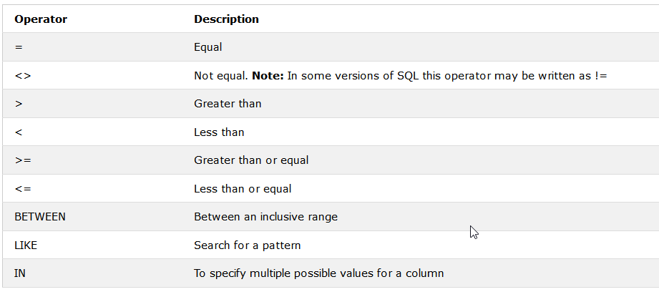
Operators in The WHERE Clause

Slide 13


SQL AND and OR Operators
The AND and OR operators are used to filter records based on more than one condition
The AND operator displays a record if all the conditions separated by AND is TRUE.
The OR operator displays a record if any of the conditions separated by OR is TRUE.

Slide 14


Combining AND and OR
You can also combine the AND and OR operators.

Slide 15

SQL ORDER BY Keyword
The ORDER BY keyword is used to sort the result-set in ascending or descending order.
The ORDER BY keyword sorts the records in ascending order by default. To sort the records in descending order, use the DESC keyword.

Slide 16


SQL INSERT INTO Statement
The INSERT INTO statement is used to insert new records in a table.

Slide 17

SQL UPDATE Statement
The UPDATE statement is used to update existing records in a table.
To update more than one column, use a comma as seperator.
In an update statement, it is the WHERE clause that determines how many records which will be updated.

Slide 18

SQL DELETE Statement
The DELETE statement is used to delete rows in a table

Slide 19
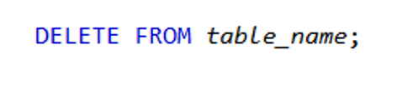
Delete All Data
It is possible to delete all rows in a table without deleting the table. This means that the table structure, attributes, and indexes will be intact.

Slide 20
The SQL SELECT TOP Clause
The SELECT TOP clause is used to specify the number of records to return
The SELECT TOP clause can be very useful on large tables with thousands of records. Returning a large number of records can impact on performance.

Slide 21

SQL LIKE Operator
The LIKE operator is used in a WHERE clause to search for a specified pattern in a column.

Slide 22
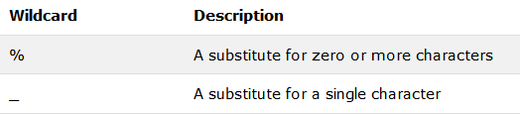
SQL Wildcard Characters
In SQL, wildcard characters are used with the SQL LIKE operator

Slide 23

SQL IN Operator
The IN operator allows you to specify multiple values in a WHERE clause.

Slide 24

SQL BETWEEN Operator
The BETWEEN operator is used to select values within a range.
The BETWEEN operator selects values within a range. The values can be numbers, text, or dates.

Slide 25


SQL Aliases
SQL aliases are used to give a database table, or a column in a table, a temporary name.

Slide 26


NULL
A field with a NULL value is a field with no value

Slide 27
Užduotys
Atrinkite asmenų pavardę ir gimimo datą, kurių vardas Tomas;
Iš lentelės Asmenys atrinkite įrašus, kurie tenkina šias sąlygas:
asmens varde yra raidė a, nesvarbu didžioji ar mažoji;
pavardėje yra raidė i;
gimimo data tarp 1985-01-05 ir 1999-12-10;
Atrinkite asmenis, kurių vardas Tomas arba jų pavardė prasideda raide G.

Slide 28
Different SQL Joins
SQL joins are used to combine rows from two or more tables.
INNER JOIN: Returns all rows when there is at least one match in BOTH tables
LEFT JOIN: Return all rows from the left table, and the matched rows from the right table
RIGHT JOIN: Return all rows from the right table, and the matched rows from the left table
FULL JOIN: Return all rows when there is a match in ONE of the tables

Slide 29
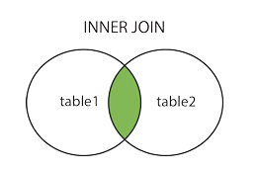


SQL INNER JOIN
The INNER JOIN keyword selects all rows from both tables as long as there is a match between the columns in both tables.

Slide 30
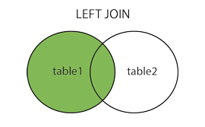


SQL LEFT JOIN
The LEFT JOIN keyword returns all rows from the left table (table1), with the matching rows in the right table (table2). The result is NULL in the right side when there is no match.

Slide 31
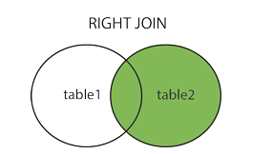


SQL RIGHT JOIN
The RIGHT JOIN keyword returns all rows from the right table (table2), with the matching rows in the left table (table1). The result is NULL in the left side when there is no match.

Slide 32
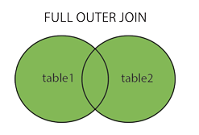

SQL FULL OUTER JOIN
The FULL OUTER JOIN keyword returns all rows from the left table (table1) and from the right table (table2).
The FULL OUTER JOIN keyword combines the result of both LEFT and RIGHT joins.

Slide 33
Užduotis
Atrinkite vardus asmenų, kurie nenurodė gyvenamosios vietos.
Atrinkite asmenis, kurie gyvena Gėlių gatvėje ir turi kortelę.
Atrinkite asmens dokumento numerį, kuris neturi nurodytos gyvenamosios vietos.

Slide 34


SQL UNION Operator
The SQL UNION operator combines the result of two or more SELECT statements.
Notice that each SELECT statement within the UNION must have the same number of columns. The columns must also have similar data types. Also, the columns in each SELECT statement must be in the same order.
The UNION operator selects only distinct values by default. To allow duplicate values, use the ALL keyword with UNION.

Slide 35

SQL INTERSECT Operator
The SQL INTERSECT clause/operator is used to combine two SELECT statements, but returns rows only from the first SELECT statement that are identical to a row in the second SELECT statement. This means INTERSECT returns only common rows returned by the two SELECT statements.

Slide 36

SQL EXCEPT Operator
The query returns all rows in the first query that are not returned in the second query.

Slide 37

The SQL SELECT INTO
The SELECT INTO statement selects data from one table and inserts it into a new table.

Slide 38
SQL DROP TABLE
The DROP TABLE statement is used to drop an existing table in a database.

Slide 39

SQL TRUNCATE TABLE
The TRUNCATE TABLE statement is used to delete the data inside a table, but not the table itself.

Slide 40



SQL ALTER TABLE
The ALTER TABLE statement is used to add, delete, or modify columns in an existing table.
The ALTER TABLE statement is also used to add and drop various constraints on an existing table.

Slide 41
Užduotis
Atrinkite asmens vardą ir pavardę, kurie turi ir pasą ir kortelę.

Slide 42
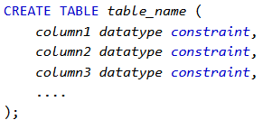
SQL Constraints
Constraints can be specified when the table is created with the CREATE TABLE statement, or after the table is created with the ALTER TABLE statement.

Slide 43
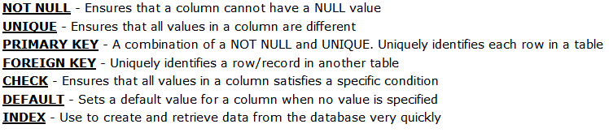
SQL Constraints
SQL constraints are used to specify rules for the data in a table.
Constraints are used to limit the type of data that can go into a table. This ensures the accuracy and reliability of the data in the table. If there is any violation between the constraint and the data action, the action is aborted.
Constraints can be column level or table level. Column level constraints apply to a column, and table level constraints apply to the whole table.

Slide 44
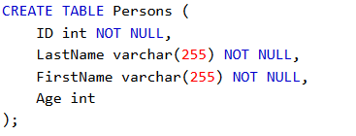

SQL NOT NULL Constraint
By default, a column can hold NULL values. The NOT NULL constraint enforces a column to NOT accept NULL values.
The NOT NULL constraint enforces a field to always contain a value. This means that you cannot insert a new record, or update a record without adding a value to this field.

Slide 45
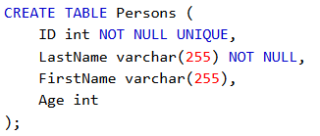
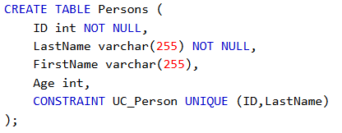

SQL UNIQUE Constraint
The UNIQUE constraint ensures that all values in a column are different.
Both the UNIQUE and PRIMARY KEY constraints provide a guarantee for uniqueness for a column or set of columns.
A PRIMARY KEY constraint automatically has a UNIQUE constraint.
However, you can have many UNIQUE constraints per table, but only one PRIMARY KEY constraint per table.

Slide 46
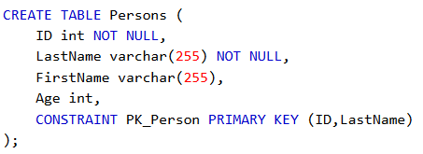



SQL PRIMARY KEY Constraint
The PRIMARY KEY constraint uniquely identifies each record in a database table.
Primary keys must contain UNIQUE values, and cannot contain NULL values.
A table can have only one primary key, which may consist of single or multiple fields.

Slide 47
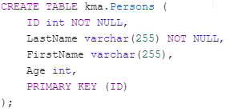
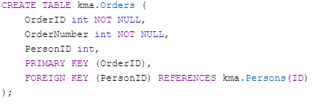


SQL FOREIGN KEY Constraint
A FOREIGN KEY is a key used to link two tables together.
A FOREIGN KEY in a table points to a PRIMARY KEY in another table.

Slide 48

DROP a FOREIGN KEY

Slide 49
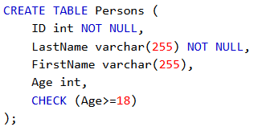
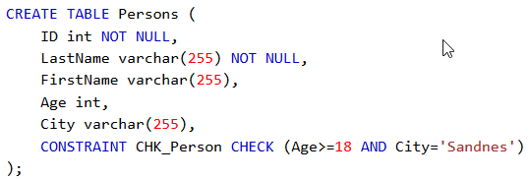

SQL CHECK Constraint
The CHECK constraint is used to limit the value range that can be placed in a column.
If you define a CHECK constraint on a single column it allows only certain values for this column.
If you define a CHECK constraint on a table it can limit the values in certain columns based on values in other columns in the row.

Slide 50
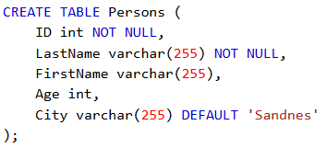
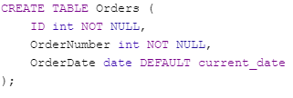

SQL DEFAULT Constraint
The DEFAULT constraint is used to provide a default value for a column.
The default value will be added to all new records IF no other value is specified.

Slide 51

SQL CREATE INDEX Statement
The CREATE INDEX statement is used to create indexes in tables.
Indexes are used to retrieve data from the database very fast. The users cannot see the indexes, they are just used to speed up searches/queries.
Updating a table with indexes takes more time than updating a table without (because the indexes also need an update). So, only create indexes on columns that will be frequently searched against.

Slide 52

SQL CREATE VIEW Statement
In SQL, a view is a virtual table based on the result-set of an SQL statement.
A view contains rows and columns, just like a real table. The fields in a view are fields from one or more real tables in the database.
You can add SQL functions, WHERE, and JOIN statements to a view and present the data as if the data were coming from one single table.

Slide 53
Užduotis
1. Pateikite skriptą, kuris sukurtų trijų lentelių schemą pasirinkta tema. Kuriant schemą būtų panaudota:
Trys Primary key 3t.
Du Foreign Key 2t.
Check constraint, po lentelės sukūrimo 1t.
Default constraint 1t.
Not null constraint, lentelės kūrimo metu 1t.
2. Sukurtai schemai pateikti užklausas:
Pateikti insert sakinių, pradinių duomenų užpildymui 3t.
Užklausa su where sąlyga, kuri pademonstruotų AND, OR operatorių naudojimą 2t.
Užklausą, kuri demonstruotų <> ir IN naudojimą 2t.
Užklausą, kuri parodytų kaip veikia bet kuri iš join operacijų 2t.
3. Pasidomėti GROUP BY užklausa, pateikti pvz. savo sukurtai schemai. 5t.
4. Pateikti sukurtų duomenų sunaikinimo skriptą. 5t.

Slide 54
https://www.w3schools.com/sql/sql_null_values.asp

