Slide 1
ASP.NET Web API
Pranešėjas: Kęstutis Matavičius
2018 balandis

Slide 2
ASP.NET Web API
ASP.NET Web API is a framework for building HTTP services that can be accessed from any client including browsers and mobile devices.
Notes:
REST is the underlying architectural principle of the web.

Slide 3
What is Web API?
API - Application Programing Interface.
API is some kind of interface which has a set of functions that allow programmers to access specific features or data of an application, operating system or other services.
API over the web which can be accessed using HTTP protocol.
It is a concept and not a technology. We can build Web API using different technologies such as Java, .NET etc.

Slide 4
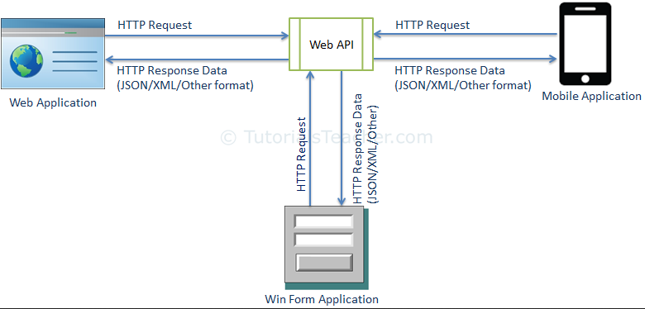
ASP.NET Web API
The ASP.NET Web API is an extensible framework for building HTTP based services that can be accessed in different applications on different platforms such as web, windows, mobile etc. It works more or less the same way as ASP.NET MVC web application except that it sends data as a response instead of html view. It is like a webservice or WCF service but the exception is that it only supports HTTP protocol.

Slide 5
ASP.NET Web API Characteristics
ASP.NET Web API is an ideal platform for building RESTful services.
ASP.NET Web API is built on top of ASP.NET and supports ASP.NET request/response pipeline.
ASP.NET Web API maps HTTP verbs to method names.
ASP.NET Web API supports different formats of response data. Built-in support for JSON, XML, BSON format.

Slide 6
Web API Controller
We created Web API with MVC project in the previous section where it generated a simple controller. Here, you will learn about Web API Controller in detail.
Web API Controller is similar to ASP.NET MVC controller. It handles incoming HTTP requests and send response back to the caller.
Web API controller is a class which can be created under the Controllers folder or any other folder under your project's root folder. The name of a controller class must end with "Controller" and it must be derived from Microsoft.AspNetCore.Mvc.Controller class. All the public methods of the controller are called action methods.

Slide 7
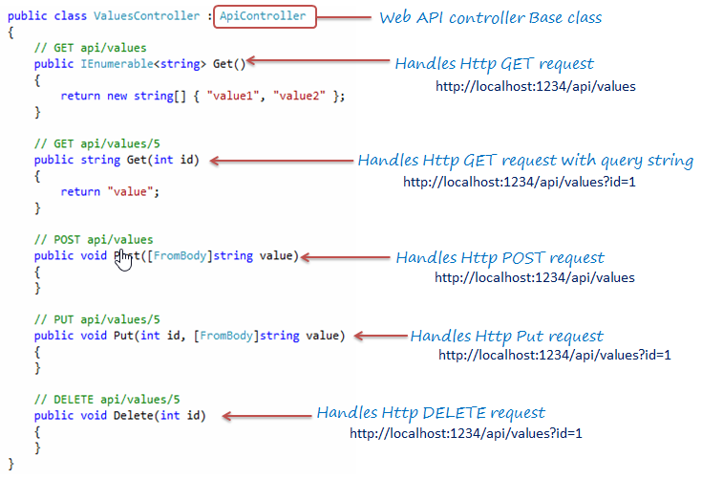
Web API Controller
Notes:
As you can see in the above example, ValuesController class is derived from ApiController and includes multiple action methods whose names match with HTTP verbs like Get, Post, Put and Delete.
Based on the incoming request URL and HTTP verb (GET/POST/PUT/PATCH/DELETE), Web API decides which Web API controller and action method to execute e.g. Get() method will handle HTTP GET request, Post() method will handle HTTP POST request, Put() mehtod will handle HTTP PUT request and Delete() method will handle HTTP DELETE request for the above Web API.
The following figure illustrates the significance of Web API controller and action methods.

Slide 8
Test Web API
Fiddler
Postman
Notes:
http://www.tutorialsteacher.com/webapi/test-web-api

Slide 9
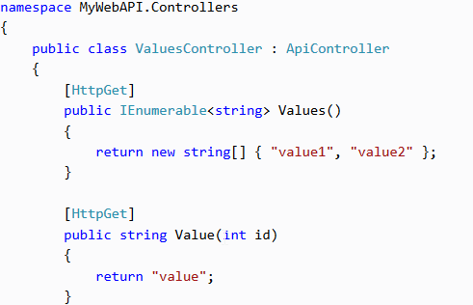
Web API Controller
If you want to write methods that do not start with an HTTP verb then you can apply the appropriate http verb attribute on the method such as HttpGet, HttpPost, HttpPut etc. same as MVC controller.

Slide 10
Web API Controller Characteristics
It must be derived from Controller class.
It can be created under any folder in the project's root folder. However, it is recommended to create controller classes in the Controllers folder as per the convention.
Action method name can be the same as HTTP verb name or it can start with HTTP verb with any suffix (case in-sensitive) or you can apply Http verb attributes to method.
Return type of an action method can be any primitive or complex type.

Slide 11
Action Method Naming Conventions
HTTP Request Method | Possible Web API Action Method Name | Usage
GET | Get() get() GET() GetAllStudent() *any name starting with Get * | Retrieves data.
POST | Post() post() POST() PostNewStudent() *any name starting with Post* | Inserts new record.
PUT | Put() put() PUT() PutStudent() *any name starting with Put* | Updates existing record.
DELETE | Delete() delete() DELETE() DeleteStudent() *any name starting with Delete* | Deletes record.
Notes:
Gali būti ir kitaip
otherwise apply http verbs attribute

Slide 12
Web API Routing
Web API routing is similar to ASP.NET MVC Routing.
It routes an incoming HTTP request to a particular action method on a Web API controller.
Web API supports two types of routing
Convention-based Routing
Attribute Routing

Slide 13
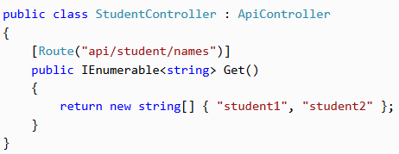
Attribute Routing
Attribute routing is supported in Web API 2. As the name implies, attribute routing uses [Route()] attribute to define routes. The Route attribute can be applied on any controller or action method.
Notes:
In the above example, the Route attribute defines new route "api/student/names" which will be handled by the Get() action method of StudentController. Thus, an HTTP GET request http://localhost:1234/api/student/names will return list of student names.

Slide 14
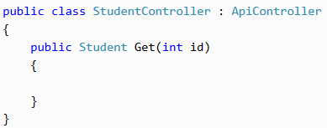
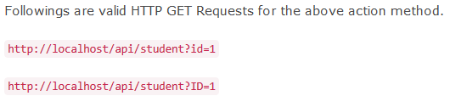
Get Action Method with Primitive Parameter
Notes:
As you can see above Get action method includes id parameter of int type. So, Web API will try to extract the value of id from the query string of requested URL, convert it into int and assign it to id parameter of Get action method. For example, if an HTTP request is http://localhost/api/student?id=1 then value of id parameter will be 1.
Followings are valid HTTP GET Requests for the above action method.
http://localhost/api/student?id=1
http://localhost/api/student?ID=1

Slide 15
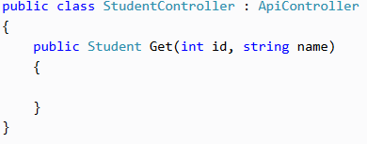
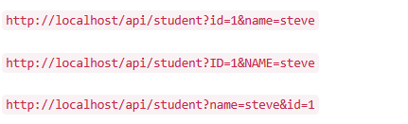
Get Action Method with Multiple Primitive Parameters
Notes:
As you can see above, Get method includes multiple primitive type parameters. So, Web API will try to extract the values from the query string of request URL. For example, if an HTTP request is http://localhost/api/student?id=1&name=steve then value of id parameter will be 1 and name will be "steve".
Followings are valid HTTP GET Requests for the above action method.
http://localhost/api/student?id=1&name=steve
http://localhost/api/student?ID=1&NAME=steve
http://localhost/api/student?name=steve&id=1

Slide 16
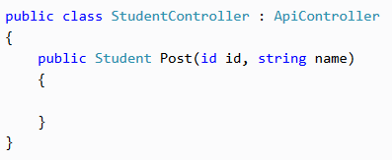
POST Action Method with Primitive Parameter
HTTP POST request is used to create new resource. It can include request data into HTTP request body and also in query string.
Notes:
As you can see above, Post() action method includes primitive type parameters id and name. So, by default, Web API will get values from the query string. For example, if an HTTP POST request is http://localhost/api/student?id=1&name=steve then the value of id will be 1 and name will be "steve" in the above Post() method.

Slide 17
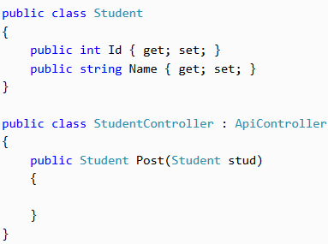
POST Action Method with Complex Parameter
The above Post() method includes Student type parameter. So, as a default rule, Web API will try to get the values of stud parameter from HTTP request body.

Slide 18
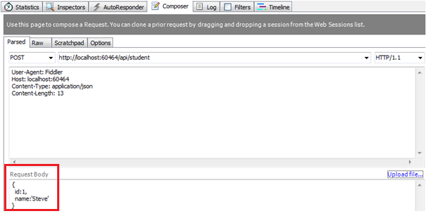
Post Method with Complex Type Parameter
Following is a valid HTTP POST request in the fiddler for the above action method.
Notes:
Web API will extract the JSON object from the Request body above and convert it into Student object automatically because names of JSON object properties matches with the name of Student class properties (case-insensitive).

Slide 19
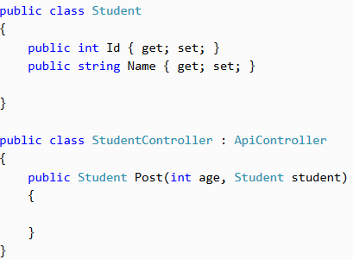
POST Method with Mixed Parameters
Post action method can include primitive and complex type parameters.
Notes:
Consider the following example.

Slide 20
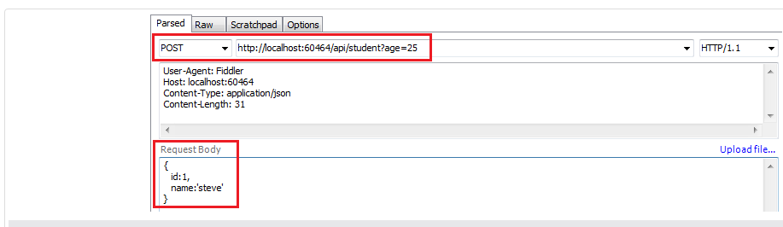
POST Method with Mixed Parameters
Notes:
The above Post method includes both primitive and complex type parameter. So, by default , Web API will get the id parameter from query string and student parameter from the request body.
Following is a valid HTTP POST request in the fiddler for the above action method.

Slide 21
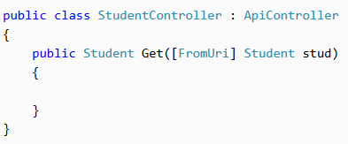
[FromUri] and [FromBody]
Use [FromUri] attribute to force Web API to get the value of complex type from the query string and [FromBody] attribute to get the value of primitive type from the request body, opposite to the default rules.
Notes:
In the above example, Get method includes complex type parameter with [FromUri] attribute. So, Web API will try to get the value of Student type parameter from the query string. For example, if an HTTP GET request http://localhost:xxxx/api/student?id=1&name=steve then Web API will create Student object and set its id and name property values to the value of id and name query string.

Slide 22
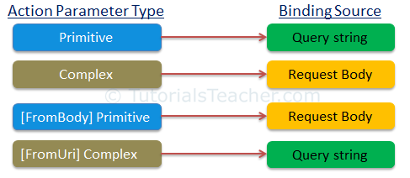
Parameter binding rules

Slide 23
Action Method Return Type
The Web API action method can have following return types.
Void;
Primitive type or Complex type;
HttpResponseMessage;
IActionResult;

Slide 24
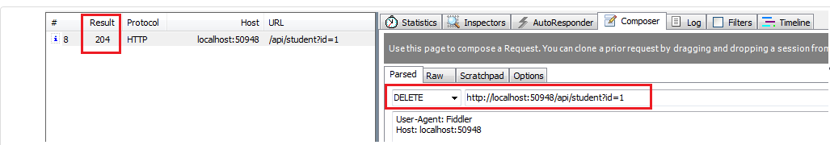
Void
It's not necessary that all action methods must return something. It can have void return type.
Notes:
As you can see above Delete action method returns void. It will send 204 "No Content" status code as a response when you send HTTP DELETE request as shown below.

Slide 25
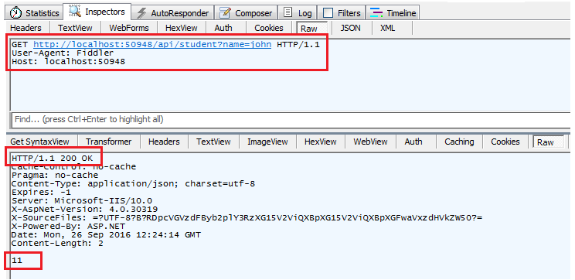
Primitive or Complex Type
An action method can return primitive or other custom complex types as other normal methods.
Notes:
// GET api/values
public string GetId( int Id)
{
return "Kęstas";
//return new string[] { "value1", "value2" };
}
public Types.Student GetStudent( string name)
{
return new Types.Student {Id = 2, Vardas = "KMA" };
//return new string[] { "value1", "value2" };
}

Slide 26
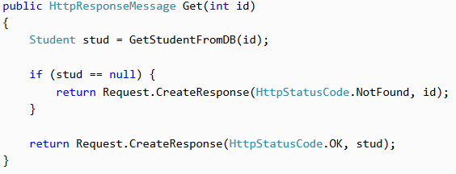
HttpResponseMessage
Web API controller always returns an object of HttpResponseMessage to the hosting infrastructure.
Notes:
In the above action method, if there is no student with specified id in the DB then it will return HTTP 404 Not Found status code, otherwise it will return 200 OK status with student data.
public HttpResponseMessage Get(int id) { Student stud = GetStudentFromDB(id); if (stud == null) { return Request.CreateResponse(HttpStatusCode.NotFound, id); } return Request.CreateResponse(HttpStatusCode.OK, stud); }
[HttpGet]
public HttpResponseMessage kmaApi(int id) {
if (id == 1)
{
return Request.CreateResponse(HttpStatusCode.NotFound, id);
}
else
{
return Request.CreateResponse(HttpStatusCode.OK, new Person { Vardas = "Kęstutis", Pavarde = "Matavičius"});
}
}

Slide 27
IActionResult
An action method in Web API can return an implementation of IActionResult class.
You can create your own class that implements IActionResult or use various methods of Controller class that returns an object that implement the IActionResult.
Notes:
public IHttpActionResult Get(int id) { Student stud = GetStudentFromDB(id); if (stud == null) { return NotFound(); } return Ok(stud); }
In the above example, if student with specified id does not exists in the database then it will return response with the status code 404 otherwise it sends student data with status code 200 as a response. As you can see, we don't have to write much code because NotFound() and Ok() method does it all for us.
You can create your own class that implements IHttpActionResult or use various methods of ApiController class that returns an object that implement the IHttpActionResult.

Slide 28
Media Type
Media type specifies the format of the data as type/subtype e.g. text/html, text/xml, application/json, image/jpeg etc.
In HTTP request, MIME type is specified in the request header using Accept and Content-Type attribute. The Accept header attribute specifies the format of response data which the client expects and the Content-Type header attribute specifies the format of the data in the request body so that receiver can parse it into appropriate format.

