Slide 1
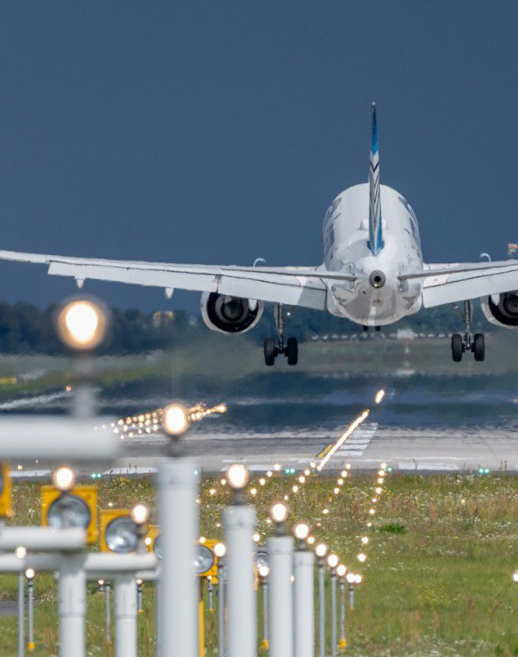
High Cloud Airlines
Prepared By :
Shrushti Sanjay Shukla
Amar Sutar
Ketaki Bhawari
Priyanka M
Devki Dasharath Mane
Ajinkya Keshav Kate

Slide 2
Contents:
1. Overview
2. List of KPI’s
3. Dashboard
4. Insights
5. Recommendations
6. Conclusion

Slide 3

Overview
High Cloud Airlines aims to provide exceptional travel experience while prioritizing sustainability and innovation
Focus on data-driven decision-making to improve airline performance
Use historical flight and passenger data to identify trends
Customer satisfaction by offering personalized services, including flexible booking options

Slide 4

Improve operational efficiency and customer experience
Committed to providing a safe and secure environment for our passengers
Offer a wide range of domestic and international routes, connecting major cities and popular travel destinations
Support management with actionable insights

Slide 5
List of KPI’s
1) Load Factor Analysis(Yearly, Quarterly& Monthly)
Evaluates seat utilization trends over different time periods
Higher load factor reflects stronger passenger demand and better capacity utilization
2) Load Factor by Carrier
Assesses passenger distribution across airlines
Highlights the top 5 carriers with the highest passenger volume
3) Top 10 Airlines by Passenger Preference
Ranks airlines based on total passengers carried
Southwest Airlines Co. leads with the highest passenger count(8018),indicating strong customer preference

Slide 6
4) Most Active Routes by Number of Flights
Identifies high-traffic routes based on flight frequency
5) Weekdays vs Weekend Load Factor Utilization
Compares passenger occupancy patterns across weekdays and weekends
Load factor is significantly higher on weekdays(71%)compared to weekends(29%),indicating strong business-driven travel
6) Flights Distribution by Distance Group
Analyzes flights volume based on travel distance
Short routes dominate, while flight frequency decreases as distance increases

Slide 7
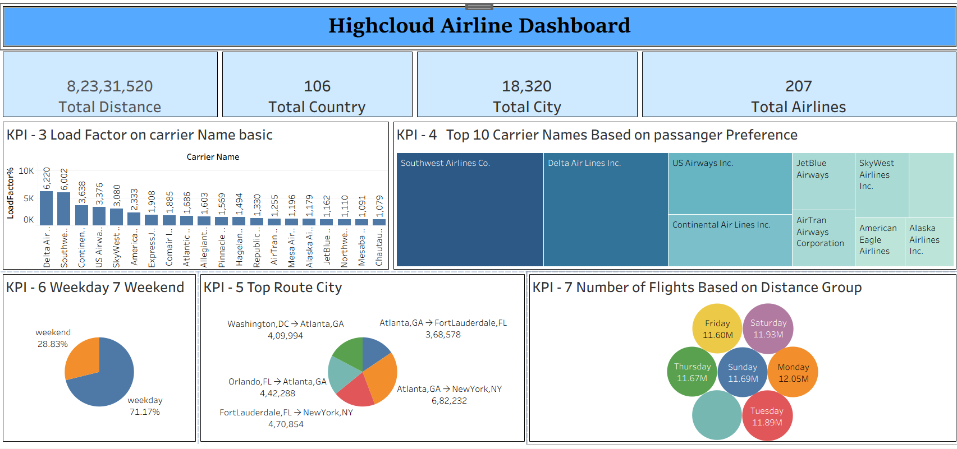
Tableau Dashboard
Used for advanced visual storytelling and route analysis

Slide 8
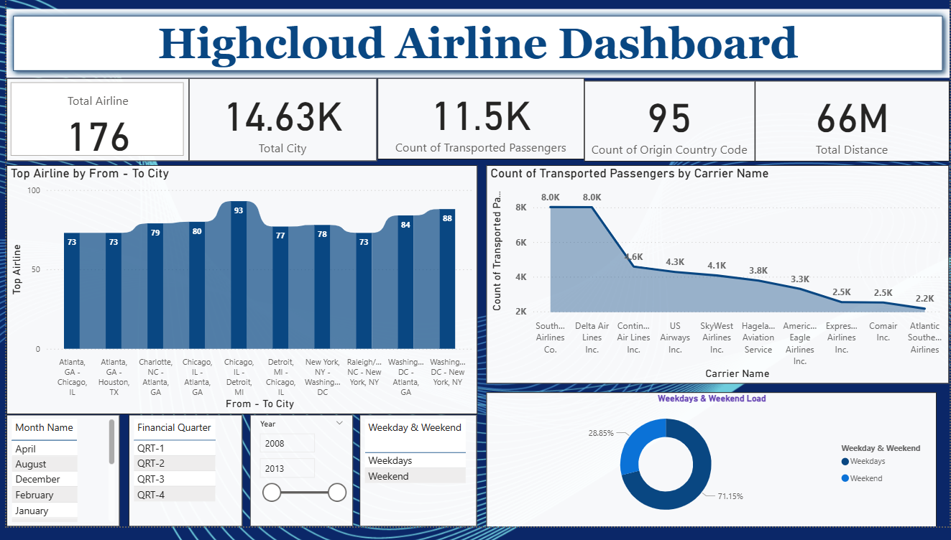
Power BI Dashboard
Used for interactive visuals, KPI comparison, and trend analysis

Slide 9
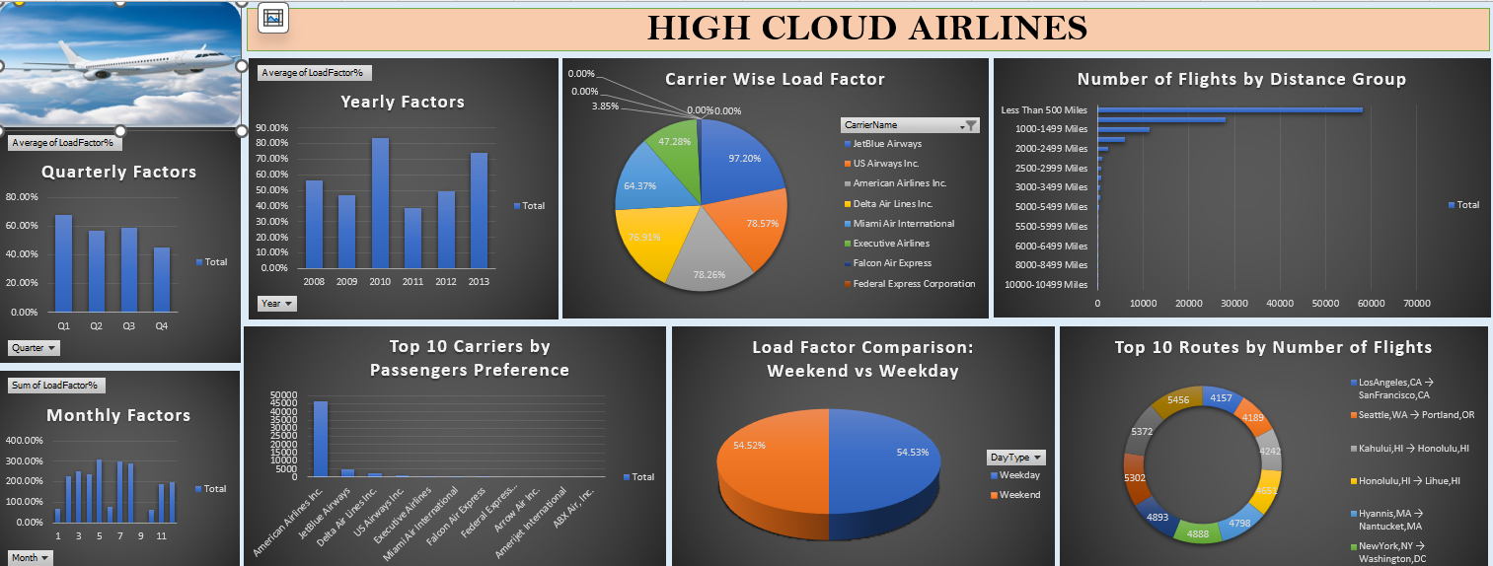
Excel Dashboard
Used for quick summaries, pivot tables, and validation

Slide 10
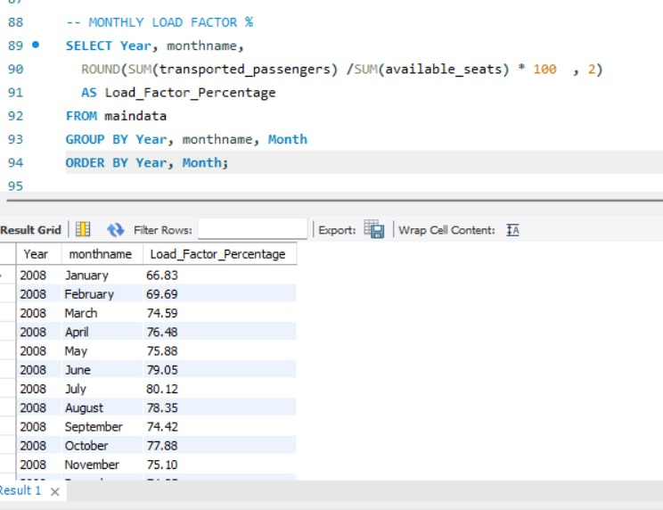
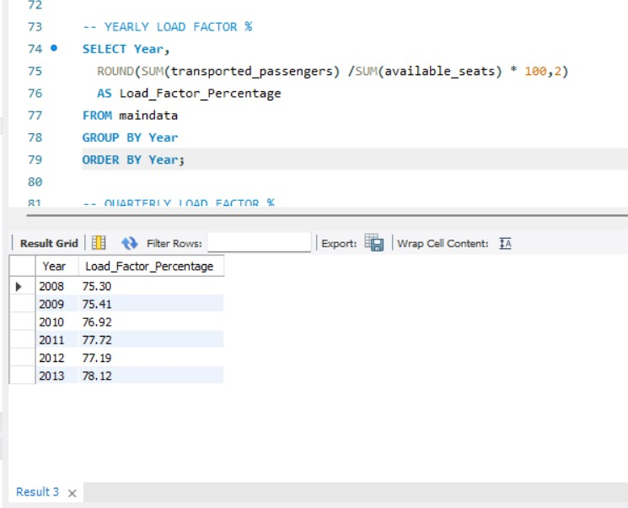
SQL Work
Used for data extraction, transformation, and KPI calculation

Slide 11
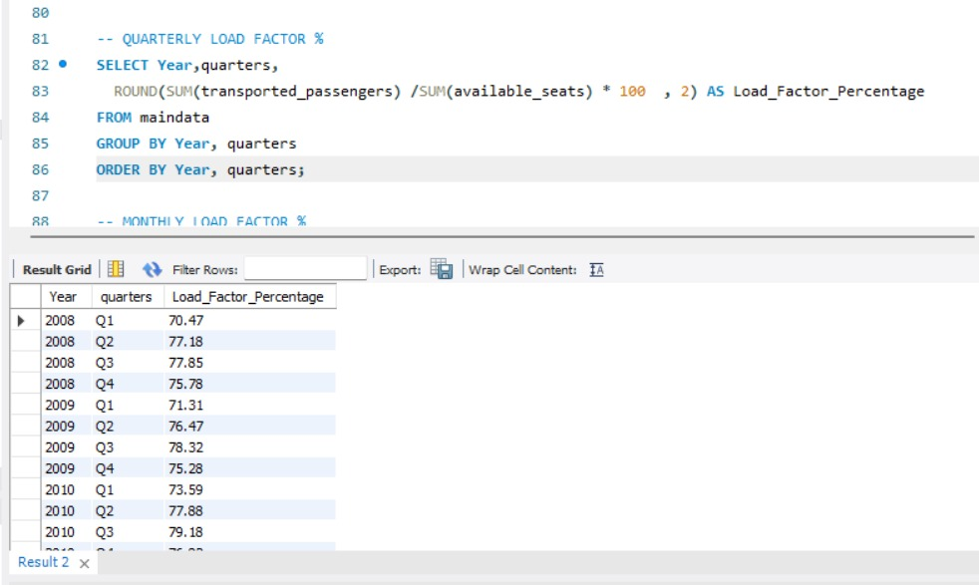
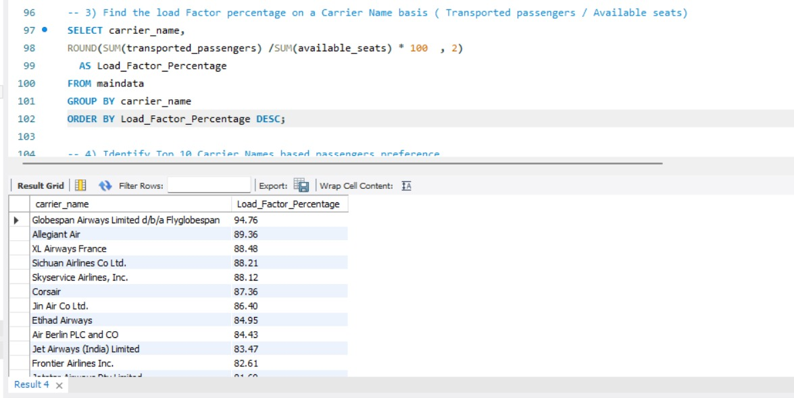
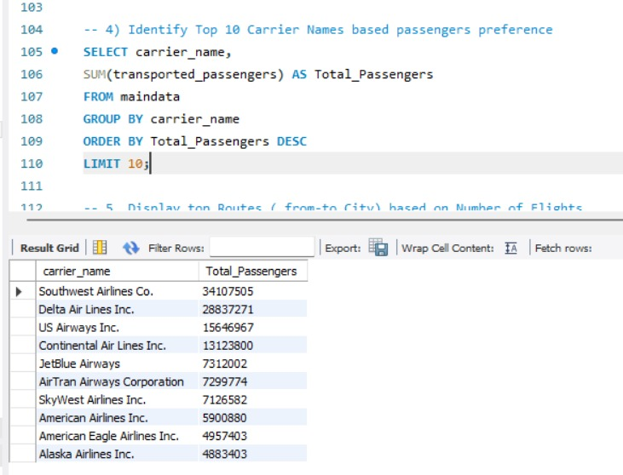
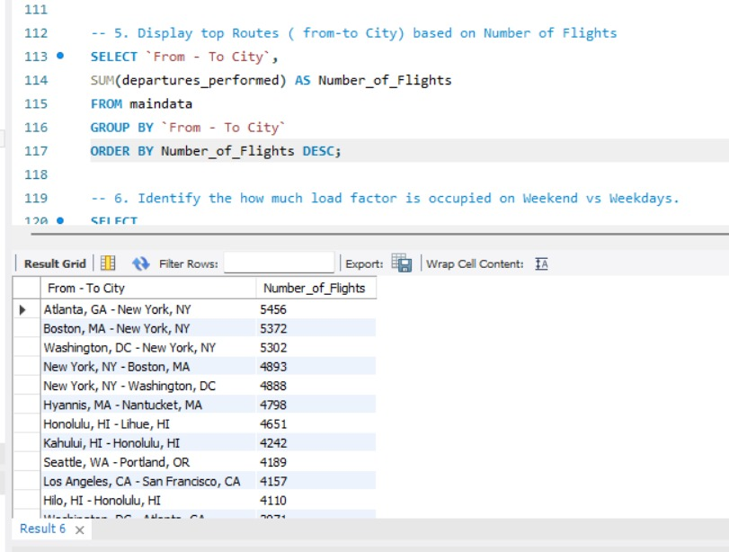

Slide 12
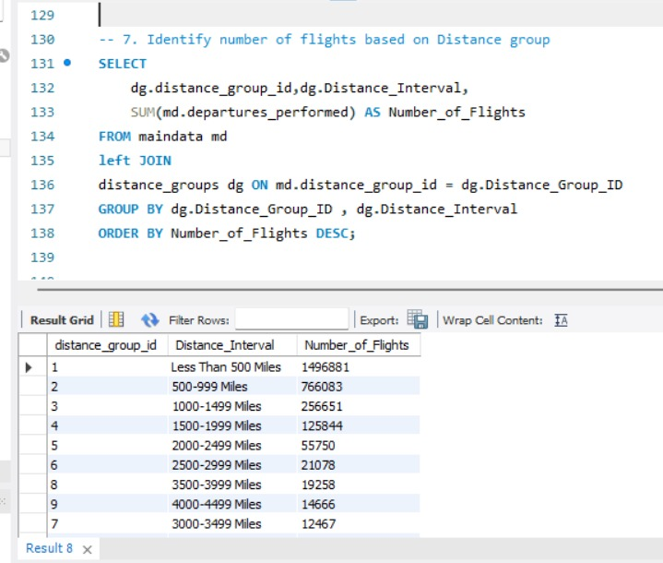
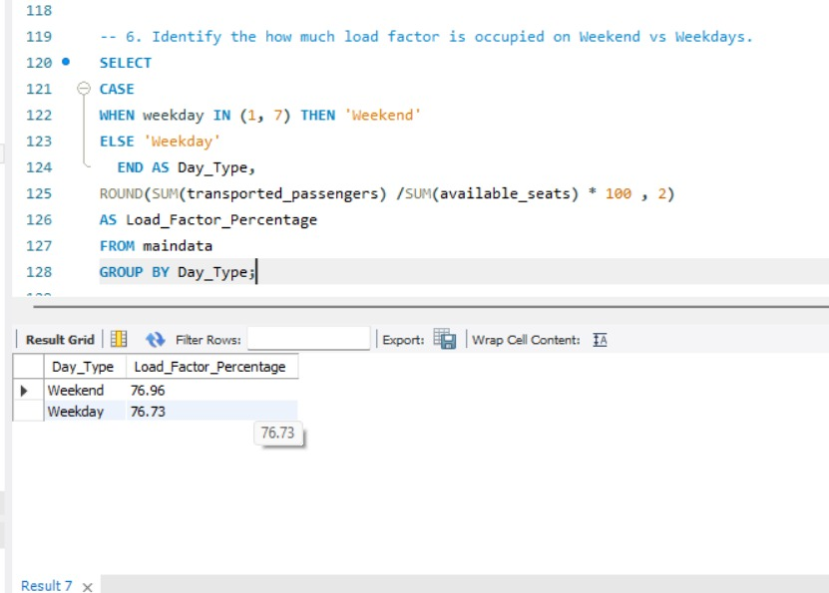

Slide 13
Insights
High-demand routes show consistent passenger flow
Weekday demand is significantly higher
Short-distance routes contribute to volume
Passengers demand is concentrated among top-performing carriers

Slide 14
Balancing high-demand tourist destinations with emerging markets helps reduce dependency on seasonal revenue
Strategic partnerships with sustainable and eco-conscious service providers can improve brand value and customer satisfaction
Expanding into underserved and high-potential international markets presents significant growth opportunities

Slide 15
Recommendations
Optimizing routes with consistently high load factors can improve profitability and reduce operational inefficiencies
Data-driven route planning enables airlines to identify low-performing sectors and realign capacity effectively
Customer preference trends highlight the importance of punctuality , pricing and service quality in driving repeat travel

Slide 16
Leveraging passenger demand patterns supports smarter fleet utilization and
fuel cost optimization
Sustainability initiatives can also contribute to long-term cost savings and
regulatory compliance
Introduce promotional offers for low-load periods

Slide 17
Conclusion
High Cloud Airlines plans to grow its route network while keeping safety and reliability at the core of its operations.
This helps balance cost, capacity and customer needs.
By harnessing the power of data, we can drive positive changes and supports long-term strategic planning in the aviation sector.

Slide 18
Thank You

