Slide 1

Hospital Length of Stay Prediction
By Ketaki Nagarkar
Springboard Data Science Capstone
Mentor: Ben Bell

Slide 2
Why is predicting Length of Stay important ?
Predicting patient Length of Stay (LOS) at admission will assist with
Improved planning and resource allocation for medical facilities
Avoiding excessive expenditure for patients and hospitals
Improving quality of medical care for patients

Slide 3
Who will benefit from this project?
Hospital management
Insurance Companies/ Primary Insurance Payers
Patients and their families

Slide 4
Dataset:
De-identified healthcare data was obtained from New York State Department of Health. A 5 percent random sample of this dataset was used for the project.
Hospital Inpatient Discharges (SPARCS De-Identified) Downloadable File: 2014 | State of New York (ny.gov)
The data consisted of hospital stay details including diagnosis, procedures, codes, patient characteristics, length of stay and charges
The data was checked for missing values and inconsistencies prior to EDA. Abortion records were redacted in this datset and corresponding values for columns were null, these records were dropped. Columns not helpful to predicting LOS such as total charges were dropped.

Slide 5
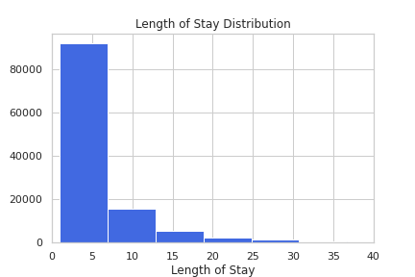
EDA: Analysis of Length of Stay (LOS)
A zoom in shows that majority of hospital stays lie at or below mean i.e. 6 days or less. A smaller fraction of the hospital stays are more than mean.

Slide 6
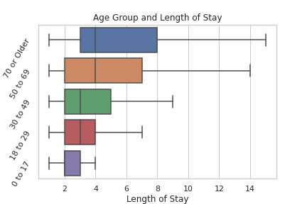
EDA: Age appears to be positively correlated with LOS

Slide 7
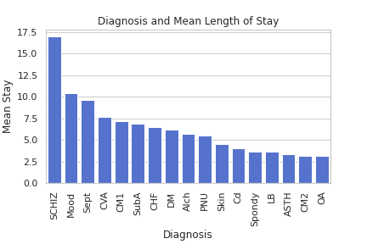
EDA: Diagnosis Groups
There is significant variability in mean LOS amongst different diagnosis groups. An independent t test on the two commonly occurring Diagnostic groups was statistically significant, yielding a p value < 0.01

Slide 8
Data Wrangling and PreProcessing:
The target variable LOS was remapped on the basis of below/at mean or above mean LOS.
LOS <= 5.5 was remapped as 0
LOS > 5.5 was remapped as 1
Categorical features were converted to dummy variable for Logistic Regression and Random Forest Classifier modeling.

Slide 9
Modeling:
A 5% fraction was grid searched and the best parameters were applied to the ultimate models. The CatBoost classifier has a better ROC_AUC score and at the best threshold a better f1 score for our class of interest compared to the other models.
Models | Roc_Auc score | F1 score of ‘above_mean’ LOS at best threshold
Random Forest | 0.752 | 0.62
Logistic Regression | 0.751 | 0.62
CatBoost | 0.756 | 0.63

Slide 10
Next Steps:
Additional information such as Hospital tier type, socio economic data based on geographic location, majority payer type based on geographic location can be incorporated in future modeling to understand the influence of these factors.

Slide 11
Conclusion:
By using this project modeling for LOS predictions, hospitals can plan their staffing and resource allocation.This will improve quality of patient care, hospital efficiency and financial health.
Patients will also benefit from this information by being able to plan for their expenses, medical leave and related costs.

Slide 12
References:
1) Hospital Inpatient Discharges (SPARCS De-Identified) Downloadable File: 2014 | State of New York (ny.gov)
2) (The ABCs of DRGs | ACP Hospitalist)
3) (Medicare and Health Insurance | Office for the Aging (ny.gov))
4)Medicare Guidelines for Inpatient Rehab Coverage (healthline.com)
5) Inpatient or outpatient hospital status affects your costs | Medicare
6) Decreasing the Patient Length of Stay (LOS) to Lower HAIs (centrak.com)
8)https://www.debt.org/medical/hospital-surgery-costs/
9) NYC Health + Hospitals patient care locations - 2011 | NYC Open Data (city of new york.us).
10) https://www.hcup-us.ahrq.gov/toolssoftware/ccs10/ccs10

