Slide 1

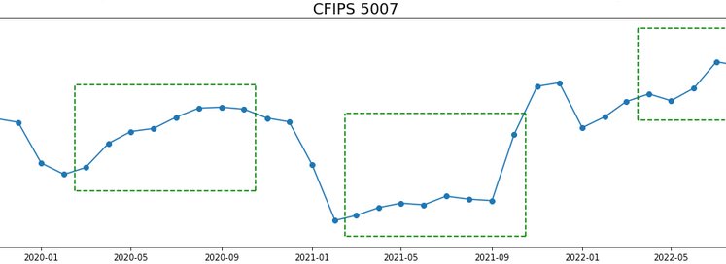
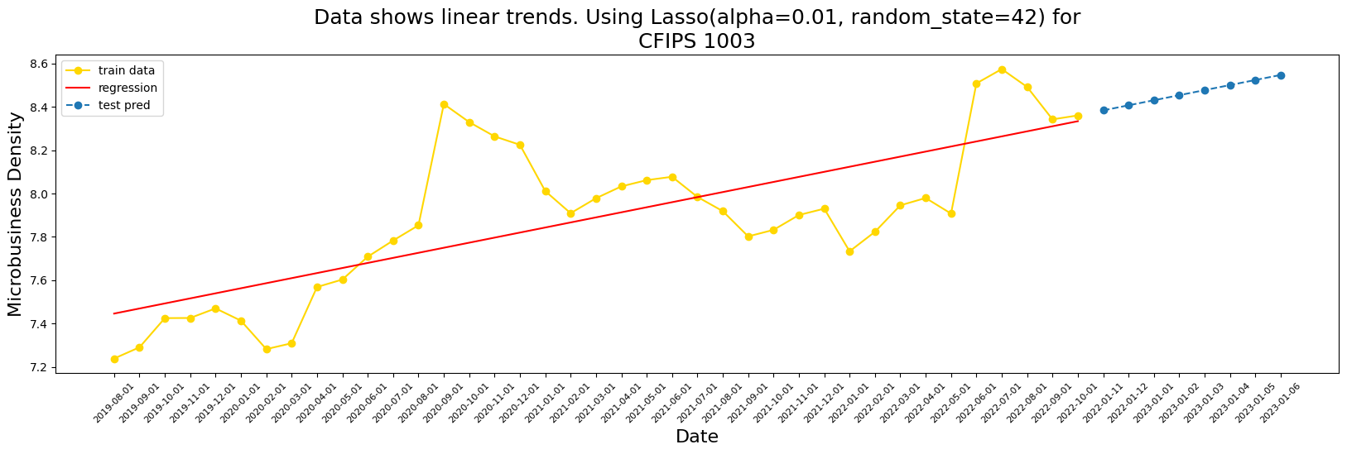
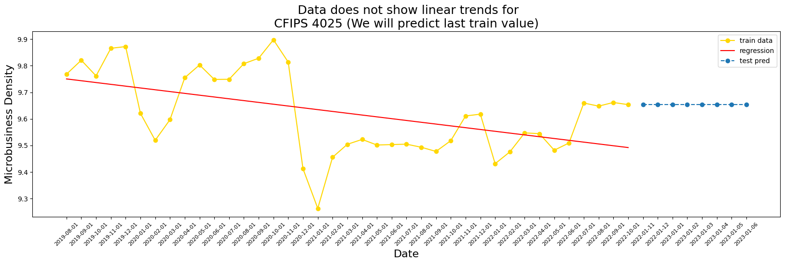
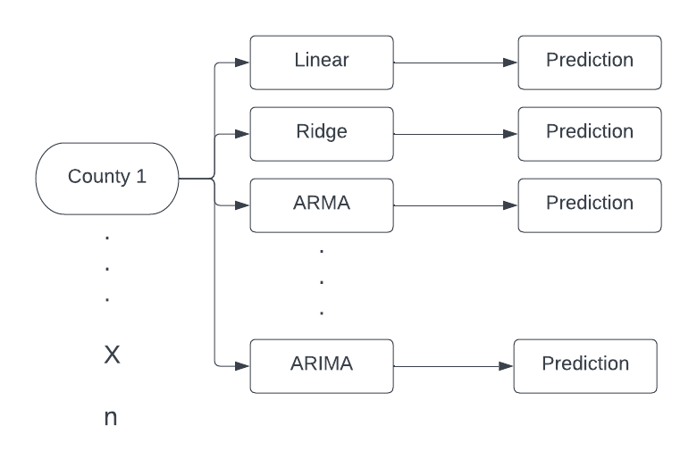
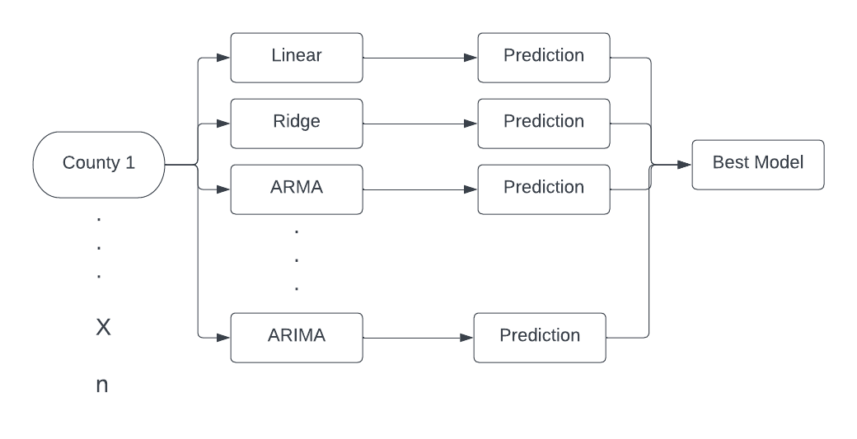
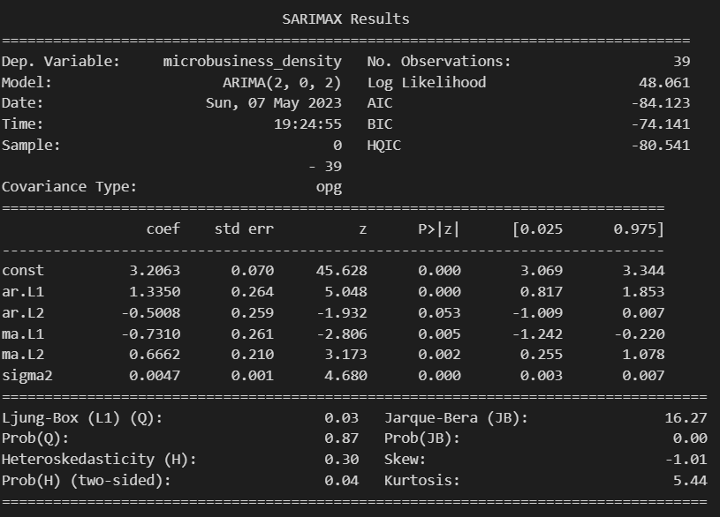
Predicting Microbusiness Density in USA
Ketan Kapse (G24637377) and Sai Abhishree Pappusetty (G26078396)
Department of Computer Science
Abstract
Methodology
Results
Conclusion
This project is aimed at predicting microbusiness density levels for US counties using multiple machine learning and statistical models. Historic data is available from the GoDaddy dataset in Kaggle, which is used for forecasting microbusiness activity levels in the future.
Models such as Linear Regression, Auto Regression, Moving Average, Auto Regressive Moving Average, etc. were trained on the temporal data to make predictions. The performance of these models have been discussed and issues encountered have been described.
We are using the GoDaddy microbusiness dataset [4] for this project. The dataset consists of 3135 timeseries data of counties in the US. Each of these series has a length of 39, with each datapoint corresponding to a single month ranging from August 2019 to October 2022 and its associated microbusiness density level. The dataset is split into two files, train.csv and test.csv as the training and testing data respectively.
For the test set, we need to make forecasts of the microbusiness density levels for the next eight months, i.e., November 2022 to June 2023. Since, each timeseries corresponds to a county, we need to make 3135 * 8 predictions which is approximately 25000 predictions.
We utilized the following regression models to predict the microbusiness densities for the counties:
Linear Regression
Ridge Regression
Lasso Regression
Auto Regression
Moving Average
Auto Regressive Moving Average
Auto Regressive Integrated Moving Average
Every single one of the above models was trained on the training set and predictions for all the counties were made using the trained models.
The above figure describes the workflow that we followed for our project.
In case of linear, lasso and ridge regression, if the train error was found to be more than 15 percent (value selected arbitrarily), we assumed that the particular time series data did not follow a linear trend and we used the last known value in the train and test predictions.
We evaluated these models using the MAPE metric. Upon further analysis, we observed that these three models performed almost identically on counties with linear trends and had similar MAPE values.
The following shows two counties, one with a linear time series data and another which does not.
A major issue with using these models for predictions is that only a small minority of the counties’ time series have linear trends within the error threshold (around 400), making it necessary to incorporate more models for the other counties.
For the AR, MA, ARMA and ARIMA models, imported from the statsmodels library, we first utilized the auto_arima model from the pmdarima package to generate p,d and q (non-seasonal) orders for each county data. Auto ARIMA basically fits all of the above models onto the county data and generates the orders after taking into account the Akaike Information Criterion (AIC) and Bayesian Information Criterion (BIC) values. The lower these values, the better is the model. This allowed us to avoid manually fitting each of the above models one by one on the 3135 time series data. Next, we stored these orders in a dictionary and used them to fit each of the stats models on the county data.
The following is the fit summary of the ARMA model on CFIPS 13035 using the orders generated by the auto ARIMA.
Our project serves as a great baseline for developing further insights into microbusiness activity in different counties.
Results can be further improved if seasonal data is taken into account. For example, in the following figure, the green boxes highlight the presence of linear seasonal patterns in data for the county with cfips = 5007.
Considering seasonal variations will help provide more accurate forecasts especially with multiple seasonal patterns being present in the counties’ time series .
Furthermore, inclusion of more data about the counties themselves can be used to make better predictions. Features from US census data for each county can be used to fine tune the forecasts.
Models such as tree based regressors like XtremeGradientBoosting and LightGradientBoosting can also be utilized as they have shown to have great performance on time series problems.
Once enough models have been determined, each of these models can then be used to predict on all of the county data and the best model can be selected using metrics such as MAPE or SMAPE, not unlike the working of the Auto ARIMA model. A possible workflow model can look as follows:
In conclusion, We analyzed the microbusiness density dataset and trained several models on the time series data of each county in the dataset. Furthermore, we generated forecasts for the next 8 months present in the test set.
Introduction
Microbusinesses (MBs) are typically defined as businesses that operate on a very small scale and have an online presence. They have fewer than 10 employees and are usually managed directly by their owners. Examples of such businesses can be local cafes, restaurants, grocery stores, etc.
MBs play an important role in the growth of the local economy since they provide employment opportunities and are a means of income for individuals living in the local geographic area. They also play an important part in the country’s economy. According to the Small Business Association, there were approximately 30.7 small-scale businesses in the US in 2019, with MBs constituting about 89% of them
A major issue associated with MBs is that they are often too small or too new to show up in traditional economic data sources, making it nearly impossible for policymakers to study them and develop plans to promote their growth. Moreover, in 2022, these businesses were reported to employ around 66 million US citizens, which is approximately 46.4% of the working population .
Regions with higher levels of microbusiness development and activity can benefit from policies and funding that would foster their growth, strengthening the economy. This project aims to predict the microbusiness density levels for US counties using multiple machine learning models. We believe that our project will act as a steppingstone for more in-depth analysis of MBs
References
https://www.kaggle.com/competitions/godaddy-microbusiness-density-forecasting/data
https://cdn.advocacy.sba.gov/wp-content/uploads/2021/08/30144808/2021-Small-Business-Profiles-For-The-States.pdf
Shereen Elsayed, et al. "Do We Really Need Deep Learning Models for Time Series Forecasting?". CoRR abs/2101.02118. (2021).
Phillip G. Gould, et al. "Forecasting time series with multiple seasonal patterns". European Journal of Operational Research 191. 1(2008): 207-222.

