Slide 1

Smart Study Assistant Agent 📚
AI-Powered Personalized Learning System
Developer : Ketan Dutt
Program : Google GenAI Academy 2026

Slide 2
Transforming Static Materials into Interactive Learning
Upload Materials
Ask Questions
Generate Quizzes
PDFs or notes
AI explanations
Exam simulations
Track Weak Areas
Revision Plans
Automatic detection
Personalized schedules
Acts as a personal AI tutor, adapting to each student's learning needs.

Slide 3

Students Face Critical Challenges
Current Problems
Traditional Methods
Complex topics difficult to understand
No personalized guidance
Inefficient revision strategies
Weak areas go untracked
Static ❌
Non-adaptive ❌
Time-consuming ❌

Slide 4





Our AI-Powered Solution
Interactive Learning
Converts notes into dynamic experience
Simple Explanations
Complex concepts made easy
Active Recall
Quizzes for retention
Smart Tracking
Weak topics identified
Structured Plans
Revision schedules created
Result: Smart, adaptive, and efficient learning

Slide 5
How It Meets Build Criteria
Google Gemini API
AI Agent Workflow
Real-World Data
Generative AI implementation
Complete pipeline architecture
PDF processing capability
Actionable Outputs
End-to-End Application
Answers, quizzes, insights, plans
UI + backend integration

Slide 6


Unique Value Proposition
Complete Ecosystem
Not just a chatbot—full learning platform
Personalized Tutor
Adapts to individual needs
Weak Area Detection
Automatic topic identification
Smart Revision
Intelligent planning system
Special Feature: "Explain Like I'm 10" Mode
Makes learning accessible to beginners

Slide 7
Comprehensive Feature Set
PDF Upload
AI Q&A
Quiz Generator
Text extraction
Smart answering
MCQs + explanations
Exam Mode
Weak Tracking
Revision Planner
Test simulation
Topic detection
Smart scheduling
Flashcards
Summary Generator
Progress Dashboard
Interactive system
Concise notes
Visual tracking

Slide 8
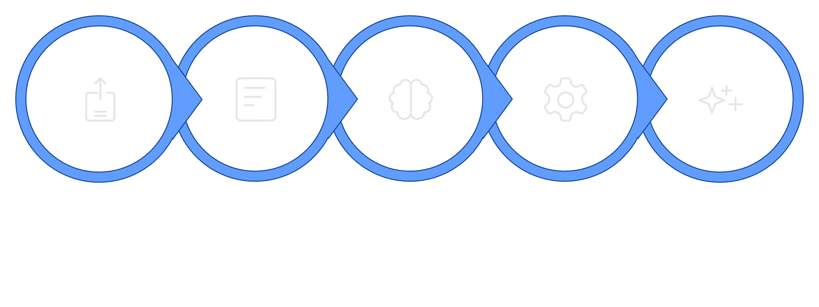
System Workflow
Analyze (Gemini)
Select Feature
Generate Output
Upload PDF
Extract Text
Complete AI Agent Pipeline

Slide 9

Technology Stack
Core Technologies
AI Architecture
Google Gemini API (GenAI)
Python backend
Streamlit UI framework
PyPDF for PDF parsing
python-dotenv for security
Pandas for analytics
Google Cloud Run deployment
Context selection (chunking + ranking)
Prompt engineering
Gemini API integration
JSON parsing & validation
Retry logic for robustness
Caching for performance
Error handling

Slide 10
Performance Dashboard & Impact
80%
3-5
100%
Score Tracking
Day Plans
Focus Areas
Real-time percentage display
Automated study schedules
Weak topics prioritized
Progress Insights
Smart Revision
Score tracking, weak topics, mistake frequency, visual progress
3–5-day plans, daily goals, actionable tasks, topic prioritization
Flashcards System
Data-Driven Learning
AI-generated cards, weak topic focus, interactive reveal, memory retention
Quiz scores, performance trends, improvement tracking

Slide 11
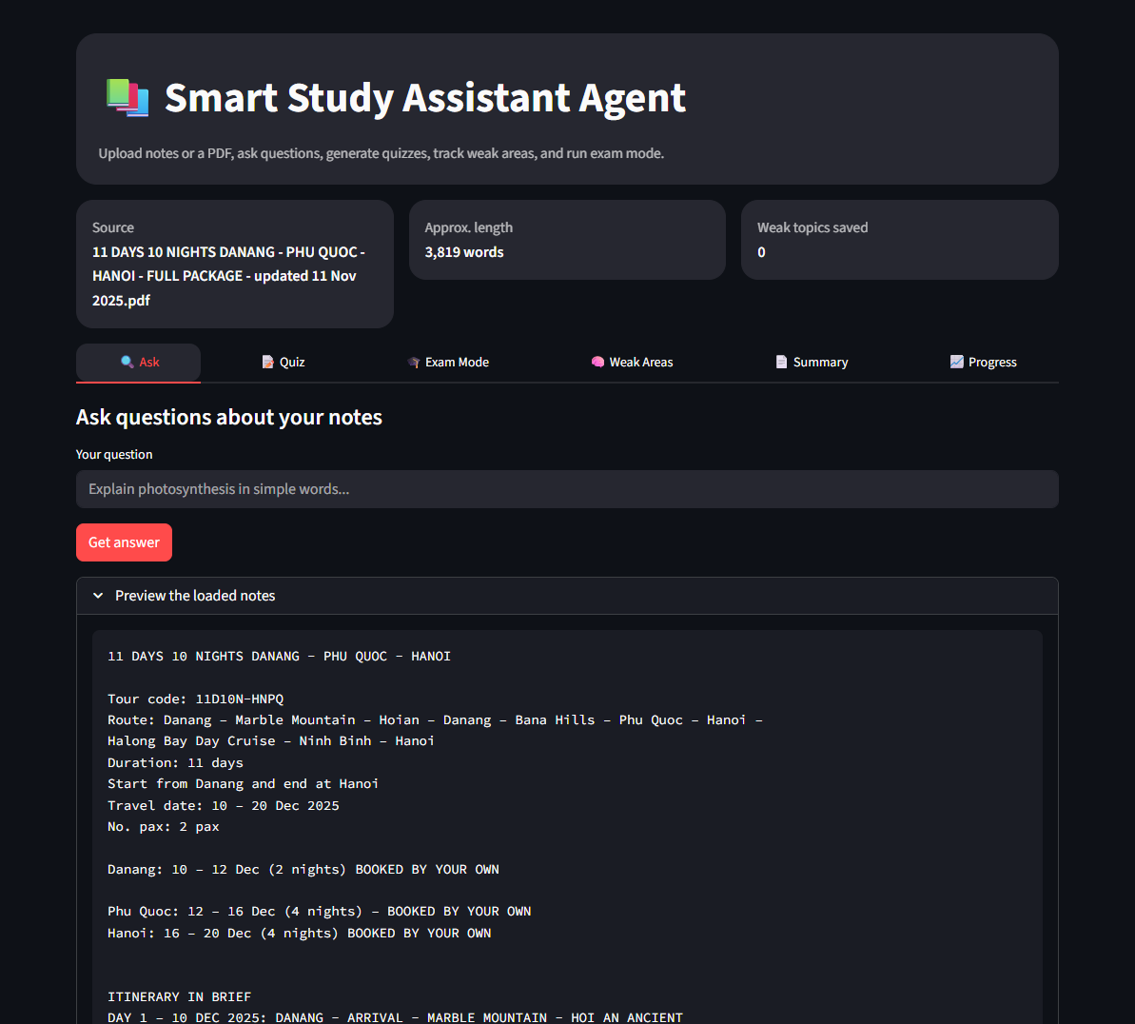
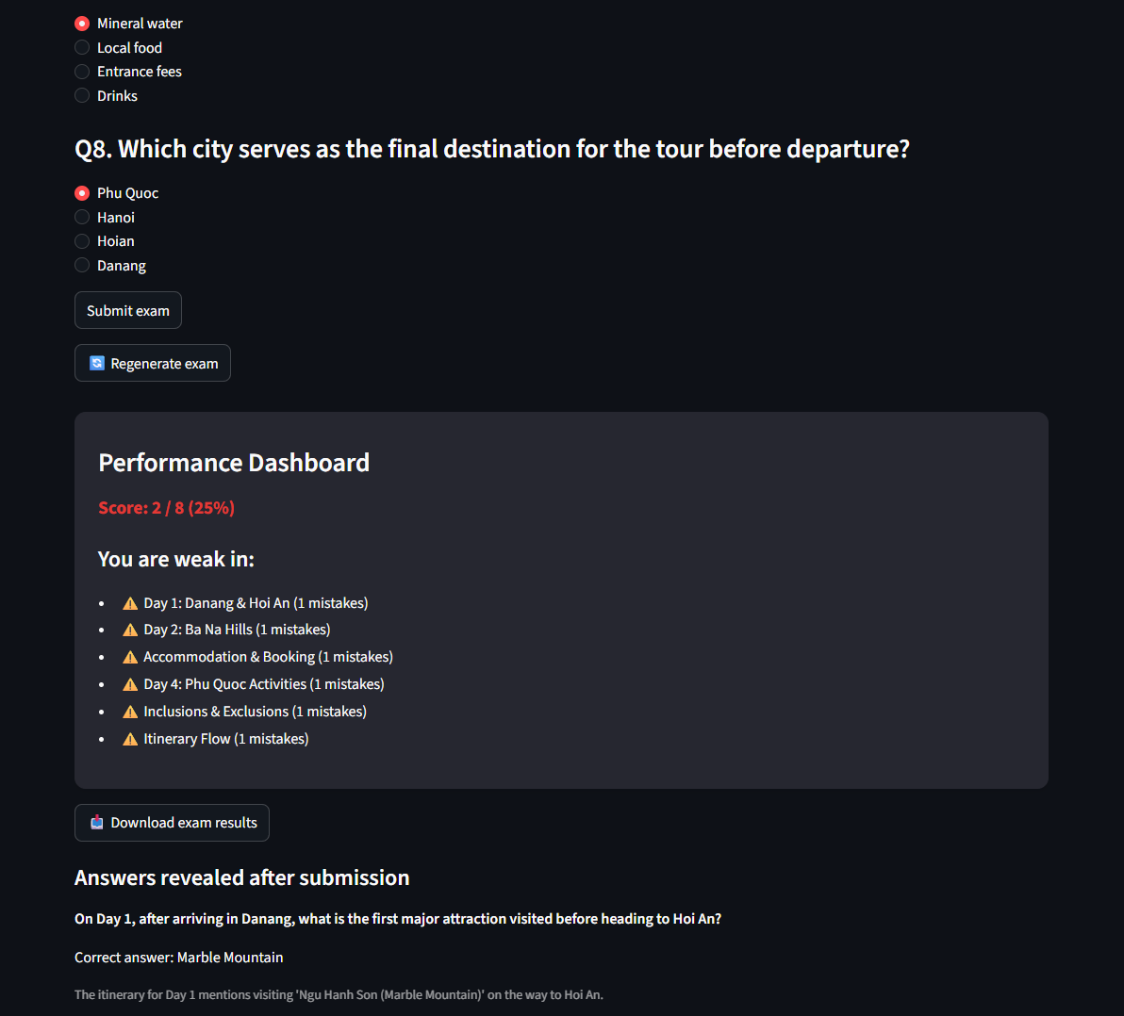
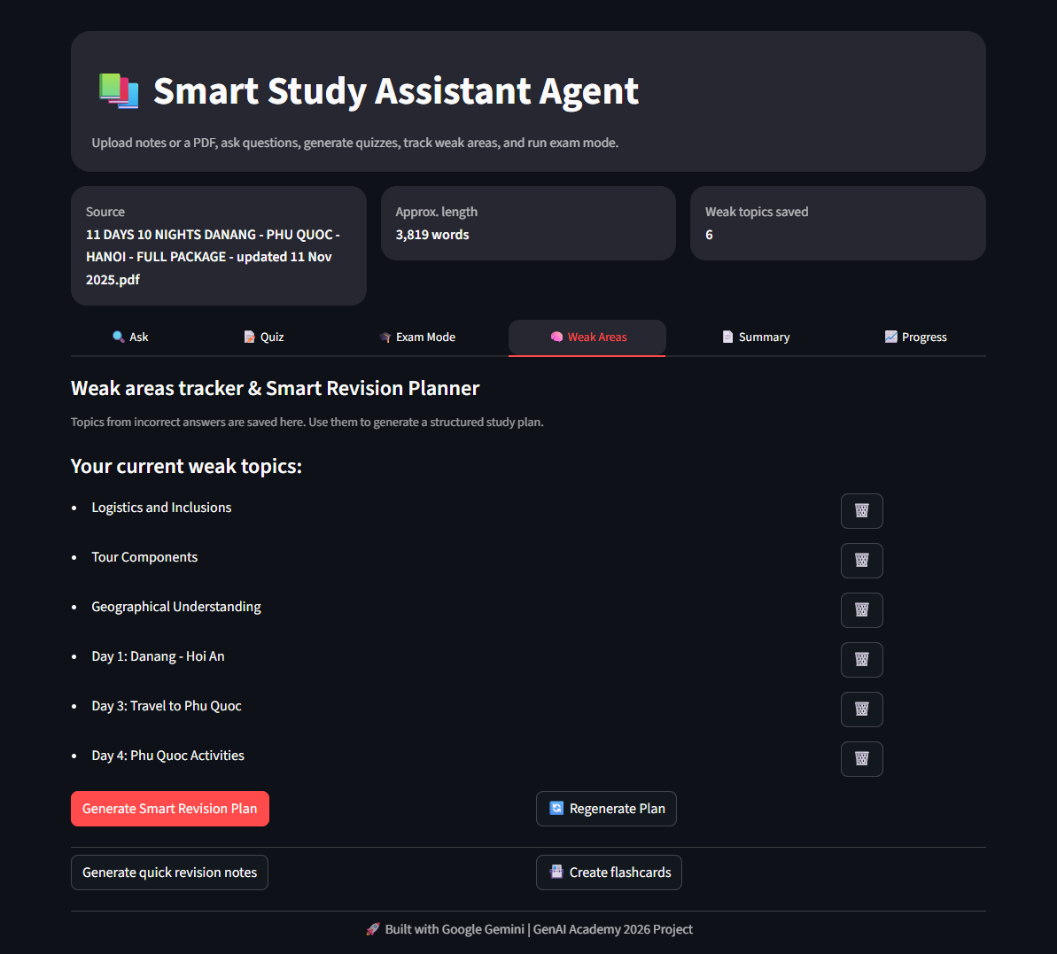
Intuitive Design in Action
Explore the seamless experience of our Smart Study Assistant, designed for ease of use.
Our user interface brings advanced AI features to your fingertips, simplifying complex study tasks and enhancing your learning journey.

Slide 12


🙏 Thank You
Thank you for your time and consideration.
📚 Smart Study Assistant Agent
Generative AI transforms traditional learning into personalized education, improving student outcomes with scalable AI-driven systems.
🔗 Connect with me
Ketan Dutt
GitHub: https://github.com/KetanDutt
Email: ketan.dutt@yahoo.in
🚀 Built using Google Gemini | GenAI Academy 2026

