Slide 1

Mini Project Report on
TEXT CLASSIFICATION
BACHELOR OF TECHNOLOGY
IN
COMPUTER SCIENCE & ENGINEERING
Student Name: Ketan Singh Rautela University Roll No. 2018881
Submitted by:
Under the Mentorship of
Dr. S S Samant
Assistant Professor

Slide 2
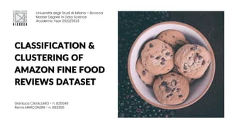
Table of Contents
Chapter No. | Description
Chapter 1 | Introduction
Chapter 2 | Literature Survey
Chapter 3 | Methodology
Chapter 4 | Result and Discussion
Chapter 5 | Conclusion and Future Work

Slide 3
Chapter 1
Introduction
Classification of Texts, also known as Textbook tracking or Textbook classification, is the
process of dividing Textbooks into groups. Using natural language processing (NLP), bibliographers can
search for books and prioritize or sort by their content. The potential of informal books is extensive similar to
email, social media, websites and many other platforms . However, it can be difficult to extract value from this data unless it is organized in some way. Doing this used to be a small and efficient process, as manually sorting data takes time and money. Textbooks using NLP have proven to be fast, efficient and can be used to model data..
Text classification is often the first step in selecting a dataset for further processing, and perhaps the only step in
writing a book like a critical review. Entries in parentheses are not intended to provide information in a textbook that is not an order form. One way to teach the classification of books is to use builting methods to identify methods for describing data and reuse and reuse these features to choose the order to be used for a particular document. Sentimental analysis is one way of doing that.
Areas such as business, product management, education and management already use the
process of extracting and analyzing information from data.

Slide 4
Important Libraries Used:
Pandas - Pandas is an open source Python package that's utmost extensively used for data science/ data analysis and machine literacy tasks. It's erected on top of another package named NumPy, which provides support for multi-dimensional arrays.
2. NumPy - In Python we've lists that serve the purpose of arrays, but they're slow to reuse. NumPy aims to give an array object that's over to 50x faster than traditional Python lists. The array object in NumPy is known as ndarray, it provides a lot of supporting functions that make working with ndarray veritably easy. Arrays are veritably constantly used in data wisdom, where speed and coffers are veritably important.
3. NLTK- NLTK stands for Natural Language Toolkit. It is a powerful open-source library in Python that provides tools and resources for working with human language data, primarily in the field of natural language processing (NLP). NLTK was developed by the Natural Language Processing Group at the University of Pennsylvania. NLTK offers a wide range of functionalities, including text processing, tokenization, stemming, part-of-speech tagging, named entity recognition.
4.Seaborn- Seaborn is a Python data visualization library grounded on Matplotlib. It provides a high- position interface for creating seductive and instructional statistical plates. Seaborn is designed to work seamlessly with pandas data frames, making it a popular choice for data visualization in data analysis and exploratory data analysis ( EDA).

Slide 5
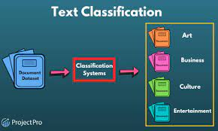
1.4 Applications:
1.Sentimental Analysis.
2.Spam Detection.
3.Language Identification.
4.Intent Classification.

Slide 6
Chapter 2
Literature Survey
This paper represents an exploration of the contributions that have already been made in the academic ﬁeld. There are many literature Surveys done where the use of text classification become very efficient and authentic. Some of them are-
When the number of documents increased, the computational complexity also increased( Stas, Juhar & Hladek 2014). ML is frequently seen as an offshoot of statistics as far as data mining is concerned. It employs advanced models to make opinions grounded on its own cognizance (Du, 2017; Ranjan & Prasad, 2017). still, a purely statistical and purely ML approach is considered less competent, there- fore a mongrel approach is generally preferred (Srivastava,2015).
“ A Comparison of Event Models for Naive Bayes Text Bracket" by Andrew McCallum and Kamal Nigam (1998).This influential paper introduced the use of Naive Bayes classifiers for textbook bracket and compared different event models( Bag of Words, Bigrams, Trigrams) on a range of datasets. It laid the foundation for textbook bracket using statistical machine literacy ways.
"Automatic Text Categorization Using Neural Networks" by Y. LeCun, L. Bottou, Y. Bengio, and P. Haffner (1998): This paper explored the application of neural networks, specifically the Multilayer Perceptron (MLP), for text classification tasks. It demonstrated the potential of neural networks in handling complex text data and paved the way for deep learning in NLP.
" Support Vector Machines for Text Categorization" by Thorsten Joachims ( 1998) This paper demonstrated the effectiveness of Support Vector Machines( SVM) for textbook classification tasks. It showed that SVMs outperformed traditional approaches like Naive Bayes on colorful textbook datasets and gained fashionability as a important bracket fashion.

Slide 7
" Convolutional Neural Networks for judgment Bracket" by Yoon Kim( 2014) This paper introduced the operation of Convolutional Neural Networks( CNN) for judgment - position textbook classification. CNNs were firstly developed for image recognition but were shown to be effective in textbook classification as well.
" Attention Is All You Need" by Vaswani etal.( 2017) This groundbreaking paper introduced the Transformer armature, which utilizes tone- attention mechanisms to reuse successional data. Mills revolutionized NLP tasks, including textbook bracket, and models like BERT( Bidirectional Encoder Representations from Mills) achieved state- of- the- art results.
"XLNet: Generalized Autoregressive Pretraining for Language Understanding" by Yang et al. (2019): XLNet is an extension of the BERT model that utilizes permutation-based training to capture bidirectional context while avoiding the limitations of traditional masked language models. It improved upon BERT's performance on several tasks, including text classification.
"ULMFiT: Universal Language Model Fine-tuning for Text Classification" by Jeremy Howard and Sebastian Ruder (2018): This paper presented ULMFiT, a transfer learning approach for text classification that leverages pre-trained language models. ULMFiT demonstrated significant performance improvements with limited labeled data.
This literature survey highlights some of the key milestones in the development of text classification methods, from traditional statistical approaches to modern deep learning models.

Slide 8
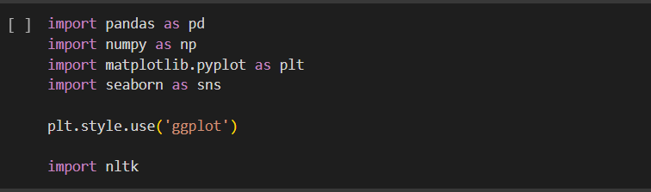
Chapter 3
Methodology
The methodology for text classification involves a series of steps and techniques to process, represent, and classify textual data accurately.
3.1 Pre-processing the Dataset:
The first step is to remove all the unjustified data from the transformation dataset. We'll cancel the starting and end of the dataset. This is the data that's inapplicable to us. Data preprocessing is the process of transforming raw data into an understandable format. It is also an important step in data mining as we cannot work with raw data. The quality of the data should be checked before applying machine learning or data mining algorithms. Eventually, we will make sure we've only unique words. This will help the model train better avoiding redundant confusion due to the reiteration of words.
3.2 Import Libraries and Dataset:
We import some of the important libraries of python like pandas, numpy , NLTK, seaborn and matplotlib for the working of our project. Importing of libraries is like this –

Slide 9
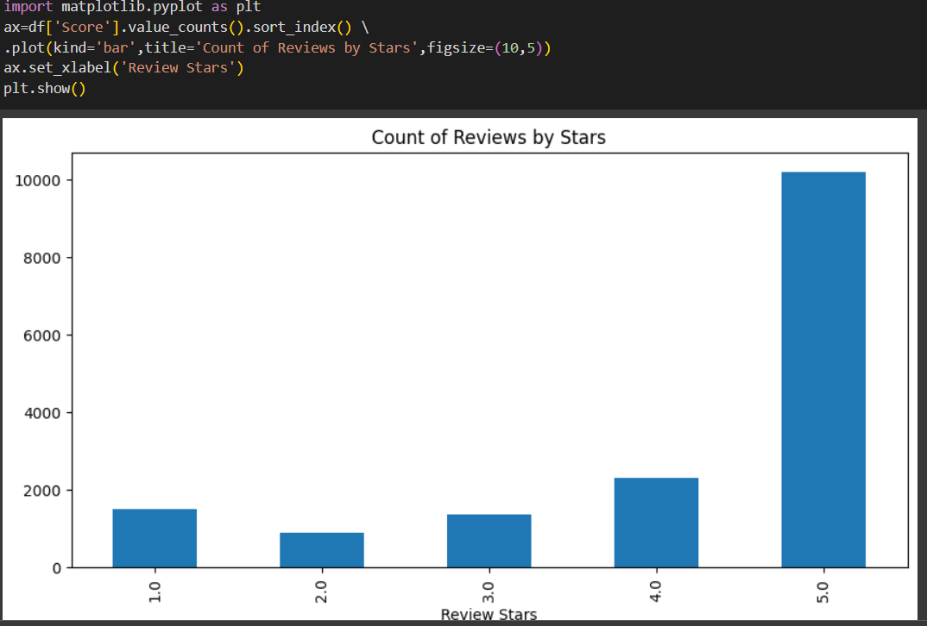
Importing of Dataset plays an important role it is second step after importing of libraries as all the operations will be done on these dataset. Importing of dataset will be done by csv library by passing the path of that file.
3.3 Feature Extraction and Representation:
a. Convert the pre-processed text data into numerical feature vectors that machine learning algorithms can process.
b. Common techniques include Bag-of-Words (BoW), Term Frequency-Inverse Document Frequency (TF-IDF), and word embeddings (e.g., Word2Vec, GloVe).
3.4 Visualizing the Model:

Slide 10
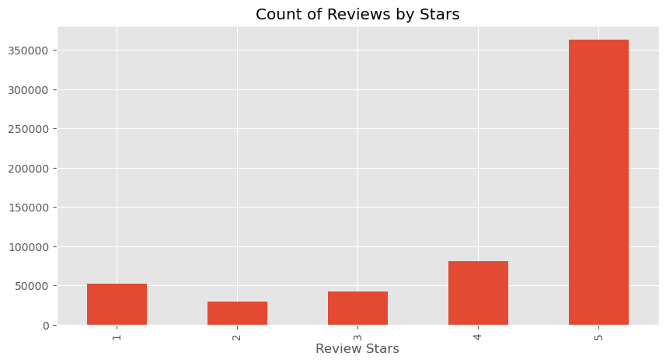

Slide 11
3.4
Model Training:
Feed the numerical feature vectors and corresponding labels into the chosen model for training.
Optimize hyperparameters through techniques like grid search or random search.
Split the dataset into training and validation sets to train the model and evaluate its performance.

Slide 12

3.5 Tokenization:
Tokenization is a crucial step in text classification, where a piece of text is divided into individual units called tokens. Tokens can be words, sub-words, characters, or even phrases, depending on the tokenization strategy used. Tokenization is the first step in converting raw text into a format that machine learning models can process.
There are different tokenization techniques used in text classification, and the choice of tokenization method can significantly impact the performance of the model.
3.6 Import Sentimental Analyzer:
To perform sentiment analysis for text classification, you can use various libraries and tools in Python. One popular choice is the Natural Language Toolkit (NLTK) library, which provides a Sentiment Analyzer module.
Using NLTK-
To import the Sentimental Analyzer NLTK library is used first we have to import this library after that the Sentimental Analyzer import .

Slide 13

3.7 Import Vader Model :
To use the VADER (Valence Aware Dictionary and Sentiment Reasoner) model for sentiment analysis in text classification, you'll need to install the vaderSentiment library. VADER is a lexicon and rule-based sentiment analysis tool specifically designed for social media text and short informal text, making it well-suited for sentiment analysis tasks.
3.8 Model Testing and Deployment:
a. Once satisfied with the model's performance, test it on a separate test dataset to assess its generalization capabilities.
b. Deploy the trained model to make predictions on new, unseen text data.
3.9 Performance Analysis and Iteration:
a. Analyze the model's performance on real-world data and monitor its behaviour in production.
b. Iteratively improve the model based on feedback and observations from users or stakeholders.

Slide 14
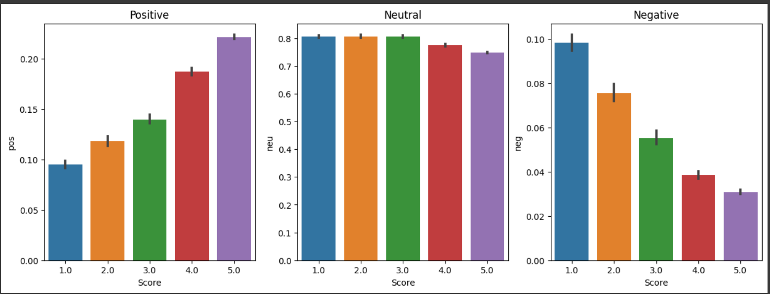
Result and Discussion
Chapter 4
The model is used for Sentimental Analysis of dataset of Amazon Food Review and by using some important libraries of Python like Pandas, NumPy, seaborn, matplotlib and two models Vader Model and Sentimental Analyzer these are used for statistical analysis of the dataset. In the dataset we have Reviews of the customers for food. By using the models we get the statistical analysis of them in form of graph. Some of them are-

Slide 15
DISCUSSION
In general textbook bracket ways form the base for any knowledge discovery process. As they give formal structure to raw data. Some of the major issues in textbook bracket system are preprocessing to remove markers, stop words, point birth to remove non- instructional terms, storehouse, access, parameter estimation data imbalance overfitting etc.
Extracting deep meaning or concepts from documents is difficult in data mining procedures. The semantic techniques face more issues in natural language processing scenarios especially for automation. This is mainly due to the problem of ambiguity in natural language. The presence of heterogeneous components in text documents like emails, abbreviations, SMS code further challenge the existing text mining tools as each require a different algorithm to be sorted. Mitigating the data breach in data storage facilities is another important requirement in text analysis. Though its a matter of data security the need for text analysis applications security

Slide 16
Chapter 5
Conclusion and Future Work
We made this project by using the Vader Model for Sentimental Analysis of the dataset of Amazon Food Review. This project shows the all statistical analysis of the reviews like positive, negative and neutral. This all will be done by the Sentimental Analyzer model and the also Vader Model. These two models are very helpful for sentimental analysis. This project is helpful in many fields like spam detection, Intent Classification and Language Detection.
An approach of erecting a common model was proposed in which the judgment representation model and Hierarchical bracket model should be combined into one model. therefore, the parameters of judgment representation model and parameters of hierarchical classiﬁer can be bettered at the same time in each of training phases. However, based on the literature, semi-supervised text classification is gaining importance in text mining due to its classification efficiency. It reduces temporal costs. Some of the other crucial issues are, performance boosting, handling large taxonomies, feature selection, document zones and data imbalance.
Naïve Bayes can be improved by improving the prior probability and model iteration . For instance, designing a model using an improved Naïve Bayes algorithm has been applied in designing ﬂood analysis. The experiment in the paper shows that comprehensive index calculations lead to more reliable values of the prior prob-ability that help improve the estimation of posterior probability and the uncertainty can be reduce in frequency calculation. But its performance in text classiﬁcation needs to be improved further.
Based on the literature review, the data
acquisition, feature extraction and classiﬁer algorithms are the three most important
parts that requires improvement.
Based on the literature review, the data
acquisition, feature extraction and classiﬁer algorithms are the three most important
parts that requires improvement.
Based on the literature review, the data
acquisition, feature extraction and classiﬁer algorithms are the three most important
parts that requires improvement.
Based on the literature review, the data acquisition, feature extraction and classiﬁer algorithms are the three most important parts that requires improvement.

