Slide 1

Mini Project Report on
SMOKE DETECTION USING ARDUINO
BACHELOR OF TECHNOLOGY
IN
COMPUTER SCIENCE & ENGINEERING
Student Name: Ketan Singh Rautela University Roll No. 2018881
Submitted by:
Under the Mentorship of
Dr. Upma Jain
Assistant Professor

Slide 2
Table of Contents
Chapter No. | Description
Chapter 1 | Introduction
Chapter 2 | Literature Survey
Chapter 3 | Methodology
Chapter 4 | Result and Discussion
Chapter 5 | Conclusion and Future Work
 | References

Slide 3
Chapter 1
Introduction
Air is one of the assets of human existence that can be obtained freely. Proper and awful air quality can affect human health and activities. Smooth air can cause a person to sense relaxed in a certain area that allows them to do activities nicely and have amusing life. Alternatively, terrible air quality because of pollution can truly interfere with lifestyles activities because it is polluted with various sorts of toxic materials originating from natural pollutants, vehicle pollutants, and cigarette smoke pollution which are dangerous to human fitness. Cigarette smoke is one of the air pollutions. inhaling other people's cigarette smoke is more dangerous than smoking your very own cigarette. Even the risks that ought to be borne by way of passive people who smoke are three times that of lively people who smoke. Cigarette smoke is also very damaging to the fitness of sufferers in hospitals, particularly a person suffering from bronchial asthma. For human beings with allergies who experience troubles in their airlines, their asthma can relapse sometimes because of inhaling cigarette smoke. And from various studies that talk the detection of cigarette smoke, there are a pretty number of them, which includes a cigarette detection device in a closed room based totally at the net of factors (IoT) . design of a cigarette smoke detection system using an Arduino-primarily based short Message service (SMS) Alert, hearth detection is very crucial for protection of surroundings and safety of human beings.

Slide 4

Video fire detection has become has grow to be warm topic for the researcher in the discipline of fireplace detection. Detection strategies based on image information are more powerful than different techniques which use sensor or multisensory wi-fi community structures. hearth detection can improve the accuracy of the fireplace alarm, actual-time and the robustness
Smoke is the good indicator of fireplace. For early fire detection machine traits of smoke need to think about while dealing with photo information. reaction to surroundings conditions, unsteady nature of smoke, form and semi-transparency are the distinctive traits of the smoke.

Slide 5
Chapter 2
Literature Survey
There had been many previous studies that discussed smoke detection, there are quite number of them, such as a cigarette detection machine in a closed room primarily based on the internet of things (IoT). Design of a cigarette smoke detection gadget using an Arduino . Design of the multiple warning system for detecting cigarette smoke the use of an Arduino based MQ-135 sensor. Layout and build an alarm for detection of cigarette smoke and noise within the study room routinely based totally on a microcontroller . Design of a smoke detector in a smoking room using an MQ-2 sensor with an Atmega328 microcontroller . Sensor, microcontroller, and IoT based smoke and fireplace detection gadget layout . layout and build a detector and neutralizer of indoor cigarette smoke the usage of the Arduino-based totally PI (Propositional fundamental) technique . design and build a smoke and flame detector for fitness and hearth prevention primarily based on Arduino Uno. As stated, detection of hearth is very vital parameter in many fields of business area, forest place, and many others. After many scientific research and have a look at happening the flame detection and smoke detection, a few algorithms are specifically designed for this reason

Slide 6
Chapter 3
Methodology
Hardware
The tools and materials we use in designing a threshold level detector in a smoke-free room consist of hardware and software, including
The hardware used includes:
a. A computer with a minimum specification of Dual Core Ram 2Gb works as a place to run Arduino Applications.
b. Minimum Arduino Uno Microcontroller System is the main minimum board in running the Arduino Uno microcontroller .
c. LED s to warn the danger.
d. Buzzer as a tool to make sound .
g. Power Supply 5 V to the Arduino .
h. Hook-up wires to connect the circuit and a breadboard.

Slide 7
Software
The software used in this research are:
a. Windows 11 Ultimate 64 Bit: The operating system used to run all the software on the computer.
b. Arduino IDE 1.8.2: a software used in developing microcontroller applications starting from writing source programs, compiling, uploading, and testing terminals.

Slide 8
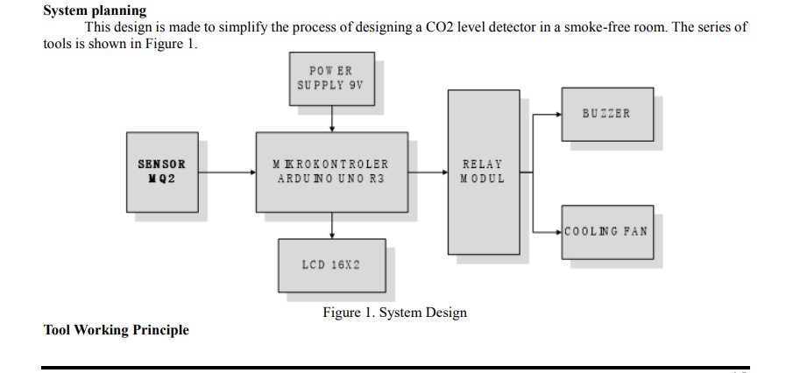
System planning
This design is made to simplify the process of designing a smoke level detector for a smoke-free room. The series of tools is shown in Figure 1.

Slide 9
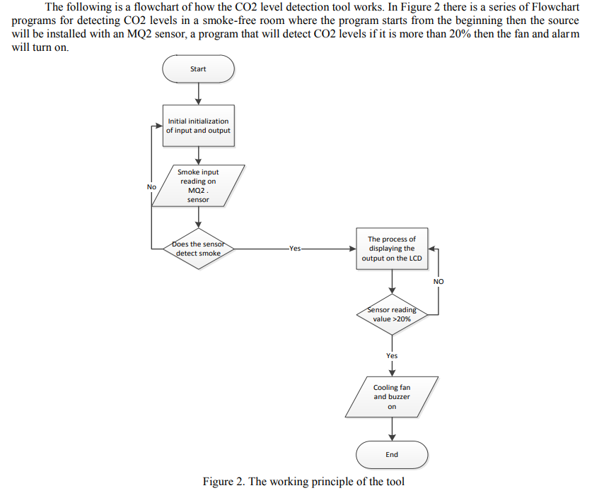
The following is a flowchart of how the CO2 level detection tool works. In Figure 2 there is a series of Flowchart programs for detecting CO2 levels in a smoke-free room where the program starts from the beginning then the source will be installed with an MQ2 sensor, a program that will detect CO2 levels if it is more than 20% then the fan and alarm will turn on.

Slide 10
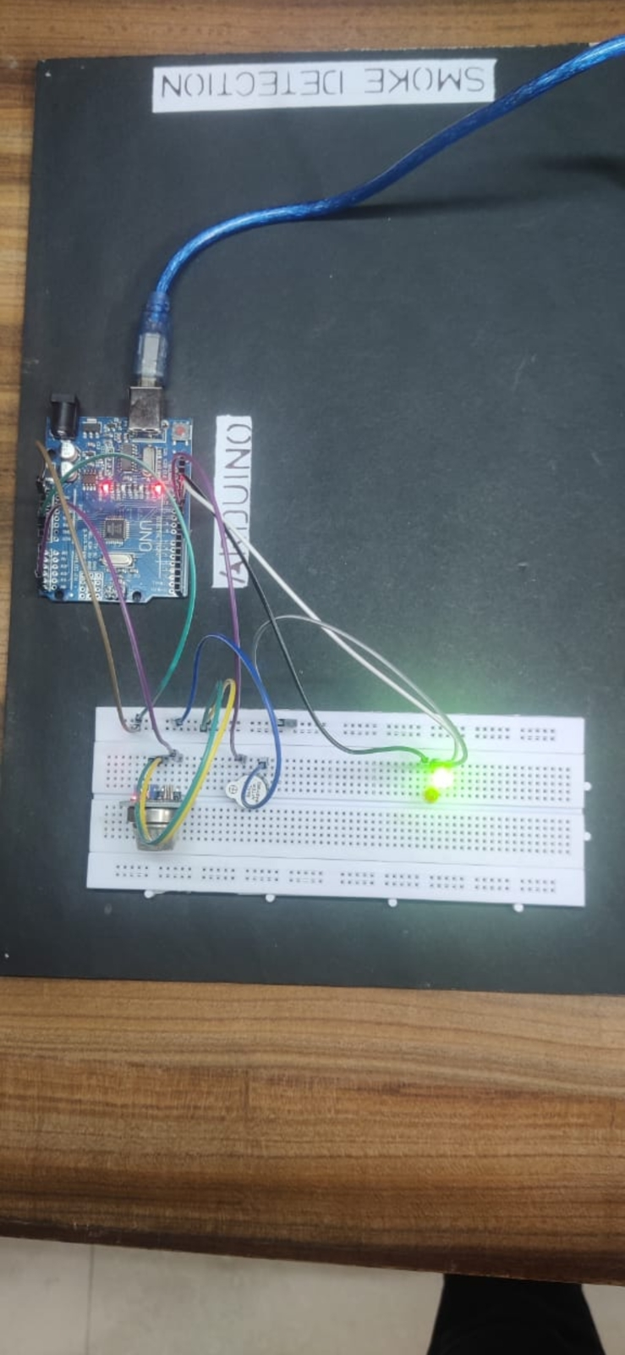
Set of tools
By using the Fritzing application, the following tool design is obtained, this smoke level detector works based on input from the sensor which will read the level, then the module will process the data, then be notified to Node and controlled by Arduino.
Node MCU instructs the LEDs and buzzer to live and helps in taking necessary actions.

Slide 11
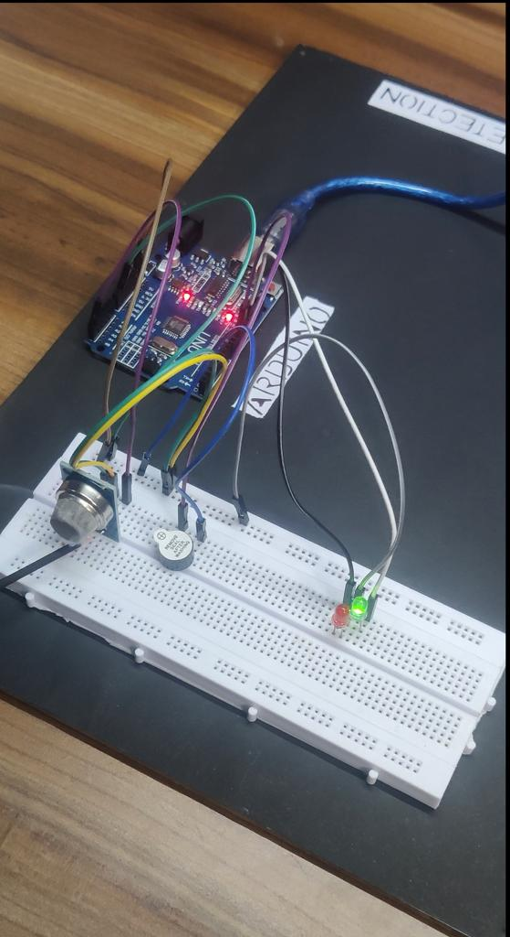
Result and Discussion
Chapter 4
Hardware implementation
Hardware implementation for making this setup is using one mq-2 sensor, Arduino U N O, and LEDs, assembled using a breadboard , for voltage divider we will be using 5V Relay, a buzzer , while a screen to Arduino output to read the content value as soon as possible in the test process try.

Slide 12
DISCUSSION
Testing of the detection and cleaning system of cigarette smoke was carried out at three different locations namely at Raja coffee, Primer Caffe, and Poltas Kantin, and the results showed that open spaces had higher smoke levels than closed spaces because they were easy to detect and clean using a colling fan.

Slide 13
Chapter 5
Conclusion and Future Work
The ability of this smoke detector to detect the presence of cigarette smoke in the air depends on the concentration of smoke, the distance from the source and sensor, and the direction of movement of the smoke. and from the results of tests carried out at three locations, it was explained that a closed room equipped with a colling fan to clean cigarette smoke levels made the room cleaner and reduced co2 levels.
In a fire, smoke and deadly gases tend to spread farther and faster than heat, leading to death from inhalation of smoke and toxic gases. The proposed system will give the combine result at the output whether smoke and fire is present or not. The system performance can be improved with the use of optimal algorithms for detecting motion area and extracting features of fire. Neural network based outputs from both flame and smoke modules are combined to get a final output with different states as: both smoke and flame are present, fire with smoke but without flame, fire with flame but without smoke and non-fire i.e. no smoke and no flame. The enhanced system will performed well than the existing system in terms of detection rate.

