Slide 1
Predicting the Popularity Index of the restaurants using Yelp Dataset
Submitted by: Ketan Walia

Slide 2
Approach
Our Objective: Predicting the popularity index of the restaurants in the yelp dataset.
Focus – “Open” restaurants
Fit a linear regression model on the dataset.
Split the dataset to have 50 – 50 training and testing data.
Built the model using training set and tested it on the test set.

Slide 3
Obtain data
Yelp dataset – obtained online from the yelp challenge website.
The business subset of the entire dataset was considered.
Considered around 6600+ instances of data.
More than 100 attributes.
Data Cleaning:
  Missing values were logically dealt by replacing with 0
  Attributes with less than 50% blank values were selected .

Slide 4
Libraries
Standard:
  Imported libraries such as pandas, numpy, matplotlib
  Imported linear regression from sklearn.linear_model
Custom: Self Library
  mylibrary.py

Slide 5
Iteration
For Loops:
  Used for iterating the process of joining data from two CSV files
  Used for filtering open restaurants out of the dataset.
  Used for generating the column stats iteratively.
  Used for checking the attributes if they have atleast 50% populated values

Slide 6
File I/O
Input files:
  The dataset from yelp.
  The final dataset file to fit the model
Read file:
  Reading two csv files before combining them
  Reading the popularity index restaurants file.
Output files:
  A combined CSV file from the huge dataset.
  CSV file that contains open restaurants.
  CSV file that has column stats.
  CSV file that has the final selected attributes.

Slide 7
Data Structure
Have used the following Data Structure:
  List
  Dictionary
  Arrays
  Data frames
  Series
  Stacks

Slide 8
Object orientation
Created Class with methods:
  Giving distribution/histogram of a particular column
  Giving the mean of a particular column
  Giving the Variance of a particular column
  Giving the frequency of a particular column
  Giving the maximum & minimum value in the column
  Getting to a particular column
Creating Objects from the class
Inheritance- Inherited one class from the other

Slide 9
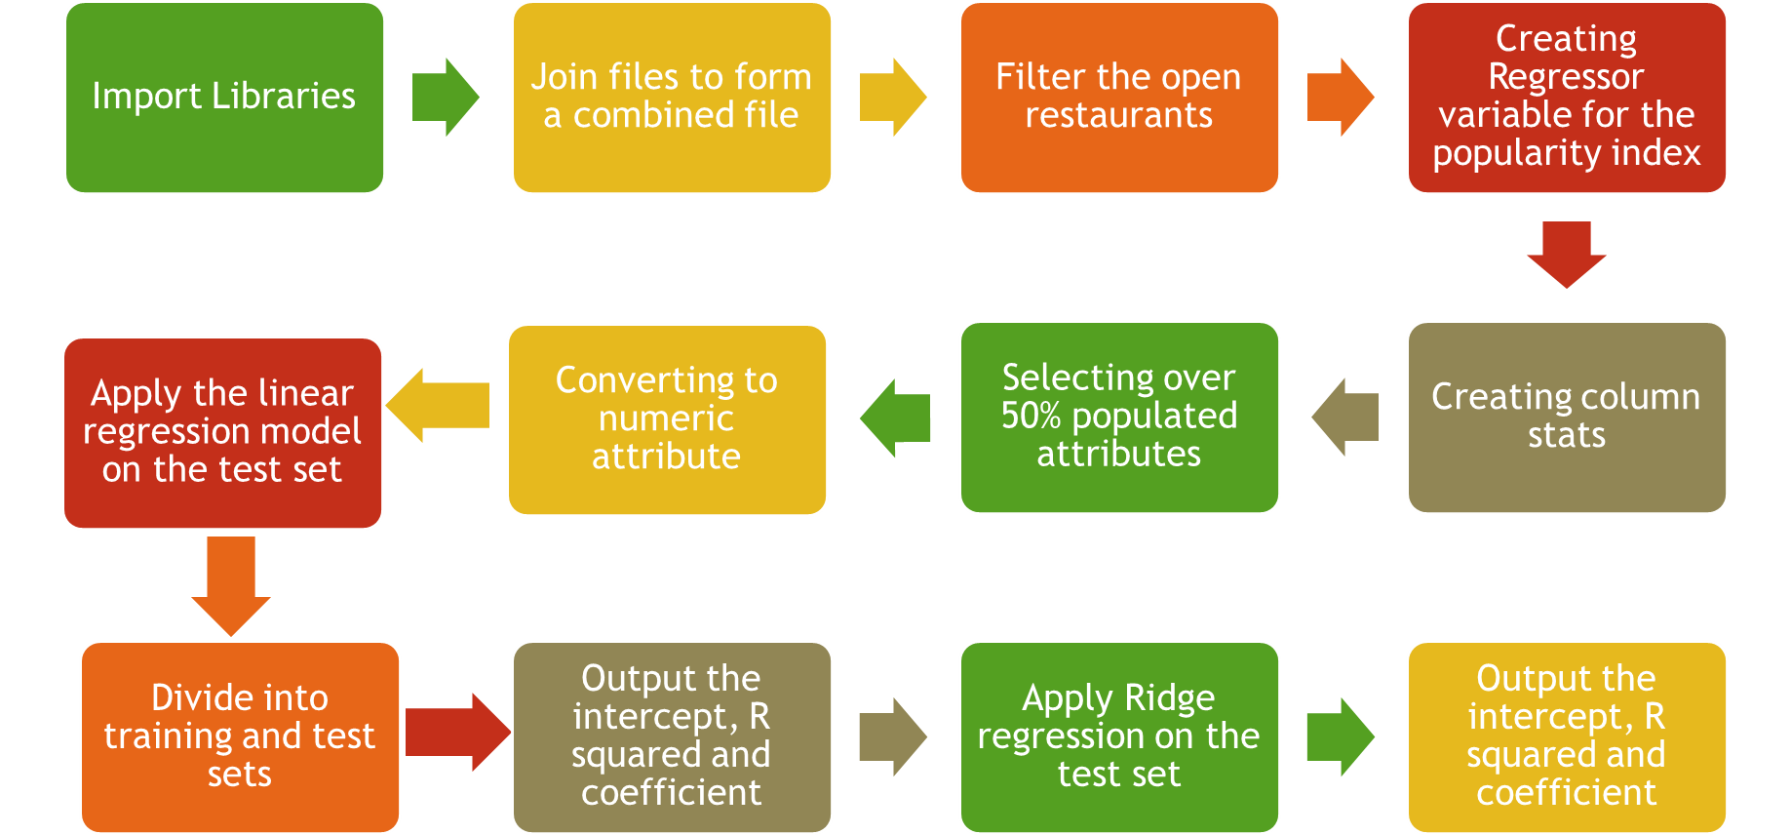
Flow of code

Slide 10
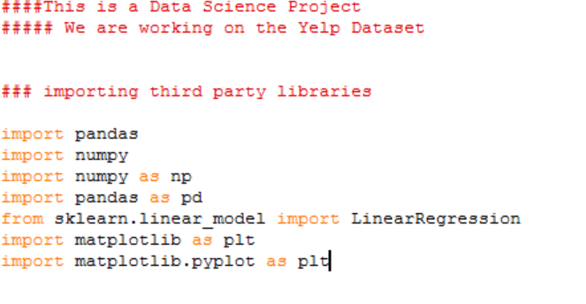
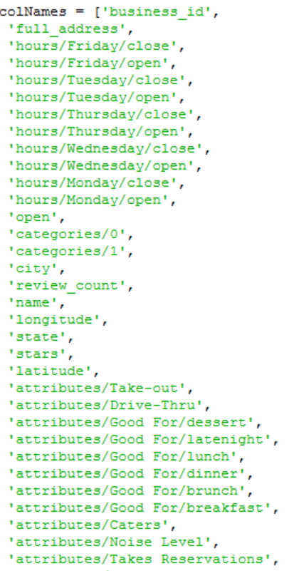
Importing Libraries
Joined two files to
Form a combined file

Slide 11
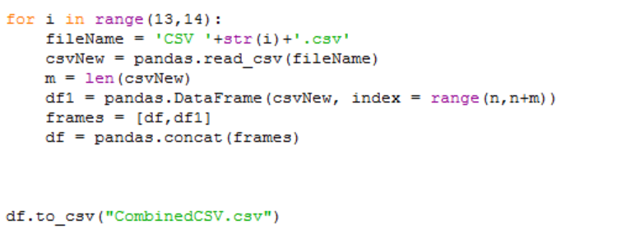
Combining two csv files into one
Output the file

Slide 12
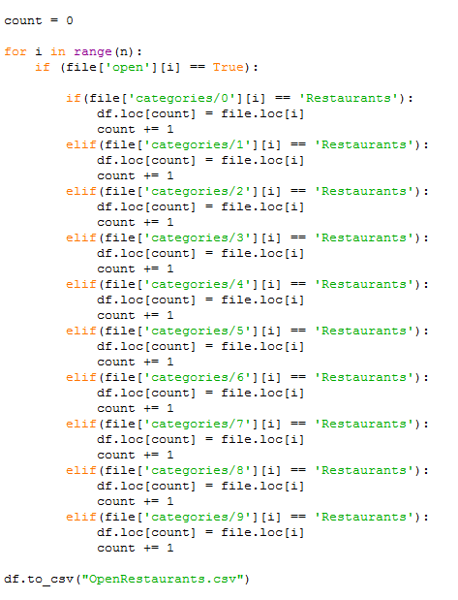
Criteria: Select only restaurants
which are open
Checked for the word “Restaurants”
In the first seven categories.
(We had to do this as if the “Restaurants”
Word appeared in one of the first seven
categories, the business is treated as
A restaurant.)
These list of open restaurants are written into a CSV file

Slide 13
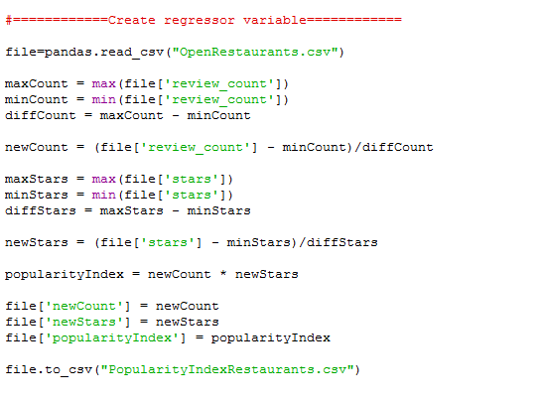
Normalized and created three new Attributes – newStars, newCount and popularity Index
Calculated the popularity index
Using the attributes
Wrote the file with popularity index to a CSV file

Slide 14
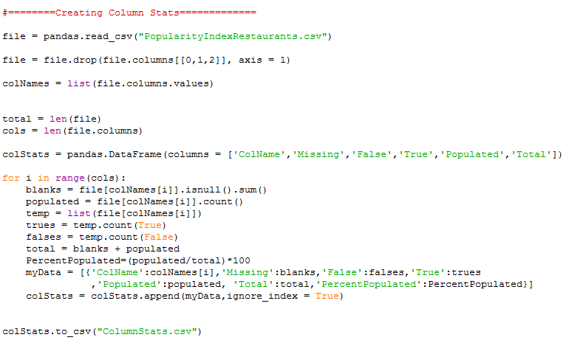
Calculated the number of missing, False, true or populated values in the columns
Wrote it to a CSV file

Slide 15
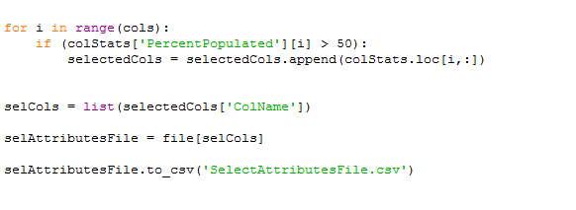
Selected only attributes which had atleast half of the values which are populated (populated = not missing)
Wrote it to the final CSV, called the “SelectAtrributesFile”. This is our final CSV with all data filtered and cleaned

Slide 16
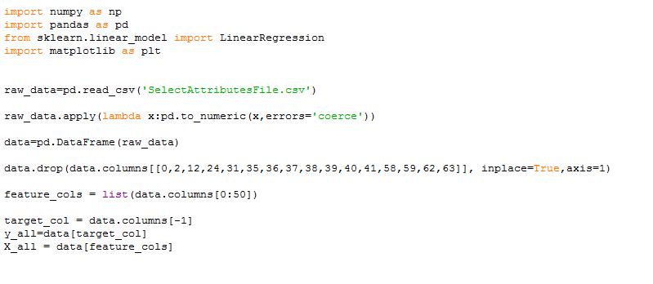
Importing libraries : numpy, pandas, Scikit Learn And matplotlib
Converting the dataframe type to numeric
Dropped columns which had
negligible variance
Separating the Regressor variable from the dataset

Slide 17
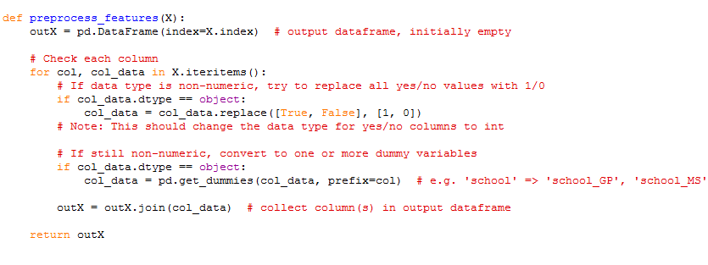
Defining function to generate dummy variables for categorical variables
Output and join the result to columns in the dataframe

Slide 18
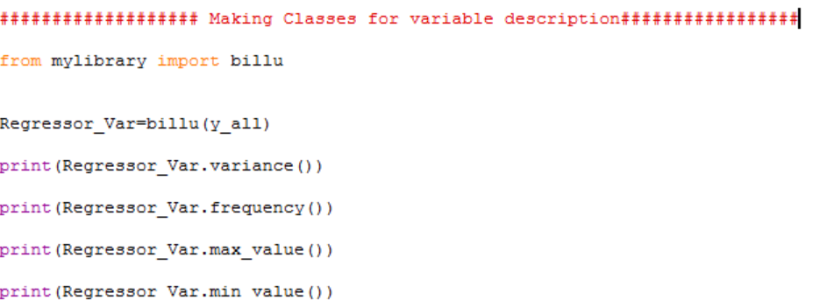
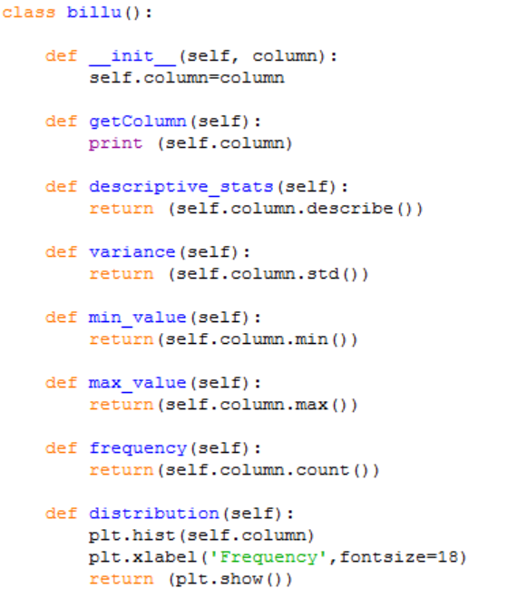
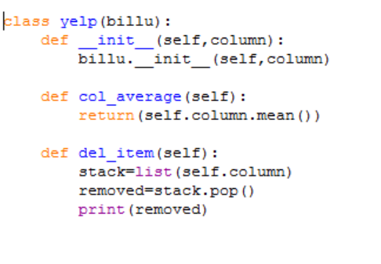
Making an object from the class in the main program and using the methods
Making self library “mylibrary.py” having a class named-billu with the mentioned methods
Inheriting another class “Pop_index_av” from the class “billu”

Slide 19
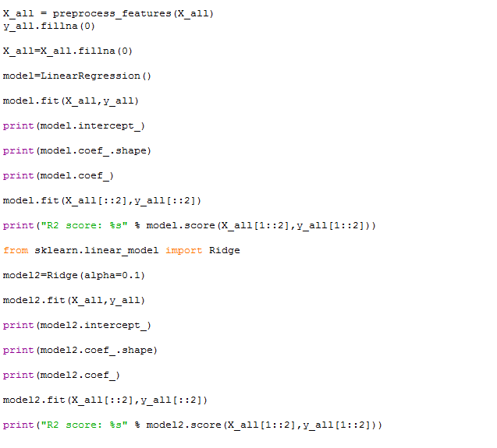
Building a Linear Regression Model
Fitting the model on every even sample and testing on every odd sample.
Print out the R Squared value, intercept and the coeff. for the linear regression model
Building & Applying the ridge regression
Model to the test set
Print out the R squared, intercept, and the coefficients

Slide 20
Building a Linear Regression Model
Fitting the model on every even sample and testing on every odd sample.
Print out the R Squared, intercept and the coeff for the linear regression model
Applying the ridge regression
Model to the test set
Print out the R squared, intercept, and the coefficients

Slide 21
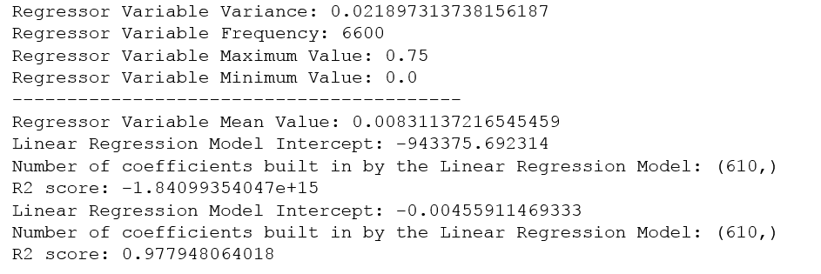
Output
There is high multicollinearity among the regressor variables.
Adding L2 penalty in the Multiple Regression Model constraints variance of beta coefficients & improves R square value considerably.

