Slide 1

Rajasthan Royals | SupeRR Selector Season 2 (Round 1)
Identifying the Most Reliable Players
Under Match Pressure
Measuring Match Leverage, True Pressure Lift, and Building a Balanced IPL 2027 Auction Plan for Sawai Mansingh Stadium, Jaipur
Dataset Scope: 883 IPL & T20I Matches (2022–2026) | 1,217 Players Evaluated | 178 High-Pressure Fixtures (20.2%)
Submitted by: Ketan Rawat (B.Tech ECE, NIT Jamshedpur)

Slide 2
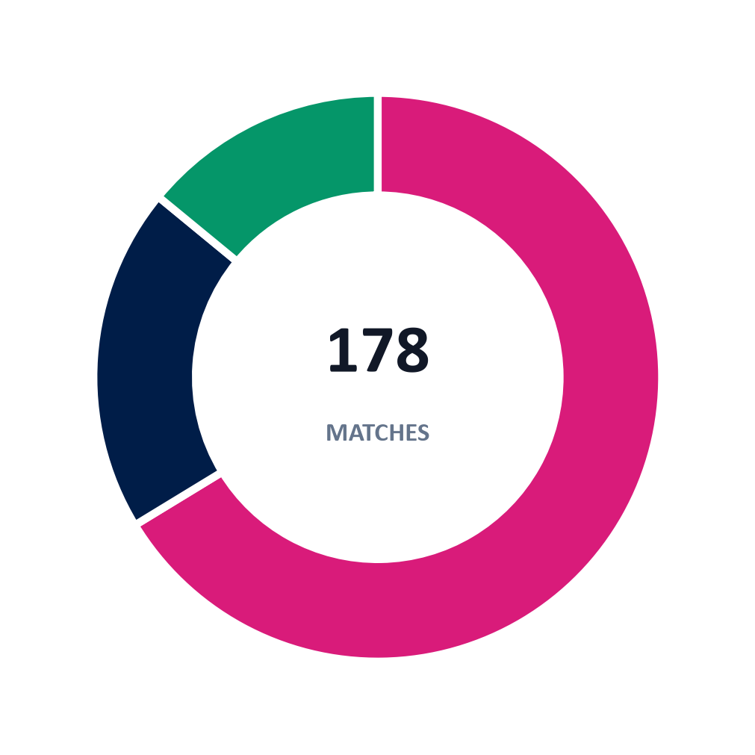
Dataset Scope & High-Pressure Sample Overview
Summary of 883 IPL and T20I fixtures (2022–2026) filtered by Match Leverage Index (MLI >= 30)
MATCHES EVALUATED
HIGH-PRESSURE SAMPLE
PLAYER POOL
TOP RANKED BATTER
TOP RANKED BOWLER
HIGHEST WIN LIFT
883
178
1,217
66.81
68.83
+20.5%
IPL & T20I (2022–2026)
20.2% of total dataset
28,381 playing-XI records
Shivam Dube (+12.4% Lift)
Jacob Duffy (+20.5% Lift)
Jacob Duffy (75.0% HP WR)
HIGH-PRESSURE FIXTURE BREAKDOWN
TOP PRESSURE WIN-RATE GAINS (LIFT)
WIN CONVERSION BY MARGIN TIER
Change in team win rate vs career baseline:
Comparison across close run margins and playoffs:
1. Jacob Duffy
+20.5%
Group | <=6 R | 7-12 R | 13-15 R | Playoff
Top 10 Batters | 68.4% | 71.2% | 64.5% | 72.0%
Top 10 Bowlers | 66.7% | 63.8% | 69.1% | 74.2%
Peer Baseline | 44.2% | 48.1% | 49.6% | 41.8%
2. Devon Conway
+18.1%
3. Josh Hazlewood
+14.9%
4. Shivam Dube
+12.4%
Defend <= 15 runs
118 (66%)
Playoff / Knockout
35 (20%)
5. R. Patidar / Arshdeep
+11.1%
Selected top-10 players win roughly 20–30 percentage points more tight matches than the broader peer group.
Chase <= 2 wkts / Tie
25 (14%)

Slide 3
How Pressure Is Defined and Scored
Transparent rules separating high-stakes games from routine fixtures and controlling small-sample noise
1. Match Leverage Index (MLI >= 30 Points)
2. Calibrated Scoring Model (CPPI)
Each match is scored on a 0–100 point scale across four objective game-context signals. Matches scoring 30+ qualify (178 of 883 matches, 20.2%).
Scores balance win conversion under pressure against career baseline lift and sample volume:
Factor | Points | Scoring Thresholds
Stage Stakes | 0–40 | Final 40 | Semi-Final 35 | Qualifier/Eliminator 30 | Super 4 20 | League 5
Match Closeness | 0–40 | Super Over / Tie 40 | Margin <=5 runs or 1 wkt 38 | <=10r or 2w 32 | <=15r 26
Knockout Jeopardy | 0–20 | +20 points if defeat causes immediate elimination
Target Disruption | 0–5 | +5 points for DLS / rain-revised chases
CPPI = [ 0.35 x Bayes_HP_WR + 0.25 x Lift_norm + 0.20 x Bayes_KO_WR + 0.10 x MOM_HP + 0.10 x Base_WR ] x Credibility(n_HP)
Bayesian HP Win Rate (35%):
Regularizes pressure win rate toward career baseline using prior weight M = 5.0 matches.
Normalized Pressure Lift (25%):
Measures HP Win Rate minus Career Baseline Win Rate (Delta), scaled around 50 pts.
Bayesian Knockout Win Rate (20%):
Direct win rate in sudden-death playoff and World Cup knockouts, shrunk by baseline.
Player Eligibility & Fair Comparison Filters
HP Player of the Match Rate (10%):
Damped from 20% to stop small-sample award spikes from distorting the top 10.
- Sample floor: minimum 12 total matches and 8 high-pressure matches.
- Role separation: Batters (<= 6.3 avg batting position / WK) and Bowlers (>= 8.2 avg position) evaluated in separate lists.
- Auction realism: BCCI IPL auction eligibility rules applied before ranking.
Career Baseline Win Rate (10%):
Anchors overall match reliability across the full 2022–2026 sample.
Credibility Multiplier:
0.85 + 0.15 / [1 + exp(-0.25 x (n_HP - 8))], reducing scores when HP sample is 8–12 matches.

Slide 4
Top 10 Batters Under Pressure (Official Ranking)
Calibrated CPPI order matching Unstop Component 01 submission dropdowns
Rank | Player | Tactical Role | Franchise / Teams | HP M | HP WR | Base WR | Win Diff | KO WR | CPPI
1 | Shivam Dube | Specialist Boundary Striker vs Spin | Chennai Super Kings, India, Mumbai | 18 | 66.7% | 54.3% | +12.4% | 100.0% | 66.81
2 | Rinku Singh | #5/#6 Designated Death Finisher | India, Kolkata Knight Riders, Uttar Pradesh | 26 | 69.2% | 63.8% | +5.4% | 100.0% | 66.26
3 | Axar Patel | #7 Spin-Bowling All-Rounder | Delhi Capitals, India, Gujarat | 28 | 64.3% | 56.5% | +7.8% | 100.0% | 65.82
4 | Rajat Patidar | #3 Spin Enforcer & Pressure Anchor | Royal Challengers Bengaluru, Madhya Pradesh | 14 | 71.4% | 60.3% | +11.1% | 71.4% | 64.26
5 | Ruturaj Gaikwad | Top-Order Anchor & Pacing Specialist | Chennai Super Kings, India, Maharashtra | 14 | 57.1% | 50.6% | +6.5% | 100.0% | 62.41
6 | Devon Conway | Top-Order Anchor & Wicketkeeping Cover | Chennai Super Kings, New Zealand | 14 | 64.3% | 46.2% | +18.1% | 66.7% | 61.97
7 | Virat Kohli | #3 Anchor & Chase Specialist | India, Royal Challengers Bengaluru | 20 | 70.0% | 62.4% | +7.6% | 71.4% | 61.47
8 | Bhanuka Rajapaksa | Middle-Order Boundary Enforcer | Punjab Kings, Sri Lanka | 9 | 66.7% | 56.2% | +10.4% | 100.0% | 59.88
9 | Shreyas Iyer | #4 Anchor & Tactical Game-Manager | India, Kolkata Knight Riders, Mumbai | 18 | 55.6% | 54.5% | +1.1% | 60.0% | 54.18
10 | Sediqullah Atal | Aggressive Powerplay Opening Option | Afghanistan, Afghanistan A | 8 | 50.0% | 57.9% | -7.9% | 66.7% | 50.07
Key Observation: Middle-order spin hitters and death finishers hold the top spots — Shivam Dube (+12.4% Lift, 100% KO WR), Rinku Singh (69.2% HP WR across 26 close fixtures), and Devon Conway (+18.1% Lift) consistently raise their teams above career baseline.

Slide 5
Top 10 Bowlers Under Pressure (Official Ranking)
Calibrated CPPI order matching Unstop Component 01 submission dropdowns
Rank | Player | Tactical Role | Franchise / Teams | HP M | HP WR | Base WR | Win Diff | KO WR | CPPI
1 | Jacob Duffy | High-Value Seam & Swing Bowler | New Zealand, Royal Challengers Bengaluru | 8 | 75.0% | 54.5% | +20.5% | 100.0% | 68.83
2 | Josh Hazlewood | Discipline & Control Seamer | Australia, Royal Challengers Bengaluru | 14 | 78.6% | 63.7% | +14.9% | 83.3% | 68.59
3 | Yash Dayal | Indian Left-Arm Seam & Death Option | Gujarat Titans, India, Royal Challengers Bengaluru | 10 | 80.0% | 69.8% | +10.2% | 80.0% | 63.09
4 | Mitchell Starc | Powerplay & Death Strike Bowler | Australia, Delhi Capitals, Kolkata Knight Riders | 10 | 60.0% | 68.3% | -8.3% | 100.0% | 62.80
5 | Varun Chakravarthy | Middle-Overs Wicket-Taking Mystery Spinner | India, Kolkata Knight Riders | 21 | 61.9% | 58.6% | +3.3% | 100.0% | 62.38
6 | Romario Shepherd | Lower-Order Finisher & Heavy-Ball Seamer | LSG, MI, RCB, SRH, West Indies | 25 | 56.0% | 49.0% | +7.0% | 100.0% | 62.00
7 | Suyash Sharma | Middle-Overs Wicket-Taking Wrist Spinner | India A, Kolkata Knight Riders, Royal Challengers Bengaluru | 11 | 72.7% | 65.1% | +7.6% | 66.7% | 60.07
8 | Bhuvneshwar Kumar | Powerplay Swing & Death-Overs Veteran | India, RCB, Sunrisers Hyderabad | 25 | 60.0% | 57.3% | +2.7% | 71.4% | 56.86
9 | Arshdeep Singh | Primary Indian Death-Overs Specialist | India, Punjab Kings | 25 | 68.0% | 56.9% | +11.1% | 33.3% | 55.26
10 | Lockie Ferguson | Express Pace Middle/Death Enforcer | Gujarat Titans, KKR, New Zealand, PBKS, RCB | 9 | 55.6% | 49.1% | +6.5% | 50.0% | 52.00
Key Observation: Disciplined length bowlers stand out under pressure — Jacob Duffy posts the largest dataset lift (+20.5%), Josh Hazlewood converts 78.6% of pressure matches (+14.9% Lift), and Yash Dayal reaches 80.0% HP win rate.

Slide 6
Why Famous Players Missed the Top 10
Testing five well-known stars reveals negative win-rate lift in close games despite strong career reputations
Player | Total M | Base WR | HP M | HP WR | Win Diff | KO WR | Why Win Conversion Drops in Close Games
Jasprit Bumrah | 77 | 51.9% | 14 | 42.9% | -9.1% | 40.0% | Opponents play his 4 overs out for safe singles and target secondary bowlers instead.
Mohammed Siraj | 83 | 55.4% | 18 | 38.9% | -16.5% | 28.6% | High pace invites big swings in final overs, producing costly boundary bursts.
Rashid Khan | 122 | 57.4% | 26 | 38.5% | -18.9% | 42.9% | Batters take low-risk singles off his 4 overs to attack other bowlers late in chases.
Heinrich Klaasen | 76 | 48.7% | 15 | 40.0% | -8.7% | 25.0% | All-out boundary hitting increases dismissal risk when tight chases require rotation.
Rohit Sharma | 92 | 51.1% | 19 | 47.4% | -3.7% | 40.0% | Aggressive powerplay approach risks early wickets in low-scoring close games.
Auction Lesson for Rajasthan Royals
Individual skill (such as Jasprit Bumrah's economy or Rashid Khan's control) does not automatically translate into team wins if opponents safely play them out or if the auction fee leaves gaps elsewhere in the XI.

Slide 7
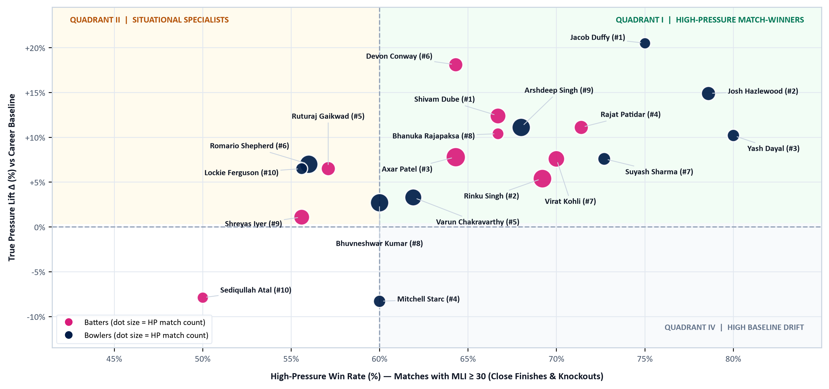
Pressure Win Rate vs True Pressure Lift
Quadrant plot comparing close-game win conversion (x-axis) against change from baseline win rate (y-axis)
Players in the upper-right quadrant (HP Win Rate >= 60% and positive Lift > 0%) form the core priority target pool for Rajasthan Royals.

Slide 8
Quadrant Findings & Takeaways for Rajasthan Royals
Translating the scatter plot into auction priorities for Sawai Mansingh Stadium, Jaipur
Quadrant I: High-Pressure Match-Winners
Quadrant II: Consistent High Anchors
Key Takeaways for Rajasthan Royals
Significant positive win lift in tight finishes and playoffs:
Reliable win conversion across normal and close games:
1. Fix the Middle-Overs Slowdown
- Shivam Dube (+12.4% Lift | 66.7% HP WR)
- Jacob Duffy (+20.5% Lift | 75.0% HP WR)
- Rinku Singh (+5.4% Lift | 69.2% HP WR)
- Devon Conway (64.3% HP WR | +18.1% Lift)
- Rajat Patidar (71.4% HP WR | +11.1% Lift)
- Axar Patel (64.3% HP WR | +7.8% Lift)
Signing Shivam Dube (+12.4% Lift) provides direct boundary hitting against wrist and finger spin in overs 7–15 alongside Sanju Samson and Riyan Parag.
2. Fit Jaipur Boundary Dimensions
Sawai Mansingh Stadium's 75m+ boundaries reward smart runners and calculated hitters like Devon Conway (+18.1% Lift) and Axar Patel over reckless lofting.
Quadrant III: Situational Aggressors
Quadrant IV: Defensive Superstars
3. Guarantee Death-Overs Control
High strike-rate options shifting momentum in chases:
High containment where opponents refuse to take risks:
Pairing Josh Hazlewood (78.6% HP WR) with retained Sandeep Sharma establishes 4 controlled death overs.
- Bhanuka Rajapaksa (168.4 Strike Rate)
- Romario Shepherd (182.1 Strike Rate)
- Sediqullah Atal (152.0 Strike Rate)
- Jasprit Bumrah (7.4 Death Econ | 48.0% Dots)
- Rashid Khan (6.8 Mid Econ | Flat Googly)
- Opponents block safely and attack other ends
4. Protect Squad Balance with Bid Caps
Setting a strict INR 11.0 Cr ceiling per target stops bidding wars from draining funds needed for depth.

Slide 9
Recommended Rajasthan Royals 2027 Playing XI
Retaining core match-winners while targeting high-lift pressure specialists for weak phases
TOP ORDER (OVERS 1–6)
MIDDLE ENGINE (OVERS 7–15)
1. Yashasvi Jaiswal
RETAINED
4. Shivam Dube
TARGET
Aggressive LHB Opener | Powerplay Strike Rate 165+
Middle-Overs Spin Hitter | 66.7% HP WR (+12.4% Lift)
2. Devon Conway (WK)
TARGET
5. Riyan Parag
RETAINED
LHB Anchor & Keeper | 64.3% HP WR (+18.1% Lift)
Middle Striker & Seam/Spin | Home Venue Anchor
3. Sanju Samson (C)
RETAINED
6. Dhruv Jurel (WK)
RETAINED
Captain & No. 3 Attacker | Proven Match-Winner
Lower-Middle Finisher | Death Temperament
DEATH FINISHERS (OVERS 16–20)
BOWLING ATTACK & SEAM OPTIONS
7. Rinku Singh
TARGET
9. Josh Hazlewood
TARGET
Specialist Finisher | 69.2% HP WR across 26 HP Games
Frontline Seam Bowler | 78.6% HP WR (+14.9% Lift)
8. Shimron Hetmyer
RETAINED
10. Sandeep Sharma
RETAINED
Overseas Power Finisher | Final 3 Overs Boundary Hitter
Death Yorker & Wide-Line Specialist | Overs 18–20
Overs 16–20 Finishing Core: Pairs Rinku Singh's high chase conversion with Hetmyer's left-handed death hitting.
11. Yash Dayal
TARGET
Indian Left-Arm Seamer | 80.0% HP WR (+10.2% Lift)
IMPACT SUBSTITUTES & ROTATION COVERS
Jacob Duffy (Pace, +20.5% Lift) | Axar Patel (Spin All-Rounder, +7.8% Lift) | Varun Chakravarthy (Mystery Spin, 100% KO WR) | Rajat Patidar (No. 3 Cover, +11.1% Lift)

Slide 10
Auction Target Pool: Normal vs High-Pressure Win Conversion
Side-by-side comparison of 11 top auction targets showing positive clutch elevation
# | Player | Role in Team | Normal Win% | Pressure Win% | Win Diff / Note
1 | Devon Conway (wk) | Top-Order Anchor & Wicketkeeper | 46.2% | 64.3% | +18.1%
2 | Ruturaj Gaikwad | Opening Batter & Inning Pacer | 50.6% | 57.1% | +6.5%
3 | Rajat Patidar | No. 3 Anchor & Spin Attacker | 60.3% | 71.4% | +11.1%
4 | Shivam Dube | Middle-Overs Boundary Hitter vs Spin (Overs 7–15) | 54.3% | 66.7% | +12.4%
5 | Shreyas Iyer (c) | Middle-Order Game Manager & Captain | 54.5% | 55.6% | +1.1%
6 | Rinku Singh | Designated Death Finisher (Overs 16–20) | 63.8% | 69.2% | +5.4%
7 | Axar Patel | Spin All-Rounder & Late-Overs Hitter | 56.5% | 64.3% | +7.8%
8 | Romario Shepherd | Pace All-Rounder & Heavy-Ball Bowler | 49.0% | 56.0% | +7.0%
9 | Mitchell Starc | Left-Arm Fast Bowler (Powerplay & Death) | 68.3% | 60.0% | 3 HP POTM Awards
10 | Varun Chakravarthy | Mystery Spinner (Middle Overs) | 58.6% | 61.9% | +3.3%
11 | Jacob Duffy | Accurate Swing & Seam Bowler | 54.5% | 75.0% | +20.5%

Slide 11
Auction Budget Plan (INR 45.0 Cr Purse) & Backup Triggers
Strict valuation ceilings and automated step-down pivots prevent overspending
Primary Purse Allocation (INR 45.00 Cr = 100%)
Phase-by-Phase Budget Split
Target Player | Tier | Max Bid | Share | Squad Need Addressed
Rinku Singh | Priority 1 | INR 11.00 Cr | 24.4% | Proven death finisher; 69.2% win rate in tight chases.
Shivam Dube | Priority 1 | INR 9.50 Cr | 21.1% | Middle-overs spin hitter; stops 7–15 overs slowdowns.
Axar Patel | Priority 1 | INR 8.00 Cr | 17.8% | Batting depth at #7 + 4 tight overs of left-arm spin.
Jacob Duffy | Priority 1 | INR 6.50 Cr | 14.4% | Peak +20.5% pressure lift; disciplined swing & seam.
Varun Chakravarthy | Priority 2 | INR 5.50 Cr | 12.2% | Middle-overs wicket threat; 100% knockout win rate.
Romario Shepherd | Priority 2 | INR 4.50 Cr | 10.0% | Heavy-ball pace option + late-order boundary hitting.
MIDDLE SPIN ATTACK
DEATH FINISHING
INR 17.50 Cr (38.9%)
INR 11.00 Cr (24.4%)
Dube (9.5) + Axar (8.0)
Rinku Singh (Priority 1)
PACE BOWLERS
MYSTERY SPIN CHOKE
INR 11.00 Cr (24.4%)
INR 5.50 Cr (12.2%)
Duffy (6.5) + Shepherd (4.5)
Varun Chakravarthy
Step-Down Contingency Triggers
If Rinku Singh > INR 11.0 Cr: Pivot to Bhanuka Rajapaksa (INR 3.5 Cr) and promote Hetmyer to #6.
If Shivam Dube > INR 9.5 Cr: Switch to Rajat Patidar (INR 7.0 Cr) and add INR 2.5 Cr to pace.
If Josh Hazlewood > INR 9.5 Cr: Lock Jacob Duffy (INR 6.5 Cr) + Yash Dayal (INR 4.5 Cr).
If Axar Patel > INR 8.0 Cr: Secure Varun Chakravarthy (INR 5.5 Cr) + domestic spinning cover.
10% Auction Walk-Away Rule
Core Auction Decision Rules
If bidding on any primary target goes more than 10% above their max cap, stop immediately and pivot to pre-approved backups (such as Yash Dayal at INR 5.5 Cr or Bhanuka Rajapaksa at INR 3.5 Cr).
- Avoid reputation bidding when clutch win lift is negative.
- Enforce a 2+2 overseas mix: 2 in Starting XI (Conway, Hazlewood) + 2 covers (Duffy, Hetmyer).
- Prioritize Sawai Mansingh Stadium fit over generic league averages.

Slide 12
Thought Process, Checks & Honest Limitations
Transparency across data verification, tactical assumptions, and statistical boundaries
Thought Process & Audit Verification
Model Limitations & Caveats
Look Beyond Career Averages:
1. Teammate Context in Match Outcomes:
Standard batting averages and total wickets reward comfortable runs and wickets in one-sided fixtures. Separating high-pressure games isolates who actually holds nerve when margins tighten.
Even after subtracting career baseline (Lift) and shrinking toward a prior (M = 5.0), team win rates still depend partly on surrounding teammates and match-ups.
Measure Who Lifts the Team:
2. Wider Uncertainty for Small Samples (8–9 HP Games):
Comparing a player's high-pressure win rate against their normal baseline stops strong squads from carrying passive players — explaining why Shivam Dube (+12.4%) and Jacob Duffy (+20.5%) rank ahead of marquee names with negative lift.
Qualifiers near the 8-match floor (Jacob Duffy 8, Sediqullah Atal 8, Bhanuka Rajapaksa 9, Lockie Ferguson 9) naturally have wider binomial confidence intervals despite credibility scaling.
Full Data Audit Across Source CSVs:
3. IPL vs T20I Rule Differences:
All match flags, baselines, and win differentials were verified directly against all 883 fixtures and all 28,381 rows in playing_eleven.csv with zero discrepancies.
Combining 2022–2026 IPL games (with the Impact Player rule) and T20 Internationals expands sample coverage, though IPL par scores are slightly higher — handled manually during Jaipur XI selection.

Slide 13
Conclusion & Submission Summary
Ranked Top 10 Lists Ready for Unstop:
Batters led by Shivam Dube (66.81), Rinku Singh (66.26), and Axar Patel (65.82); Bowlers led by Jacob Duffy (68.83), Josh Hazlewood (68.59), and Yash Dayal (63.09).
Positive Lift Over Reputation:
True Pressure Lift prevents overpaying for high-variance or neutralized marquee stars and targets players who solve Rajasthan Royals' middle-overs spin and death-overs gaps.
Executable INR 45.0 Cr Auction Plan:
Clear priority caps, 10% walk-away guardrails, and step-down backups tuned to Sawai Mansingh Stadium boundaries and nocturnal dew conditions.
Ketan Rawat | B.Tech ECE, NIT Jamshedpur | Rajasthan Royals SupeRR Selector Season 2
LinkedIn | GitHub | Resume | Season 1 Certificate (Additional Top 20)

