Slide 1
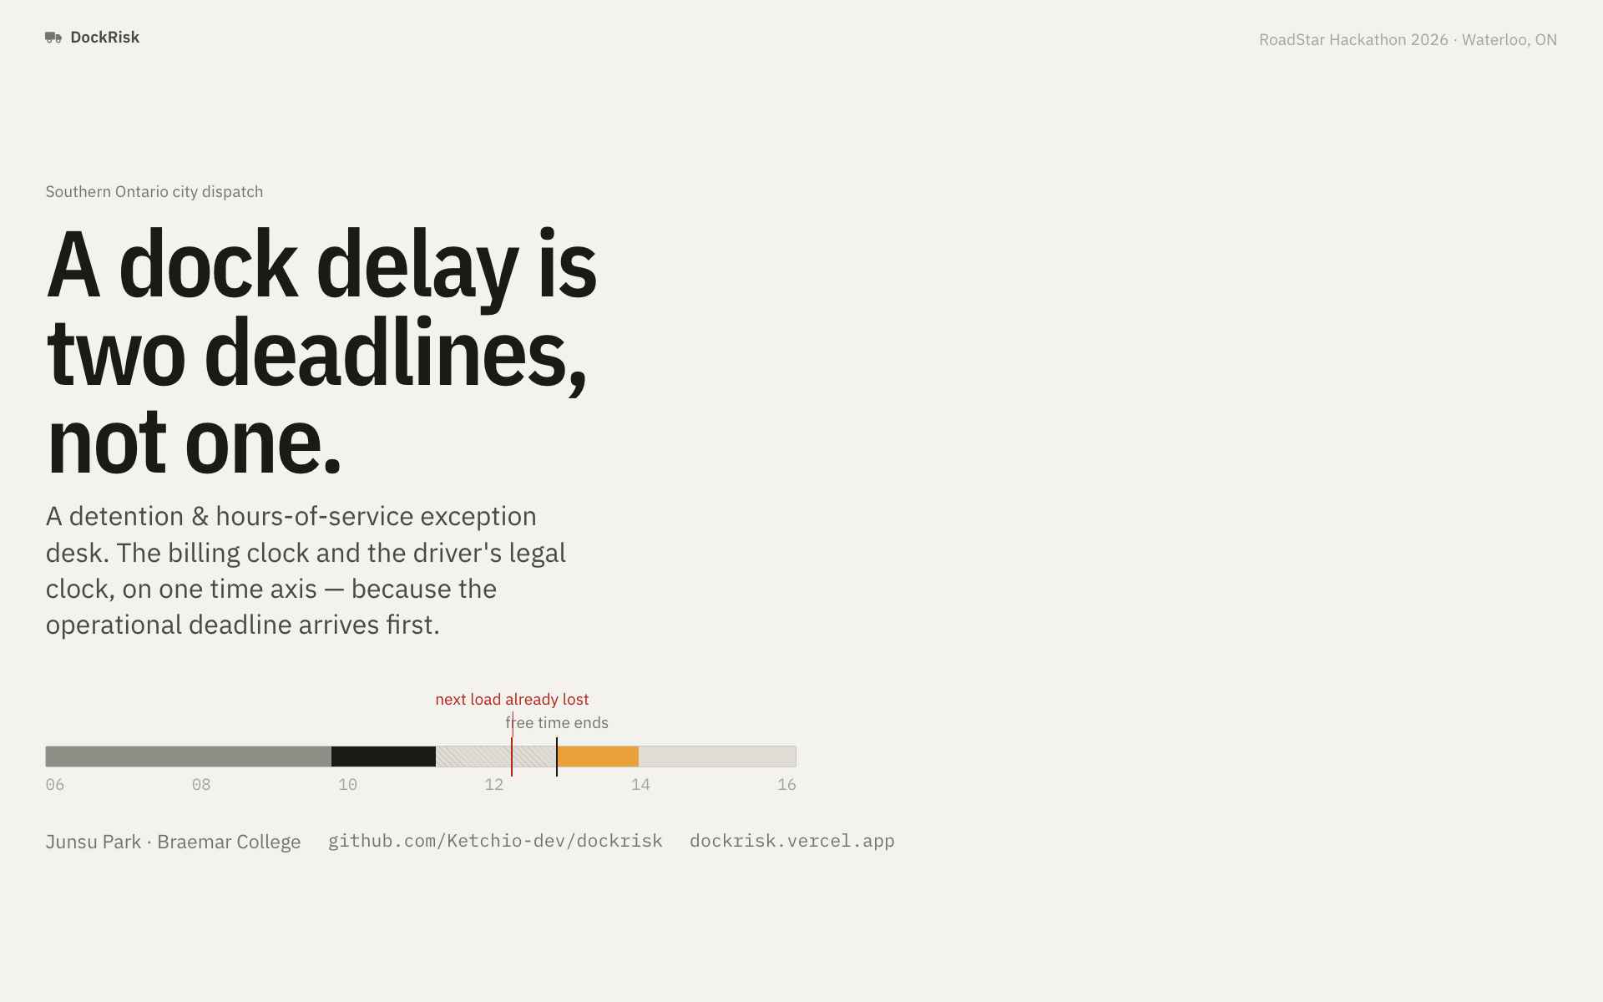
Notes:
Open cold, on the bar. "This is one truck's Sunday. The hatched part is the two hours of free time the contract gives the customer. The amber is money. And this red tick — the one that matters — is the moment the driver's next load became impossible. It happens before the amber starts."
Then: "Nobody in city dispatch is watching that red tick. That's the whole talk."
Keep it to 40 seconds. Do not read the subtitle aloud.

Slide 2
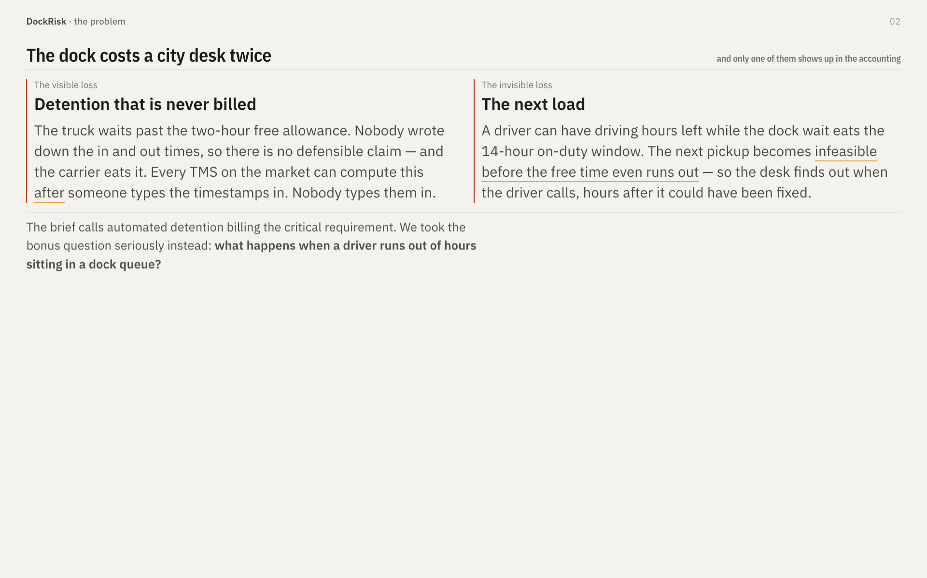
Notes:
• Land the asymmetry: the visible loss is an accounting problem, the invisible one is an operations problem. Only the second one is still open.
• The last line is the organizers' own bonus-focus question, quoted from the brief. Say that out loud — "this is your question, not ours." It buys credibility for the next four minutes.
• ~60 seconds. Do not linger; the numbers slide does the convincing.

Slide 3
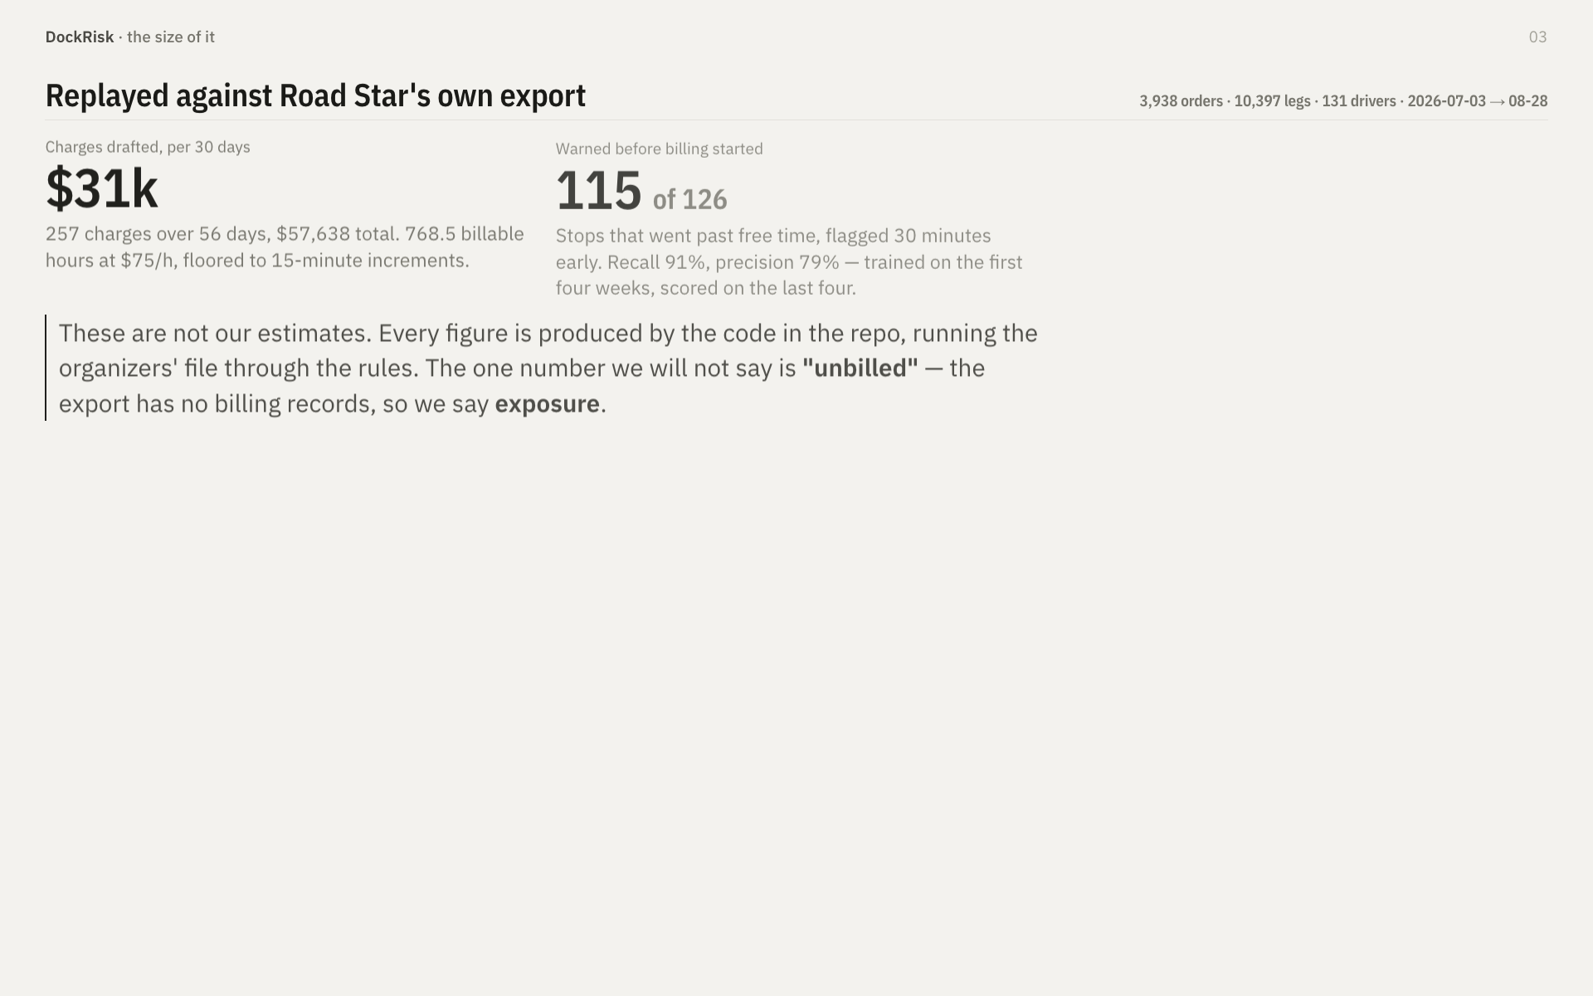
Notes:
• This is the Industry Impact slide — 25% of the score, the heaviest single criterion. Slow down here.
• Point at $31k and say: "that is one month, one mid-size carrier, from your file."
• The last paragraph is deliberate. A fleet GM in the room will grade you on saying exposure instead of unbilled . Say the distinction out loud — it signals you read the data instead of the pitch deck.
• If asked "is 79% precision good?" — answer: a false positive costs a dispatcher one glance; a false negative costs the charge and the load.

Slide 4
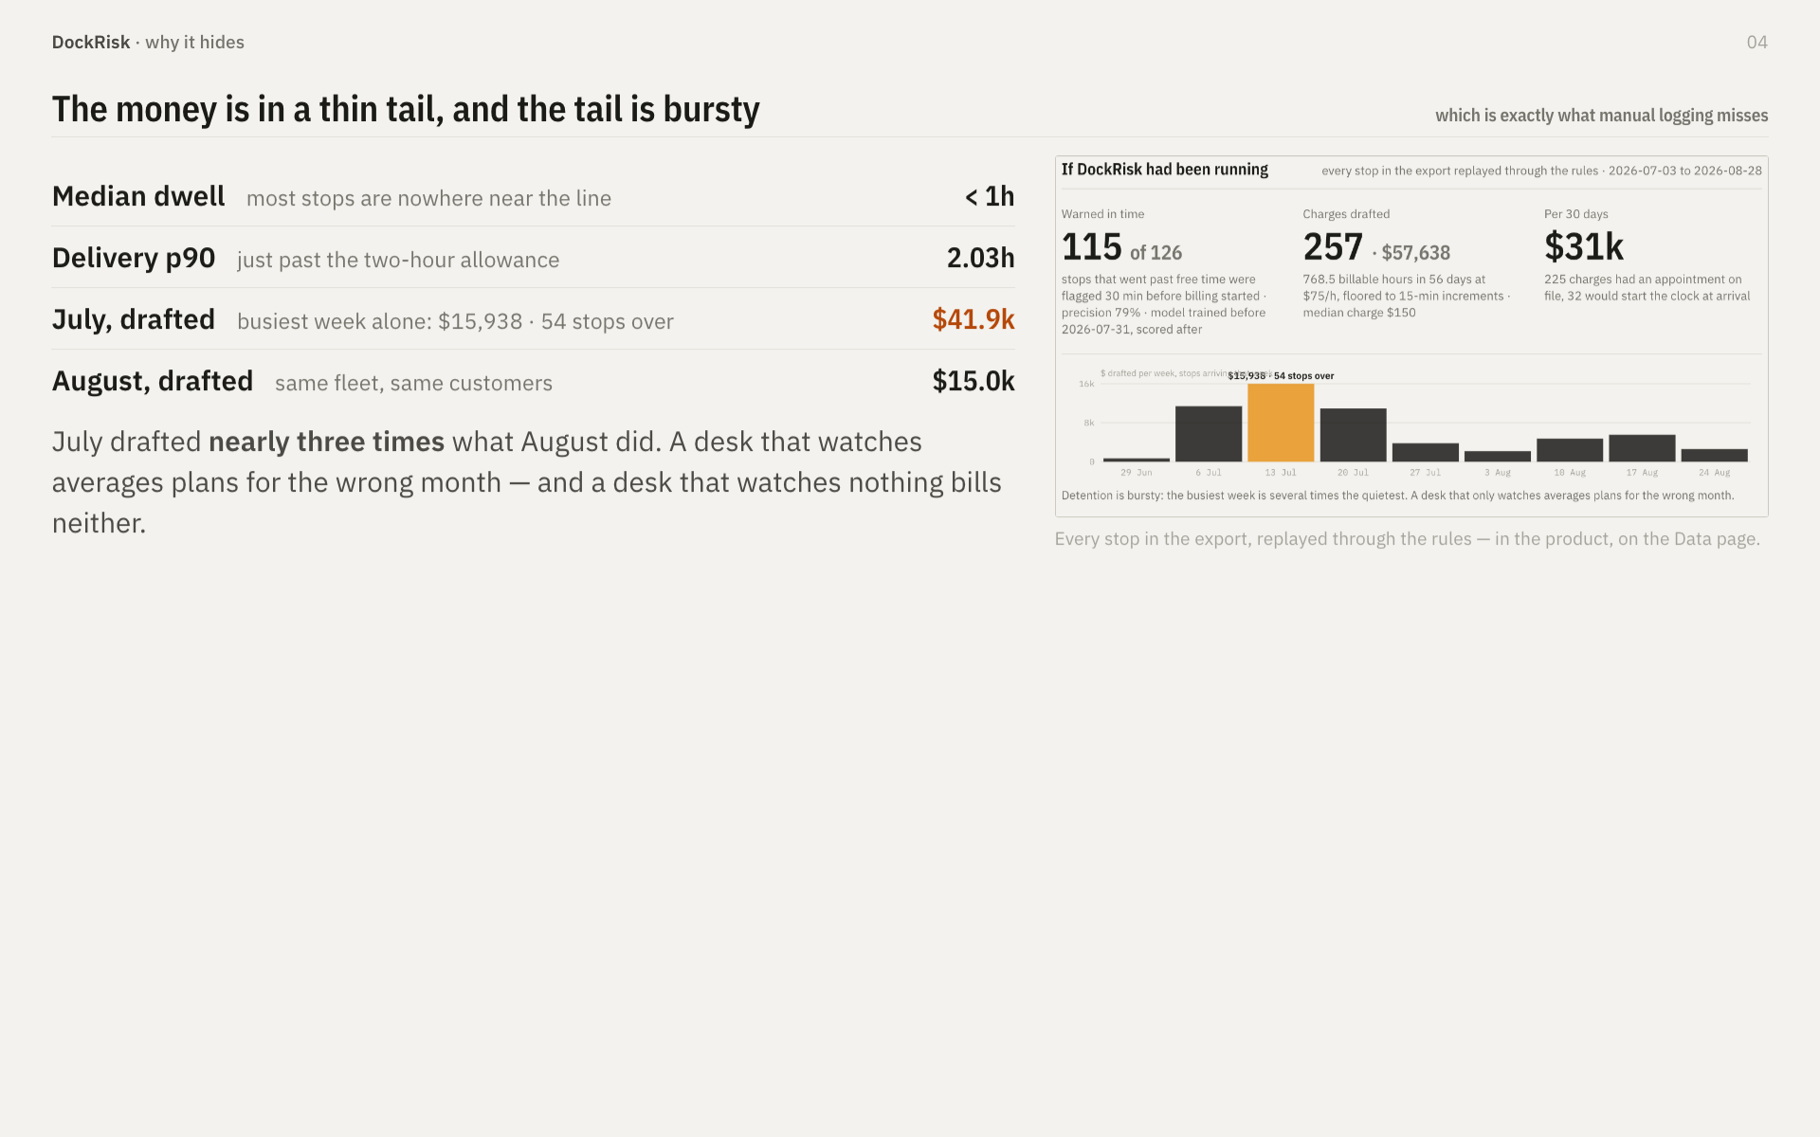
Notes:
• The point of this slide is why nobody has solved it already : the average stop looks fine. You cannot staff for a problem whose median is "no problem."
• "Nearly three times" — say the two numbers, $41.9k and $15.0k, don't just say the ratio.
• The chart on the right is a real product screen, not a slide graphic. Mention that once; it earns Technical Execution points quietly.
• ~50 seconds.

Slide 5
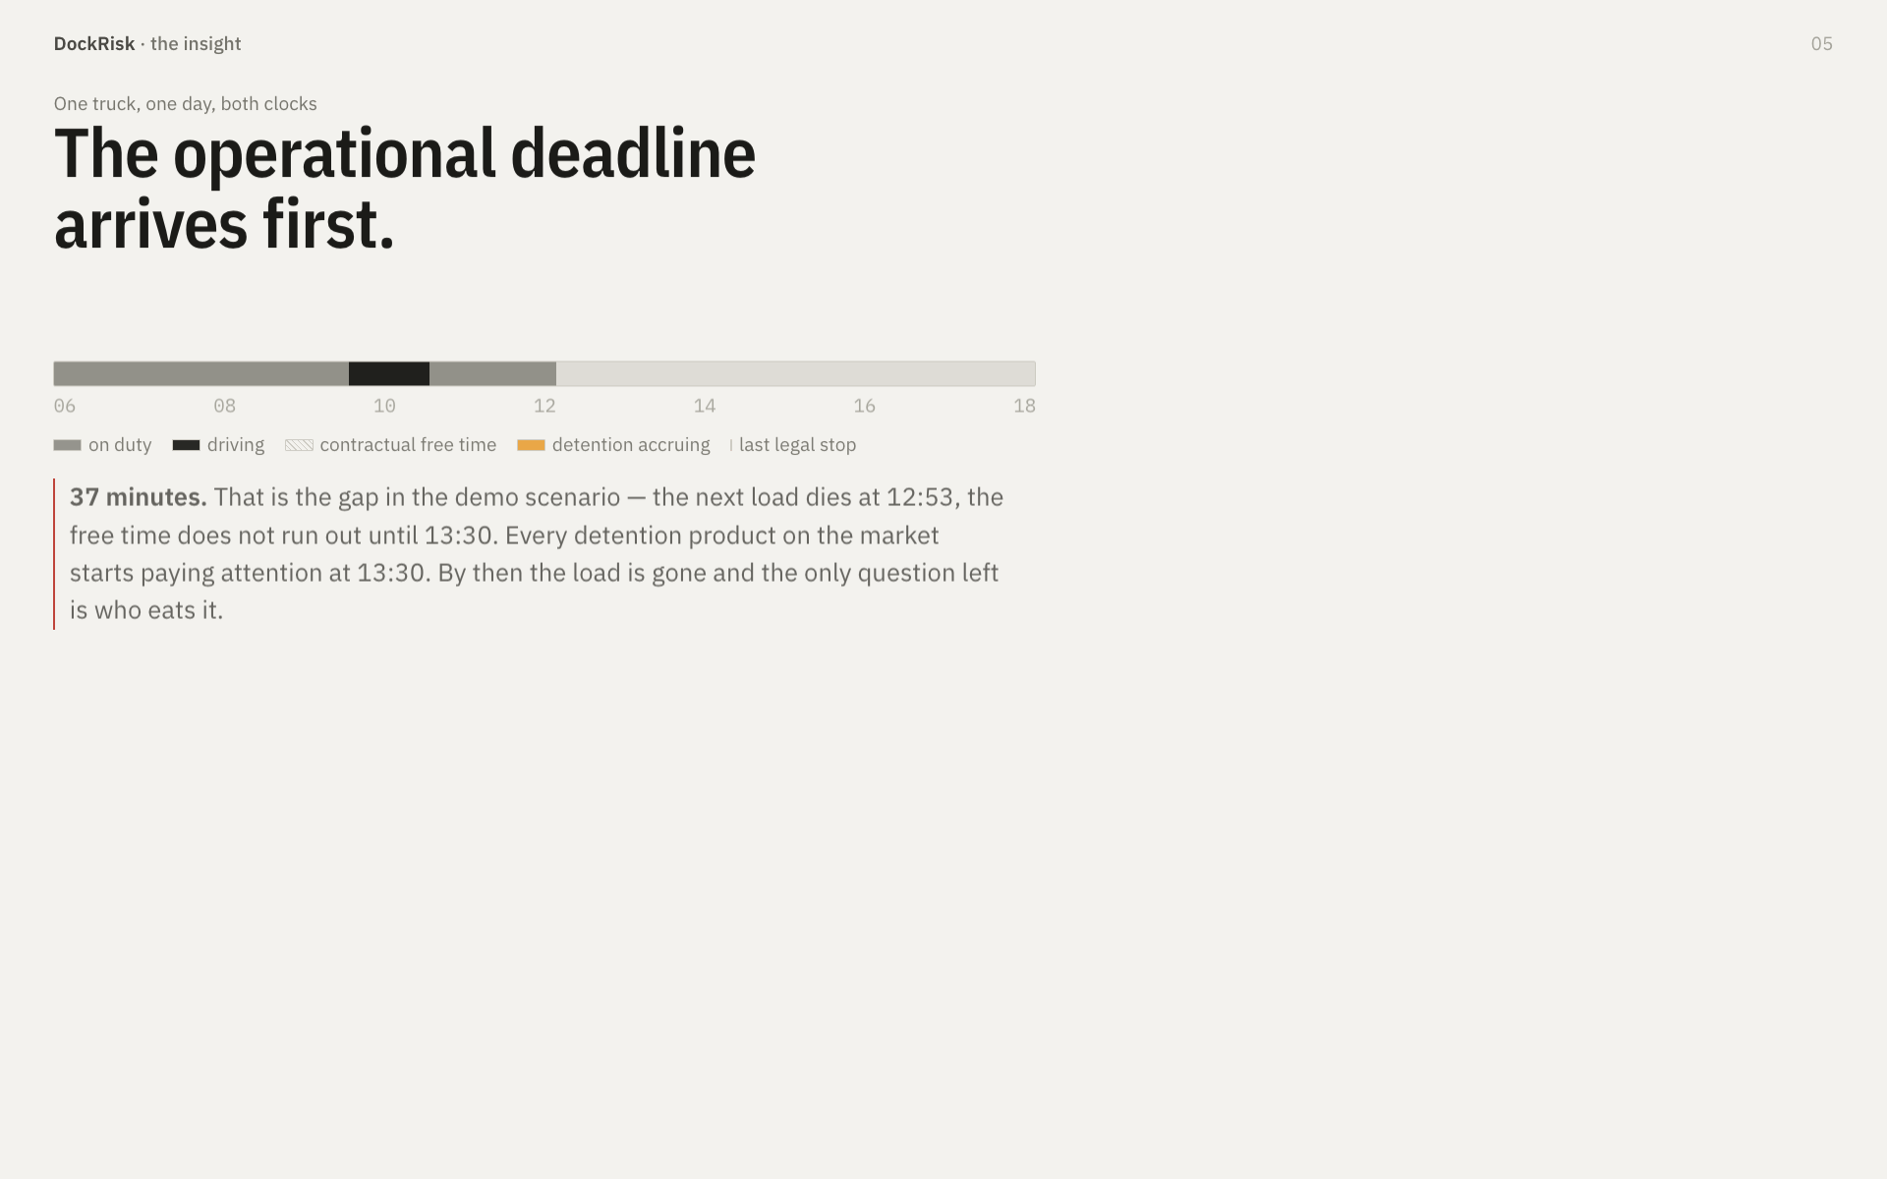
Notes:
• This is the slide the whole talk is built on. If they remember one thing, it is that the red tick sits to the left of the amber.
• Let the bar finish drawing before you speak. The amber block is the last thing to appear — that timing is the argument.
• Trace it with your hand: "on duty… driving… he arrives… free time… and here" — tap the red tick — "the next load is already gone. Thirty-seven minutes before anybody's detention timer even starts."
• Innovation is 20%. This is where you earn it. Do not rush.

Slide 6
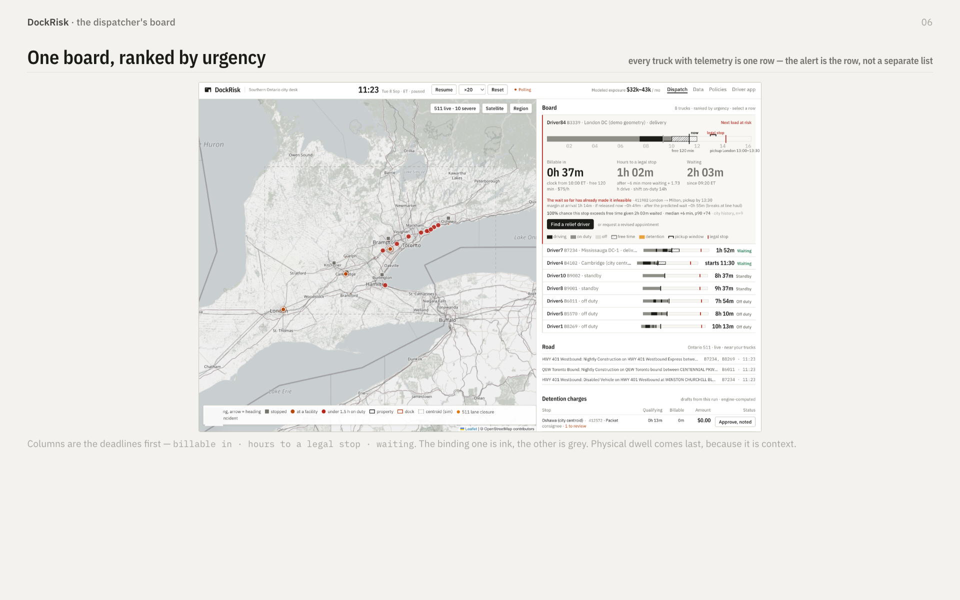
Notes:
• Do not narrate the whole screen. Name three things and move: the map, the ranked board, the road strip underneath.
• "Eight trucks. Only one is a problem. It is at the top because it is the most urgent, not because it arrived first."
• If the projector is washing out the map, skip straight to the next slide — the numbers there are the point, not the pixels.
• This is the natural place to switch to the live app. Decide beforehand: slide 6 or slide 9. Do not decide on stage.

Slide 7
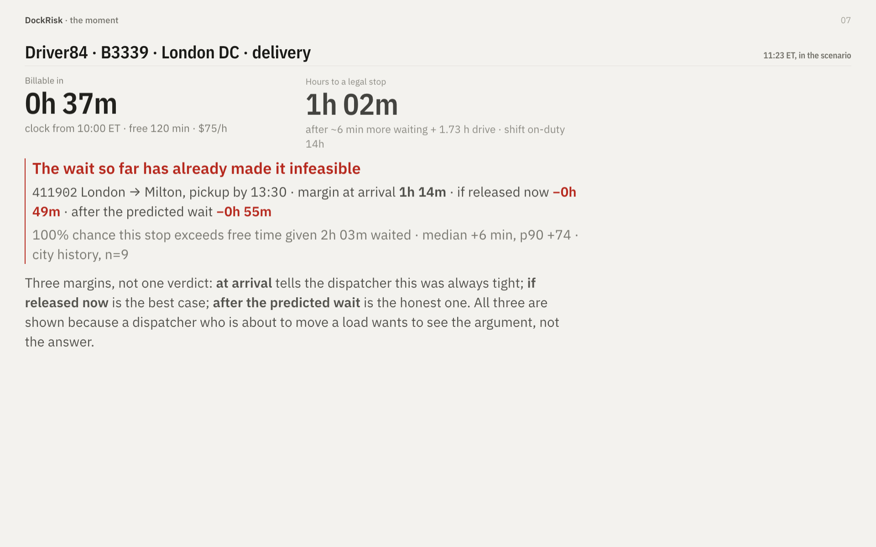
Notes:
• Read the three clocks left to right, then stop. Let the red block do its own work.
• The negative margins are the punchline: "minus forty-nine minutes. Even if they release him this second, he cannot make the pickup legally."
• "n=9" is deliberate and worth pointing at — we show the sample size behind the prediction rather than hiding a thin one. If a judge asks whether nine is enough: no, and that is why the number is on the screen.
• Technical Execution is 20%. This slide plus the packet slide carry it.

Slide 8
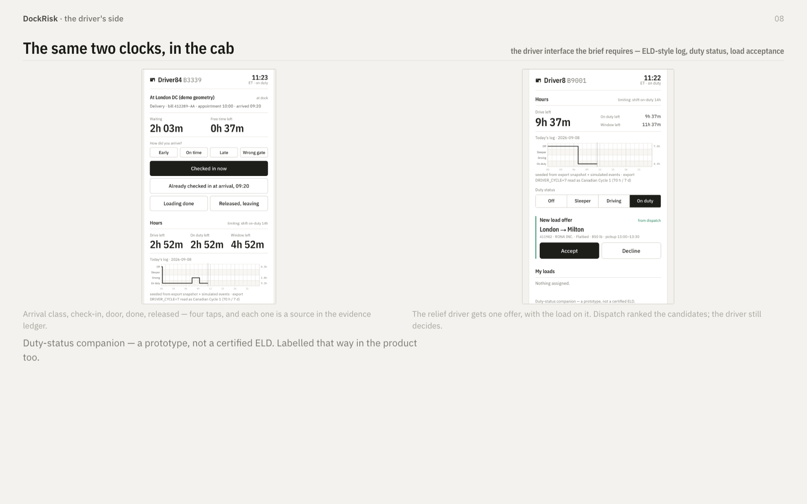
Notes:
• The driver app exists because the check-in tap is evidence , not UX garnish. Say that: "this tap is what makes the charge defensible — it is the difference between a claim and an argument."
• Best Mobile App is one of the five special awards. Thirty seconds here is cheap.
• Do not oversell: read the grey line at the bottom out loud. Claiming ELD certification in front of a fleet operator would be a bad thirty seconds.

Slide 9
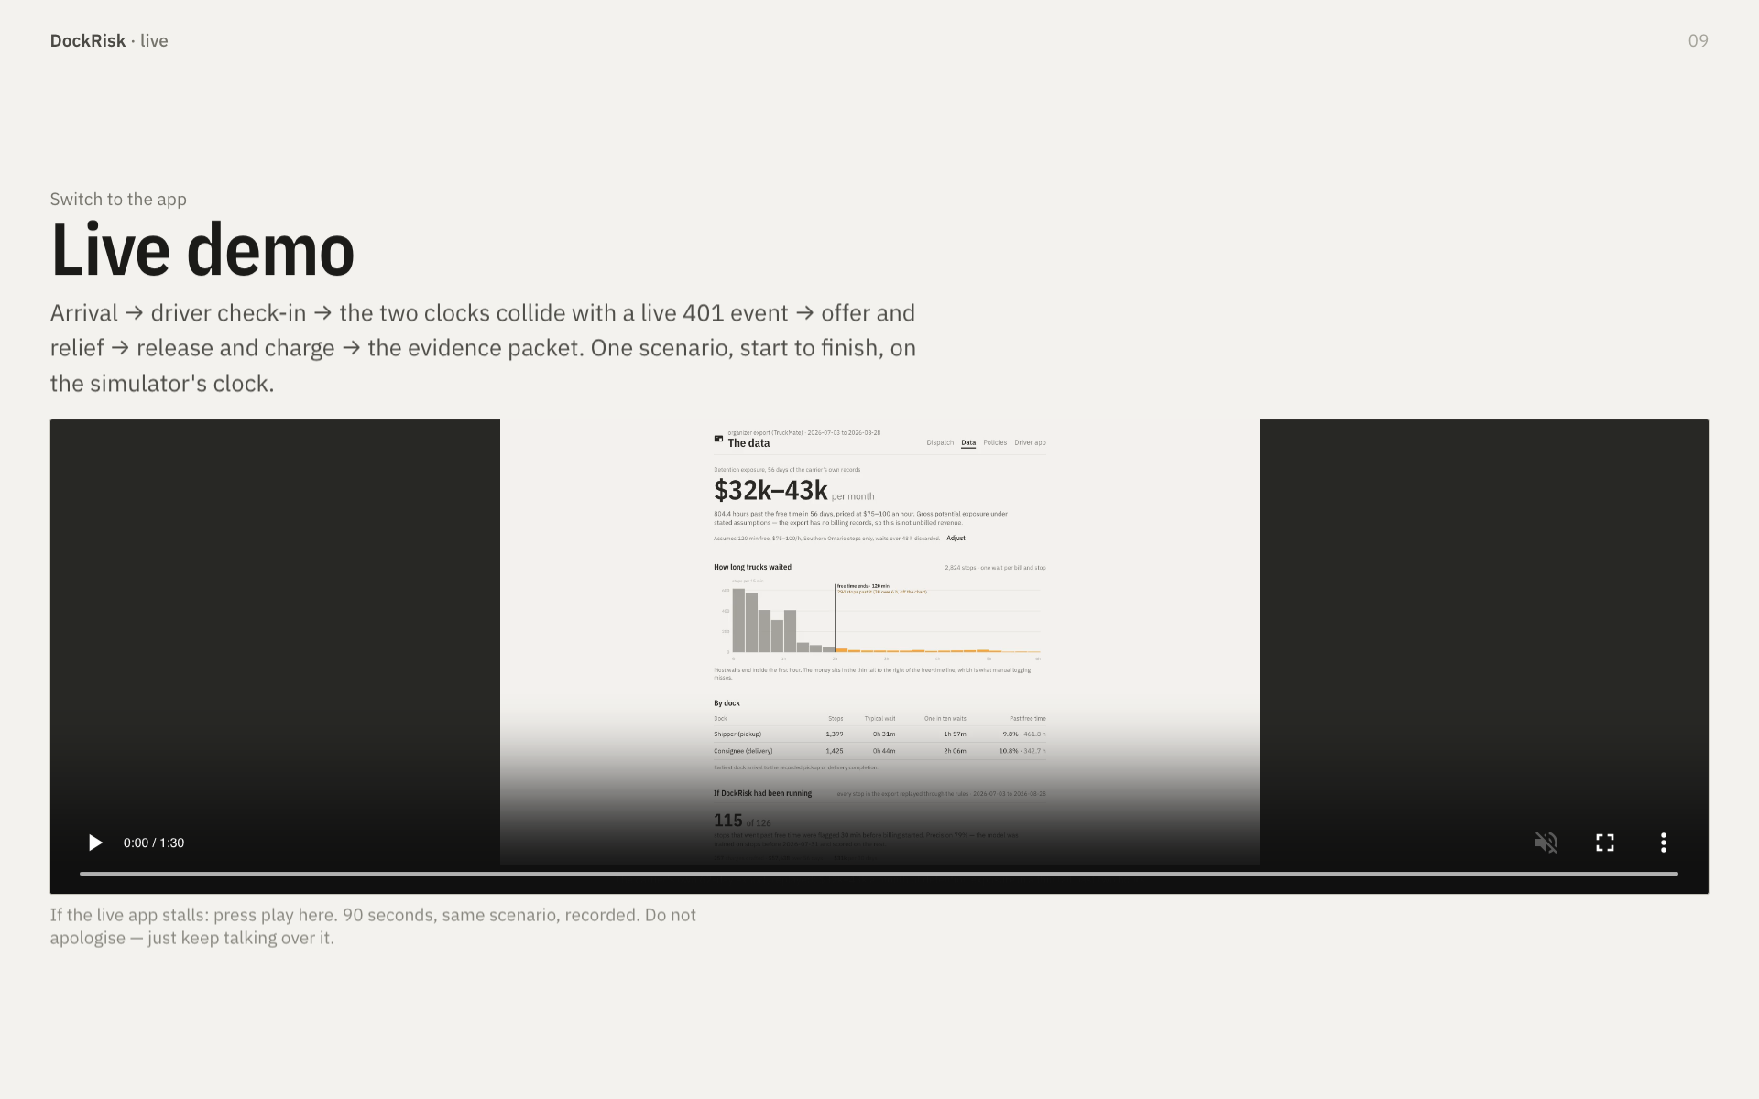
Notes:
• The single biggest risk in the whole presentation. "Failed demo" is the explicit 1-out-of-5 anchor for Presentation & Demo Quality.
• Rule for the day: if the live app is not showing what you want within fifteen seconds , hit play on this video and carry on narrating. Never debug on stage.
• Warm the tile cache and the simulator before doors close. Have the scenario already at ~11:00.
• Budget six to seven minutes here. It is the longest single block; everything before it was setup.

Slide 10
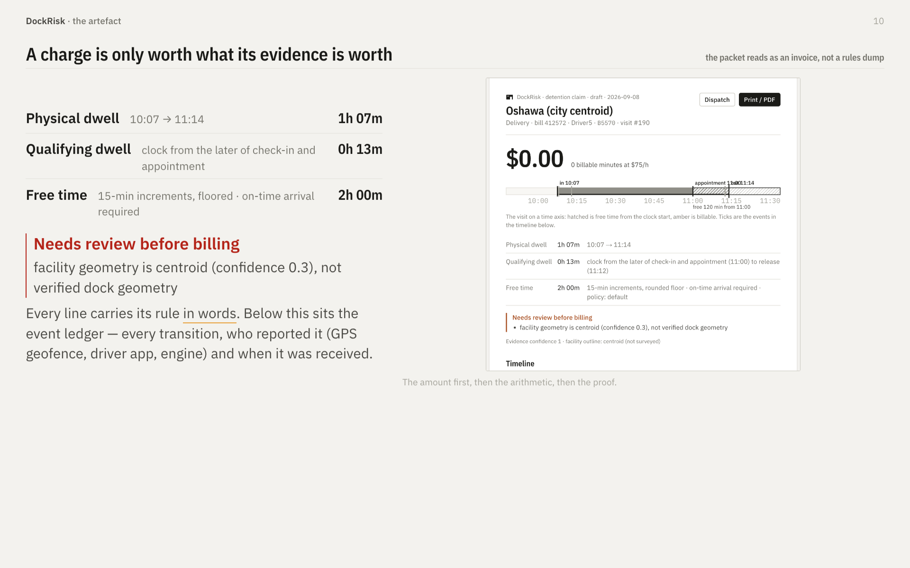
Notes:
• Note the amount on screen is $0.00 — deliberately. Do not skip past it; it is the strongest slide in the deck. "This stop did not earn a charge, and the packet says why. A tool that only shows you the wins is a tool nobody trusts on Monday."
• The red review block is the same idea: the system refuses to bill against a city-centroid facility and says so.
• If a judge is a carrier operator, this is the slide they will ask about. Let them.

Slide 11
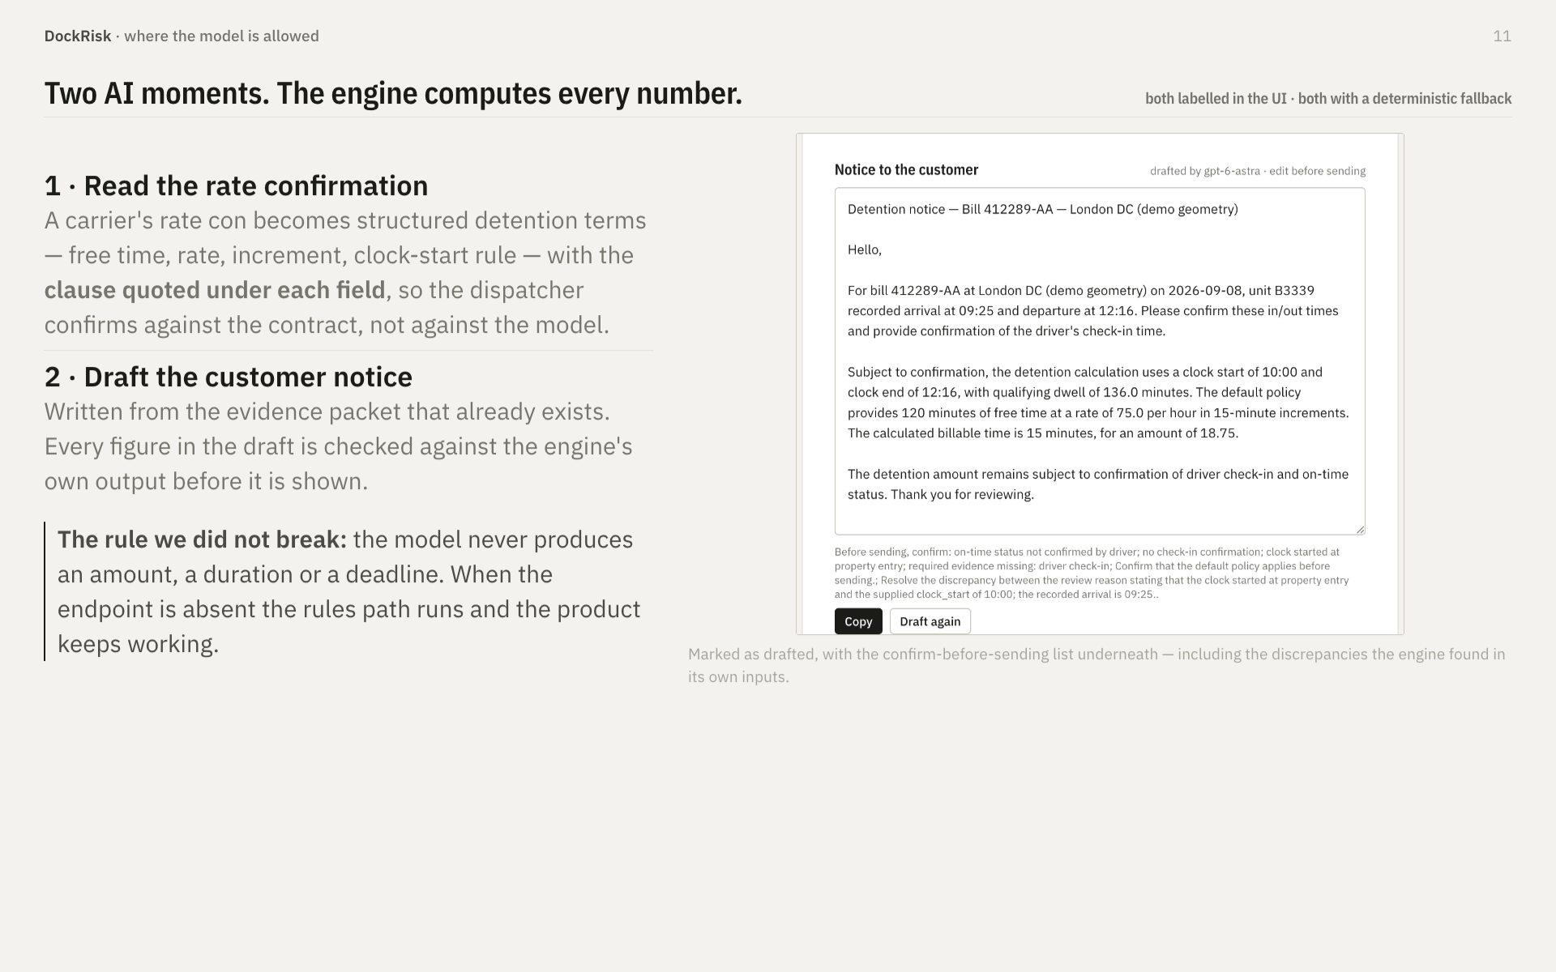
Notes:
• Best Use of AI is a special award, and the honest framing wins it more often than a bigger model does.
• Say the rule plainly: "the model reads and writes. It never counts." Judges have sat through six demos where an LLM confidently invented a dollar figure.
• Point at the pre-send checklist. The system is arguing against its own draft — that is the detail worth ten seconds.

Slide 12
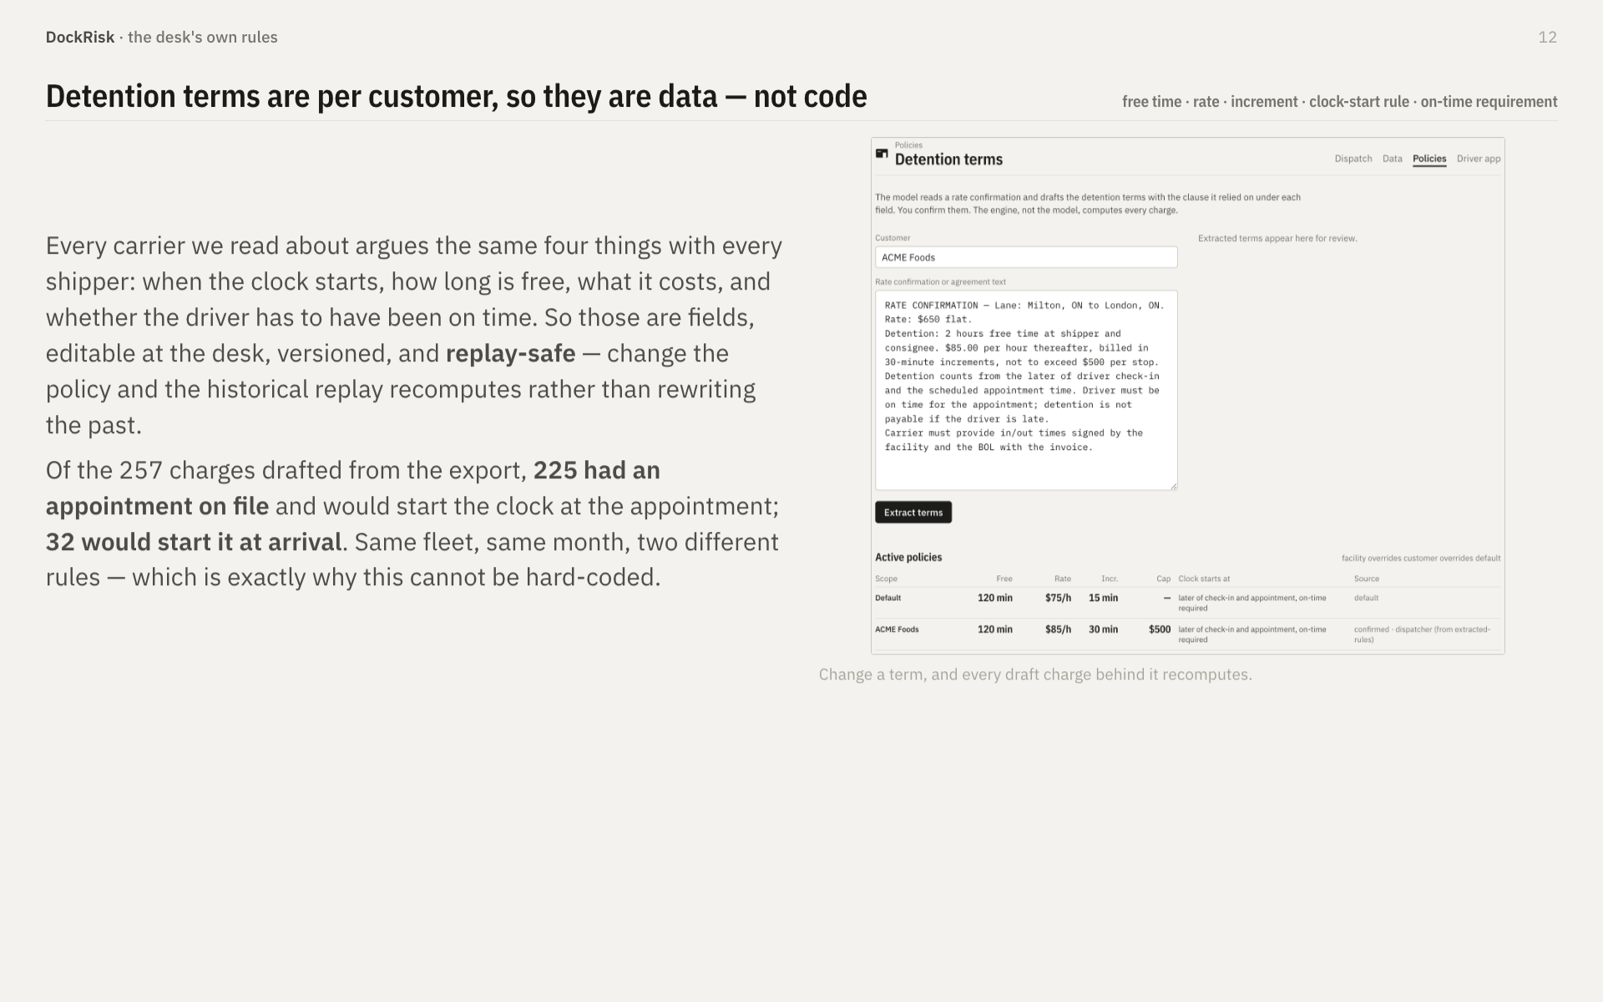
Notes:
• This is a quiet slide that answers the obvious challenge — "our contracts are all different" — before anyone asks it.
• The 225 / 32 split is real and comes from the export. Use it; it proves the point better than the argument does.
• Forty seconds. If you are running long, this is the first slide to cut.

Slide 13
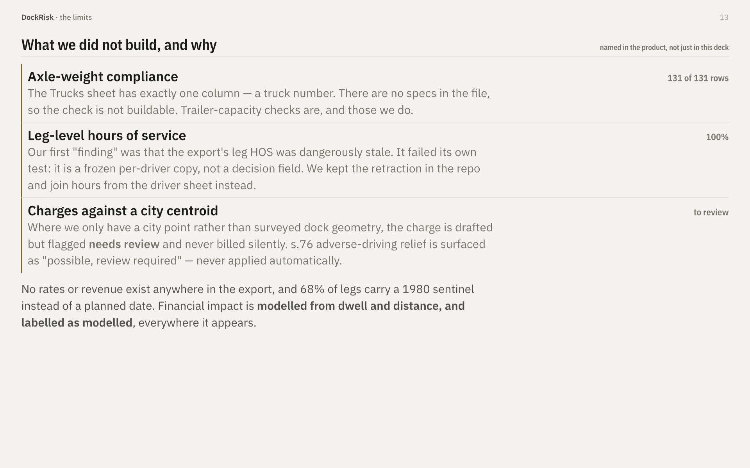
Notes:
• Counter-intuitive but true: this slide wins points. Judges have spent the day being told everything works. Naming three things that do not is the fastest credibility you can buy.
• The retraction story is the one to tell if you only tell one: "we found a bug in their data, we were wrong, we wrote down that we were wrong." That is Problem Discovery, which the brief lists as a judged area.
• Do not sound apologetic. Deliver it as engineering discipline, because it is.

Slide 14
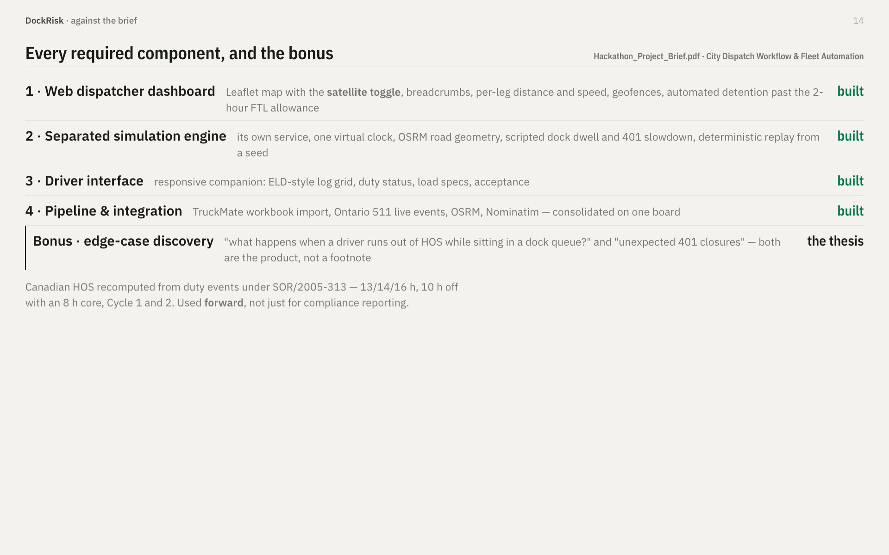
Notes:
• Use of Provided Data & APIs is 15%, and this slide is the whole of it. Do not skip it to save time — cut slide 12 instead.
• Say "satellite toggle" explicitly. The brief states it twice, which means it is on someone's checklist.
• The last row is the argument: the bonus question was not an add-on for us, it was the reason the product exists.

Slide 15
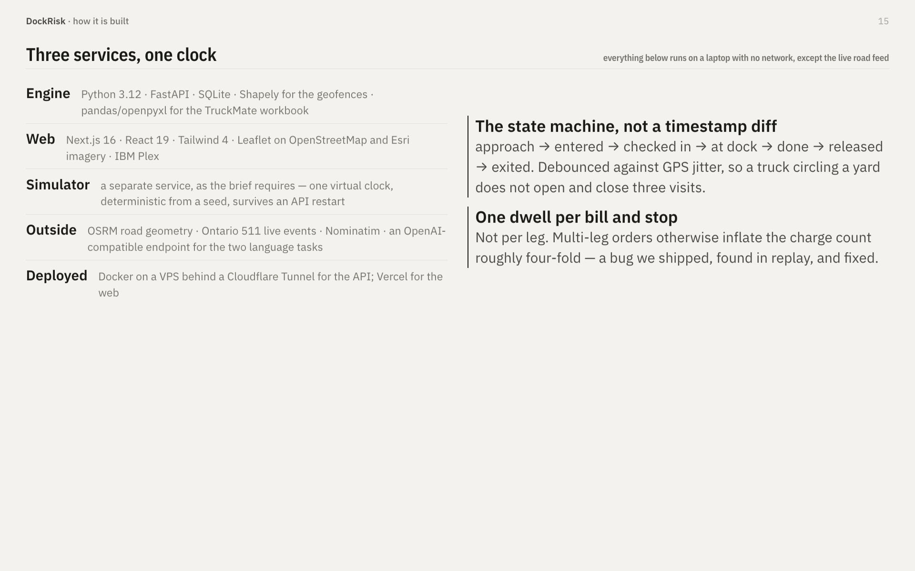
Notes:
• Move fast here — thirty seconds. A stack list does not win anything on its own; the two boxes on the right do.
• "Survives an API restart" and "deterministic from a seed" are the phrases that matter to a technical judge. Say both.
• If someone asks why a separate simulator: the brief requires it, and it is also the only honest way to demo a historical export where every leg is already finished.

Slide 16
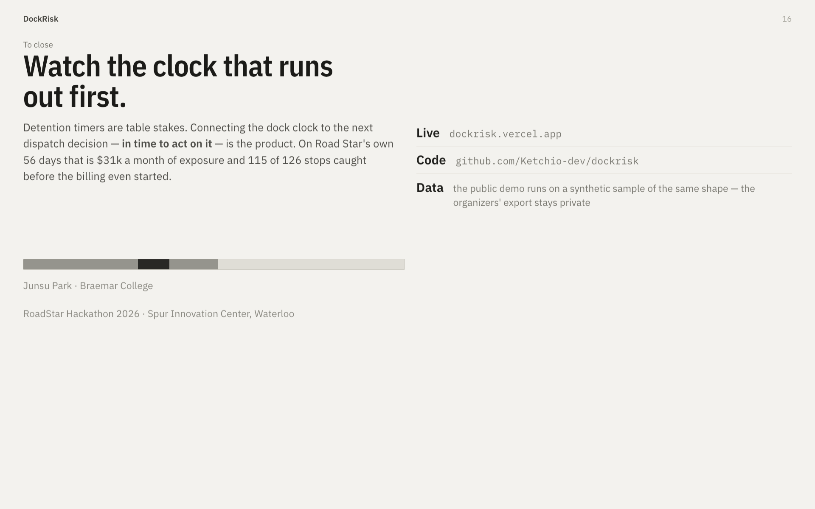
Notes:
• End on the sentence, not on "any questions?". Say it, tap the red tick, stop talking.
• Leave this slide up through Q&A — the URLs stay on screen while judges are writing.
• Likely questions: why not just use the TMS? (it computes after the fact, from timestamps nobody enters) · how do you know the dwell prediction generalises? (we do not, past n=9 per city — that is why n is on screen) · what would you build next? (verified dock geometry, then the appointment renegotiation the desk currently does by phone).

