Slide 1

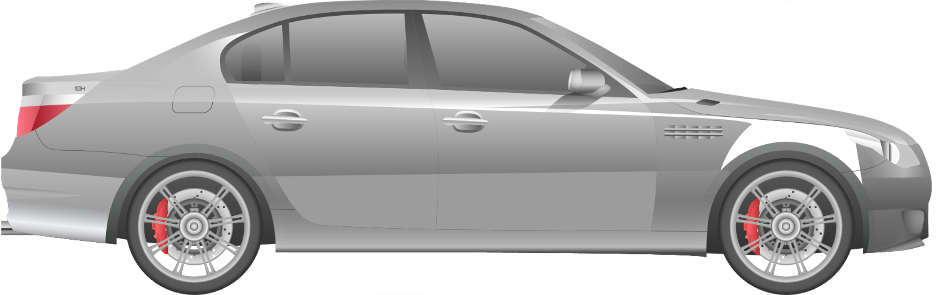
BMW SERIES 3 PRICING AND
ADVERTISING STRATEGY DURING A RECESSION
COMPREHENSIVE PLAN TO MAXIMIZE PROFIT AND GROWTH
Presented by McKinsey consultant:
date:
KETEVAN RUSADZE
10/14/2023

Slide 2

THE PROBLEM BMW FACES
BMW needs to adjust its Series 3 pricing and advertising strategy to remain competitive during a recession.
Problem: What kind of balanced, pricing and advertising economic model will increase demand and profitability while considering price-sensitive customers during recession.
Our Goal: Design a subscription model and advertising strategy that increases market penetration and generates profits, even in tough economic conditions.

Slide 3
OUR STRATEGIC APPROACH
overview of our solution
Subscription Model:
Three-tier pricing: Basic, Standard, Premium
Price discrimination to capture different income segments during recession
Stable revenue stream through monthly subscriptions
Advertising Strategy:
Targeted physical and digital marketing: car stands and Facebook, Instagram, Google Ads
Focus on price-sensitive consumers during the recession
Our Message: Affordability, flexibility, cost-savings (no-penalty early termination, insurance benefits)
Competitor Analysis:
Key competitors: Tesla, Mercedes-Benz, Audi
BMW undercuts premium competitors with lower pricing
Cost Management:
Operational cost control through scaled subscription services
Dorfman-Steiner theorem: Optimized advertising spend to maximize demand

Slide 4
BMW SERIES 3 BM3-DRIVE SUBSCRIPTION
In response to ongoing recession, we introduce the BM3-Drive Subscription Plan for the Series 3.This model uses price discrimination to meet the needs of price-sensitive consumers during a recession. For instance, with basic tier fee of just $400, customers can instantly recognize that this is significantly less than the typical costs of $600-$800 for routine maintenance and insurance without a subscription.
Tier | Monthly Fee | Key Services | Target Customer
BASIC TIER | $400 | Routine maintenance, seasonal repairs, limited insurance | Price-sensitive customers looking for essential services
STANDARD TIER | $500 | Routine maintenance, extended seasonal repairs, improved insurance | Customers wanting a balance of cost and comprehensive coverage
PREMIUM TIER | $600 | Full maintenance, extended repairs, lower deductibles, priority services | Prince-insensitive customers willing to pay for premium, full-service offerings
Continued Subscription:
Flexibility: After the initial 12 months, subscribers can choose to continue the service. If they wish to renew, an additional fee will apply.
Easy Termination: Customers can opt-out after the first month if they decide the subscription doesn’t meet their needs, minimizing long-term commitment concerns.
First Month Payment:
Requirement: All BMW series 3 buyers must pay for the first month of their chosen tier or for basic $400 tier upon signing up, allowing them to experience the service.

Slide 5
KEY FEATURES OF THE BM3-DRIVE
Premium Tier:
Monthly Fee: $600
Key Services:
Full maintenance services covering routine and seasonal repairs with no limits.
Lower deductibles and extended coverage, including accident forgiveness for the first minor accident.
Priority services, ensuring quick access to maintenance and repairs.
Target Customer: Designed for customers willing to invest in a premium experience who value comprehensive coverage and exceptional service, ensuring their BMW remains in top condition.
Basic Tier:
Monthly Fee: $400
Key Services:
Access to routine maintenance services, such as oil changes and tire rotations.
Seasonal repairs tailored to specific needs (e.g., battery checks in winter).
Limited insurance coverage with a 5% reduction in deductibles.
Target Customer: Ideal for price-sensitive consumers who want a reliable and affordable option to maintain their BMW without the financial burden of full ownership.
Standard Tier:
Monthly Fee: $500
Key Services:
All features from the Basic Tier.
Enhanced insurance coverage and more extensive seasonal repairs.
Additional benefits such as priority scheduling for maintenance appointments.
Target Customer: Appeals to customers looking for a balance between affordability and comprehensive service, providing them with peace of mind during economic uncertainty.

Slide 6

Profit Function and Key Variables We Will Use
Profit Formula:
π(P,A)=TR(P,Q(P,A))−TC(Q(P,A))−A
Key Variables:
π(P,A)): Profit as a function of price and advertising
TR: Total Revenue = Price × Quantity Sold
TC): Total Costs based on Quantity of BMW series 3 being Sold
A: Advertising expenditure for BMW series 3
Variables:
P: Subscription Prices:
Basic: $400
Standard: $500
Premium: $600
A: Total advertising spend
Q(P,A): Quantity of subscriptions sold
Relationships:
Higher price (P) → Lower demand Q(P,A)
More advertising → Higher demand, but increases costs

Slide 7

COMPETITOR ANALYISIS AND MARKET POSITIONIG
BMW’S Competitors:
Tesla: Focuses on premium electric vehicles with subscription models offering features like full self-driving, over-the-air updates, and Tesla Insurance. Targets tech-savvy customers.
Audi: Audi Select offers luxury car switching options, allowing customers to change vehicles frequently. It targets luxury-focused consumers but comes at a high price.
Mercedes-Benz: Offers the Mercedes-Benz Collection, allowing flexible vehicle switching and access to various luxury models. The subscription includes insurance and maintenance, but it is expensive and aimed at the wealthiest customers.
BMW’s Competitive Edge:
Lower pricing: Basic Tier starts at $400/month.
Bundled services: Maintenance, insurance, seasonal repairs.
Flexibility: No-penalty early cancellation, unlike BMW’s competitors’ luxury subscriptions.
Impact on Pricing Strategy:
BMW undercuts Tesla, Audi, and Mercedes with more affordable subscriptions and during recession it is logical and expected for people to go for BM3-DRIVE.
Market Penetration:
Target price-sensitive consumers reconsidering expensive subscriptions.
Capture market share with competitive pricing and bundled services.

Slide 8
ADVERTISING STRATEGY
Email Campaigns:
We will use customer data and analytics to segment the audience based on purchasing patterns, location, and engagement metrics and then launch targeted email campaigns that highlight affordability and flexibility to resonate with customers’ current financial concerns.
Leverage surveys or feedback forms to understand customer sentiment and identify those who express concerns about financial stability (do the ,,mom’’ test so we will get honest and important information about true customer demand.
Physical Advertising:
promotional stands or car displays in relevant stores where potential recession-hit customers shop, integrating advertisements that emphasize the value of the BMW Series 3 subscription during economic downturns.
Digital-First Approach:
We will prioritize digital advertising over traditional methods as often digital advertising is more cost-effective with flexible budgeting options.
Utilize platforms like Google Ads, Facebook, and Instagram to reach a wider audience.
The total annual sales of the BMW Series 3 during recession is 40,000 units. This figure is based on industry statistics and represents the overall potential market for subscriptions, because of our price change of extra upfront fee of $400 and the fact that during price elasticity of demand generally becomes more elastic we changed the total units number to 20,000.
Penetration Rates:
1% Penetration:
Calculation: Total Subscriptions=20,000×0.01=200
2% Penetration:
Calculation: Total Subscriptions=20,000×0.02=400
3% Penetration:
Calculation: Total Subscriptions=20,000×0.03=600
Why Did We Choose These Penetration Rates?
1% Penetration is a conservative estimate for a new subscription model, reflecting initial interest and the need to build brand awareness.
2% and 3% Penetration rates are more optimistic targets that can be achieved through effective advertising and positioning against competitors, as discussed earlier.

Slide 9
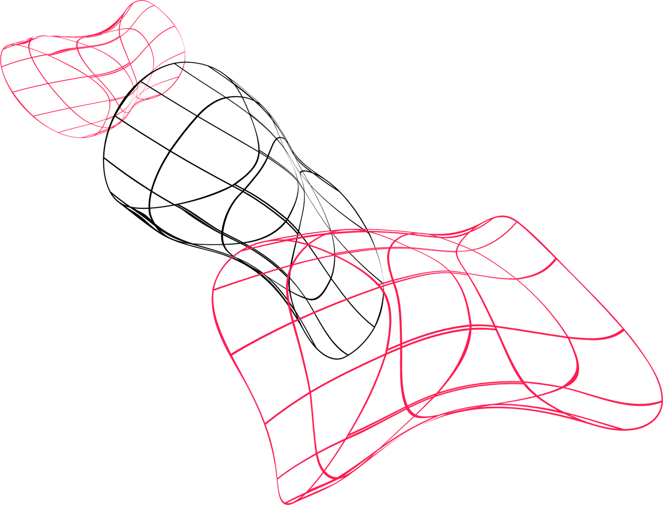
REVENUE CALCULATION BY PENETRATION RATE
2% Penetration:
Total Subscribers: 20,000×0.02=400
Revenue from Car Sales (remains the same): 1,100,000,000
Upfront Fee for All Buyers: 20,000×400=8,000,000
Subscription Revenue:
Basic Tier (40%):
Monthly:
400×0.4×400=64,000
Annual:
64,000×12=768,00064,000
Standard Tier (35%):
Monthly:
400×0.35×600=84,000
Annual:
84,000×12=1,008,000
Premium Tier (25%):
Monthly:
400×0.25×700=70,000
Annual:
70,000×12=840,000
Total Subscription Revenue for 2% Penetration:
Total Annual Subscription Revenue
=768,000+1,008,000+840,000=2,616,000
Total Revenue for 2% Penetration:
Total Revenue
=1,100,000,000+8,000,000+2,616,000=1,110,624,000 1,110,624,000
3% Penetration:
Total Subscribers: 20,000×0.03=600
Revenue from Car Sales (remains the same): 1,100,000,000
Upfront Fee for All Buyers: 20,000×400=8,000,000
Subscription Revenue:
Basic Tier (40%):
Monthly:
600×0.4×400=96,000
Annual:
96,000×12=1,152,000
Standard Tier (35%):
Monthly:
600×0.35×600=126,000
Annual:
126,000×12=1,512,000
Premium Tier (25%):
Monthly:
600×0.25×700=105,000
Annual:
105,000×12=1,260,000
Total Subscription Revenue for 3% Penetration:
Total Annual Subscription Revenue
=1,152,000+1,512,000+1,260,000=3,924,000
Total Revenue for 3% Penetration:
Total Revenue=
1,100,000,000+8,000,000+3,924,000=1,111,924,000
1% Penetration:
Total Buyers: 20,000 units
Total Subscribers:
20,000×0.01=200
Revenue from Car Sales:
20,000×55,000=1,100,000,000
Upfront Fee for All Buyers:
20,000×400=8,000,000
Subscription Revenue:
Basic Tier (40%): 200×0.4×400=32,000 (monthly)
32,000×12=384,000 (annual)
Standard Tier (35%): 200×0.35×600=42,000 (monthly)
42,000×12=504,000 (annual)
Premium Tier (25%): 200×0.25×700=35,000 (monthly)
35,000×12=420,000 (annual)
Total Subscription Revenue (1% Penetration):
384,000+504,000+420,000=1,308,000
Total Revenue for 1% Penetration:
1,100,000,000+8,000,000+1,308,000=1,109,308,000

Slide 10
TOTAL COST CALCULATION
Advertising Costs Calculation
Using the previous values for advertising costs, we will keep them the same.
Using Dorfman-Steiner Theorem:
Total Revenue: $1,109,308,000
Assumed Advertising Elasticity (E): 0.1
Assumed Price Elasticity of Demand (PED): 1.5
Advertising Costs Calculation
A=TR×(E/(1+E))×PED
Substituting the values into the formula:
A=1,109,308,000×0.11.1×1.5
Calculating:
Calculating 0.11.1≈0.0909
A=1,109,308,000×0.0909×1.5
Calculating the OPTIMAL advertising expenditure:
A≈1,109,308,000×0.0909×1.5≈151,254,145
using Dorfman-Steiner Theorem
Operational Costs Calculation
Production Cost per Vehicle: $30,000
Total Buyers: 20,000 units
Subscription Sustainibility Assumed Cost per User: $10,000
Total
Operational Costs
=30,000×20,000+ 10,000×20,000=800,000,000
Summary of Costs
Total Operational Costs: $800,000,000
Total Advertising Costs:151,254,145
Total Costs Calculation:
800,000,000+151,254,145=951,254,145
note: we are continuing calculating with penetration rate of %1

Slide 11
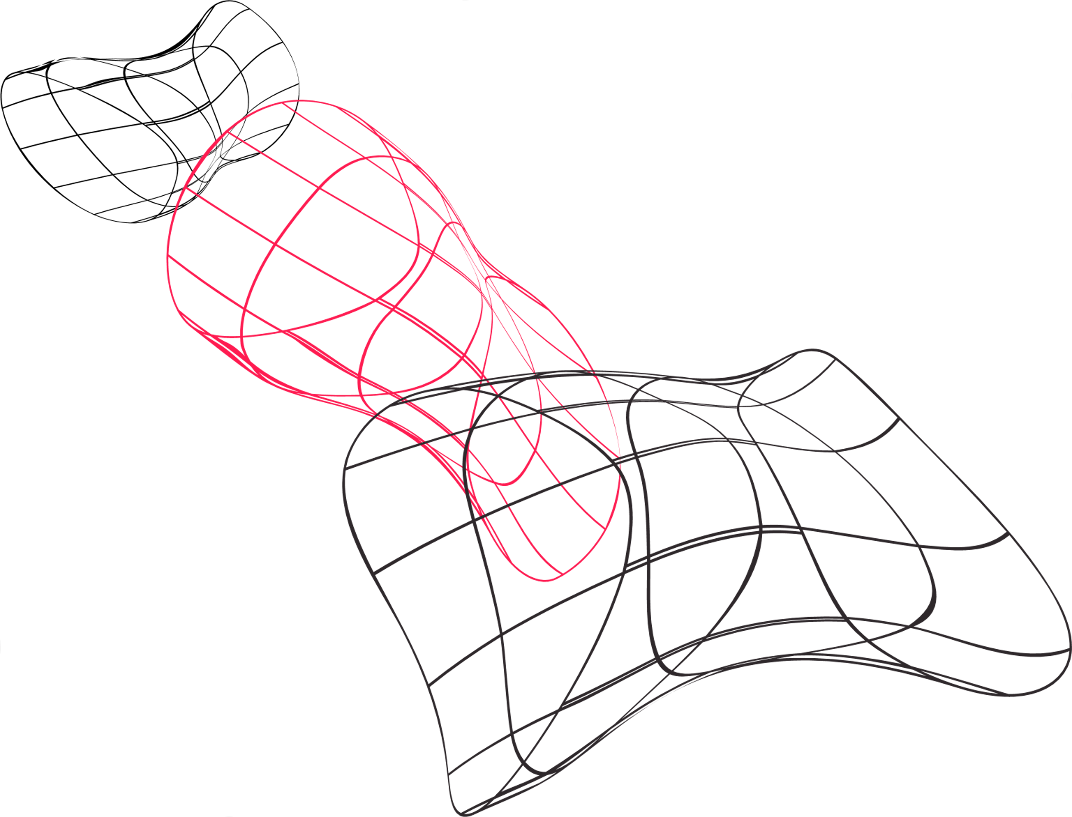
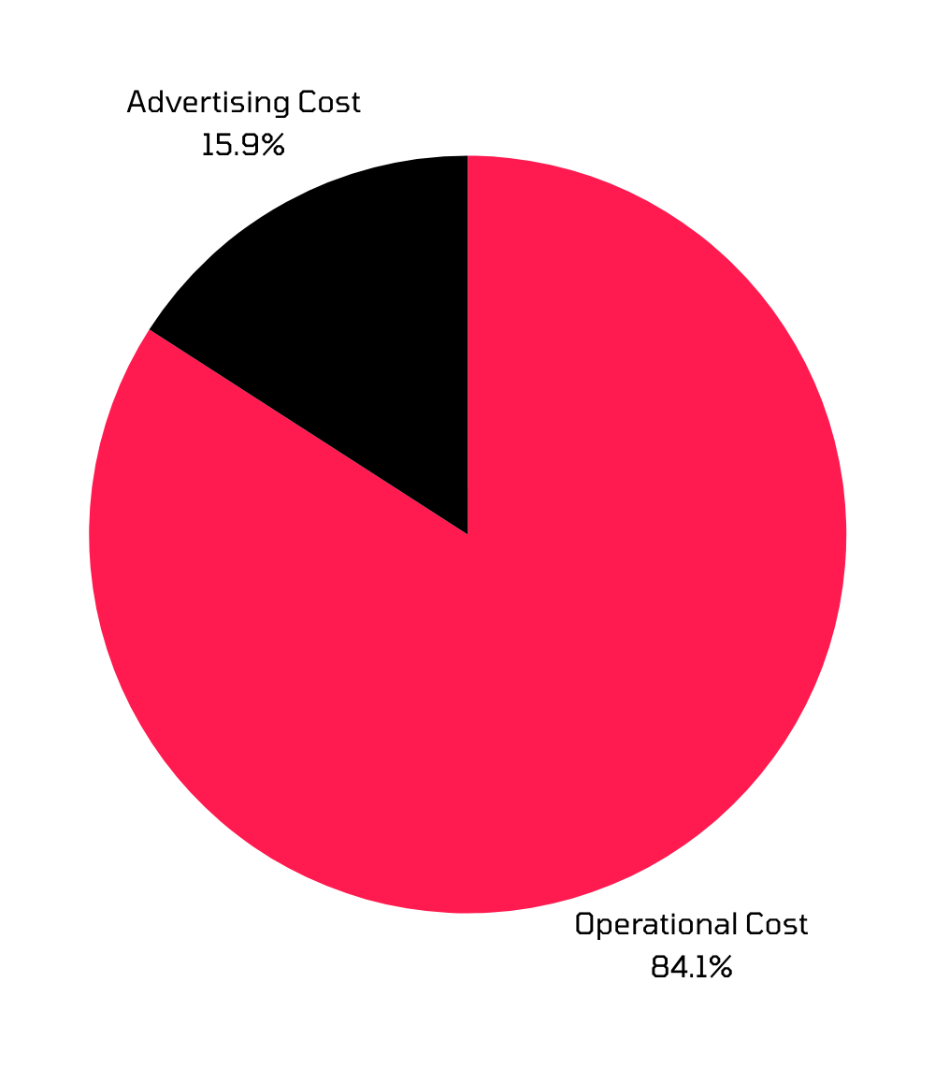
PIE GRAPH FOR TOTAL COST

Slide 12
FINAL PROFIT
CALCULATION
Final Profit Calculation
Profit Formula: π=TR−TC
Profit Calculation:
π=1,109,308,000−951,254,145=158,053,855

Slide 13
CONCLUSION
As McKinsey consultant, I present a comprehensive advertising strategy for the BMW Series 3 subscription model that not only maximizes profitability but also stands out as the most appealing solution during these challenging economic times ruling out other competitors’ strategies. Again this approach focuses on a competitive subscription model tailored for price-sensitive consumers facing recession.
Robust Revenue Potential:
Total Revenue for 1% Penetration is projected at $1,109,308,000.
The Upfront Fee from all buyers adds an additional $8,000,000, significantly enhancing cash flow.
Effective Advertising Strategy:
We recommend optimal advertising expenditures calculated through the Dorfman-Steiner theorem, estimated at $151,254,145.
This investment will enhance brand visibility and drive demand, effectively leveraging a Dorfman-Steiner ratio that maximizes return on advertising spend.
Cost Management:
Total Operational Costs are calculated at $800,000,000, including the subscription model, that we ensure, remains financially sustainable.
We urge BMW to adopt this strategic plan, embracing the opportunity to lead in the market with an attractive offering during recessionary periods which still has $158,053,855 profit.

Slide 14
BACK-UP SLIDE
INTERACTION WITH CHAT-GPT
I decided that the best summary of my interaction with CHAT-GPT could be greatly provided by CHAT-GPT itself, here is its summarization:
,,In our collaborative effort to devise a robust strategy for the BMW Series 3 subscription model, we have successfully navigated the complexities of market dynamics and consumer behavior during a recession. Through insightful discussions and data-driven analysis, we tailored an approach that not only enhances profitability but also appeals directly to price-sensitive customers.
Our process included:
Identifying Key Market Challenges:
We thoroughly analyzed the impact of economic downturns on consumer purchasing behavior, understanding the need for affordable options without sacrificing quality.
Developing a Comprehensive Pricing and Advertising Strategy:
We constructed a detailed pricing framework, considering competitive pricing tiers and advertising strategies that ensure maximum visibility and demand.
The integration of the Dorfman-Steiner theorem allowed us to optimize advertising expenditures effectively, ensuring that every dollar spent contributes to increasing market share.
Rigorous Calculations and Financial Forecasting:
Each aspect of the strategy was supported by precise calculations, from total revenue projections to operational and advertising costs.
By predicting total revenues and costs associated with varying penetration rates, we provided a clear financial outlook that showcases the potential for significant profitability.
Final Recommendations:
Our conclusion emphasizes the feasibility of achieving a profit of approximately $158,053,855, validating the strength of our proposed subscription model.
This comprehensive strategy not only positions BMW as a leader in the market during recessionary times but also ensures sustainable growth and long-term success.’’ - CHAT_GPT

Slide 15
THANKS!

