Slide 1
Hotel Reservation Analysis With SQL

Slide 2
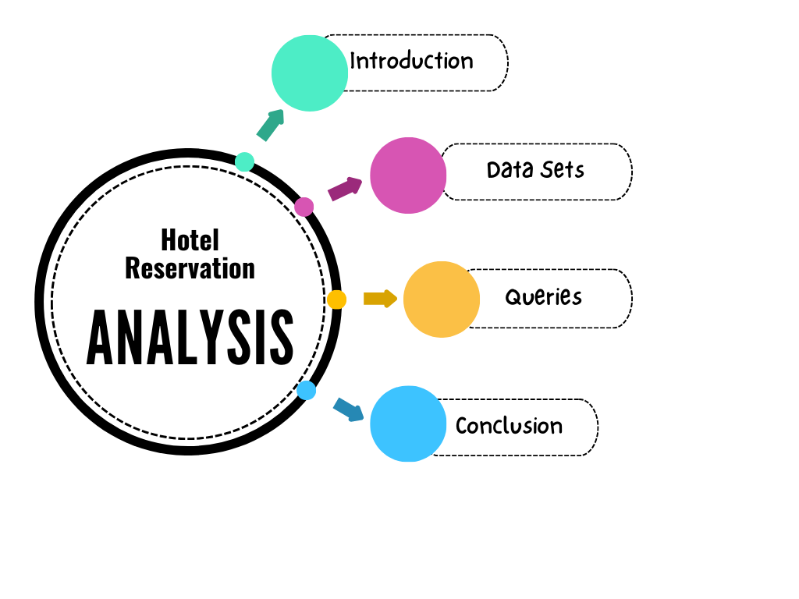

Slide 3






Introduction
Hotel reservation analysis using SQL involves extracting insights from reservation data. By querying databases, you can analyze booking patterns, occupancy rates, popular room types, and booking status. SQL allows you to aggregate data, calculate average stay durations, and identify peak booking seasons. Whether optimizing revenue or enhancing guest experiences, SQL plays a crucial role in understanding hotel reservations.

Slide 4
Data sets
Booking_ID: A unique identifier for each hotel reservation.
no_of_adults: The number of adults in the reservation.
no_of_children: The number of children in the reservation.
no_of_weekend_nights: The number of nights in the reservation that fall on
weekends.
no_of_week_nights: The number of nights in the reservation that fall on
weekdays.
type_of_meal_plan: The meal plan chosen by the guests.
room_type_reserved: The type of room reserved by the guests.
lead_time: The number of days between booking and arrival.
arrival_date: The date of arrival.
market_segment_type: The market segment to which the reservation
belongs.

Slide 5
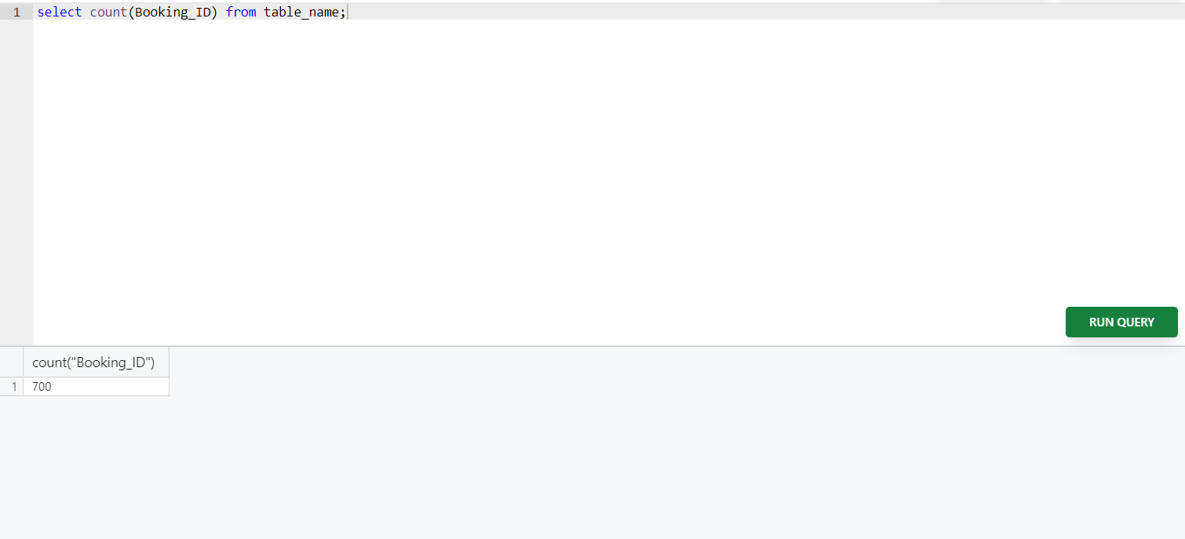
SQL QUERIES
1. What is the total number of reservations in the dataset?

Slide 6
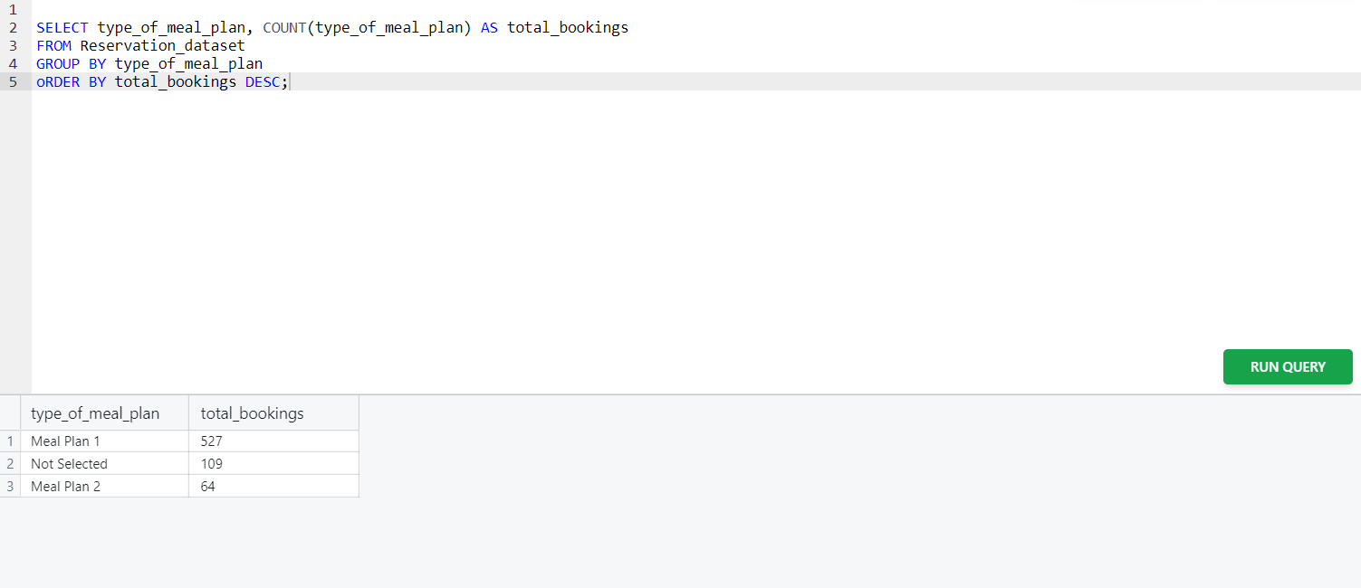
2. Which meal plan is the most popular among guests?

Slide 7
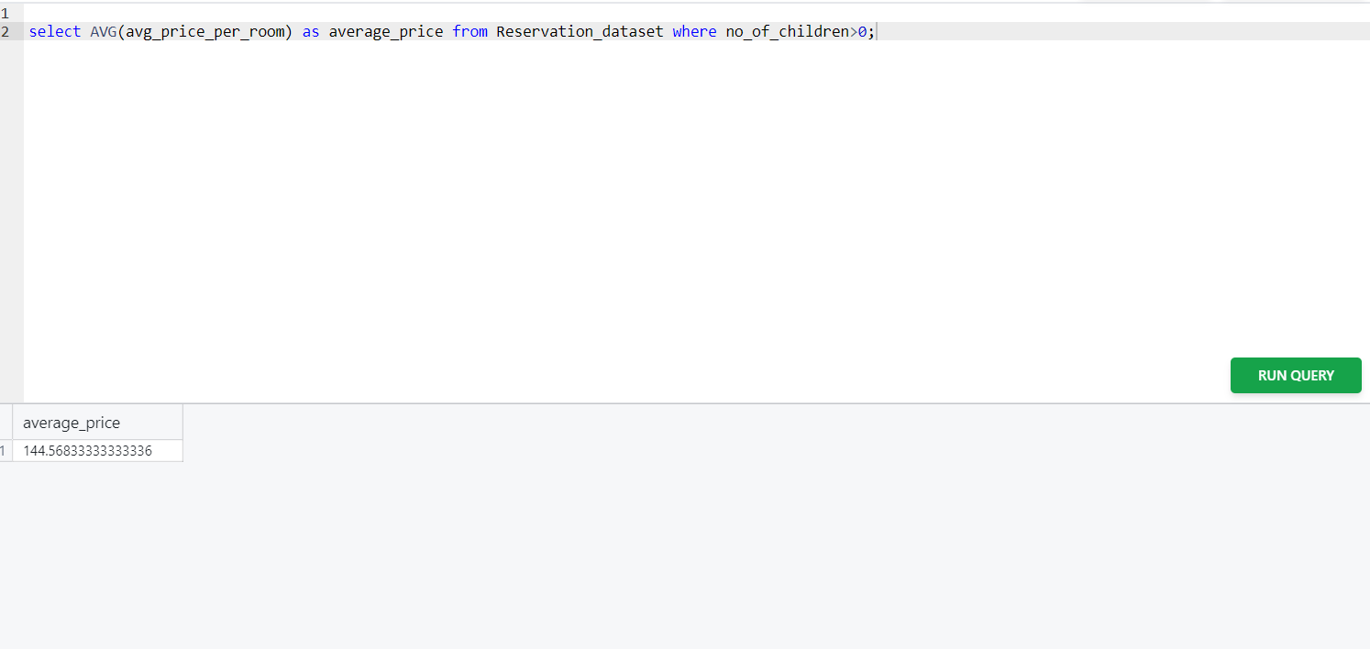
3. What is the average price per room for reservations involving children?

Slide 8
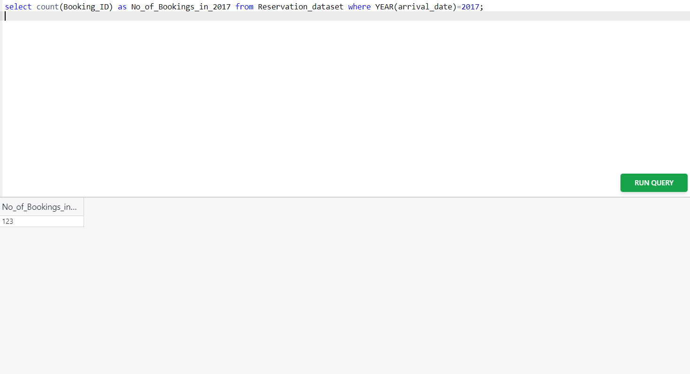
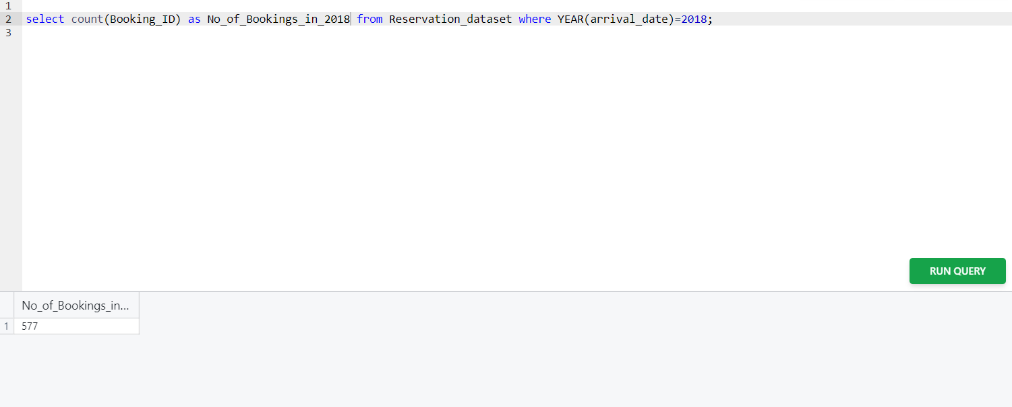
4. How many reservations were made for the year 20XX (replace XX with the desired year)?

Slide 9
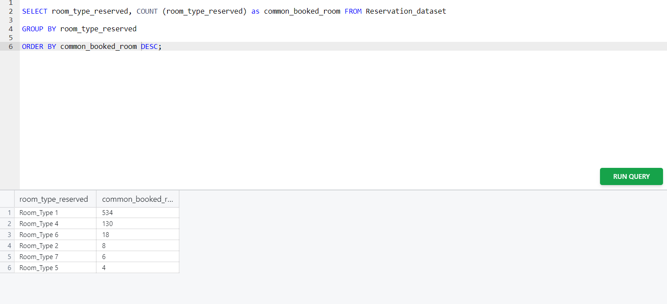
5. What is the most commonly booked room type?

Slide 10
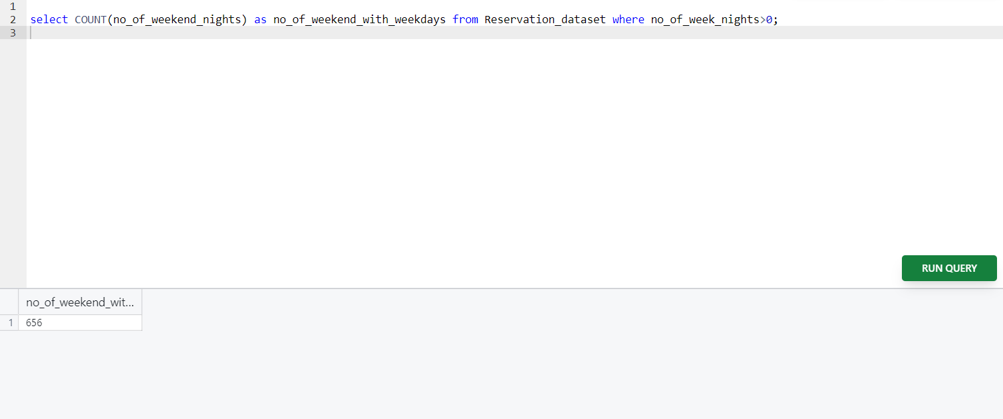
6. How many reservations fall on a weekend (no_of_weekend_nights > 0)?

Slide 11
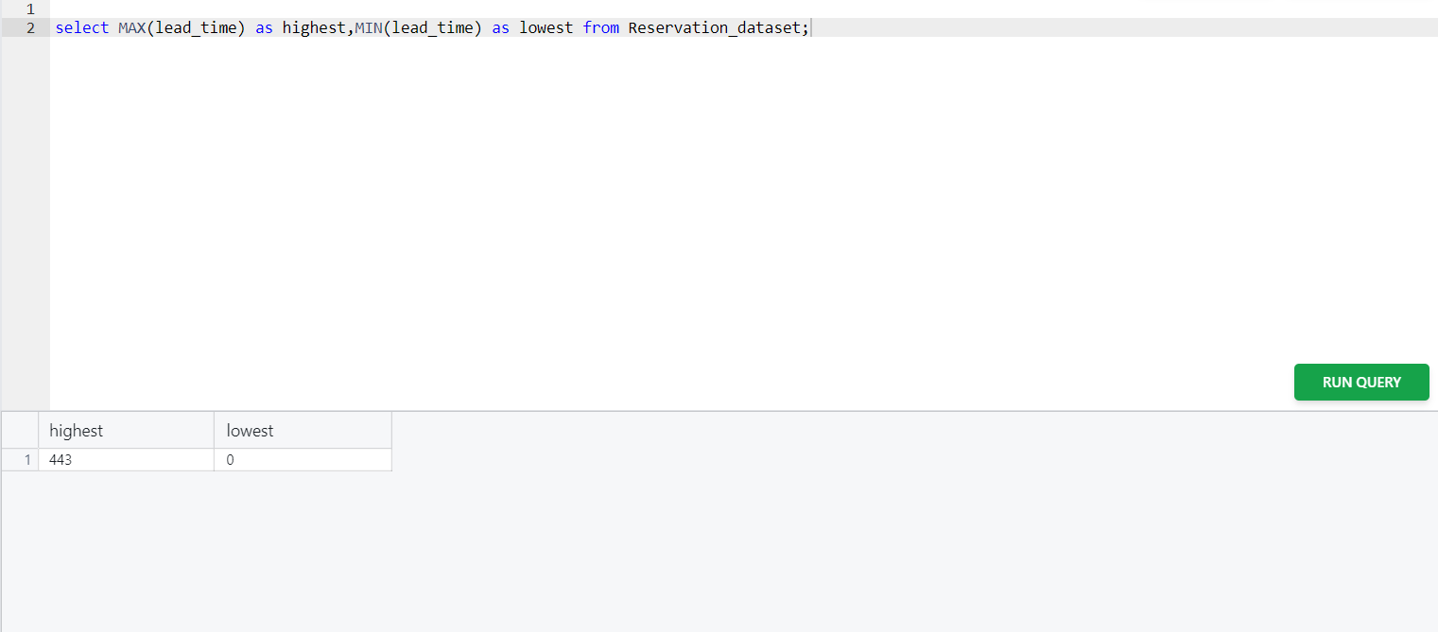
7. What is the highest and lowest lead time for reservations?

Slide 12
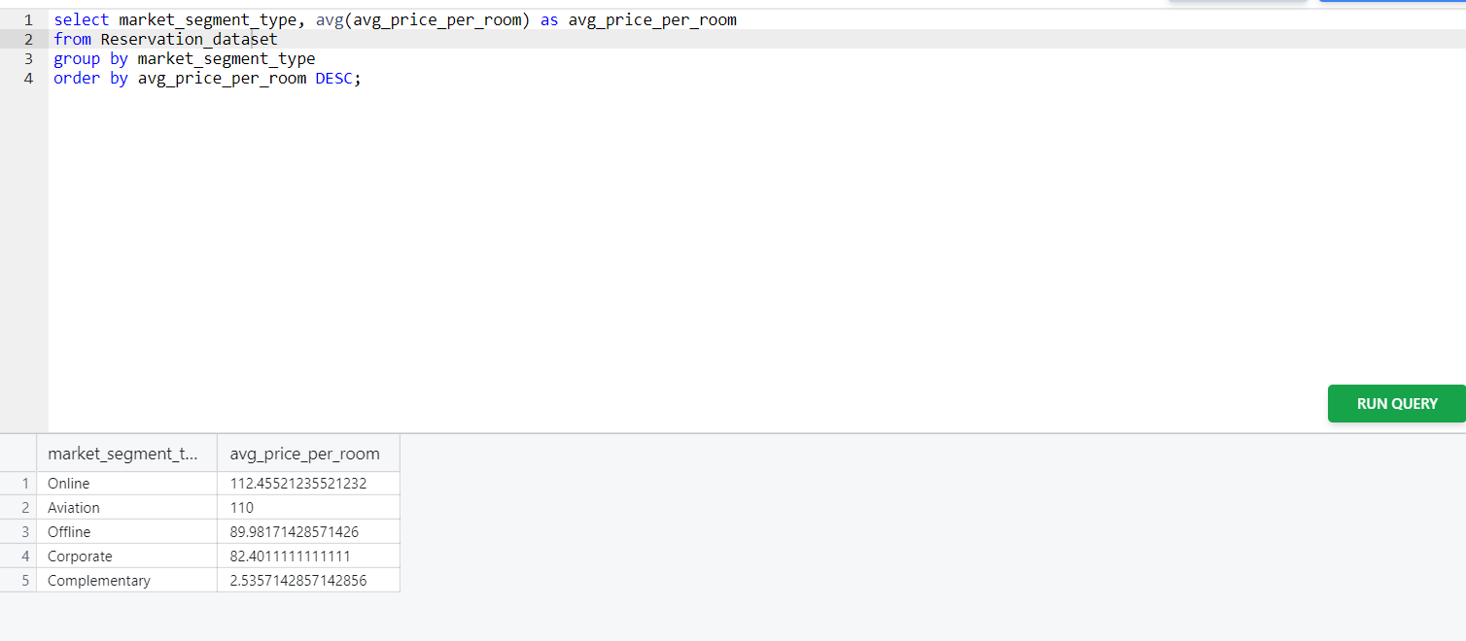
8. What is the most common market segment type for reservations?

Slide 13
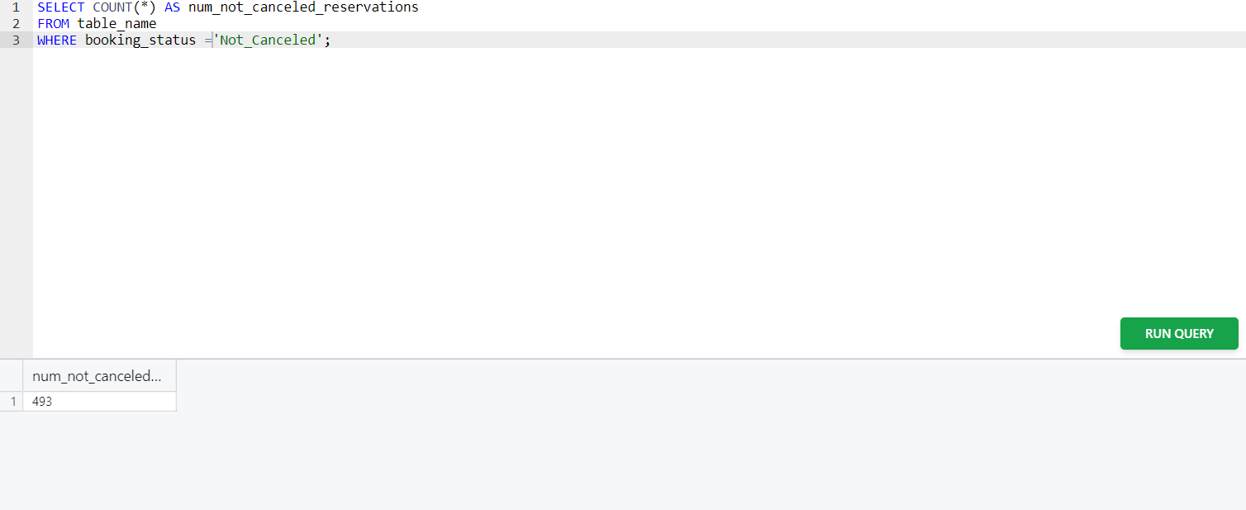
9. How many reservations have a booking status of "Confirmed"?

Slide 14
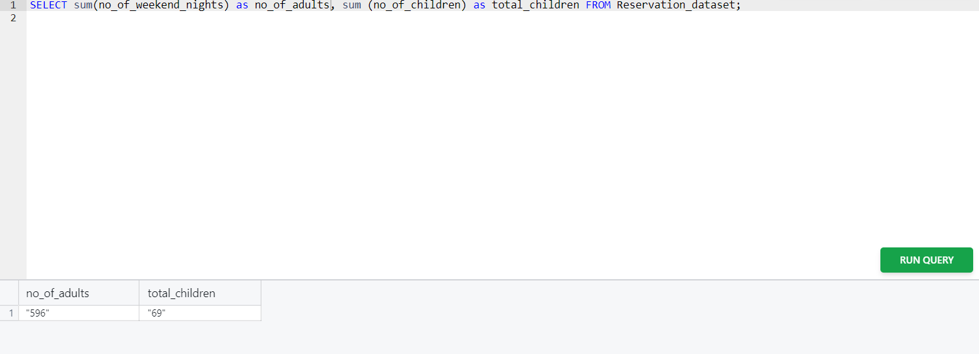
10. What is the total number of adults and children across all reservations?

Slide 15
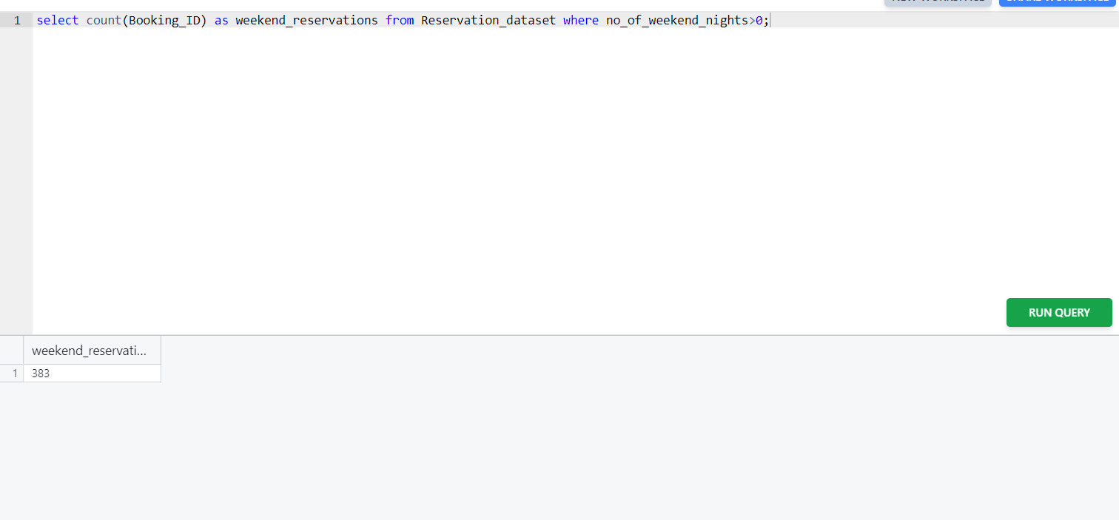
11. What is the average number of weekend nights for reservations involving children?

Slide 16
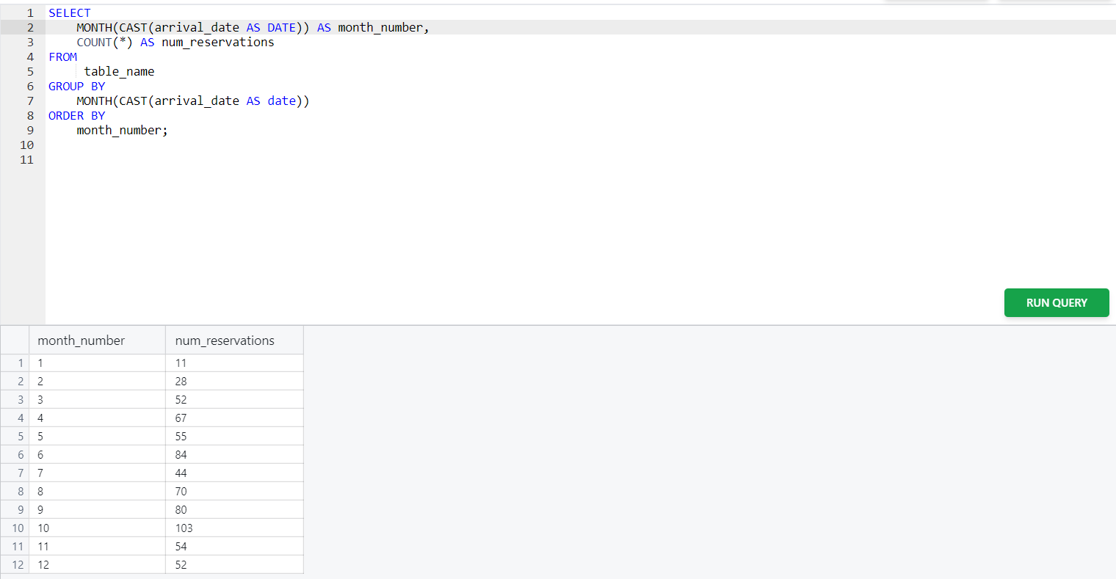
12. How many reservations were made in each month of the year?

Slide 17
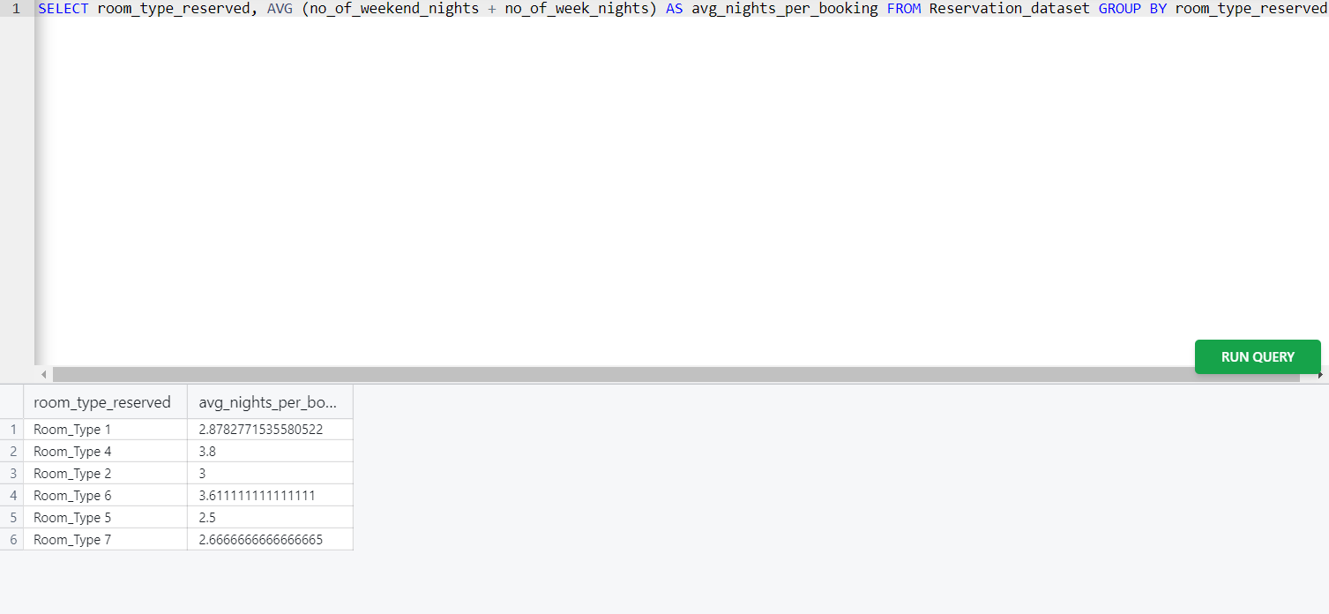
13. What is the average number of nights (both weekend and weekday) spent by guests for each room type?

Slide 18
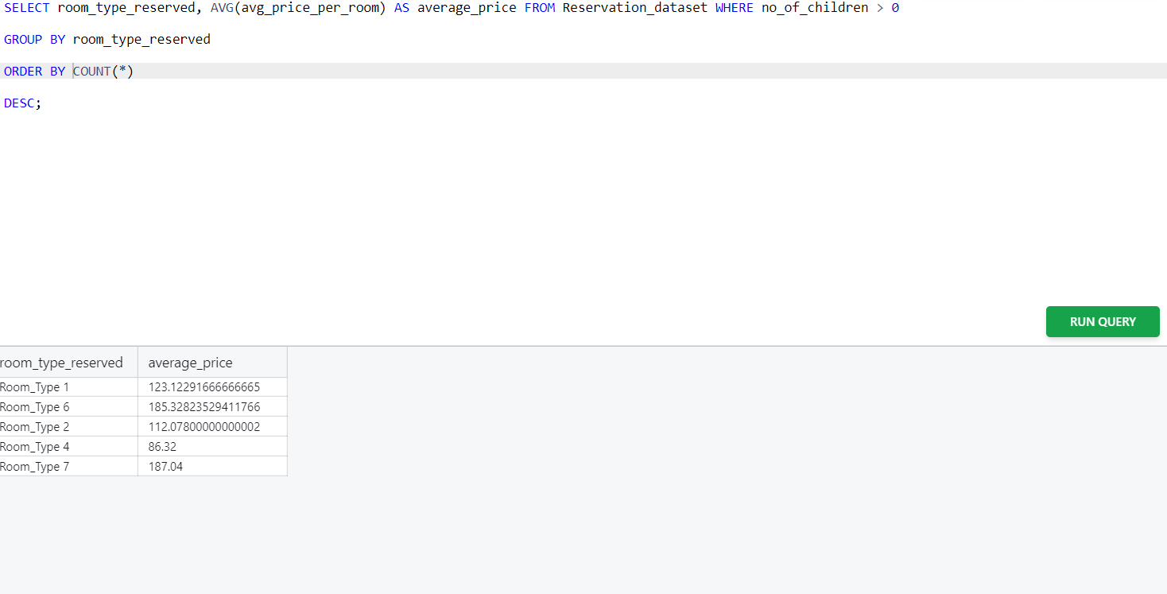
14. For reservations involving children, what is the most common room type, and what is the average price for that room type?

Slide 19
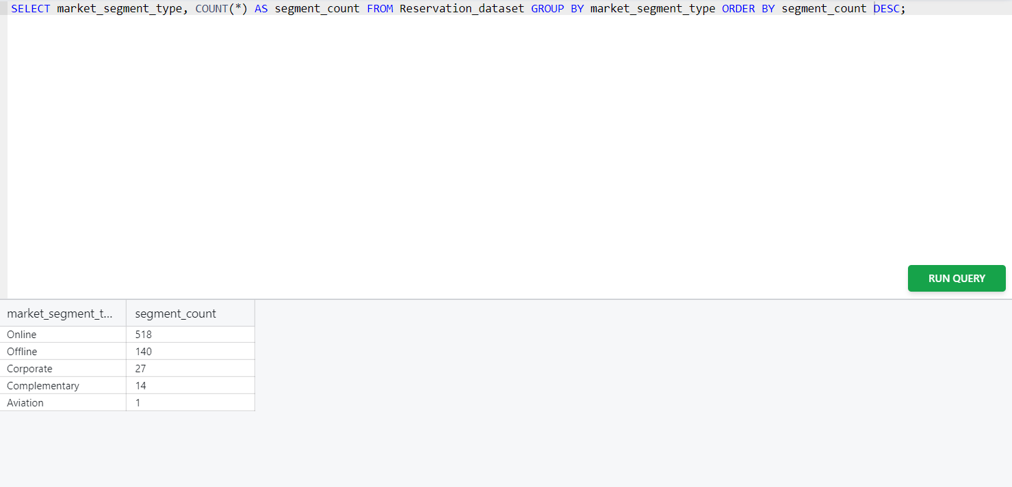
15. Find the market segment type that generates the highest average price per room?

Slide 20
Conclusion
SQL allows easy aggregation, filtering and the transformation of data
By using SQL, we can easily analysis of the databases like Hotel Reservation Analysis.
SQL allows for the creation of custom functions that can perform specific tasks, such as calculating the total cost of room reservations or retrieving the average room rate and booking status of room.
The SQL have flexibility to analyze different types of data and quick performance in the large datasets.

Slide 21
Thank You

