Slide 1
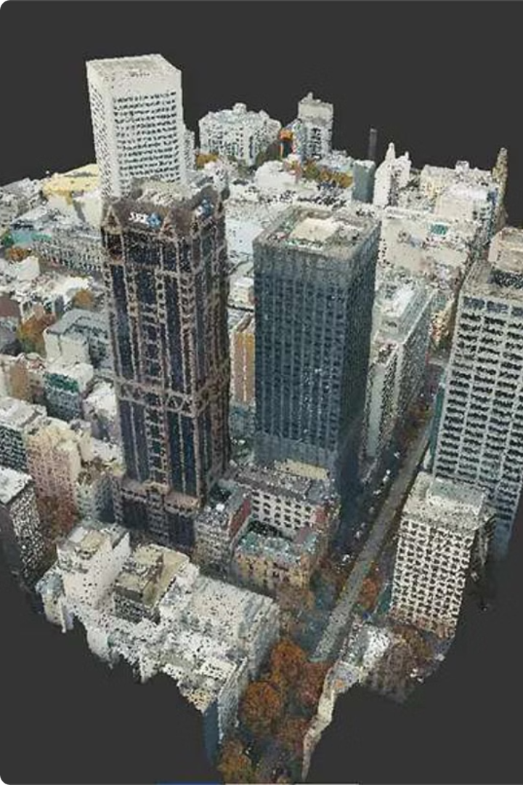

PointFusion: A Deep Learning Approach for 3D Object Detection
This presentation introduces PointFusion, a novel method for accurate 3D object detection. PointFusion leverages the power of deep learning to integrate RGB images with 3D point cloud data, enabling robust and versatile object detection across diverse environments.

Slide 2
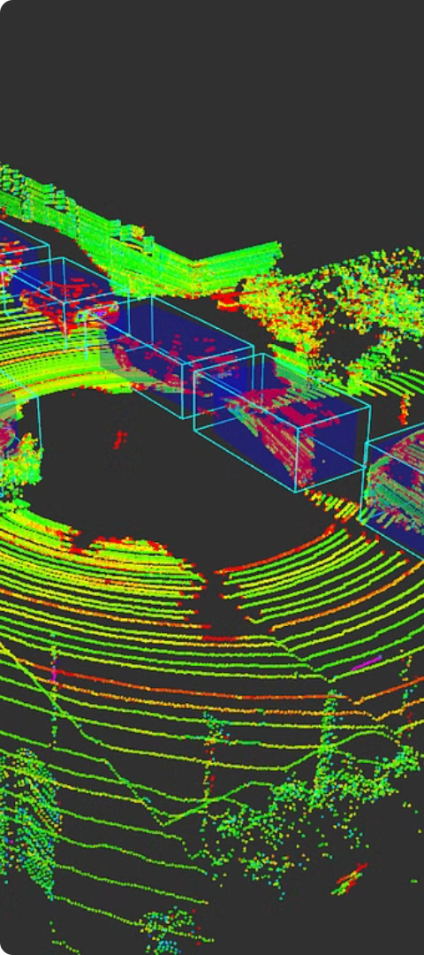
Related Work
1
Traditional Methods
2
Deep Learning Approaches
Traditional methods often rely on handcrafted features and geometric constraints, limiting their performance and adaptability.
Recent deep learning approaches have shown promising results in 3D object detection, but they often struggle with handling complex scenes and integrating diverse data sources.
3
Point Cloud Processing
Point cloud processing techniques have advanced significantly, but integrating them with RGB images for object detection remains a challenging task.

Slide 3
Model Overview
PointFusion Architecture
Feature Extraction
Feature Fusion
The point cloud encoder utilizes a PointNet-based architecture to extract spatial and geometric features from the point cloud data. The RGB image encoder employs a convolutional neural network (CNN) to extract visual features from the image.
The extracted features are fused using an attention mechanism that dynamically weights the contributions of each data source based on their relevance to the object detection task.
PointFusion employs a multi-stage architecture that combines a point cloud encoder with an RGB image encoder. The encoders extract features from their respective data sources, which are then fused through a novel attention mechanism.

Slide 4




Methodology
Data Acquisition
Data Preprocessing
Feature Extraction and Fusion
Object Detection
PointFusion utilizes synchronized RGB images and 3D point cloud data acquired from various sensors, such as LiDAR or depth cameras.
The acquired data is preprocessed to remove noise, outliers, and irrelevant information, ensuring accurate feature extraction and object detection.
The fused features are fed into a detection module that predicts the bounding boxes and class labels of the detected objects.
The point cloud encoder and RGB image encoder extract features from their respective data sources, which are then fused using the attention mechanism.

Slide 5
Evaluation and Results
Dataset
Metric
PointFusion
Baseline
KITTI
Average Precision (AP)
82.5%
78.1%
SUN-RGBD
Average Precision (AP)
79.2%
75.8%

Slide 6
Conclusion and Future Work
Conclusion
Future Work
Applications
PointFusion demonstrates superior performance in 3D object detection compared to existing methods, achieving state-of-the-art results on benchmark datasets.
Future work will focus on improving the robustness and efficiency of PointFusion by exploring advanced deep learning architectures and optimization techniques.
PointFusion has the potential to revolutionize various applications, including autonomous driving, robotics, and augmented reality.

Slide 7

Thank You

