Slide 1
15/18-213 Recitation:
Multithreaded Synchronization
Isaac Manjarres
Recitation 14: 30 Nov 2015

Slide 2
Agenda
Proxy Lab
Basic server code examples
Debugging tools
Concurrency
The Good, The Bad, and The Ugly
Shared Memory: Synchronization
Critical Sections and Locking
Common bugs

Slide 3
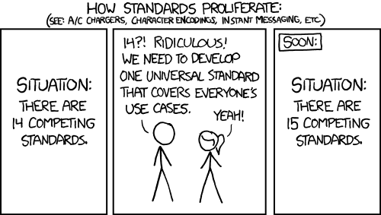
Proxy Lab
Due next Tuesday on December 8th, 2015
You may use a MAX of two late days
Make it robust to unexpected hiccups in input
The Internet is standardized, but not really

Slide 4
The Echo Server – Sequential Handling
void echo(int connfd) {
size_t n; char buf[MAXLINE]; rio_t rio;
// initialize robust io for reading on file descriptor
Rio_readinitb(&rio, connfd);
while((n = Rio_readlineb(&rio, buf, MAXLINE)) != 0) {
printf("server received %d bytes\n", (int)n);
// read to buffer, and write it back
Rio_writen(connfd, buf, n);
}
}

Slide 5
The Echo Server – Sequential Handling
int main(int argc, char **argv) {
int listenfd, connfd;
struct sockaddr_storage clientaddr; socklen_t clientlen;
char client_hostname[MAXLINE]; client_port[MAXLINE];
listenfd = Open_listenfd(argv[1]);
while(1) { // Handle requests one at a time. I hope I’m not popular!
clientlen = sizeof(struct sockaddr_storage); // Important!
connfd = Accept(listenfd, (SA*)&clientaddr, &clientlen);
Getnameinfo((SA*)&clientaddr, clientlen, client_hostname,
MAXLINE, client_port, MAXLINE, 0);
echo(connfd);
Close(connfd);
}
assert(0);
}

Slide 6
The Echo Server: Finding Its Weakness
Using telnet, we can observe a weakpoint within this iterative approach.
The second client cannot connect, because echo has not yet closed its connection with the first client.
telnet localhost 15213
./echo 15213
telnet localhost 15213

Slide 7
More Advanced Debugging
Telnet requires you to type everything yourself
Web protocols (like HTTP) can be tedious to type
Use curl to form requests for you
curl --proxy http://localhost:port url.com
Redirect output using >, for non-text files
Don’t forget that binary data is not the same as text data
Be careful when using functions that are meant to operate only on strings. They will not work properly with binary data

Slide 8
How Threads Work: Nuances
Threads run within the same process context
Arbitrary interleaving and parallelization similar to processes from Shell Lab
But keep in mind they are separate logical flows, not separate processes
This implies that there are still context switches, much like with processes, but they are of less duration since threads have less context to store away than processes

Slide 9
Critical Points for Threads
Threads have their own:
Thread ID
Stack(contained within the stack area for that process)
Stack Pointer
Instruction Pointer
General Purpose Registers
Status Codes
Threads share:
Code sections
Heap
Open files

Slide 10
Anatomy of pthread_create
Pointer to a variable that will hold the new thread’s ID
Threads created with pthread_create:
int pthread_create(pthread_t *threadID,
const pthread_attr_t *attr,
void *(*start_routine)(void *), void *arg);
NULL for this course
Pointer to a function that takes in a void pointer, and returns a void pointer. This function is what the new thread will execute.
Pointer to an argument for the function
that the thread will execute. Can pass
Multiple arguments by putting them in
a struct and passing a pointer to the
struct

Slide 11
Working Together: When to use Threads
Let’s sum up the elements in an array.
The boring way:
int sum = 0;
for (int i = 0; i < n; i++)
sum += nums[i];

Slide 12
Sums: The Fun Way
void *thread_fun(void *vargp) {
int myid = *((int *)vargp);
size_t start = myid * nelems_per_thread;
size_t end = start + nelems_per_thread;
size_t i;
size_t index = myid*spacing;
data_t sum = 0;
for (i = start; i < end; i++) // sum our section
sum += i;
psum[index] = sum;
return NULL;
}
Notes:
result = 0;
!
/* Add up the partial sums computed by each thread */
for (i = 0; i < nthreads; i++)
result += psum[i*spacing];
/* Add leftover elements */
for (e = nthreads * nelems_per_thread; e < nelems; e++)
result += e;
!
return result;
Threaded

Slide 13
Sums: The Fun Way
nelems_per_thread = nelems / nthreads;
// Create threads and wait for them to finish
for (i = 0; i < nthreads; i++) {
myid[i] = i;
Pthread_create(&tid[i], NULL, thread_fun, &myid[i]);
}
for (i = 0; i < nthreads; i++)
Pthread_join(tid[i], NULL);
Notes:
result = 0;
!
/* Add up the partial sums computed by each thread */
for (i = 0; i < nthreads; i++)
result += psum[i*spacing];
/* Add leftover elements */
for (e = nthreads * nelems_per_thread; e < nelems; e++)
result += e;
!
return result;
Threaded

Slide 14
Sums: The Fun Way
result = 0;
// Add up the partial sums computed by each thread
for (i = 0; i < nthreads; i++)
result += psum[i*spacing];
// Add leftover elements
for (e = nthreads * nelems_per_thread; e < nelems; e++)
result += e;
return result;
Notes:
result = 0;
!
/* Add up the partial sums computed by each thread */
for (i = 0; i < nthreads; i++)
result += psum[i*spacing];
/* Add leftover elements */
for (e = nthreads * nelems_per_thread; e < nelems; e++)
result += e;
!
return result;
Threaded

Slide 15
Advantages & Disadvantages
Good:
We can (potentially) make it faster
We can exploit better use of the cache
Bad:
Hard to write!
Shared resources difficult to manage
Here, we provide mutual exclusion by going to different sections of the array between threads, but we can’t always do this.

Slide 16
Critical Sections and Shared Variables
Let’s try some more counting with threads.
volatile int total = 0;
void incr(void *ptr) {
pthread_detach(pthread_self());
for (int i = 0; i < *ptr; i++)
total++;
}
Notes:
hread_t pid1, pid2;
pthread_create(&pid1,NULL,
inc_counter
, 100);
pthread_create(&pid2,NULL,
inc_counter
, 100);

Slide 17
Critical Sections and Shared Variables
#define NTHREADS 2
#define NINCR 100
int main() {
pthread_t tids[NTHREADS];
int y = NINCR;
for (int i = 0; i < NTHREADS; i++)
pthread_create(&tids[i], NULL, incr, &y);
// output will range between NTHREADS-y*NTHREADS
printf(“total is: %d”, total);
}

Slide 18


What happens
1
2
0
1
2
1
3
total
2
thread 1
2
thread 2

Slide 19
Mutexes
Solution: Lock/suspend execution of thread until resource is “acquired”
volatile int total = 0;
pthread_mutex_t M;
void incr(void *ptr) {
pthread_detach(pthread_self());
for (int i = 0; i < *ptr; i++) {
pthread_mutex_lock(&M);
total++; // CRITICAL SECTION
pthread_mutex_unlock(&M);
}
}

Slide 20
Mutexes
Remember to initialize the mutex first!
#define NTHREADS 2
#define NINCR 100
volatile int total = 0;
pthread_mutex_t M;
...
int main() {
...
pthread_mutex_init(&M);
...
}

Slide 21
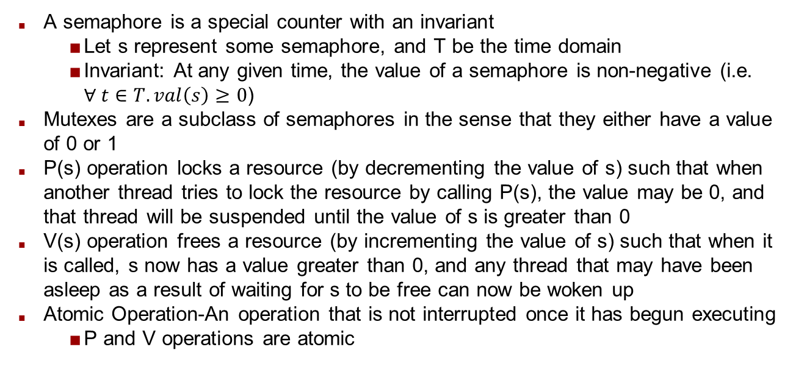
Semaphores and Atomicity
A semaphore is a special counter with an invariant
Let s represent some semaphore, and T be the time domain
Invariant: At any given time, the value of a semaphore is non-negative (i.e. $∀ t∈T. val\left(s\right)≥0$)
Mutexes are a subclass of semaphores in the sense that they either have a value of 0 or 1
P(s) operation locks a resource (by decrementing the value of s) such that when another thread tries to lock the resource by calling P(s), the value may be 0, and that thread will be suspended until the value of s is greater than 0
V(s) operation frees a resource (by incrementing the value of s) such that when it is called, s now has a value greater than 0, and any thread that may have been asleep as a result of waiting for s to be free can now be woken up
Atomic Operation-An operation that is not interrupted once it has begun executing
P and V operations are atomic

Slide 22
Problem solved… right?
Locks in threads are slow
This is a terrible way to sum up to 200
Avoid shared memory if you can
This is one of the simpler models for thread sync.
Reading vs. Writing
Producers and Consumers

Slide 23
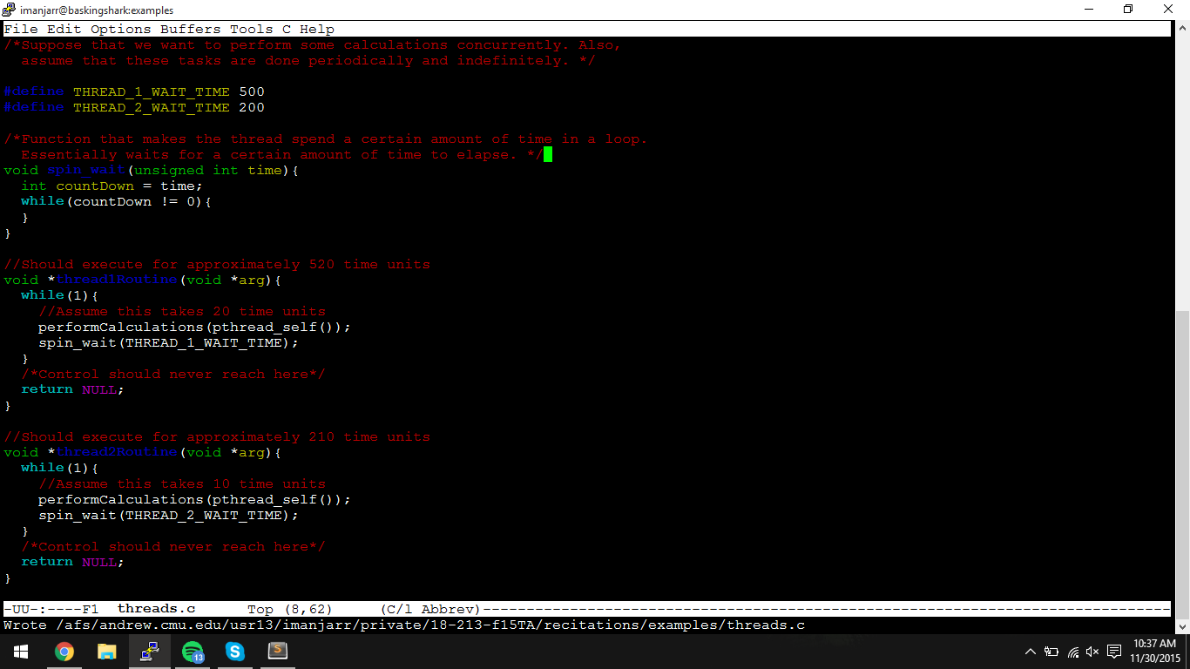
Synchronization Gone Wrong Part 1

Slide 24
Synchronization Gone Wrong Part 2
What’s wrong with this?
Note how there is only a small fraction of time per thread where calculations are actually being done
The great majority of the time is spent waiting to execute calculations again
This is a waste of valuable processor time
Do not do this
Solution
Write code that will minimize the amount of time that the processor is not doing anything useful

Slide 25
Readers and Writers
cache
writer
reader
reader
reader
reader

Slide 26
Readers and Writers
:(
cache
writer
reader
reader
reader
reader

Slide 27
Readers and Writers
cache
writer
reader
reader
reader
reader

Slide 28
Readers and Writers
cache
writer
reader
:(
reader
reader
reader

Slide 29
Readers and Writers
cache
writer
reader
reader
reader
reader

Slide 30
Concurrency and Starvation
In previous example, readers block one writer
Writer might not get the resource
Writer is being starved of resource
Make sure that readers don’t hold resource for long

Slide 31
Problem: Deadlock
I’ll give you x if you give me y.
I’ll give you y if you give me x.
Well, that’s awkward.
Thread 1
Thread 2

Slide 32
Problem: Deadlock
Entire program will hang
Pay attention to how and where you lock/unlock
Program may or may not hang predictably
Thread scheduling is non-deterministic
Similar to race conditions, usually worse
Critical section should be as small as possible

Slide 33
Problem: Livelock
Similar to Deadlock
Two programs feed back on one another
Spins indefinitely instead of hanging
Two people trying to get past each other in a hallway
Both move the same direction simultaneously
Both do an awkward dance from side to side
Dance continues indefinitely
Often happens when threads attempt to compensate for deadlock

Slide 34
Recognitions
Slides adapted from Jack Biggs

