Slide 1
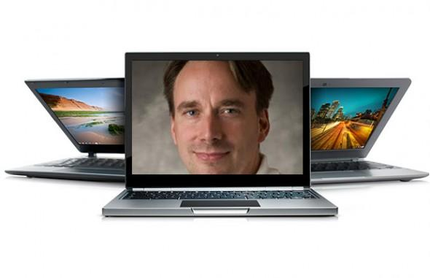
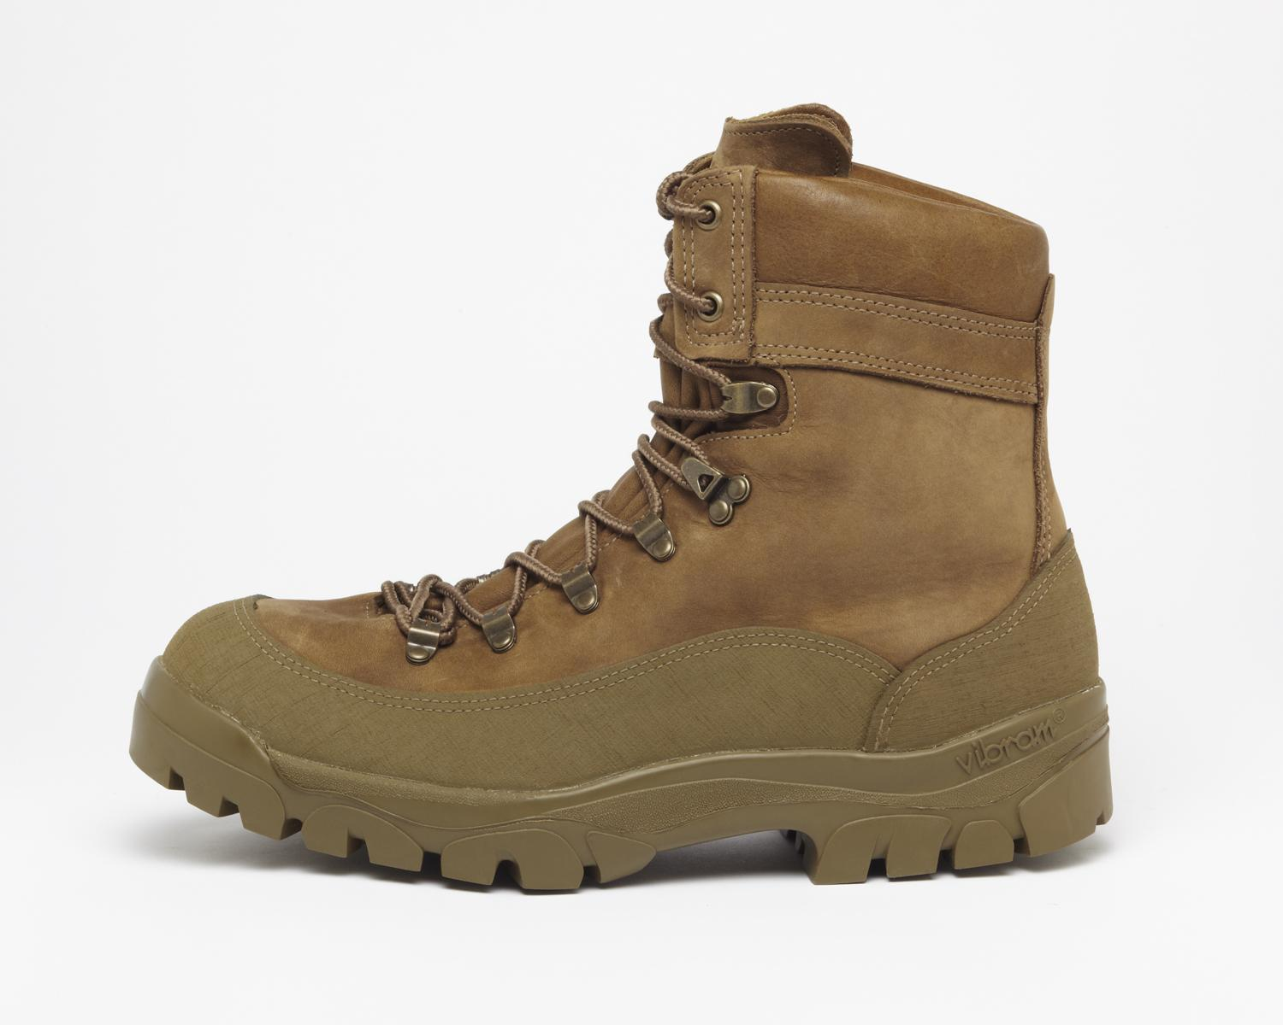

Linux Boot Camp
Jenna MacCarley, Peter Pearson, Shashank Goyal
9/19/2015

Slide 2
Connecting
SSH
Windows users: PuTTY (http://www.chiark.greenend.org.uk/~sgtatham/putty/download.html)
Mac/Linux users: Use ‘ssh’ command at terminal
ssh andrewid@shark.ics.cs.cmu.edu
Files
Windows: Tectia file transfer
Mac/Linux users: Use ‘scp’ command at terminal:
scp –r andrewid@unix.andrew.cmu.edu:~private/myfolder /some/local/folder
scp myfile.c andrewid@unix.andrew.cmu.edu:~private/myfolder

Slide 3
A message from Peter….
FOR THE LOVE OF ALL THAT IS HOLY AND SACRED, USE THE SHARK MACHINES FOR ALL OF YOUR ASSIGNMENTS

Slide 4
Welcome!
$ ls
$ cd private
$ mkdir 15-213
$ cd 15-213
$ mv ~/Downloads/datalab-handout.tar .
$ tar xvf datalab-handout.tar
$ cd datalab-handout

Slide 5
Some Nice Terminal Shortcuts
Pressing tab will autocomplete file and folder names!
Control+C will stop execution of your current program!
Control+R will let you search your command history!
Control+L will clear your screen!
cmd arg1 … argN > file1.txt will put the output of cmd into file1.txt!
cmd arg1 … argN < file2.txt will pull the input of cmd from file2.txt!
Use the up and down arrow keys to scroll through your command history!

Slide 6
Linux file pathing
~ is your HOME DIRECTORY
This is where you start from after you SSH in
On bash, you can also use $HOME
. is an alias for your PRESENT WORKING DIRECTORY!
.. is the file path for the PARENT DIRECTORY of your present working directory!
/ is the file path for the TOP-LEVEL DIRECTORY
You probably won’t use this too much in this class

Slide 7
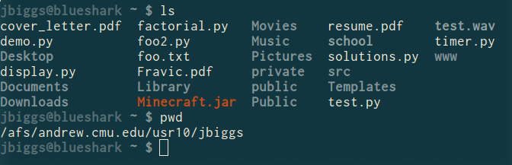
ls <dir> - LiSt
Lists the files in the present working directory, or, if specified, dir.
pwd tells you your Present Working Directory.

Slide 8
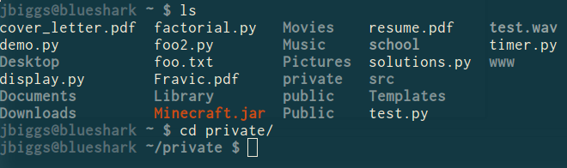
cd <directory> - Change Directory
Changes your present working directory to directory
Your main tool for navigating a unix file system

Slide 9
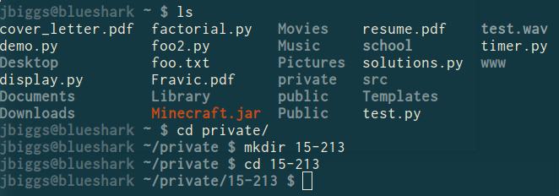
mkdir <dirname> - MaKe DIRectory
Makes a directory dirname in your present working directory.
Directories and folders are the same thing!

Slide 10
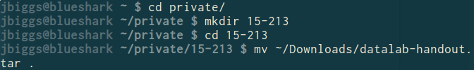
mv <src> <dest> - MoVe
cp works in exactly the same way, but copies instead
for copying folders, use cp -r
dest can be into an existing folder (preserves name), or a file/folder of a different name
Also used to re-name files without moving them
src can be either a file or a folder

Slide 11
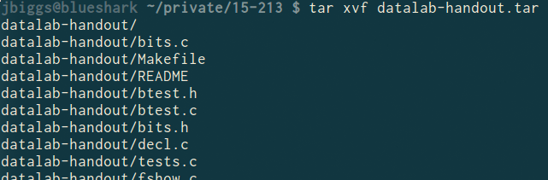
tar <options> <filename> - Tape ARchive
Compression utility, similar to zip files on Windows
For full list of options, see man tar
As name suggests, was used on tapes!
x - extract, v - verbose, f - file input
All of our handouts will be in tar format.

Slide 12
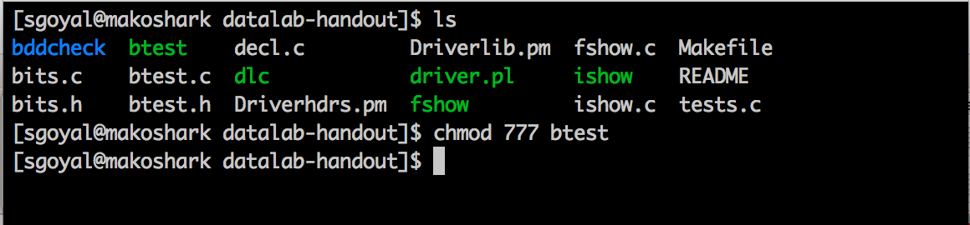
chmod <permissions> <src>
chmod is used to change the permissions of a file or directory.
777 will give all permissions
src can be either a file or a folder

Slide 13
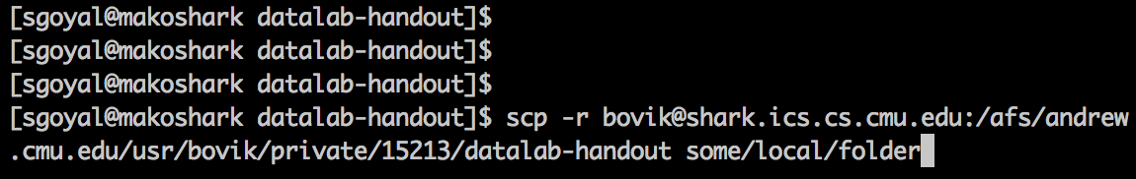
scp <src> <dest>
Allows files to be copied to/from or between different hosts.
The full path to the remote host needs to be specified
Use the -r option to copy folders

Slide 14
rm <file1> <file2> … <filen> - ReMove
Essentially the delete utility
To remove an (empty) directory, use rmdir
To remove a folder and its contents, use rm -rf
Please be careful, don’t delete your project.
There is no “Trash” here. It’s gone.
If someone asks you to use rm –rf / ignore them

Slide 15
What’s in a file? (using cat)
cat <file1> <file2> … <filen> lets you display the contents of a file in the terminal window.
Use cat -n to add line numbers!
You can combine multiple files into one!
cat <file1> … <filen> > file.txt
Good for seeing what’s in small files.
Try cat -n bits.c. Too big, right?

Slide 16
What’s in a file? (using less)
less <file> will give you a scrollable interface for viewing large files without editing them.
To find something, use /
To view the next occurrence, press n
To view previous occurrence, press N
To quit, use q
Try it: Type “/isPower2”

Slide 17

What’s in a file? (using grep)
grep <pattern> <file> will output any lines of file that have pattern as a substring
grep -v will output lines without pattern as substring
grep -R will search recursively
Try it: grep ‘isPower2’ bits.c
grep -v ‘*’ bits.c
grep -R ‘unsigned’ .

Slide 18
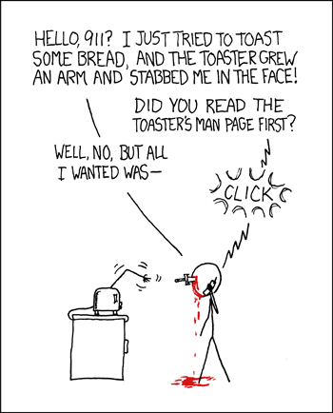
man <thing>
What is that command? What is this C standard library function? What does this library do? Check to see if it has a man page!
Pages viewed with less
Try it!
man grep
man tar
man printf
man strlen

Slide 19
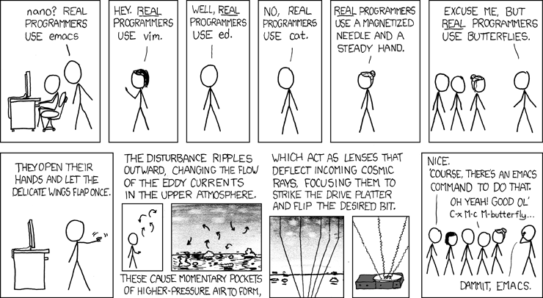
Editors (a touchy subject)

Slide 20
Vim (vi – improved) Basics
Some different modes:
Normal mode:
The first mode you enter. Hit the escape key to return to this mode at any time
Everything entered here is interpreted as a command
Command-line mode:
Used for entering editor commands (necessary to save file & quit the editor)
Enter “:” in Normal mode to get to this mode
Insert mode:
To edit text
Enter “i” in Normal mode to get to this mode

Slide 21
Vim Basics
Useful commands:
Copying/pasting/deleting lines:
yy (yank) or 5 yy (yank next 5 lines)
dd (delete) or 5 dd (delete next 5 lines)
p (paste)
Search (/search_string or ?search_string)
Useful editor commands:
Write (w)
Quit (q) quit no-save (q!)

Slide 22
Vimrc File
Stores vim configuration info
Can make your editing experience even better!
Notably:
Smart indentation
Line numbers
Changing tabs to default to 2 or 4 spaces
Colors
To edit, type: vim ~/.vimrc

Slide 23
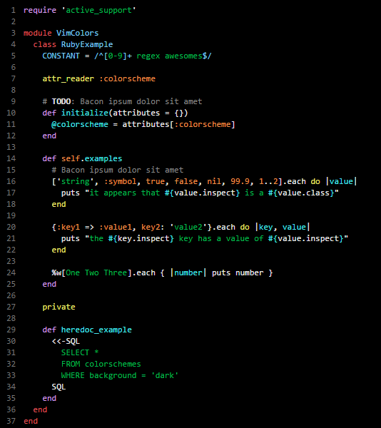
Vim colors
Download a .vim color scheme file from the web (or make your own)
Copy to ~/.vim/colors folder (make this folder if it doesn’t exist)
Some useful places to download color schemes:
http://vimcolors.com/
http://cocopon.me/app/vim-color-gallery/
Makes your editor pretty!

Slide 24
Jenna’s Vimrc File
set tabstop=2
set shiftwidth=2
set expandtab
set viminfo='100,h
colorscheme desertedocean
set number
syntax on
filetype on
filetype indent on
filetype plugin on
set smartindent

Slide 25
More resources on Vim
A good intro tutorial: http://www.engadget.com/2012/07/10/vim-how-to/
An interactive tutorial: http://www.openvim.com/
man vim
Google

Slide 26
Commands related to 15-213
gdb, the GNU Debugger, will be used for bomb lab.
objdump –d displays the symbols in an executable.
gcc is the GNU C Compiler.
make reads a configuration file to run a series of commands. Often used for compiling your programs.
We will provide other tools in the handouts as well

Slide 27
