Slide 1
Bits, Bytes, and Integers – Part 2 15-213/15-513: Introduction to Computer Systems 3rd Lecture, May 18, 2023
Instructors:
Brian Railing (15-513)

Slide 2
Today: Bits, Bytes, and Integers
Representing information as bits
Bit-level manipulations
Integers
Representation: unsigned and signed; negation and addition
Conversion, casting, extension, truncation
Multiplication, division, shifting
Byte order in memory, pointers, strings

Slide 3



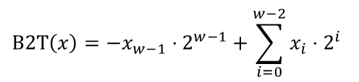
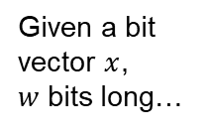
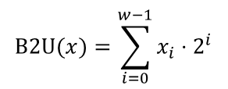
Encoding “Integers”
Unsigned
Signed (twos complement)
Given a bit vector $x$, $w$ bits long…
$$\text{B}\text{2}U(x)=\sum_{i=0}^{w−1}{x_{i}⋅2^{i}}$$
$$\text{B}\text{2}\text{T}\left(x\right)=−x_{w−1}⋅2^{w−1}+\sum_{i=0}^{w−2}{x_{i}⋅2^{i}}$$
Sign Bit
Examples (w = 5)
±16 | 8 | 4 | 2 | 1
0 | 1 | 0 | 1 | 0
$$0+8+0+2+0=$$
10
16 | 8 | 4 | 2 | 1
1 | 0 | 1 | 1 | 0
-16 | 8 | 4 | 2 | 1
$$16+8+0+2+0=$$
26
$$−16+8+0+2+0=$$
−10

Slide 4
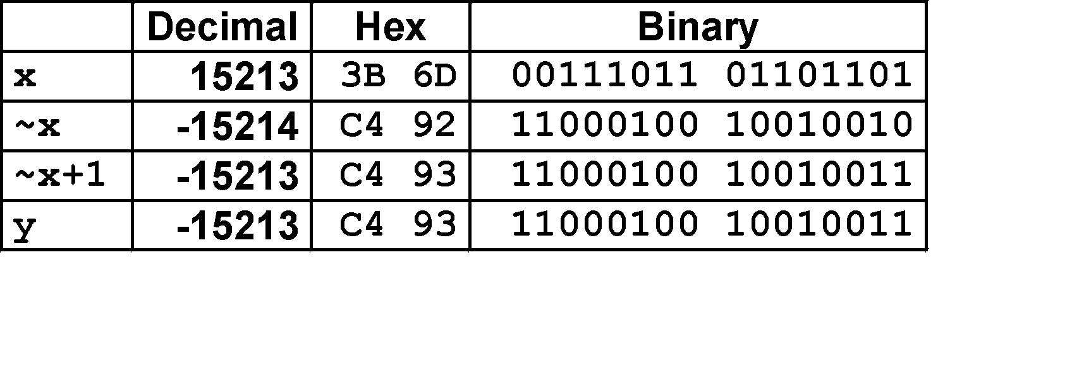
Negation: Complement & Increment
Negate through complement and increase ~x + 1 == -x
Why?
-x + x == 0 (by definition)
~x + x == 1111…111 == -1
~x + x + 1 == 0
(~x+1) + x == 0
~x+1 == -x
x
1
0
0
1
1
1
0
1
+
~x
0
1
1
0
0
0
1
0
−1
1
1
1
1
1
1
1
1
Example: x = 15213

Slide 5
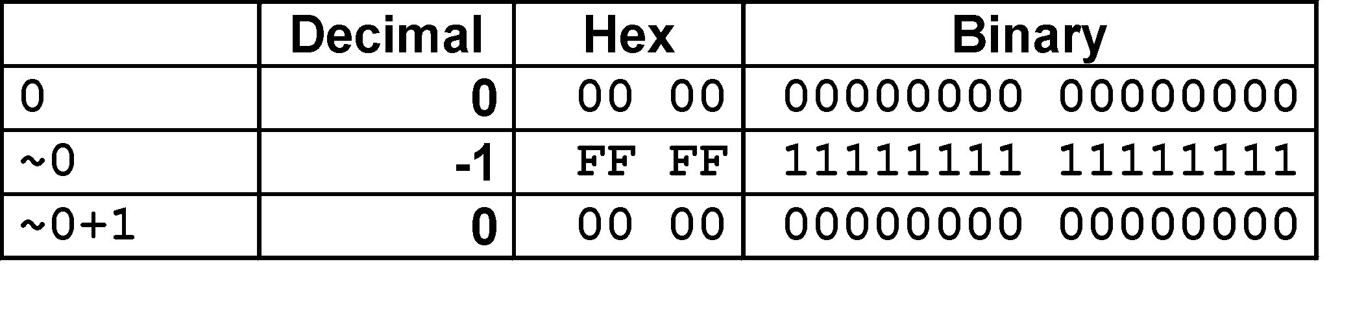
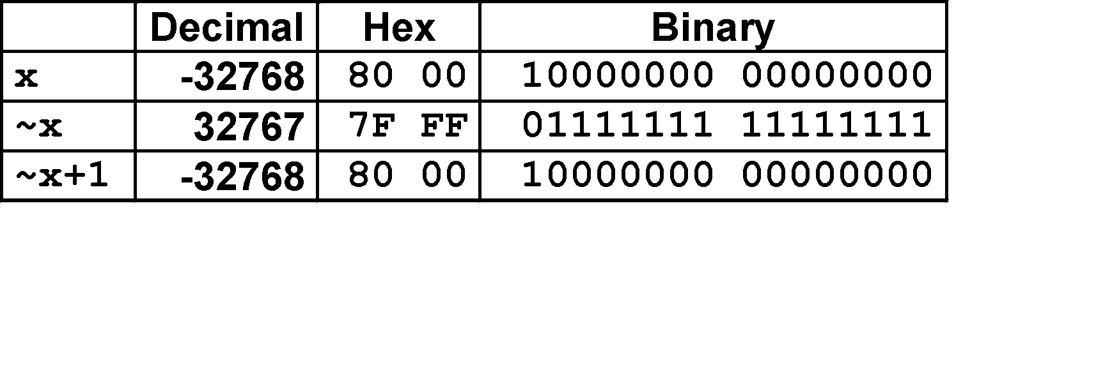


Complement & Increment Examples
$$x=0$$
$${x=T}_{min}$$
Oops!
It’s still negative!

Slide 6
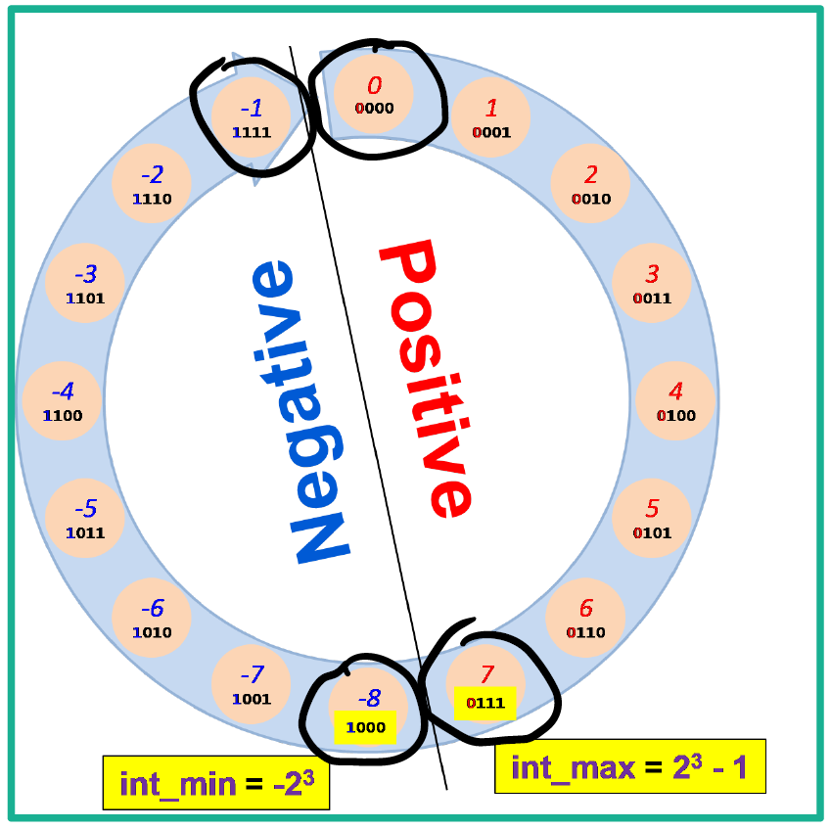
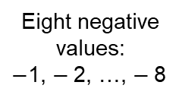
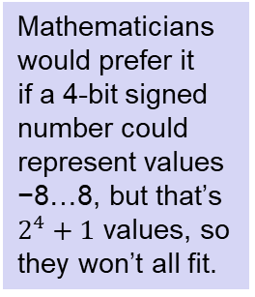
Eight negative values:
$−$1, $−$2, …, $−$8
Eight non-negative values:
0, 1, …, 7
Mathematicians would prefer it if a 4-bit signed number could represent values −8…8, but that’s $2^{4}+1$ values, so they won’t all fit.
What if we made a 4-bit signed number only represent values −7…7? Then we wouldn’t be using bit pattern 1000…

Slide 7
Unsigned Addition
Operands: w bits
u
• • •
+
v
• • •
True Sum: w+1 bits
u + v
• • •
Discard Carry: w bits
UAdd_{w}(u , v)
• • •
Decimal
Hex
Binary
Standard Addition Function
Ignores carry output
Implements Modular Arithmetic
s = UAdd_{w}(u , v) = u + v mod 2^{w}
0
0
0000
1
1
0001
2
2
0010
3
3
0011
4
4
0100
5
5
0101
6
6
0110
7
7
0111
unsigned char
1110 1001
+ 1101 0101
E9
+ D5
233
+ 213
8
8
1000
9
9
1001
A
10
1010
B
11
1011
C
12
1100
D
13
1101
E
14
1110
F
15
1111

Slide 8
Unsigned Addition
Operands: w bits
u
• • •
+
v
• • •
True Sum: w+1 bits
u + v
• • •
Discard Carry: w bits
UAdd_{w}(u , v)
• • •
Decimal
Hex
Binary
Standard Addition Function
Ignores carry output
Implements Modular Arithmetic
s = UAdd_{w}(u , v) = u + v mod 2^{w}
0
0
0000
1
1
0001
2
2
0010
3
3
0011
4
4
0100
5
5
0101
6
6
0110
7
7
0111
unsigned char
1110 1001
+ 1101 0101
E9
+ D5
233
+ 213
8
8
1000
9
9
1001
A
10
1010
1 1011 1110
1BE
446
B
11
1011
C
12
1100
1011 1110
BE
190
D
13
1101
E
14
1110
F
15
1111

Slide 9
Visualizing (Mathematical) Integer Addition
Integer Addition
4-bit integers u, v
Compute true sum Add₄(u , v)
Values increase linearly with u and v
Forms planar surface
Add₄(u , v)
v
u

Slide 10
Visualizing Unsigned Addition
Wraps Around
If true sum ≥ 2^{w}
At most once
Overflow
UAdd₄(u , v)
True Sum
2^{w+1}
Overflow
2^{w}
v
0
Modular Sum
u

Slide 11
Two’s Complement Addition
Operands: w bits
u
• • •
+
v
• • •
True Sum: w+1 bits
u + v
• • •
Discard Carry: w bits
TAdd_{w}(u , v)
• • •
TAdd and UAdd have Identical Bit-Level Behavior
Signed vs. unsigned addition in C:
int s, t, u, v;
s = (int) ((unsigned) u + (unsigned) v);
t = u + v
Will give s == t
1110 1001
+ 1101 0101
E9
+ D5
-23
+ -43
1 1011 1110
1BE
-66
1011 1110
BE
-66

Slide 12
Visualizing 2’s Complement Addition
NegOver
Values
4-bit two’s comp.
Range from -8 to +7
Wraps Around
If sum ≥ 2^{w–1}
Becomes negative
At most once
If sum < –2^{w–1}
Becomes positive
At most once
TAdd₄(u , v)
v
u
PosOver

Slide 13
TAdd Overflow
Functionality
True sum requires w+1 bits
Drop off MSB
Treat remaining bits as 2’s comp. integer
True Sum
0 111…1
2^{w}–1
PosOver
TAdd Result
0 100…0
2^{w –1}–1
011…1
0 000…0
0
000…0
1 011…1
–2^{w –1}
100…0
1 000…0
–2^{w}
NegOver

Slide 14
Today: Bits, Bytes, and Integers
Representing information as bits
Bit-level manipulations
Integers
Representation: unsigned and signed; negation and addition
Conversion, casting, extension, truncation
Multiplication, division, shifting
Byte order in memory, pointers, strings

Slide 15
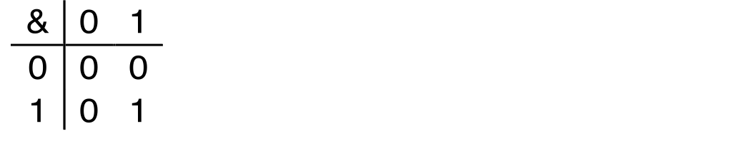
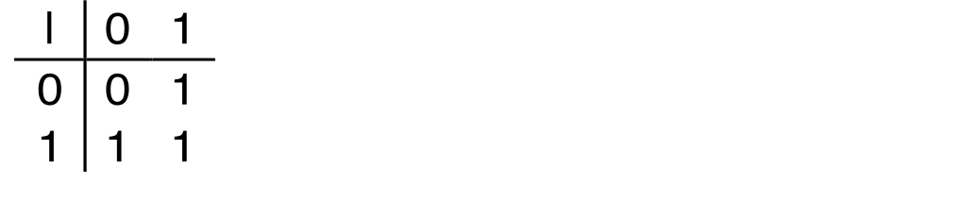
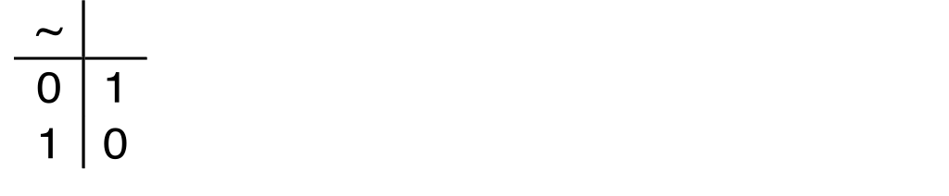
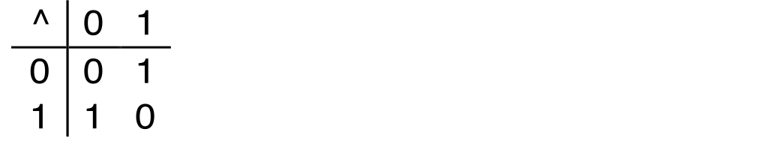
Boolean Algebra
Developed by George Boole in 19th Century
Algebraic representation of logic
Encode “True” as 1 and “False” as 0
And
A&B = 1 when both A=1 and B=1
Or
A|B = 1 when either A=1 or B=1
Not
~A = 1 when A=0
Exclusive-Or (Xor)
A^B = 1 when either A=1 or B=1, but not both

Slide 16
Activity: https://canvas.cmu.edu/courses/30386/assignments/525231
Do model 2, then stop.

Slide 17
General Boolean Algebras
Operate on Bit Vectors
Operations applied bitwise
All of the Properties of Boolean Algebra Apply
01101001
& 01010101
01000001
01101001
| 01010101
01111101
01101001
^ 01010101
00111100
~ 01010101
10101010
01000001
01111101
00111100
10101010

Slide 18
Example: Representing & Manipulating Sets
Representation
Width w bit vector represents subsets of {0, …, w–1}
a_{j} = 1 if j ∈ A
01101001 { 0, 3, 5, 6 }
76543210
01010101 { 0, 2, 4, 6 }
76543210
Operations
& Intersection 01000001 { 0, 6 }
| Union 01111101 { 0, 2, 3, 4, 5, 6 }
^ Symmetric difference 00111100 { 2, 3, 4, 5 }
~ Complement 10101010 { 1, 3, 5, 7 }

Slide 19
Bit-Level Operations in C
Decimal
Hex
Binary
Operations &, |, ~, ^ Available in C
Apply to any “integral” data type
long, int, short, char, unsigned
View arguments as bit vectors
Arguments applied bit-wise
Examples (Char data type)
~0x41 → 0xBE
~01000001₂ → 10111110₂
~0x00 → 0xFF
~00000000₂ → 11111111₂
0x69 & 0x55 → 0x41
01101001₂ & 01010101₂ → 01000001₂
0x69 | 0x55 → 0x7D
01101001₂ | 01010101₂ → 01111101₂
0
0
0000
1
1
0001
2
2
0010
3
3
0011
4
4
0100
5
5
0101
6
6
0110
7
7
0111
8
8
1000
9
9
1001
A
10
1010
B
11
1011
C
12
1100
D
13
1101
E
14
1110
F
15
1111

Slide 20
Bit-Level Operations in C
Decimal
Hex
Binary
Operations &, |, ~, ^ Available in C
Apply to any “integral” data type
long, int, short, char, unsigned
View arguments as bit vectors
Arguments applied bit-wise
Examples (Char data type)
~0x41 → 0xBE
~01000001₂ → 10111110₂
~0x00 → 0xFF
~00000000₂ → 11111111₂
0x69 & 0x55 → 0x41
01101001₂ & 01010101₂ → 01000001₂
0x69 | 0x55 → 0x7D
01101001₂ | 01010101₂ → 01111101₂
Operations &, |, ~, ^ Available in C
Apply to any “integral” data type
long, int, short, char, unsigned
View arguments as bit vectors
Arguments applied bit-wise
Examples (Char data type)
~0x41 → 0xBE
~0100 0001₂ → 1011 1110₂
~0x00 → 0xFF
~0000 0000₂ → 1111 1111₂
0x69 & 0x55 → 0x41
0110 1001₂ & 0101 0101₂ → 0100 0001₂
0x69 | 0x55 → 0x7D
0110 1001₂ | 0101 0101₂ → 0111 1101₂
0
0
0000
1
1
0001
2
2
0010
3
3
0011
4
4
0100
5
5
0101
6
6
0110
7
7
0111
8
8
1000
9
9
1001
A
10
1010
B
11
1011
C
12
1100
D
13
1101
E
14
1110
F
15
1111

Slide 21
Contrast: Logic Operations in C
Contrast to Bit-Level Operators
Logic Operations: &&, ||, !
View 0 as “False”
Anything nonzero as “True”
Always return 0 or 1
Early termination
Examples (char data type)
!0x41 → 0x00
!0x00 → 0x01
!!0x41→ 0x01
0x69 && 0x55 → 0x01
0x69 || 0x55 → 0x01
p && *p (avoids null pointer access)
Watch out for && vs. & (and || vs. |)…
one of the more common oopsies in
C programming

Slide 22
Activity: https://canvas.cmu.edu/courses/30386/assignments/525231
Do model 3, then stop.

Slide 23
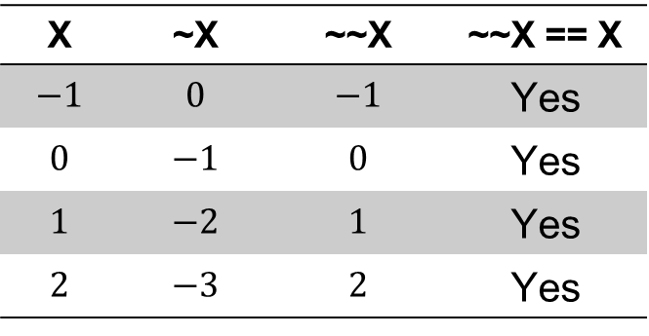
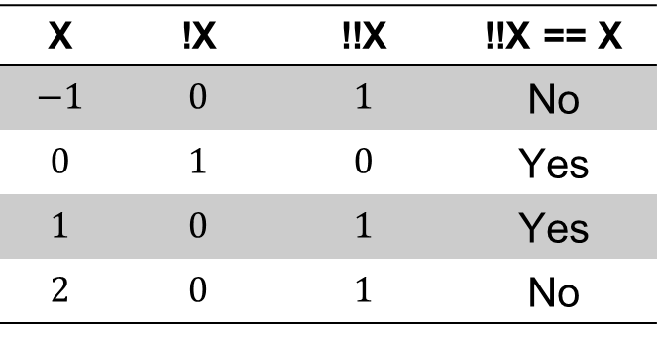
Logical versus Bitwise
X | !X | !!X | !!X == X
$$−1$$ | $$0$$ | $$1$$ | No
$$0$$ | $$1$$ | $$0$$ | Yes
$$1$$ | $$0$$ | $$1$$ | Yes
$$2$$ | $$0$$ | $$1$$ | No
X | ~X | ~~X | ~~X == X
$$−1$$ | $$0$$ | $$−1$$ | Yes
$$0$$ | $$−1$$ | $$0$$ | Yes
$$1$$ | $$−2$$ | $$1$$ | Yes
$$2$$ | $$−3$$ | $$2$$ | Yes
!!x != x
~~x == x

Slide 24
Today: Bits, Bytes, and Integers
Representing information as bits
Bit-level manipulations
Integers
Representation: unsigned and signed; negation and addition
Conversion, casting, extension, truncation
Multiplication, division, shifting
Byte order in memory, pointers, strings

Slide 25
Mapping Between Signed & Unsigned
Two’s Complement
Unsigned
T2U
s
T2B
B2U
u
X
Maintain Same Bit Pattern
Unsigned
U2T
Two’s Complement
u
U2B
B2T
s
X
Maintain Same Bit Pattern
Mappings between unsigned and two’s complement numbers: Keep bit representations and reinterpret

Slide 26
Relation between Signed & Unsigned
Unsigned
U2T
Two’s Complement
u
U2B
B2T
s
X
Maintain Same Bit Pattern
w–1
0
u
+
+
+
• • •
+
+
+
s
-
+
+
• • •
+
+
+
Large positive weight
becomes
Large negative weight

Slide 27

Mapping Signed ↔ Unsigned
Bits
0000
0001
0010
0011
0100
0101
0110
0111
1000
1001
1010
1011
1100
1101
1110
1111
Signed
0
1
2
3
4
5
6
7
-8
-7
-6
-5
-4
-3
-2
-1
Unsigned
0
1
2
3
4
5
6
7
8
9
10
11
12
13
14
15
=
$$±16$$

Slide 28
Conversion Visualized
2’s Comp. → Unsigned
Ordering Inversion
Negative → Big Positive
UMax
UMax – 1
TMax + 1
Unsigned
Range
TMax
TMax
2’s Complement Range
0
0
–1
–2
TMin

Slide 29
Signed vs. Unsigned in C
Constants
By default are considered to be signed integers
Unsigned if have “U” as suffix
0U, 4294967259U
Casting
Explicit casting between signed & unsigned same as U2T and T2U
int tx, ty;
unsigned ux, uy;
tx = (int) ux;
uy = (unsigned) ty;
Implicit casting also occurs via assignments and procedure calls
tx = ux; int fun(unsigned u);
uy = ty; uy = fun(tx);

Slide 30
Casting Surprises
Expression Evaluation
If there is a mix of unsigned and signed in single expression, signed values implicitly cast to unsigned
Including comparison operations <, >, ==, <=, >=
Examples:
Constant 1 | Constant 2 | Relation | Evaluation
0 | 0U | == | Unsigned
-1 | 0 | < | Signed
-1 | 0U | > | Unsigned
INT_MAX | INT_MIN | > | Signed
(unsigned)INT_MAX | INT_MIN | < | Unsigned
-1 | -2 | > | Signed
(unsigned)-1 | -2 | > | Unsigned
INT_MAX | ((unsigned)INT_MAX) + 1 | < | Unsigned
INT_MAX | (int)(((unsigned)INT_MAX) + 1) | > | Signed

Slide 31
Summary Casting Signed ↔ Unsigned: Basic Rules
Bit pattern is maintained
But reinterpreted
Can have unexpected effects: adding or subtracting 2^{w}
Expression containing signed and unsigned int
int is cast to unsigned!!

Slide 32
Today: Bits, Bytes, and Integers
Representing information as bits
Bit-level manipulations
Integers
Representation: unsigned and signed; negation and addition
Conversion, casting, extension, truncation
Multiplication, division, shifting
Byte order in memory, pointers, strings

Slide 33
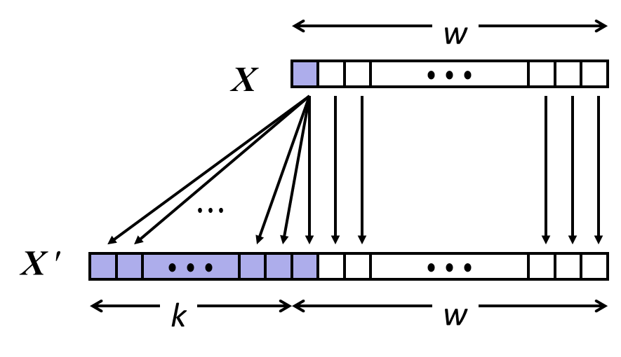
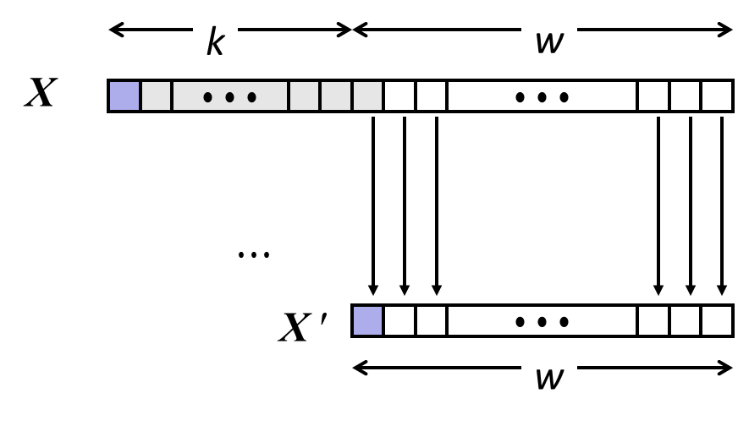
Sign Extension and Truncation
Sign Extension
Truncation
Make k copies of sign bit
Chop off k highest bits

Slide 34
Sign Extension: Simple Example
Positive number
Negative number
-16 | 8 | 4 | 2 | 1
0 | 1 | 0 | 1 | 0
-16 | 8 | 4 | 2 | 1
1 | 0 | 1 | 1 | 0
10 =
-10 =
-32 | 16 | 8 | 4 | 2 | 1
0 | 0 | 1 | 0 | 1 | 0
-32 | 16 | 8 | 4 | 2 | 1
1 | 1 | 0 | 1 | 1 | 0
10 =
-10 =

Slide 35
Truncation: Simple Example
No sign change
Sign change
-16 | 8 | 4 | 2 | 1
0 | 0 | 0 | 1 | 0
-16 | 8 | 4 | 2 | 1
0 | 1 | 0 | 1 | 0
2 =
10 =
 | -8 | 4 | 2 | 1
 | 0 | 0 | 1 | 0
 | -8 | 4 | 2 | 1
 | 1 | 0 | 1 | 0
2 =
-6 =
2 mod 16 = 2
10 mod 16 = 10U mod 16 = 10U = -6
-16 | 8 | 4 | 2 | 1
1 | 1 | 0 | 1 | 0
-16 | 8 | 4 | 2 | 1
1 | 0 | 1 | 1 | 0
-6 =
-10 =
 | -8 | 4 | 2 | 1
 | 1 | 0 | 1 | 0
 | -8 | 4 | 2 | 1
 | 0 | 1 | 1 | 0
-6 =
6 =
-6 mod 16 = 26U mod 16 = 10U = -6
-10 mod 16 = 22U mod 16 = 6U = 6

Slide 36
Today: Bits, Bytes, and Integers
Representing information as bits
Bit-level manipulations
Integers
Representation: unsigned and signed; negation
Conversion, casting
Extension, truncation, shifting
Addition, multiplication
Representations in memory, pointers, strings

Slide 37
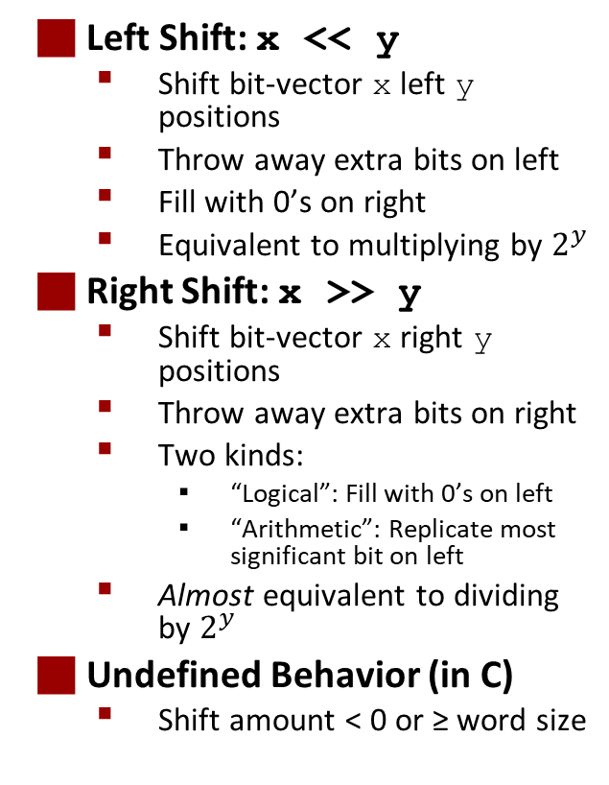
Shifting
Left Shift: x << y
Shift bit-vector x left y positions
Throw away extra bits on left
Fill with 0’s on right
Equivalent to multiplying by $2^{y}$
Right Shift: x >> y
Shift bit-vector x right y positions
Throw away extra bits on right
Two kinds:
“Logical”: Fill with 0’s on left
“Arithmetic”: Replicate most significant bit on left
Almost equivalent to dividing by $2^{y}$
Undefined Behavior (in C)
Shift amount < 0 or ≥ word size
Argument x | 01100010
<< 3 | 00010000
Logical >> 2 | 00011000
Arithmetic >> 2 | 00011000
Argument x | 10100010
<< 3 | 00010000
Logical >> 2 | 00101000
Arithmetic >> 2 | 11101000

Slide 38
Multiplication
Goal: Computing Product of w-bit numbers x, y
Either signed or unsigned
But, exact results can be bigger than w bits
Unsigned: up to 2w bits
Result range: 0 ≤ x * y ≤ (2^{w} – 1) ² = 2^{2w} – 2^{w+1} + 1
Two’s complement min (negative): Up to 2w-1 bits
Result range: x * y ≥ (–2^{w–1})*(2^{w–1}–1) = –2^{2w–2} + 2^{w–1}
Two’s complement max (positive): Up to 2w bits, but only for (TMin_{w})²
Result range: x * y ≤ (–2^{w–1}) ² = 2^{2w–2}
So, maintaining exact results…
would need to keep expanding word size with each product computed
is done in software, if needed
e.g., by “arbitrary precision” arithmetic packages

Slide 39
Activity: https://canvas.cmu.edu/courses/30386/assignments/525231
Do model 4, then stop.

Slide 40
Unsigned Multiplication in C
u
• • •
Operands: w bits
*
v
• • •
True Product: 2*w bits
u · v
• • •
• • •
UMult_{w}(u , v)
Discard w bits: w bits
• • •
Standard Multiplication Function
Ignores high order w bits
Implements Modular Arithmetic
UMult_{w}(u , v) = u · v mod 2^{w}
1110 1001
* 1101 0101
E9
* D5
233
* 213
1100 0001 1101 1101
C1DD
49629
1101 1101
DD
221

Slide 41
Signed Multiplication in C
u
• • •
Operands: w bits
*
v
• • •
True Product: 2*w bits
u · v
• • •
• • •
TMult_{w}(u , v)
Discard w bits: w bits
• • •
Standard Multiplication Function
Ignores high order w bits
Some of which are different for signed vs. unsigned multiplication
Lower bits are the same
1110 1001
* 1101 0101
E9
* D5
-23
* -43
0000 0011 1101 1101
03DD
989
1101 1101
DD
-35

Slide 42
Power-of-2 Multiply with Shift
Operation
u << k gives u * 2^{k}
Both signed and unsigned
Examples
u << 3 == u * 8
(u << 5) – (u << 3) == u * 24
Most machines shift and add faster than multiply
Compiler generates this code automatically
k
u
• • •
Operands: w bits
*
2^{k}
0
•••
0
1
0
•••
0
0
True Product: w+k bits
u · 2^{k}
• • •
0
•••
0
0
Discard k bits: w bits
UMult_{w}(u , 2^{k})
•••
0
•••
0
0
TMult_{w}(u , 2^{k})

Slide 43
Today: Bits, Bytes, and Integers
Representing information as bits
Bit-level manipulations
Integers
Representation: unsigned and signed; negation and addition
Conversion, casting, extension, truncation
Multiplication, division, shifting
Byte order in memory, pointers, strings

Slide 44
Byte-Oriented Memory Organization
00•••0
FF•••F
• • •
Programs refer to data by address
Imagine all of RAM as an enormous array of bytes
An address is an index into that array
A pointer variable stores an address
System provides a private address space to each “process”
A process is an instance of a program, being executed
An address space is one of those enormous arrays of bytes
Each program can see only its own code and data within its enormous array
We’ll come back to this later (“virtual memory” classes)

Slide 45
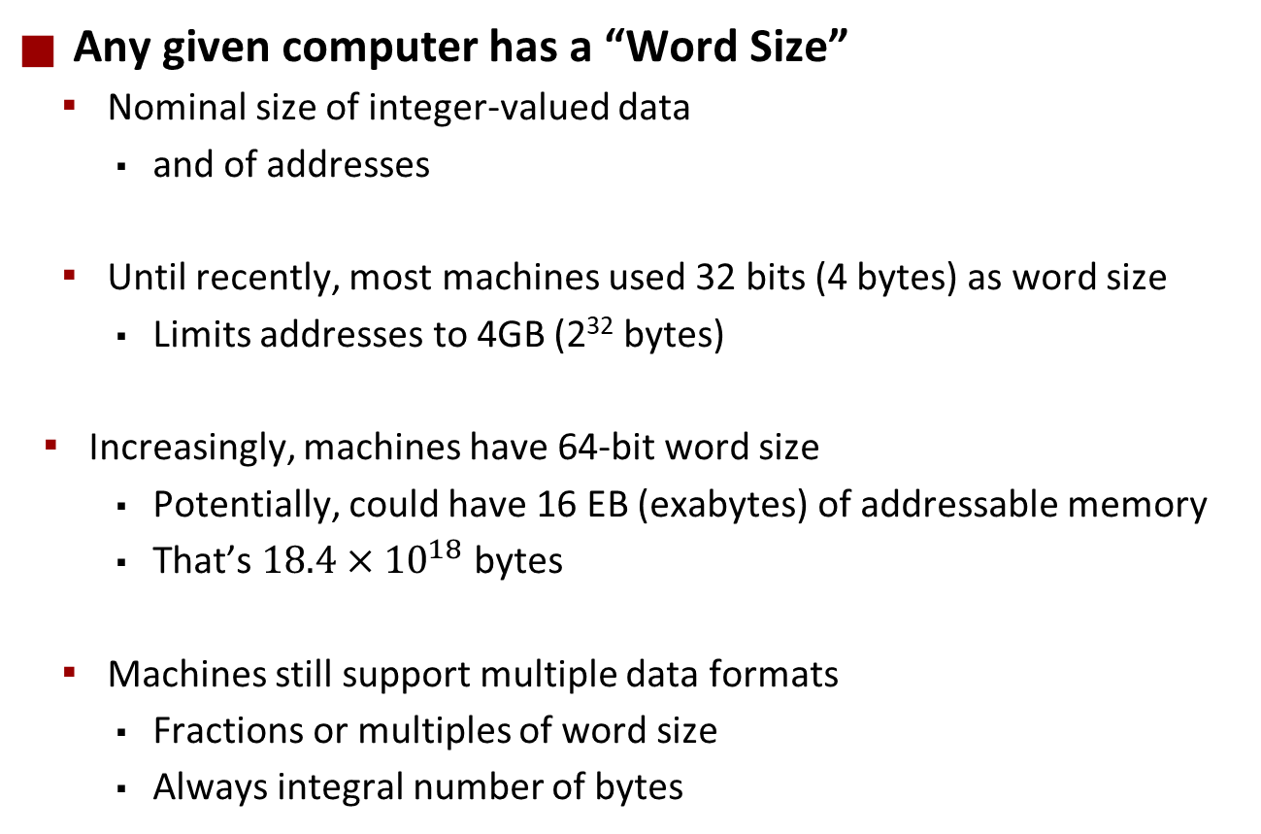
Machine Words
Any given computer has a “Word Size”
Nominal size of integer-valued data
and of addresses
Until recently, most machines used 32 bits (4 bytes) as word size
Limits addresses to 4GB (2³² bytes)
Increasingly, machines have 64-bit word size
Potentially, could have 16 EB (exabytes) of addressable memory
That’s $18.4×{10}^{18}$ bytes
Machines still support multiple data formats
Fractions or multiples of word size
Always integral number of bytes
Yes, both of these numbers are correct.
This discrepancy is known as the Great Storage Industry Marketing Lie. Ask me about it after class if you really want to know.

Slide 46
Addresses Always Specify Byte Locations
32-bit
Words
64-bit
Words
Bytes
Addr.
Address of a word is address of the first byte in the word
Addresses of successive words differ by 4 (32-bit) or 8 (64-bit)
0000
Addr
=
??
0001
0000
0002
Addr
=
??
0003
0000
0004
Addr
=
??
0005
0004
0006
0007
0008
Addr
=
??
0009
0008
0010
Addr
=
??
0011
0008
0012
Addr
=
??
0013
0012
0014
0015

Slide 47
Example Data Representations
C Data Type | Typical 32-bit | Typical 64-bit | x86-64
char | 1 | 1 | 1
short | 2 | 2 | 2
int | 4 | 4 | 4
long | 4 | 8 | 8
float | 4 | 4 | 4
double | 8 | 8 | 8
pointer | 4 | 8 | 8

Slide 48
Byte Ordering
So, how are the bytes within a multi-byte word ordered in memory?
Conventions
Big Endian: Sun, PPC Mac, network packet headers
Least significant byte has highest address
Little Endian: x86, ARM processors running Android, iOS, and Windows
Least significant byte has lowest address

Slide 49
Byte Ordering Example
Example
Variable x has 4-byte value of 0x01234567
Address given by &x is 0x100
Big Endian
0x100
0x101
0x102
0x103
01
01
23
23
45
45
67
67
Little Endian
0x100
0x101
0x102
0x103
67
67
45
45
23
23
01
01

Slide 50
Representing Integers
Decimal: 15213
Binary: 0011 1011 0110 1101
Hex: 3 B 6 D
int A = 15213;
long int C = 15213;
IA32, x86-64
Sun
IA32
x86-64
Sun
6D
00
Increasing addresses
3B
00
6D
6D
00
00
3B
3B
3B
00
00
6D
00
00
3B
00
00
6D
00
int B = -15213;
00
IA32, x86-64
Sun
00
00
93
FF
C4
FF
FF
C4
FF
93
Two’s complement representation

Slide 51
Examining Data Representations
Code to Print Byte Representation of Data
Casting pointer to unsigned char * allows treatment as a byte array
typedef unsigned char *pointer;
void show_bytes(pointer start, size_t len){
size_t i;
for (i = 0; i < len; i++)
printf(”%p\t0x%.2x\n",start+i, start[i]);
printf("\n");
}
Printf directives:
%p: Print pointer
%x: Print Hexadecimal

Slide 52
show_bytes Execution Example
int a = 15213;
printf("int a = 15213;\n");
show_bytes((pointer) &a, sizeof(int));
Result (Linux x86-64):
int a = 15213;
0x7fffb7f71dbc 6d
0x7fffb7f71dbd 3b
0x7fffb7f71dbe 00
0x7fffb7f71dbf 00

Slide 53
Representing Pointers
int B = -15213;
int *P = &B;
Sun
IA32
x86-64
EF
FF
FB
2C
AC
28
F5
FF
3C
1B
FE
82
FD
7F
00
00
Different compilers & machines assign different locations to objects
Even get different results each time run program

Slide 54
Representing Strings
char S[6] = "18213";
Strings in C
Represented by array of characters
Each character encoded in ASCII format
Standard 7-bit encoding of character set
Character “0” has code 0x30
Digit i has code 0x30+i
String should be null-terminated
Final character = 0
Compatibility
Byte ordering not an issue
IA32
Sun
31
38
32
31
33
00
31
38
32
31
33
00

Slide 55
Representing x86 machine code
x86 machine code is a sequence of bytes
Grouped into variable-length instructions, which look like strings…
But they contain embedded little-endian numbers…
Example Fragment
Deciphering Numbers
Value: 0x12ab
Pad to 32 bits: 0x000012ab
Split into bytes: 00 00 12 ab
Reverse: ab 12 00 00
Address Instruction Code Assembly Rendition
8048365: 5b pop %ebx
8048366: 81 c3 ab 12 00 00 add $0x12ab,%ebx
804836c: 83 bb 28 00 00 00 00 cmpl $0x0,0x28(%ebx)

