Slide 1
Code Optimization 15-213/15-513: Introduction to Computer Systems 12th Lecture, June 13, 2023
Instructors:
Brian Railing

Slide 2
Today
Principles and goals of compiler optimization
Examples of optimizations
Obstacles to optimization
Machine-dependent optimization
Benchmark example

Slide 3
Back in the Good Old Days, when the term "software" sounded funny and Real Computers were made out of drums and vacuum tubes, Real Programmers wrote in machine code.
Not FORTRAN. Not RATFOR. Not, even, assembly language.
Machine Code.
Raw, unadorned, inscrutable hexadecimal numbers. Directly.
— “The Story of Mel, a Real Programmer”
Ed Nather, 1983
Notes:
Forty years ago, Ed Nather wrote a story about a fellow named Mel, whom he’d known twenty years before that, back when computers were made out of drums and vacuum tubes.
(Drums, by the way, were what we used for stable storage before disks and after paper tape. Big metal cylinder with magnetic media wrapped around the outside.)
Mel wrote his programs in machine code. Raw, unadorned, inscrutable hexadecimal numbers. Directly.
Ed was impressed. Ed thought, of the two of them, Mel was the real programmer. But this is machismo. Programming in machine code is the bad kind of difficult. I’ve done it a couple times, for tiny little things, and you spend all your time triple-checking that individual inscrutable hexadecimals mean what you want them to mean, and you have no brain left over to think about what your program actually does.
Since the very beginning of computers, people have been trying to make the computer do the tedious, inscrutable parts of programming, so they, the humans, could concentrate on the fun, creative parts.

Slide 4

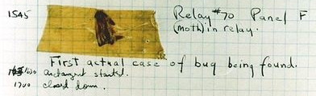
Rear Admiral Grace Hopper
First person to find an actual bug (a moth)
Invented first compiler in 1951 (precursor to COBOL)
“I decided data processors ought to be able to write their programs in English, and the computers would translate them into machine code”
Notes:
People like Admiral Grace Hopper, here, who found the very first bug. A moth, stuck in one of ENIAC’s relays.
But more importantly, she thought up the idea of compiling.
She said, “I decided data processors ought to be able to write their programs in English, and the computers would translate them into machine code.”
“data processors” was what they called “computer users” back in 1951. The people, trying to get the computer to crunch data for them.

Slide 5

John Backus
Developed FORTRAN in 1957 for the IBM 704
Oldest machine-independent programming language still in use today
“Much of my work has come from being lazy. I didn't like writing programs, and so, when I was working on the IBM 701, I started work on a programming system to make it easier to write programs”
Notes:
And people like John Backus, who designed FORTRAN, the oldest machine-independent programming language that’s still used today.
“I was lazy, I didn’t like writing programs, I wanted to make it easier”, he said.

Slide 6

Fran Allen
Pioneer of many optimizing compilation techniques
Wrote a paper in 1966 that introduced the concept of the control flow graph, which is still central to compiler theory today
First woman to win the ACM Turing Award
Notes:
And Fran Allen, who realized that a compiler shouldn’t just directly translate the FORTRAN or Algol or whatever to machine code, it should optimize.
It should produce a machine code program that computes the same results as the source code, but does this as efficiently as possible, even if that means changing up how it works.

Slide 7
Goals of compiler optimization
Minimize number of instructions
Don’t do calculations more than once
Don’t do unnecessary calculations at all
Avoid slow instructions (multiplication, division)
Avoid waiting for memory
Keep everything in registers whenever possible
Access memory in cache-friendly patterns
Load data from memory early, and only once
Avoid branching
Don’t make unnecessary decisions at all
Make it easier for the CPU to predict branch destinations
“Unroll” loops to spread cost of branches over more instructions
Notes:
How do we define “make this as efficient as possible” in a way that a computer can carry out?
One obvious goal is to minimize the number of instructions we execute. Don’t do the same calculation over and over again. Don’t do unnecessary calculations at all.
Another obvious goal, as you’re seeing right now in cache lab, is to avoid waiting for memory. That means making the best possible use of the registers, and accessing memory in a pattern that maximizes locality, and stuff like that.
And another important goal, for reasons we’ll talk about later today, is to avoid branching, especially unpredictable branching.

Slide 8
Limits to compiler optimization
Generally cannot improve algorithmic complexity
Only constant factors, but those can be worth 10x or more…
Must not cause any change in program behavior
Programmer may not care about “edge case” behavior, but compiler does not know that
Exception: language may declare some changes acceptable
Often only analyze one function at a time
Whole-program analysis (“LTO”) expensive but gaining popularity
Exception: inlining merges many functions into one
Tricky to anticipate run-time inputs
Profile-guided optimization can help with common case, but…
“Worst case” performance can be just as important as “normal”
Especially for code exposed to malicious input (e.g. network servers)
Notes:
Compilers aren’t magic and they aren’t creative. This means they can’t do everything for you.
In most cases they can’t make your algorithm better. They can edit all the unnecessary instructions out of your bubble sort, but it will still be bubble sort, not quicksort.
They don’t know what’s in or out of scope of your design, so they can’t change any behavior, not even edge-case behavior you never cared about… unless the language says it’s OK. A language spec might allow its compilers to apply the associative law to floating-point calculations even though floating point arithmetic isn’t associative.
They usually only look at one function at a time, just to keep compilation time down—except that inlining merges many functions into one.
And they typically have no information about what will happen when the program is run.

Slide 9
Two kinds of optimizations
entry
Local optimizations work inside a single basic block
Constant folding, strength reduction, dead code elimination, (local) CSE, …
Global optimizations process the entire control flow graph of a function
Loop transformations, code motion, (global) CSE, …
setup
Easy?
easy
complex
loop
Done?
exit
Notes:
A fundamental idea in compiler theory is the control flow graph. That was Fran Allen’s insight: draw a flowchart of all the decisions that the program makes, and use mathematical graph theory to analyze it. It’s a directed graph and it can have cycles – those are the loops.
We can divide optimizations into two classes based on how they interact with the control flow graph. Local optimizations work on one basic block at a time – that’s a chunk of “straight line” code, containing neither gotos nor labels. They have limited impact but they’re reliable. Doing local optimizations is just about always a win.
Global optimizations, on the other hand, process an entire function at once. They can move code between basic blocks and rearrange the graph. They can be very powerful but they’re not always a good idea.

Slide 10
Today
Principles and goals of compiler optimization
Examples of optimizations
Obstacles to optimization
Machine-dependent optimization
Benchmark example
Notes:
There are hundreds of optimizations you could do. We have an entire course about writing compilers, 15-411. Just to give you a taste, here are some examples of things just about every compiler will do.

Slide 11
Next several slides done live…
https://godbolt.org/z/Es5s8qsvj
Go to Godbolt (the compiler explorer) to play around with C and the resulting assembly generated under different compiler optimizations (change the flag from –O3 to –Og, etc. to see more or less aggressive optimization).
If you missed class, aof the concepts we explored during the live demo are explained in the next few slides, so peek at them and then try playing with the compiler explorer!

Slide 12
Constant folding
Do arithmetic in the compiler long mask = 0xFF << 8; → long mask = 0xFF00;
Any expression with constant inputs can be folded
Might even be able to remove library calls… size_t namelen = strlen("Harry Bovik"); → size_t namelen = 11;
Notes:
Probably the most obvious local optimization there is: if you can have the compiler do some math, instead of doing it when the program is run, that’s a win. For example, you remember all those wacky expressions you had to write in data lab to get big constants? If you go back and disassemble your solutions you’ll probably see hex FF00 instead of hex FF shift left 8, and so on.
Really clever compilers might be able to fold through C library functions with constant arguments.

Slide 13
Dead code elimination
Don’t emit code that will never be executed if (0) { puts("Kilroy was here"); } if (1) { puts("Only bozos on this bus"); }
Don’t emit code whose result is overwritten x = 23; x = 42;
These may look silly, but...
Can be produced by other optimizations
Assignments to x might be far apart
Notes:
If code is never going to be executed, don’t write it out! And don’t do any calculations that would only be used by code that’s never executed, or that has its result overwritten before it’s used.
You might be thinking “why would anyone write that in the first place?” but other optimizations often make code be dead. Maybe that “if zero” was “if some arithmetic that the constant folder evaluated to zero” in the source code.

Slide 14
Common subexpression elimination
Factor out repeated calculations, only do them once
norm[i] = v[i].x*v[i].x + v[i].y*v[i].y;
→
elt = &v[i];
x = elt->x;
y = elt->y;
norm[i] = x*x + y*y;
Notes:
If you’ve got to do a calculation, only do it once, and remember the result. This complex expression reads from memory four times, but we can calculate the address of v[i] just once…
… and we can load dot x and dot y from memory once each
… and finally we can do all the arithmetic in registers.
This can be a local or a global optimization and there are at least five different algorithms for it.

Slide 15
Code motion
Move calculations out of a loop
Only valid if every iteration would produce same result
long j; for (j = 0; j < n; j++) a[n*i+j] = b[j];
→ long j;
int ni = n*i; for (j = 0; j < n; j++) a[ni+j] = b[j];
Notes:
Sometimes a program computes the same value over and over because the expression is inside a loop. If every iteration of the loop computes the same result, we say the calculation is a ‘loop invariant’ and we move it to above the loop. It’s CSE in time instead of space. In the example, n times I is invariant so we make a temp variable for it.

Slide 16
Inlining
Copy body of a function into its caller(s)
Can create opportunities for many other optimizations
Can make code much bigger and therefore slower (size; i-cache)
int pred(int x) {
if (x == 0)
return 0;
else
return x - 1;
}
int func(int y) {
return pred(y)
+ pred(0)
+ pred(y+1);
}
int func(int y) {
int tmp;
if (y == 0) tmp = 0; else tmp = y - 1;
if (0 == 0) tmp += 0; else tmp += 0 - 1;
if (y+1 == 0) tmp += 0; else tmp += (y + 1) - 1;
return tmp;
}
Notes:
One of the most important global optimizations is inlining. Take a short function and copy its body in place of all calls to it. Obviously this cuts out the function call overhead, but it also gets around that one-function-at-a-time restriction and gives the compiler opportunities to do more other optimizations. Here we have two simple functions and there’s not much to do to either one by itself, but if we combine them…

Slide 17
Inlining
Copy body of a function into its caller(s)
Can create opportunities for many other optimizations
Can make code much bigger and therefore slower
int pred(int x) {
if (x == 0)
return 0;
else
return x - 1;
}
int func(int y) {
return pred(y)
+ pred(0)
+ pred(y+1);
}
int func(int y) {
int tmp;
if (y == 0) tmp = 0; else tmp = y - 1;
if (0 == 0) tmp += 0; else tmp += 0 - 1;
if (y+1 == 0) tmp += 0; else tmp += (y + 1) - 1;
return tmp;
}
Always true
Does nothing
Can constant fold
Notes:
Now each of the function calls is an expression that we can optimize based on the value of x at each call site.

Slide 18
Inlining
Copy body of a function into its caller(s)
Can create opportunities for many other optimizations
Can make code much bigger and therefore slower
int func(int y) {
int tmp;
if (y == 0) tmp = 0; else tmp = y - 1;
if (0 == 0) tmp += 0; else tmp += 0 - 1;
if (y+1 == 0) tmp += 0; else tmp += (y + 1) - 1;
return tmp;
}
int func(int y) {
int tmp = 0;
if (y != 0) tmp = y - 1;
if (y != -1) tmp += y;
return tmp;
}
Notes:
And so inlining plus local optimizations produces this much simpler function.
This kind of opportunity to simplify the code after inlining, comes up a whole lot in C++ with template functions. If you ever wondered why almost the entire implementation of std::string and std::map is in the header files? It’s so the compiler can inline all of it and then simplify it down to the cases that matter for the actual program.
The catch to inlining is that if you do it too much, the program can become really big. Too big for the instruction cache. That makes it slow no matter what.

Slide 19
Today
Principles and goals of compiler optimization
Examples of optimizations
Obstacles to optimization
Machine-dependent optimization
Benchmark example
Notes:
There are hundreds of optimizations you could do. We have an entire course about writing compilers, 15-411. Just to give you a taste, here are some examples of things just about every compiler will do.

Slide 20
Memory Aliasing
/* Sum rows of n X n matrix a and store in vector b. */
void sum_rows1(double *a, double *b, long n) {
long i, j;
for (i = 0; i < n; i++) {
b[i] = 0;
for (j = 0; j < n; j++)
b[i] += a[i*n + j];
}
}
movq $0, (%rsi)
pxor %xmm0, %xmm0
.L4:
addsd (%rdi), %xmm0
movsd %xmm0, (%rsi)
addq $8, %rdi
cmpq %rcx, %rdi
jne .L4
Code updates b[i] on every iteration
Why couldn’t compiler optimize this away?
Notes:
A is N-by-N square matrix and we want to sum up the values in each row and put the sums in another array B.
The compiler loads b[i] from memory, adds a[i][j], and writes it back, on each cycle. Why?

Slide 21
Memory Aliasing
/* Sum rows of n X n matrix a and store in vector b. */
void sum_rows1(double *a, double *b, long n) {
long i, j;
for (i = 0; i < n; i++) {
b[i] = 0;
for (j = 0; j < n; j++)
b[i] += a[i*n + j];
}
}
Value of B:
double A[9] =
{ 0, 1, 2,
4, 8, 16},
32, 64, 128};
double B[3] = A+3;
sum_rows1(A, B, 3);
double A[9] =
{ 0, 1, 2,
0, 8, 16},
32, 64, 128};
double A[9] =
{ 0, 1, 2,
0, 8, 16},
32, 64, 128};
double A[9] =
{ 0, 1, 2,
1, 8, 16},
32, 64, 128};
double A[9] =
{ 0, 1, 2,
3, 8, 16},
32, 64, 128};
double A[9] =
{ 0, 1, 2,
3, 0, 16},
32, 64, 128};
double A[9] =
{ 0, 1, 2,
3, 3, 16},
32, 64, 128};
double A[9] =
{ 0, 1, 2,
3, 6, 16},
32, 64, 128};
double A[9] =
{ 0, 1, 2,
3, 22, 16},
32, 64, 128};
double A[9] =
{ 0, 1, 2,
3, 22, 0},
32, 64, 128};
double A[9] =
{ 0, 1, 2,
3, 22, 32},
32, 64, 128};
double A[9] =
{ 0, 1, 2,
3, 22, 96},
32, 64, 128};
double A[9] =
{ 0, 1, 2,
3, 22, 224},
32, 64, 128};
init: [4, 8, 16]
i = 0: [3, 8, 16]
i = 1: [3, 22, 16]
i = 2: [3, 22, 224]
Code updates b[i] on every iteration
Must consider possibility that these updates will affect program behavior
Notes:
Well, what if B is inside A? Then, every time we modify B, we change the values in A and that might change what the next addition produces. Watch what happens to the values in A as I step through the loop.
Remember I said the compiler can’t change any program behavior? That it doesn’t know what the programmer wanted? This could have been what the programmer wanted, even though what you get in B is not the sum of each row in A as it was before the call.
This is called pointer aliasing, or memory aliasing.

Slide 22
Avoiding Aliasing Penalties
/* Sum rows of n X n matrix a and store in vector b. */
void sum_rows2(double *a, double *b, long n) {
long i, j;
for (i = 0; i < n; i++) {
double val = 0;
for (j = 0; j < n; j++)
val += a[i*n + j];
b[i] = val;
}
}
pxor %xmm0, %xmm0
.L4:
addsd (%rdi), %xmm0
addq $8, %rdi
cmpq %rax, %rdi
jne .L4
movsd %xmm0, (%rsi)
Use a local variable for intermediate results
Use restrict keyword
Tells compiler that this is the “only” pointer to that memory location
Notes:
What can we do about it? The simplest thing is to do the code motion by hand. We use a local variable to hold the sum, and write to b[i] only once per outer loop.

Slide 23
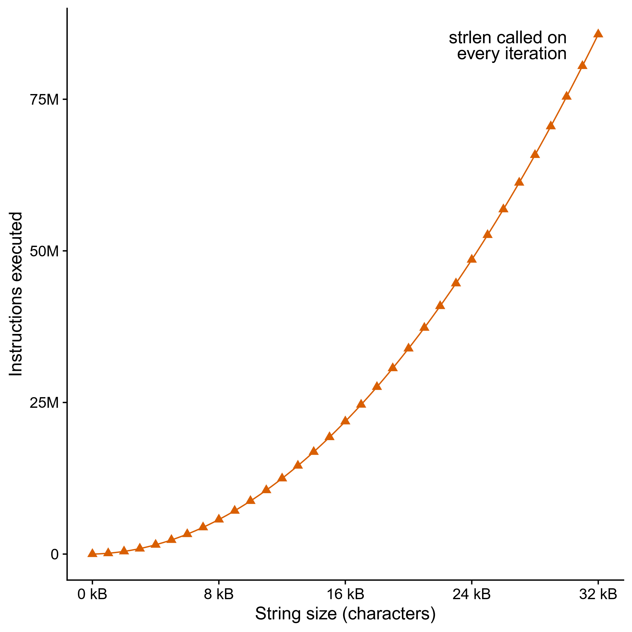
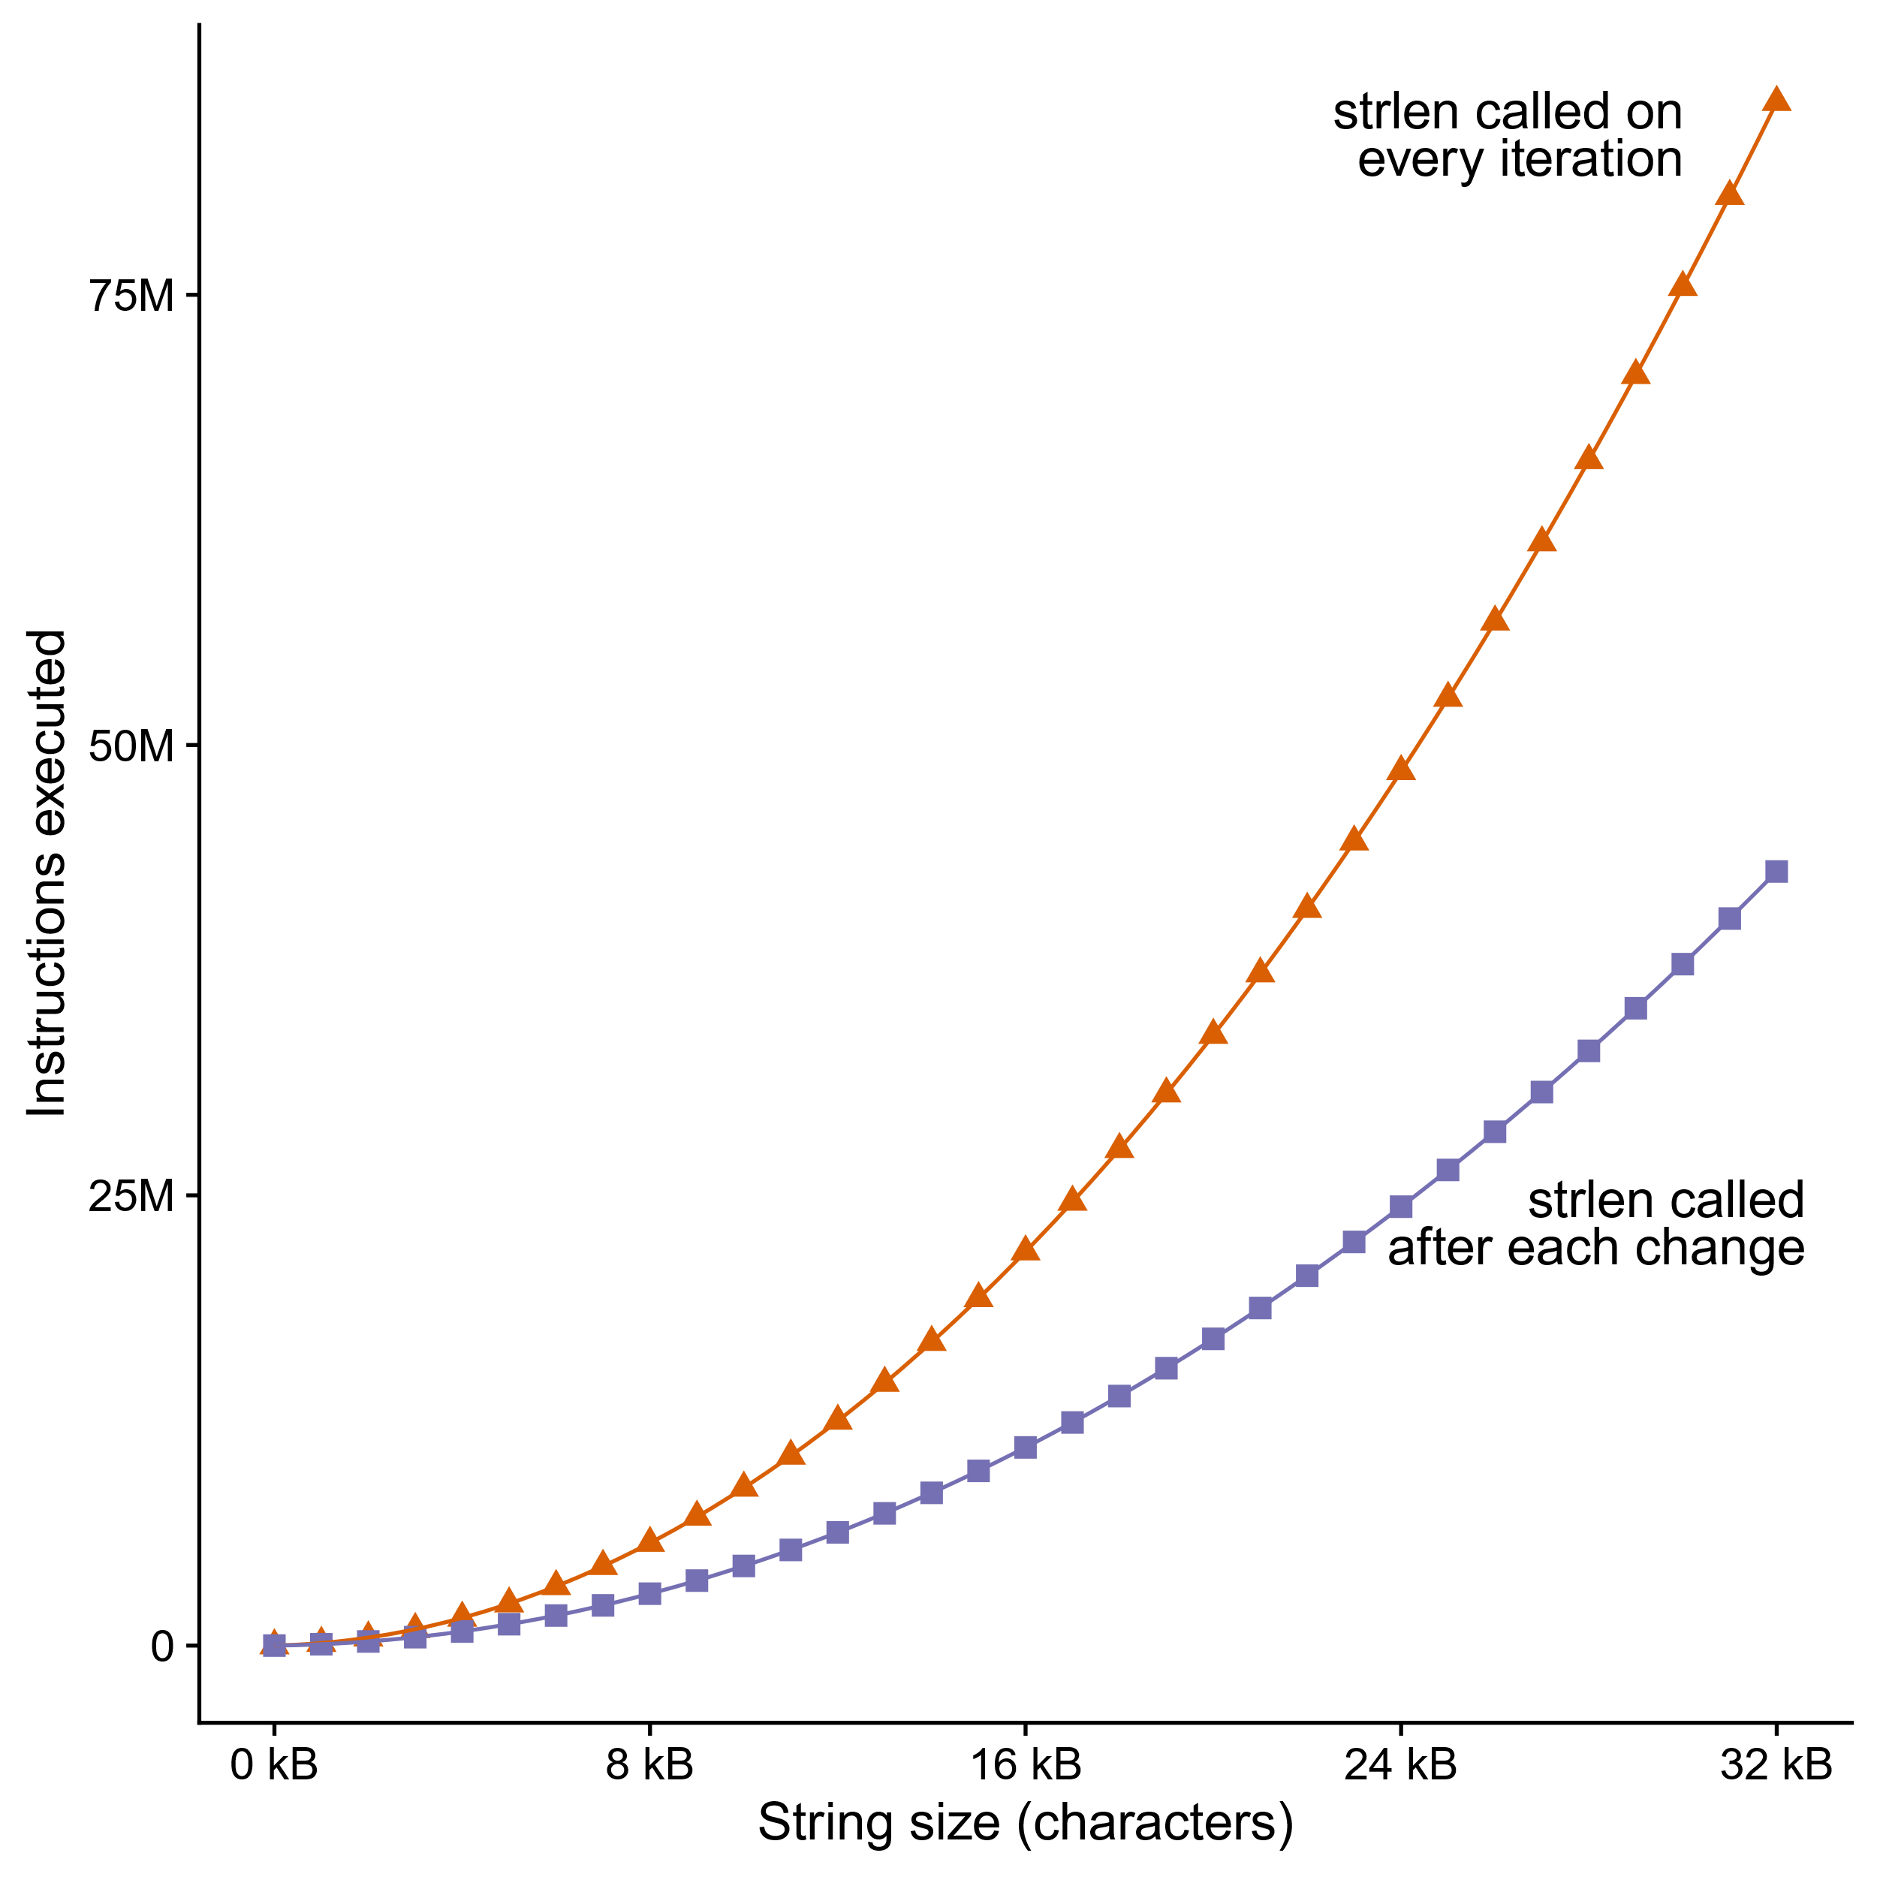
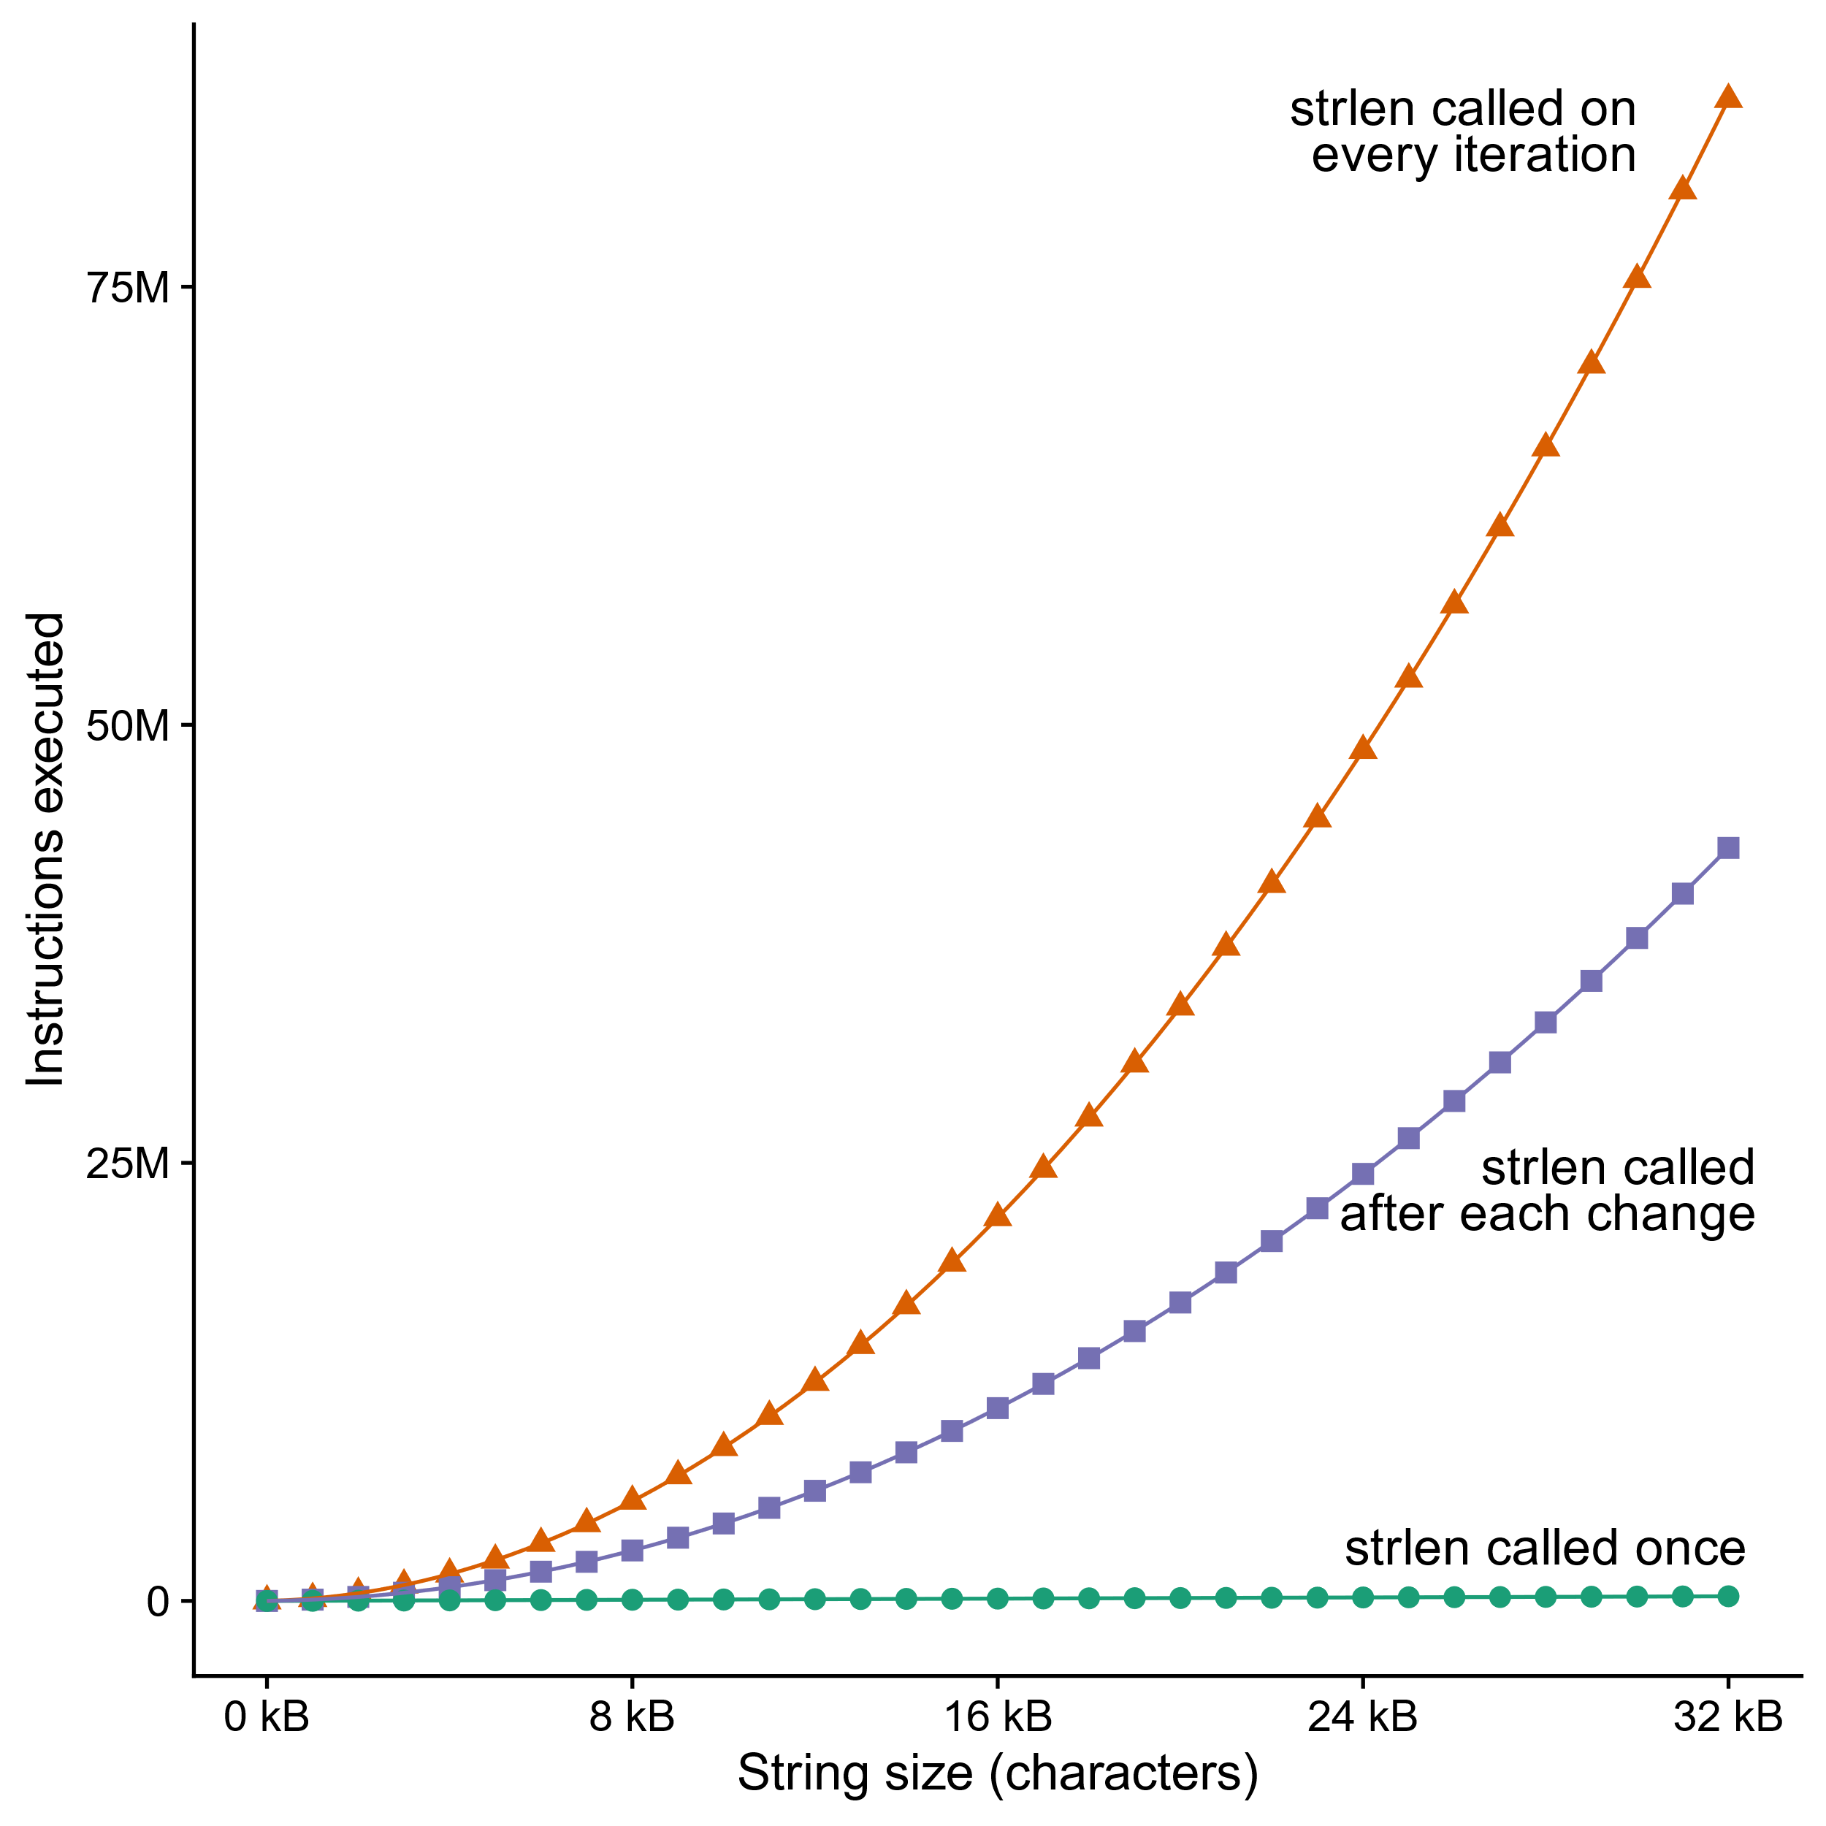
Can’t move function calls out of loops
void lower_quadratic(char *s) {
size_t i;
for (i = 0; i < strlen(s); i++)
if (s[i] >= 'A' && s[i] <= 'Z')
s[i] += 'a' - 'A';
}
void lower_still_quadratic(char *s) {
size_t i, n = strlen(s);
for (i = 0; i < n; i++)
if (s[i] >= 'A' && s[i] <= 'Z') {
s[i] += 'a' - 'A';
n = strlen(s);
}
}
void lower_linear(char *s) {
size_t i, n = strlen(s);
for (i = 0; i < n; i++)
if (s[i] >= 'A' && s[i] <= 'Z')
s[i] += 'a' - 'A';
}
Lots more examples of this kind of bug: accidentallyquadratic.tumblr.com
Notes:
And because the compiler doesn’t know most of that, if you call strlen in a loop, it has to assume the result could change evey time.
In the function at the top, we have “for (I = 0, I < strlen(s), I++)”, we’re calling strlen, which scans the whole string, for every character in the string, and that’s O(n squared) time complexity. 75 million instructions executed to lowercase 32k of text.
[space] GCC on the sharks does know that strlen is a “pure function”, meaning it doesn’t have any side effects and its return value only depends on its argument and the data pointed to by its argument. That means it can assume strlen will return the same thing on each iteration UNLESS the loop changes the string. So it only calls strlen right after each change. I generated the data for the graph with strings that were exactly 50 percent uppercase, so, the middle function is twice as fast, but it’s still quadratic.
[space] If we manually move the strlen call out of the loop and only call it once, now we get linear time complexity.
[space] This is called “accidentally quadratic” complexity because the programmer probably didn’t intend for lower to be this slow, but it is anyway.
Complexity theorists make a huge deal about the difference between polynomial and exponential time, but for practical purposes,
Quadratic is already too slow.
Even n log n can be too slow – database wranglers spend a lot of time avoiding sorting.

Slide 24
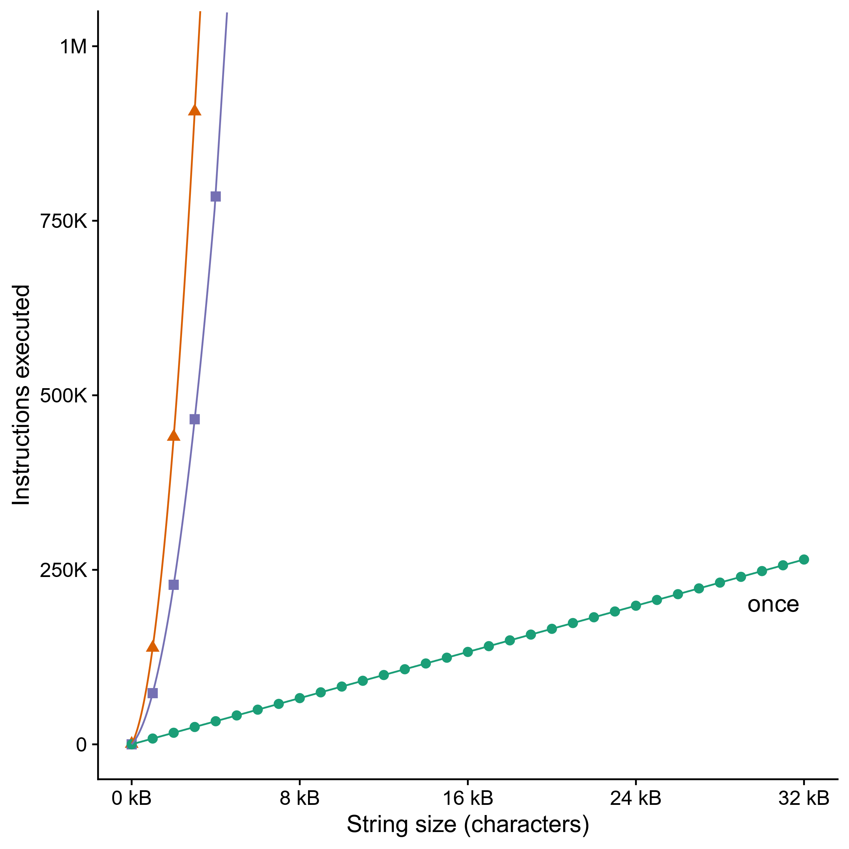
Can’t move function calls out of loops
void lower_quadratic(char *s) {
size_t i;
for (i = 0; i < strlen(s); i++)
if (s[i] >= 'A' && s[i] <= 'Z')
s[i] += 'a' - 'A';
}
void lower_still_quadratic(char *s) {
size_t i, n = strlen(s);
for (i = 0; i < n; i++)
if (s[i] >= 'A' && s[i] <= 'Z') {
s[i] += 'a' - 'A’;
n = strlen(s);
}
}
void lower_linear(char *s) {
size_t i, n = strlen(s);
for (i = 0; i < n; i++)
if (s[i] >= 'A' && s[i] <= 'Z')
s[i] += 'a' - 'A';
}
every iteration
after each change
Notes:
I zoomed in on the bottom of the graph so you can see that “lower_linear” really is linear and not O(1). But look how much of a difference it makes to call strlen only once.
We can lowercase 32kB of text in the same number of CPU cycles that it takes lower_still_quadratic to do two kilobytes.

Slide 25
Quiz
https://canvas.cmu.edu/courses/34989/quizzes/103072

Slide 26
Today
Principles and goals of compiler optimization
Examples of optimizations
Obstacles to optimization
Machine-dependent optimization
Benchmark example
Notes:
There are hundreds of optimizations you could do. We have an entire course about writing compilers, 15-411. Just to give you a taste, here are some examples of things just about every compiler will do.

Slide 27
Modern CPU Design
Instruction Control
Fetch
Control
Address
Instruction
Cache
Retirement
Unit
Register
File
Instruction
Decode
Instructions
Operations
Register Updates
Prediction OK?
Execution
Functional
Units
Branch
Arith
Arith
Arith
Load
Store
Operation Results
Addr.
Addr.
Data
Data
Data
Cache
Notes:
To understand the goals of machine-dependent optimizations you have to understand what a modern CPU is like. In the bottom part of the slide are the “functional units” that are actually doing the work. Each is specialized for a type of instruction – such as arithmetic, memory, and branching – and notice there are several arithmetic units, so it can do several arithmetic instructions at the same time. There’s a bus that feeds data from the registers to the functional units, and another bus that takes the data back to the registers, and yet a third bus going from the load and store units out to the data cache.
Meanwhile, at the top of the slide, we have the control circuitry, whose job is to read instructions from memory and dispatch them to appropriate functional units. It will try to keep all of them busy, even if that means executing instructions “out of order” – as soon as all the inputs to an instruction are available, and there’s a free functional unit that can process it, it goes, even if it was later in the machine code than other instructions that are still waiting.
This is just a taste – Professor Railing has an entire course about how these boxes are put together. 418.

Slide 28
Branches Are A Challenge
Instruction Control Unit must work well ahead of Execution Unit to generate enough operations to keep EU busy
If the CPU has to wait for the result of the cmp before continuing to fetch instructions, may waste tens of cycles doing nothing!
404663: mov $0x0,%eax
404668: cmp (%rdi),%rsi
40466b: jge 404685
40466d: mov 0x8(%rdi),%rax
. . .
404685: repz retq
Executing
Need to know which way to branch …
Notes:
In order to keep all of those functional units busy, the control unit has to be fetching instructions well in advance of what’s currently being executed. But that means code like this poses a problem. Suppose the control unit has just fetched the jge instruction. It needs to know, right now, what to fetch next. But that depends on the result of the cmp, and the cmp is ten instructions back in the queue, so it’s going to be at least a half-dozen cycles before we know its result. More if that paren-rdi memory access misses the cache.
Nobody knows how to make a wire that sends data backwards in time, not even a little, so what do we do?
Anyone know?

Slide 29
Branch Prediction
Guess which way branch will go
Begin executing instructions at predicted position
But don’t actually modify register or memory data
404663: mov $0x0,%eax
404668: cmp (%rdi),%rsi
40466b: jge 404685
40466d: mov 0x8(%rdi),%rax
. . .
404685: repz retq
Predict Taken
Continue
Fetching Here
Notes:
The control unit makes a guess. It starts fetching from the destination it guessed, and dispatching instructions, but the results of all those instructions are marked “speculative”. They are held in the “retirement unit” until the result of the cmp is known. If the guess was correct, then the CPU can commit all those results and keep going.
But if it guessed wrong, what’s it got to do?
It has to throw away all that speculative work and start over, fetching from the correct path through the code.

Slide 30
Branch Prediction Through Loop
401029: mulsd (%rdx),%xmm0,%xmm0
40102d: add $0x8,%rdx
401031: cmp %rax,%rdx
401034: jne 401029
Assume
array length = 100
i = 98
Predict Taken (OK)
401029: mulsd (%rdx),%xmm0,%xmm0
40102d: add $0x8,%rdx
401031: cmp %rax,%rdx
401034: jne 401029
i = 99
Predict Taken
(Oops)
401029: mulsd (%rdx),%xmm0,%xmm0
40102d: add $0x8,%rdx
401031: cmp %rax,%rdx
401034: jne 401029
Read invalid location
Executed
i = 100
401029: mulsd (%rdx),%xmm0,%xmm0
40102d: add $0x8,%rdx
401031: cmp %rax,%rdx
401034: jne 401029
Fetched
i = 101
Notes:
So for instance here’s a little loop – walking through the elements of an array of doubles and multiplying register xmm0 by each one – suppose there are 100 elements in the array, and the control unit is guessing that the jne instruction will jump. That’s a good guess the first 99 times through the loop. But when we get to element 100, oops! Jne fell through, but we guessed it would jump, and we executed another four instructions and fetched four more beyond that before we noticed.

Slide 31
Branch Misprediction Invalidation
401029: mulsd (%rdx),%xmm0,%xmm0
40102d: add $0x8,%rdx
401031: cmp %rax,%rdx
401034: jne 401029
Assume
array length = 100
i = 98
Predict Taken (OK)
401029: mulsd (%rdx),%xmm0,%xmm0
40102d: add $0x8,%rdx
401031: cmp %rax,%rdx
401034: jne 401029
i = 99
Predict Taken
(Oops)
401029: mulsd (%rdx),%xmm0,%xmm0
40102d: add $0x8,%rdx
401031: cmp %rax,%rdx
401034: jne 401029
i = 100
Invalidate
401029: mulsd (%rdx),%xmm0,%xmm0
40102d: add $0x8,%rdx
401031: cmp %rax,%rdx
401034: jne 401029
i = 101
Notes:
So now we have to throw out four instructions’ worth of calculations, and four more fetches, and back up the visible processor state to what it should have been at the point of the mis-predicted branch, and start over.

Slide 32
Branch Misprediction Recovery
401029: mulsd (%rdx),%xmm0,%xmm0
40102d: add $0x8,%rdx
401031: cmp %rax,%rdx
401034: jne 401029
401036: jmp 401040
. . .
401040: movsd %xmm0,(%r12)
i = 99
Definitely not taken
Reload
Pipeline
Performance Cost
Multiple clock cycles on modern processor
Can be a major performance limiter
Notes:
We roll the register state back to loop cycle 99 and the instruction fetcher starts over, fetching from 401036 instead of 401029. The instruction at 401036 is an unconditional jump – those don’t require guessing. It just does it. Fetch from 401040 next. And we go on.
As you might imagine, this is expensive. We just wasted a bunch of time and electricity. On a real CPU it wouldn’t be a measly four to eight instructions’ worth of wasted work, either, it would be more like fifty instructions. Tens to hundreds of clock cycles.
This is also one of the most troublesome parts of a modern CPU to implement correctly. You’ve probably heard about the “Spectre” hardware security bugs –the root cause of those is that Intel and AMD and ARM and IBM, they all got the “back up and start over” process wrong.

Slide 33
Branch Prediction Numbers
A simple heuristic:
Backwards branches are often loops, so predict taken
Forwards branches are often ifs, so predict not taken
>95% prediction accuracy just with this!
Fancier algorithms track behavior of each branch
Subject of ongoing research
2011 record (https://www.jilp.org/jwac-2/program/JWAC-2-program.htm): 34.1 mispredictions per 1000 instructions
Current research focuses on the remaining handful of “impossible to predict” branches (strongly data-dependent, no correlation with history)
e.g. https://hps.ece.utexas.edu/pub/PruettPatt_BranchRunahead.pdf

Slide 34
Optimizing for Branch Prediction
Reduce # of branches
Transform loops
Unroll loops
Use conditional moves
Not always a good idea
Make branches predictable
Sort data https://stackoverflow.com/questions/11227809
Avoid indirect branches
function pointers
virtual methods
.Loop:
movzbl 0(%rbp,%rbx), %edx
leal -65(%rdx), %ecx
cmpb $25, %cl
ja .Lskip
addl $32, %edx
movb %dl, 0(%rbp,%rbx)
.Lskip:
addl $1, %rbx
cmpq %rax, %rbx
jb .Loop
.Loop:
movzbl 0(%rbp,%rbx), %edx
movl %edx, %esi
leal -65(%rdx), %ecx
addl $32, %edx
cmpb $25, %cl
cmova %esi, %edx
movb %dl, 0(%rbp,%rbx)
addl $1, %rbx
cmpq %rax, %rbx
jb .Loop
Memory write now unconditional!
Notes:
What can the compiler do to make the branch predictor’s job easier? Well, it can reduce the number of branches. Several of the loop transformations I showed you earlier can do this, and remember that most CPU time is spent in a loop, so that’s the place to target. Unrolling loops, which we’re about to see, also does this, although it’s not the main reason for unrolling.
The compiler can also turn branches into conditional moves. On the right, that’s the assembly language for the lowercase-a-string function from earlier, in two versions: with a branch, at the top; with a conditional move, at the bottom. This particular branch is liable to be hard to predict because it depends entirely on the string, so it’s a good target for converting to conditional moves – but watch out! [reveal] We are now writing each character back to memory whether or not it changed! Probably not a big deal, unless you have a write-through cache, but still a potential reason not to do this.
If we can’t get rid of branches, maybe we can make them more predictable. Processing data in sorted order often makes branches more predictable – click that stack overflow link for a fun story about that. Another thing that really helps is to avoid using indirect branches – function pointers, virtual method calls, jump tables – because processors haven’t put as much effort into optimizing those. Microsoft’s C++ compiler will try to guess which concrete implementation of a virtual method is most likely to be in use, and inline that one, wrapped in an if-I-guessed-right conditional.

Slide 35
Loop Unrolling
Amortize cost of loop condition by duplicating body
Creates opportunities for CSE, code motion, scheduling
Prepares code for vectorization
Can hurt performance by increasing code size
for (size_t i = 0; i < nelts; i++) {
A[i] = B[i]*k + C[i];
}
for (size_t i = 0; i < nelts - 4; i += 4) {
A[i ] = B[i ]*k + C[i ];
A[i+1] = B[i+1]*k + C[i+1];
A[i+2] = B[i+2]*k + C[i+2];
A[i+3] = B[i+3]*k + C[i+3];
}
When would this change be incorrect?
Notes:
Why would it make the code faster if you duplicate the loop body four times?
The most elemental reason is that it means you execute the loop condition and branch four times less often. That probably doesn’t make a huge difference for this code, but suppose the value of “nelts” is super unpredictable except it’s always a multiple of four – then we just reduced the frequency of branch misprediction stalls by a factor of four.
It also creates opportunities for a bunch of other optimizations, which we’ll look at next.
You do have to watch out for increasing code size, though, like with inlining. And you also have to watch out for running out of registers. If there’s not enough registers to hold all of the variables and intermediates, this probably won’t be faster.
Also, I want to ask: [reveal] When is this change incorrect?
This change is incorrect when the number of elements is not a multiple of 4. Sometimes the compiler can emit code to do the last few array elements separately from the loop, but that takes up even more space.

Slide 36
Scheduling
Rearrange instructions to make it easier for the CPU to keep all functional units busy
For instance, move all the loads to the top of an unrolled loop
Now maybe it’s more obvious why we need lots of registers
for (size_t i = 0; i < nelts - 4; i += 4) {
A[i ] = B[i ]*k + C[i ];
A[i+1] = B[i+1]*k + C[i+1];
A[i+2] = B[i+2]*k + C[i+2];
A[i+3] = B[i+3]*k + C[i+3];
}
for (size_t i = 0; i < nelts - 4; i += 4) {
B0 = B[i]; B1 = B[i+1]; B2 = B[i+2]; B3 = B[i+3];
C0 = C[i]; C1 = C[i+1]; C2 = C[i+2]; C3 = B[i+3];
A[i ] = B0*k + C0;
A[i+1] = B1*k + C1;
A[i+2] = B2*k + C2;
A[i+3] = B3*k + C3;
}
When would this change be incorrect?
Notes:
If we have a lot of work to do within a basic block, maybe it doesn’t have to be done all in a straight line. [reveal] Maybe, for instance, we can take that unrolled loop and move all the memory loads to the beginning, so they can all issue at once and then the math can happen in whatever order the data comes back. The CPU’s control unit might be able to do this itself, but then again it might not, and either way it works better if the compiler helps.
[reveal] When is this change incorrect?
This change is incorrect when A overlaps B or C, so the writes to A change the values being read from B or C. Like with the vector row sums from earlier.

Slide 37
Today
Principles and goals of compiler optimization
Examples of optimizations
Obstacles to optimization
Machine-dependent optimization
Benchmark example
Notes:
There are hundreds of optimizations you could do. We have an entire course about writing compilers, 15-411. Just to give you a taste, here are some examples of things just about every compiler will do.

Slide 38
Benchmark Example: Data Type for Vectors
/* data structure for vectors */
typedef struct{
size_t len;
data_t *data;
} vec;
len
0
1
len-1
data
Data Types
Use different declarations for data_t
int
long
float
double
/* retrieve vector element
and store at val */
int get_vec_element
(*vec v, size_t idx, data_t *val)
{
if (idx >= v->len)
return 0;
*val = v->data[idx];
return 1;
}

Slide 39
Benchmark Computation
void combine1(vec_ptr v, data_t *dest)
{
long int i;
*dest = IDENT;
for (i = 0; i < vec_length(v); i++) {
data_t val;
get_vec_element(v, i, &val);
*dest = *dest OP val;
}
}
Compute sum or product of vector elements
Data Types
Use different declarations for data_t
int
long
float
double
Operations
Use different definitions of OP and IDENT
+ / 0
* / 1

Slide 40
Cycles Per Element (CPE)
Convenient way to express performance of program that operates on vectors or lists
Length = n
In our case: CPE = cycles per OP
Cycles = CPE*n + Overhead
CPE is slope of line
psum1
Slope = 9.0
psum2
Slope = 6.0

Slide 41
Benchmark Performance
void combine1(vec_ptr v, data_t *dest)
{
long int i;
*dest = IDENT;
for (i = 0; i < vec_length(v); i++) {
data_t val;
get_vec_element(v, i, &val);
*dest = *dest OP val;
}
}
Compute sum or product of vector elements
Method | Integer |  | Double FP
Operation | Add | Mult | Add | Mult
Combine1 unoptimized | 22.68 | 20.02 | 19.98 | 20.18
Combine1 –O1 | 10.12 | 10.12 | 10.17 | 11.14
Combine1 –O3 | 4.5 | 4.5 | 6 | 7.8
Results in CPE (cycles per element)

Slide 42
Basic Optimizations
void combine4(vec_ptr v, data_t *dest)
{
long i;
long length = vec_length(v);
data_t *d = get_vec_start(v);
data_t t = IDENT;
for (i = 0; i < length; i++)
t = t OP d[i];
*dest = t;
}
Move vec_length out of loop
Avoid bounds check on each cycle
Accumulate in temporary

Slide 43
Effect of Basic Optimizations
void combine4(vec_ptr v, data_t *dest)
{
long i;
long length = vec_length(v);
data_t *d = get_vec_start(v);
data_t t = IDENT;
for (i = 0; i < length; i++)
t = t OP d[i];
*dest = t;
}
Method | Integer |  | Double FP
Operation | Add | Mult | Add | Mult
Combine1 unoptimized | 22.68 | 20.02 | 19.98 | 20.18
Combine1 –O1 | 10.12 | 10.12 | 10.17 | 11.14
Combine1 –O3 | 4.5 | 4.5 | 6 | 7.8
Combine4 | 1.27 | 3.01 | 3.01 | 5.01

Slide 44
Loop Unrolling
void unroll2a_combine(vec_ptr v, data_t *dest)
{
long length = vec_length(v);
long limit = length-1;
data_t *d = get_vec_start(v);
data_t x0 = IDENT;
data_t x1 = IDENT;
long i;
/* Combine 2 elements at a time */
for (i = 0; i < limit; i+=2) {
x0 = x0 OP d[i];
x1 = x1 OP d[i+1];
}
/* Finish any remaining elements */
for (; i < length; i++) {
x0 = x0 OP d[i];
}
*dest = x0 OP x1;
}
Notes:
Loop unrolling saves on the overhead to check bounds and jump. What is the compiled assembly?

Slide 45
Loop Unrolled Assembly
Remember modern CPU designs
Multiple functional units
So how many cycles should this loop take to execute?
.L3:
imulq (%rdx), %rcx
addq $16, %rdx
imulq -8(%rdx), %rdi
cmpq %r8, %rdx
jne .L3
Notes:
Key objective: 5 instructions, mental model is 1 cycle per instruction
Secondary objective: variables are “optimized out”, but a student should be able to identify them
Code from previous slide, using longs and multiplication. Compiled at -O2 -fno-unroll-loops with a current compiler. At O3, the compiler now does vectorization.

Slide 46
Effect of Loop Unrolling
Method | Integer |  | Double FP
Operation | Add | Mult | Add | Mult
Combine1 unoptimized | 22.68 | 20.02 | 19.98 | 20.18
Combine1 –O1 | 10.12 | 10.12 | 10.17 | 11.14
Combine1 –O3 | 4.5 | 4.5 | 6 | 7.8
Combine4 | 1.27 | 3.01 | 3.01 | 5.01
Unroll | 0.81 | 1.51 | 1.51 | 2.51
Multiple instructions every cycle!

Slide 47
Going Further
Compiler optimizations are an easy gain
20 CPE down to 3-5 CPE
With careful hand tuning and computer architecture knowledge
4-16 elements per cycle
Newest compilers are closing this gap

Slide 48
Summary: Getting High Performance
Good compiler and flags
Don’t do anything sub-optimal
Watch out for hidden algorithmic inefficiencies
Write compiler-friendly code
Watch out for optimization blockers: procedure calls & memory references
Look carefully at innermost loops (where most work is done)
Tune code for machine
Exploit instruction-level parallelism
Avoid unpredictable branches
Make code cache friendly

