Slide 1


DEPARTMENT OF COMPUTER ENGINEERING
G.V. ACHARYA INSTITUTE OF ENGINEERING AND TECHNOLOGY
UNIVERSITY OF MUMBAI
A.Y. 2025– 2026
Fake News Detection With Uploaded tracking and Verification Mechanism
Group Members
1) Harsha Ravindra Kadam
2) Amruta Nana Kamble
3) Yogita Bhau Godambe
4) Ketki Dilip Rasal

Slide 2
INTRODUCTION
In today’s fast-paced digital world, information spreads faster than ever before. While this enables quick access to news and updates, it also makes it alarmingly easy for fake news and misinformation to circulate widely, often causing confusion, panic, or manipulation of public opinion. The growing influence of social media and online platforms has amplified the need for robust systems that can verify the authenticity of shared content.
The aim of this project is to develop an intelligent system that performs fake news detection, tracks the source IP address of the person spreading the information, and verifies barcodes and certificates associated with documents and news items. This multi-functional approach ensures content is not only verified but also traceable to its point of origin.
The system uses Natural Language Processing (NLP) and Machine Learning (ML) algorithms to analyze and classify news as real or fake. Simultaneously, an IP tracking module logs the location and network details of users responsible for disseminating questionable information.
To enhance document authentication, the project integrates barcode verification, scanning codes embedded in official content to confirm legitimacy. Moreover, Google Lens and OCR technology are used to analyze physical documents or certificates, extracting and cross-verifying their content against trusted databases.

Slide 3
Objective
1.To develop an intelligent system capable of detecting fake news using advanced NLP and machine learning algorithms.
2. To identify and analyze textual news content for credibility and classify it as real or fake.
3. To implement a source tracking mechanism that captures and logs the IP address of users who post or share fake news.
4. To create a database for tracking news distribution patterns and identifying original sources.
5. To integrate a barcode/QR code verification module for validating news articles, certificates, and other official documents.
6. To utilize Google Lens or OCR technology for scanning certificates and extracting data from images.
7. To cross-verify certificate and document data with official or institutional databases for authenticity.
8. To reduce the spread of misinformation by enabling real-time verification.
9. To enhance public trust in digital news platforms and social media.
10. To ensure accountability through IP-based tracing of misinformation sources

Slide 4
problem statement
Detect fake news using machine learning,
Track the IP address of the originator,
Verify barcodes and certificates,
Analyze documents using OCR and Google Lens,

Slide 5
Methodology:
1.Input Collection:
The system accepts inputs in the form of textual news content, URLs, image uploads (certificates or documents), or scanned barcodes/QR codes.
2. Fake News Detection using NLP & ML:
The input text is processed using Natural Language Processing (NLP) techniques such as tokenization, stop-word removal, and stemming.
3. IP Address Tracking Module:
When a user submits content, their IP address is captured and logged.
4.Barcode/QR Code Verification Module:
If a barcode/QR code is scanned, the system reads the code using a barcode reader library
5.Certificate Detection using Google Lens/OCR:
Uploaded certificates or scanned documents are processed through OCR tools (e.g., Tesseract OCR or Google Vision API).
5.Result Generation and Reporting:
The system compiles the analysis into a report containing:
  Fake news detection result
  IP address and source location
  Barcode verification status
  Certificate validation result

Slide 6
Tools & Technologies
NLP & ML Libraries: NLTK, SpaCy, Scikit-learn, TensorFlow, PyTorch
Deep Learning Models: BERT, RoBERTa for text classification
OCR & Image Recognition: Tesseract OCR, Google Lens API
Barcode & QR Detection: Pyzbar, OpenCV, ZBar library
IP Tracking: Python socket, ipwhois, and geolocation APIs
Web Scraping & Data Extraction: BeautifulSoup, Scrapy
Database: MySQL or MongoDB for logs and reports
Backend Framework: Flask or Django
Frontend Tools: React.js / HTML / CSS
Visualization: Matplotlib, Plotly for results reporting
Deployment Tools: Docker, AWS / Google Cloud for hosting
Security: JWT for authentication, SSL for secure connections

Slide 7
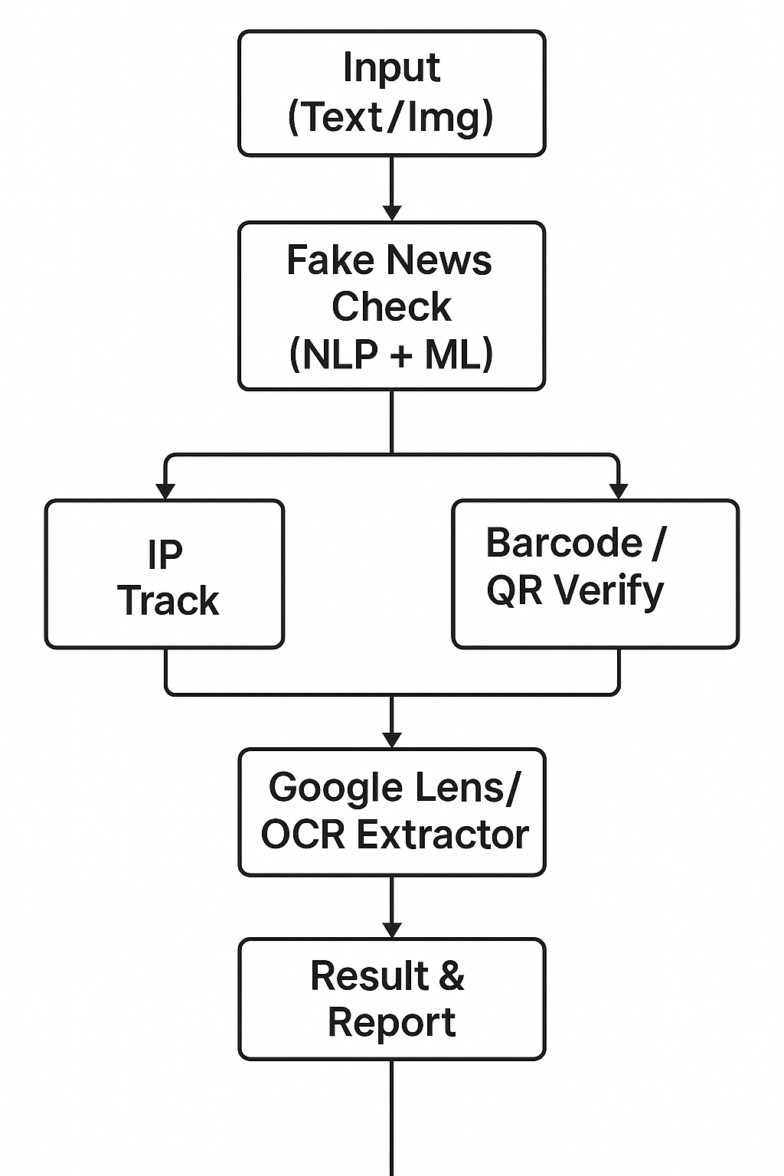
Block Diagram
End

Slide 8
Future Scope
Integration with Social Media APIs: Direct real-time monitoring of Facebook, X (Twitter), Instagram, and WhatsApp for fake news detection.
AI-Powered Deepfake Detection: Ability to detect manipulated images, videos, and deepfake audio to prevent advanced misinformation.
Blockchain for News Verification: Using blockchain to create immutable verification records for news and certificates.
Advanced Geo-Tracking: Incorporating geolocation tracking for pinpointing the origin of misinformation.
Collaboration with News Agencies: Partnering with media houses to verify news before publication.

Slide 9
Limitations
IP Tracking Challenges:
  May fail with VPNs, proxies, or dynamic IPs.
Data Privacy Concerns:
  Tracking IPs can raise legal and ethical issues.
Google Lens Dependency:
  Requires internet access and may not verify low-quality or manipulated images.
Machine Learning Limitations:
  May produce false positives/negatives if the training dataset is insufficient.
Scalability Issues:
  Real-time detection for viral content requires high processing power.

Slide 10
Conclusion
The Fake News Detection Analysis System provides a robust and automated solution to identify and verify fake news and its sources. By integrating NLP-based text analysis, IP tracking, barcode verification, and certificate detection through Google Lens, it ensures that misinformation can be detected, traced, and mitigated efficiently.
This system not only enhances digital trust and cybersecurity but also supports law enforcement and media monitoring agencies in holding fake news spreaders accountable. By leveraging AI, image recognition, and data analytics, the solution serves as a powerful step towards creating a safer and more reliable digital ecosystem.

Slide 11
THANK YOU!

