Slide 1
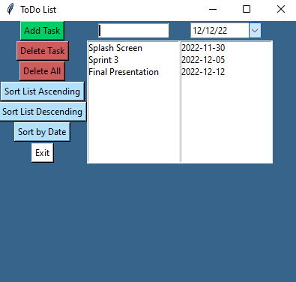
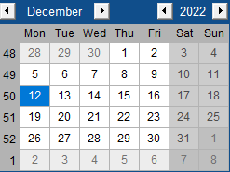
To-Do List with Dates
A way to keep track of your tasks and when they need to be completed
By: Alex Dohany

