Slide 1
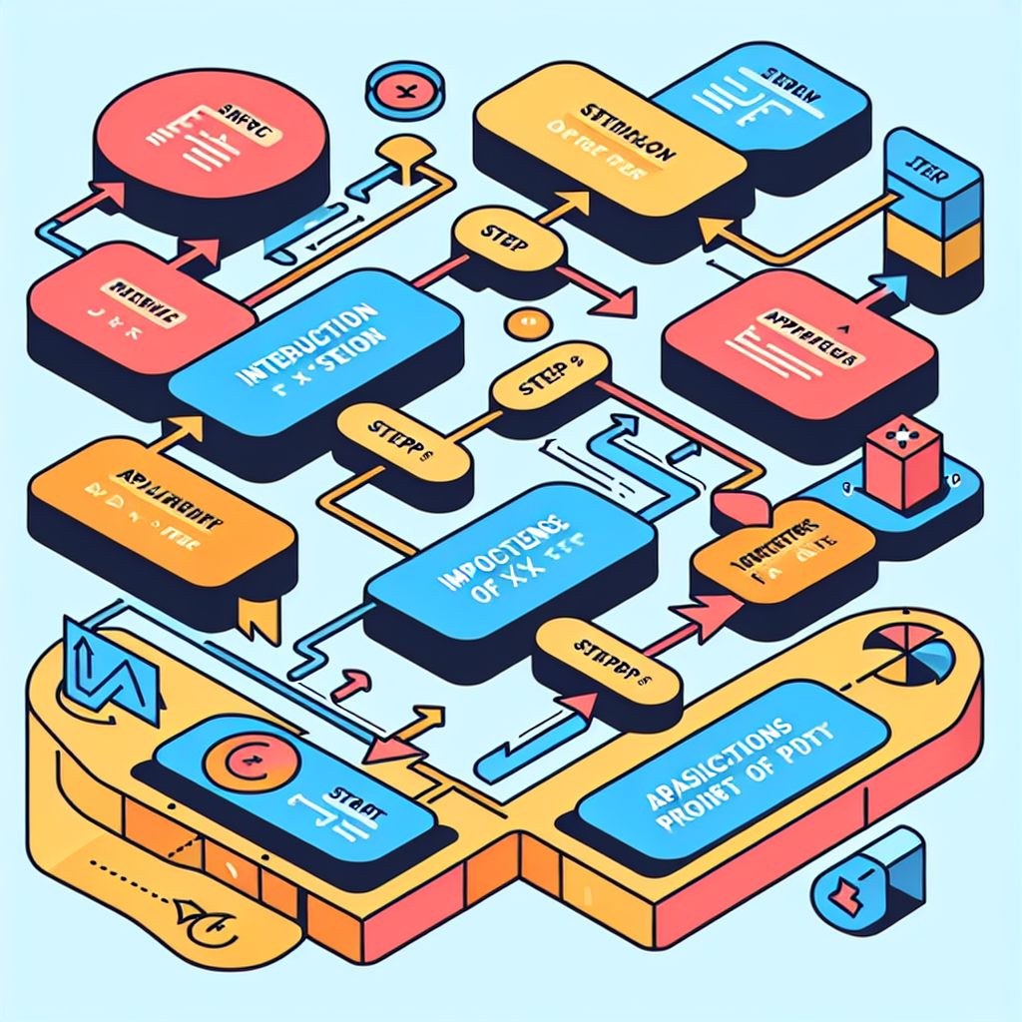
Slide 1: Introduction to X
Definition of X
Importance of X
Applications of X
Basic properties of X
Notes:
An overview of what X is and its significance.

Slide 2

Slide 2: Working with X
Key concepts related to X
Methods for analyzing X
Common challenges when dealing with X
Best practices for working with X
Notes:
Understanding how to effectively work with X.

Slide 3
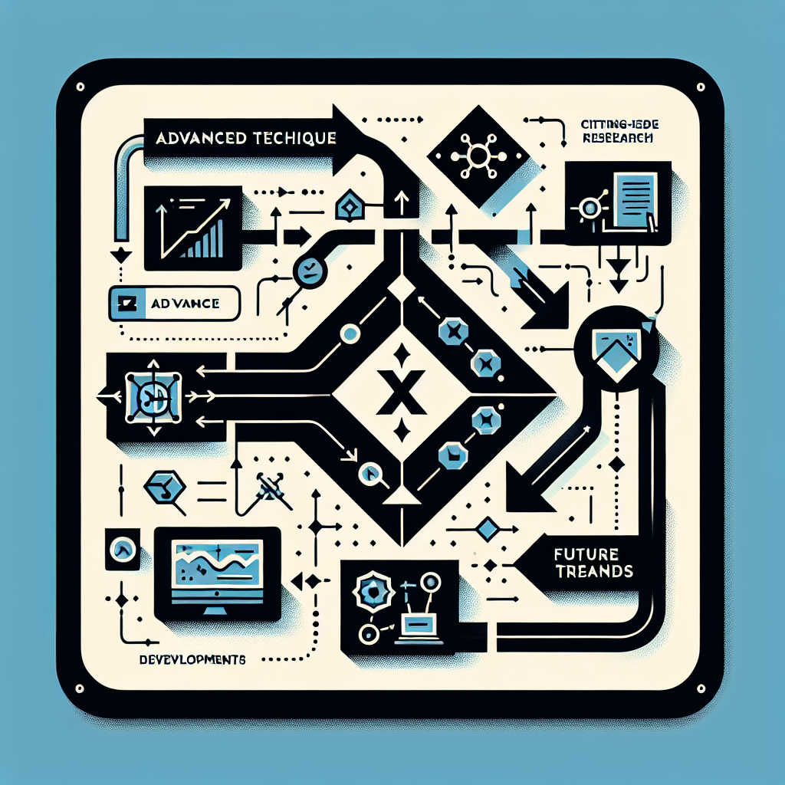
Slide 3: Advanced Topics in X
Advanced techniques for X
Cutting-edge research in the field of X
Future trends and developments in X
Notes:
Exploring advanced aspects and the future of X.

