Slide 1
Introduction to Parsers and
Recursive Descent Parsing
Alex Aiken Lecture (Mods by Vijay Ganesh)

Slide 2
Lecture Outline
So far in the course, we have covered basics of computability and formal languages, regular languages and their properties, context-free languages/grammars and their properties, lexers
Introduction to parsing
Recursive descent
Extensions of CFG for parsing
  Precedence declarations
  Error handling
  Semantic actions
Constructing a parse tree
Alex Aiken Lecture (Mods by Vijay Ganesh)

Slide 3




The Structure (Phases) of a Compiler
Semantic Analysis (Type Checking,…)
Input Program
Lexical Analyzer
Tokens
Parser
AST
Three
Address
Format
Intermediate Representation (IR)
Output
Program
Code
Generation
Code Optimizations
Alex Aiken Lecture (Mods by Vijay Ganesh)

Slide 4
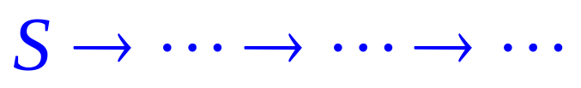
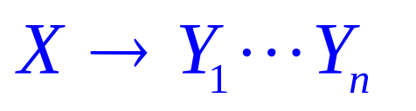
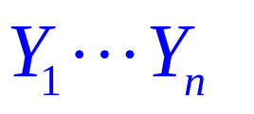

Derivations and Parse Trees
A derivation is a sequence of productions
A derivation can be drawn as a tree
  Start symbol is the tree’s root
  For a production
    add children to node
Alex Aiken Lecture (Mods by Vijay Ganesh)

Slide 5
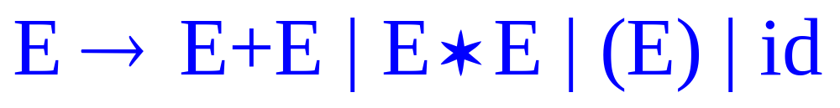

Derivation Example
Grammar
String
Alex Aiken Lecture (Mods by Vijay Ganesh)

Slide 6
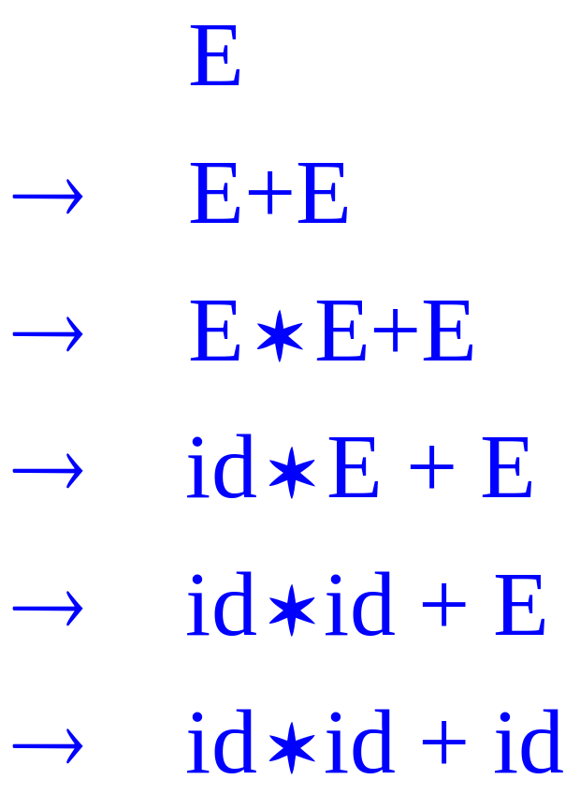
Derivation Example (Cont.)
E
E
+
E
E
*
E
id
id
id
Alex Aiken Lecture (Mods by Vijay Ganesh)

Slide 7

Derivation in Detail (1)
E
Alex Aiken Lecture (Mods by Vijay Ganesh)

Slide 8
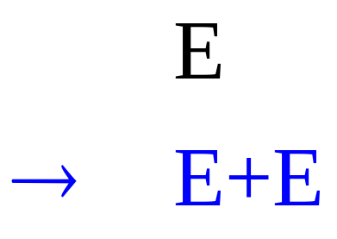
Derivation in Detail (2)
E
E
+
E
Alex Aiken Lecture (Mods by Vijay Ganesh)

Slide 9
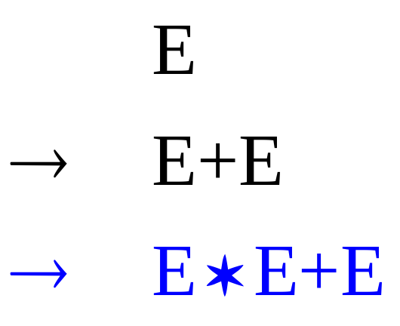
Derivation in Detail (3)
E
E
+
E
E
*
E
Alex Aiken Lecture (Mods by Vijay Ganesh)

Slide 10
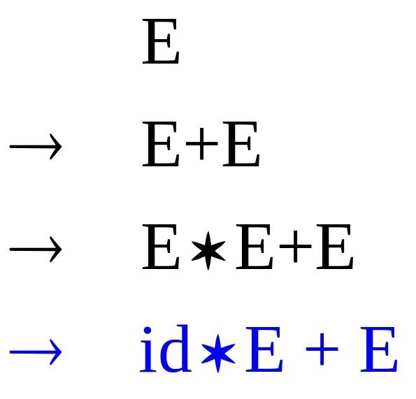
Derivation in Detail (4)
E
E
+
E
E
*
E
id
Alex Aiken Lecture (Mods by Vijay Ganesh)

Slide 11
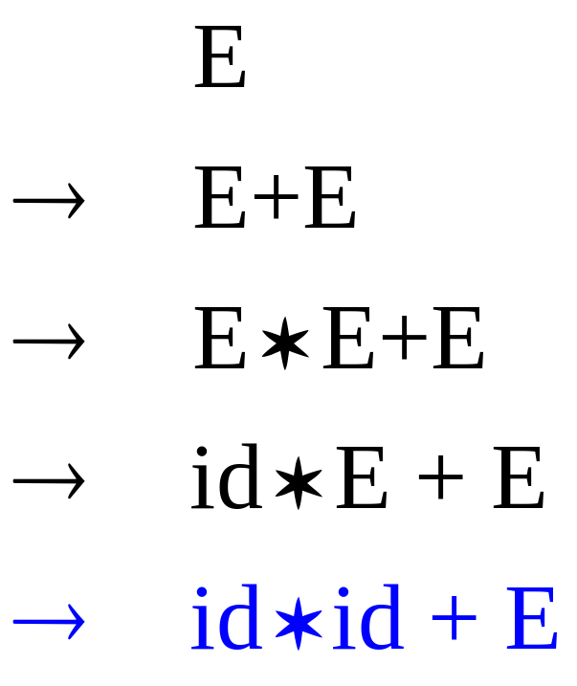
Derivation in Detail (5)
E
E
+
E
E
*
E
id
id
Alex Aiken Lecture (Mods by Vijay Ganesh)

Slide 12
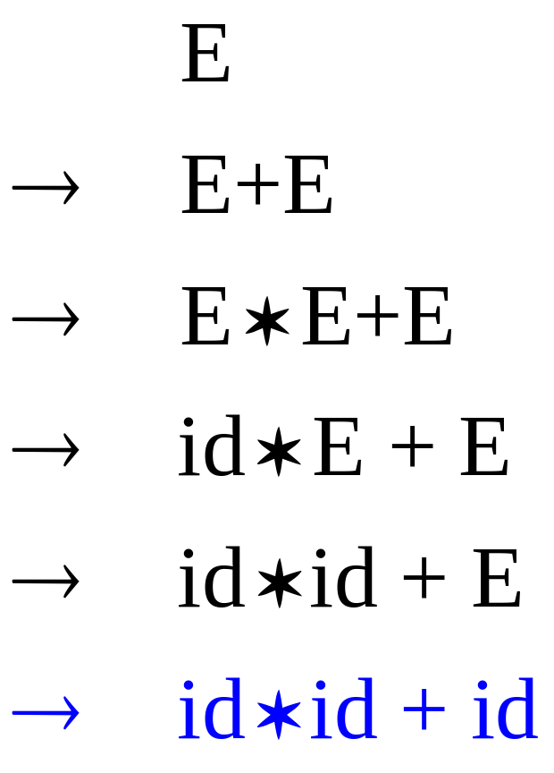
Derivation in Detail (6)
E
E
+
E
E
*
E
id
id
id
Alex Aiken Lecture (Mods by Vijay Ganesh)

Slide 13
Notes on Derivations
A parse tree has
  Terminals at the leaves
  Non-terminals at the interior nodes
An in-order traversal of the leaves is the original input
The parse tree shows the association of operations, the input string does not
Alex Aiken Lecture (Mods by Vijay Ganesh)

Slide 14
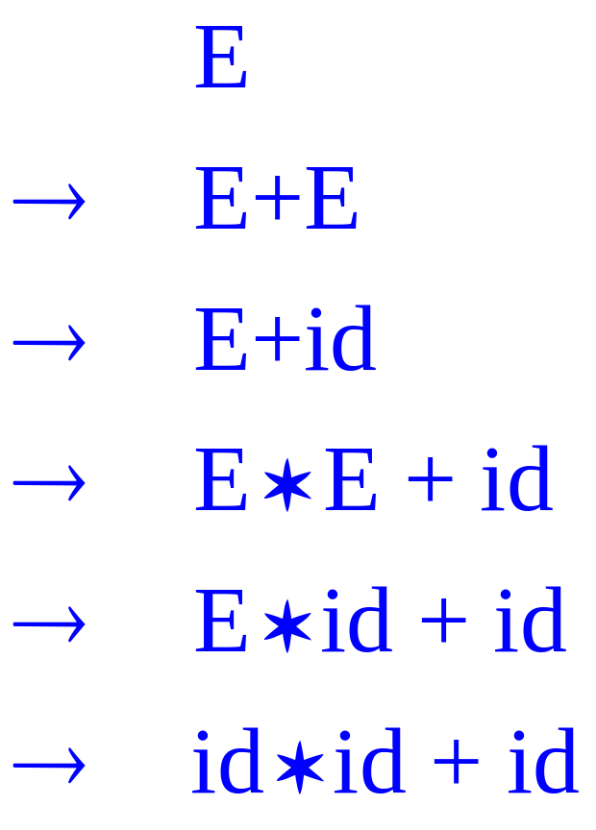
Left-most and Right-most Derivations
The example is a left-most derivation
  At each step, replace the left-most non-terminal
There is an equivalent notion of a right-most derivation
Alex Aiken Lecture (Mods by Vijay Ganesh)

Slide 15
Bottom-up vs. Top-down
 | Top-down Parsers | Bottom-up Parsers
Successful Parse | From start symbol of grammar to the string | From the string to the start symbol of the grammar
Example of grammars | LL(k) Left-to-right, Leftmost derivation first | LR(k), LALR Left-to-right, Rightmost derivation first (in reverse)
Example of parser technique | Recursive-descent | Shift-reduce
Ease of implementation | Very easy | Many grammar generators available (Yacc, Bison,…)
Issue with left-recursion | Yes | No
Issues with left-factoring | Yes | No
Alex Aiken Lecture (Mods by Vijay Ganesh)

Slide 16
Recursive Descent Parsing
E → T |T + E
T → int | int * T | ( E )
E
( int₅)
Alex Aiken Lecture (Mods by Vijay Ganesh)

Slide 17
Recursive Descent Parsing
E → T |T + E
T → int | int * T | ( E )
E
T
( int₅ )
Alex Aiken Lecture (Mods by Vijay Ganesh)

Slide 18
Recursive Descent Parsing
E → T |T + E
T → int | int * T | ( E )
E
T
Mismatch: int is not ( !
Backtrack …
int
( int₅ )
Alex Aiken Lecture (Mods by Vijay Ganesh)

Slide 19
Recursive Descent Parsing
E → T |T + E
T → int | int * T | ( E )
E
T
( int₅ )
Alex Aiken Lecture (Mods by Vijay Ganesh)

Slide 20
Recursive Descent Parsing
E → T |T + E
T → int | int * T | ( E )
E
T
Mismatch: int is not ( !
Backtrack …
int
*
T
( int₅ )
Alex Aiken Lecture (Mods by Vijay Ganesh)

Slide 21
Recursive Descent Parsing
E → T |T + E
T → int | int * T | ( E )
E
T
( int₅ )
Alex Aiken Lecture (Mods by Vijay Ganesh)

Slide 22
Recursive Descent Parsing
E → T |T + E
T → int | int * T | ( E )
E
T
Match! Advance input.
(
E
)
( int₅ )
Alex Aiken Lecture (Mods by Vijay Ganesh)

Slide 23
Recursive Descent Parsing
E → T |T + E
T → int | int * T | ( E )
E
T
(
E
)
( int₅ )
Alex Aiken Lecture (Mods by Vijay Ganesh)

Slide 24
Recursive Descent Parsing
E → T |T + E
T → int | int * T | ( E )
E
T
(
E
)
T
( int₅ )
Alex Aiken Lecture (Mods by Vijay Ganesh)

Slide 25
Recursive Descent Parsing
E → T |T + E
T → int | int * T | ( E )
E
T
Match! Advance input.
(
E
)
T
( int₅ )
Alex Aiken Lecture (Mods by Vijay Ganesh)
int

Slide 26
Recursive Descent Parsing
E → T |T + E
T → int | int * T | ( E )
E
T
Match! Advance input.
(
E
)
T
( int₅ )
Alex Aiken Lecture (Mods by Vijay Ganesh)
int

Slide 27
Recursive Descent Parsing
E → T |T + E
T → int | int * T | ( E )
E
T
End of input, accept.
(
E
)
T
( int₅)
Alex Aiken Lecture (Mods by Vijay Ganesh)
int

Slide 28
A Recursive Descent Parser. Preliminaries
Let TOKEN be the type of tokens
  Special tokens INT, OPEN, CLOSE, PLUS, TIMES
Let the global next point to the next token
Alex Aiken Lecture (Mods by Vijay Ganesh)

Slide 29
A (Limited) Recursive Descent Parser (2)
Define boolean functions that check the token string for a match of
  A given token terminal
  bool term(TOKEN tok) { return *next++ == tok; }
  The nth production of S:
  bool S_{n}() { … }
  Try all productions of S:
  bool S() { … }
Alex Aiken Lecture (Mods by Vijay Ganesh)

Slide 30
A (Limited) Recursive Descent Parser (3)
For production E → T
bool E₁() { return T(); }
For production E → T + E
bool E₂() { return T() && term(PLUS) && E(); }
For all productions of E (with backtracking)
  bool E() {
  TOKEN *save = next;
  return (next = save, E₁())
  || (next = save, E₂()); }
Alex Aiken Lecture (Mods by Vijay Ganesh)

Slide 31
A (Limited) Recursive Descent Parser (4)
Functions for non-terminal T
bool T₁() { return term(INT); }
bool T₂() { return term(INT) && term(TIMES) && T(); }
bool T₃() { return term(OPEN) && E() && term(CLOSE); }
  bool T() {
  TOKEN *save = next;
  return (next = save, T₁())
  || (next = save, T₂())
  || (next = save, T₃()); }
Alex Aiken Lecture (Mods by Vijay Ganesh)

Slide 32
Recursive Descent Parsing. Notes.
To start the parser
  Initialize next to point to first token
  Invoke E()
Notice how this simulates the example parse
Easy to implement by hand
  But not completely general
  Cannot backtrack once a production is successful
  Works for grammars where at most one production can succeed for a non-terminal
Alex Aiken Lecture (Mods by Vijay Ganesh)

Slide 33
Example
  E → T |T + E ( int )
  T → int | int * T | ( E )
bool term(TOKEN tok) { return *next++ == tok; }
bool E₁() { return T(); }
bool E₂() { return T() && term(PLUS) && E(); }
bool E() {TOKEN *save = next; return (next = save, E₁())
  || (next = save, E₂()); }
bool T₁() { return term(INT); }
bool T₂() { return term(INT) && term(TIMES) && T(); }
bool T₃() { return term(OPEN) && E() && term(CLOSE); }
bool T() { TOKEN *save = next; return (next = save, T₁())
  || (next = save, T₂())
  || (next = save, T₃()); }
Alex Aiken Lecture (Mods by Vijay Ganesh)

Slide 34
When Recursive Descent Does Not Work
Consider a production S → S a
bool S₁() { return S() && term(a); }
bool S() { return S₁(); }
S() goes into an infinite loop
A left-recursive grammar has a non-terminal S
  S →⁺ Sα for some α
Recursive descent does not work in such cases
Alex Aiken Lecture (Mods by Vijay Ganesh)

Slide 35
Elimination of Left Recursion
Consider the left-recursive grammar
S → S α | β
S generates all strings starting with a β and followed by a number of α
Can rewrite using right-recursion
S → β S’
S’ → α S’ | ε
Alex Aiken Lecture (Mods by Vijay Ganesh)

Slide 36
More Elimination of Left-Recursion
In general
S → S α₁ | … | S α_{n} | β₁ | … | β_{m}
All strings derived from S start with one of β₁,…,β_{m} and continue with several instances of α₁,…,α_{n}
Rewrite as
  S → β₁ S’ | … | β_{m} S’
  S’ → α₁ S’ | … | α_{n} S’ | ε
Alex Aiken Lecture (Mods by Vijay Ganesh)

Slide 37
General Left Recursion
The grammar
  S → A α | δ
  A → S β
  is also left-recursive because
S →⁺ S β α
This left-recursion can also be eliminated
See Textbook or the Aho, Sethi and Ullman book for general algorithm
Alex Aiken Lecture (Mods by Vijay Ganesh)

Slide 38
Summary of Recursive Descent
Simple and general parsing strategy
  Left-recursion must be eliminated first
  … but that can be done automatically
Unpopular because of backtracking
  Thought to be too inefficient
In practice, backtracking is eliminated by restricting the grammar
Alex Aiken Lecture (Mods by Vijay Ganesh)

Slide 39
Error Handling
Purpose of the compiler is
  To detect non-valid programs
  To translate the valid ones
Many kinds of possible errors (e.g. in C)
Error kind Example Detected by …
  Lexical … $ … Lexer
  Syntax … x *% … Parser
  Semantic … int x; y = x(3); … Type checker
  Correctness your favorite program Tester/User
Alex Aiken Lecture (Mods by Vijay Ganesh)

Slide 40
Syntax Error Handling
Error handler should
  Report errors accurately and clearly
  Recover from an error quickly
  Not slow down compilation of valid code
Good error handling is not easy to achieve
Alex Aiken Lecture (Mods by Vijay Ganesh)

Slide 41
Approaches to Syntax Error Recovery
From simple to complex
  Panic mode
  Error productions
  Automatic local or global correction
Not all are supported by all parser generators
Alex Aiken Lecture (Mods by Vijay Ganesh)

Slide 42
Error Recovery: Panic Mode
Simplest, most popular method
When an error is detected:
  Discard tokens until one with a clear role is found
  Continue from there
Such tokens are called synchronizing tokens
  Typically the statement or expression terminators
Alex Aiken Lecture (Mods by Vijay Ganesh)

Slide 43
Syntax Error Recovery: Panic Mode (Cont.)
Consider the erroneous expression
  (1 + + 2) + 3
Panic-mode recovery:
  Skip ahead to next integer and then continue
Bison: use the special terminal error to describe how much input to skip
  E → int | E + E | ( E ) | error int | ( error )
Alex Aiken Lecture (Mods by Vijay Ganesh)

Slide 44
Syntax Error Recovery: Error Productions
Idea: specify in the grammar known common mistakes
Essentially promotes common errors to alternative syntax
Example:
  Write 5 x instead of 5 * x
  Add the production E → … | E E
Disadvantage
  Complicates the grammar
Alex Aiken Lecture (Mods by Vijay Ganesh)

Slide 45
Error Recovery: Local and Global Correction
Idea: find a correct “nearby” program
  Try token insertions and deletions
  Exhaustive search
Disadvantages:
  Hard to implement
  Slows down parsing of correct programs
  “Nearby” is not necessarily “the intended” program
  Not all tools support it
Alex Aiken Lecture (Mods by Vijay Ganesh)

Slide 46
Syntax Error Recovery: Past and Present
Past
  Slow recompilation cycle (even once a day)
  Find as many errors in one cycle as possible
  Researchers could not let go of the topic
Present
  Quick recompilation cycle
  Users tend to correct one error/cycle
  Complex error recovery is less compelling
  Panic-mode seems enough
Alex Aiken Lecture (Mods by Vijay Ganesh)

