Slide 1








Tech Survey Analytics: Visualizing Programming Trends, Demographics, and Technology Preferences
Asmajahan Karkal
July 2023

Slide 2



OUTLINE
Executive Summary
Introduction
Methodology
Results
Visualization – Charts
Dashboard
Discussion
Findings & Implications
Conclusion
Appendix

Slide 3

EXECUTIVE SUMMARY
Emerging trends in programming languages and databases
•Conducting a demographics survey
•Assessing the technological divide between countries
•Analyzing gender disparities in the job market

Slide 4

INTRODUCTION
Objective: Analyzing the Patterns and Trends in Technology Jobs
Purpose of the Analysis:
To comprehend the current and future job demands in the technology field.
Identifying the leading programming languages in high demand.
Recognizing the top databases sought after in the industry.
Evaluating the popularity of Integrated Development Environments (IDEs).
Target Audience: Individuals aspiring to pursue careers in the technical field and professionals working in IT departments.

Slide 5

METHODOLOGY
Sources of Data Collection:
Stack Overflow Developer 2019 Survey
GitHub Job Postings
Programming Languages Annual Salary
Data Exploration
Data Cleaning
Data Visualization
Presentation

Slide 6
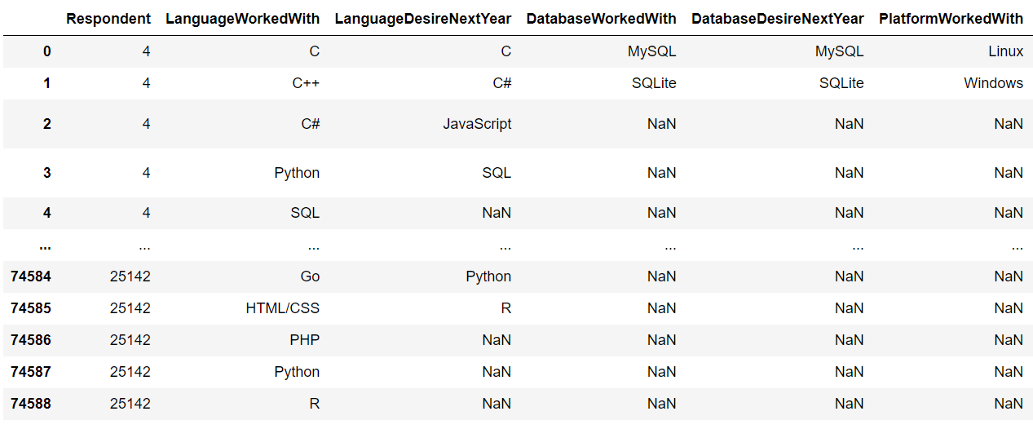
The following results have been obtained from the provided table:

Slide 7
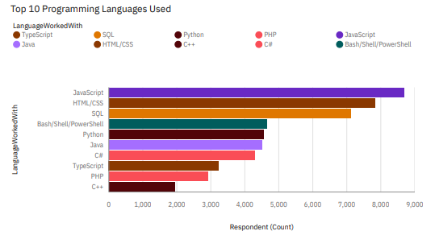
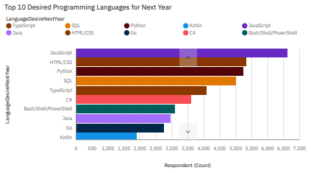
PROGRAMMING LANGUAGE TRENDS
Current Year
Next Year

Slide 8
PROGRAMMING LANGUAGE TRENDS - FINDINGS & IMPLICATIONS
Findings
JavaScript, HTML/CSS, and SQL are the top three programming languages for this year.
Python and TypeScript are expected to gain popularity in the coming year.
PowerShell will experience a decline in demand in the next year.
Implications
Web development continues to be in high demand, reinforcing the importance of JavaScript, HTML/CSS, and SQL skills.
Companies still rely on SQL for managing Big Data technologies.
With the increasing demand for AI and ML, Python remains the best choice for those looking to specialize in these fields.

Slide 9
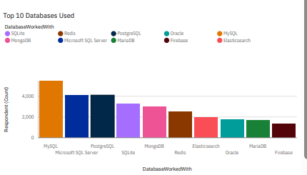
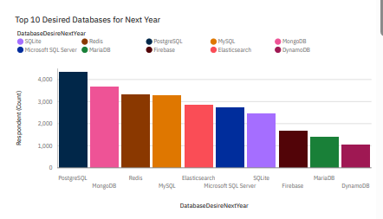
DATABASE TRENDS
Current Year
Next Year

Slide 10
DATABASE TRENDS - FINDINGS & IMPLICATIONS
Findings
MySQL is the most popular database.
Microsoft SQL closely follows as the second most popular choice.
MongoDB and Redis are emerging as favorites among users.
Elasticsearch is a newcomer gaining attention.
Implications
Open-source databases continue to be the preferred choice for companies, with MySQL leading the way.
NoSQL databases like MongoDB and Redis will have a significant impact on storing non-relational data.
Redis's support for abstract data types offers versatility and flexibility in data storage.
Elasticsearch provides pre-tuned search capabilities for websites, apps, and ecommerce stores, enhancing user experience and efficiency in data retrieval.

Slide 11

DASHBOARD
https://us1.ca.analytics.ibm.com/bi/?perspective=dashboard&pathRef=.my_folders%2FCapstone_Project%2FIBM_Capstone&action=view&mode=dashboard&subView=model0000018972040174_00000000

Slide 12
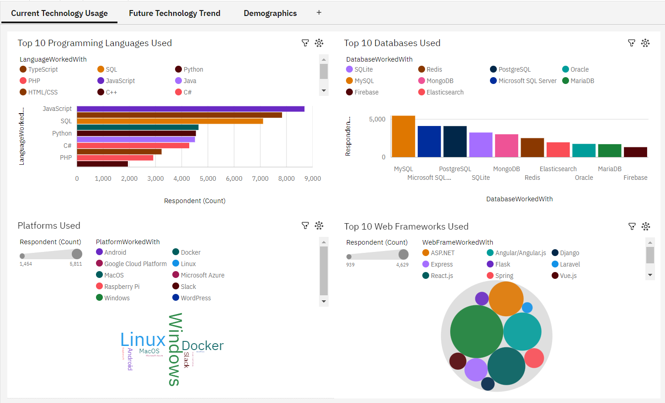
DASHBOARD TAB 1

Slide 13
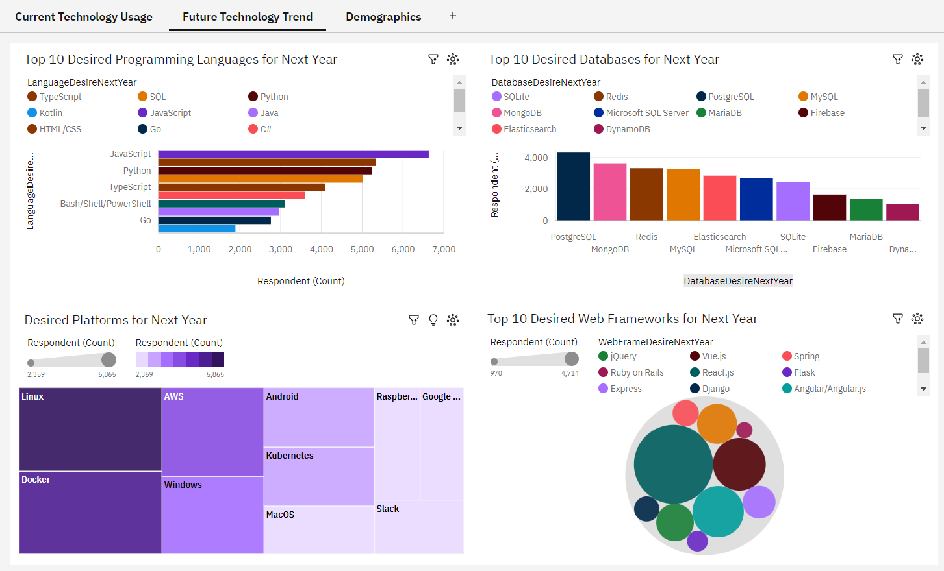
DASHBOARD TAB 2

Slide 14
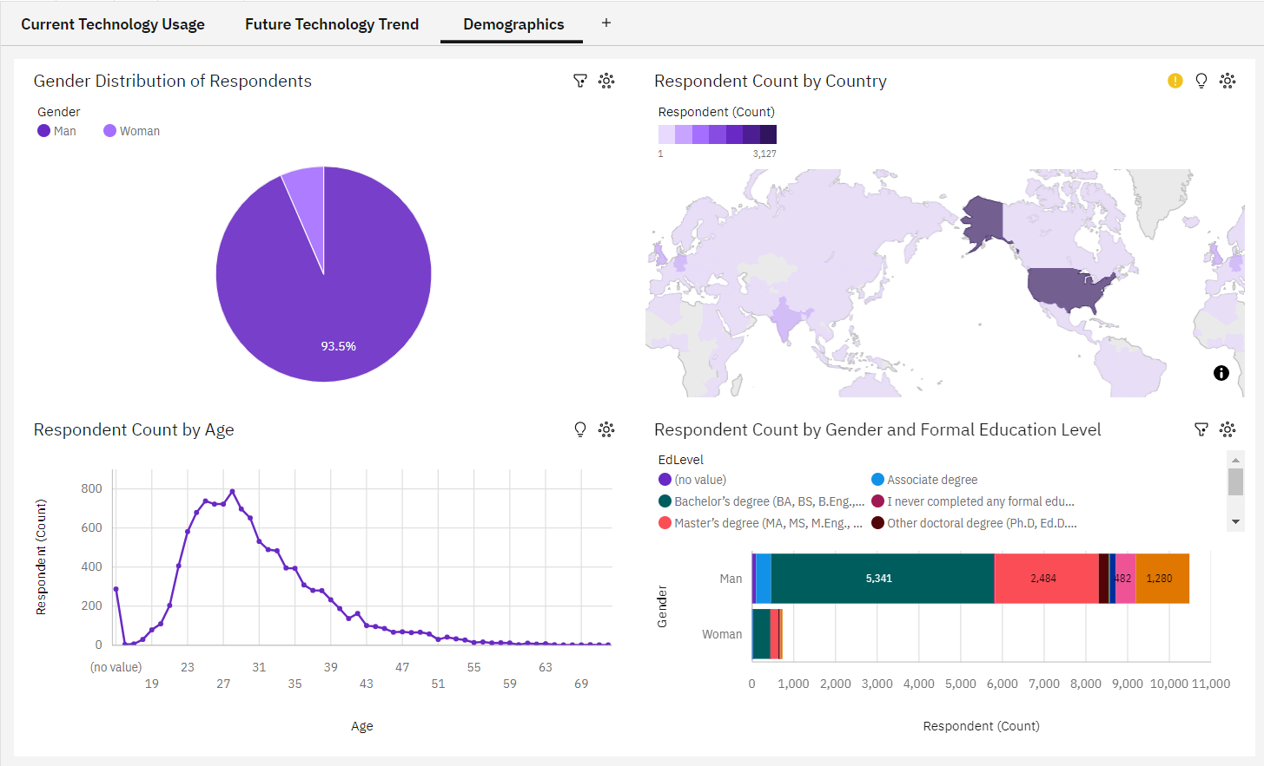
DASHBOARD TAB 3
Screenshot of dashboard tab 3 goes here

Slide 15
DISCUSSION
Technology Trends now and future: AI, blockchain, cloud computing, IoT.
Training and Reskilling workers: Equipping for tech advancements.
Females in Tech: Promoting diversity.
Bridge tech gaps in developing countries.
Eliminate age and education discrimination in employment.

Slide 16
OVERALL FINDINGS & IMPLICATIONS
Findings
Technology rapidly evolves each year.
Technology concentration in countries like USA and India.
Gender gap persists in technology jobs.
Growing popularity of platforms like Docker and AWS.
Implications
Companies must be adaptable to cope with fast-paced technological changes.
Efforts needed to distribute technology advancements to less developed countries.
Gender disparity influences job hiring practices.
A shift towards faster app deployments and increased reliance on cloud services in the future.

Slide 17

CONCLUSION
Technology Trends: AI integration, cloud growth, progressive web apps, microservices.
Programming Languages: Python, JavaScript, Java popular.
Databases: MySQL, PostgreSQL widely used.
Platforms: AWS, Azure, Google Cloud leading.
Demographics: Increasing diversity, emphasis on inclusivity.
Actions: Promote upskilling, foster diversity, tech education.
Future: Utilize ML for trend and salary predictions.

Slide 18
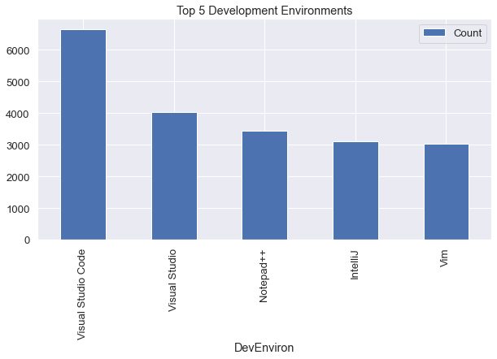

APPENDIX

Slide 19
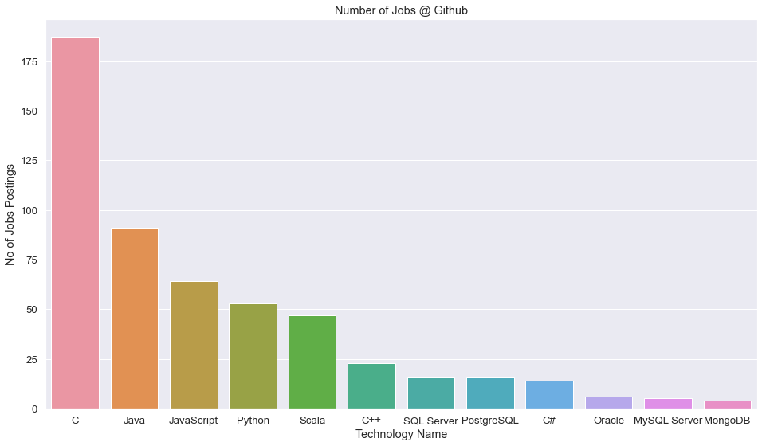
JOB POSTINGS

Slide 20
POPULAR LANGUAGES

