Slide 1
FRAMECRAFT
Long-form conversations.
Editable short-form stories.
AI-powered video clipping with inspectable choices
and a working local editing pipeline.
a complete moment
WORKING LOCAL PRODUCT / OCTOBER 2026
Original workflow illustration
FRAMECRAFT
01
Notes:
Project stage: working local prototype. Project creator account confirmed by GitHub API as KevBrad. No commercial traction or external funding has been established.

Slide 2
Editing starts before the first cut
The hardest moment to find is often the one that still makes sense on its own.
Review
footage
Find the
moment
Trim the
story
Reframe
video
Correct
captions
Refine the
edit
Export and
check
A compelling sentence can lose its value when the question, explanation or payoff falls outside the cut.
FRAMECRAFT
02
Notes:
Problem framing is a product hypothesis based on the editing workflow. No user-interview study or quantified time saving is claimed.

Slide 3
A focused first customer
INITIAL CUSTOMER HYPOTHESIS
VALUE TO TEST
Independent podcasters
and educators
More usable clips
from existing recordings
Fewer manual repairs
Clear source context
Control before publishing
People with recurring conversations, lessons or webinars and a need to review each published claim.
FRAMECRAFT
03
Notes:
Qualitative opportunity and proposed initial segment. Demand, addressable market, customer willingness to pay and time savings are not validated. No numeric market estimate is included.

Slide 4
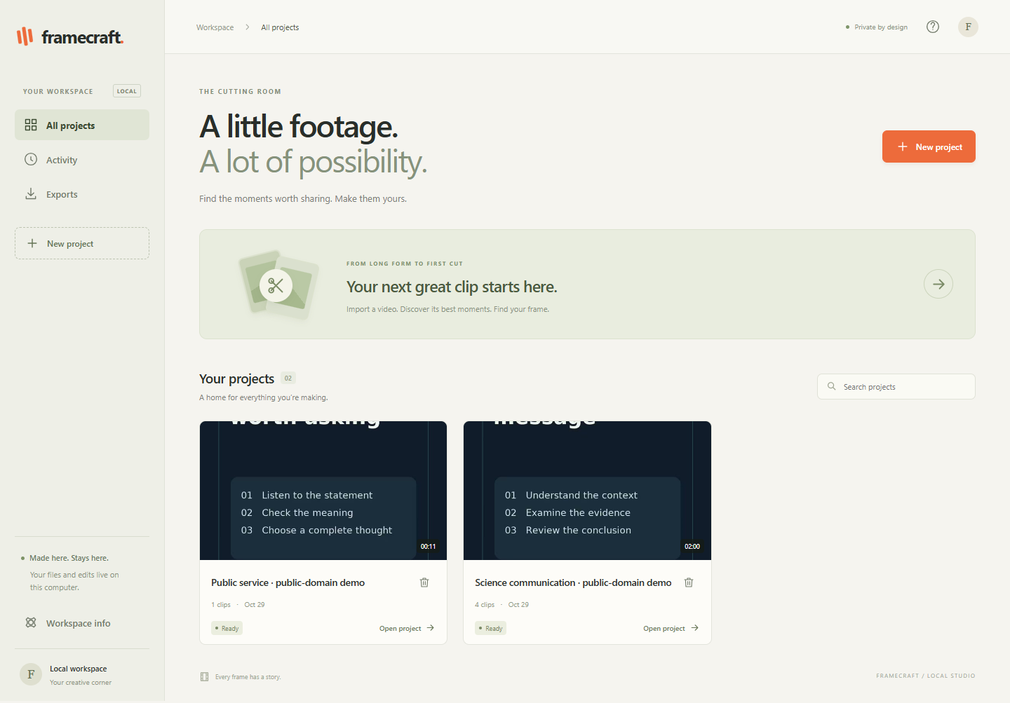
A working path from import to export
Framecraft finds candidate moments, explains its ranking and keeps the edit in the creator’s hands.
01
Import and analyze
Authorized files or supported connections feed a durable local pipeline.
Import / Analyze / Rank / Edit / Export
FRAMECRAFT
04
Notes:
Actual application screenshot from an isolated demo workspace captured29October2026. The displayed demonstration uses public-domain government speech with original graphics. No private production project is visible. Direct HTTPS imports and reusable authorized originals are implemented. YouTube references alone do not establish downloadable media. Google Drive live OAuth remains unverified.

Slide 5
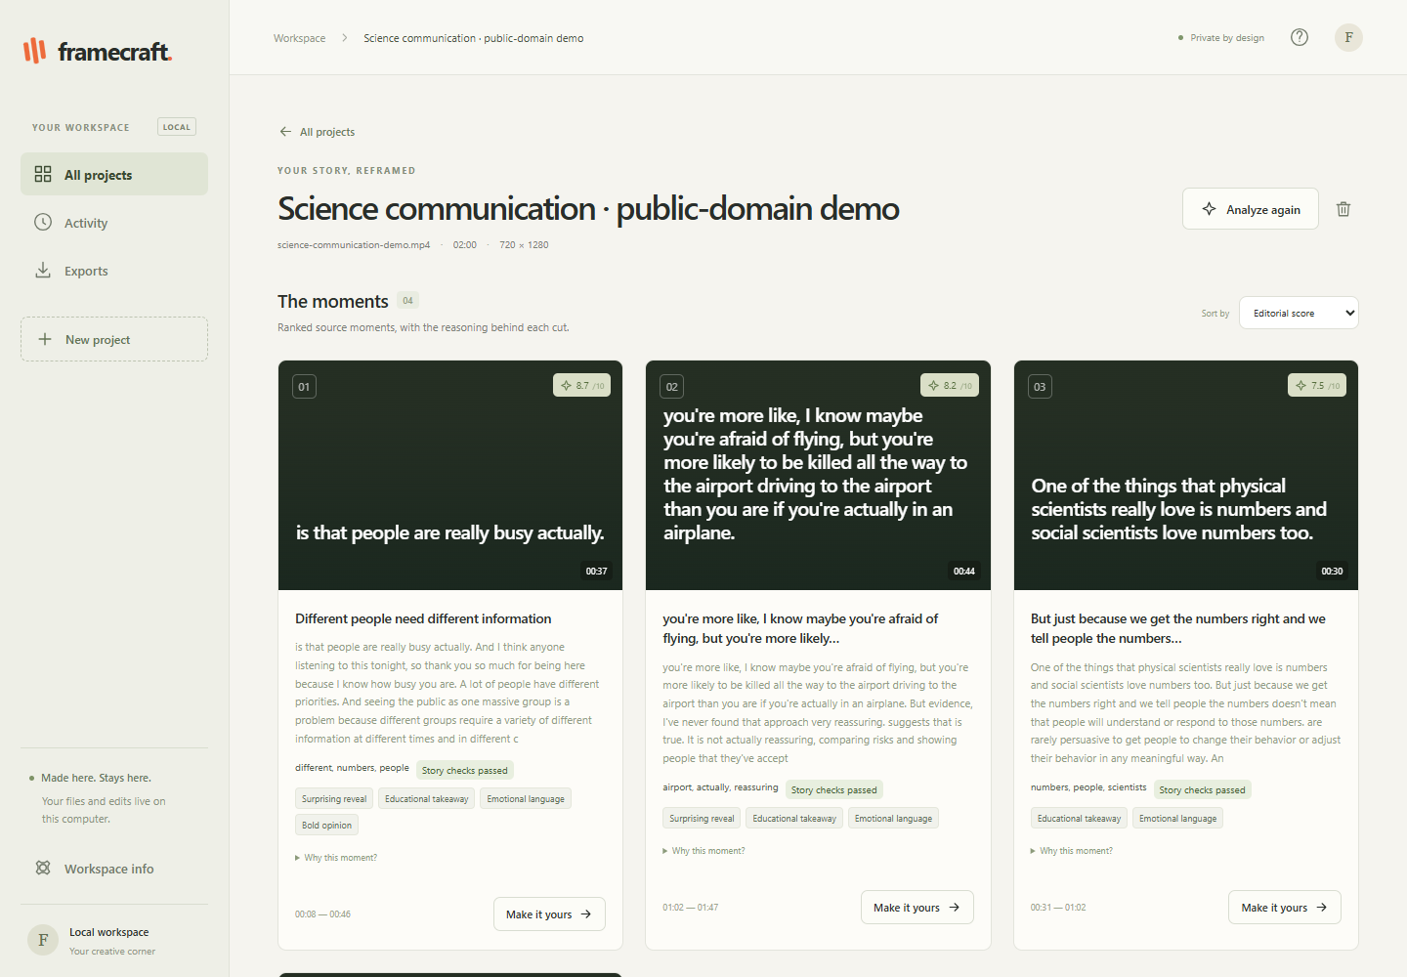
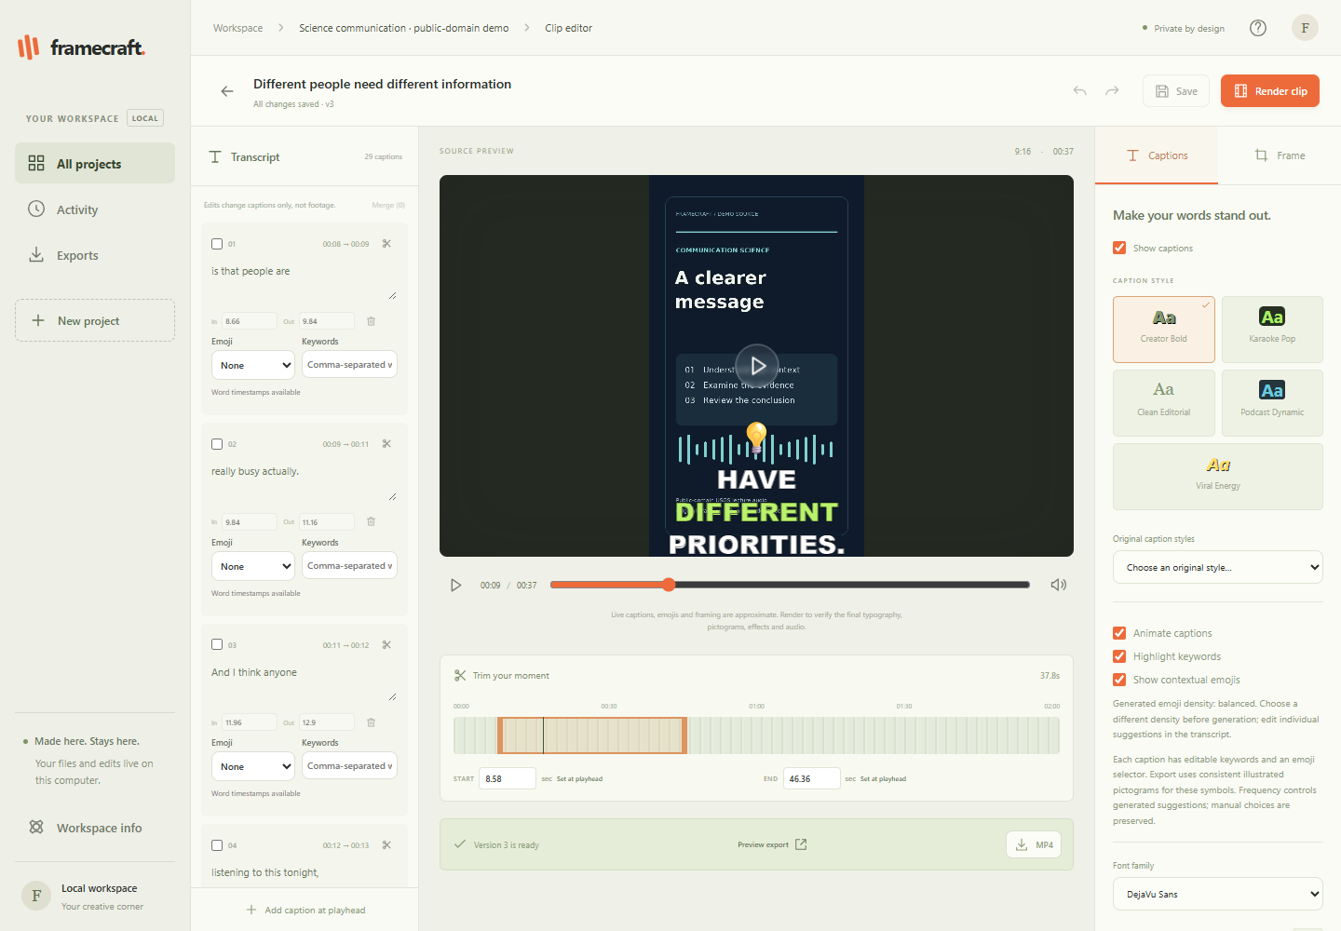
The creator can inspect and refine every cut
See the evidence
Edit the actual result
Source timestamps and heuristic score evidence.
Saved captions, framing and rendered preview.
FRAMECRAFT
05
Notes:
Both captures show real application states on29October2026, not mockups. Editorial scores are heuristic estimates. The live source canvas approximates typography; rendered MP4 preview is authoritative. Corrections persist and clear obsolete recognized word estimates.

Slide 6
Local media processing, durable project state
01
02
03
04
05
06
Authorized intake
Bounded worker
Speech recognition
Highlight selection
Visual edit
Render and verify
File, HTTPS, source registry
Process gate and checkpoints
Whisper word estimates
Context and ranked evidence
Captions and scene framing
FFmpeg, libass, ffprobe
React and TypeScript
Creator controls
FastAPI and durable queues
Separate import and analysis stages
SQLite WAL and local files
Sources, edits and export history
FRAMECRAFT
06
Notes:
Verified against current source29October2026. SQLite schema2. Separate durable import and analysis consumers. Windows workers use a Job Object with2048MiBdefault. ASR reads30second cores with2second context per side. The editorial engine builds90second extractive units and uses lexical/acoustic heuristics. OpenCV geometric framing is not active-speaker identity. No hosted model inference, Redis or PostgreSQL is implemented.

Slide 7
Control over each cut
LOCAL PROCESSING
EXPLAINABLE CHOICES
REVERSIBLE EDITING
No mandatory paid AI key
Evidence beside the score
Saved work stays available
Speech recognition and media analysis run on the user’s machine.
Creators can inspect hooks, context, payoff and source timestamps.
Versioned edits and previous selections survive reanalysis.
Direction to validate: a review-first workflow for creators who value source control.
FRAMECRAFT
07
Notes:
All three current behaviors are source-verified. The privacy/control positioning is a proposed customer value proposition, not evidence of market preference or exclusive competitive advantage. Metadata/OAuth/download network activity can still occur. Framecraft is a local single-user application, not a reviewed public SaaS.

Slide 8
Different approaches to the same editing job
Product | Documented focus | Delivery / evidence
Vizard | Full-context clips and captions | Hosted product / advertised
OpusClip | Multimodal prompt discovery | Hosted product / advertised
Submagic | Captions, effects and editing | Hosted product / advertised
Framecraft | Heuristic ranking and editable captions | Local Windows app / verified prototype
Framecraft gaps: reliable active-speaker attribution, forced alignment and broad multimodal reasoning.
Sources: official product documentation, accessed 29 Oct 2026. Vendor claims are not independent tests.
FRAMECRAFT
08
Notes:
Official sources accessed29October2026: https://vizard.ai/blog/meet-vizard-model-v2-full-context-clips-that-the-algorithm-actually-rewards ; https://www.opus.pro/clipanything ; https://www.submagic.co/ . Third-party rows reflect advertised capabilities only. We did not run an independent same-source benchmark against these products. No superiority ranking or unverified feature-absence claim is made.

Slide 9
Product development and technical validation
290
60 min
1080p
automated tests + 4 subtests
continuous speech processed
real H.264 / AAC exports
Source duration | Analysis runtime | Words | Peak private memory
13 min 29 s | 101.20 s | 2,750 | 1,341 MiB
15 min | 104.08 s | 2,131 | 1,309 MiB
60 min | 311.62 s | 9,224 | 1,397 MiB
Tests rerun 29 Oct. Long-video evidence: 23 Oct 2026, one CPU workstation. Engineering validation only.
FRAMECRAFT
09
Notes:
Publication rerun29October2026:290tests+4subtests passed78.73s, no skips. TypeScript/Vite build passed. Historical media evidence23October2026 was re-inspected, not rerun in this publication phase. Timings include import/upload plus validation, ASR, selection and framing; exclude later export. Intel i7-11800H, CPUint8,4threads, tiny.en. Process-tree private memory sampled100ms, not an exact Job Object high-water measurement. No customer count, revenue or commercial traction is implied. See docs/VERIFIED_RESULTS.md and historical-long-video-metrics.csv.

Slide 10
A focused validation and business model
PROPOSED FIRST EXPERIMENT
BUSINESS HYPOTHESES
5–10 creator trials
Creator subscription
Usage tier for higher volume
Use authorized recordings. Review the first batch together. Measure clips kept, editing effort and export reliability.
Professional editing controls
Test willingness to pay before choosing a price.
Demand, pricing and unit economics remain unvalidated.
FRAMECRAFT
10
Notes:
Proposed plan only.5–10is a planned trial cohort, not an existing user count. Framecraft has no established paying-customer, revenue, funding or product-market-fit claim. Potential subscriptions and usage tiers are hypotheses; no actual pricing is announced.

Slide 11
The next milestones have clear evidence gates
QUALITY EVIDENCE
CREATOR TRIALS
DEPLOYMENT READINESS
Better selection and timing
A workflow people keep using
A responsible hosted pilot
Label reference moments. Measure recognition errors and word onsets. Review failure cases.
Observe editing effort, clip acceptance, usability and willingness to pay.
Establish account security, operational controls and per-minute processing cost first.
FRAMECRAFT
11
Notes:
Future work, no completion dates committed. Reliable speaker-aware framing, forced alignment, stronger semantic selection and approved provider integrations remain planned/experimental. Public cloud operation requires security, tenancy and cost controls beyond the current single-user loopback app.

Slide 12
A useful product, built through measured iteration
KevBrad
github.com/KevBrad/
framecraft-ai
Project direction, research, requirements and testing,
with AI-assisted implementation.
Working local prototype
Seeking validation and startup support
SUPPORT THAT WOULD ACCELERATE THE NEXT STAGE
Product mentorship
Creator introductions
Independent technical review
Project and contact profile
FRAMECRAFT
12
Notes:
Confirmed GitHub handle:KevBrad. No public display name, employer, degree, cofounder, personal email or funding round was confirmed. The project reflects user-led product requirements/research/iteration and materially AI-assisted code creation. Support request is qualitative and does not assert an active fundraising round. GitHub project URL:https://github.com/KevBrad/framecraft-ai .

