Slide 1



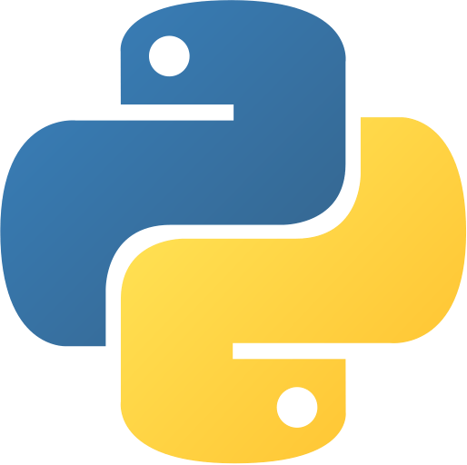

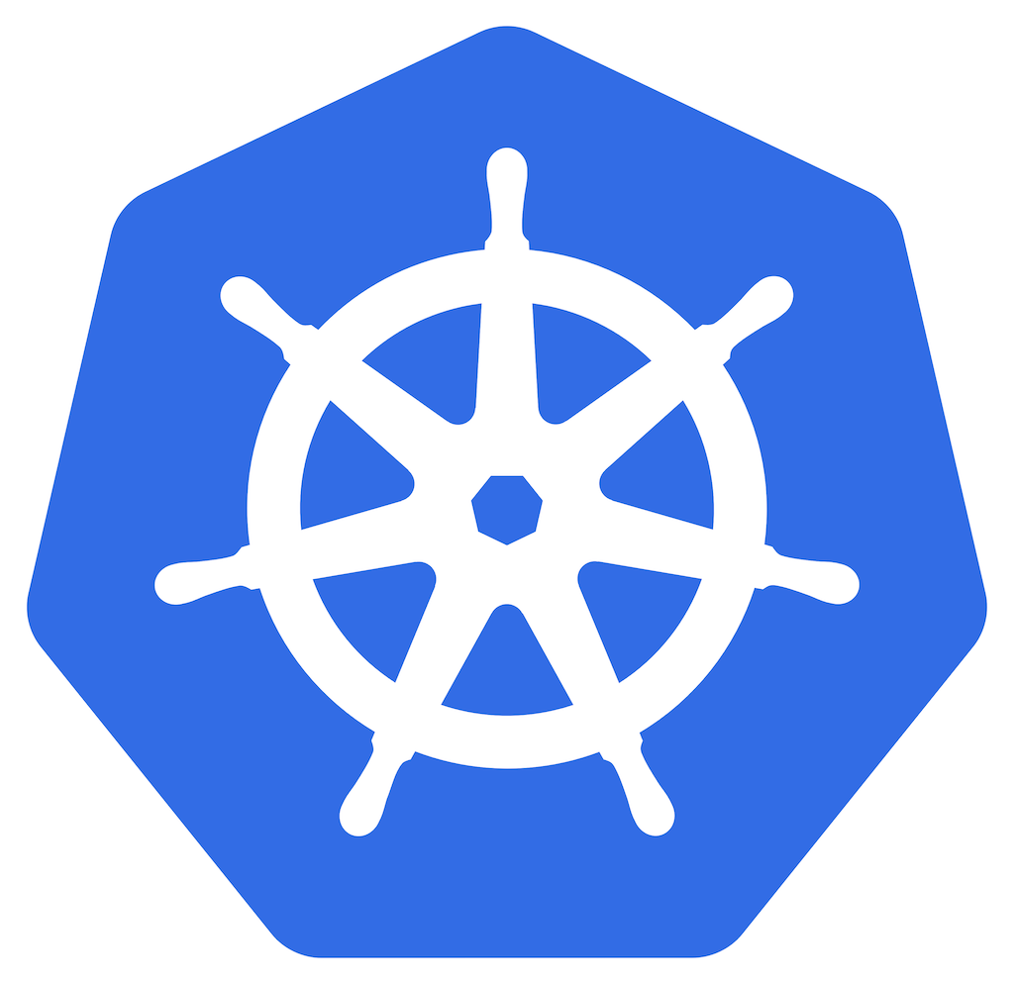
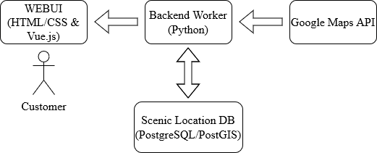

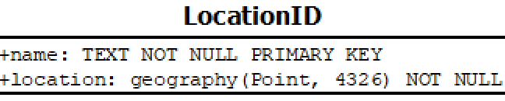
Scenic Navigation App
Kevin Buss, Jacob Marvel, Nicholas Santone Robert Silver
https://github.com/KevBuss/Group1-CSC468
Introduction: The Scenic Navigation App aims to transform mundane routes into memorable journeys by prioritizing enjoyment over speed. Current navigation apps focus on reaching destinations quickly, but our app reimagines everyday travel by creating personalized, scenic routes.
Frontend/WEBUI: The frontend of the Scenic Navigation App is built using Vue.js. The map component will enable users to search and select locations, providing the foundation for generating scenic routes and displaying turn-by-turn directions. This version implements features such as map initialization, location search with autocomplete, and a basic direction-fetching button between two points.
Backend Worker: The backend, written in Python, serves as the central hub of the Scenic Navigation App. It handles incoming requests from the frontend, interacts with the database to retrieve scenic coordinates, and communicates with the Google Maps API key stored in the backend. The server acts as the intermediary between the user interface and the underlying data and external services. It ensures smooth data flow and efficient processing of user requests.
Location Database: The database will store information about scenic locations around West Chester. By utilizing a relational database model with PostGIS, we can leverage the power of spatial data to enhance the route generation process.
Containerization and Cloud Integration: To enhance the app's scalability and portability, we are leveraging Docker for containerization. The Vue.js application has been containerized using a two-stage Dockerfile, which compiles the app and serves it using an HTTP server. This containerization lays the groundwork for integration with Kubernetes for orchestration. Additionally, we are planning to implement CI/CD pipelines and deploy the app on CloudLab infrastructure. These pipelines will automate the integration of code changes, perform testing, and streamline the deployment process. By embracing containerization and cloud technologies, we aim to ensure the app's reliability, scalability, and ease of deployment.

