Slide 1








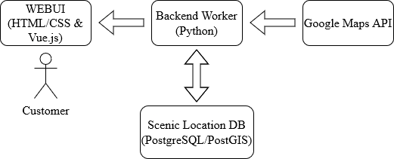
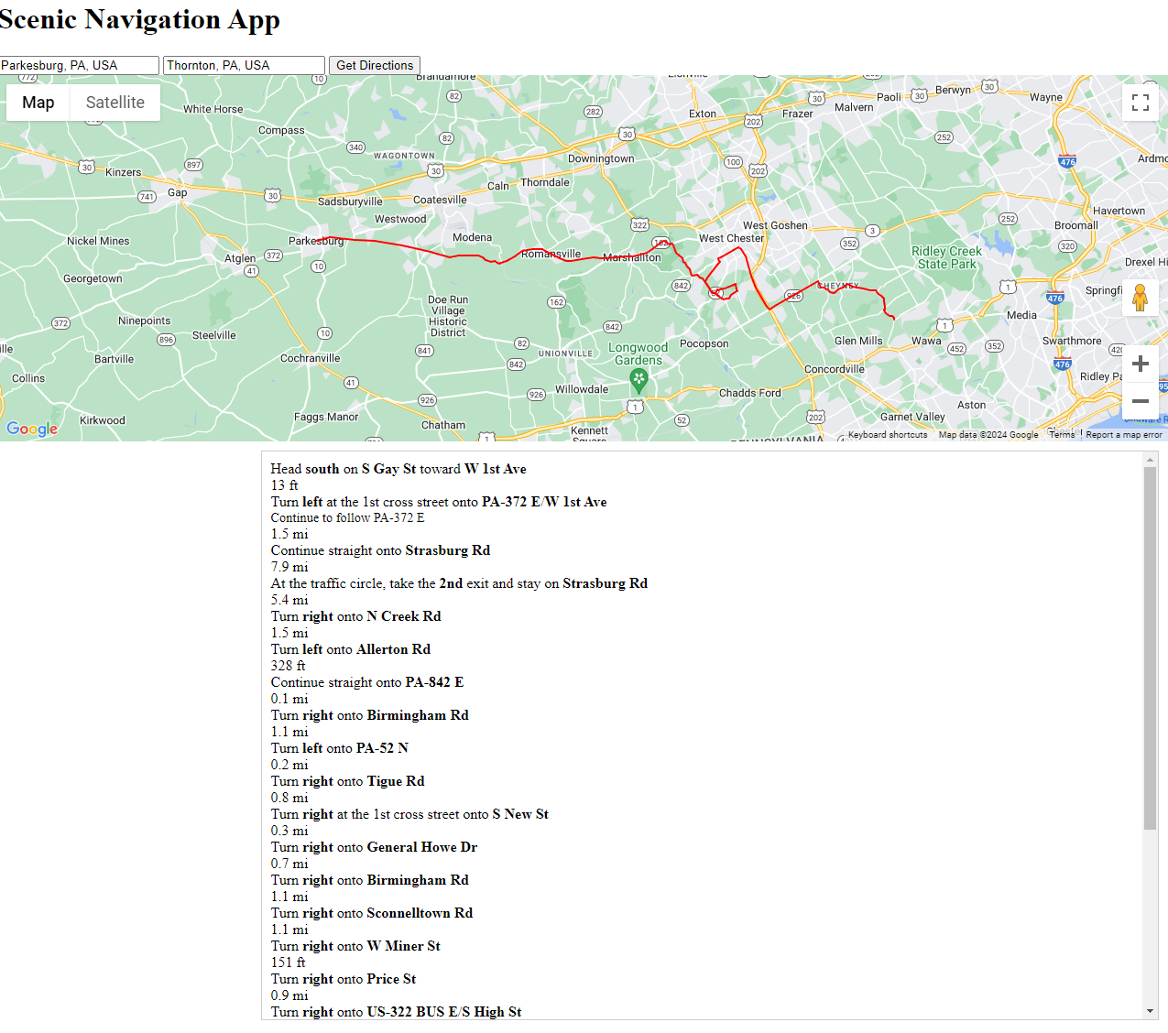
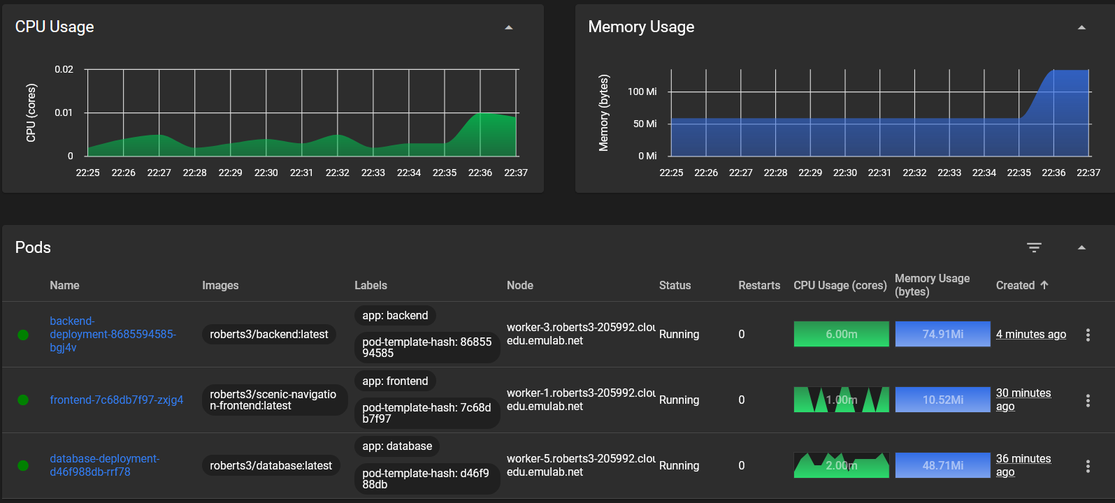
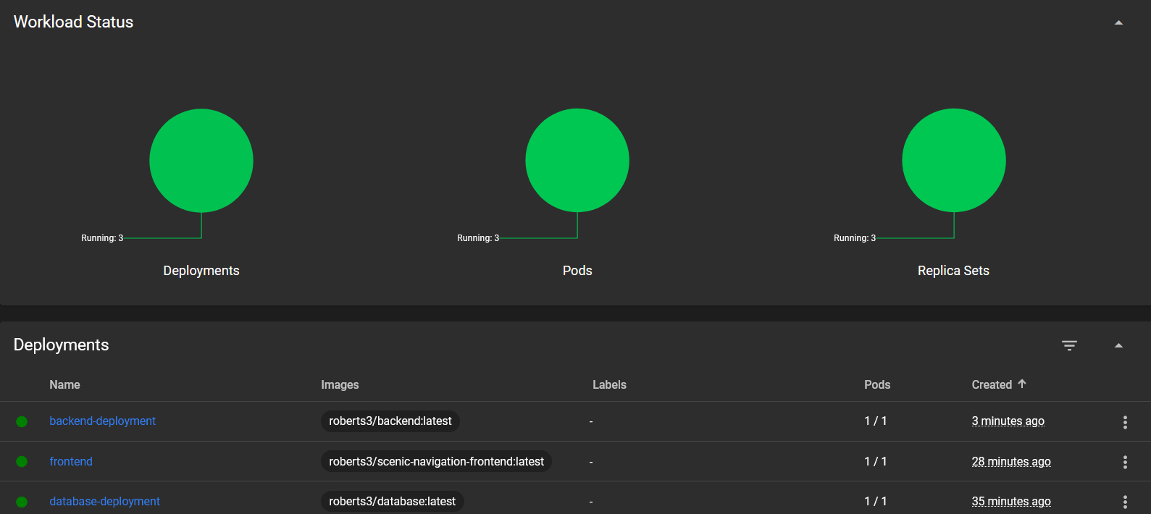
Scenic Navigation App
Kevin Buss, Jacob Marvel, Nicholas Santone, Robert Silver
https://github.com/KevBuss/scenic-navigation-app
Scenic Navigation App: The Scenic Navigation App aims to transform mundane routes into memorable journeys by prioritizing enjoyment over speed. Current navigation apps such as Google Maps focus on reaching destinations quickly, or Waze for it’s real time traffic alerts, but our app reimagines everyday travel by creating scenic routes
Spatial Data Storage: Uses PostGIS for advanced geospatial data management. Allows the use of storing locations as coordinates in the database.
User Interface: Using Vue.js, our user interface offers a dynamic user experience for selecting and visualizing scenic routes and autocomplete location searches.
Backend: Our backend manages data flow between frontend, database, and API. It interacts with database to fetch scenic coordinates and utilizes a Google Maps API key for mapping functionalities.
Containerization and Cloud Integration: Our infrastructure employs a Dockerfile and Kubernetes deployment for each of the three components; WebUI, Backend, and Database. This enhances scalability and portability. Kubernetes controls manage, scale, and maintain container deployment.

