Slide 1





$${\underline{e}}^{0}=\left[\begin{matrix}1 & 0 & 0 \\ 0 & 1 & 0 \\ 0 & 0 & 1\end{matrix}\right]$$
or,
${\left\{{\vec{e}}_{1}\right\}}^{0}=\left\{\begin{matrix}1 \\ 0 \\ 0\end{matrix}\right\}$, ${\left\{{\vec{e}}_{2}\right\}}^{0}=\left\{\begin{matrix}0 \\ 1 \\ 0\end{matrix}\right\}$, ${\left\{{\vec{e}}_{3}\right\}}^{0}=\left\{\begin{matrix}0 \\ 0 \\ 1\end{matrix}\right\}$
$$Z$$
$$Y$$
${\underline{e}}^{0}$
$$X$$

Slide 2




$${\underline{e}}^{2}=\left[A^{21}\right]{\underline{e}}^{1}$$
similarly,
$${\underline{e}}^{1}=\left[A^{10}\right]{\underline{e}}^{0}$$
$${\underline{e}}^{2}=\left[A^{20}\right]{\underline{e}}^{0}$$
giving,
$${\underline{e}}^{2}=\left[A^{20}\right]{\left[A^{10}\right]}^{T}{\underline{e}}^{1}$$
$$\left\{\begin{matrix}{\vec{e}}_{1}^{2} \\ {\vec{e}}_{2}^{2} \\ {\vec{e}}_{3}^{2}\end{matrix}\right\}=\left[\begin{matrix}a_{11}^{20} & a_{12}^{20} & a_{13}^{20} \\ a_{21}^{20} & a_{22}^{20} & a_{23}^{20} \\ a_{31}^{20} & a_{32}^{20} & a_{33}^{20}\end{matrix}\right]{\left[\begin{matrix}a_{11}^{10} & a_{12}^{10} & a_{13}^{10} \\ a_{21}^{10} & a_{22}^{10} & a_{23}^{10} \\ a_{31}^{10} & a_{32}^{10} & a_{33}^{10}\end{matrix}\right]}^{T}\left\{\begin{matrix}{\vec{e}}_{1}^{1} \\ {\vec{e}}_{2}^{1} \\ {\vec{e}}_{3}^{1}\end{matrix}\right\}$$
$${\underline{e}}^{1}$$
$$Z$$
${\underline{e}}^{2}$
$$Y$$
${\underline{e}}^{0}$
$$X$$

Slide 3




$$\left\{\begin{matrix}{\vec{e}}_{1}^{2} \\ {\vec{e}}_{2}^{2} \\ {\vec{e}}_{3}^{2}\end{matrix}\right\}=\left[\begin{matrix}a_{11}^{21} & a_{12}^{21} & a_{13}^{21} \\ a_{21}^{21} & a_{22}^{21} & a_{23}^{21} \\ a_{31}^{21} & a_{32}^{21} & a_{33}^{21}\end{matrix}\right]\left\{\begin{matrix}{\vec{e}}_{1}^{1} \\ {\vec{e}}_{2}^{1} \\ {\vec{e}}_{3}^{1}\end{matrix}\right\}$$
where,
$$\left(\left[A^{21}\right]−I\right)\vec{n}=0$$
The Screw angle, and axis can be found using
$$θ=\cos^{−1}\left[\frac{trace\left[A^{21}\right]−1}{2}\right]$$
$$n_{i}=\frac{a_{jk}−a_{kj}}{2sinθ}$$
where 𝑖, 𝑗, 𝑘 = 1, 2, 3 𝑐𝑦𝑐𝑙𝑖𝑐𝑎𝑙𝑙𝑦 (Einstein notation)
$${\underline{e}}^{1}$$
$$Z$$
$$\vec{n},θ$$
${\underline{e}}^{2}$
$$Y$$
${\underline{e}}^{0}$
$$X$$

Slide 4


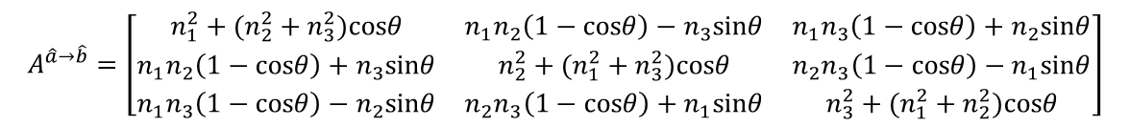


$$\vec{a}$$
$$\vec{n}=\frac{\hat{a}+\hat{b}}{\left\|\hat{a}+\hat{b}\right\|}, θ_{\hat{a}+\hat{b}}$$
$$Z$$
$$\vec{b}$$
$$\vec{n}=\frac{\hat{a}×\hat{b}}{\left\|\hat{a}×\hat{b}\right\|},θ_{\hat{a}×\hat{b}}$$
$$Y$$
$$A^{\hat{a}→\hat{b}}=\left[\begin{matrix}n_{1}^{2}+(n_{2}^{2}+n_{3}^{2})cosθ & n_{1}n_{2}\left(1−cosθ\right)−n_{3}sinθ & n_{1}n_{3}\left(1−cosθ\right)+n_{2}sinθ \\ n_{1}n_{2}\left(1−cosθ\right)+n_{3}sinθ & n_{2}^{2}+(n_{1}^{2}+n_{3}^{2})cosθ & n_{2}n_{3}\left(1−cosθ\right)−n_{1}sinθ \\ n_{1}n_{3}\left(1−cosθ\right)−n_{2}sinθ & n_{2}n_{3}\left(1−cosθ\right)+n_{1}sinθ & n_{3}^{2}+(n_{1}^{2}+n_{2}^{2})cosθ\end{matrix}\right]$$
${\underline{e}}^{0}$
$$X$$

Slide 5
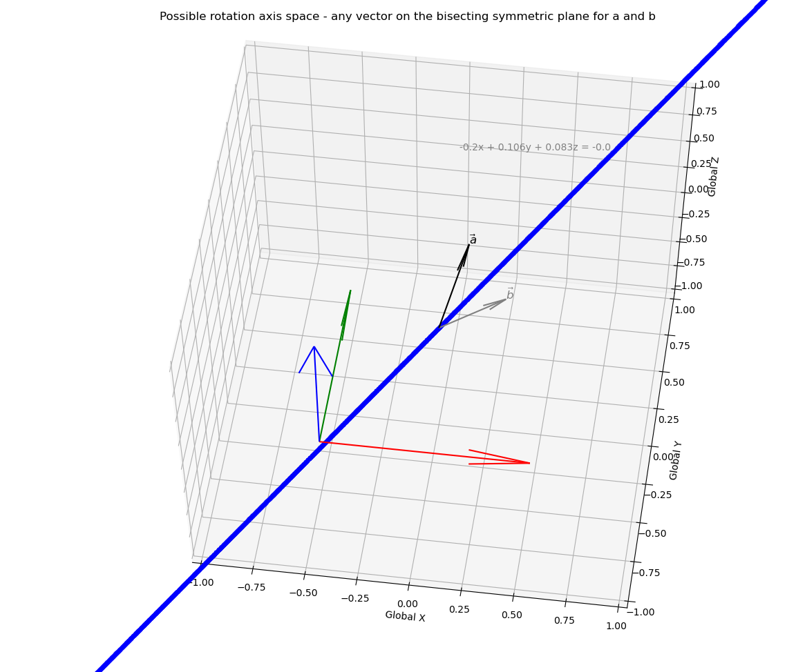

$$θ$$

