Slide 1

Weather in the U.S.
Kevin Duran

Slide 2
Importance:
Accurate weather forecasts provide early warnings for severe weather events, enabling timely evacuations and disaster preparedness.
One example of this is the CenterPoint Energy's installation of 100 advanced weather stations in Houston. This was done in aims to improve real time data collection for better emergency response during disasters like hurricanes
Weather data Overtime is essential for studying climate patterns & assessing climate change
This is shown with NOAA and organization that utilizes historical weather data to monitor environmental changes and inform policy decisions.

Slide 3
Experimental Specifications
GitHub Repository
https://github.com/KevMD-23/CIS-4560-Weather
Data Source:
Weather In the U.S.
https://www.kaggle.com/datasets/nachiketkamod/weather-dataset-us/data
Cluster Version: Hadoop 3.1.2
Nodes: 5
Memory: 31 GB
Dataset size (8.37 GB)
Final Row Records Count (1,048,576) (1.88GB.csv)
CPU Info
AMD Ryzen 7 7730U with Radeon Graphics(8Cores @ 2.0GHz)

Slide 4

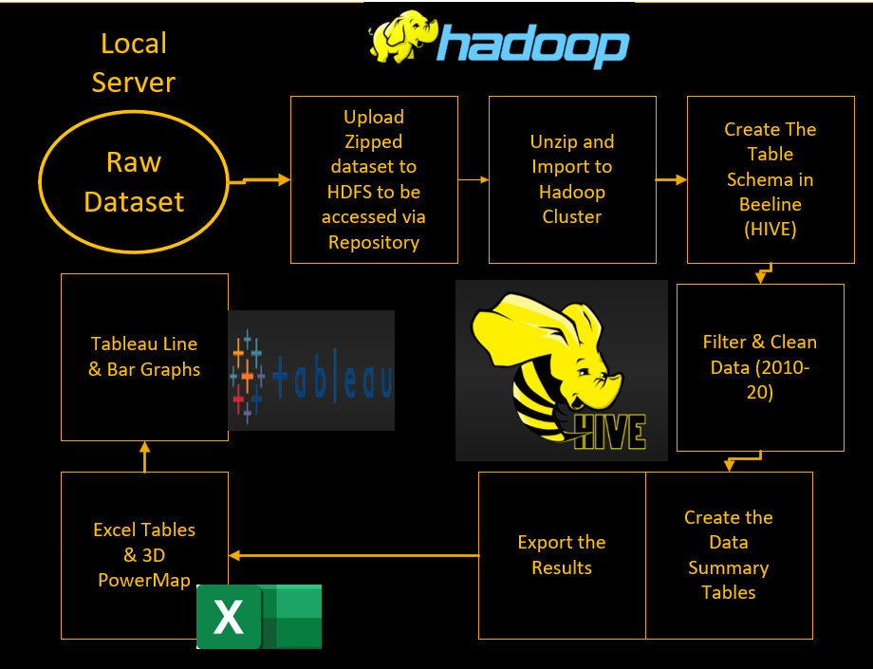
WorkFlow

Slide 5
HEAT MAP Avg Celsius Temp Across U.S.
https://youtu.be/S8K3D9iy6-o

Slide 6
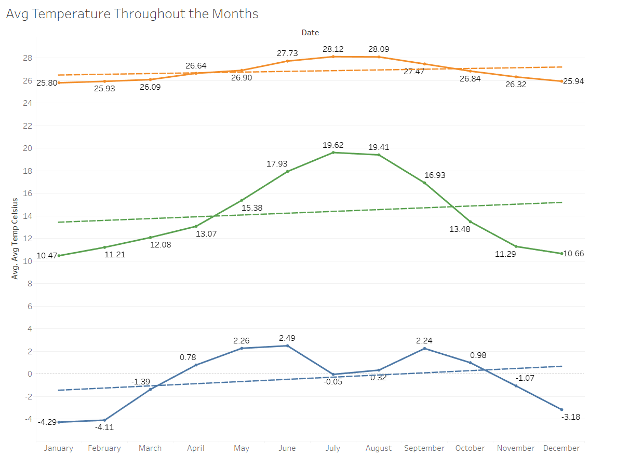
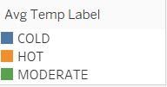
Moderate zones show most seasonal fluctuation, at 10.47°C January, to a peak in July of 19.62°C before dipping to 10.66°C in December
Hot zones relatively stable throughout the year, between 25.8°C in January, and 28.12°C in July and 28°C, This shows low volatility
Cold zones have the sharpest monthly changes, from -4.29°C in December up to 2.49°C in June then going to –3.18°C in December, indicating high sensitivity to seasons

Slide 7
Prcp by Temp Label Across U.S.
https://youtu.be/LU-de2BVNjY

Slide 8
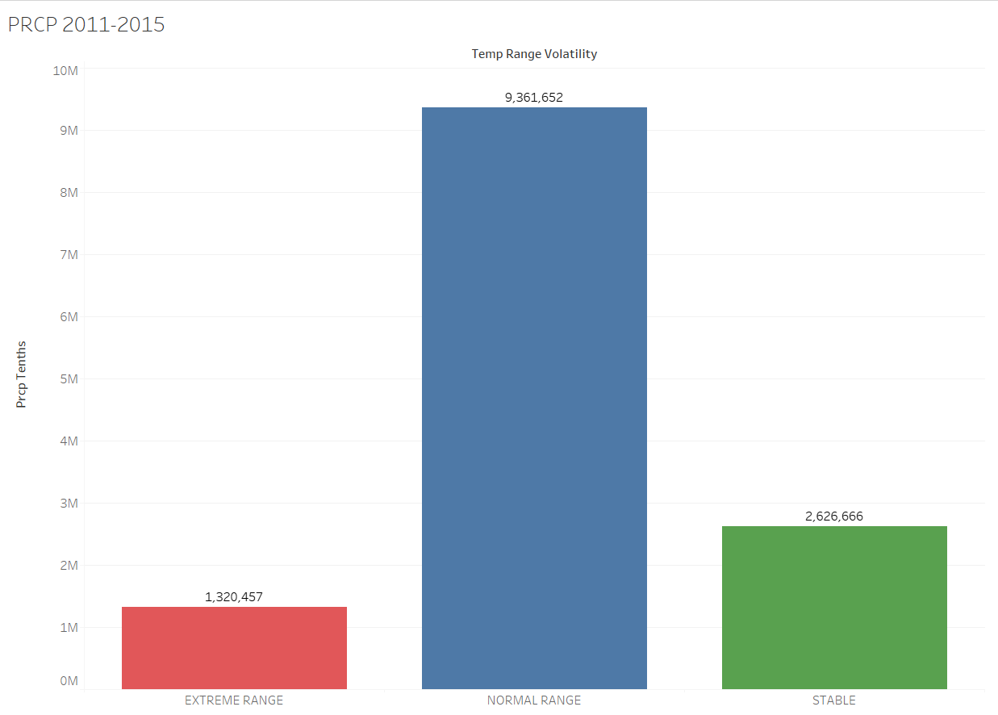
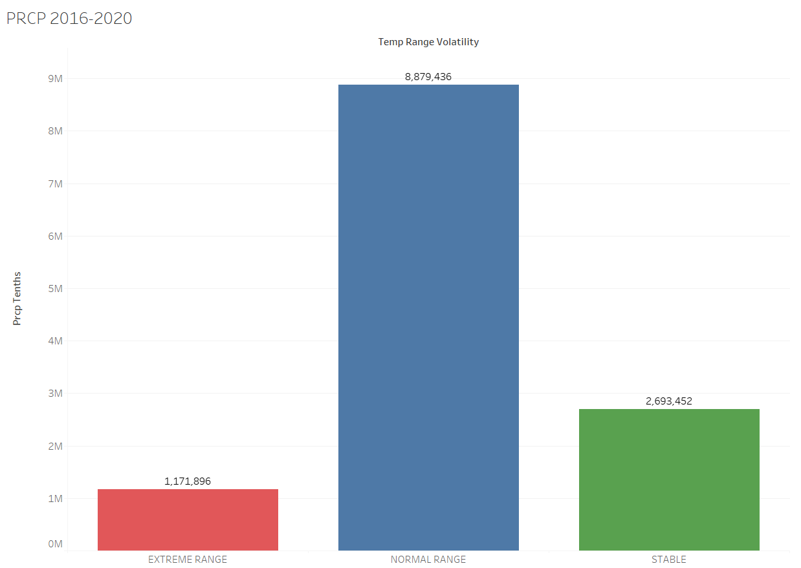
Precipitation 2011-15 vs 2016-20

Slide 9
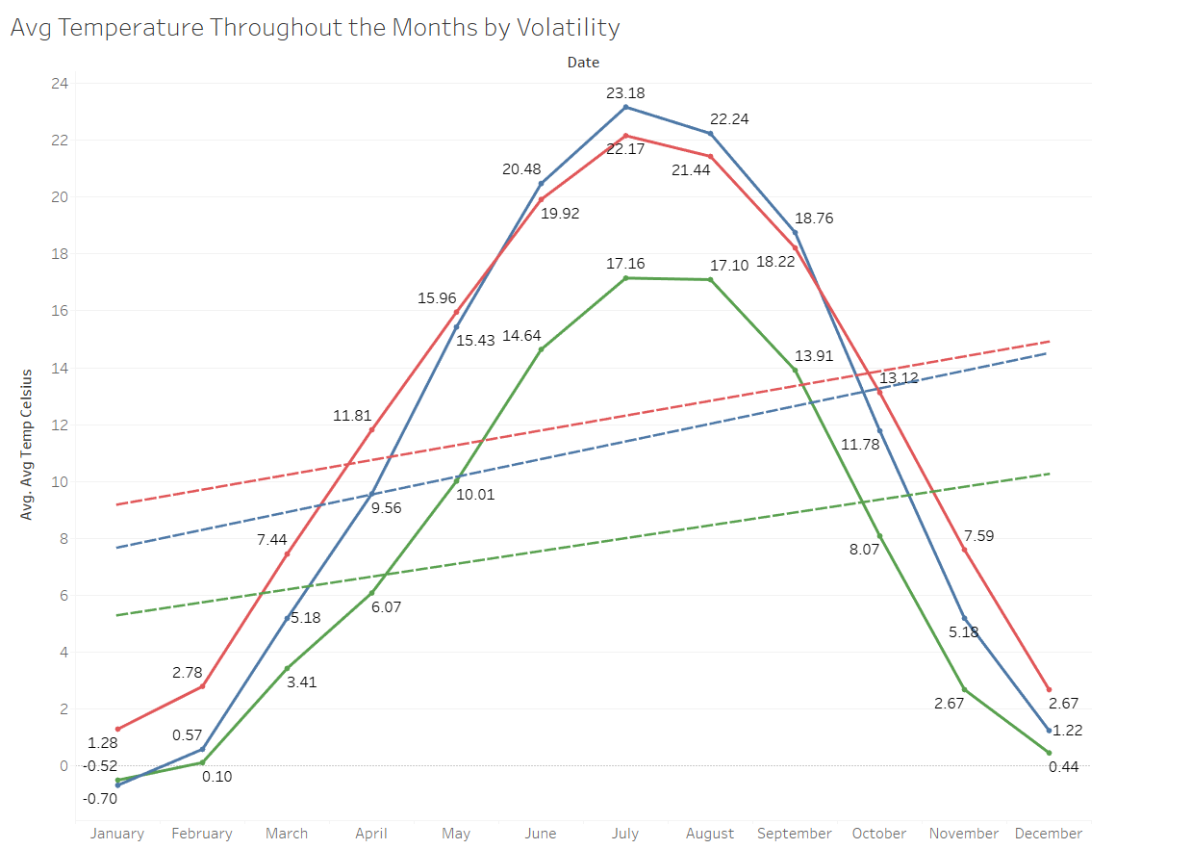

Extreme range areas show the most dramatic change from -0.70°C in January to a peak of 23.18°C in July, Showing intense climate Volatility
Stable zones maintain a narrow, gradual curve through months, between 5.18°C in January and 18.76°C in July, Shows consistency
Normal range areas are inbetween 1.28°C in January and 22.17°C in July and ending in December with 2.67°C, This shows moderate and balanced volatility

Slide 10
References
Kamod, N. (2024.). Weather Dataset (US) [Data set]. Kaggle. Retrieved April 24, 2025, https://www.kaggle.com/datasets/nachiketkamod/weather-dataset-us/data
National Oceanic and Atmospheric Administration. (n.d.). Why Weather Observations Matter. NOAA National Centers for Environmental Information. https://www.ncei.noaa.gov/news/why-weather-observations-matter
Hao, C. (2025, April 29). Can real-time weather data help Houston ride out the next hurricane? Houston Chronicle. https://www.chron.com/weather/article/centerpoint-weather-stations-houston-20300280.php
National Academies of Sciences, Engineering, and Medicine. (2012). Weather Services for the Nation: Becoming Second to None. Washington, DC: The National Academies Press. Retrieved from https://doi.org/10.17226/13429

