Slide 1
Knowledge Management
UE17CS342
Project Title : Product Recommendation Mobile Application
Project Guide : Dr. Jayashree
Project Team : Karthik N - PES1201700692
Arushi Bohra - PES1201700703
Nahusha A - PES1201700044
Kevin Arulraj - PES1201700659

Slide 2
Project Abstract and Scope
Product Recommendation System:
to help shop owners or local businesses
it helps them to choose products wrt the competition to help them maximise profits
Enables them to compare their product in hindsight with what their competitors have
Overall helps in smarter & more statistical decision making

Slide 3
Design Approach
To design a solution to this problem, we needed an efficient way to reach the consumer.
The vast majority of our consumers are small kirana store owners who cannot afford to have a laptop/PC in their small stores, thus we designed a mobile application to help reach these shop owners.
With the boom of 4G in India, majority of Indians have had easier access to smartphones and the internet.
Thus making a mobile application is a feasible and convenient option for the consumers

Slide 4
Knowledge Management concepts used
Tacit to tacit knowledge collection
Tacit to explicit knowledge collection
Explicit to tacit knowledge collection

Slide 5
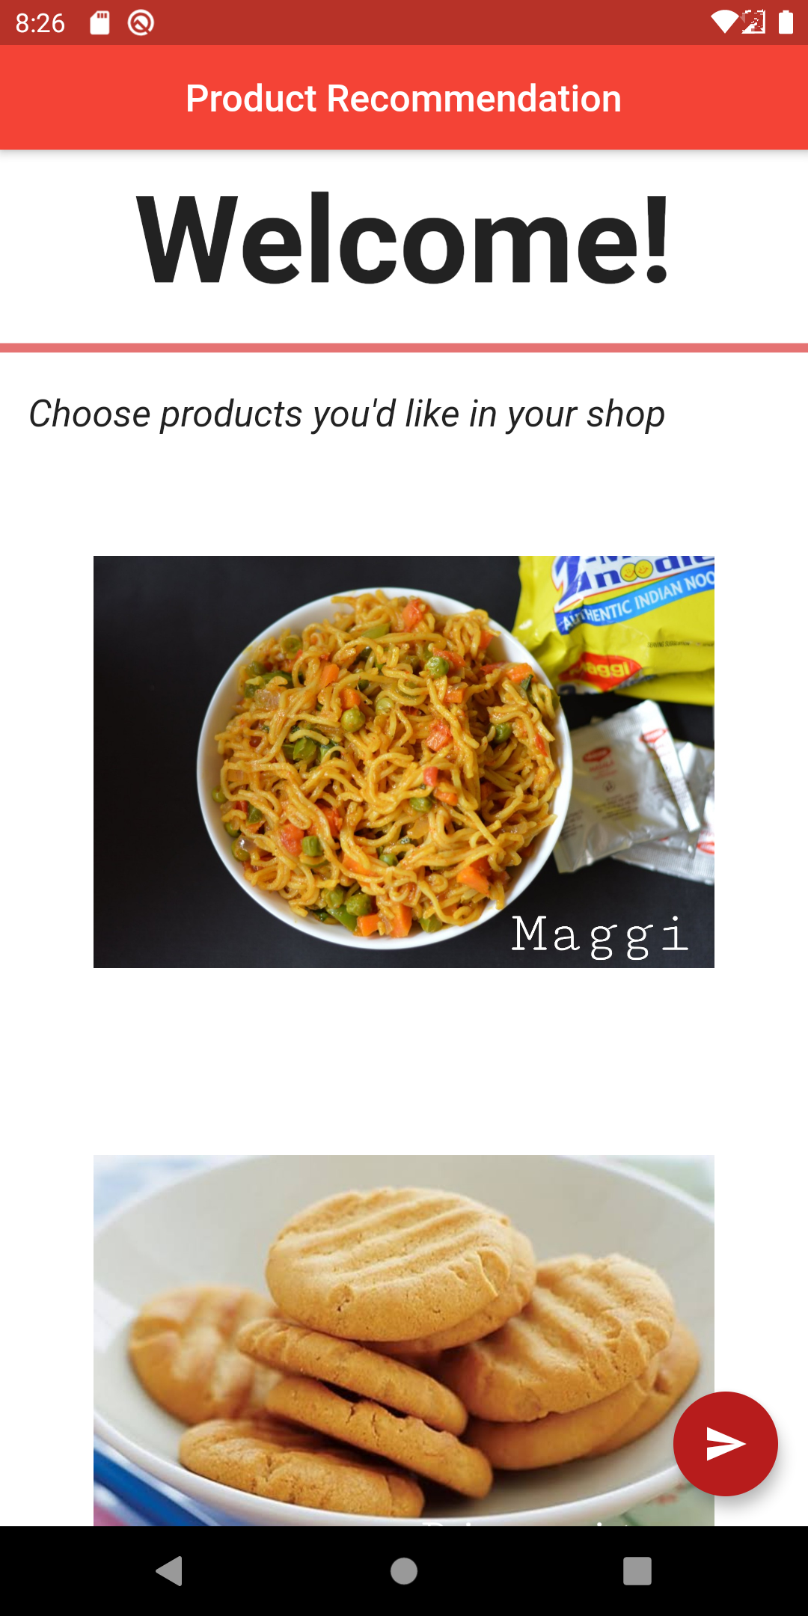
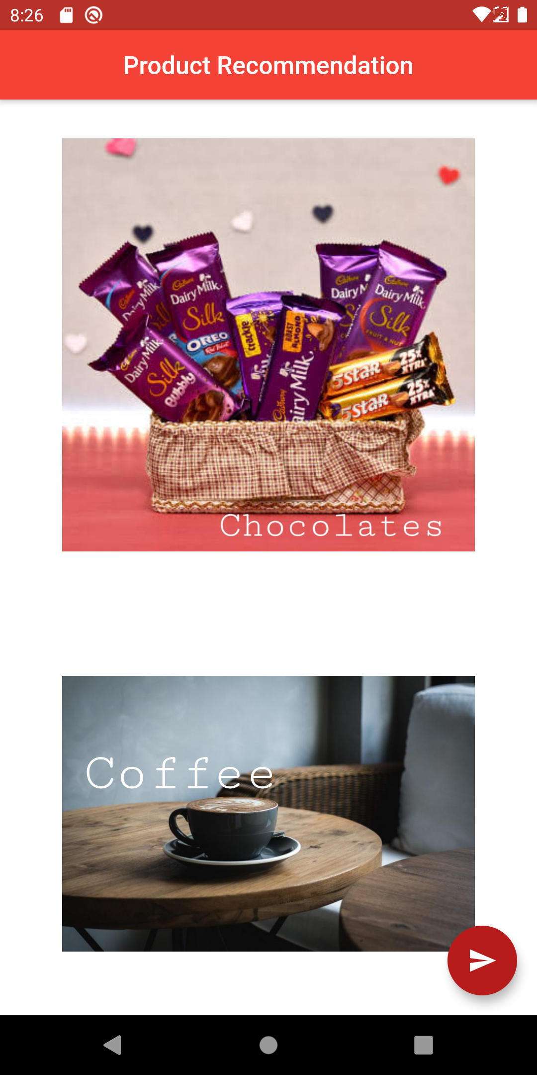
Design Description/UI Design
Welcome Page

Slide 6
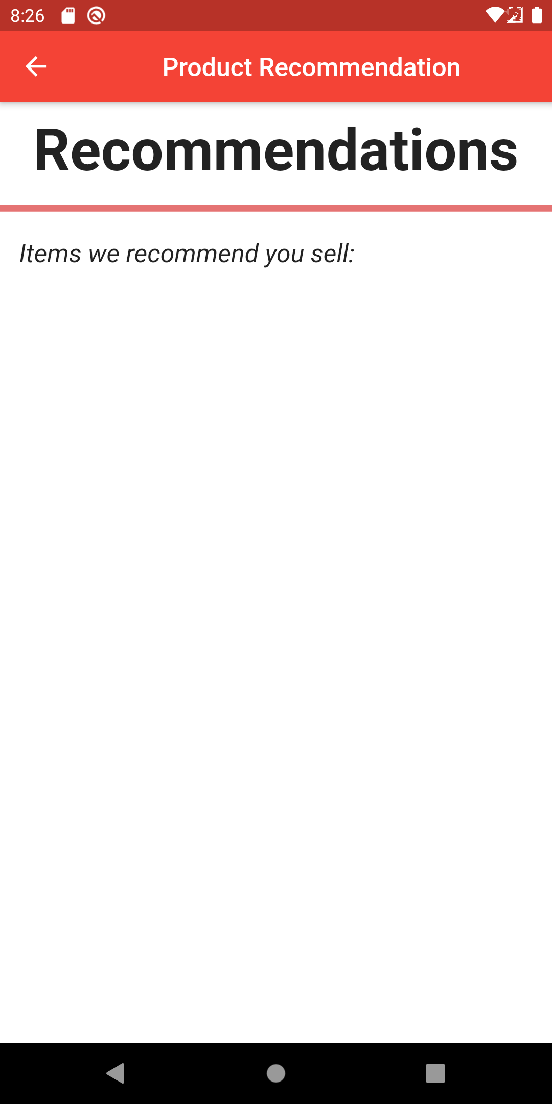
Design Description/UI Design
Recommendations Page

Slide 7


Technologies Used
Flutter App Development
To accomplish our goal, we decided to use Flutter by Google. It works on a language called Dart and is a cutting edge technology in the world of app development
An application written in Flutter can run on both iOS and Android devices
Notes:
‹#›

Slide 8
Project Progress So far
After enquiring and collecting opinions from shop owners based on what kind of application they’d like and what would be a suitable UI for them to use.
We collected this data and created a prototype mobile application that can help kirana store owners and more.
Notes:
‹#›

Slide 9
Project Demo
Notes:
‹#›

Slide 10
Thank You

