Slide 1
Stable Isotope Final Project: Evidence of Isotopic Fractionation During Vapor Exchange Between the Atmosphere and the Snow Surface in Greenland
Paper by: Madsen et al.,
Poor representation and notebook by: Kevin Rozmiarek

Slide 2
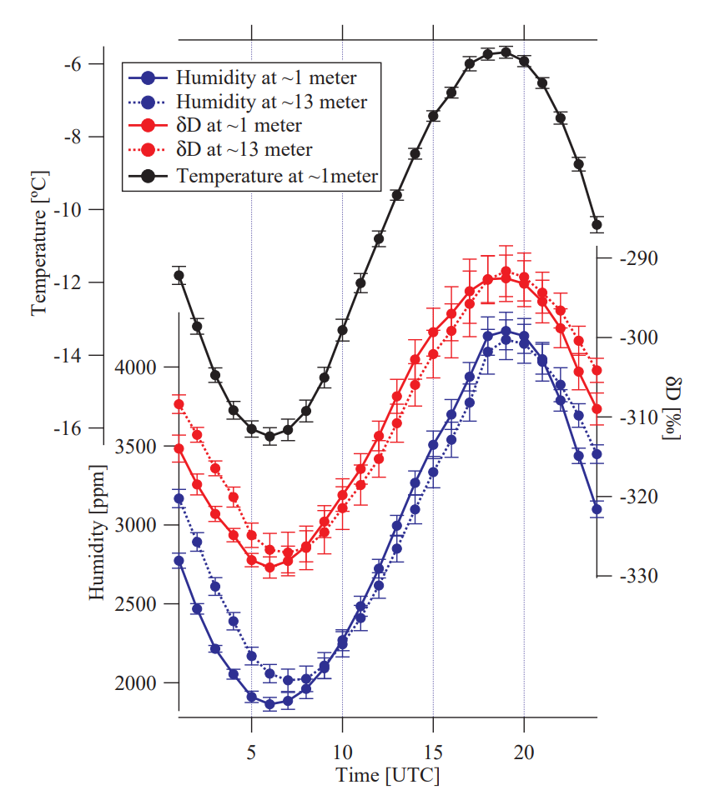
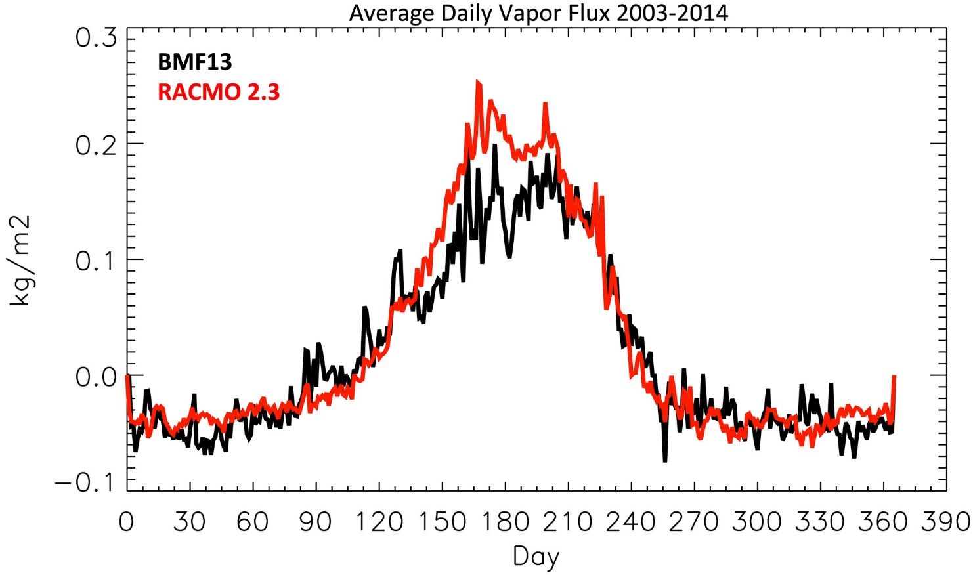
Some backdrop
TLDR: We haven’t actually closed our understanding the water cycle on ice sheets.
Steen-Larsen et al 2013
(Boisvert et al 2016)
Estimates of loss due to sublimation range from 6% to 18% of (39 to 120 gigatonnes/year (Boisvert et al. 2016: 6%; Lenarts et al. 2012: 12%; Box and Steffen, 2001:18%).
The mean diurnal cycle on days with clear sky and calm weather. Stacked based on diurnal cycles between days ∼ 180 and ∼ 190. Error bars indicate the standard deviation on the mean.

Slide 3
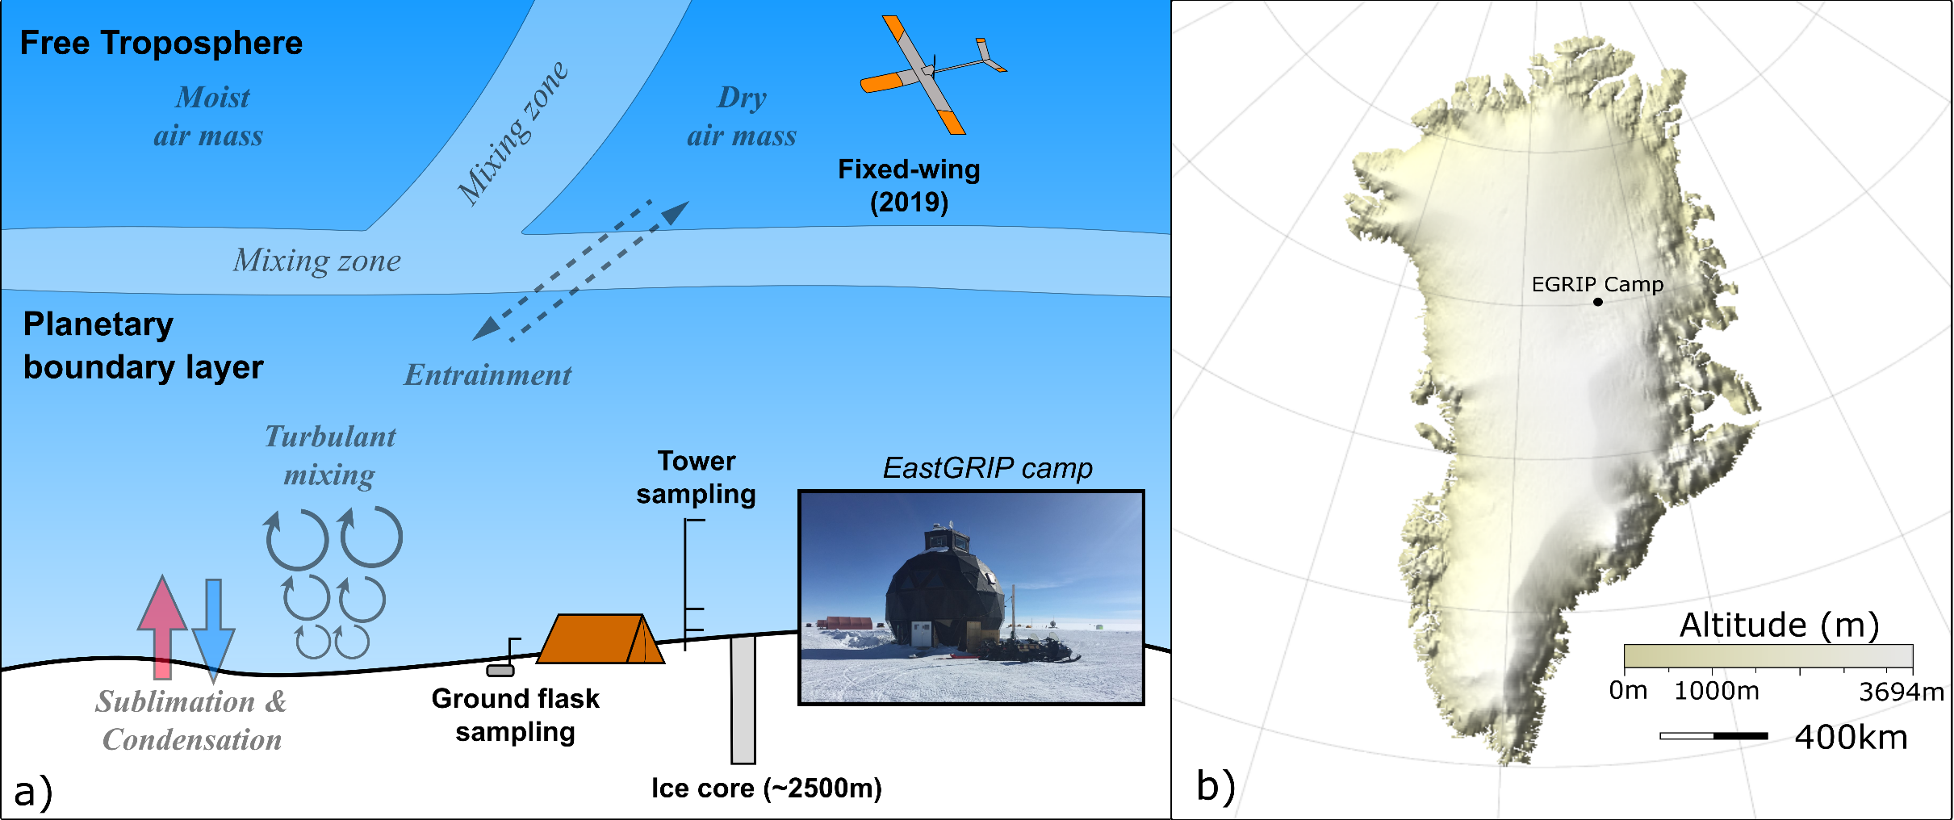
Where are we at?
Rozmiarek et al., in prep

Slide 4
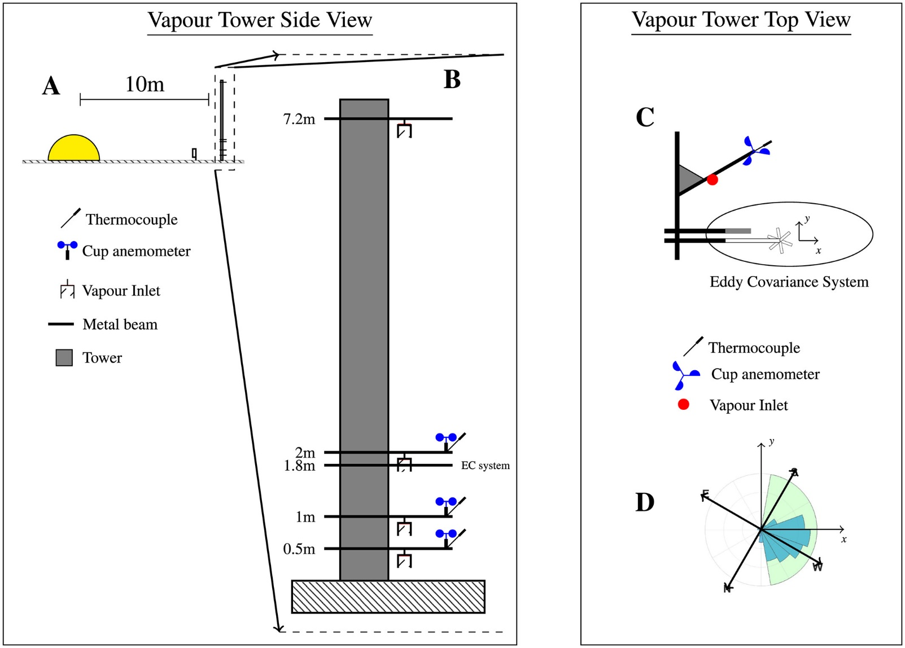
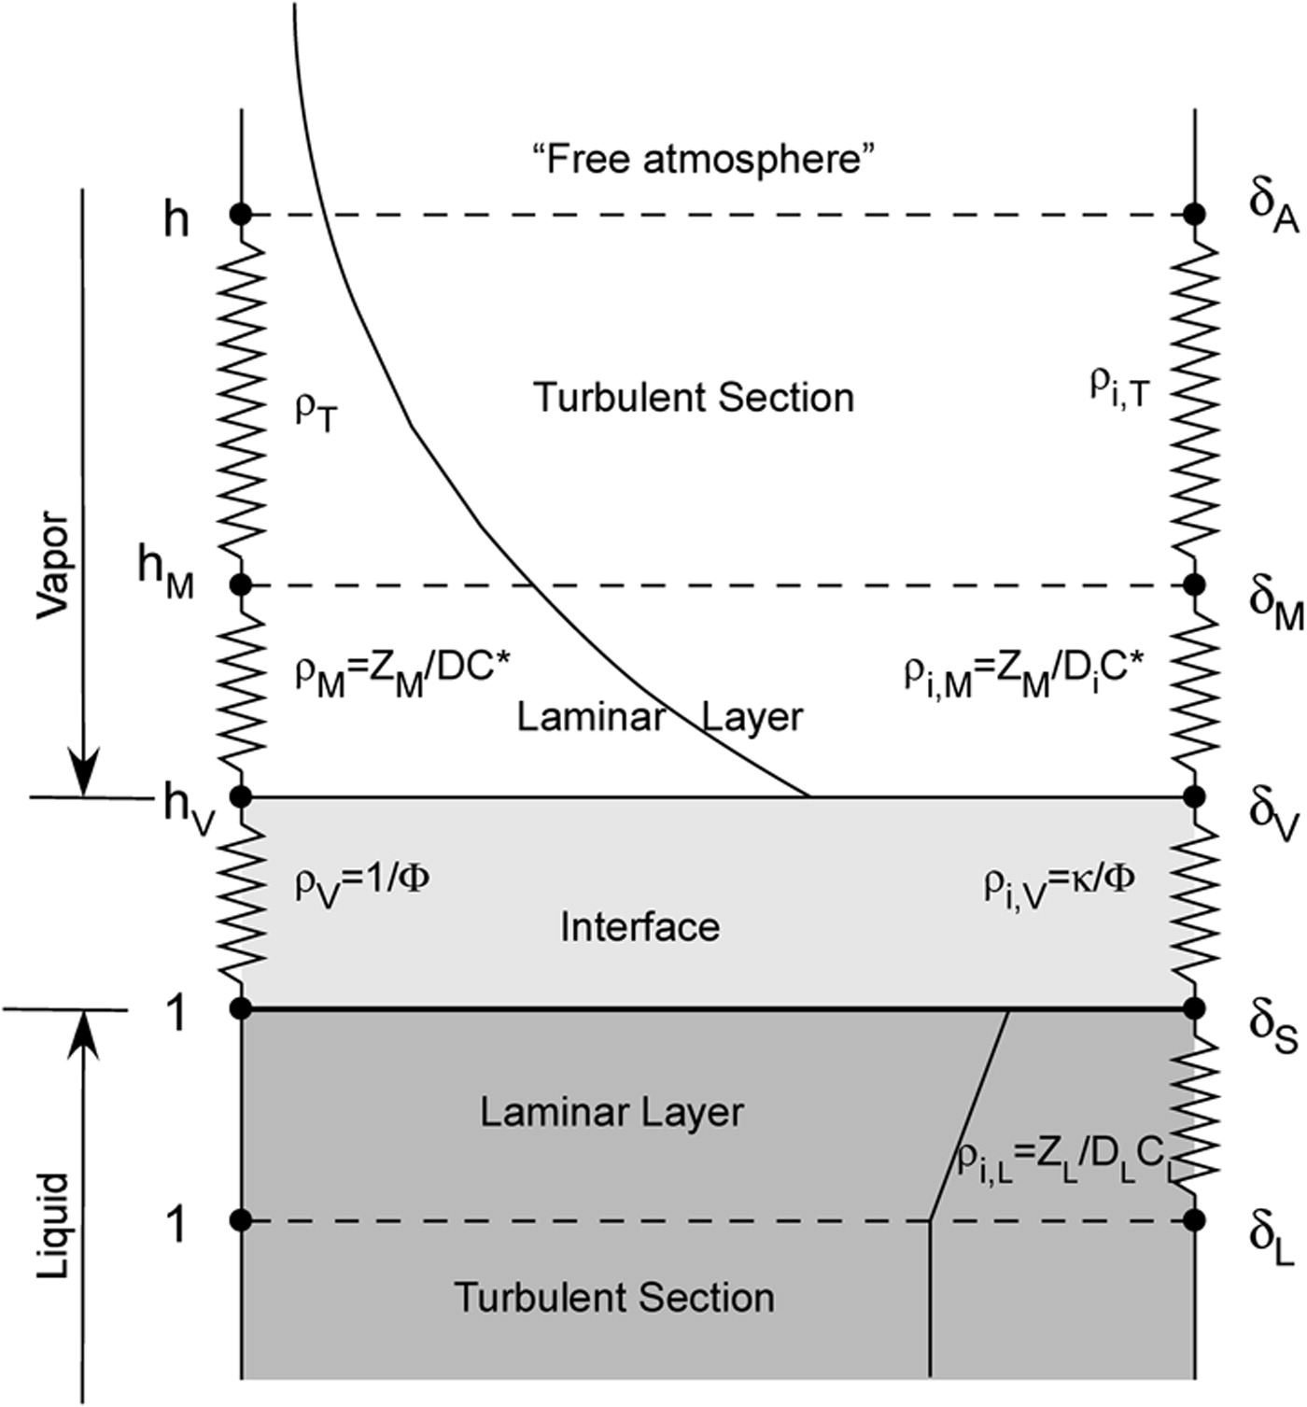
Horita et al., 2008

Slide 5



So how do we math at this?
Horita et al., 2008

Slide 6
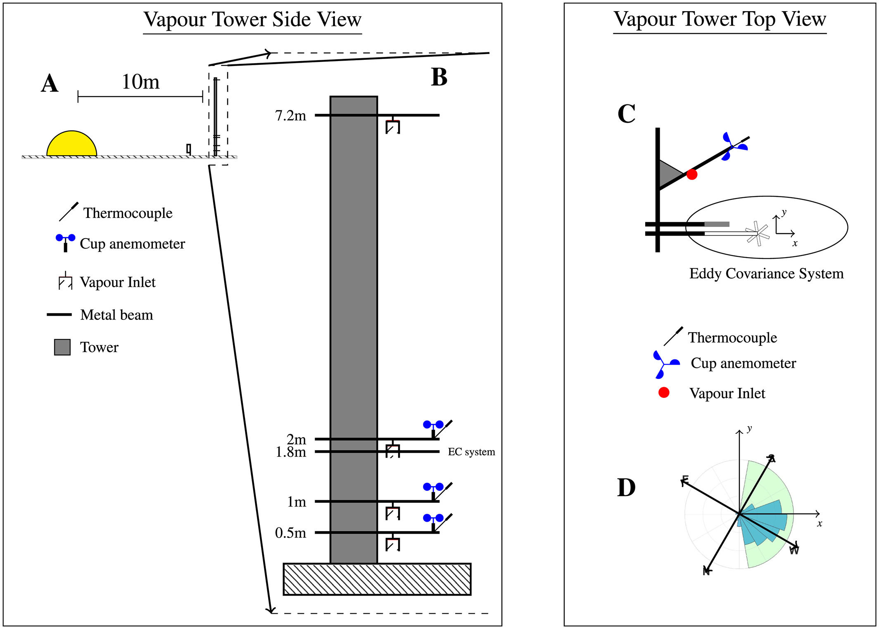

How is this model forced?

Slide 7
What to look forward to after the break.

Slide 8
Citations
Horita, Juske, Kazimierz Rozanski, and Shabtai Cohen. "Isotope effects in the evaporation of water: a status report of the Craig–Gordon model." Isotopes in environmental and health studies 44.1 (2008): 23-49.

