Slide 1
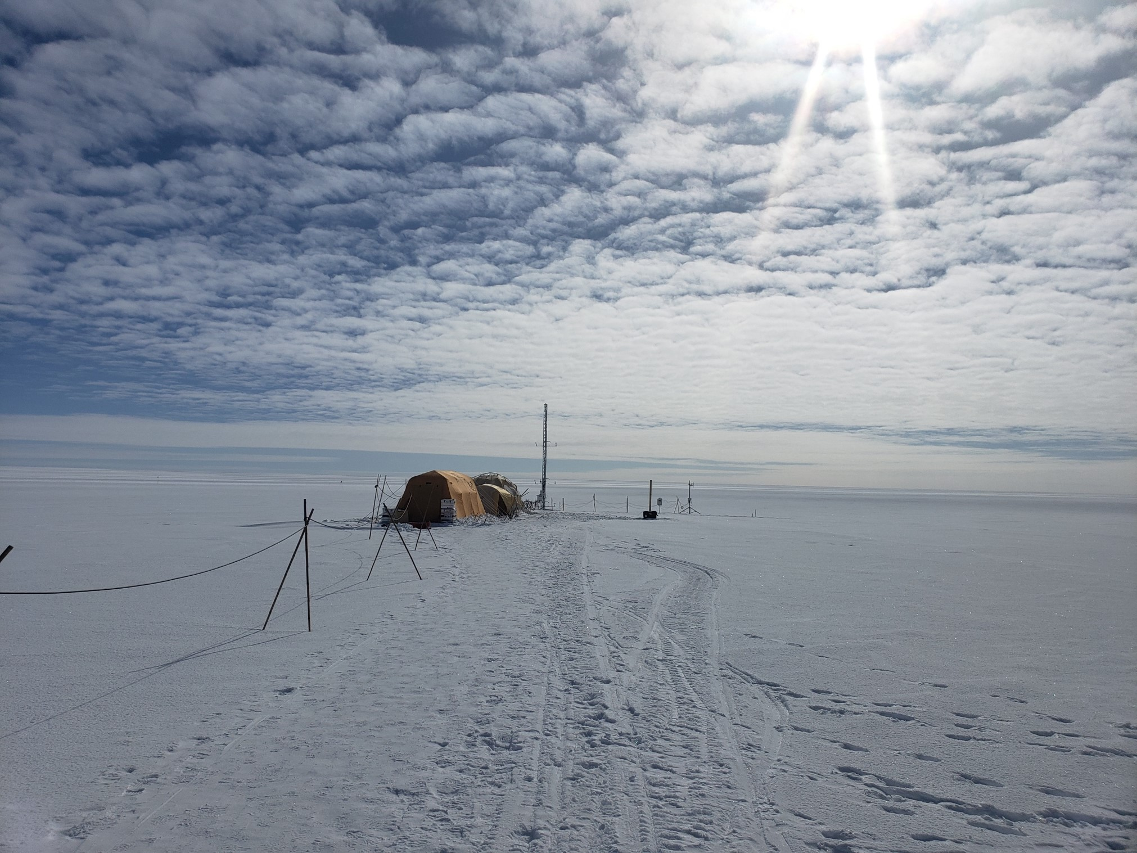
Stable Isotope Final Project: Evidence of Isotopic Fractionation During Vapor Exchange Between the Atmosphere and the Snow Surface in Greenland
Paper by: Madsen et al.,
Poor representation and notebook by: Kevin Rozmiarek

Slide 2
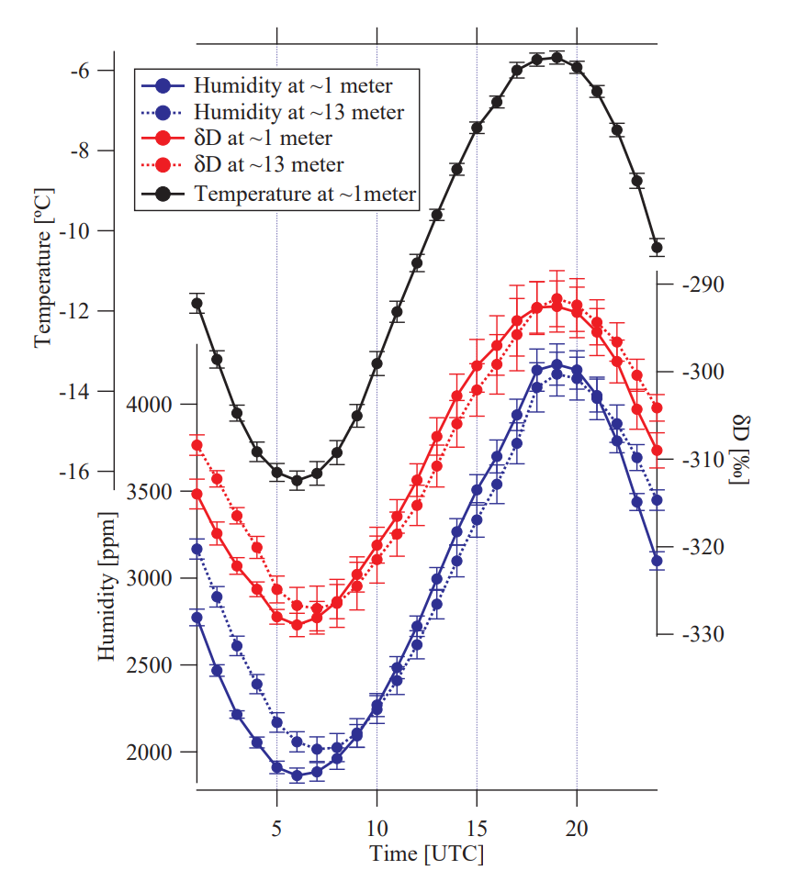
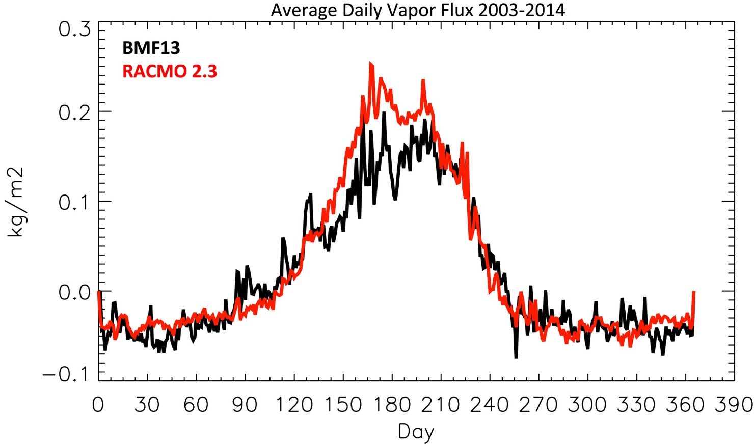
Some backdrop
TLDR: We haven’t actually closed our understanding the water cycle on ice sheets.
Steen-Larsen et al 2013
(Boisvert et al 2016)
Estimates of loss due to sublimation range from 6% to 18% of (39 to 120 gigatonnes/year (Boisvert et al. 2016: 6%; Lenarts et al. 2012: 12%; Box and Steffen, 2001:18%).
The mean diurnal cycle on days with clear sky and calm weather. Stacked based on diurnal cycles between days ∼ 180 and ∼ 190. Error bars indicate the standard deviation on the mean.

Slide 3
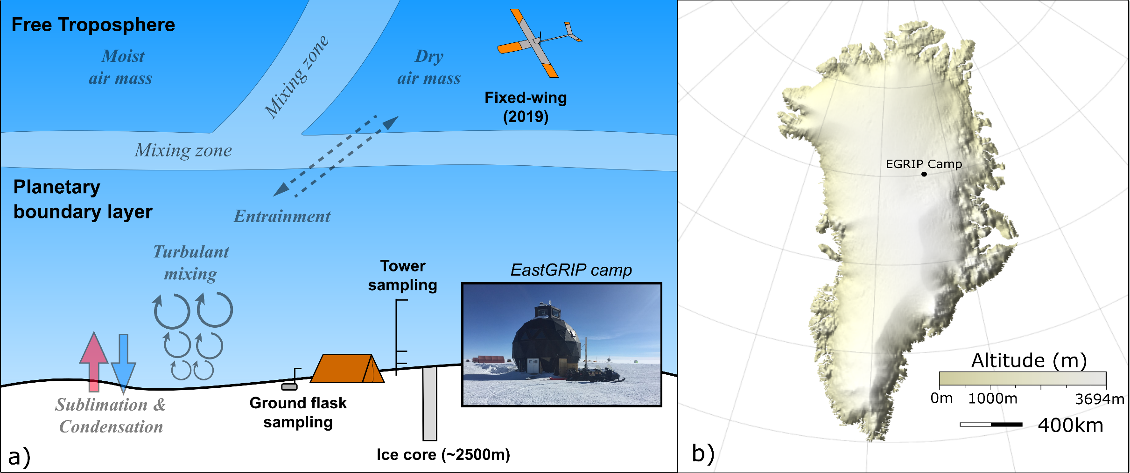
Where are we at?
Rozmiarek et al., in prep

Slide 4
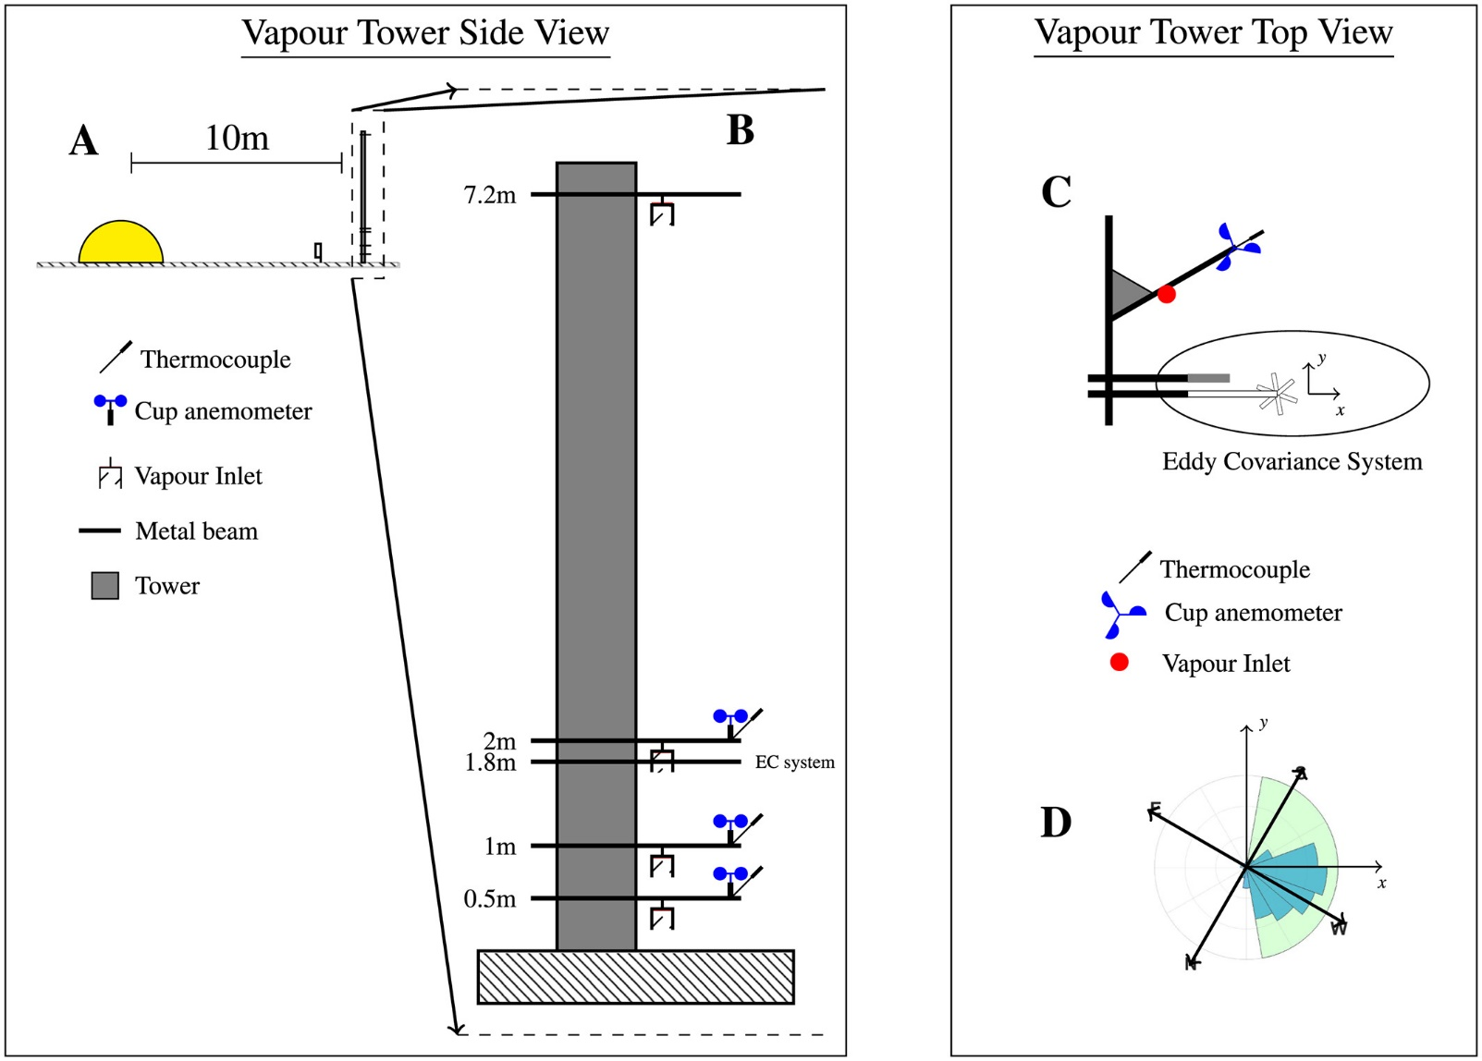
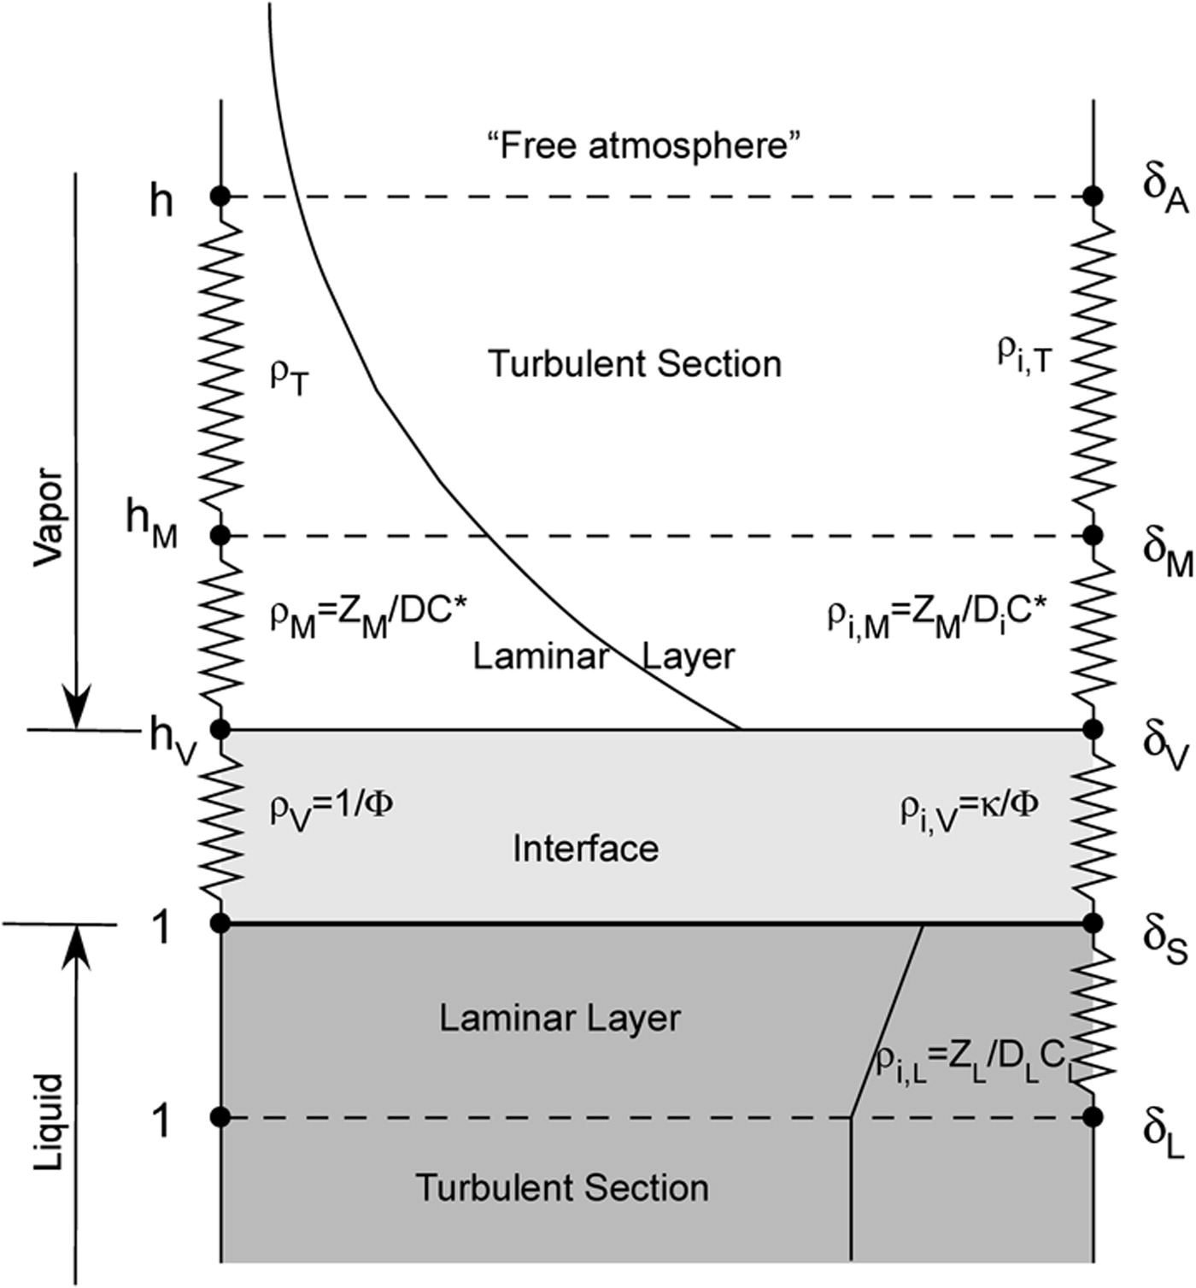
Tower system
Horita et al., 2008
Madsen et al., 2019

Slide 5



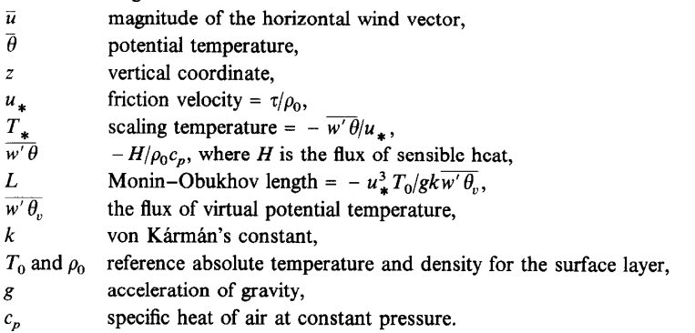
So how do we math at this?
Ol’ fashioned diffusion equation
Much less gross
Horita et al., 2008
Gross

Slide 6
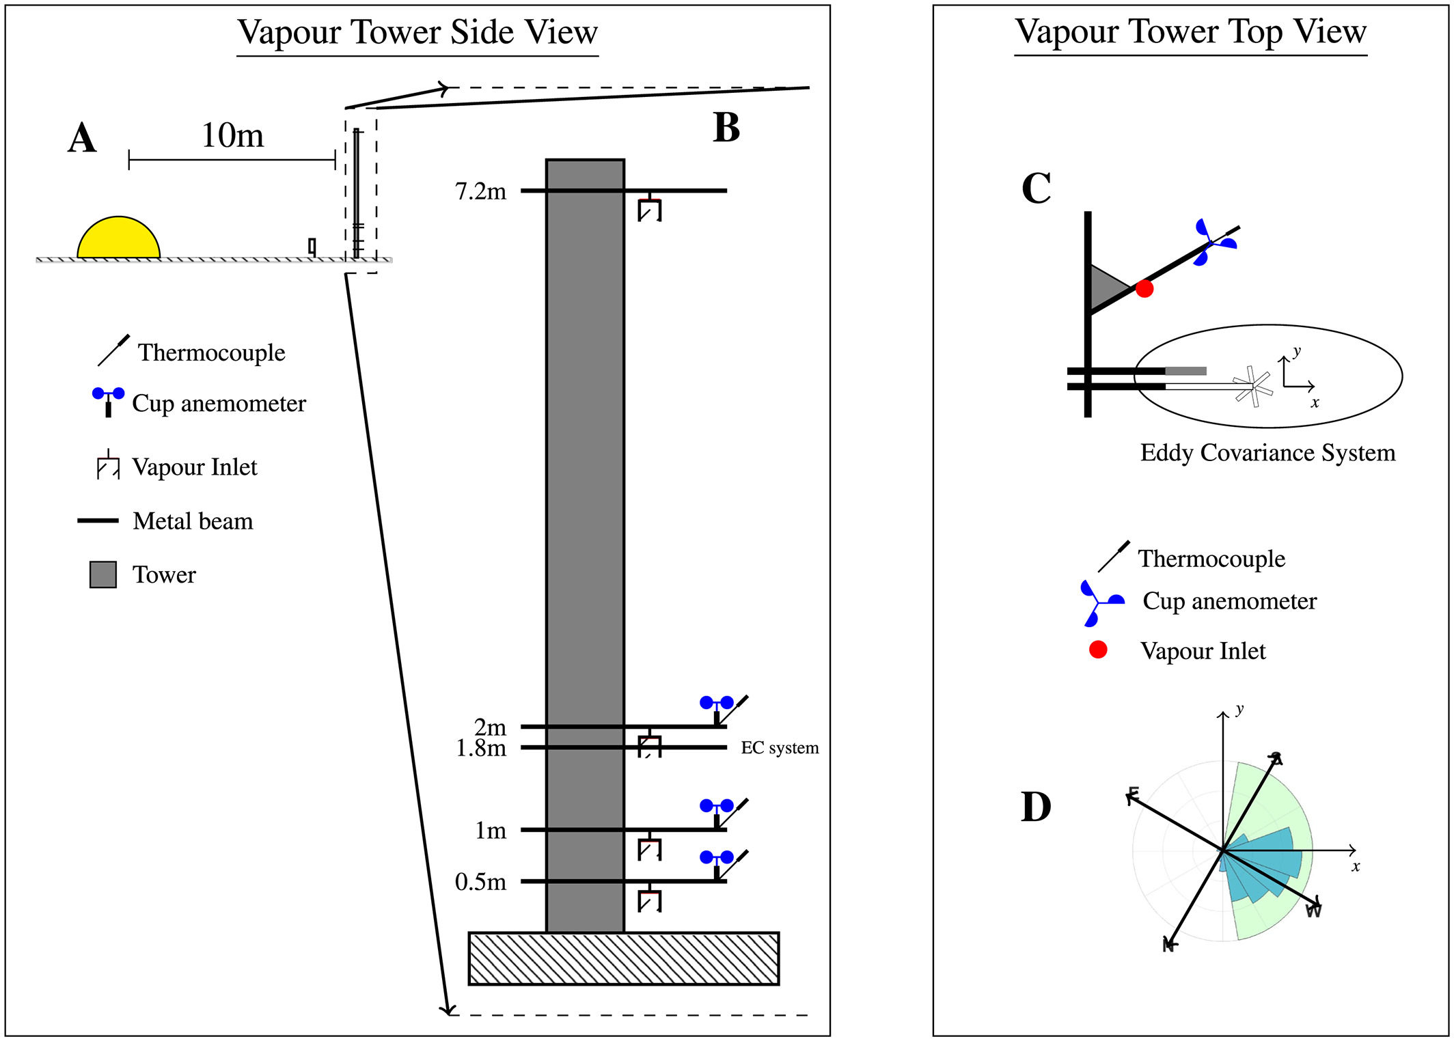
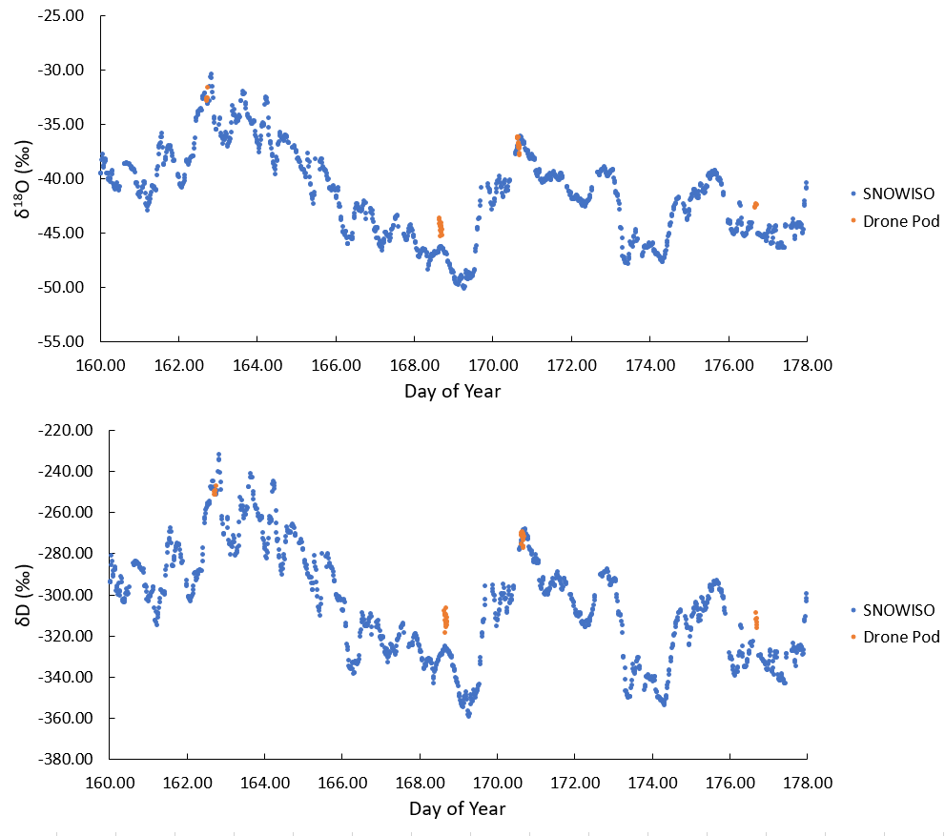

How is this model forced?
Snow
Rozmiarek et al., in prep
Snow Samples
Madsen et al., 2019

Slide 7
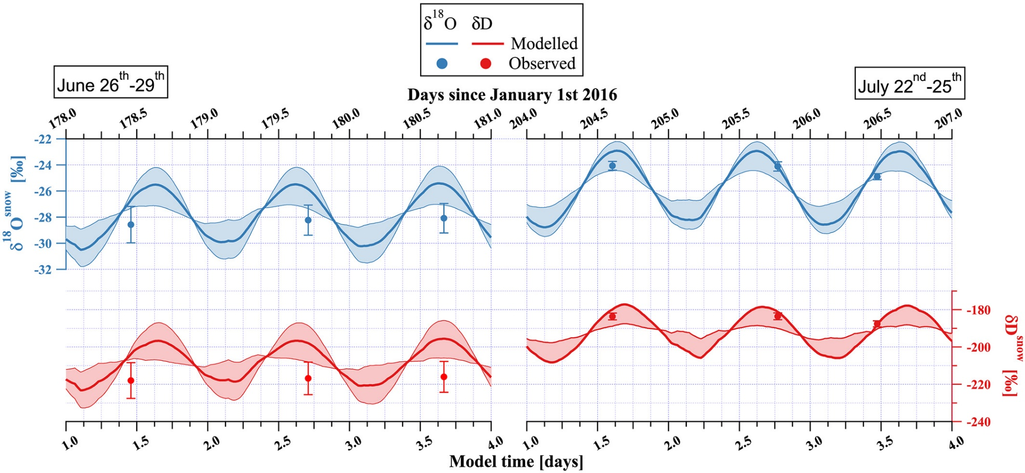
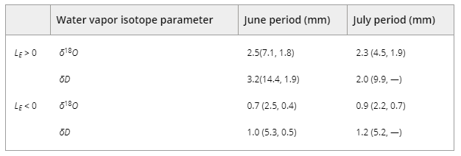
What did they see?
The model produces half decent results for the snowpack.
Snow has a diurnal variation of 2.5‰ in δ¹⁸O and 13‰ in δD (10-20% of the firn signal!)
Still unclear if the VSL exists like we think it does. Big if true.
Snow equilibrium depth for two different latent heat cases
Note. The 95% confidence bounds are giving in the parentheses.

Slide 8
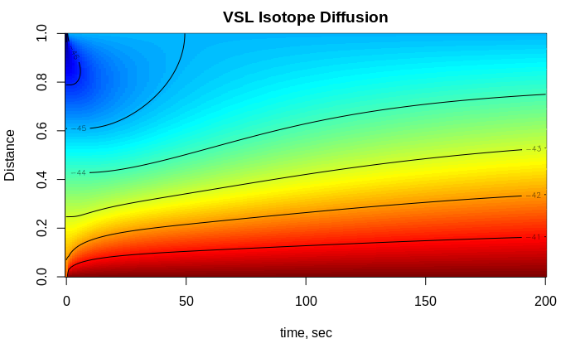
What to look forward to after the break.
VSL is the gateway to and from the firn via diffusion.
“A positive linear relation between B*_{best} and ∆z is expected since the influence of the bottom boundary condition is more attenuated for a thicker VSL.”
We are going to explore if this is true via by a toy diffusion model.
VSL Distance

