Slide 1

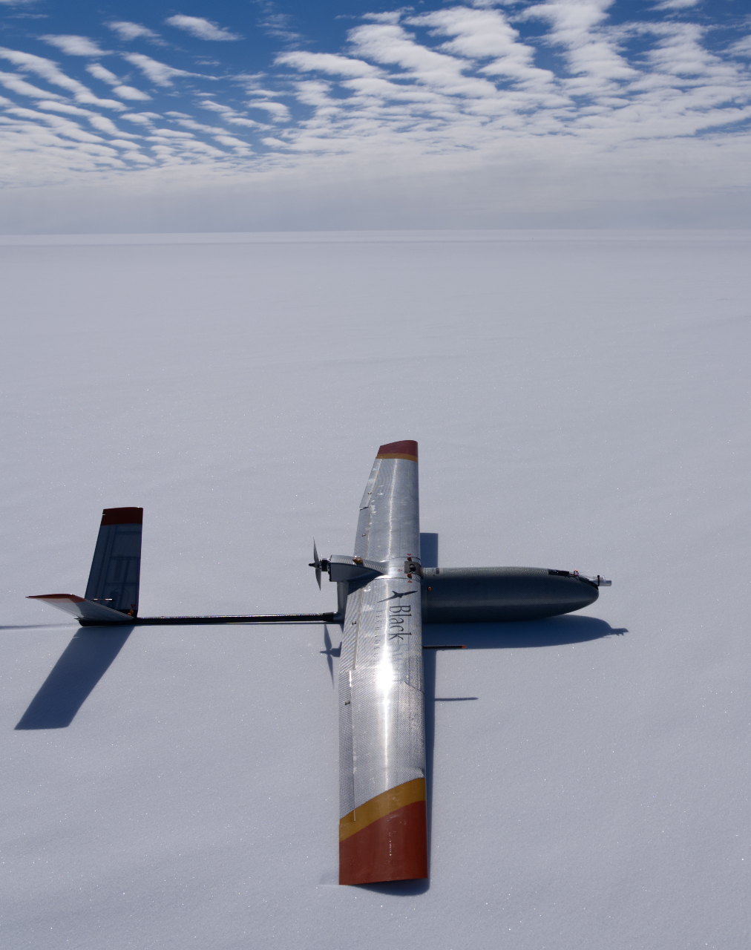

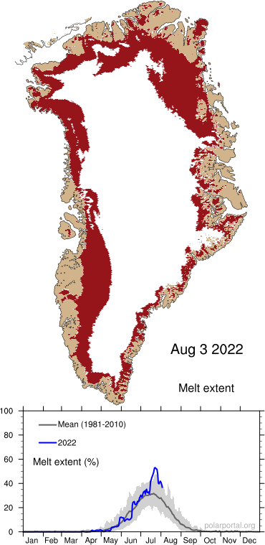

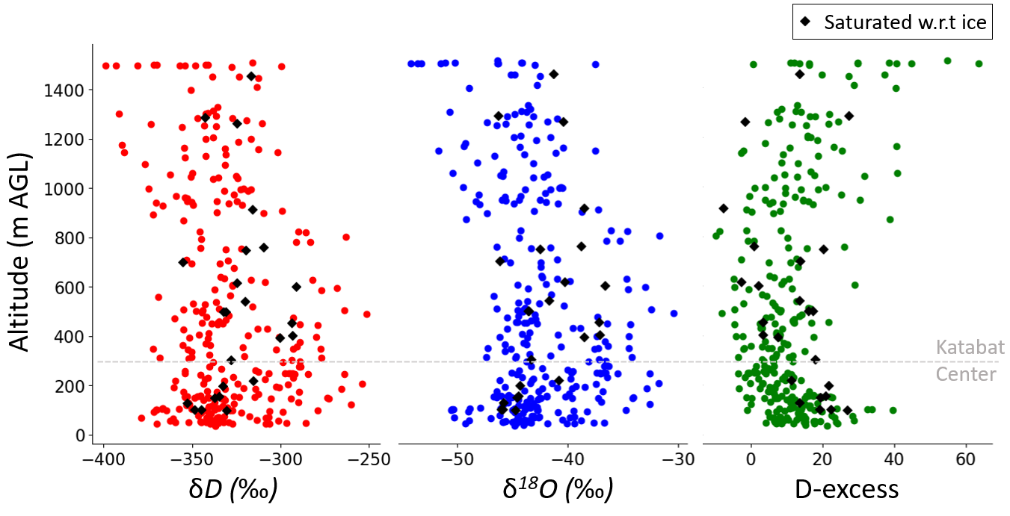

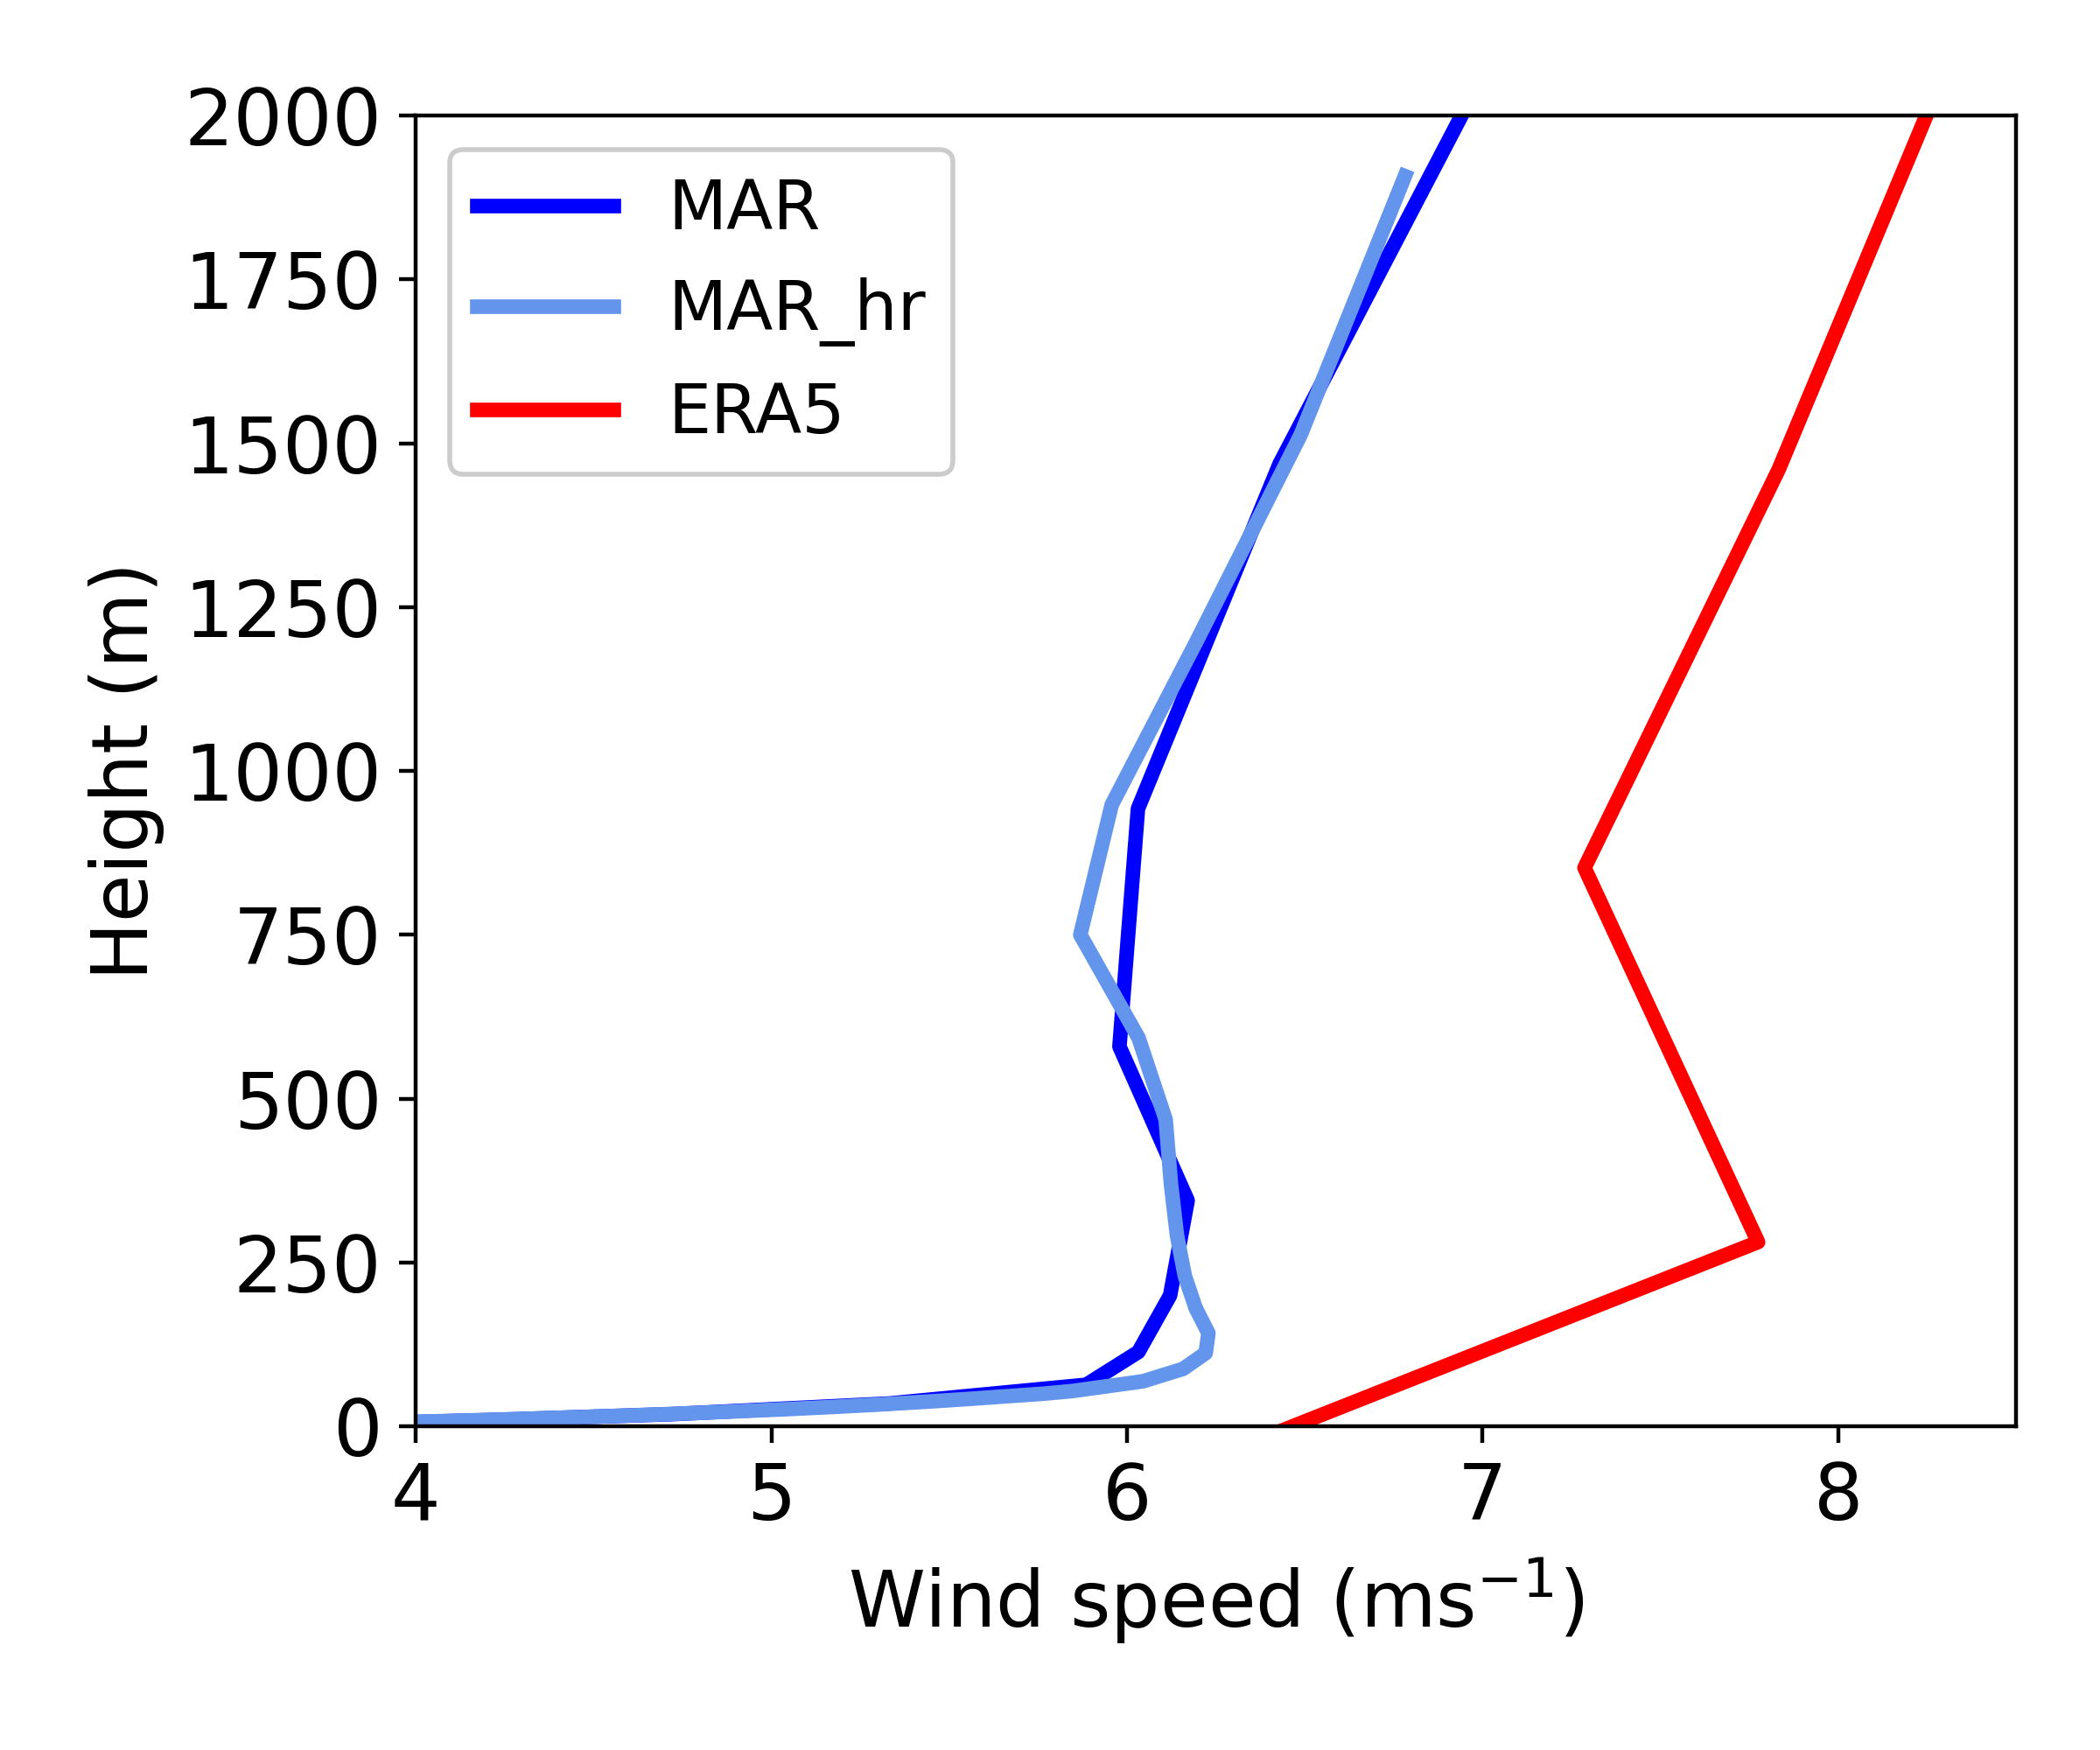

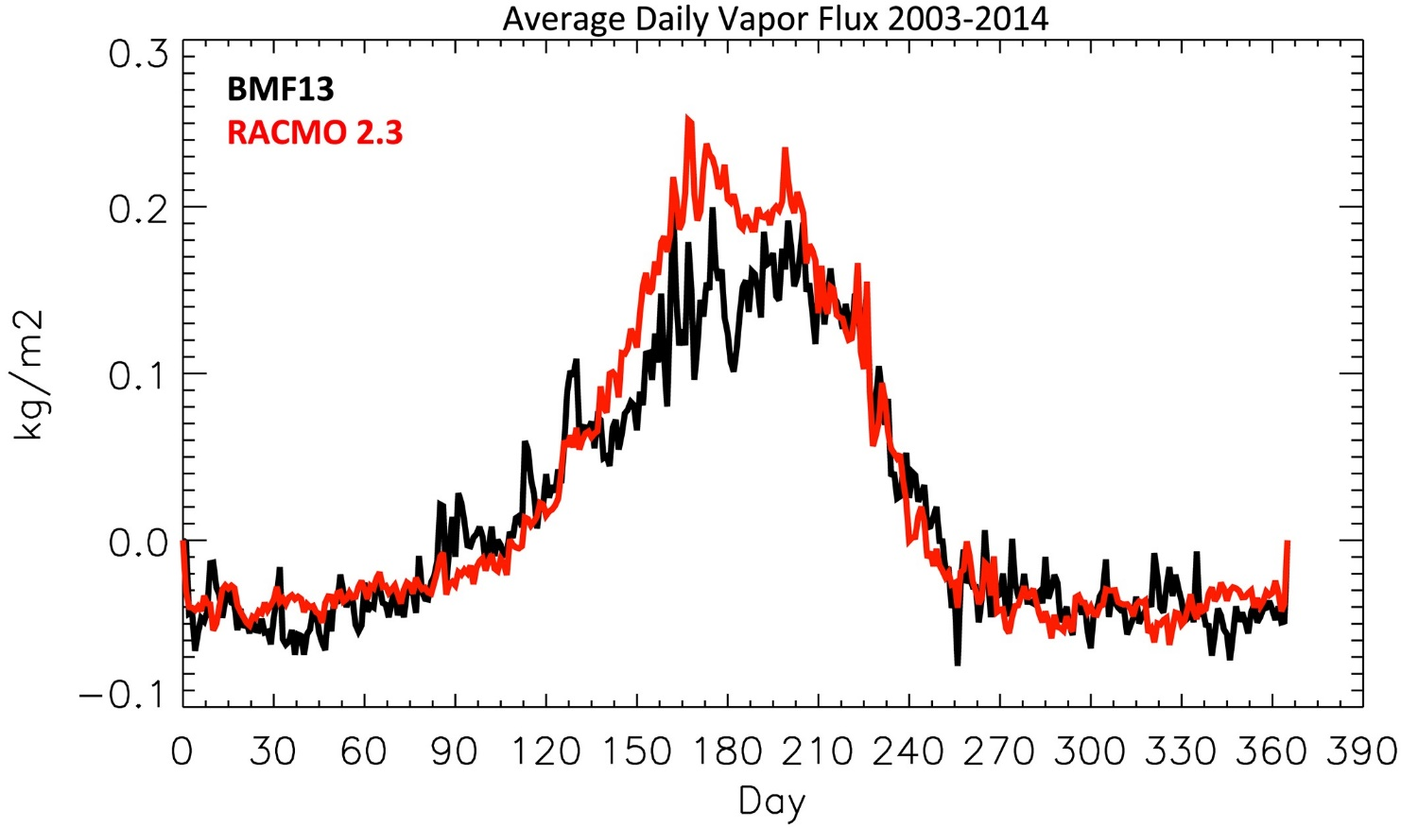
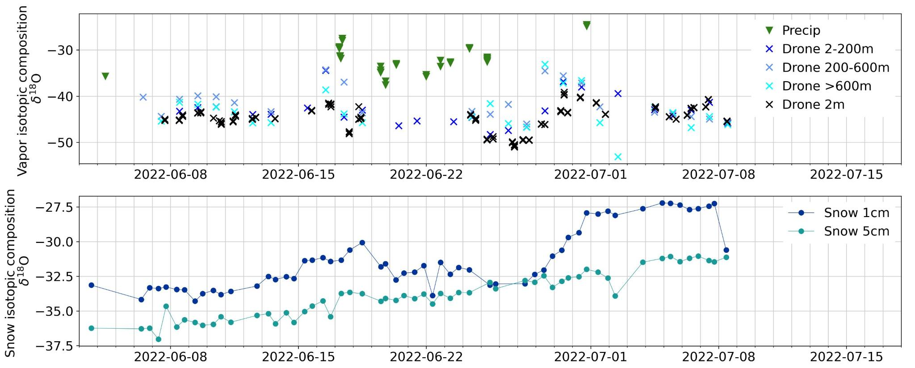
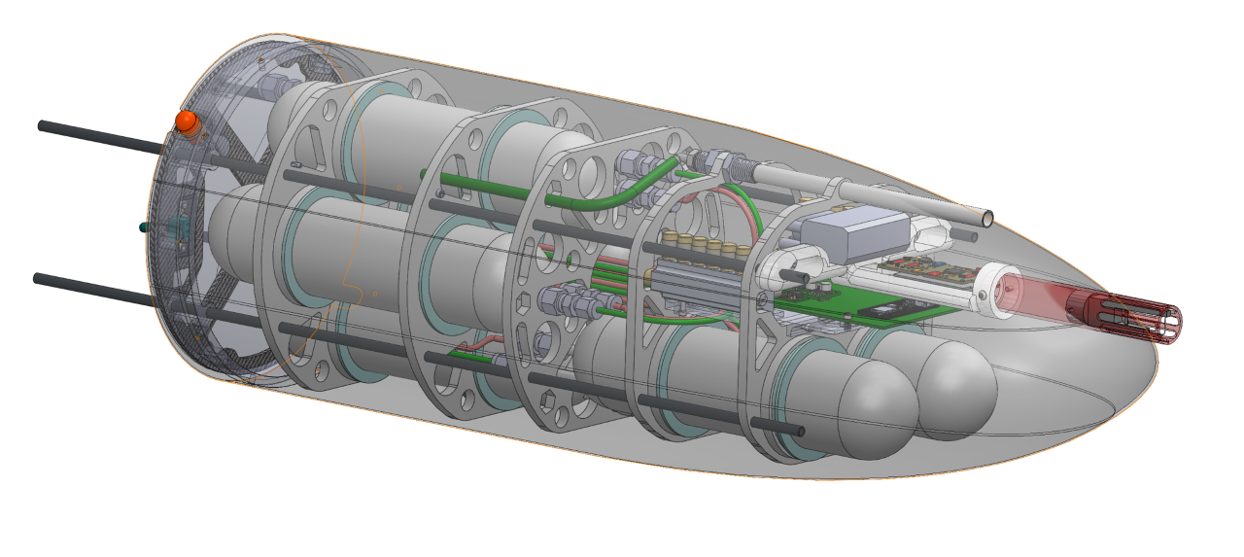
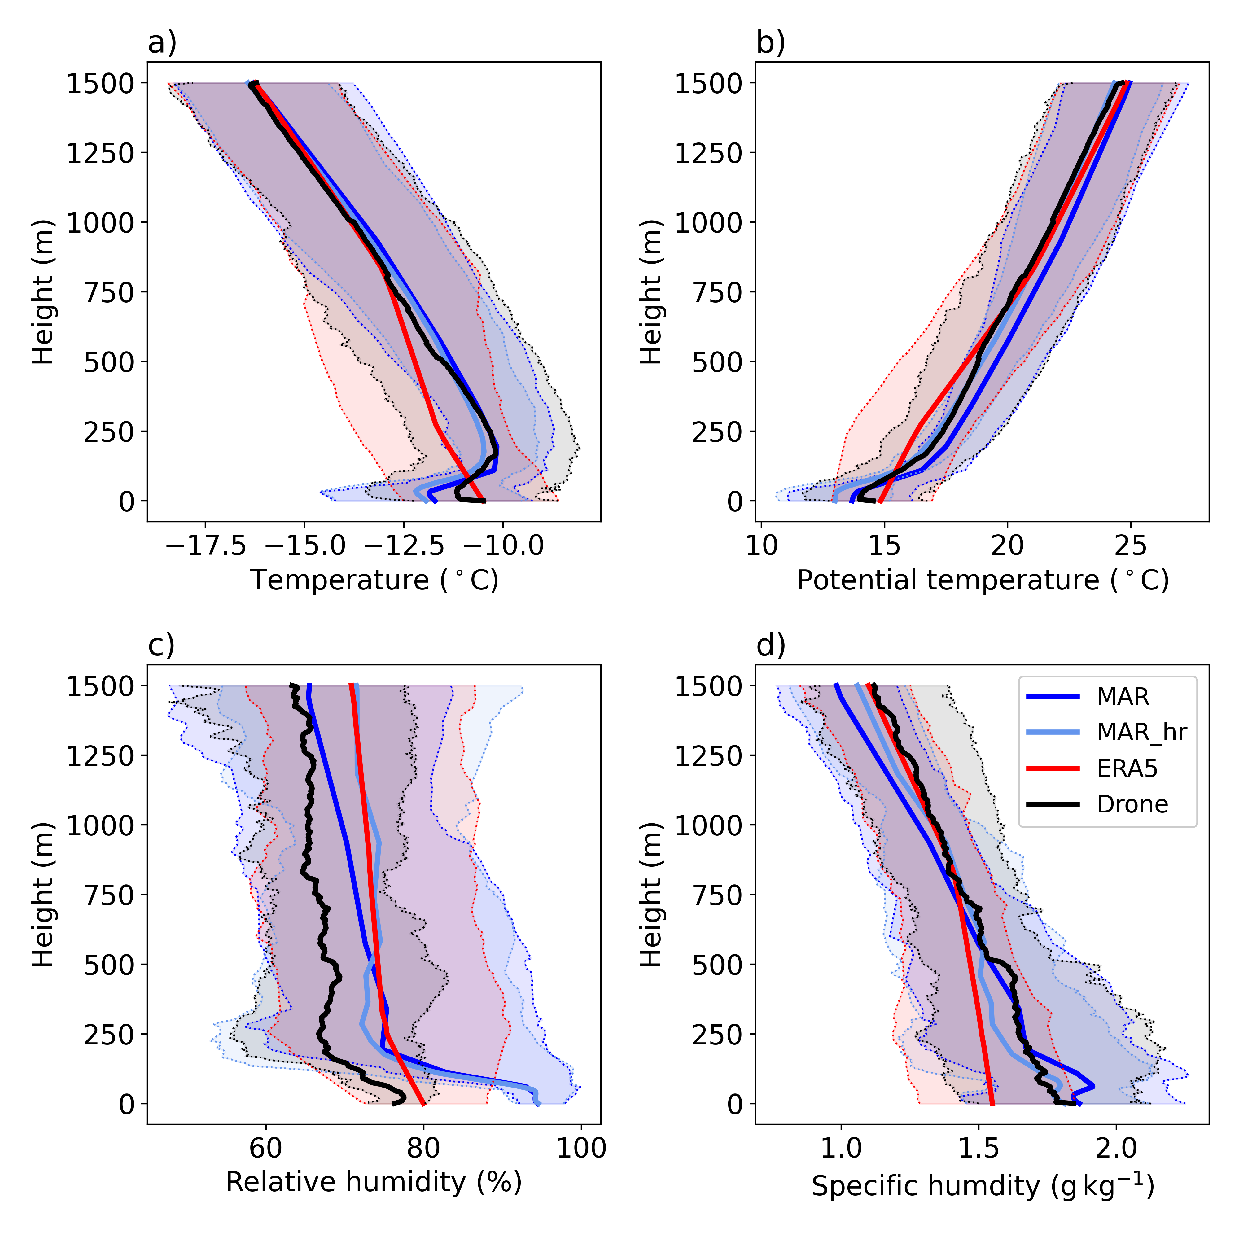
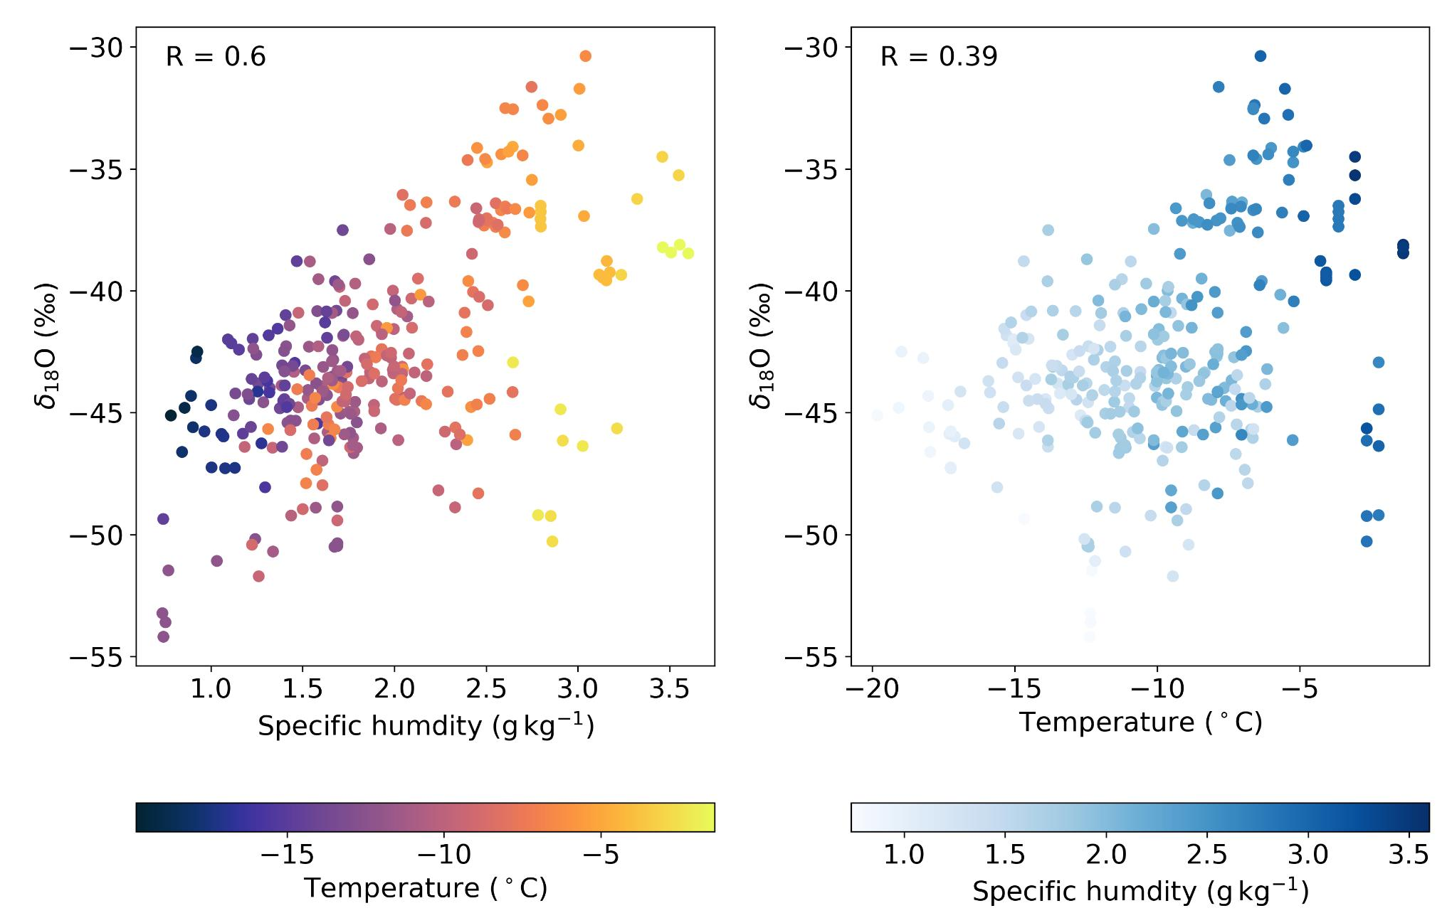





Atmospheric profiles of water-vapor isotopes and meteorological conditions informs the impact of sublimation and mixing on the northeast Greenlandic Ice Sheet
Kevin Rozmiarek^{1,2}, Laura Dietrich³, Bruce Vaughn¹, Bradley Markle^{1,2}, Valerie Morris¹, Hans Christian Steen-Larsen³, Xavier Fettweis⁴, Chloe Brashear¹, Hayley Bennett^{1,2},, Tyler Jones¹
The first summer record of water-vapor isotopes in the planetary boundary layer above Greenland provides new insights into the physics of transport and ice-atmosphere exchange of water vapor.
Revolutionising the Study of Neurodegenerative Disease
1. Introduction
5. Isotope stories to tell
Clear sky precipitation (diamond dust) could give us high dxs but we don’t see it often!
Water isotopes are a useful measurement for constraining the hydrological cycle in the arctic. Here we present measurements of water-vapor isotopes for 105 flights up to 1500m above the EastGRIP ice core camp during the summer of 2022. We compare atmospheric profiles to the polar climate models MAR and ERA5. The results provide evidence for sublimation from the ice sheet that affects the near-surface atmosphere’s isotopic composition.
EastGRIP
Higher variability above the inversion may indicate contribution from many source locations
Lower variability in dxs may be due to this altitude’s common moisture source - the upslope katabat
2. Why water vapor?
Water vapor is the strongest natural greenhouse gas.
It transports large amounts of energy through latent heat.
Water vapor flux to/from the ice sheet is not well understood and, by extension, its contribution to ice sheet mass balance.
The isotopic composition of water vapor is a record of physical processes that occur in the hydrologic cycle, relative to a given parcel of air.
All isotopic data from 105 flights in summer 2022 at EGRIP plotted vs. altitude
Both isotopes of water vapor enrich up to the inversion at about 300 m. Both δD and δ¹⁸O values are depleted relative to surface snow and ice.
Dxs is higher at the surface, indicating mixing with a non-equilibrium fractionating source, such as sublimation
Surface melt extent for the ice sheet at the end of the campaign. Anomalies are no longer anomalous when it comes to surface melt in Greenland.¹
Average modelled wind speed at EGRIP for summer 2022
3. Methods
Precipitation is always enriched compared to the atmosphere
Air retrieval made by a custom air-capture payload onboard a Black Swift S2 drone
Water-vapor isotope measurement made by introduction to a Picarro L2130-i calibrated across both isotopes and specific humidity
Radiosonde data taken by onboard Vaisala RSS-421
Estimates of loss due to sublimation range from 6% to 18% of (39 to 120 gigatonnes/year (Boisvert et al. 2017: 6%; Box and Steffen, 2001:18%).^{2,3}
Snow depletes in depth showing the possible temperature-isotope relation of earlier season precipitation
The Black Swift S2:
Flight ceiling: 6000m
Flight time: 110 min
Wind limit: 30 kts
Range: 90 km
Payload weight: 2.3 kg
Samples: 4-6 550 ml flasks
The air capture payload
Top: All flask δ¹⁸O measurements plotted over time binned into separate altitude categories. Included are precipitation measurements from collection boxes and flasks taken near surface at 2m. Bottom: Measurements of the average value of surface snow at 0-1 cm and 0-5 cm are plotted over time.
4. Model Comparison
Because of the Clausius-Clapeyron relation, we expect a relationship between humidity and temperature, but what of isotopes? Do we see a temperature effect like we do with precipitation?
We find that vapor isotopes in the atmosphere are better predicted by humidity (R=0.6) than temperature (R=0.39). The reasons why may be complex, but ice sheet sublimation likely plays a role.
We compare the average across all 105 flights to the MAR and ERA5 models MAR is a purpose-built model for polar regions. It targets surface mass balance, air-snow interactions, and atmospheric circulation over ice sheets, including katabatic winds. ERA5 by contrast, is a global model, without MAR’s finer tuned polar modules.
We can draw some general conclusions here from this comparison:
At a certain altitude, all models do well
ERA misses the typical inversion height
Both models overestimate relatively humidity
Both models are poorly constrained at the surface
.
Comparison between MAR, MAR (high resolution), ERA5, and drone observations. Observations are binned to 1m and averaged across all 105 flights in summer 2022 at EGRIP field camp.
All flask measurements from 105 flights plotted again humidity and temperature
Places
References
Download
¹Institute of Arctic and Alpine Research, University of Colorado Boulder, Boulder, CO 80309, USA
²Department of Geological Sciences University of Colorado Boulder, Boulder, CO 80309, USA
³Geophysical Institute, University of Bergen and Bjerknes Centre for Climate Research, Bergen, 5020, Norway
⁴University of Liège, Belgium
¹Danish Meteorological Institute “http://polarportal.dk/en/greenland/surface-conditions/ Accessed Aug 3, 2022
²Boisvert, Linette N., et al. "Using remotely sensed data from AIRS to estimate the vapor flux on the Greenland ice sheet: Comparisons with observations and a regional climate model." Journal of Geophysical Research: Atmospheres 122.1 (2017): 202-229.
³Box, Jason E., and Konrad Steffen. "Sublimation on the Greenland ice sheet from automated weather station observations." Journal of Geophysical Research: Atmospheres 106.D24 (2001): 33965-33981.
This work is funded by NSF Polar Programs award #1833165
Kevin.Rozmiarek@Colorado.edu

